Slide 1
MATLAB for Image Processing
TA: Feng Zhou

Slide 2
Introduction
Key Advantages
Fast Implementation
Natural Matrix Operation
Powerful Image Processing / Computer Vision Toolboxs

Slide 3
Import / Export / Display
Functions
imread
imwrite
imshow
Read image
Save image
Display image
Supported Formats: BMP, GIF, HDF, JPEG, PCX, PNG, TIFF, etc
Example
X = imread(’mug.jpg');
imwrite(X, ’mug2.jpg');
imshow(X);

Slide 4
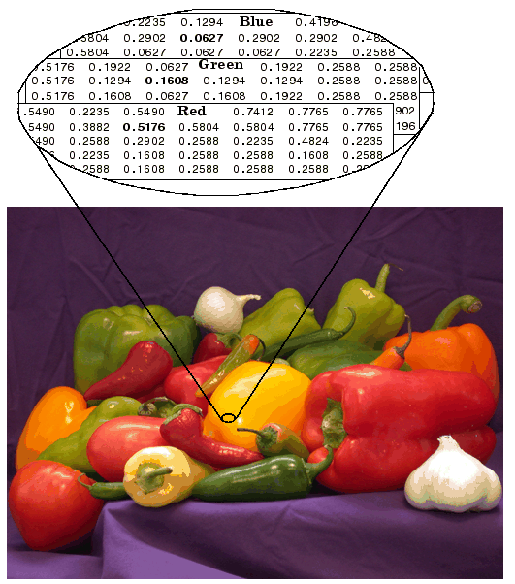
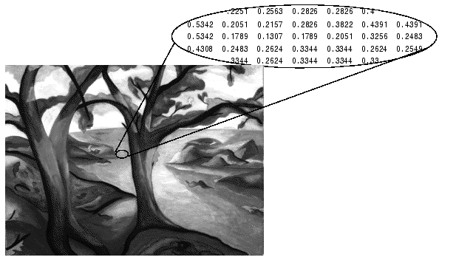
Data-structure
Gray image m x n [0, 255] uint8 or [0, 1] double
RGB image m × n × 3 [0, 255] uint8 or [0, 1] double

Slide 5
Conversion
Functions
im2double
rgb2gray
Integer to Double Precision
RGB Color to Grayscale
Example
X = imread(’mug.jpg');
Y = rgb2gray(X);
Z = im2double(Y);

Slide 6
Re-size / Crop
Functions
imresize
imcrop
getrect
Re-size image
Crop image
Get a rectangle from user’s input
Example
X = imread(’mug.jpg');
Y = imresize(X, 0.5);
Rect = getrect;
Z = imcrop(X, Rect);

Slide 7
Geometrical Transform
Functions
imrotate
imtransform
maketform
Rotate image
Transform image (eg., affine)
Create a transformation
Example
X = imread(’mug.jpg');
Y = imrotate(X, 45);
A = [1 0 0; .5 1 0; 0 0 1];
tform = maketform('affine', A);
Z = imtransform(X, tform);

Slide 8
Filtering
Functions
fspecial
filter2
medfilt2
Create a filter
Apply filter to image
Apply Median filter to image
Example
X = imread(’mug.jpg');
XG = im2double(rgb2gray(X));
h = fspecial('gaussian', 10, 3);
Y = filter2(h, XG);

Slide 9
Edge Detection
Functions
edge
Compute edge for the given image
Example
X = imread(’mug.jpg');
XG = im2double(rgb2gray(X));
Y = edge(XG, 'sobel');
Z = edge(XG, ‘canny');

Slide 10
Video Import / Display
Functions
VideoReader
read
pause
Return a video reading handler
Read one frame
Halt execution temporarily
Example
hr = VideoReader('walk.avi');
for iF = 1 : hr.NumberOfFrames
X = read(hr, iF);
imshow(X);
pause(.1);
end

Slide 11
Video Export
Functions
VideoWriter
open
writeVideo
close
Return a video writing handler
Start to write content
Write one frame
Finish the writing
Example
hw = VideoWriter('walk2.avi’);
open(hw);
for iF = 1 : nF
writeVideo(hw, X);
end
close(hw);

Slide 12
3rd-Party Toolbox (Personal Recommendation)
VLFeat
Implementation of Many CV Methods (eg, SIFT, SURF, SVM)
http://www.vlfeat.org/
Piotr Dollar’s toolbox
Implementation of Many CV Methods (eg, Optical Flow)
http://vision.ucsd.edu/~pdollar/toolbox/
mexopencv
Using OpenCV in Matlab
http://www.cs.stonybrook.edu/~kyamagu/mexopencv/
CVX
Optimization
http://cvxr.com/cvx/

Slide 13
Questions

