Slide 1
Glottal Features For Speech-based Cognitive Load Classification
Wayne
04/16/2018

Slide 2
Cognitive load is the amount of mental demand imposed while performing a task.
In speech, cognitive load info presents in frequency < 1KHz
→ Glottal source excitation

Slide 3
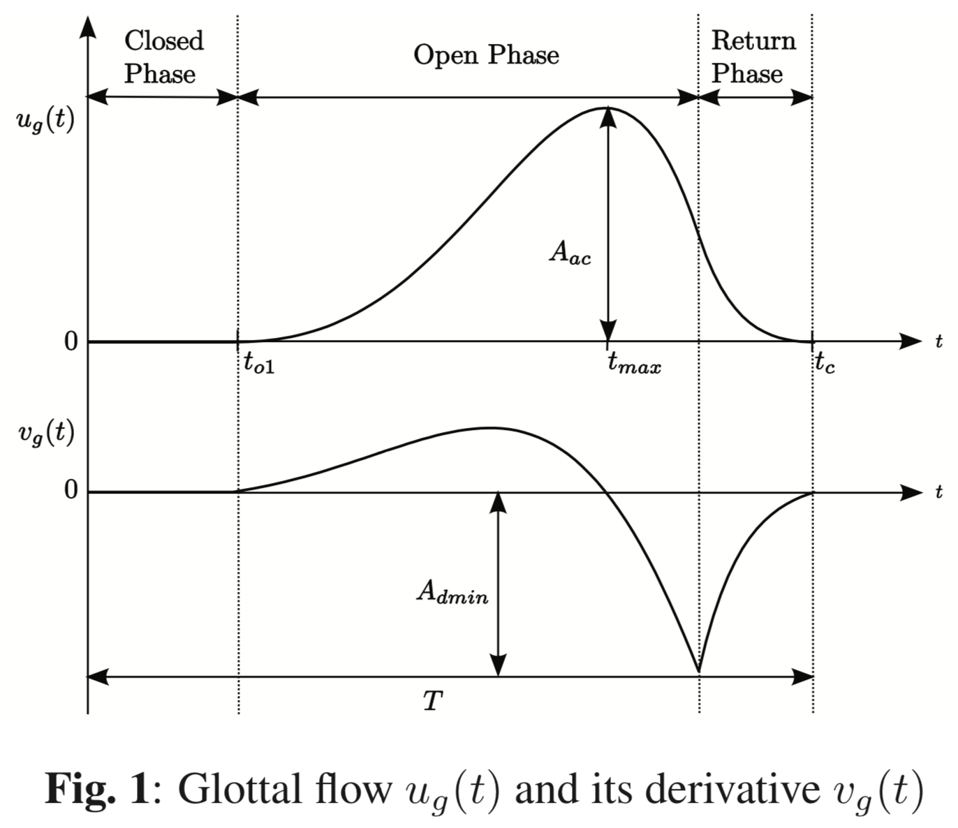
Glottal parameters can be used for cognitive load classification.
Glottal source waveform, or glottal flow, is a quasi-periodic waveform.
Defined as the volume velocity of air flowing through the vocal folds.

Slide 4
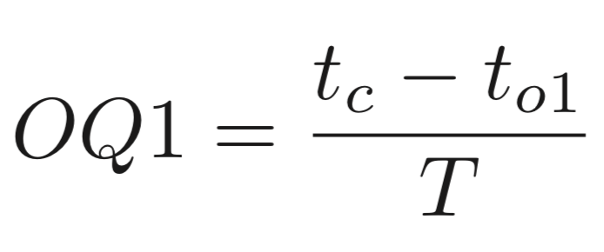
Parameters relating to the open phase of the glottal pulse
primary open quotient (OQ1)
secondary open quotient (OQ2)
amplitude-based open quotient (OQa)

Slide 5
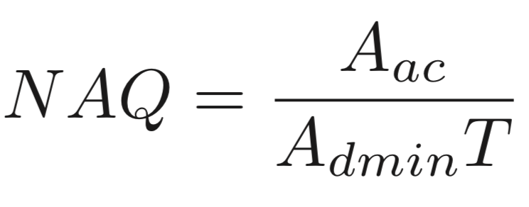
Parameters relating to the closing phase of the glottal pulse
closing quotient (ClQ)
amplitude quotient (AQ)
normalized amplitude quotient (NAQ)

Slide 6
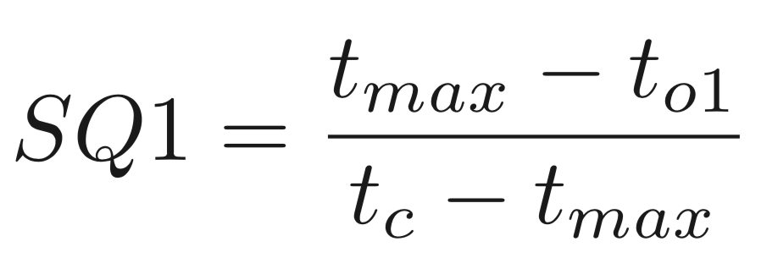
Parameters relating to the symmetry of the glottal pulse
primary speed quotient (SQ1)
secondary speed quotient (SQ2)
quasi open quotient (QOQ)

Slide 7
Glottal parameters are linked to voice quality.
Voice quality of speech in terms of the different phonation types
modal, creaky, breathy, falsetto, harshness, whisper
Creaky speech
aka vocal fry, laryngealized or pressed speech
narrower glottal pulses with longer closed phases
lower OQ1 values, lower NAQ values and higher SQ1 values
Breathy speech
more sinusoidal glottal flow with shorter or no closed phase
higher OQ1 values, higher NAQ values and lower SQ1 values

Slide 8
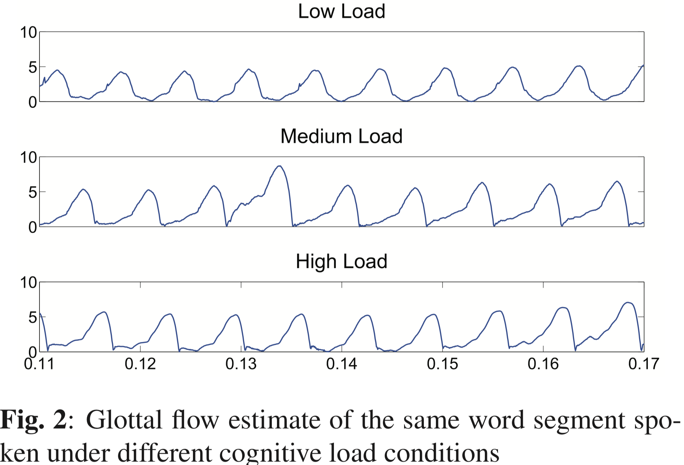
Glottal parameters estimation
Estimate glottal flow
iterative adaptive inverse filtering (IAIF) in APARAT toolbox
remove the vocal tract contribution from speech through successive approximation of the all-pole vocal tract filter

Slide 9
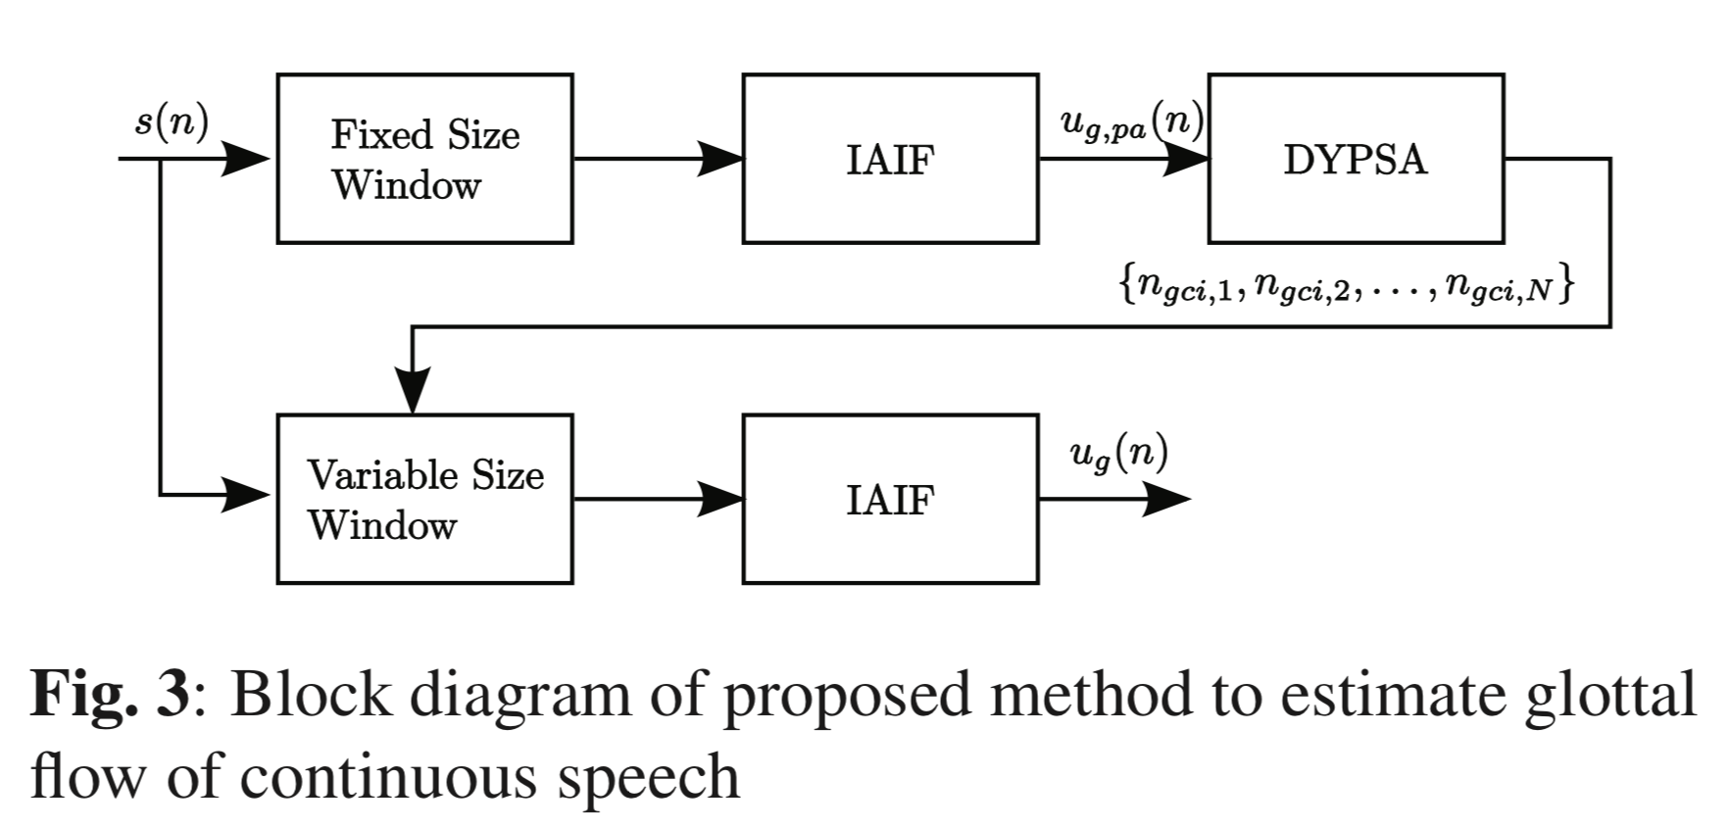

Glottal parameters estimation
Estimate glottal flow
32ms
Pitch-asynchronous
Dynamic Programming Projected Phase-Slope Algorithm
Glottal closure instants
Determined by $n_{gci}$

Slide 10
Glottal parameters estimation
Obtain OQ1, NAQ and SQ1 using APARAT toolkit

Slide 11
Stroop test database
14 randomly selected native English speakers
Perform reading tasks under three differently calibrated cognitive load conditions
Control mental effort: mismatches between the font colors and the meanings of the color words + time limits

Slide 12
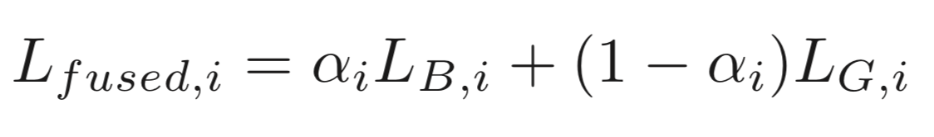
Evaluation
Classifier: UBM-GMM (8)
Features
glottal parameters (OQ1, NAQ and SQ1)
glottal prameters + 7 MFCCs, pitch, intensity and shifted delta cepstra coefficients
Metric
Linear likelihood score fusion

Slide 13
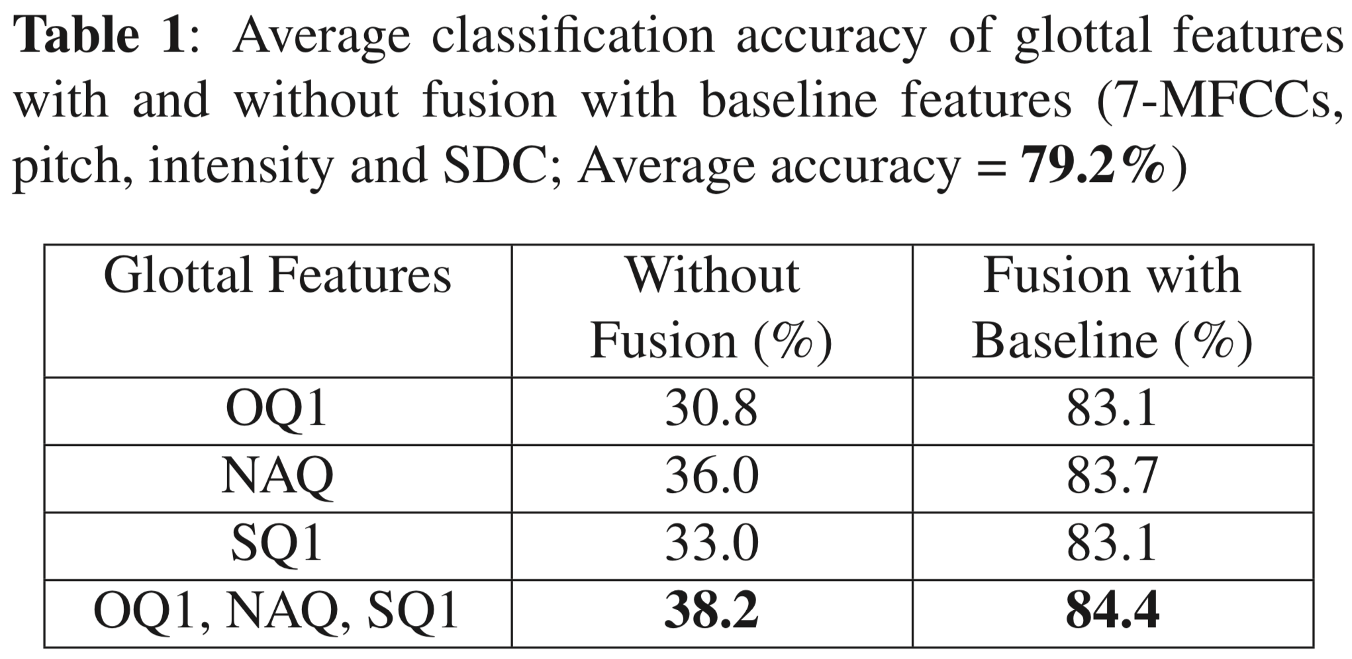
Evaluation

