Slide 1
Version Control Your Jenkins Jobs w/ Jenkins Job Builder
presented by Wayne Warren

Slide 2
Wayne Who?
Quality Engineer at Puppet Labs
Core Jenkins Job Builder (JJB) developer
Past lives:
  Embedded Linux kernel & filesystem developer
  White box testing of medical devices
  Computer Engineering degree
Find me online!
  https://github.com/waynr/
  “waynr” on irc.freenode.net
    #openstack-infra

Slide 3
Outline
Assumptions
Jenkins Job Builder 1.x
  What is it?
  Why use it?
  Simple Example
  Difficulties
Jenkins Job Builder 2.x
Jenkins Manager
  What is it?
  Why use it?
  Demo
Q&A

Slide 4
Assumptions
Familiarity with version control
Familiarity with the concept of “Continuous Integration” (CI)
Understand distinction between YAML and Python
Notes:
Continuous Integration
Specifically, Jenkins
YAML: data-serialization format
Python: object-oriented programming language
1 minute crash course in CI...

Slide 5
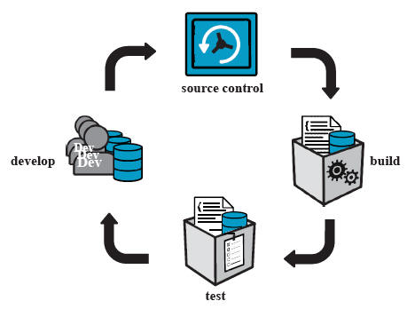
Continuous Integration
Notes:
“CI” is really more of a concept
As such people have different ideas about it
At its core...
Mention what role Jenkins plays in this process

Slide 6
What is Jenkins Job Builder (JJB)?
Command line tool
Maintained by Openstack Infra community
Define Jenkins jobs in YAML
Generate Jenkins job XML
Create/update jobs using Jenkins' HTTP API

Slide 7
Why use JJB?
Reduce CI configuration effort.
Reduce “drift” between similar CI jobs.
Quickly & easily deploy CI changes.
Minimize time spent in the Jenkins UI.

Slide 8
Version control job configuration!
Revert to known good configurations.
  Reduce negative consequences of change.
  Reduce fear of change.
Enable gating of changes on team review.
Periodically enforce configuration state.
Notes:
Easily revert...
Revert all bad jobs at once rather than one-by-one as would be necessary through the web ui.

Slide 9
Simple JJB Demo
Notes:
Before presenting...
After presenting...
I could stop here and you would walk away with a useful tool that would help you maintain your Jenkins jobs, however...

Slide 10
Difficulties w/ JJB DSL
No best practices or style guide.
Confusing variable scoping and default value rules.
Counter-intuitive collection management.
Steep learning curve.
Notes:
I think I can do better...
No best practices:
How to share configuration between Jenkins instances?
How to organize directory structure?
Primary unit of reuse – macros or job-templates? Not clear.

Slide 11
Difficulties w/ JJB 1.x Codebase
Impossible to understand procedural code.
Unclear domain boundaries.
Monolithic classes.
CLI tests bound to API implementation details.
Notes:
Domain boundaries: the class whose primary responsibility is to deal with YAML code does not load YAML files...

Slide 12
JJB 2.x Refactor : Goals
Maintain CLI compatibility w/ 1.x
Strictly define and document API
Disentangle high-level objects
Separate XML generation from YAML parsing.
Rewrite tests bound to internal JJB implementation details.
Notes:
High-level objects:
Builder
YamlParser
ModuleRegistry
Rewrite tests
Test at CLI and API boundaries instead.

Slide 13
JJB 2.x Refactor: Progress
Refactoring is largely complete.
Awaiting review:
  https://review.openstack.org/#/q/topic:+jjb-2.0.0-api
JJB reviews can last many months.
No PyPi packages available yet :(

Slide 14
Jenkins Manager
Command line tool & job definition API built with JJB 2.x library.
https://github.com/waynr/jenkins-manager
Define jobs & pipelines in Python.
More of a hobby/experiment. (< 1 week old)
No plans to use at Puppet Labs.
Notes:
No plans to use at Puppet Labs.
Caveat: during dry-run of this presentation coworkers expressed much enthusiasm

Slide 15
Why use Jenkins Manager?
<insert reasons for using JJB here>

Slide 16
Why use JJB?
Reduce CI configuration effort.
Reduce “drift” between similar CI jobs.
Quickly & easily deploy CI changes.
Minimize time spent in the Jenkins UI.

Slide 17
Why use Jenkins Manager?
<insert reasons for using JJB here>
Data serialization is for computers.
Python is relatively well-known.
Create, Package, & Share your CI abstractions.
Use community-defined CI abstractions.
Write unit tests for your CI jobs.
Notes:
To quote a coworker: “I'd rather sit and stare at Python than YAML all day.”
Python...
Well-known compared to JJB DSL
Chances are you or someone on your team is familiar with it.
Unit test...
Increased confidence in reliability of abstractions.

Slide 18
Jenkins Manager Demo

Slide 19
Demo Summary

Slide 20
Questions & Answers

Slide 21
More Info
Presentation, notes, tutorial
  Github repo
Openstack
  JJB official documentation
  JJB git repo
  JJB developer manual
  #openstack-infra on irc.freenode.net
Puppetlabs QE Team is hiring!
  https://puppetlabs.com/about/careers

