Slide 1
A DEVELOPMENT RELATIONSHIP SYSTEM
MentorBridge
Matching the right mentee to the right mentor — then keeping the relationship
moving through sessions, actions, feedback and measurable outcomes.
10
20
8
100%
MENTORS
MENTEES
EXPERTISE AREAS
EXPLAINABLE MATCHES
Challenge 08 · Mentor Management System · Built by The Visionaries

Slide 2



THE BRIEF
Mentoring outgrew the spreadsheet
As the programme scales, expertise, availability, matching, bookings, attendance and outcomes
become unmanageable through spreadsheets and informal messages.
Do not build a booking system. Build a development relationship system.
Explainable matching
Capacity that holds
The full relationship
Not just a score — mentors are recommended with the reasons that led there.
Assignment is blocked or flagged the moment a mentor is over-allocated.
Sessions, notes, agreed actions, feedback and outcomes — not just a calendar.
MENTORBRIDGE
02

Slide 3




USERS
Four roles, one relationship
Mentee
Mentor
Programme Admin
Coach / Supervisor
Finds a mentor through explainable recommendations, requests sessions, tracks goals and actions.
Manages capacity, confirms sessions, records notes and guidance, gives structured feedback.
Assigns and reassigns mentors, guards capacity, reports hours, no-shows and demand.
Read-only oversight of matches, sessions, feedback and outcomes across the programme.
MENTORBRIDGE
03

Slide 4



HOW IT'S BUILT
A clean three-tier architecture
Simple, stable and explainable — every layer does one job.
Front End
Backend API
Database
HTML · CSS · JavaScript
→
Node.js · Express · JWT
→
SQLite (better-sqlite3)
Login, matching, dashboards, session and feedback screens for every role.
Routes call a service layer for matching, capacity, scheduling and reporting rules.
12 tables: users, profiles, expertise, matches, sessions, actions, feedback, outcomes.
Deployed on Render · JSON REST API · Bearer-token auth · Role checks enforced server-side
MENTORBRIDGE
04

Slide 5
DATA MODEL
Twelve tables, one clear story
People
Matching
The Relationship
users
mentors
mentees
expertise_categories
mentor_expertise
mentee_needs
availability_slots
matches
sessions
actions
feedback
outcomes
One active match per mentee, enforced at the database level. "Overdue" is never stored — it's computed from the due date every time an action is read, so it can never go stale.
MENTORBRIDGE
05

Slide 6
SIGNATURE FEATURE
Explainable matching, not a black box
Every recommendation returns a score out of 100 — and the exact reasons behind it.
SCORE BREAKDOWN — 100 POINTS
LIVE EXAMPLE
Expertise match
40 pts
Thandi Mokoena — 76% match
Availability overlap
20 pts
Senior Financial Manager · Nedbank
Covers Finance & Funding (1 of 2 support areas)
Both free on Tuesdays
Shared language: English
Mentee is flexible on mode
3 of 4 places free
Shared language
15 pts
Mode / location
10 pts
Remaining capacity
15 pts
Reasons are generated live from real profile data — never hard-coded.
MENTORBRIDGE
06

Slide 7
ASSIGNMENT & CAPACITY
Capacity you can trust
Capacity is never stored — it's derived from active matches every time, so it can't drift out of sync.
Blocked by default
MENTOR CAPACITY
Assigning past capacity returns an error — no silent over-allocation.
Thandi Mokoena
Admin override, with a reason
2 / 2 mentees — AT CAPACITY
An admin can assign anyway, but only with a written justification that's stored on the match.
409 capacity_reached
"Thandi is at capacity (2/2). Send override:true with an override_reason to assign anyway."
Safe reassignment
If a reassignment fails, the mentee's original match stays active — nothing is left half-changed.
MENTORBRIDGE
07

Slide 8




BEYOND THE CALENDAR
The full mentoring loop
This is what "development relationship system" means in practice.
1
2
3
4
5
Session
Notes
Actions
Feedback
Outcome
Requested → confirmed → completed. Overlaps are rejected automatically.
Attendance, duration, focus and guidance recorded by the mentor.
Agreed next steps with an owner and due date — auto-flagged overdue.
Structured ratings from both mentor and mentee, one per session.
Real development milestones linked back to the relationship.
Nothing here is a bare calendar entry — every session carries the record that turns a meeting into progress.
MENTORBRIDGE
08

Slide 9
REPORTING
A dashboard for every role
Mentee
Mentor
Admin
Matched mentor & goals
Upcoming & past sessions
Actions & completion %
Outcomes achieved
Capacity & mentees
Hours (total & monthly)
Overdue actions
Feedback received
Hours, sessions, no-shows
Requested expertise vs supply
Unmatched mentees
Stalled relationships
MENTORBRIDGE
09

Slide 10
PRICING
Transparent mentor pricing
Every mentor card shows an hourly rate in rand, so mentees can weigh cost alongside the match score.
Johan Botha
R850 / hour
Sipho Dlamini
R550 / hour
Founder & CFO · Cape Agri Group
Engineering Manager · Discovery
Ayesha Patel
R800 / hour
Lerato Molefe
R500 / hour
Corporate Lawyer · Bowmans
HR & Talent Executive · Sasol
Pieter van der Merwe
R750 / hour
Naledi Sithole
R450 / hour
Supply Chain Director · Barloworld
Head of Marketing · Takealot
Michael Naidoo
R700 / hour
Zanele Khumalo
R350 / hour
Strategy Consultant · Deloitte
Digital Growth Lead · Yoco
Thandi Mokoena
R650 / hour
Refilwe Nkosi
R300 / hour
Senior Financial Manager · Nedbank
Careers Coach · Independent
Rates are per 60-minute session in ZAR and are prototype values. Price never changes the match score; admins see each rate beside capacity and hours.
MENTORBRIDGE
10

Slide 11
PROTOTYPE DATA
By the numbers
10
20
8
10
MENTORS
MENTEES
EXPERTISE AREAS
ACTIVE MATCHES
15
10
15
20
BOOKED SESSIONS
COMPLETED SESSIONS
ACTION ITEMS
FEEDBACK RECORDS
TECH STACK
Node.js + Express • SQLite • JWT auth • HTML / CSS / JS • REST API • Render hosting • Git + GitHub
MENTORBRIDGE
11

Slide 12
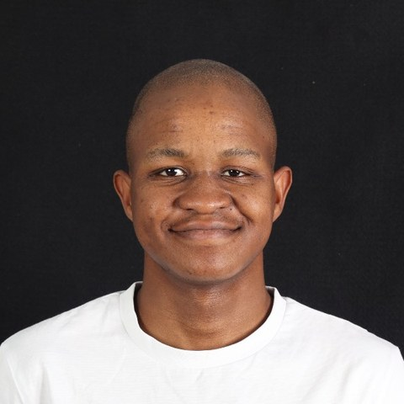
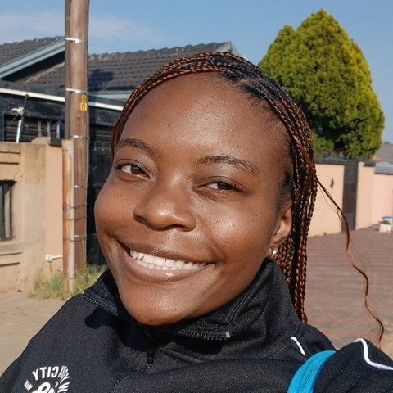
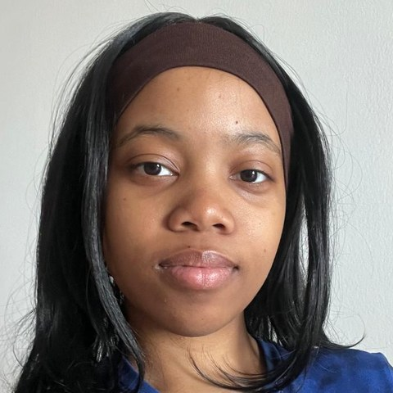

THE TEAM
The Visionaries
The people behind MentorBridge.
Matete
Lerato
Leah
Phenyo
Front-End Lead
Matching Engine Lead
QA & Hosting Lead
Dashboards & Reporting Developer
UI, portal navigation, layouts and responsive styling.
Weighted matching algorithm and explainable scoring.
Deployment, live demo hosting, testing and bug fixing.
Live analytics: hours, no-shows, capacity and admin reports.
MENTORBRIDGE
12

Slide 13

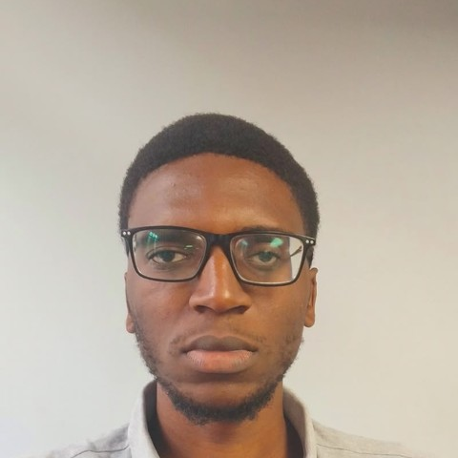
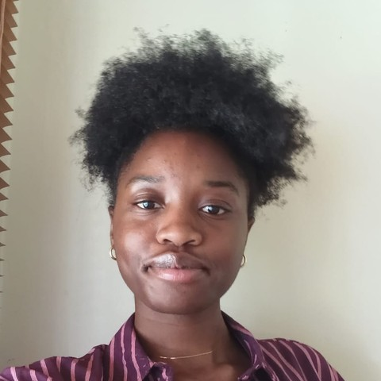
THE TEAM
The Visionaries, continued
Database, backend and business analysis.
Mpho
Ndzalama
Tabitha
DB Lead
Backend Lead
Business Analyst
Database design for users, profiles, matches, sessions, actions and feedback.
Express API, JWT login and the rules behind capacity and scheduling.
Requirements, user stories and acceptance criteria drawn from the challenge brief.
MENTORBRIDGE
13

Slide 14
From good intentions
to structured development.
Thank you — questions welcome.
MentorBridge · Challenge 08 · The Visionaries

