Slide 1
M1 / DATA EXPLORATION
From EHR to evidence
A visual guide to the MIMIC-IV-ED dataset exploration notebook
What students will learn
How an emergency-department stay becomes one analysis row
How to read variables, distributions, frequencies, and missingness
How imputation and correlation support, but do not replace, judgment
| 425,087 rows | 120 columns
Notes:
Open by framing the deck as a map for the notebook, not a replacement for running it. The central idea is that a clinical record is not born as a tidy machine-learning table. It is assembled from events, identifiers, timestamps, measurements, and outcome definitions. M1 asks students to slow down and understand that construction before they model anything. Tell students that the numbers on this slide are recomputed from the current local CSV, so the deck is tied to the same evidence they will see. By the end, students should be able to explain what one row means, when each variable becomes available, how missingness is represented, what a summary statistic says, and what the exported handoff tables contain.

Slide 2
THE ROUTE
M1 / 02
A notebook is a chain of questions
01
02
03
04
Context
Construction
Inspection
Preparation
What is an EHR, and why does it matter?
How did MIMIC-IV-ED become this table?
What do the fields, distributions, and gaps say?
What is cleaned, imputed, audited, and exported?
The habit: every number should have a definition, a time window, and a provenance.
Notes:
Use this slide to establish the order of operations. Students often jump from a CSV to a model because the table looks finished. M1 reverses that impulse. First we define the domain and the dataset. Then we identify the row grain and the time boundary. Only after that do we inspect variable meanings, distributions, category counts, missingness, and relationships. The final step is preparation for later work. Emphasize that these are not disconnected notebook sections. A variable dictionary depends on the construction process. A missingness interpretation depends on when a measurement could have been collected. An imputation rule depends on the measurement's units and valid range. The outputs are useful because the earlier definitions make them auditable.

Slide 3
01 / CONTEXT
M1 / 03
What is an electronic health record?
An EHR is a longitudinal digital record of care: observations, actions, decisions, and outcomes captured across clinical workflows.
Why the structure matters
The same person can have many encounters.
A value has meaning only with time and units.
Documentation reflects workflow, not just physiology.
Patient
Encounter
Observation
Outcome
identity and history
arrival and location
vitals, labs, notes
Labels can be defined after the encounter ends.
disposition and events
EHR -> MIMIC-IV-ED -> reproducible notebook evidence
Notes:
Define EHR broadly enough that students understand it is more than a spreadsheet of diagnoses. It is a record generated by care delivery. Some fields are measurements, some are orders or actions, some are administrative timestamps, and some are retrospective outcomes. The workflow creates structure and bias. For example, a vital sign can be missing because it was not measured, not documented, or not included in the extraction window. The fact that a field is present in a file does not tell us when it was known. Connect this directly to M1: the notebook asks students to classify identifiers, timing fields, demographics, triage observations, prior history, later ED measurements, and downstream outcomes before using them analytically.

Slide 4
01 / context
Why EHR data is powerful - and difficult
Scale
Realism
Many encounters and measurements make patterns visible.
Data reflects actual workflows, missingness, and operational choices.
Timing
Responsibility
The same value can be valid for description but invalid for triage prediction.
Privacy, bias, leakage, and clinical interpretation stay in scope.
The data is valuable because it is close to care. That is also why definitions matter.
Notes:
Pause on the tension in this slide. EHR data offers scale and realism that controlled datasets often lack, but it carries the traces of clinical workflow. A test is more likely to appear when someone orders it. A later measurement is more likely to appear for patients who remain in the ED. A disposition field is informative, but it is also downstream of the decision we may want to predict. The lesson for M1 is not that EHR data is unusable. The lesson is that usefulness comes from explicit boundaries: what is one row, what was available at the prediction time, how was each field created, and what does missing mean here?

Slide 5
01 / CONTEXT
M1 / 05
MIMIC-IV-ED: a clinical data resource
MIMIC is a large, de-identified database designed for reproducible clinical research and education.
M1 notebook
ED
IV
ED stay
Uses the extracted teaching table.
emergency-department encounters
major MIMIC data release
the row grain used in M1
Recomputes claims from the local generated CSV.
Treats the table as a research artifact, not a clinical tool.
MIMIC context is important, but the notebook's immediate object is the locally extracted master table.
Keeps provenance and limitations visible.
Notes:
Introduce MIMIC as a research and education resource, then make the important distinction between the source database and this notebook's local teaching table. Students should not assume that every field in the CSV was directly copied from one raw table. The local extraction has already applied joins, time windows, transformations, and outcome definitions. M1 therefore begins with provenance and recomputes summaries from the current CSV. Also make the non-clinical boundary explicit: this is not a decision-support system, and an imputed value in the notebook should not be interpreted as a clinical replacement measurement.

Slide 6
02 / CONSTRUCTION
M1 / 06
How the dataset becomes one analysis table
1
Source events
Link keys
3
Time windows
Master table
2
4
ED, hospital, patient, medication, and outcome records
subject_id | hadm_id | stay_id
triage, first hour, later ED, after-stay outcome
one row per ED stay
Join logic is part of the data. A row is a constructed claim about an encounter.
The notebook verifies row counts, unique stay_id values, repeat subjects, column families, and timing boundaries before analysis.
Notes:
Walk from left to right. The source system contains events in different tables and at different grains. Link keys give us the relationships: subject_id identifies a person, hadm_id links to a hospital admission when present, and stay_id identifies an ED stay. Time windows decide whether a value belongs to triage, the first hour, later ED care, or a downstream outcome. The master table then chooses one row per ED stay. Stress that the join is not a neutral technical step. If a join duplicates a stay, drops a stay, or attaches a later event to an earlier snapshot, the resulting analysis changes. This is why M1 checks uniqueness and describes the row grain before making plots.

Slide 7
02 / CONSTRUCTION
M1 / 07
Read every variable against the encounter timeline
One row = one ED stay
arrival
triage
first hour
later ED
departure
edregtime
triage_*
early measurements
ed_*_last
edouttime
Availability is a modeling decision: a later ED measurement may be descriptive but outside a triage-time prediction boundary.
One subject can have multiple stays
Notes:
This is one of the most important slides in the deck. Ask students to point to the earliest time at which each example could be known. triage_acuity and triage vitals belong near arrival. ed_los_hours is known after departure. disposition is downstream of the ED decision. ed_*_last is a later measurement and should not automatically be used as a triage predictor. The notebook includes an exercise asking students to classify fields by availability. Also distinguish subject from stay: repeated visits are not duplicate rows if the row grain is an ED stay. They do matter for modeling because random row splits can put the same subject in both training and test sets.

Slide 8
03 / INSPECTION
M1 / 08
The variable dictionary is a map of meaning
Identifiers & timing
Demographics & arrival
stay_id, subject_id, hadm_id, intime, outtime
age, gender, race, insurance, transport
Triage measurements
Prior utilization
temperature, heart rate, oxygen saturation,
acuity
ED, hospital, and ICU counts over
30/90/365 days
Later ED measurements
Outcomes
ed_*_last and medication counts
LOS, hospitalization, critical outcome,
revisit
A plausible name is not a definition. Read the generated dictionary and the extraction contract.
Notes:
Use the six families to help students read the notebook's generated variable dictionary. Identifiers and timestamps support auditing, but they are not automatically predictors. Demographics and arrival fields describe representation and presentation context. Triage measurements are observations available near the beginning of the stay. Prior utilization summarizes history before the index stay. Later ED measurements and medications may be useful for retrospective description but violate a triage-time boundary. Outcomes are labels or downstream events. The dictionary is generated from the actual columns, which is a useful reproducibility pattern: the documentation follows the data rather than becoming a manually maintained list that silently drifts.

Slide 9
03 / inspection
How to read the symbols and suffixes
NaN
missing value; not automatically zero or normal
*_last
last recorded ED measurement in the defined window
n_*_30d / 90d / 365d
count over a prior utilization window
outcome_*
label or downstream event, not a triage observation
_iterative
a new imputed analysis column; raw field is preserved
%
a proportion expressed per 100 rows
The same column name carries both a data type and a time meaning.
Notes:
Teach these as reading conventions rather than memorization. NaN means the value is missing in the table; it does not tell us why. A suffix such as _last describes a selection rule inside a time window. A count variable is numeric, but it represents a historical event count rather than a physiologic measurement. outcome_ fields are retrospective labels and must be kept out of a model that is supposed to operate at triage. The _iterative suffix is especially important: it names a new derived column (impute0d, while the raw measurement remains available. Ask students to interpret triage_acuity_iterative in words: an estimated version of the triage acuity field, generated by the selected imputation method, constrained to the valid acuity range.

Slide 10
03 / INSPECTION
M1 / 10
Summary statistics are compact descriptions, not verdicts
Mean
Standard deviation
Median
arithmetic average; sensitive to extreme values
typical spread around the mean
middle ordered value; robust to skew
sum(x) / n
sqrt(variance)
50th percentile
IQR
Percentiles
Missing %
middle 50% of the distribution
locate values in the ordered distribution
how much of a column is absent
75th - 25th percentile
p01, p25, p50, p75, p99
missing / total * 100
For skewed clinical variables, show the median and IQR alongside the mean and standard deviation.
Notes:
Explain why the notebook asks for more than mean and standard deviation. Emergency-department length of stay is often skewed, and utilization counts can have many zeros with a long right tail. The mean can be pulled upward by a small number of long stays. The median and IQR describe the center and middle spread more robustly. Percentiles show the tails and are useful for spotting implausible values or heavy skew. Missing percentage is not a descriptive statistic about the observed values, but it is essential context for interpreting them. Encourage students to report both the numerical summary and the data-generating interpretation: a high missing percentage may reflect a selective workflow rather than a random absence.

Slide 11
03 / INSPECTION
M1 / 11
What the current M1 table says at a glance
425,087
120
205,504
69,952
ED-stay rows
variables in the CSV
unique subjects
subjects with multiple stays
Variable
Median
IQR
99th pct
Missing %
age
53.00
34.00
93.00
0.02%
triage_acuity
3.00
1.00
4.00
1.64%
triage_temperature
98.00
1.10
101.30
5.51%
triage_heartrate
84.00
24.00
134.00
4.02%
triage_o2sat
99.00
3.00
100.00
4.85%
triage_sbp
133.00
28.00
198.00
4.30%
ed_los_hours
5.47
4.79
30.48
0.00%
Interpretation requires units: temperature is stored in Fahrenheit-like values when detected; ED LOS is in hours; acuity is ordinal 1-5.
Notes:
Read the table as an example of disciplined reporting. The counts establish the scale and repeated-subject structure. The summary table then gives students a compact view of center, spread, tail behavior, and missingness. Do not let the impressive-looking numbers become detached from units. The temperature cleaning logic detects Fahrenheit-like values and uses Fahrenheit-equivalent bounds. ED length of stay is in hours. Triage acuity is an ordinal scale from 1 to 5, so its median is interpretable as a location on an ordered category scale, not as a precise physical measurement. Point out that the 99th percentile is useful for seeing tail behavior, while missing percentage tells us how much observed information is available in the first place.

Slide 12
03 / INSPECTION
M1 / 12
Categorical frequencies describe representation
A frequency table answers: which labels appear, how often, and how much of the table do they cover?
triage_acuity
gender
ordinal
nominal
3.0: 225,066 | 2.0: 139,411 | 4.0: 28,504
F: 229,898 | M: 195,189
race
arrival_transport
nominal
nominal
WHITE: 228,123 | BLACK/AFRICAN AMERICAN: 76,798 | OTHER: 20,752
WALK IN: 251,849 | AMBULANCE: 155,752 |
UNKNOWN: 15,352
Frequency is not causality, quality, fairness, or clinical meaning. Rare and missing categories need review before encoding.
Notes:
Contrast ordinal and nominal variables. Triage acuity has an order, so the labels 1 through 5 represent increasing urgency in the dataset's coding. Gender, race, and arrival transport are categories without the same numeric order. A frequency table can reveal representation, rare labels, unexpected codes, and missing categories. It cannot establish whether a category is clinically meaningful or whether a difference is causal. Remind students that percentages should use a declared denominator, and that keeping missing categories visible is often more honest than silently dropping them. Later encoding choices depend on this review: ordinal categories may need a different treatment from nominal categories, and rare labels may require grouping or explicit documentation.

Slide 13
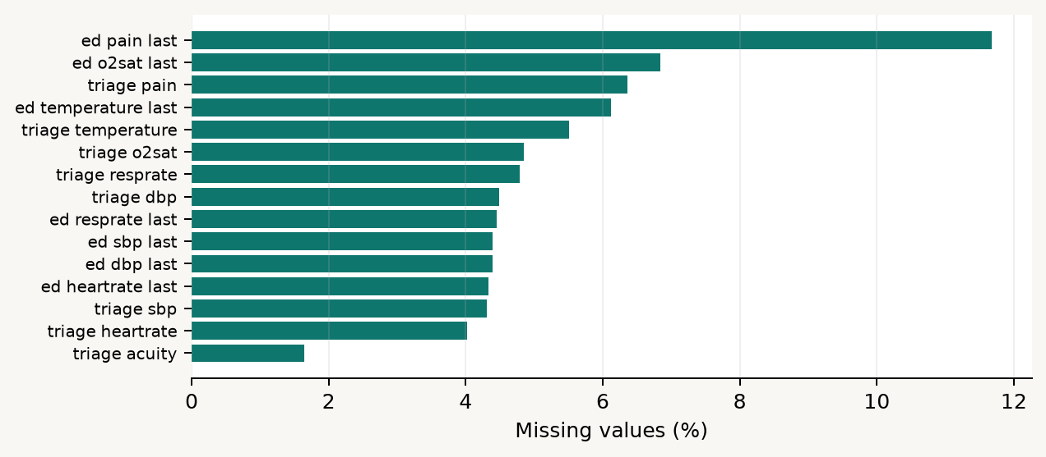
04 / PREPARATION
M1 / 13
Missingness is part of the data-generating process
A blank can mean
the test was not ordered
the value was not documented
the event fell outside the time window
the extraction did not find a match
the measurement was removed as implausible
M1 inspects missingness before choosing an imputation strategy.
Notes:
The chart shows missing percentages for the 15 vital fields used in the M1 imputation exercise. The exact reason for a blank is usually not recoverable from the value alone. That uncertainty matters because missingness can reflect clinical workflow and severity. A later ED measurement may be absent because the patient left earlier, not because the patient was normal. The notebook therefore reports raw missingness, applies source-informed range cleaning to a working copy, and keeps the raw columns intact. In later modeling, missingness indicators may preserve the fact that an observation was absent. Imputation then estimates a value for a specific analytical purpose; it does not recreate the original clinical measurement.

Slide 14
04 / preparation
Imputation: estimate carefully, validate honestly
The notebook creates a known test by hiding 20% of cells in rows that were originally complete.
1
2
3
4
complete rows
mask 20%
fit imputer
score hidden cells
Compared methods
Important guardrails
Median | KNN | Iterative | Autoencoder-style MLP
Range-clean first | constrain outputs | score masked cells only | preserve raw data
Local result: iterative selected | validation rows: 10,000 | masked cells: 29,943
Notes:
Explain the validation design slowly. We need a known reference value, so the notebook starts with rows where all candidate vitals are observed. It hides 20 percent of the cells, fits each method on the masked table, and scores only the deliberately hidden cells. This is not proof that real missing values are recoverable; it is a controlled comparison of reconstruction behavior. The methods represent increasingly structured assumptions: a column median, local neighbors, chained regression models, and an autoencoder-style neural reconstruction. The current notebook constrains iterative output using the same variable-specific valid bounds used in cleaning. That prevents an ordinal acuity field from becoming negative, while still allowing the method to produce fractional estimates. The local comparison currently selects the method shown on the slide; students should rerun rather than treat the result as universal.

Slide 15
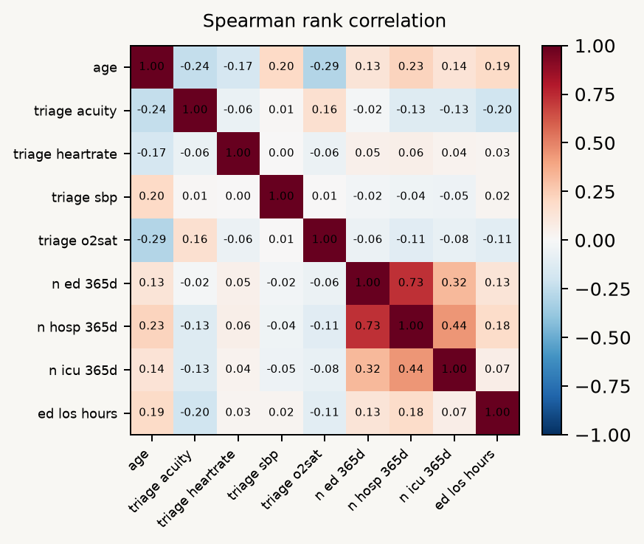
03 / INSPECTION
M1 / 15
Correlation asks whether variables move together
How to read it
Spearman correlation uses ranks, so it captures monotonic association.
+1 means variables rise together; -1 means one rises as the other falls.
0 means little monotonic association in this table.
Correlation is not causation and does not prove predictive usefulness.
Different time windows can create leakage concerns even when correlation is strong.
Notes:
Define correlation as a descriptive relationship between two variables. The notebook uses Spearman correlation for selected numeric fields, which works on ranks and is less dependent on a linear relationship. A positive value means high ranks tend to occur with high ranks; a negative value means high ranks tend to occur with low ranks. The matrix is useful for generating questions, spotting redundant variables, and checking whether a claimed relationship is plausible. It is not a causal analysis. It also does not settle whether a field belongs in a prediction model. For example, a later ED measurement may correlate strongly with length of stay because it is observed during the evolving stay, but that does not make it valid at triage. Timing and availability remain the controlling questions.

Slide 16
05 / OUTPUTS
M1 / 16
What M1 hands forward
M1_variable_dictionary.csv
M1_missingness.csv
families, dtypes, non-missing counts, missing percentage
column-level missingness for audit and discussion
M1_imputation_comparison.csv
M1_vital_imputation_audit.csv
MSE, MAE, and masked-cell counts by method
raw vs imputed names, ranges, and missing-after checks
M1_quality_checks.csv
M1_target_summary.csv / M1_acuity_summary.csv
negative LOS, zero LOS, IDs, targets, and range flags
outcome prevalence and descriptive acuity comparisons
Raw vital columns stay available; selected method-suffixed columns provide complete modeling estimates.
Notes:
Present the outputs as a handoff, not as clutter. Each CSV answers a different audit question. The variable dictionary explains what is present. The missingness table quantifies absence. The imputation comparison records how methods were judged. The vital audit documents the raw and derived names, ranges, and completeness. Quality checks surface values that need discussion rather than silently changing the source. Target and acuity summaries support the descriptive part of M1. The imputed export keeps stay_id, triage vitals, and the method-suffixed columns together for later work. Emphasize the preservation rule: the raw columns remain available, so students can compare source observations with analytical estimates and avoid confusing an imputed value with a measurement that actually occurred.

Slide 17
05 / outputs
The student workflow inside M1
1
Run from the workspace root or confirm the data path.
2
Verify rows, columns, unique stays, and repeated subjects.
3
Read the generated variable dictionary before plotting.
4
Compare numerical summaries with units and missingness.
5
Inspect categorical frequencies without hiding missing labels.
6
Compare imputation methods on artificially masked cells.
7
Review leakage boundaries before using a field as a predictor.
8
Inspect the exported handoff tables and document limitations.
The deliverable is not just a cleaned table. It is a defensible explanation of what the table means.
Notes:
Use this as the bridge from the deck to the notebook. Students should run the cells in order and inspect the outputs rather than treating the notebook as a black box. The order protects the reasoning: establish the data path, verify the row grain, generate the dictionary, summarize numeric and categorical variables, inspect missingness, compare imputation, run quality checks, define outcomes, and audit leakage. The final deliverable is an evidence trail. A future analyst should be able to see which columns were raw, which were derived, what rules were used, how the imputation method was selected, and what limitations remain. This mindset will carry directly into later modeling modules.

Slide 18
M1 / CLOSE
M1 / 18
Before you model, be able to say what the row means
A strong analysis begins with four answers:
Which people and encounters are represented?
What?
What does one row and each variable represent?
Who?
When?
When could each value have been known?
How sure?
What is observed, missing, cleaned, imputed, or downstream?
M1 turns a clinical data extract into a transparent analytical starting point.
Next step: carry the declared row grain, timing boundary, and data-quality evidence into modeling
Notes:
Close by returning to the four questions. Who is represented? What is one row and what does each field mean? When could the value have been known? How certain are we that it is observed rather than missing, cleaned, imputed, or downstream? If students can answer those questions from the M1 notebook, they have the foundation for the later modules. The final point is that data preparation is not merely a technical prelude. It is the first version of the scientific argument. Later models inherit the row grain, timing choices, definitions, and limitations established here.

