Slide 1
M2 / OUTCOME ANALYSIS
How long is an ED stay?
From a continuous clinical outcome to patient-disjoint classification and regression baselines
M2 teaches students to
describe a right-skewed duration without hiding its tail
compare groups without turning association into causation
build and evaluate binary and continuous baselines
425,087 rows | 4.5-hour operational split
Notes:
Open by telling students that M2 changes the outcome while preserving the ED-stay observation established in M1. The question is not simply whether a patient is sick. It is how long the emergency-department encounter lasts, and whether triage-time information can distinguish stays longer than 4.5 hours. The deck will move through two representations of the same outcome: continuous hours and a binary operational class. The first is richer but harder to map to an action. The second is easier to communicate but loses information. The notebook makes that trade-off visible rather than pretending one representation is universally correct. The numbers on this slide come from the current local M1 handoff and M2 outputs.

Slide 2
M1 RECAP
M2 / 02
Carry the data contract forward
Row grain
Time boundary
one row represents one ED stay
triage information is separated from later events
Data quality
Leakage
raw fields remain visible; imputed fields are explicit
downstream outcomes and identifiers are excluded from predictors
M2 inherits the row, timing, and quality decisions from M1; it changes the label to ED length of stay.
Notes:
Briefly reconnect to M1. Students already learned that the table is one row per ED stay, that a subject can have multiple stays, and that variable availability matters. They also saw raw and imputed vital columns kept separate, and they learned to exclude identifiers and downstream fields when defining a prediction boundary. M2 does not reset those decisions. It uses the M1 handoff and asks a new question about ED length of stay. This is a useful modeling principle: when the outcome changes, the target definition and evaluation change, but the data contract and leakage discipline still apply. Ask students to name one M1 decision that would become a problem if it were ignored here.

Slide 3
01 / QUESTION
M2 / 03
What is ED length of stay?
ED LOS is the elapsed time from emergency-department arrival to ED departure.
arrival
triage
evaluation
decision
departure
clock starts
early information
tests and treatment
disposition process
clock stops
Units matter: M2 measures the outcome in hours, not a diagnosis or a quality score.
Notes:
Define the target operationally. ED LOS is the time difference between ED arrival and ED departure. It is a duration, measured here in hours. It is not the same thing as severity, quality, or patient harm. A long stay can reflect clinical complexity, diagnostic work, bed availability, consultation, or system flow. A short stay can reflect a straightforward evaluation, an immediate transfer, or an administrative pattern. The timeline also prepares students for the modeling boundary. Triage information is available early. Some later measurements and the final disposition occur after the prediction point. The notebook retains the continuous duration and then creates a binary label only for a specific teaching question.

Slide 4
01 / question
Why ED LOS matters
Patient experience
Flow and capacity
time in the ED affects comfort, uncertainty, and access to the next step
duration is connected to rooms, staff, diagnostics, beds, and handoffs
Planning
Measurement
estimates can support staffing and operational planning when uncertainty is visible
the outcome exposes both clinical complexity and system workflow
Interpretation question: what part of LOS is clinical, and what part is operational?
Notes:
ED LOS matters because it sits at the intersection of patient experience, clinical work, and system operations. It can be used to describe flow, compare groups, and support planning. But its meaning is not one-dimensional. A longer stay may indicate more complex care, or a delay in a downstream resource. This is why the notebook treats LOS as an outcome and avoids calling group differences causal. It also explains why a model's intended action matters. A flow manager might want a probability that a stay will cross an operational threshold. A planning team might want an expected number of hours. Those are related but not interchangeable decisions.

Slide 5
02 / OUTCOME
M2 / 05
Define the cohort before describing it
425,087
425,081
62.02%
53
rows in the source table
valid non-negative LOS rows
long-stay prevalence
zero-hour stays retained
Missing LOS
0 rows are not available for this outcome analysis.
Negative LOS
6 rows are impossible durations and are excluded.
Valid extremes
34,342 valid rows exceed the 1.5 x IQR upper fence and remain in the cohort.
Quality rules change the analysis cohort, but the original table is not silently overwritten.
Notes:
Before showing a distribution, define which rows are eligible. Missing ED LOS cannot be described or modeled as a duration, so those rows are absent from the LOS cohort. A negative duration is impossible, so the notebook excludes it from LOS analyses. Zero-hour durations are retained because they may represent same-day events or administrative timing patterns and should be investigated rather than automatically discarded. Valid but unusually long durations are not deleted simply because they exceed an IQR fence. The fence is used as a flag for inspection. This distinction is important: an outlier rule can identify a value for discussion without declaring the value false. The source table remains unchanged, and the derived df_los cohort records the analysis choice.

Slide 6
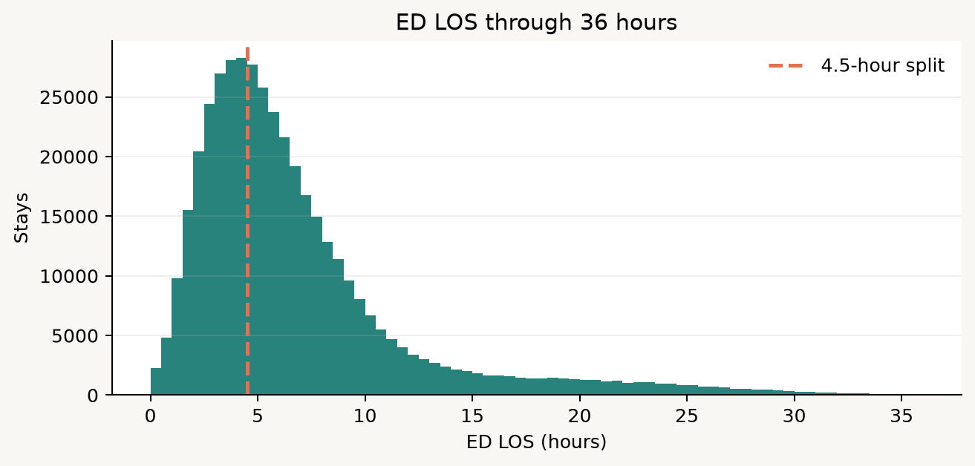
02 / OUTCOME
M2 / 06
Continuous LOS: center, spread, and tail
Current cohort
5.47 h
median: middle stay
4.79 h
IQR: middle 50%
30.48 h
99th percentile: tail
The mean is 7.16 h; the maximum is 493.07 h.
Notes:
This is the core descriptive slide. The current valid cohort has a median ED LOS of 5.47 hours and an IQR of 4.79 hours, meaning the middle half of stays spans 4.79 hours. The mean is higher than the median because the distribution has a right tail. The histogram is intentionally restricted to 36 hours for readability; the notebook does not remove longer stays from df_los for analysis. The 99th percentile and maximum show why the tail deserves attention. Teach students to report the median and IQR alongside the mean and standard deviation for a skewed duration. The summary is descriptive, not a performance judgment. It tells us what the table contains, not whether the ED is good or bad.

Slide 7
02 / OUTCOME
M2 / 07
The 4.5-hour split creates a second target
los_long_4_5h = 1 when ED LOS > 4.5 hours
shorter
longer
4.5 h
62.02%
Useful for an operational teaching question, but not a natural law. A 4.49-hour stay and a 4.51-hour stay are nearly identical.
of valid stays are above the threshold
Notes:
The notebook preserves continuous hours and also defines a binary teaching target: greater than 4.5 hours. This threshold is an operational choice inherited from the source analysis, not a biological boundary. It creates a useful classification question, but it also creates discontinuities. A stay at 4.49 hours and one at 4.51 hours fall on opposite sides of the label despite being almost identical. Two stays labeled long can also differ by many hours. Ask students what action would follow from the label before treating it as meaningful. If the action is staffing or queue management, the threshold may be useful. If the question is how much time a patient spends in the ED, the continuous target is more faithful. The target representation should follow the decision.

Slide 8
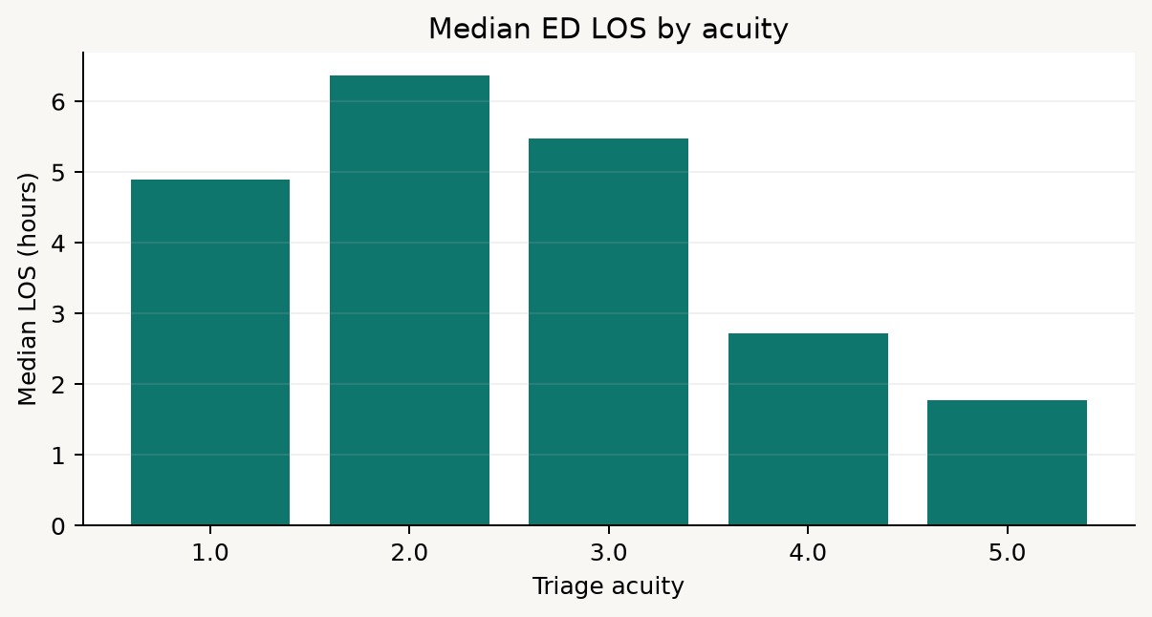
03 / GROUP ANALYSIS
M2 / 08
Group comparisons generate questions
Read the pattern carefully
Acuity 2 median: 6.37 hours.
Acuity 4 median: 2.72 hours.
Group sizes differ, so percentages need denominators.
Association may reflect case mix and workflow, not causation.
M2 also compares age groups and arrival transport.
Notes:
The group-analysis section asks how LOS varies across triage acuity, age, and arrival transport. The displayed acuity comparison is descriptive. For example, acuity 2 has a median of 6.37 hours while acuity 4 has a median of 2.72 hours in this extract. That pattern is worth investigating, but it does not prove that acuity causes a shorter or longer stay. Group size, missing categories, case mix, and workflow all matter. The notebook reports stays, mean, median, quartiles, and long-stay percentage. Encourage students to compare both center and spread, and to inspect the denominator. A small group can have a volatile percentage. The age and arrival tables extend the same reasoning. Descriptive comparisons generate hypotheses for the next analysis; they are not the final word.

Slide 9
04 / modeling
Start with the information boundary
Triage and context
Prior utilization
Clinical flags
age, gender, race, arrival transport, imputed triage vitals, acuity
ED, hospital, and ICU counts over 30, 90, and 365 days
chief-complaint indicators and CCI/ECI comorbidity indicators
Excluded from this triage-time baseline
identifiers | timestamps | disposition | ED LOS | outcomes | later ED measurements | medications
The model may be predictive only if its inputs could exist at the intended prediction time.
Notes:
Before discussing algorithms, define the input boundary. The M2 baseline uses age and demographic context, arrival transport, imputed triage measurements, triage acuity, prior utilization counts, chief-complaint flags, and comorbidity indicators. It excludes identifiers, timestamps, disposition, the LOS target, outcomes, ICU timing, revisit fields, later ED measurements, and medication counts. These exclusions are not claims that the fields have no information. They are claims about when the information becomes available and what question the model is intended to answer. A model that sees later ED measurements may perform well while answering a retrospective question rather than a triage-time question. Ask students to challenge every candidate variable with: could I know this at the prediction point?

Slide 10
04 / MODELING
M2 / 10
Train/test splitting: protect the patient boundary
1
sample
2
group
3
split
4
evaluate
50,000 rows for a responsive classroom run
subject_id keeps repeated stays together
80% train / 20% test
test performance is held until the end
40,009
9,991
32,360
8,090
training rows
test rows
train patients
test patients
Patient overlap in the split: 0
Notes:
Explain why a row-wise random split is not enough when one subject can contribute multiple ED stays. If the same subject appears in both training and test sets, the model may benefit from patient-specific patterns and the performance estimate can be optimistic. The notebook samples up to 50,000 valid LOS rows for responsiveness, then uses GroupShuffleSplit with subject_id as the grouping variable. Every sampled stay from a subject goes to one partition. The current run has 40,000 training rows and 10,000 test rows, with no patient overlap. This estimates performance for new patients from the same source distribution. It does not establish temporal generalization, external validity, or clinical utility. Those would require additional study designs.

Slide 11
04 / MODELING
M2 / 11
Classification models: different assumptions, same test set
Prior dummy
predicts the training prevalence; a minimum reference
no patient information
Logistic regression
linear decision boundary after preprocessing
transparent baseline
Decision tree
recursive rules and interactions
interpretable splits
Random forest
many trees averaged together
nonlinear ensemble
Gradient boosting
sequential trees correct earlier errors
strong tabular baseline
Fair comparison means shared features, shared preprocessing, shared split, and the same held-out test set.
Notes:
Introduce the models as a ladder of assumptions rather than a popularity contest. The prior dummy establishes what happens when we use only the class prevalence. Logistic regression provides a transparent linear baseline after imputation, missingness indicators, scaling, and one-hot encoding. A decision tree can represent simple rules and interactions. A random forest averages many trees to reduce variance. Gradient boosting builds trees sequentially, focusing later trees on earlier errors. All models in the notebook use the same declared feature set and patient-disjoint split. The comparison is meaningful because the preprocessing and test set are held constant. A higher score does not automatically make a model preferable; interpretability, calibration, threshold costs, maintenance, and intended action still matter.

Slide 12
04 / MODELING
M2 / 12
Classification metrics answer different questions
Sensitivity
Specificity
PPV
of true long stays, how many were flagged?
of shorter stays, how many were left unflagged?
of flagged stays, how many were actually long?
F1
AUROC
Average precision
a balance of precision and recall
ranking quality across all thresholds
precision-recall summary, useful with imbalance
No single metric is “the performance.” The right metric depends on the action and the cost of errors.
Notes:
Define metrics through decisions. Sensitivity, or recall, asks how many actual long stays were detected. Specificity asks how many shorter stays were correctly left unflagged. PPV asks how much a positive alert can be trusted in this prevalence context. F1 combines precision and recall at one threshold. AUROC summarizes ranking over all thresholds, while average precision summarizes precision-recall behavior and can be more informative when the positive class is not balanced. Accuracy can be misleading if one class dominates. The notebook reports a full combined table so students can see the trade-offs. Encourage them to read the confusion counts as well as the scalar metrics.

Slide 13
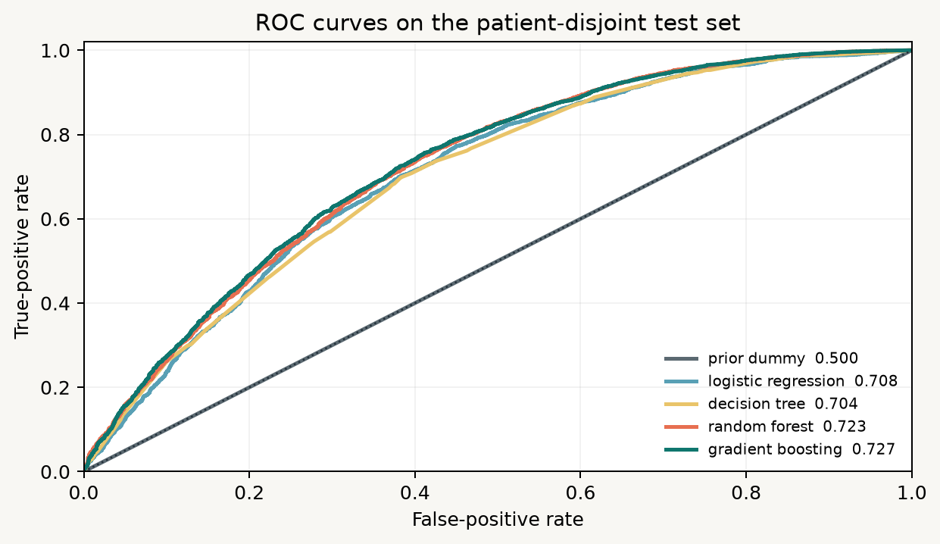
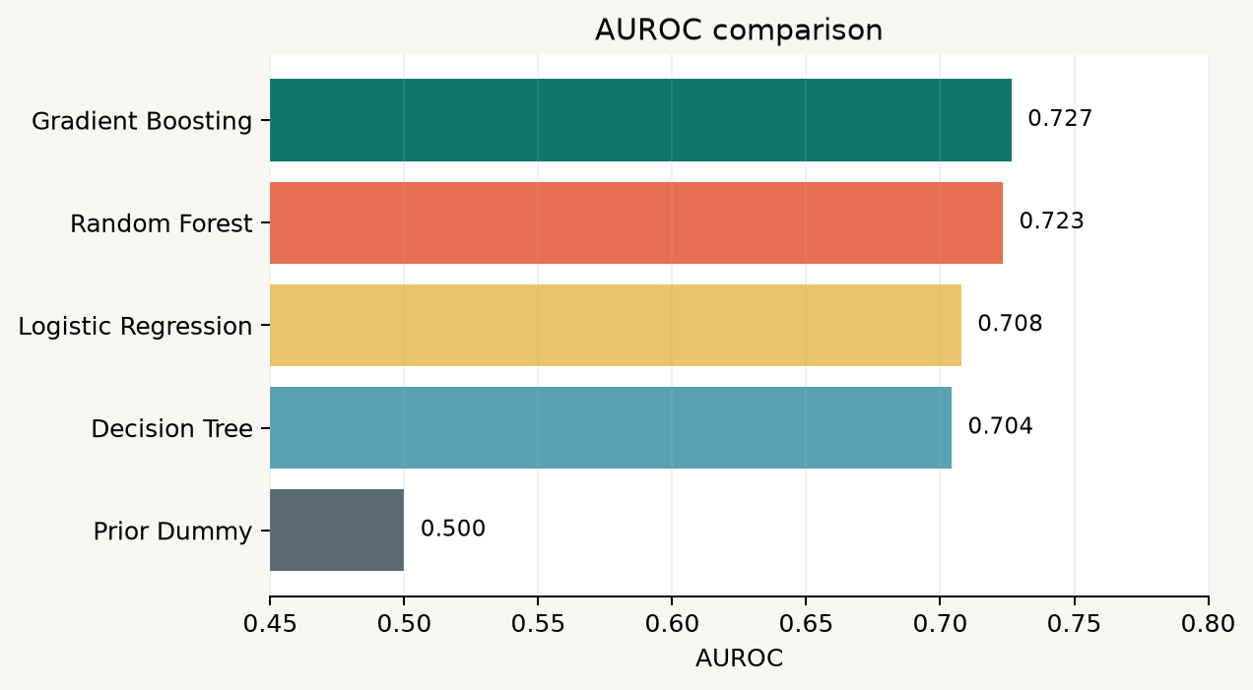
04 / MODELING
M2 / 13
AUROC: compare ranking across thresholds
Highest AUROC: gradient boosting (0.727)
Notes:
This slide shows the actual ROC curves regenerated from the M2 modeling setup. The x-axis is false-positive rate and the y-axis is true-positive rate. A curve closer to the upper-left generally ranks positive cases better. The current local results put gradient boosting first by AUROC at 0.727, followed by random forest at 0.723, logistic regression at 0.708, decision tree at 0.704, and the prior dummy at 0.500. Treat those values as this split's evidence, not a universal ranking. AUROC does not select the operating threshold, does not represent calibration, and does not tell us whether the model improves a workflow. The bar chart gives a compact comparison, while the ROC plot makes the threshold trade-off visible.

Slide 14
04 / MODELING
M2 / 14
The threshold changes the error profile
The logistic model's ranking stays the same; the action changes when the cutoff changes.
Threshold
Sensitivity
Specificity
PPV
False positives
Operational reading
0.25
0.983
0.145
0.649
3,278
Lower cutoff: more sensitivity, more alerts.
0.40
0.836
0.461
0.714
2,066
Higher cutoff: fewer false positives, more missed long stays.
0.50
0.660
0.651
0.752
1,338
Choose a cutoff with a real action and capacity constraint in mind.
0.60
0.443
0.793
0.774
795
0.75
0.126
0.949
0.800
194
Notes:
AUROC describes ranking over all possible thresholds, but a real workflow needs one operating cutoff. The threshold table uses logistic regression to show the trade-off. At 0.25, sensitivity is 0.983 but specificity is only 0.145 and there are many false positives. At 0.75, specificity rises to 0.949, but sensitivity falls to 0.126. Neither threshold is inherently correct. The choice depends on what happens after a flag: a low-cost planning prompt may tolerate more false positives, while a scarce intervention may require higher precision. The notebook makes the threshold explicit rather than hiding it inside accuracy. Ask students to write the action before choosing the metric and cutoff.

Slide 15
04 / MODELING
M2 / 15
Regression keeps the hours
Ridge regression predicts a continuous ED LOS rather than only a class.
3.80 h
6.52 h
Ridge
MAE: average absolute miss
RMSE: penalizes large misses
linear prediction with L2 regularization
0.066
shared preprocessing -> transformed features -> predicted hours
Read residuals too: a reasonable average error can hide systematic underprediction of the longest stays.
R2: variance-relative summary
A continuous prediction is more informative, but its error must still connect to a decision.
Notes:
Regression keeps the information that classification discards. The M2 notebook uses Ridge regression with the same declared features, preprocessing, and patient-disjoint test set. MAE is the average absolute error in hours and is easy to communicate: the current value is about 3.80 hours. RMSE is about 6.52 hours and is larger because it penalizes large misses more heavily. R2 is a variance-relative summary and is only about 0.066 in this baseline. These values should prompt inspection rather than embarrassment. LOS is noisy and operationally shaped. The notebook also creates observed-versus-predicted and residual plots because average metrics can hide systematic underprediction of long stays. Ask what an error of four hours means for the decision at hand.

Slide 16
04 / MODELING
M2 / 16
Binary and continuous targets support different decisions
Classification
Regression
Question: will LOS exceed 4.5 hours?
Question: how many hours is the stay?
Output: probability or class label.
Output: expected continuous duration.
Useful for alerts, routing, or thresholded actions.
Useful for planning and resource forecasting.
Cost: loses differences within each class.
Cost: errors are harder to translate into one action.
State the intended decision before choosing the target representation and metric.
Notes:
Use this slide to make the modeling choice concrete. Classification turns duration into a thresholded question. It can be easier to communicate and connect to an alert or routing action, but it discards information. Regression preserves the hours and can support capacity planning, but its errors need interpretation. The two formulations are not competitors in every context. They answer different questions. A model with good AUROC may not provide useful hour estimates. A model with acceptable MAE may not be useful for deciding whether to trigger an alert. Students should identify the intended decision first, then choose the target and metric that represent that decision.

Slide 17
05 / HANDOFF
M2 / 17
What M2 exports and what students should inspect
M2_los_summary.csv
center, spread, percentiles, and tail of valid LOS
M2_los_by_acuity.csv
descriptive LOS and long-stay rates by acuity
M2_los_by_age.csv
age-group comparisons
M2_los_by_arrival.csv
arrival-transport comparisons
M2_classification_results.csv
combined metrics for all classifiers
M2_threshold_results.csv
logistic threshold trade-offs
M2_regression_results.csv
Ridge MAE, RMSE, and R2
The handoff is an argument: cohort -> target -> boundary -> split -> metric -> limitation.
Notes:
Show students where the notebook's evidence goes. The LOS summary supports the continuous outcome. The group tables support descriptive comparisons. The classification results table lets students compare the prior dummy, logistic regression, decision tree, random forest, and gradient boosting using the same metrics. The threshold table shows that a model is not complete until an operating point is discussed. The regression table reports the hour-based metrics. These outputs are deliberately separate because each supports a different question. Ask students to inspect the denominator, cohort definition, feature boundary, patient split, metric, and limitation before they repeat a performance claim. A CSV without those definitions is not a sufficient handoff.

Slide 18
M2 / close
The M2 mental model
1
2
3
4
5
Define
Describe
Bound
Compare
Interpret
ED LOS and the eligible cohort
center, spread, tail, and groups
triage-time inputs and patient split
classification and regression metrics
connect errors to an action
A model score is only meaningful after the question, time boundary, cohort, and action are clear.
Next: carry the same discipline into the critical-outcome analysis.
Notes:
Close by repeating the sequence rather than the algorithm names. Define the outcome and eligible cohort. Describe the continuous distribution and group patterns. Declare the triage-time feature boundary and protect the patient split. Compare binary and continuous models using metrics that match the decision. Interpret the errors and limitations. The central lesson is that a model score has meaning only after those choices are visible. M2 is therefore not just a lesson about length of stay. It is a lesson about turning a clinical question into a reproducible outcome analysis without losing the context that makes the number interpretable. The next module changes the outcome again, so students must recompute rather than transfer metrics by habit.

