Slide 1
M3 / CRITICAL OUTCOME ANALYSIS
When the rare outcome matters
Sampling, model comparison, thresholds, calibration, and subgroup checks at the ED triage boundary
The central question
Can triage-era information rank ED stays by the likelihood of a critical outcome?
5,964 held-out test stays | 6.72% positive
Notes:
Open by defining the task as a retrospective benchmark, not a bedside tool. The model sees a declared triage-time feature family and is evaluated on patients held out from training. The outcome is uncommon, so accuracy alone will be especially easy to misread. This deck follows the full chain: what the composite means, why patient-disjoint evaluation matters, how training distributions can be altered, how models compare, and how a probability becomes an action. The current figures are read from the exported M3 CSVs rather than from active notebook state. Keep returning to the same sentence: a score is interpretable only when the target, time boundary, patient split, sampling strategy, threshold, and limitations are visible.

Slide 2
M1 RECAP
M3 / 02
Carry the data contract into modeling
Row grain
Timing
one row represents one ED stay
triage fields are separated from later events
Data quality
Leakage
raw and derived imputed fields remain distinguishable
identifiers, labels, and downstream fields stay out of X
M3 inherits the row, timing, quality, and leakage decisions from M1; it changes the clinical question.
M3 | critical outcome | current exported evidence
Notes:
M1 established the object being modeled: one row per ED stay, not one row per patient and not one row per measurement. It also established that availability is part of meaning. A triage vital and a later ED measurement are not interchangeable, even if both are in the CSV. M1 kept raw values and imputed analysis columns distinguishable, and it treated identifiers and downstream outcomes as audit fields rather than predictors. M3 relies on those choices. The new work is not a license to put every available column into a model. It is an opportunity to see how target rarity, sampling, and evaluation interact with the earlier data contract.

Slide 3
M2 RECAP
M3 / 03
The modeling workflow already has a rhythm
01
02
03
04
Question
Boundary
Split
Baseline
name the decision and outcome
use information available at the index time
keep repeated patients together
compare transparent models on held-out rows
M2 made the decision boundary explicit. M3 asks what changes when the positive class is rare.
M3 | critical outcome | current exported evidence
Notes:
M2 supplied the reusable modeling rhythm. Start with a clinical question. Define the target. Declare which fields could be available at the intended prediction time. Keep repeated patients together when splitting. Fit preprocessing inside the training pipeline. Compare a dummy and candidate models on the same held-out test set. M3 keeps that rhythm but adds a more demanding evaluation problem: only about 6.6 percent of stays are positive. That makes the prior probability, average precision, threshold behavior, calibration, and error counts central parts of the story rather than optional extras.

Slide 4
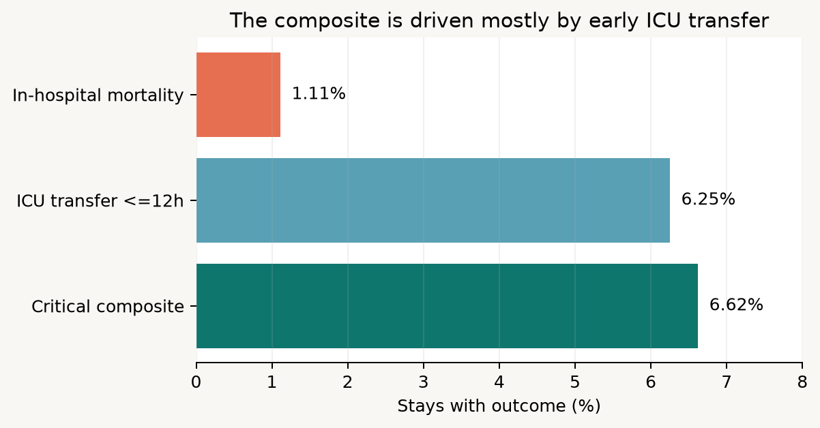
01 / CLINICAL QUESTION
M3 / 04
Why this outcome matters
Severe events, one label
Mortality and early ICU transfer both represent high-consequence outcomes.
The composite can focus a triage-risk question on severe events.
It also combines clinically different pathways, so components must remain visible.
This is a retrospective benchmark, not a diagnosis or treatment recommendation.
M3 | critical outcome | current exported evidence
Notes:
The target combines in-hospital mortality and ICU transfer within 12 hours. The current exported summary gives approximately 1.11 percent mortality, 6.25 percent early ICU transfer, and 6.62 percent for the composite. The composite is useful for a teaching benchmark because it captures severe outcomes that could motivate early risk stratification. But it also collapses two different clinical events. A model can rank the composite well while behaving differently for mortality and ICU transfer. Students should therefore avoid language that treats outcome_critical as a single biological phenomenon. The chart makes the construction auditable and keeps the component labels in view.

Slide 5
01 / clinical question
The target is defined after the stay
Arrival
Triage
ED course
Outcome
index begins
predictor window
information accrues
label becomes known
Use triage-era inputs to estimate a later label. Never let the later label leak backward into X.
Notes:
The label is retrospective. The model's intended inputs are available around triage, while mortality and ICU transfer are observed later. That temporal direction is the reason outcome fields, ICU timing, disposition, later measurements, and identifiers used to construct or link labels are excluded from the feature matrix. A field can be highly predictive and still be invalid for this question if it becomes available after triage. Ask students to classify an example such as a later heart rate, disposition, or time to ICU transfer. The point is not to weaken the model artificially. It is to make the prediction question honest.

Slide 6
02 / EVALUATION DESIGN
M3 / 06
Rare positives change how metrics should be read
6.72%
401
5,563
0
positive prevalence in the held-out test set
positive test stays
negative test stays
patient overlap across train and test
Why accuracy can mislead
The test population stays real
A majority-class dummy is accurate about 93% of the time.
Sampling changes training rows, not the held-out test population.
It finds zero critical cases.
PPV remains tied to the prevalence seen at evaluation.
Sensitivity, PPV, average precision, and confusion counts make the trade-off visible.
Patient-disjoint splitting tests generalization to unseen patients from this source.
M3 | critical outcome | current exported evidence
Notes:
The positive class is uncommon, so a prior dummy can achieve roughly 93 percent accuracy while finding no critical cases. This is why accuracy is not the headline metric here. Sensitivity asks how many critical stays were found; PPV asks how many flagged stays were truly critical; average precision summarizes the precision-recall behavior across thresholds; and the confusion counts show the operational volume. The test population is deliberately not rebalanced. If we evaluated on an artificially balanced test set, PPV and other rates would describe a different population. Sampling belongs inside training, while final evaluation stays on the original held-out patient-disjoint population.

Slide 7
03 / SAMPLING
M3 / 07
Sampling changes what the learner sees
All five strategies use the same target, but they create different training distributions.
Original
Under-sampling
Over-sampling
keep the observed 93:7 class ratio
remove some negatives to balance classes
duplicate positive rows
SMOTE
SMOTE-Tomek
create synthetic positive examples between neighbors
SMOTE plus removal of ambiguous boundary pairs
Training balance is a learning aid, not a claim that the real ED population is balanced.
M3 | critical outcome | current exported evidence
Notes:
Sampling is a training intervention. Original training preserves the observed class ratio. Random under-sampling discards some negative rows. Random over-sampling repeats positive rows. SMOTE creates synthetic minority examples based on neighboring observations, and SMOTE-Tomek adds a boundary-cleaning step. Each strategy changes the distribution presented to the learner, which can alter the threshold behavior and sometimes the ranking. None of these strategies changes the real prevalence in the held-out test population. It is also important to distinguish duplicated rows from synthetic rows and to keep preprocessing and sampling inside a training-only workflow. Sampling does not repair label ambiguity, poor timing, or missing external validation.

Slide 8
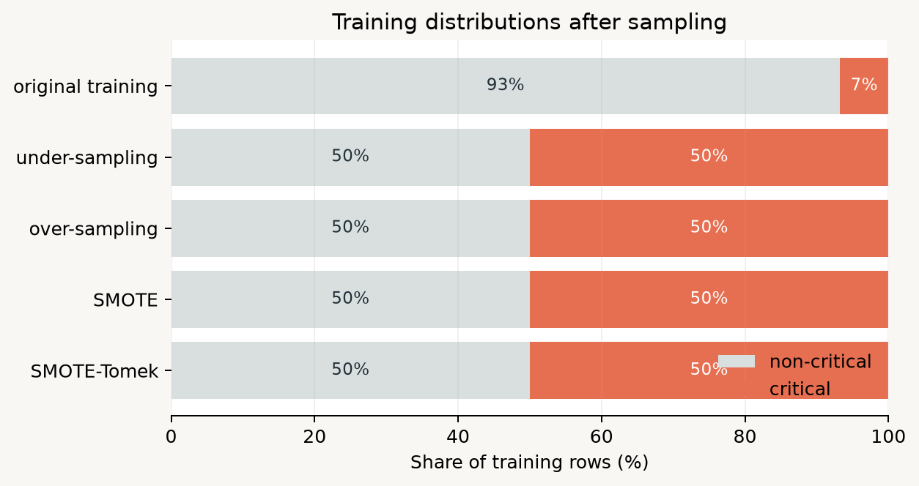
03 / SAMPLING
M3 / 08
What the sampling experiment actually produced
Read the bars
Original training retains 22,408 negatives and 1,628 positives.
Under-sampling keeps 1,628 rows per class.
The other balanced methods create 50:50 training sets, with SMOTE-Tomek slightly trimming rows.
The test set remains unbalanced and untouched.
M3 | critical outcome | current exported evidence
Notes:
The exported sampling summary shows exactly what happened. Original training has 22,408 non-critical rows and 1,628 critical rows, or about 93 to 7 percent. Random under-sampling reduces the negative class to 1,628 rows. Random over-sampling and SMOTE create balanced training distributions with 22,408 rows per class. SMOTE-Tomek has 22,385 per class after its cleaning step. These counts describe training data only. They should not be reported as the prevalence of critical outcomes in the source population. The deck uses this slide to prevent a common interpretive mistake: a balanced training table is not evidence that the clinical problem itself is balanced.

Slide 9
04 / modeling
Model families: same boundary, different assumptions
Prior dummy
uses prevalence only
reference floor
Logistic regression
linear signal after preprocessing
transparent baseline
Decision tree
rules and interactions
single-tree structure
Random forest
many trees averaged
nonlinear ensemble
Gradient boosting
trees correct earlier errors
sequential ensemble
A fair comparison holds the features, preprocessing, patient split, and test set constant.
Notes:
The candidate models form a useful ladder. The prior dummy is a reference that uses no patient information. Logistic regression provides a transparent linear baseline after numeric imputation, missingness indicators, scaling, and categorical encoding. A decision tree represents recursive rules and interactions. A random forest averages many trees. Gradient boosting builds trees sequentially, focusing later trees on earlier errors. The model family does not change the target or the information boundary. A fair comparison requires the same feature definitions, preprocessing contract, patient-disjoint split, and held-out test rows. Sampling experiments then vary the training distribution while preserving that evaluation contract.

Slide 10
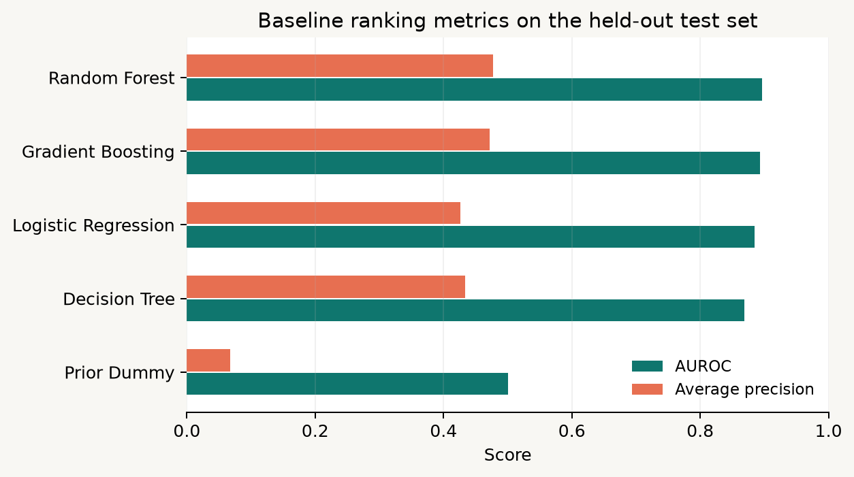
04 / MODELING
M3 / 10
Baseline models: ranking is not the same as alert usefulness
Model
AUROC
Avg precision
Sensitivity
PPV
Random Forest
0.897
0.477
0.479
0.482
Gradient Boosting
0.894
0.471
0.172
0.734
Logistic Regression
0.885
0.426
0.823
0.234
Decision Tree
0.868
0.433
0.813
0.223
Prior Dummy
0.500
0.067
0.000
0.000
Best baseline AUROC: Random Forest at 0.897
Notes:
AUROC summarizes ranking across all thresholds. Average precision summarizes precision-recall behavior and is especially useful when the positive class is uncommon. At the default 0.50 threshold, sensitivity and PPV describe a particular operating point rather than the entire ranking. In the current baseline table, random forest has the highest AUROC at about 0.897, while gradient boosting has very high specificity and PPV at the default cutoff but lower sensitivity. Logistic regression finds more positives at that cutoff but produces more false positives. The prior dummy is an important reference because its AUROC is 0.5 and its average precision follows prevalence. No single row is universally best without a named action.

Slide 11
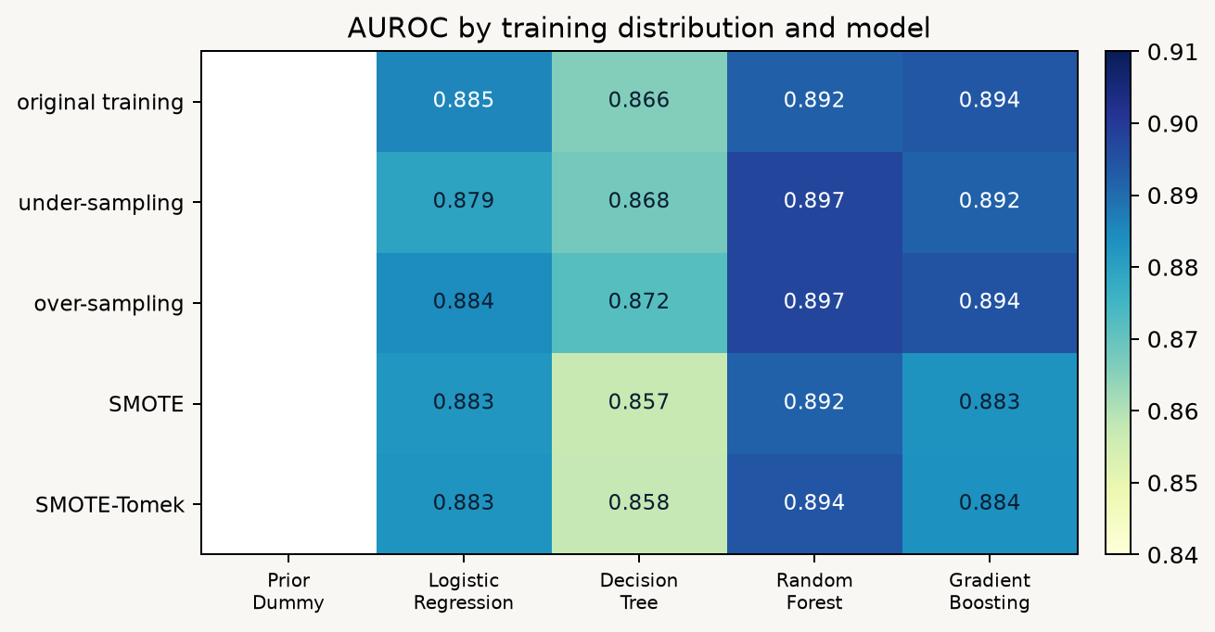
04 / MODELING
M3 / 11
Sampling changes operating behavior more than ranking
Current reading
Best sampled AUROC: Random Forest with random over-sampling (0.897).
The ranking values remain in a fairly narrow band across sampling choices.
Threshold metrics move more visibly: balancing can raise sensitivity while lowering specificity or PPV.
Sampling should be selected with the intended action and calibration in mind, not AUROC alone.
Notes:
This heatmap compares AUROC across the five training distributions and four classifier families. The current best sampled value is random forest with random over-sampling at approximately 0.897, only slightly above the strongest original-training values. That suggests the sampling choice does not radically transform ranking quality on this test set. It can still change the operating behavior substantially. Balanced training often makes the classifier more willing to call a case positive, which can raise sensitivity while increasing false positives and changing PPV. This is why the next analysis cannot stop at a heatmap. Students should inspect threshold trade-offs, calibration, and the actual alert volume on the original test population.

Slide 12
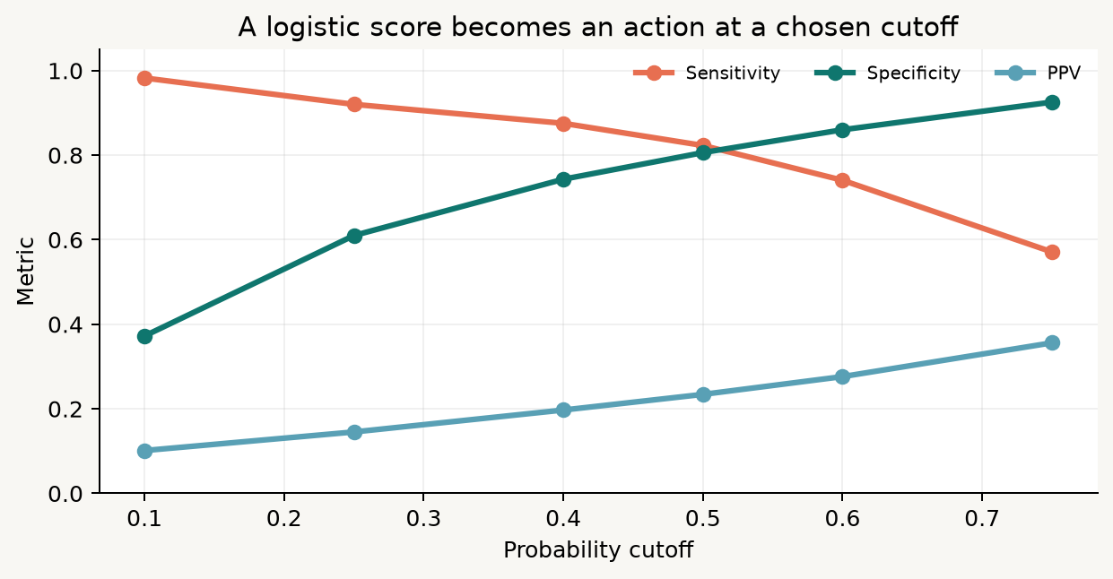
05 / THRESHOLD
M3 / 12
A probability becomes a decision at a threshold
Cutoff
Sensitivity
Specificity
PPV
False positives
0.10
0.983
0.372
0.101
3,492
0.25
0.920
0.610
0.145
2,170
0.50
0.823
0.806
0.234
1,079
0.75
0.571
0.926
0.356
414
Lower cutoff = more catches and more alerts. Higher cutoff = fewer alerts and more misses.
Notes:
The logistic regression ranking does not change when the probability cutoff changes; the action does. At 0.10, sensitivity is about 0.983 but specificity is only about 0.372 and there are 3,492 false positives. At 0.75, specificity is about 0.926, PPV is about 0.356, and sensitivity falls to about 0.571. The default 0.50 cutoff is a convention, not a clinical truth. A threshold should be chosen with a real action, capacity constraint, and error cost in mind. Also note that even a relatively high PPV in this table may mean many non-critical alerts because the test population contains thousands of non-critical stays. Counts belong beside rates.

Slide 13
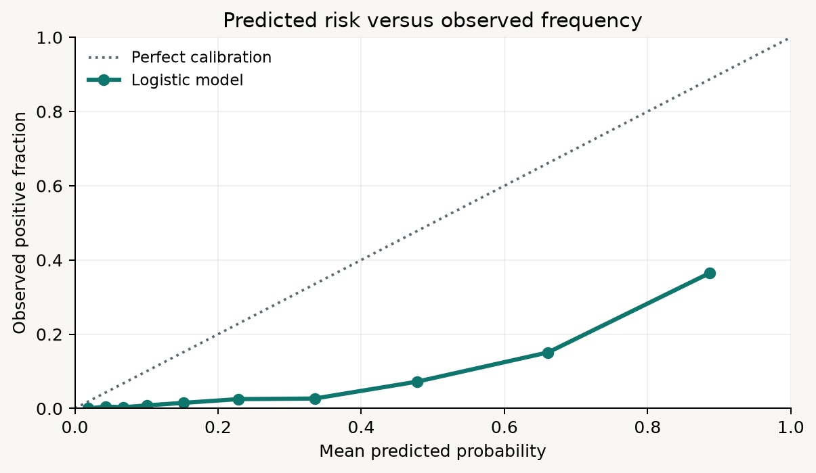
06 / PROBABILITY QUALITY
M3 / 13
Calibration asks whether probabilities mean what they say
How to read the curve
A calibrated 0.20 prediction means roughly 20% positive in similar cases.
Points below the diagonal are overconfident: predicted risk exceeds observed frequency.
The current curve is below the diagonal across much of the range.
Sampling can shift probability meaning, so recalibration may be needed after resampling.
Notes:
Calibration is different from ranking. A model can order cases well and still produce probabilities that are too large or too small. The diagonal is perfect calibration: among cases assigned a predicted probability, the observed positive fraction matches it. The current logistic calibration points sit below the diagonal across much of the range. For example, bins with mean predicted probabilities around 0.48 and 0.66 have observed positive fractions around 0.07 and 0.15, respectively. That is overprediction in these bins. The bins are empirical summaries, not proof of a stable deployment relationship. Calibration depends on population, sampling, prevalence, and model fitting. It should be checked before treating a probability as a risk estimate.

Slide 14
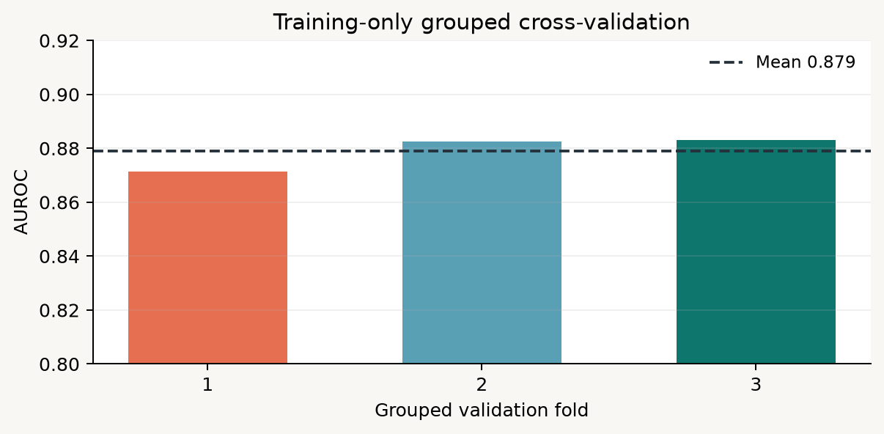
07 / STABILITY
M3 / 14
Cross-validation belongs inside training
0.879
+/- 0.007
mean grouped-CV AUROC
fold-to-fold standard deviation
The boundary
Grouped folds keep patients together.
Fold variation is evidence about training stability.
The held-out test set stays reserved for final comparison.
External and temporal validation are still needed.
Notes:
Cross-validation is used inside the training boundary to estimate how much performance varies across grouped validation folds. The current three folds have AUROCs of approximately 0.871, 0.882, and 0.883, for a mean near 0.879 and a standard deviation near 0.006. Because subject_id is used for grouping, a patient's stays do not cross a fold boundary. This is a stability check, not a replacement for the held-out test set. Repeatedly selecting a model or threshold based on the test set would turn that test set into a tuning resource. Cross-validation also does not establish temporal transportability, external validity, clinical utility, or fairness.

Slide 15
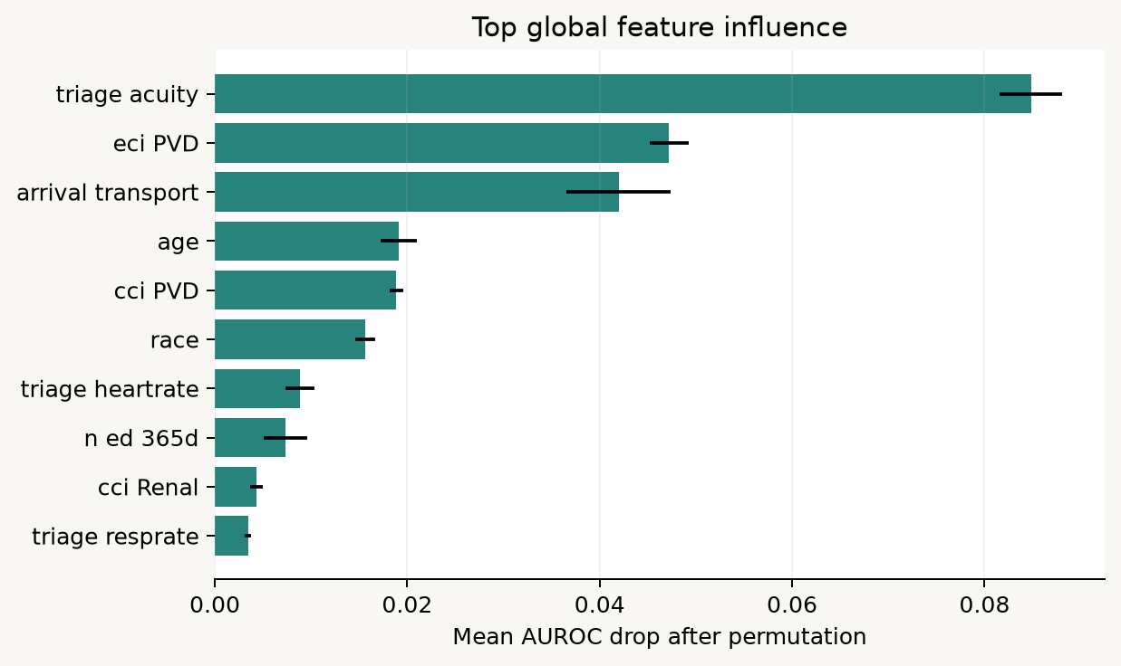
08 / EXPLAINABILITY
M3 / 15
Global feature influence: useful, limited, and not causal
Permutation logic
Shuffle one feature in held-out rows.
Measure how much AUROC falls.
A larger drop means the pipeline used that feature's information on these rows.
Correlated features can share or mask one another's influence.
Influence is not causality, clinical necessity, or fairness evidence.
M3 | critical outcome | current exported evidence
Notes:
Permutation importance asks a narrow question: how much does the model's held-out AUROC change when one input column is randomly shuffled? The current top feature is triage acuity, followed by ECI peripheral vascular disease, arrival transport, age, and CCI peripheral vascular disease. Those are global associations with this pipeline and these rows. They are not causal effects. Correlated variables can divide signal, and a feature can be influential because it is a proxy for severity, workflow, documentation, or access. Importance can also be unstable in small subgroups. Students should use the chart to generate questions and audit the feature boundary, not to write that a feature causes the outcome.

Slide 16
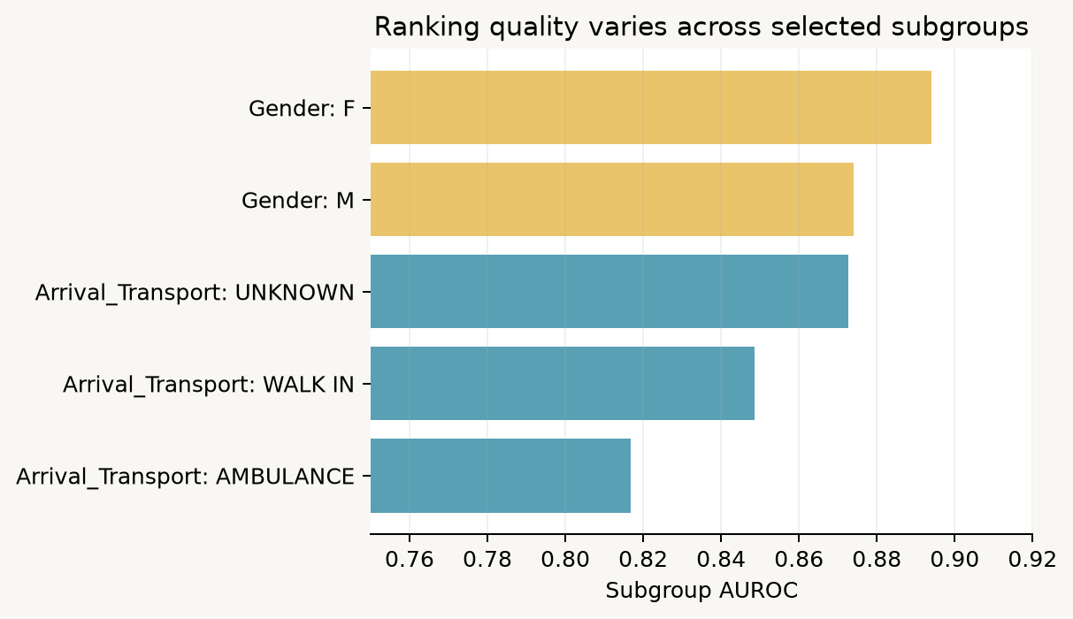
09 / SUBGROUP CHECKS
M3 / 16
Overall performance can hide uneven errors
Group
n
Prev.
Sens.
Spec.
gender: F
3,217
6.1%
0.811
0.830
gender: M
2,747
7.5%
0.834
0.778
arrival_transport: AMBULANCE
2,148
11.6%
0.880
0.571
arrival_transport: UNKNOWN
231
26.8%
1.000
0.503
arrival_transport: WALK IN
3,555
2.2%
0.468
0.950
Small groups need uncertainty, not confident ranking.
M3 | critical outcome | current exported evidence
Notes:
Subgroup analysis checks whether errors and ranking differ across slices of the test population. In the current results, gender groups have similar sensitivity but different specificity, while arrival transport groups show larger differences in prevalence and operating behavior. The race table contains several very small groups, so point estimates can be volatile. This is not a complete fairness analysis. It does not include confidence intervals, intersectional groups, missingness mechanisms, calibration by subgroup, decision consequences, or a pre-specified fairness criterion. It is an audit prompt. Students should report subgroup size and prevalence alongside metrics, avoid ranking tiny groups as if they were equally precise, and name what additional evidence would be needed.

Slide 17
10 / ERROR ANALYSIS
M3 / 17
False positives and false negatives are the actual workflow
71
1,079
1,150
logistic false negatives at 0.50
logistic false positives at 0.50
exported example rows for inspection
False negative
False positive
A critical stay receives a low score and is not flagged at the chosen cutoff.
A non-critical stay receives a high score and consumes attention or capacity.
Question: what safety net catches the miss?
Question: what is the cost of the alert volume?
Notes:
A confusion matrix becomes meaningful only when translated into workflow. At the 0.50 cutoff, the logistic model has 71 false negatives and 1,079 false positives on the held-out test set. A false negative is a critical stay that the model does not flag; a false positive is a non-critical stay that receives attention. Which error matters more depends on the intended use, the available safety net, and the cost of alert burden. The exported error examples are for inspection, not anecdotes that prove a general mechanism. Students should examine them to ask whether errors cluster by subgroup, missingness, acuity, or data availability, then state what further validation is required.

Slide 18
11 / LIMITATIONS
M3 / 18
What this analysis can and cannot support
Retrospective labels
Single-source evidence
The composite is observed after triage and combines mortality with ICU transfer.
One extracted MIMIC-IV-ED teaching table does not establish transportability.
Model scope
Uncertainty
This is a tabular baseline; free text, temporal drift, and clinical workflow are out of scope.
Point estimates lack confidence intervals and small subgroups are unstable.
Operational validity
Fairness
No prospective workflow, calibration intervention, or clinical utility study was performed.
Subgroup metrics are an initial audit, not a complete fairness or harm assessment.
Responsible conclusion: these exports support learning and hypothesis generation, not deployment or clinical decisions.
Notes:
The limitations are part of the result. The outcome is retrospective and composite. The data comes from one source and one extraction, so performance may not transport to another hospital, period, population, or workflow. The baseline is tabular and intentionally excludes raw text and many dynamic process signals. The reported metrics are point estimates without confidence intervals. Several race subgroups are small. Calibration and subgroup behavior can change with prevalence and sampling. No prospective silent trial, external validation, impact study, or clinical utility analysis was performed. Therefore the correct conclusion is educational and comparative: the workflow demonstrates how to build and interrogate a patient-disjoint benchmark. It does not justify deploying a triage intervention.

Slide 19
M3 / close
The M3 mental model
1
2
3
4
5
Define
Protect
Balance
Compare
Interrogate
component-aware target
triage boundary + patient split
training only, test stays real
ranking, thresholds, calibration
influence, subgroups, errors
A strong score is only one piece of a defensible medical ML argument.
Next: carry the same discipline into the hospitalization-specific target and leakage boundary.
Notes:
Close with the sequence rather than a winning algorithm. Define the composite and inspect its components. Protect the triage-time boundary and keep patients disjoint across train and test. Balance only the training distribution, leaving the held-out test population real. Compare ranking metrics with threshold behavior and calibration. Interrogate global feature influence, subgroup performance, and actual errors. Then state the limitations before making a claim. The reusable lesson is not that one sampling method or one model is best. It is that medical ML evaluation is a chain of explicit choices, and each choice changes what the final number means.

