Slide 1
M4 / HOSPITALIZATION AT ED TRIAGE
Can triage information anticipate a hospital stay?
A patient-disjoint benchmark from target definition through explainable Gradient Boosting
The teaching question
What does a model learn, how should its score be evaluated, and what can an explanation honestly tell us?
9,926 held-out stays | 47.2% hospitalized
Notes:
Open by separating the prediction question from the clinical decision. This deck asks whether information available at ED triage can rank stays by a later hospitalization label. It is a retrospective benchmark, not a deployed triage recommendation. The notebook keeps patients disjoint between training and test, evaluates on the original held-out population, and then explains the fitted Gradient Boosting model. The positive class is not rare in this M4 test population: approximately 47.2 percent of held-out stays are hospitalized. That changes how to interpret PPV, NPV, average precision, and accuracy compared with the previous critical-outcome module. The through-line is disciplined interpretation: define the label, protect the time boundary, read the metrics, then interrogate the model without turning associations into causes.

Slide 2
M1 RECAP
M4 / 02
The data contract comes before the model
Row grain
Availability
one record represents one ED stay
triage fields belong to the index-time window
Quality
Leakage
missingness and derived fields remain visible
identifiers, labels, and downstream fields stay out of X
M4 keeps the M1 contract and changes the outcome: hospitalization after triage.
Notes:
M1 established what a row means and why time is part of the data definition. One row is one ED stay. A triage measurement is not interchangeable with a later measurement simply because both are numeric. M1 also separated raw fields, imputed analysis fields, identifiers, and outcome-related audit columns. M4 inherits that contract. The question changes from length of stay or another prior module outcome to hospitalization, but the modeling discipline does not change. If a downstream field is predictive because it records what happened after the decision, it belongs in the audit trail, not in the model inputs.

Slide 3
M2 RECAP
M4 / 03
A clinical question becomes a testable ML task
01
02
03
04
05
Question
Target
Features
Split
Baseline
what should be predicted?
which column defines y?
what is available at triage?
which patients stay apart?
what does a simple model do?
The target and the time boundary decide what the score means.
Notes:
M2 supplied the reusable workflow: name the question, identify the target, choose the feature boundary, split data in a way that respects dependence, fit a baseline, and evaluate on held-out data. M4 is a classification problem because hospitalization is represented as yes or no. The target is not a vague clinical idea; it is a specific operational definition in the source table. The features are not all columns that happen to exist; they are the columns that could plausibly be available around triage. The split is not just a random row split because the same subject can have multiple stays. Each of those choices is part of the model, even though it is not an algorithm name.

Slide 4
01 / PROBLEM DEFINITION
M4 / 04
Hospitalization is a later disposition label
outcome_hospitalization = 1 when hadm_id is present
Arrival
Triage
ED course
Disposition
index starts
predictor window
information accrues
label becomes known
The outcome is valid for evaluation, but unavailable at the moment of prediction.
Notes:
The target is explicit: outcome_hospitalization equals one when hadm_id is present. That definition uses a field that becomes known after the triage-time prediction point. It is therefore appropriate for constructing and auditing the label, but it must not be used as an input. The timeline is the key distinction. Arrival and triage define the index window. The ED course and disposition happen later. A model can be evaluated against a later outcome, but it cannot use the later outcome or a downstream proxy while claiming to predict from triage. This is a retrospective prediction task, not a causal model of admission decisions.

Slide 5
01 / PROBLEM DEFINITION
M4 / 05
The predictor boundary is a clinical assumption
Triage
Context
Prior use
Clinical flags
vitals, acuity, pain
age, gender, race, arrival transport
ED, hospital, and ICU counts
chief complaint and comorbidity indicators
Included in X
Excluded from X
Information plausibly available at triage, transformed inside the fitted pipeline.
hadm_id, disposition, later measurements, ED departure fields, and downstream outcomes.
Notes:
The feature boundary is a modeling assumption about availability. The notebook uses triage measurements, demographic and arrival context, prior utilization counts, chief-complaint indicators, and comorbidity indicators. It excludes hadm_id because that defines the target, along with disposition, ED departure fields, later measurements, downstream outcomes, ICU timing, and other post-index information. The important teaching point is that a feature can be highly predictive and still be invalid for the intended use if it is recorded after the prediction moment. The model answers the question created by this boundary, not every question that could be answered with the full source table.

Slide 6
02 / EVALUATION DESIGN
M4 / 06
The evaluation contract keeps the test population honest
9,926
47.2%
5,240
0
held-out test stays
hospitalized in test
non-hospitalized stays
patient overlap
Why patient-disjoint matters
Why prevalence matters
Repeated stays from one subject cannot teach and test the same person.
A positive prediction is not automatically a rare-alert event in M4.
GroupShuffleSplit uses subject_id to keep patients together.
PPV and NPV depend on the evaluated population's prevalence.
The test set estimates generalization to unseen patients from this source.
Do not transfer these rates unchanged to another hospital or workflow.
Notes:
The held-out M4 test set contains 9,926 stays, with 4,686 hospitalized and 5,240 not hospitalized, or about 47.2 percent positive. The exact counts come from the Gradient Boosting row, but all models are evaluated on the same test rows. Patient-disjoint splitting matters because repeated observations from the same subject can otherwise make the task look easier than generalizing to a new patient. Prevalence matters because predictive values depend on the population being evaluated. A PPV measured in this source table is not a universal property of the model. It can change with hospital, period, case mix, admission practice, or deployment workflow.

Slide 7
03 / MODELING
M4 / 07
One preprocessing contract, four model families
Prior dummy
uses prevalence only
reference floor
Logistic regression
linear signal after preprocessing
transparent baseline
Random forest
many trees averaged
nonlinear ensemble
Gradient boosting
sequential trees correct earlier errors
explainability target
Preprocessing: imputation + missingness indicators + scaling/encoding, fitted only inside each training pipeline.
Notes:
The candidate models form a ladder from a no-information reference to nonlinear ensembles. The prior dummy predicts from the class prior and provides a floor. Logistic regression is a transparent linear baseline after preprocessing. Random Forest averages many trees. Gradient Boosting builds trees sequentially, using later trees to improve earlier residual errors. All models use the same declared feature boundary and the same patient-disjoint test partition. The deck will later focus on Gradient Boosting for native importance and SHAP. That is an explainability choice, not a claim that Gradient Boosting has the highest AUROC: the current Random Forest row has the highest AUROC. A fair presentation should say both things clearly.

Slide 8
04 / METRICS
M4 / 08
Metric vocabulary before metric results
Metric
View
Plain-language meaning
AUROC
ranking
How well positives rank above negatives across cutoffs
Average precision
ranking
Precision-recall summary, informative for the positive class
Sensitivity
threshold
Among hospitalized stays, fraction flagged positive
Specificity
threshold
Among non-hospitalized stays, fraction left negative
PPV
threshold
Among positive predictions, fraction hospitalized
NPV
threshold
Among negative predictions, fraction not hospitalized
AUROC and average precision describe ranking; the threshold metrics describe one operating point.
Notes:
Define the metrics before showing results. AUROC is the probability that a randomly chosen hospitalized stay receives a higher score than a randomly chosen non-hospitalized stay; it summarizes ranking across thresholds. Average precision summarizes the precision-recall relationship and keeps attention on the positive class. Sensitivity is the fraction of hospitalized stays flagged. Specificity is the fraction of non-hospitalized stays not flagged. PPV is the fraction of flagged stays that are hospitalized. NPV is the fraction of unflagged stays that are not hospitalized. AUROC and average precision do not choose an action threshold. Sensitivity, specificity, PPV, and NPV do. That distinction prevents a common mistake: treating a ranking score as if it were already a clinical policy.

Slide 9
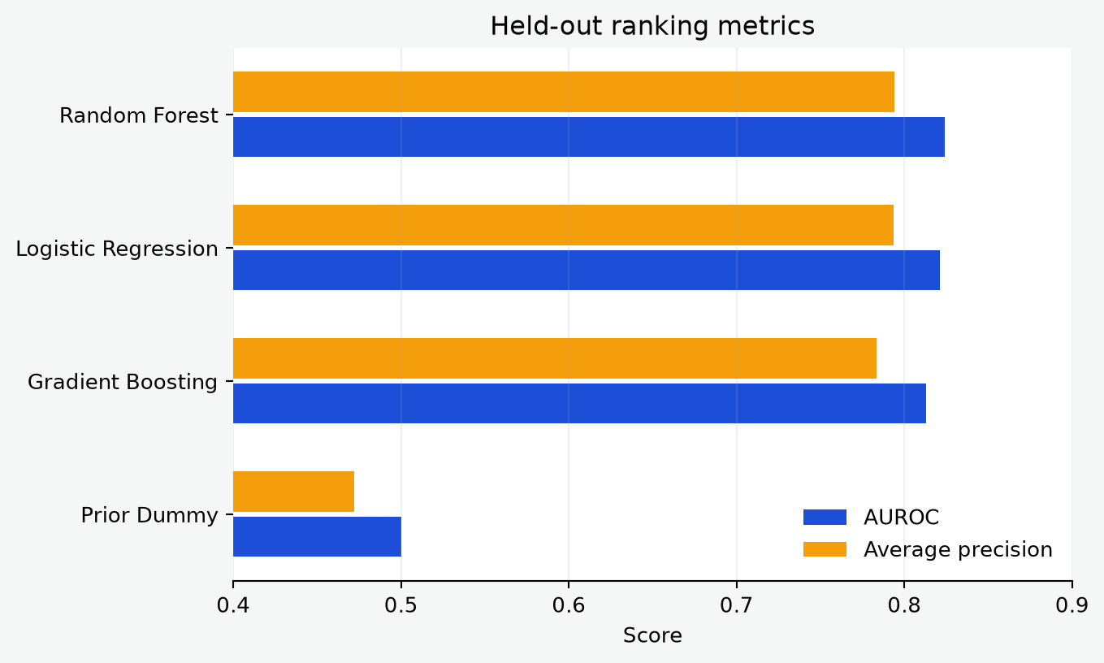
04 / METRICS
M4 / 09
Model comparison: Random Forest ranks highest, GB remains interpretable
Model
AUROC
Avg. precision
Sensitivity
PPV
Random Forest
0.824
0.794
0.773
0.715
Logistic Regression
0.821
0.794
0.745
0.726
Gradient Boosting
0.813
0.783
0.744
0.716
Prior Dummy
0.500
0.472
0.000
0.000
Best AUROC: Random Forest at 0.824 GB AUROC: 0.813
Notes:
On the held-out test set, Random Forest has the highest AUROC at 0.824, with logistic regression close behind at 0.821. Gradient Boosting is lower at 0.813, while the prior dummy sits at 0.500. Average precision is approximately 0.794 for Random Forest and logistic regression, 0.783 for Gradient Boosting, and 0.472 for the prior dummy, which matches the positive prevalence. At the default 0.50 threshold, the model rows also show different sensitivity and PPV. The teaching choice here is deliberately transparent: we use Gradient Boosting for native feature importance and SHAP because the M4 explainability request is about that fitted model. Do not silently convert that choice into a performance claim.

Slide 10
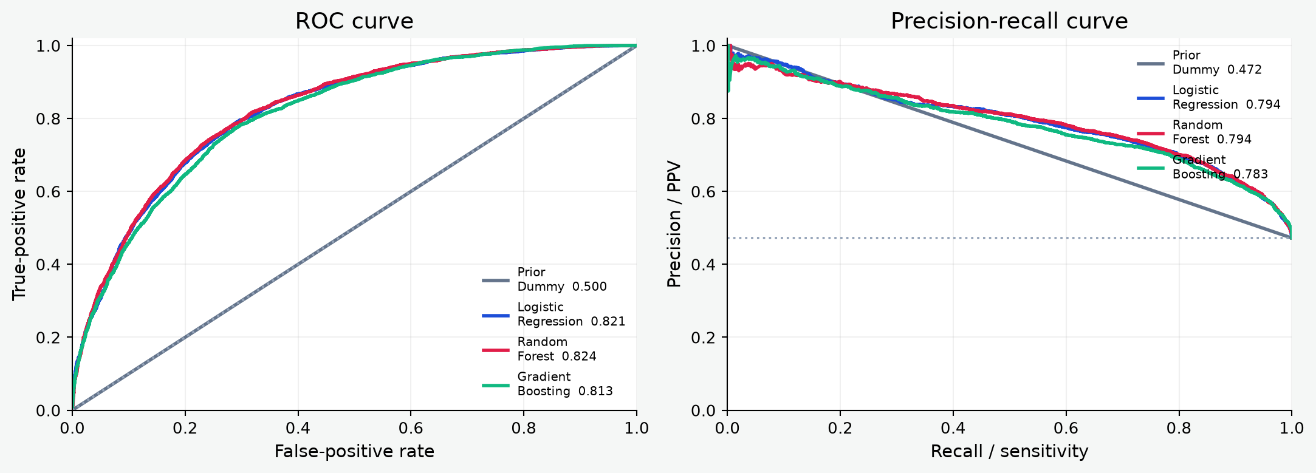
04 / METRICS
M4 / 10
ROC and precision-recall curves answer different questions
ROC: ranking across false-positive rates | PR: positive-class precision as recall changes
Notes:
Read the left panel as a ranking view across false-positive rates. A curve closer to the upper-left generally indicates stronger discrimination, and the legend gives AUROC. Read the right panel as a positive-class view: as recall increases, what precision remains? The horizontal reference is the prior positive prevalence. Because hospitalization is close to half the test population here, the precision-recall baseline is much higher than it was for a rare critical outcome. The curves should not be used to choose a clinical threshold by themselves. They show the available trade-off; the intended action, capacity, and cost of errors must choose the operating point.

Slide 11
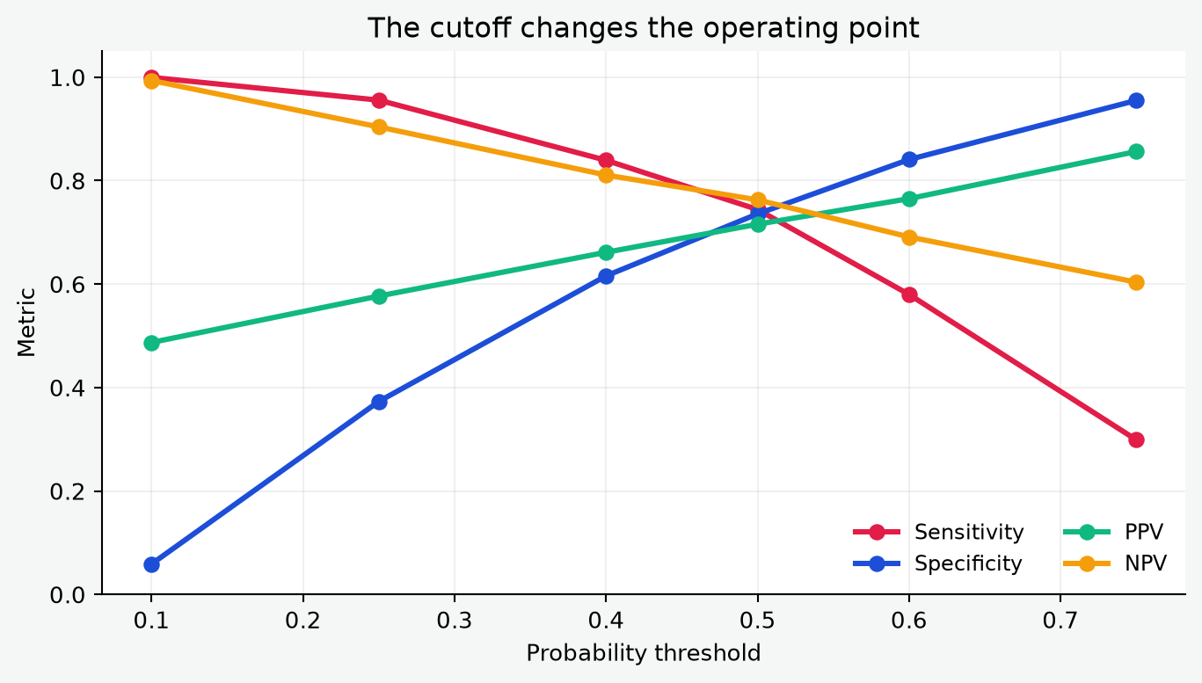
05 / THRESHOLD
M4 / 11
A probability becomes an action at a cutoff
Cutoff
Sens.
Spec.
PPV
FPs
0.25
0.956
0.373
0.577
3,285
0.50
0.744
0.736
0.716
1,385
0.75
0.299
0.955
0.856
235
Lower cutoff: catch more Higher cutoff: alert less
Notes:
The Gradient Boosting threshold table makes the policy choice visible. At 0.25, sensitivity is 0.956 but there are 3,285 false positives. At 0.50, sensitivity is 0.744, specificity is 0.736, PPV is 0.716, and there are 1,385 false positives. At 0.75, specificity rises to 0.955 and PPV to 0.856, but sensitivity falls to 0.299 and 3,286 hospitalized stays are missed. These are not competing truths; they are different operating points. A threshold should be chosen with an explicit action, available review capacity, and a stated cost for missed hospitalization versus unnecessary attention. The default 0.50 cutoff is a convention, not a clinical threshold.

Slide 12
05 / THRESHOLD
M4 / 12
The confusion matrix counts the work created by a cutoff
Predicted no
Predicted yes
At threshold 0.50
Observed no
3,855
1,385
3,487 hospitalized stays flagged
1,199 hospitalized stays missed
Observed yes
1,199
3,487
1,385 non-hospitalized stays flagged
3,855 non-hospitalized stays left negative
True negative
False positive
False negative
M4 | hospitalization at ED triage | current exported evidence
Notes:
The confusion matrix translates rates into counts. At the 0.50 cutoff, Gradient Boosting correctly flags 3,487 hospitalized stays and misses 1,199. It flags 1,385 non-hospitalized stays and correctly leaves 3,855 negative. True positives and false negatives are the hospitalized cases the model does or does not flag. False positives and true negatives describe the non-hospitalized population. The operational meaning depends on what a positive alert triggers. A false positive may consume review capacity; a false negative may delay attention. Counts should be shown next to rates because a seemingly acceptable rate can still create a large workload in a high-volume ED.

Slide 13
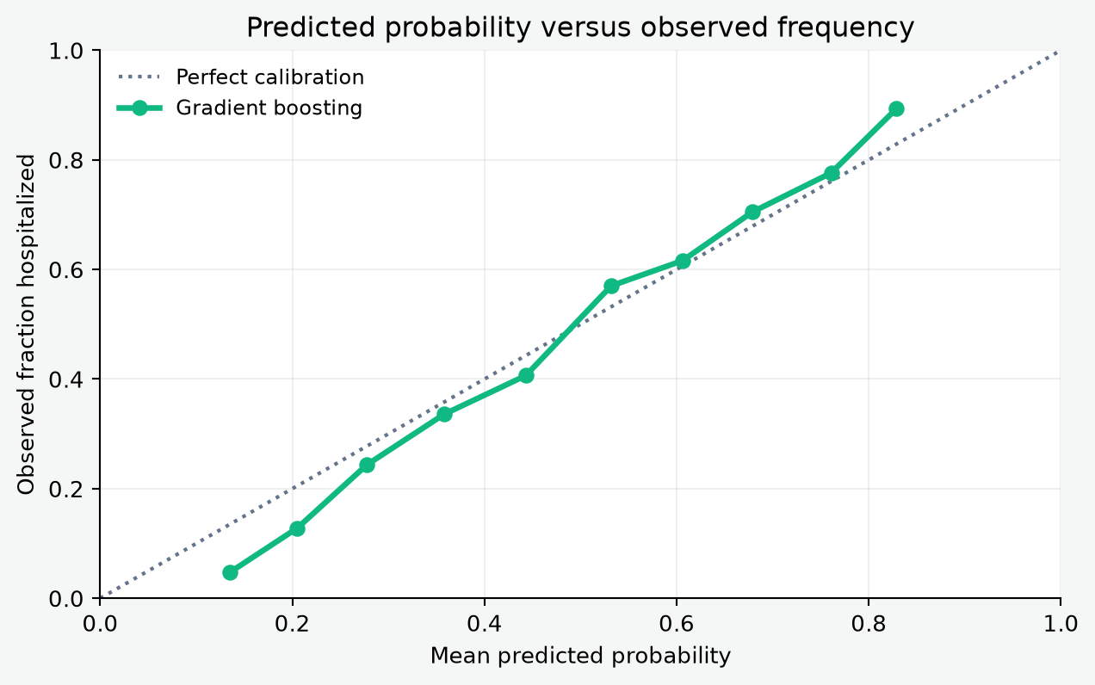
06 / CALIBRATION
M4 / 13
Discrimination is not the same as probability quality
How to read it
A calibrated 0.70 means about 70% hospitalized among similar scored cases.
Below the diagonal means predicted probability is higher than observed frequency.
The curve is below the diagonal at lower scores, then approaches and exceeds it at higher scores.
Calibration can shift with prevalence, hospital, time, and workflow.
M4 | hospitalization at ED triage | current exported evidence
Notes:
Calibration asks whether the numerical score means what it says. A perfectly calibrated group with average prediction 0.70 would have an observed hospitalization fraction near 0.70. The diagonal is that reference. Points below the diagonal indicate overprediction in those bins; points above indicate underprediction. The current Gradient Boosting curve is below the diagonal at lower predicted values and closer to or above it at the upper end. This is a descriptive test-set curve, not a guarantee that the relationship will hold in another hospital or period. A model can have useful ranking and imperfect probability meaning. If the score will be communicated as risk, calibration needs its own validation and potentially a recalibration procedure.

Slide 14
07 / STABILITY
M4 / 14
Grouped cross-validation checks variation inside training
0.823
+/- 0.002
Fold
AUROC
What this does not support
mean grouped-CV AUROC
fold-to-fold SD
1
0.822
External validity or temporal transport.
2
0.822
What this supports
Clinical utility, fairness, or a safe alert policy.
3
0.826
Patients remain grouped within each fold.
The folds show similar AUROC in this training partition.
Confidence intervals for every subgroup or threshold.
The test partition remains reserved for the final reported comparison.
Notes:
The grouped three-fold cross-validation results are 0.822, 0.822, and 0.826, with a mean of approximately 0.823 and a small fold-to-fold standard deviation. This suggests limited variation across these training folds under the same grouping rule. It is still an internal stability check, not external validation. The held-out test set should remain reserved for the final comparison rather than repeatedly tuning against it. Cross-validation also cannot establish that the model transports across hospitals, time periods, admission practices, or patient populations. Nor does it answer whether an alert improves care. Those questions need separate validation designs.

Slide 15
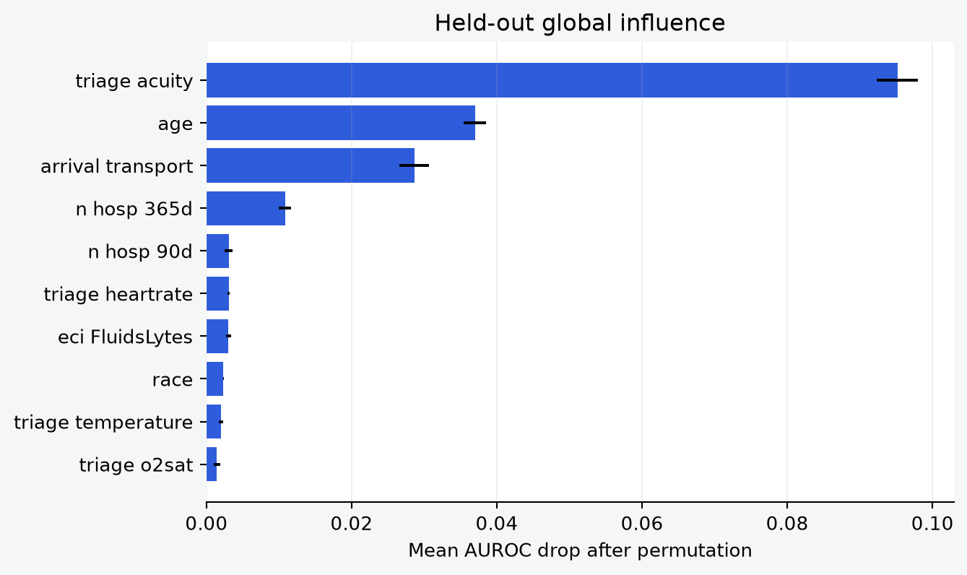
08 / GLOBAL INFLUENCE
M4 / 15
Permutation importance asks: what happens when information is disrupted?
Permutation logic
Shuffle one raw input in held-out rows.
Re-score the complete fitted pipeline.
Measure the AUROC drop.
A larger drop means the model used that input's information on these rows.
Correlated inputs can share or mask influence.
Notes:
Permutation importance is the first global influence lens. It starts from the held-out test rows, shuffles one raw feature, and measures how much the complete pipeline's AUROC falls. The current ranking is led by triage acuity, age, arrival transport, and prior hospitalization counts. This is a statement about predictive dependence in this fitted pipeline and these held-out rows. It is not a causal effect, a biological mechanism, or proof that removing a feature would change care. Correlated variables can substitute for one another, so shuffling one may understate shared information. Workflow variables can also be proxies for severity, access, or documentation.

Slide 16
09 / EXPLAINABILITY
M4 / 16
Three lenses, three different questions
Permutation importance
held-out AUROC drop
Does the full pipeline lose ranking information when this raw input is shuffled?
Native GB importance
tree split contribution
How much did this transformed feature contribute to the fitted tree partitions?
SHAP value
per-row contribution
For this row, how does this feature move the model output relative to its baseline?
All three are model explanations. None is a causal effect estimate.
Notes:
This slide defines the three influence concepts before showing the results. Permutation importance is a held-out performance perturbation. Native Gradient Boosting importance comes from the fitted tree estimator and reflects split-based importance over transformed inputs. SHAP assigns additive per-row contributions relative to a baseline model output. These methods answer different questions and should not be expected to produce identical rankings. The notebook groups one-hot categorical levels and missingness indicators back to their source feature for readability. That grouping improves communication but hides which level or indicator carried the contribution. Most importantly, predictive importance is not causality. A feature can be informative because it is a proxy, a correlated signal, or a workflow artifact.

Slide 17
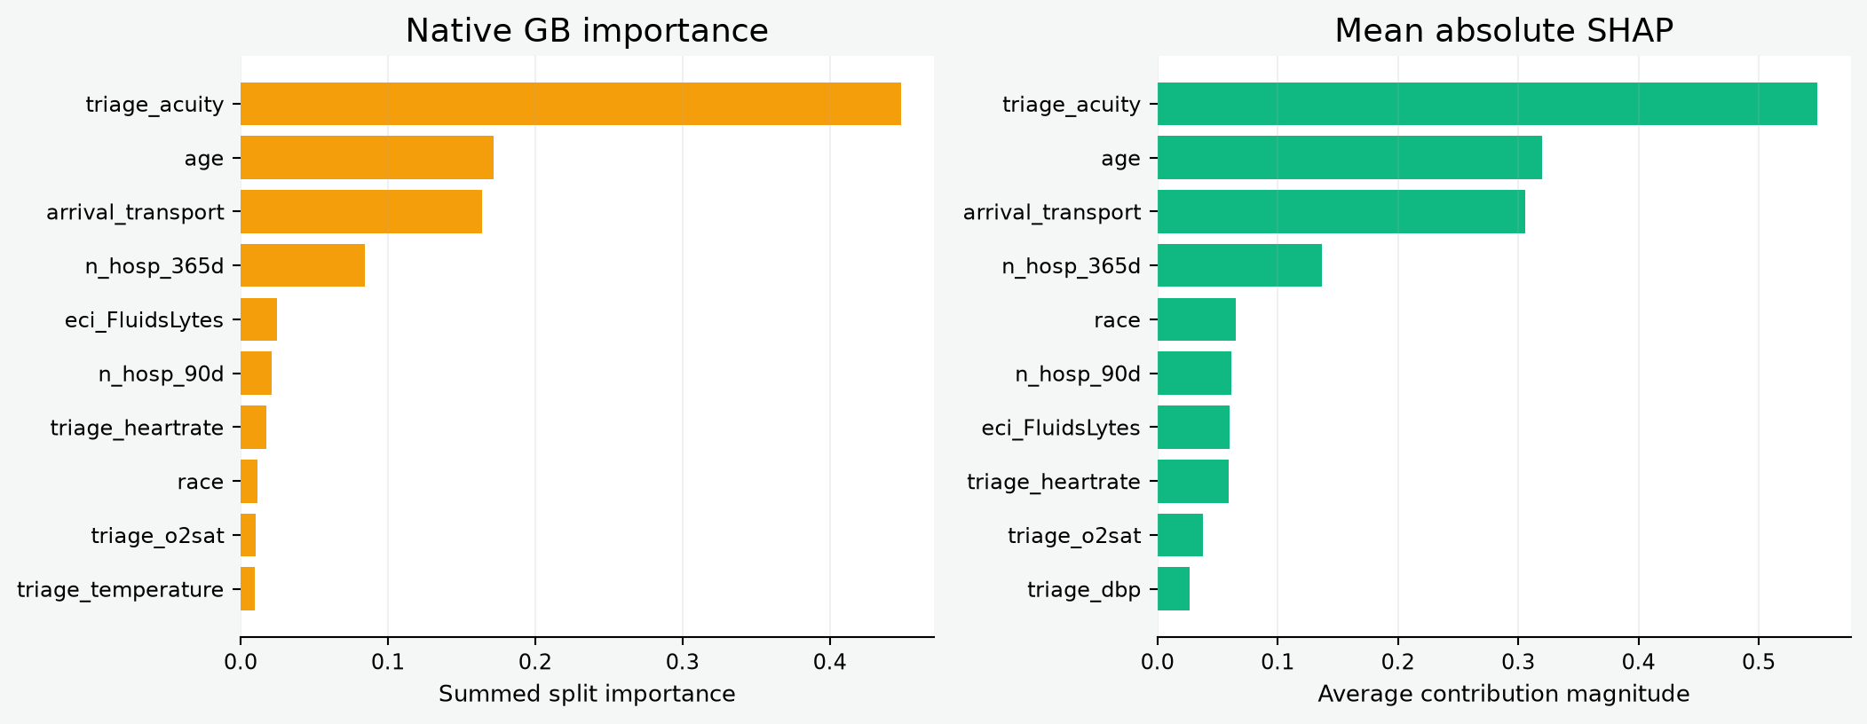
09 / EXPLAINABILITY
M4 / 17
Gradient Boosting: native splits and SHAP agree on the leaders
Triage acuity, age, arrival transport, and prior hospitalization history dominate both views.
Notes:
The native Gradient Boosting and mean absolute SHAP summaries agree on the leading source features: triage acuity, age, arrival transport, and n_hosp_365d, followed by n_hosp_90d and selected clinical indicators. Native importance gives triage_acuity approximately 0.448 of the summed transformed split importance; age is approximately 0.172; arrival transport is approximately 0.164; and n_hosp_365d is approximately 0.084. Mean absolute SHAP is largest for triage_acuity at about 0.549, followed by age at 0.320, arrival_transport at 0.306, and n_hosp_365d at 0.137. Agreement is reassuring as a descriptive pattern, but it does not validate a causal story. One-hot levels are aggregated to the source feature, so the chart intentionally answers at the source-feature level.

Slide 18
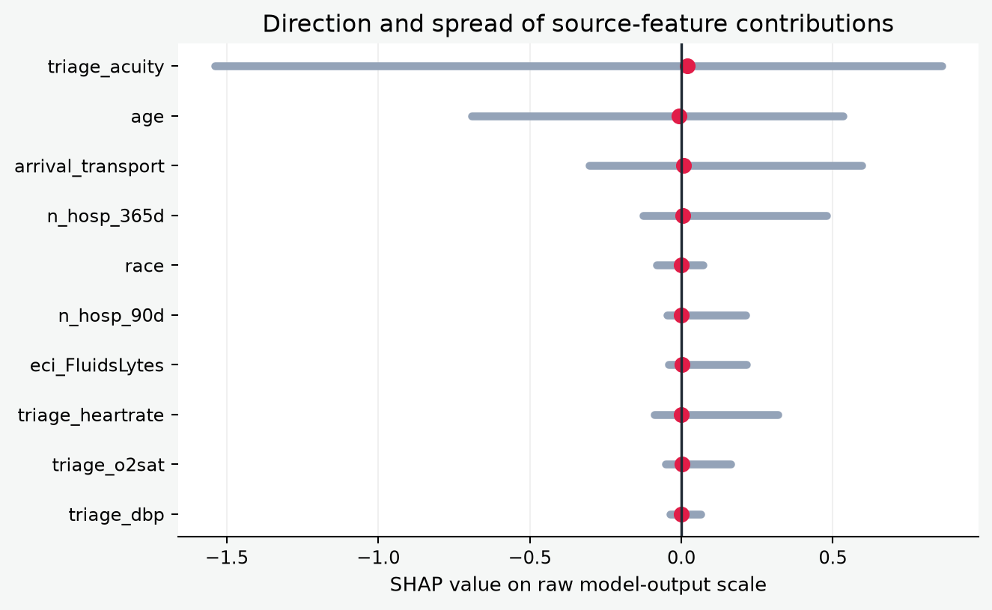
09 / EXPLAINABILITY
M4 / 18
SHAP direction: positive pushes toward hospitalization
How to read a SHAP value
Positive: moves the model output toward hospitalization.
Negative: moves the model output away from hospitalization.
Mean absolute SHAP: typical contribution magnitude.
The gray range: observed contribution spread in the held-out sample.
These values are on the estimator's raw output scale, not percentage-point probability changes.
Notes:
The direction plot uses grouped source-feature SHAP values. The zero line is the neutral point. The red dot is the mean signed contribution across the held-out explainability sample, and the gray line spans the observed minimum to maximum contribution. Positive values move the model toward a hospitalization prediction; negative values move it away. The mean can be close to zero even when a feature matters strongly in both directions, which is why mean absolute SHAP is the main global ranking measure. For this scikit-learn Gradient Boosting estimator, TreeExplainer values are additive on the estimator's raw model-output scale. They should not be described as direct percentage-point changes in predicted probability. A feature's direction can also vary by patient and by interaction with other features.

Slide 19
09 / EXPLAINABILITY
M4 / 19
Local explanations show why one row received its score
Row
Observed
P(hosp.)
Largest positive contributions
Largest negative contributions
21851
Yes
0.551
triage_acuity (+0.645); arrival_transport (+0.369); race (+0.055)
age (-0.575); n_hosp_365d (-0.067); triage_heartrate (-0.063)
13732
No
0.223
triage_heartrate (+0.019); chiefcom_headache (+0.005); n_ed_365d (+0.002)
triage_acuity (-0.363); arrival_transport (-0.267); age (-0.127)
1752
No
0.193
race (+0.055); triage_dbp (+0.014); chiefcom_headache (+0.005)
age (-0.485); triage_acuity (-0.350); arrival_transport (-0.259)
32802
No
0.576
arrival_transport (+0.538); age (+0.506); triage_dbp (+0.014)
triage_acuity (-0.320); race (-0.081); triage_heartrate (-0.075)
A local explanation is a model audit trail for one row, not a clinical justification or a causal narrative.
Notes:
The final table is local rather than global. For each sampled held-out row it reports the observed outcome, the Gradient Boosting predicted probability, and the three largest positive and negative grouped source-feature contributions. A positive contribution pushes the raw model output toward hospitalization relative to the model baseline; a negative contribution pushes it away. The table can help audit an individual score: do the dominant contributors look like triage-time information, are missingness indicators involved, and does the case sit near the chosen threshold? It should not be used to write a causal story about the patient. The explanation belongs to this model, preprocessing, sample, and baseline. It is one useful audit view, not proof that the model is clinically correct.

