Slide 1
Triggers
Tim Smith
Fiona Schwallie

Slide 2
Introduction
The core competency that we have chosen this week is Data Manipulation Language (DML) triggers. Here we will learn more about the Understand how to use inline DML triggers as well as understand how to us autonomous DML triggers.

Slide 3
Understand how to use inline DML triggers.
DML triggers can fire before or after INSERT, UPDATE, and DELETE statements. DML triggers can be statement- or row-level activities. Statement-level triggers fire and perform a statement or set of statements once no matter how many rows are affected by the DML event. Row-level triggers fire and perform a statement or set of statements for each row changed by a DML statement. A principal caveat of triggers that manage data changes is that you cannot use SQL Data Control Language (DCL) in them, unless you declare the trigger as autonomous. When triggers run inside the scope of a transaction, they disallow setting a SAVEPOINT or performing either a ROLLBACK or COMMIT statement. Likewise, they can’t have a DCL statement in the execution path of any function or procedure that they call.

Slide 4
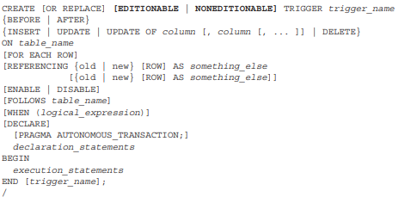
The prototype for building DML triggers is:
Oracle Database 11g Release 2 added the EDITIONABLE or NONEDITIONABLE feature of DML triggers. It allows different trigger behaviors in various editions of the Oracle database.
The BEFORE or AFTER clause determines whether the trigger fires before or after the change is written to your local copy of the data
There are two options for DML triggers. You can declare them as statement-level triggers, which are also known as table-level triggers, or you can declare them as row-level triggers.

Slide 5
Autonomous DML Triggers
Autonomous DML Triggers are when you set a block into an autonomous transaction. With this you isolate the DML in that block from the caller's transaction context. That block becomes an independent transaction that is started by another transaction, referred to as the main transaction.
Within the autonomous transaction block, the main transaction is suspended. You perform your SQL operations, commit or roll back those operations, and resume the main transaction.

Slide 6
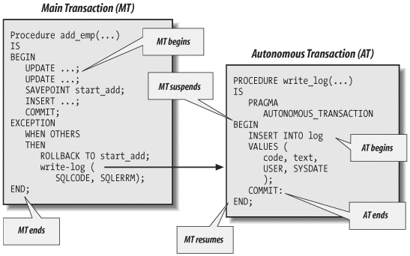
Examples of Autonomous Transactions
The image to the left is an example of where you would insert the autonomous transaction.
You begin with inserting the word PRAGMA.
Pragma simply instructs the PL/SQL compiler to establish a PL/SQL block as autonomous or independent.

Slide 7

Thank You

