Slide 1
Chapter 6 collections
Tim Smith
Fiona Schwallie

Slide 2

Overview
For this week we chose Collections. We will understand differences Between SQL Collections and Associative Arrays as well as, understanding the differences between ADT and UDT collections.

Slide 3
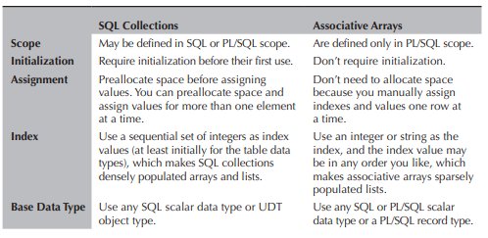
Introduction to collections
Two are SQL collections and one is a PL/SQL-only collection Oracle implements a SQL array as a varray data type and implements a SQL list as a table data type. The PL/SQL-only collection is an associative array or an index-by table data type and is implemented as a list
Below we can observe the “Differences Between SQL Collections and Associative Arrays”

Slide 4
Arrays: typically have a physical size allocated when defined. Oracle implements arrays as the varray data type and lists as the table data type. Associative arrays: are collection types that associate a unique key with a value of the index.
Object Types: Varray and Table Collections

Slide 5
ADT vs UDT
ADT | UDT
General storage structure Supports addition, removal and retrieval elements Retrieval is based on the user’s supply of an .equal() method Duplicate elements permitted | Can attach multiple data fields, each named and typed, to a single column Fields can be any valid data type, including collections and other UDTs Once created, UDTs may be used to define a column in a table

Slide 6
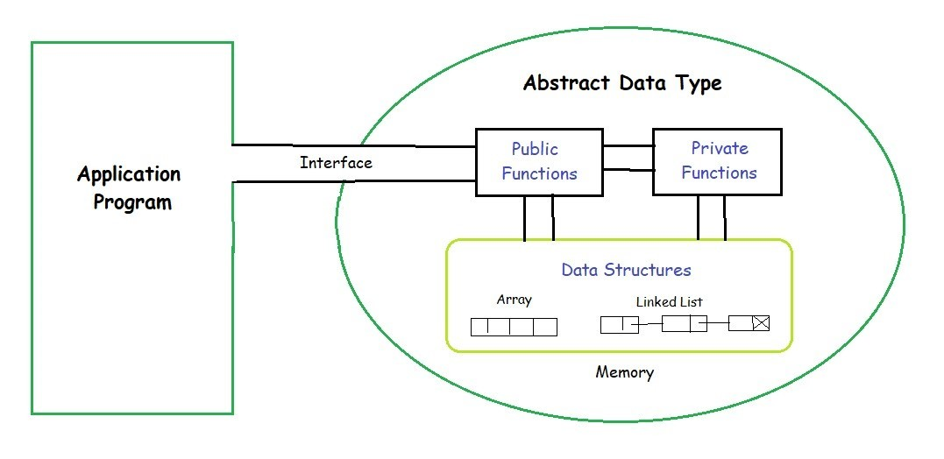
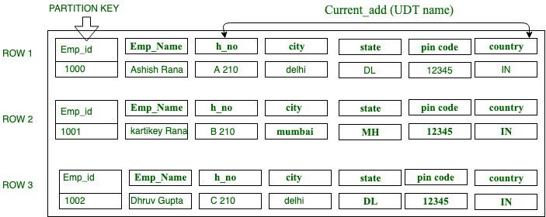
Examples of ADT & UDT
ADT | UDT

Slide 7

References
Oracle Database 12c PL/SQL Programming (byui.edu)
https://jcsites.juniata.edu/faculty/rhodes/cs240/collectionADT.htm#:~:text=The%20Collection%20ADT%20is%20a%20more%20general%20storage%20structure%20where,duplicate%20elements%20permitted
https://docs.datastax.com/en/cql-oss/3.3/cql/cql_using/useCreateUDT.html#:~:text=User%2Ddefined%20types%20(UDTs)%20can%20attach%20multiple%20data%20fields,a%20column%20in%20a%20table.

Slide 8
Thank you Tim Smith Fiona Tiffani Schwallie

