Slide 1
Transaction scope and defining functions
Tim Smith
Fiona Schwallie

Slide 2

Overview
The core competency that we have chosen this week is Transaction scope and defining functions. Here we will learn more about the pass-by-value functions as well as the pass-by-reference functions.

Slide 3
Pass-by-Value functions.
A pass-by-value function receives values when they’re called. They return a single thing upon completion. The tricky parts with this type of function are the data types of the inputs and outputs.
You can define pass-by-value functions as deterministic or parallel enable when the functions don’t alter package variables or database values. You can also define functions to return pipelined tables that mimic SQL or PL/SQL collections.
Functions return a single output variable. Output variables can be scalar values or composite data types. This means that a single variable can contain many things when it is a composite data type.

Slide 4
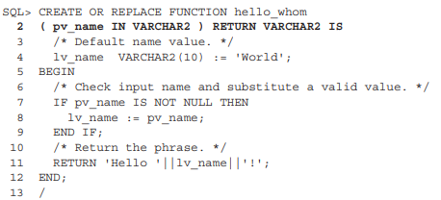
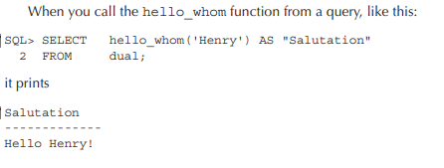
Line 2 explicitly qualifies the IN mode of operation for the pass-by-value parameter. The default for parameters when none is provided is the IN mode. So, omitting from the function’s signature doesn’t change a pass-by-value parameter’s mode of operation.
EXAMPLE
A sample “hello_whom” function, a variation on the classic “hello_whom” function, demonstrates a pass-by-value function:

Slide 5
Pass-by-reference functions
Pass-by-reference means to pass the reference of an argument in the calling function to the corresponding formal parameter of the called function. The called function can modify the value of the argument by using its reference passed in.

Slide 6
Pass-by-reference Functions continued
When the function swapnum() is called, the values of the variables a and b are exchanged because they are passed by reference. The output is:
When the function swapnum() is called, the values of the variables a and b are exchanged because they are passed by reference. The output is:
When the function swapnum() is called, the values of the variables a and b are exchanged because they are passed by reference. The output is:
#include <stdio.h>
void swapnum(int &i, int &j) {
int temp = i;
i = j; j = temp;
}
int main(void) {
int a = 10;
int b = 20;
swapnum(a, b);
printf("A is %d and B is %d\n", a, b);
return 0;
}
When the function swapnum() is called, the values of the variables a and b are exchanged because they are passed by reference. The output is: A is 20 and B is 10

Slide 7
References
https://content.byui.edu/file/16ae0a9e-bad9-45e8-acb2-3f1dd92e01f1/1/Oracle%20Database%2012c%20PL-SQL%20Programming.pdf
https://www.ibm.com/docs/en/zos/2.4.0?topic=calls-pass-by-reference-c-only

Slide 8

Thank you

