Slide 1
Knock-it
Warsame Bashir

Slide 2
Overview
What is it?
How does it work?
Challenges
Fritzing
Demo

Slide 3
What is it?

Slide 4
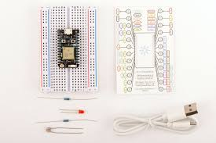
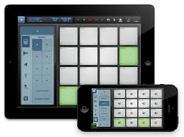
Beat Maker (Drums)
Photon
+

Slide 5
FLASHING …. LIGHTS LIGHTS

Slide 6
How does it work?

Slide 7
hEROKU AND SOCKET.IO
Johnny-Five (NODE)
Module for connecting to Photon/Arduino
Javascript based
Faster development lifecycle (if you prefer JS)
AngularJS / Express
AngularJS application front end to send ‘active’ beat to Photon

Slide 8
Challenges

Slide 9
Particle .io (weak)
Build particle site (not even documentation)
Heroku deployment process.
Hardware connection with Photon
Socket IO (Locally)

Slide 10
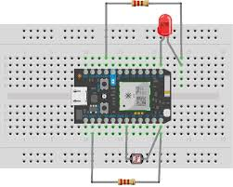

Slide 11
demo

