Slide 1

SecurePass
Honors Senior Project
Whitney Carpenter
Bachelor of Science in Cybersecurity
CSCI 499 | Dr. Hayes
April 24, 2026
Notes:
DON’T FORGET TO DESCRIBE THE PROJECT! “Hi, my name is Whitney Carpenter, and this is my Honors Senior Project, SecurePass. It’s a Chrome extension designed to help users create stronger, more secure passwords through real-time feedback and educational insights.”

Slide 2
Statement of Purpose
Weak passwords → major security risk
81% of breaches involve weak/compromised passwords
Goal: Help users create stronger passwords in real time
Local, privacy-focused evaluation
Notes:
“Weak passwords are one of the most common causes of security breaches. In fact, around 80% of hacking-related breaches involve compromised credentials.
The goal of SecurePass is to help users create stronger passwords by giving immediate feedback as they type, while also keeping everything local so no sensitive data is ever transmitted.”

Slide 3
My “Why”
Interest in cybersecurity
Passion for protecting users
Real-world relevance
Combines security & usability
Notes:
“I’ve always been interested in cybersecurity, especially how small user decisions can lead to major vulnerabilities.
Passwords are something everyone uses, but most people don’t fully understand what makes them secure. I wanted to build something that not only evaluates passwords, but actually helps users learn and improve.
That’s where SecurePass came from—combining security with usability.”

Slide 4
Honors Component
Enhanced as an Honors Capstone Project
Required real-world deployment
Chrome Web Store preparation
Notes:
“As an honors project, this went beyond a typical classroom assignment.
I was required to prepare the extension for real-world deployment, including packaging it for the Chrome Web Store and ensuring it met security and privacy standards.
This involved many challenges.”

Slide 5
Live Demo
Notes:
Define entropy (the measure of randomness/unpredictability of the password), and talk about the hash comparison happening for common passwords after full analysis button is clicked.

Slide 6
Implementation
Chrome Extension (Manifest V3)
Justification: stronger security & event-driven service workers
JavaScript, HTML, CSS
Key Components:
Content script (field detection)
Popup (evaluation logic)
SHA-256 hashing
Local processing only
Notes:
“The extension is built using a modular architecture.
A content script detects password fields and injects the UI, while the popup handles the password evaluation logic.
Password strength is calculated using both rule-based scoring and entropy.
All processing happens locally, and passwords are hashed using SHA-256, ensuring no sensitive data is stored or transmitted.”

Slide 7
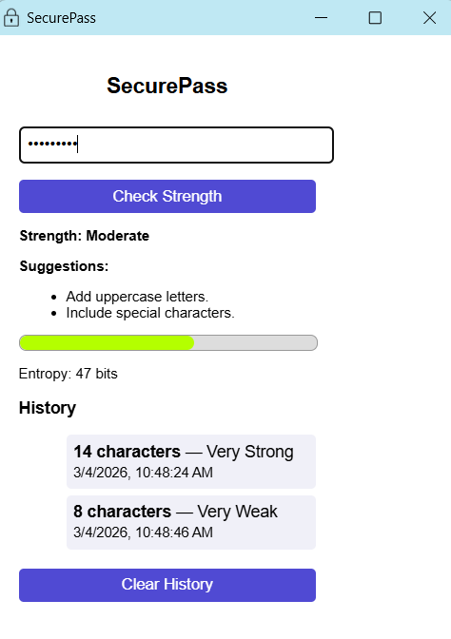
Key Features
Real-time feedback
Entropy-based evaluation
Actionable suggestions
Educational insights
Fully local (privacy-focused)
Notes:
“Some key features include real-time feedback, entropy-based scoring, and actionable suggestions.
One important aspect is the educational component—users aren’t just given a score, they’re told why and how to improve.
And everything is done locally for privacy.”

Slide 8
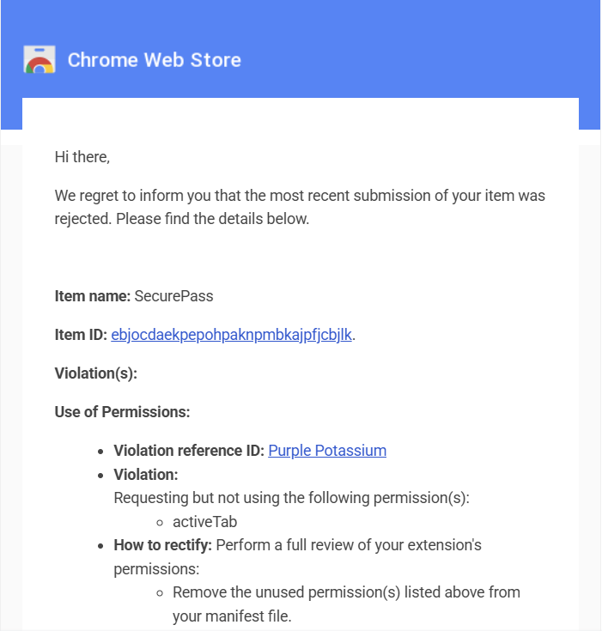
Challenges Overcome
Secure password history (hashing vs plaintext)
Dynamic websites (MutationObserver)
Chrome deployment requirements
Notes:
“One of the biggest challenges was designing a secure history feature.
I had to balance usability with security, and ultimately used hashing so that no plaintext passwords were stored.
Another challenge was handling modern websites that dynamically load content, which I solved using a MutationObserver.
Preparing the extension for Chrome deployment also introduced additional constraints and validation requirements.”

Slide 9
Test Results
100% of unit tests passed
6/6 users understood feedback
<2 second response time
No network activity detected
Notes:
“I decided to use unit tests and acceptance testing for this project, which included 6 users. All unit tests passed successfully, and user testing showed that all participants understood the feedback provided.
The extension consistently responded in under two seconds and generated no network activity, confirming that all processing is local.
This also demonstrates that the educational requirement was successfully met.”

Slide 10
Future Enhancements
Advanced password analysis
Cross-browser support
Optional history controls
Integration with breach databases
Notes:
“In the future, this could be expanded with more advanced password analysis techniques, support for other browsers, and additional user controls for history.
It could also integrate with breach databases or recommend password managers.”

Slide 11
Conclusion
Improves password security
Educates users
Privacy-focused design
Real-world ready
Notes:
“Overall, SecurePass helps users create stronger passwords, improves their understanding of security, and does so in a privacy-focused way.
It’s designed to be both practical and ready for real-world use.”

Slide 12
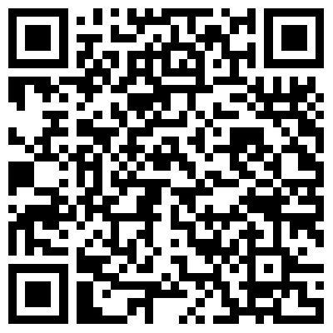
Questions?
Install SecurePass

