Slide 1
2024 Intuitive presentation template

Slide 2



Meet the new presentation toolkit
You are here
Presentation template
The presentation template is meant for presentation engagements that require a speaker to explain the visuals on slide. This file contains instructions for use and blank layouts to get you started.
Publication template
The publication template should be used for self-sustainable files. These decks are typically meant to be read and do not require a presenter. The file will include instructions and blank layouts to get you started.
PowerPoint graphics guide
This file is the master of all things PowerPoint. It will include PowerPoint best practices, when and how to use different templates, as well as a robust library of graphic elements and all things copy-and-paste-able.
Slide libraries
A collection of pre-designed slides generated with real content to show the full flexibility of our template layouts. They can be used as a foundation for your own slides and provide inspiration for new designs. This will be available in presentation and publication variations.

Slide 3
What you’ll find in this file
This file is composed of two main sections.
Section one: template introduction
The template introduction section provides you with the foundational background information for this template. It includes an overview of layouts, and an exercise on navigating the multiple type styles that have been programmed into the template.
Section two: template layouts
The following section is a collection of every layout that is designed in the template, blank and ready for you to drop in the content you need.
Helpful tip
To get started using the template right away, begin on slide 14 and delete all template introduction slides.

Slide 4



Where you can find this file in the future
When you launch PowerPoint, navigate to “New”. You should have access to the latest presentation template under the custom/shared tab under themes. If you right click and “Pin” the document, it’ll appear under the “New” section every time you launch PowerPoint.
You can also find this file, along with other toolkit and brand assets through the Brand Portal or on the Brand and Creative Leo page.
Home
New
Open
Info
Save
Save As
Print
Share
Export
Close
New
Default Theme
Blank presentation
2024 Intuitive Corp…
Office Custom/shared
2024 Intuitive Corp…

Slide 5
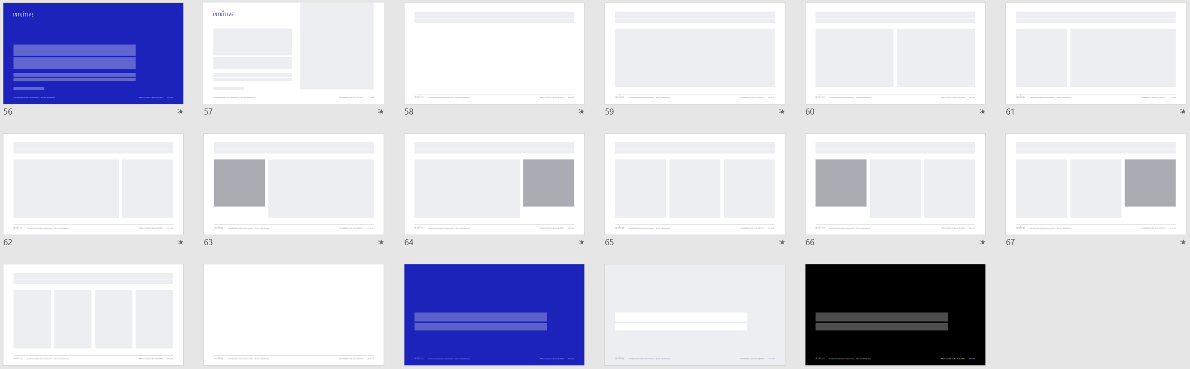
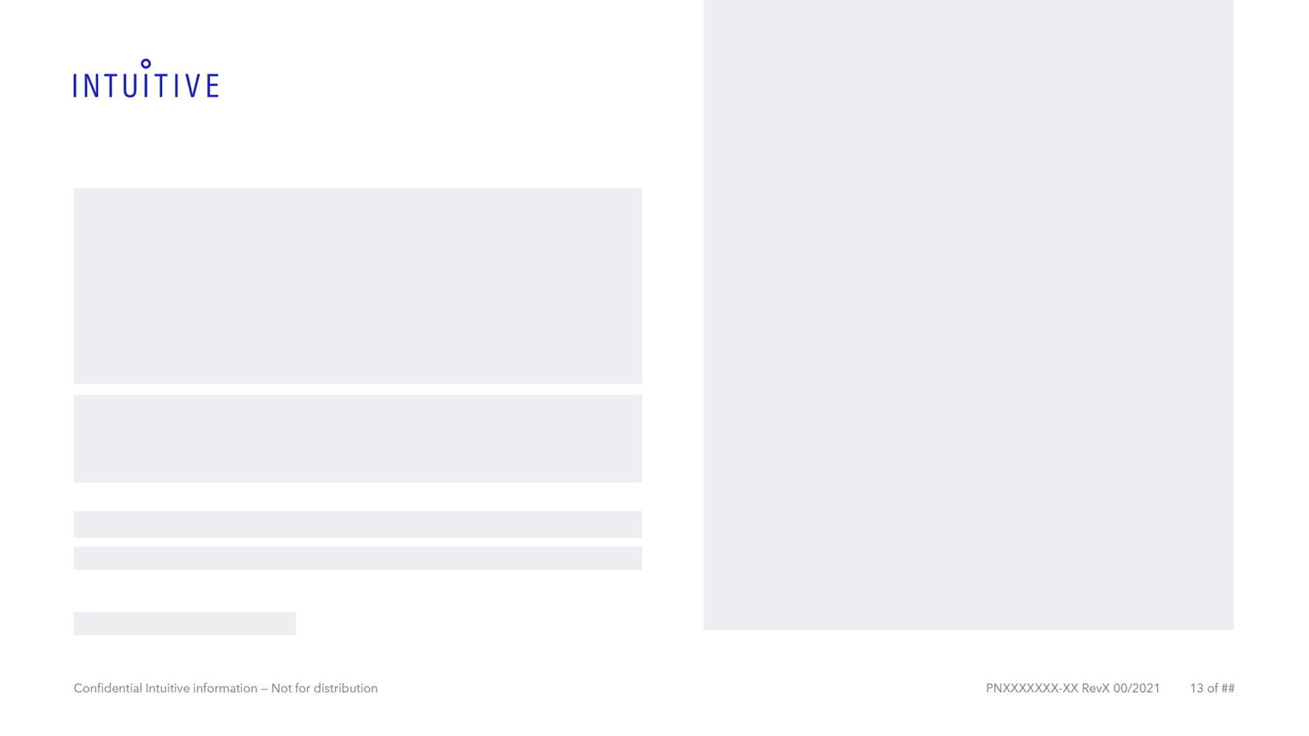
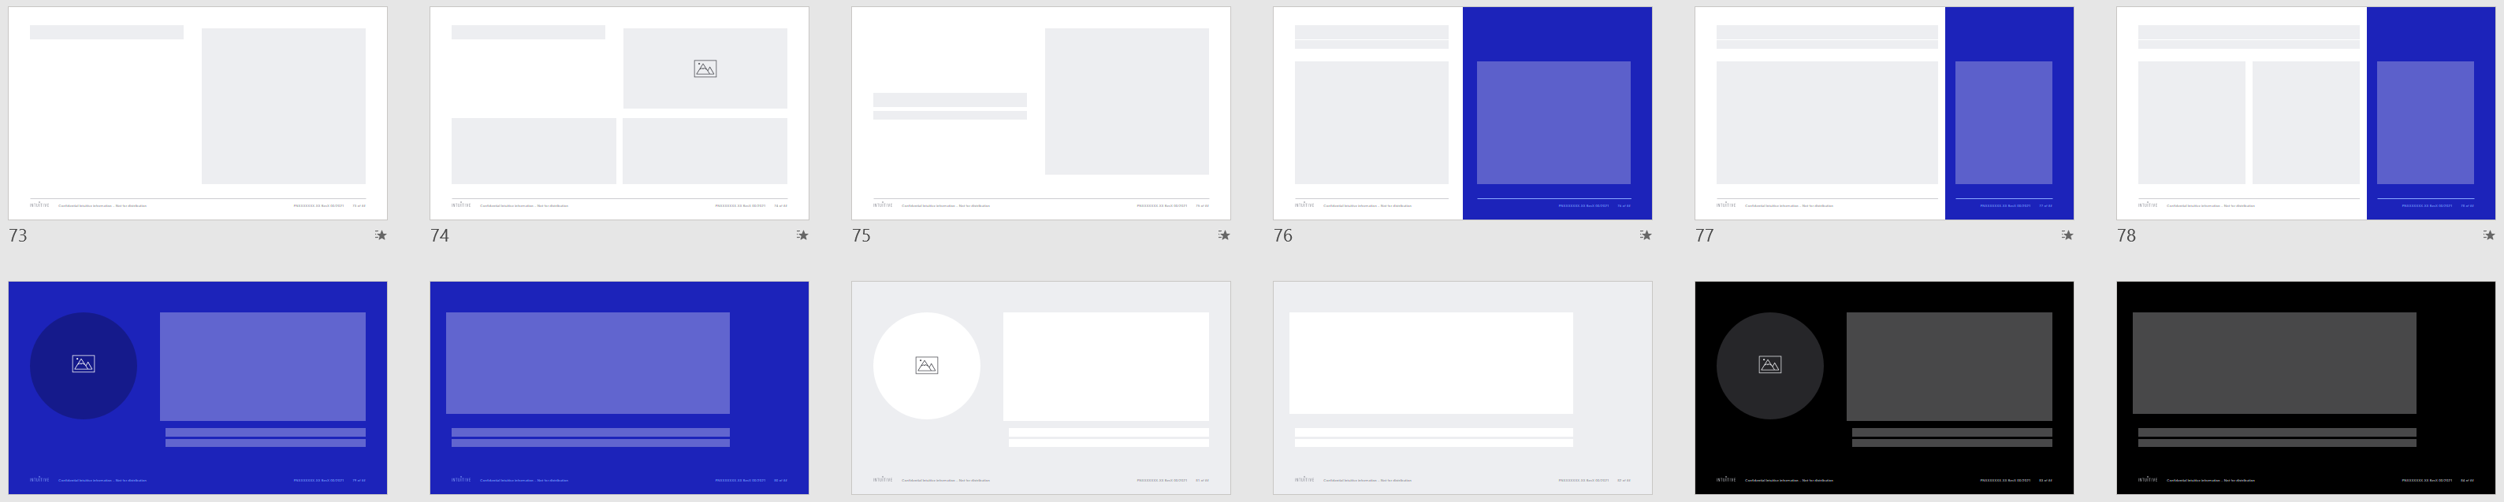
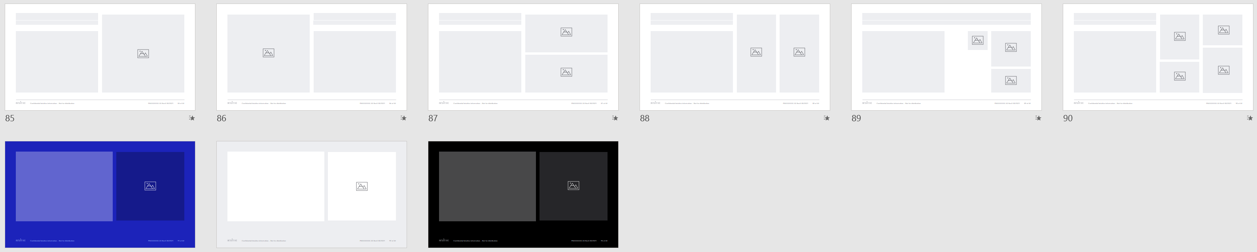
Template layouts
This file contains 42 master layouts for you to choose from
Most layouts lead with white, but some are available in different colors. Each layout should be able to easily switch from one to another.
Standard Layouts
What you would expect to see in a template. They are primarily text-forward layouts and don’t have too much fluff.
Title Layout
Title with Image Layout
Title Only Layout
Title and Content Layout
Two Content Layout
Weighted Right Layout
Weighted Left Layout
Two Content Callout Left
Two Content Callout Right
Three Content Layout
Three Content Callout Left
Three Content Callout Right
Four Content Layout
Blank
Section Divider
Sub-section Divider (Gray)
Sub-section Divider (Black)
Emphasis Layouts
Serve as foundations for specific use cases. They are more dynamic in form and include extra color.
Content Right Layout
Comparison
Title Center Layout
50/50 Layout
Two Content Panel
Three Content Panel
Quote with Image (Blue)
Quote (Blue)
Quote with Image (Gray)
Quote (Gray)
Quote with Image (Black)
Quote (Black)
Image Layouts
This section has a variety of image placeholders, gridded uniquely to help serve diverse image needs.
Content and Image (Right)
Content and Image (Left)
Horizontal Image Split Layout
Vertical Image Split Layout
Content and Image Grid (Small)
Content and Image Grid (Large)
Statement with Image (Blue)
Statement with Image (Gray)
Statement with Image (Black)
The visual to the right doesn’t include the Safety Information, References, or End layouts.

Slide 6
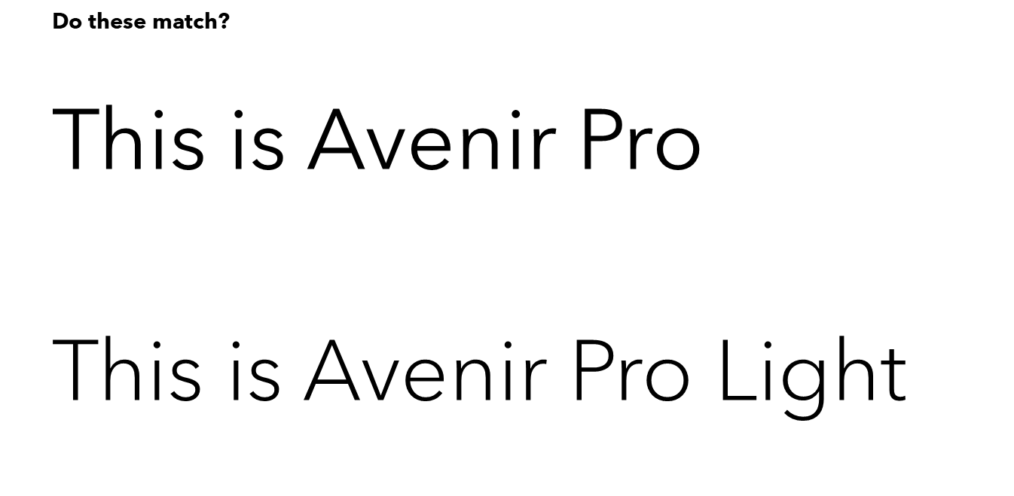
Font check
Do these match?
This is Avenir Pro
This is Avenir Pro Light
Every machine should be equipped with Avenir Next LT Pro as a standard system font. Double check the graphic on the left to ensure you’re seeing your designs properly.
If they don’t match perfectly, please contact ISI-TemplatesHelp@intusurg.com for further instruction.

Slide 7
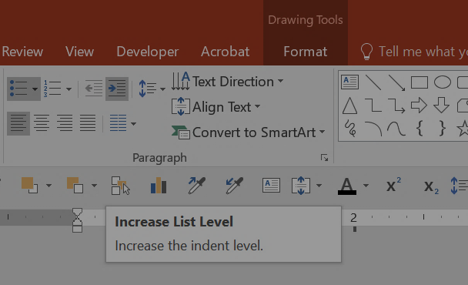

Templated typography
Most text and content placeholders have 5 levels of text styles.
Use Home › Paragraph › “Increase/Decrease List Level” to navigate through the pre-formatted type styles. You can also achieve this by highlighting your text and clicking “Tab” or “Shift+Tab” to navigate styles.
Tip: Use the same tabbing system to navigate through multiple footnote sizes. The default size is 9pt, but there are 10 and 8pt variations available for use.
Footnote default is 9pt
Tab once for 10pt footnote
Tab twice for 8pt footnote

Slide 8
Templated typography exercise
01: Body text
02: First level bullet
03: Second level bullet
04: Third level bullet
05: Headers
06: Stat style
07: Sub-headers
08: Small body text
09: Large body text
Practice tabbing below. Cycle through styles using “Tab” and “Shift+Tab” to move up and down the style list.
02: Highlight this line and press “Tab” key once
03: Highlight this line and press “Tab” key twice
04: Highlight this line and press “Tab” key three times
05: Highlight this line and press “Tab” key four times
06: Highlight this line and press “Tab” key five times
07: Highlight this line and press “Tab” key six times
08: Highlight this line and press “Tab” key seven times
09: Highlight this line and press “Tab” key eight times

Slide 9
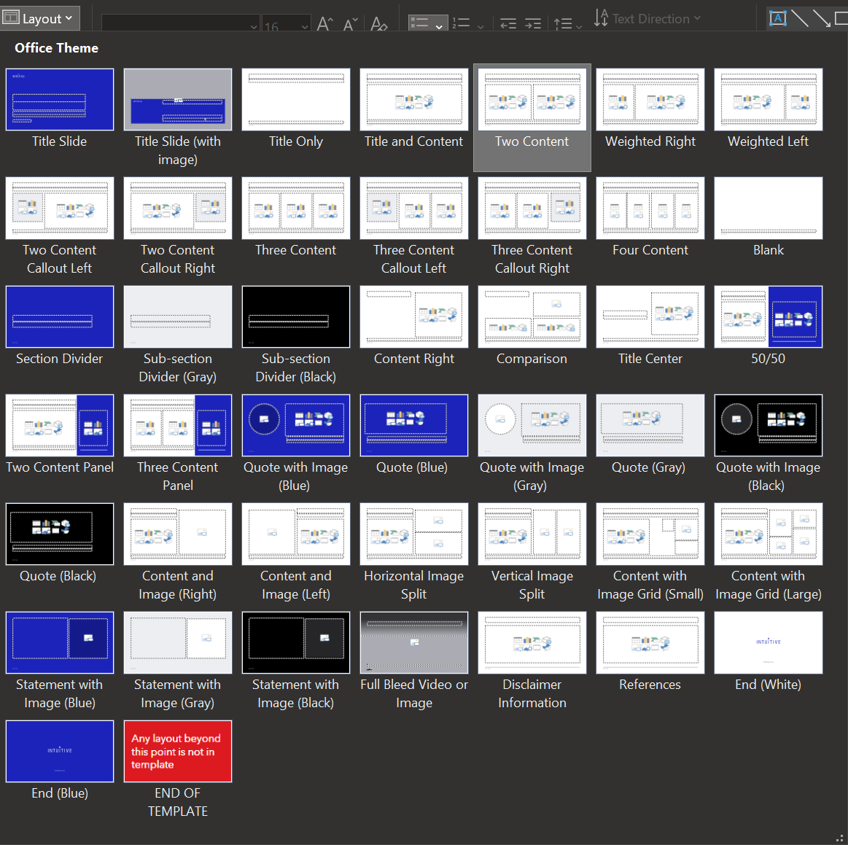
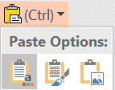
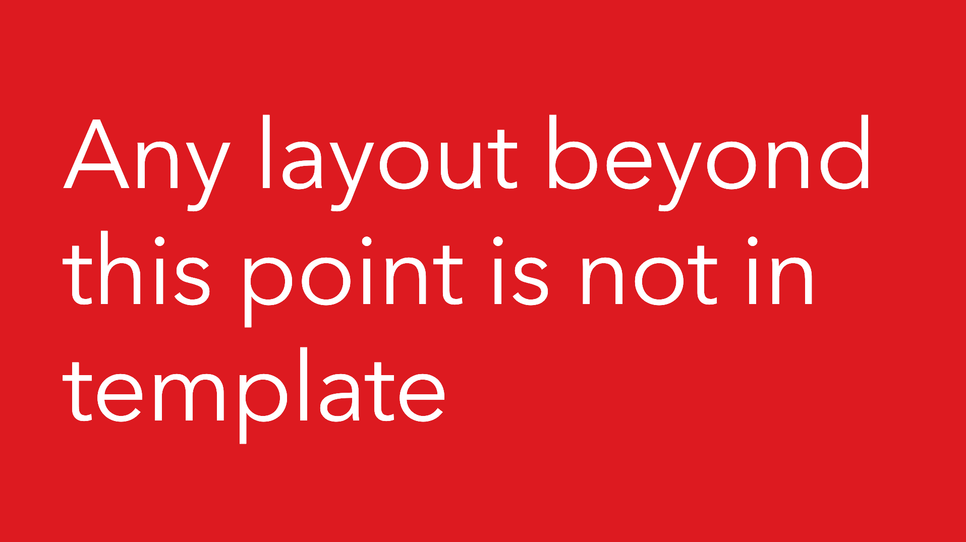
Copying and pasting slides from another deck
When pasting slides from another deck, an option will appear below the pasted slide. Make sure to select the first paste option “Use Destination Theme”.
This will limit rogue layouts appearing in the template and keep your deck consistent.
At the end of the layout options, notice this slide.
Any layouts following this slide are rogue and should be changed to one of the approved template slides.

Slide 10
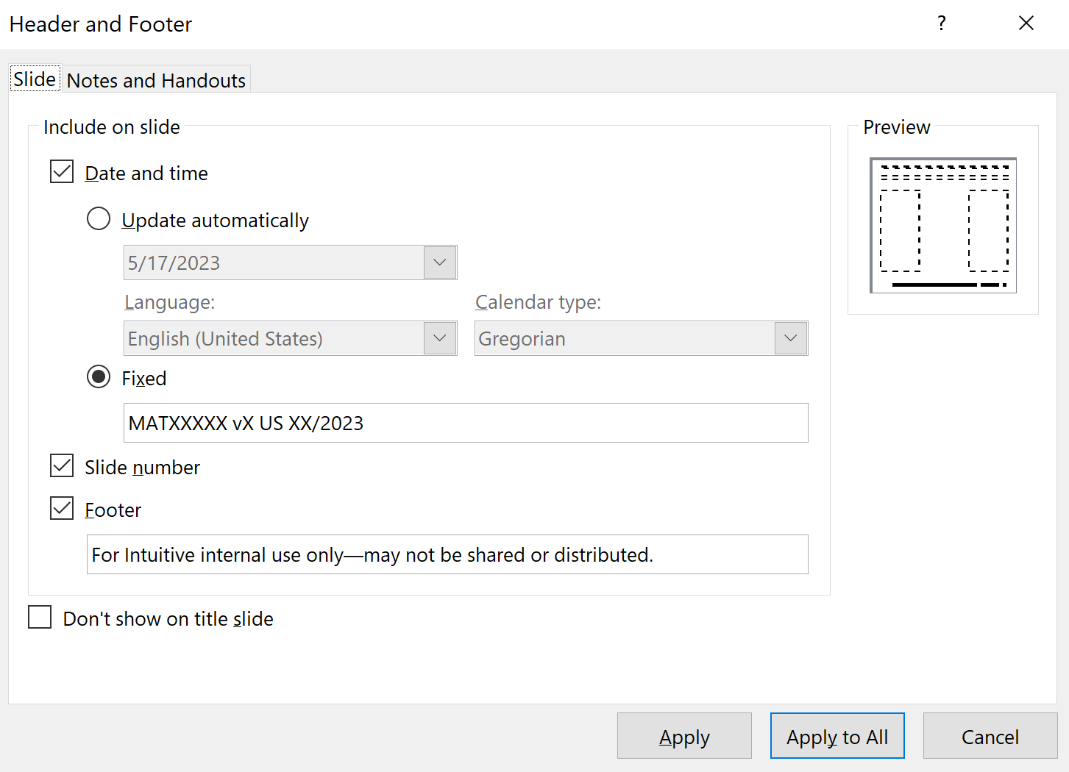
Footer guidelines
For all slides built using new layouts in the 2024 Intuitive presentation template
Confidentiality statement:
Insert › Header and Footer, then add chosen statement in the Footer field. Click Apply to All.
Select one of the two statements below:
For Intuitive internal use only—may not be shared or distributed.
​© 2024 Intuitive Surgical Operations, Inc.
Statement 1 is the default confidentiality statement. Only use statement 2 when handling external documents.
MAT number:
Insert > Header and Footer, then add the MAT in the Fixed Date field. Click Apply to All.

Slide 11
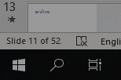
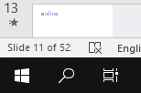
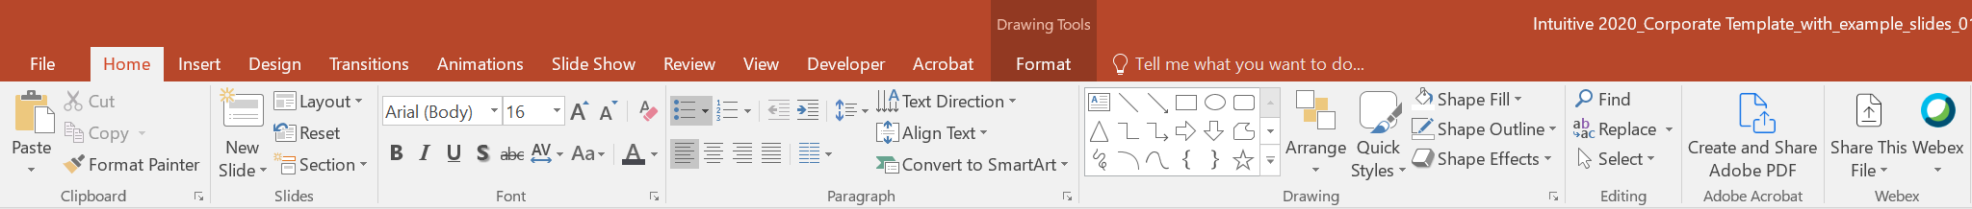
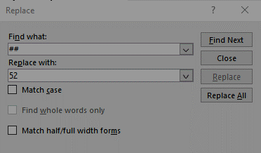
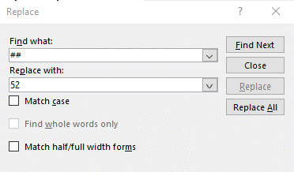
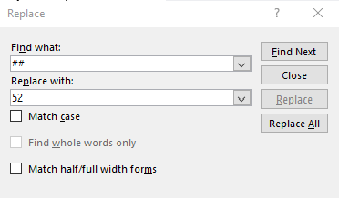
Editing the slide number
In order to stay regulatory-compliant, all documents that will be sent to Agile will require a page number format of “x of y.” This format has been applied to the PowerPoint template. Changing the "x of ##" is easy to do simply by following the steps to the right.
Edit the slide number format as the final step in completing your presentation; only when there will be no further changes to the slide count.
Step one
Locate the final slide count number. (located in the bottom left of the program)
Step two
On the “Home” tab, select “Replace”
Step three
In the “Find what” box type “##”
In the “Replace with” box, type the final slide count number.
Click “Replace All” button.

Slide 12
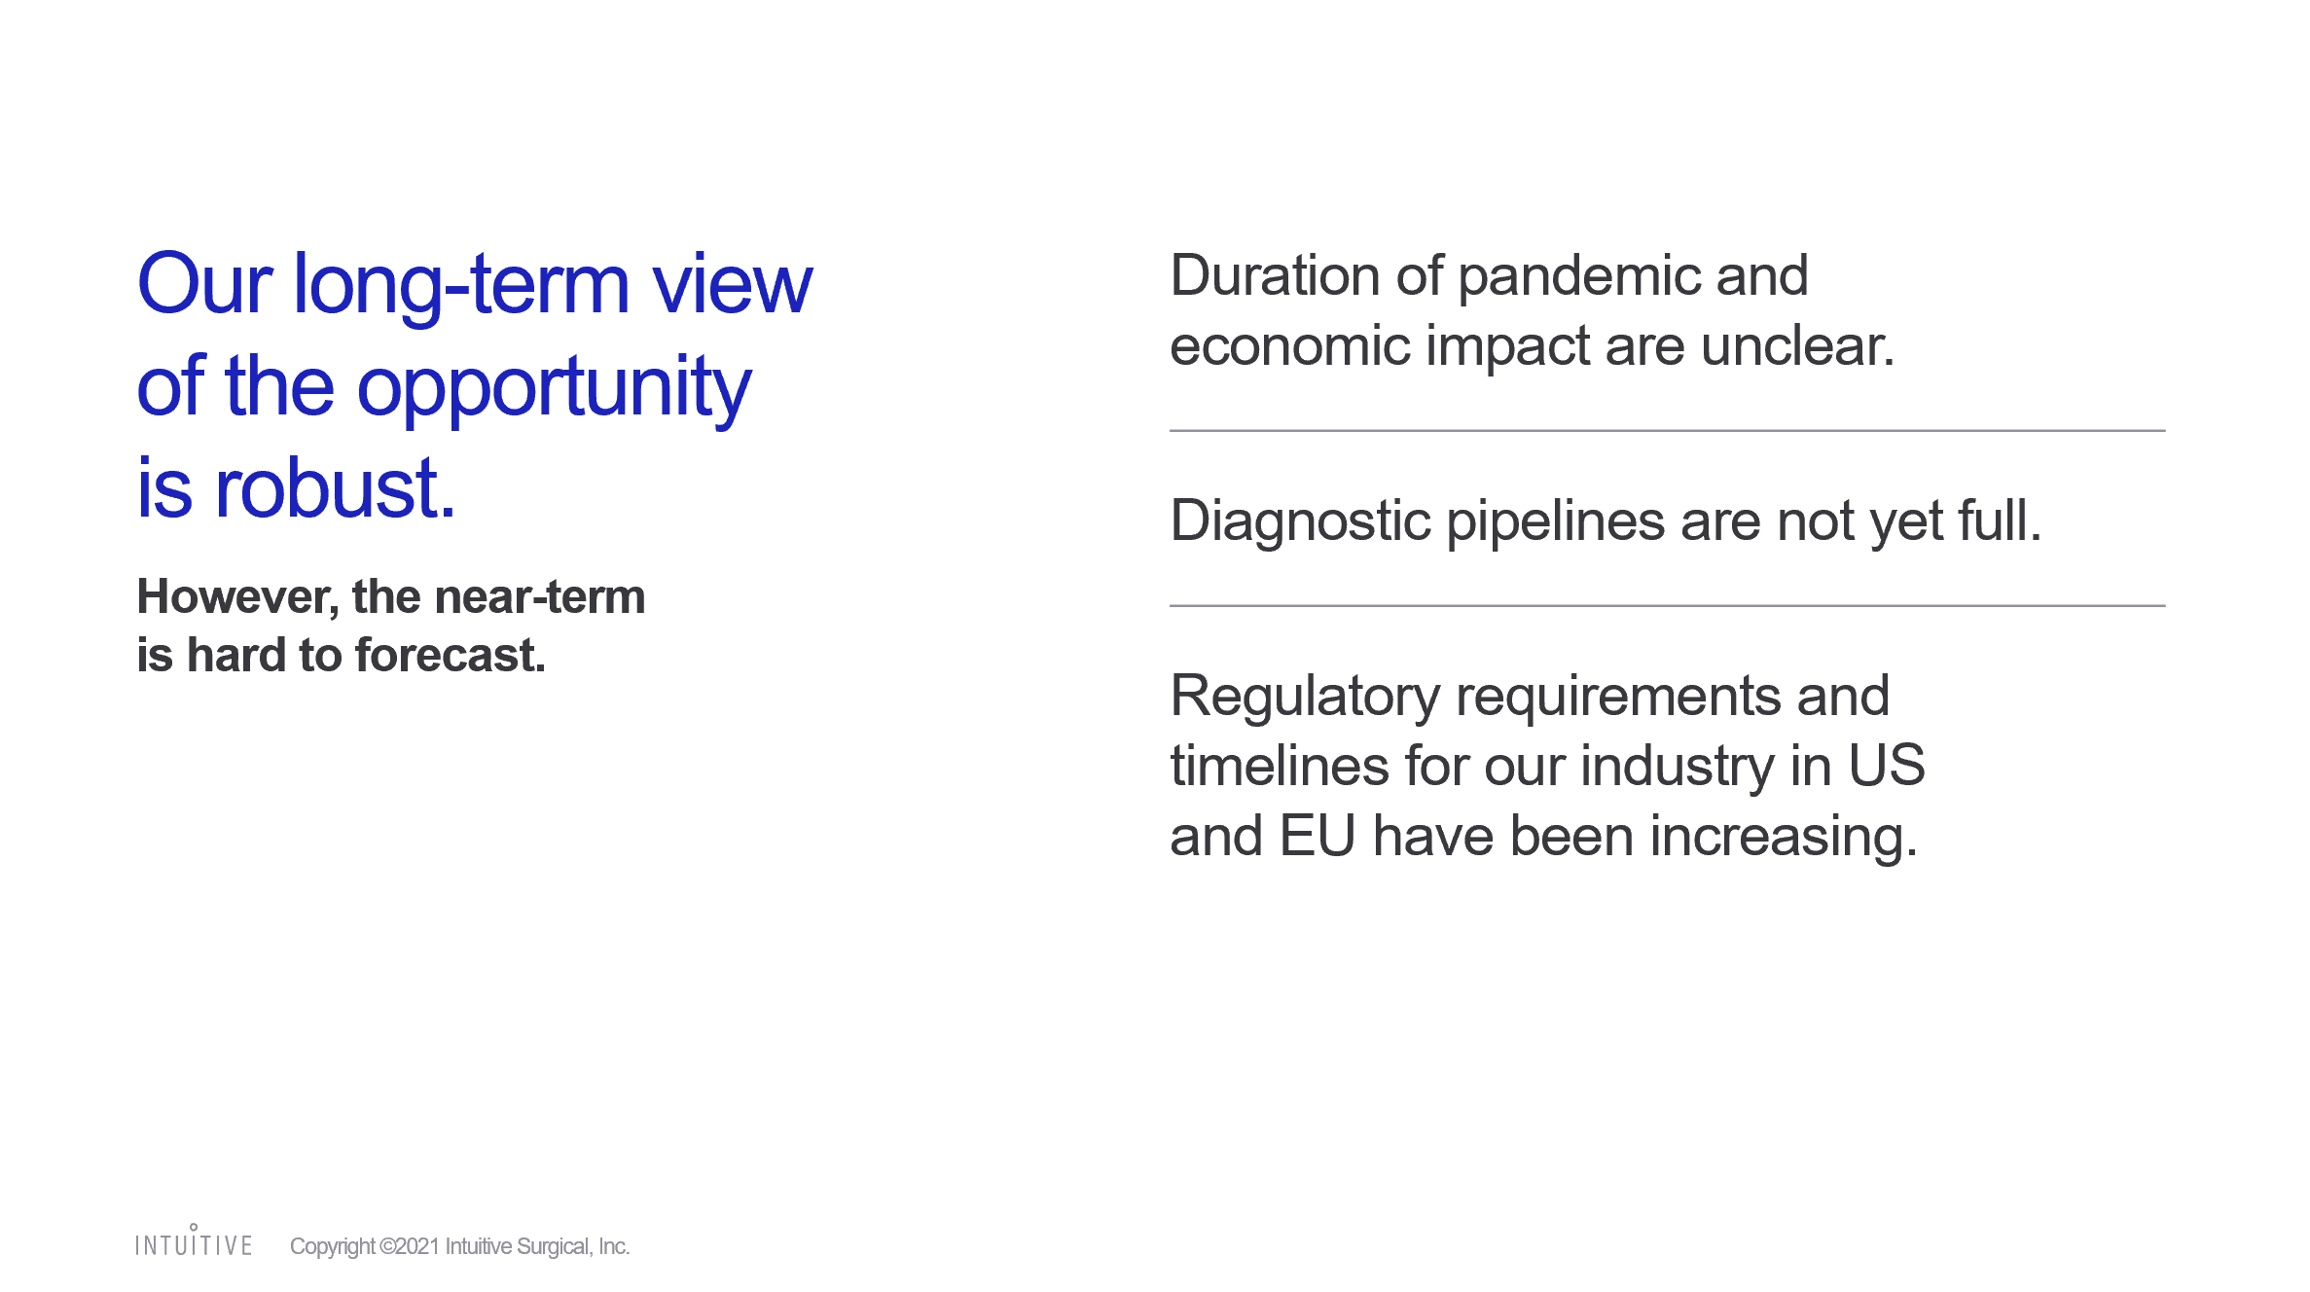
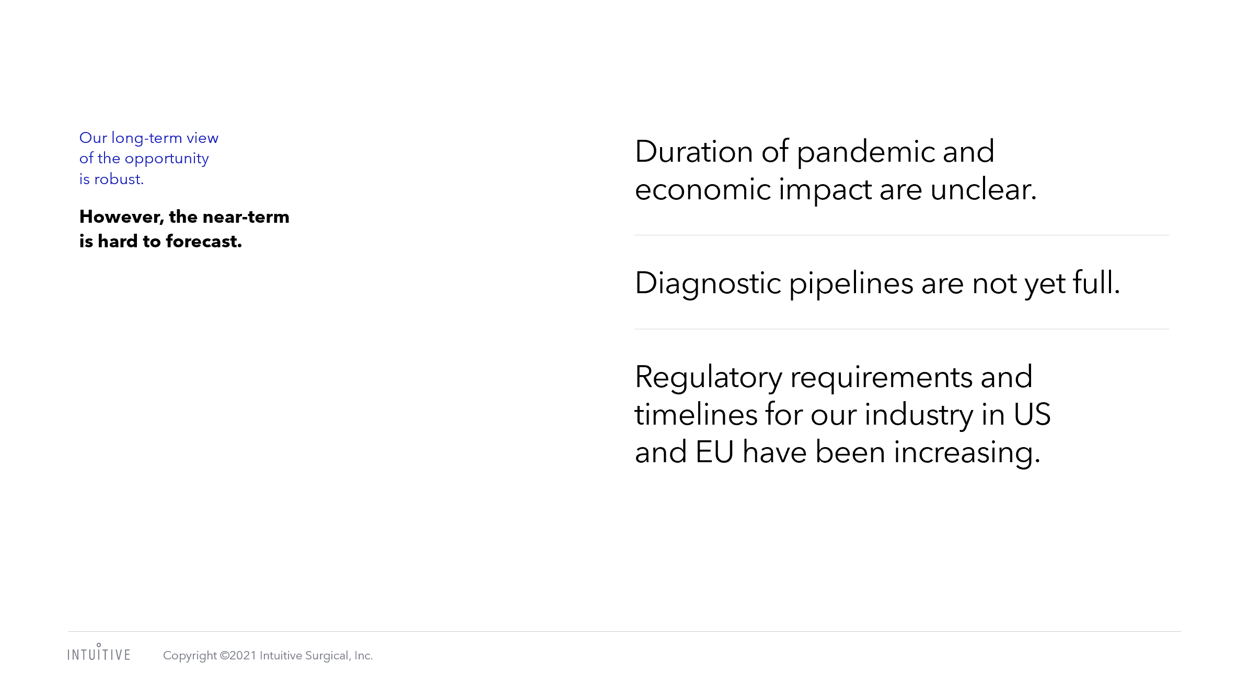
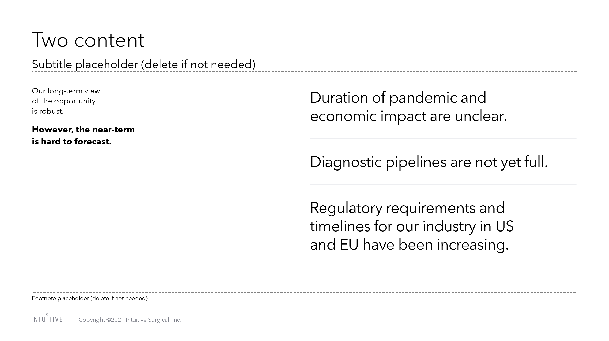
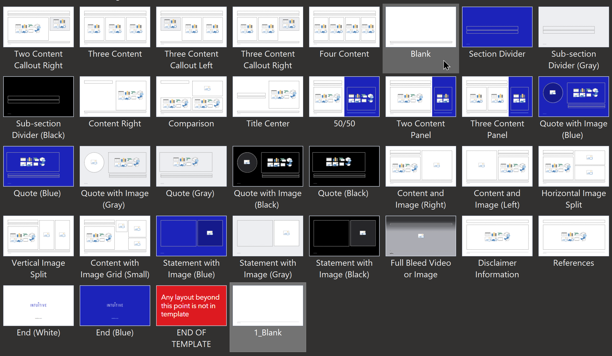

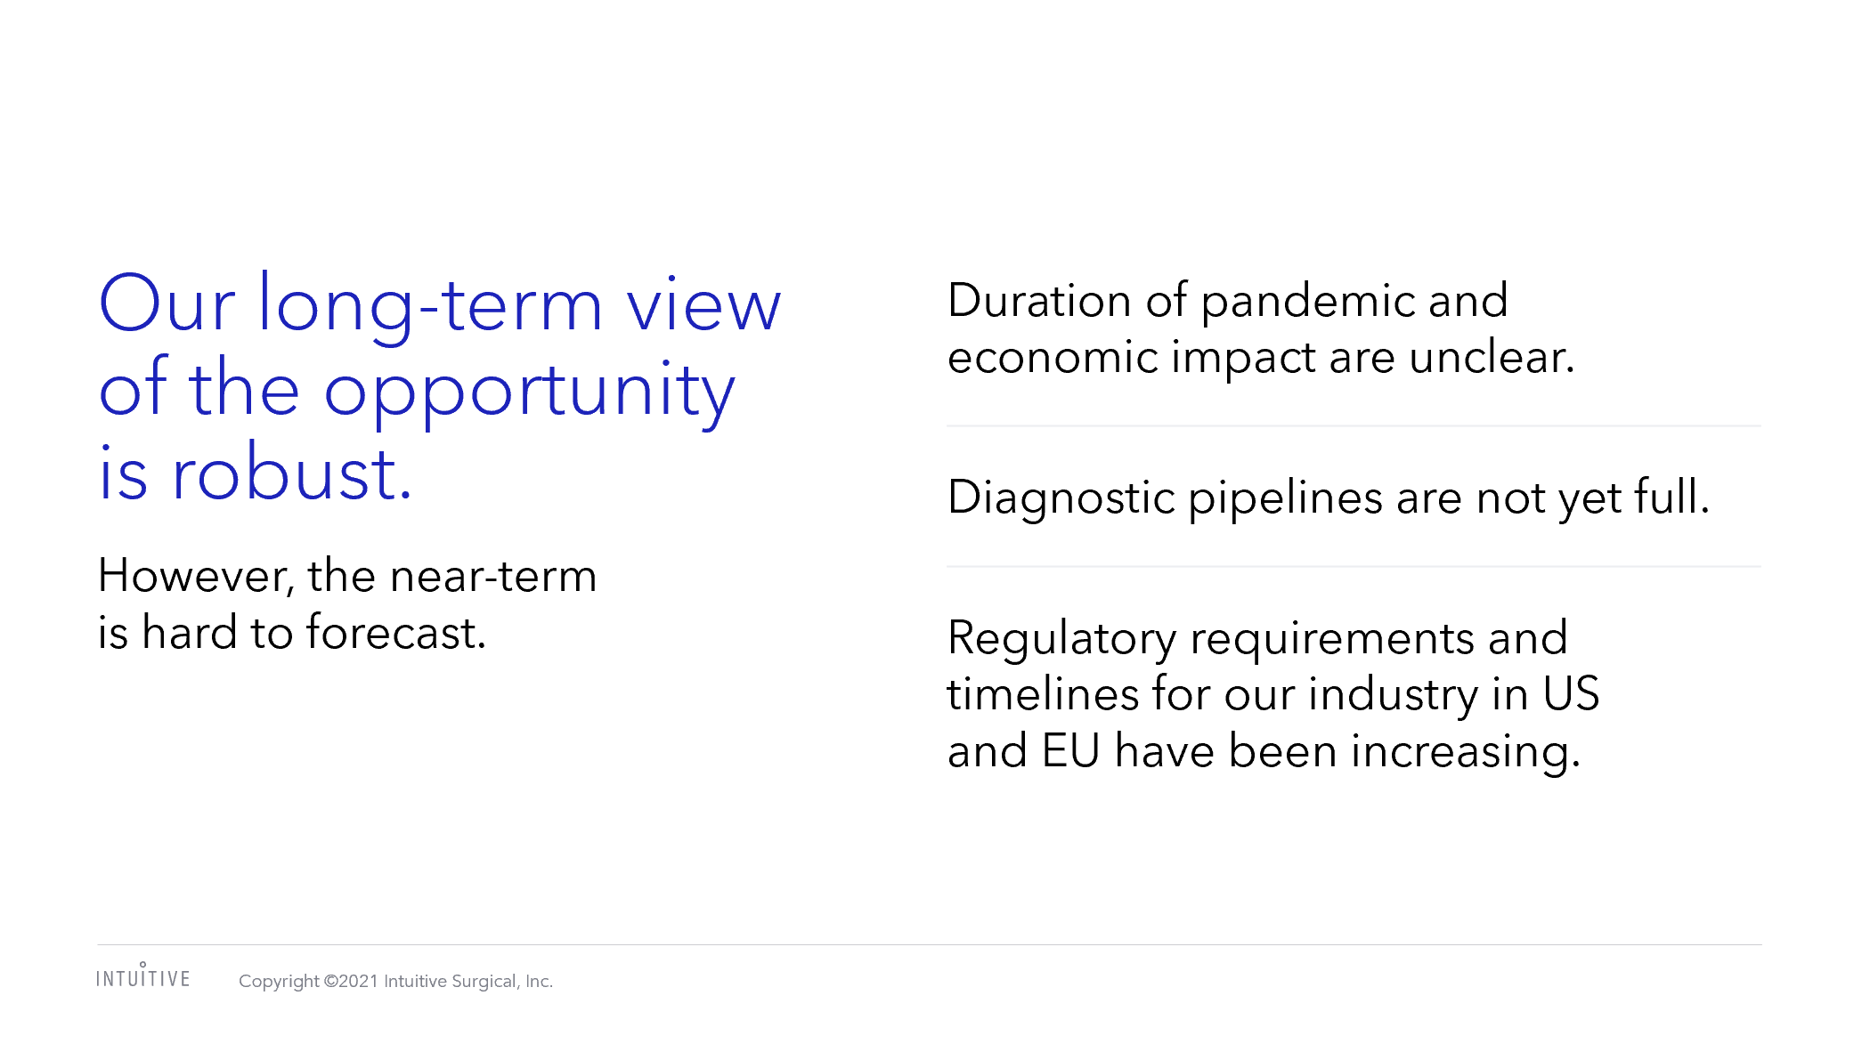
Converting content into the new template
Original slide
1. Copy and paste to destination theme
When copy and pasting slides into the new template, always right click and select “Use Destination Theme”. More than likely, a rogue layout will generate past the “Do Not Use” slide within the template. Your fonts and colors will convert but it’s not fully in template yet.
2. Choose a compliant layout and reset layout
Don’t leave your content in the rogue layout, be sure to select a proper layout within the template and “reset” your slide.
3. Reformat
Copy and paste content rather than full slides
Ideally, start with a new template layout in the 2024 template file and copy and paste your content directly into the placeholders. Reformat your text using the tabbing system.
1. Copy and pasted “to destination theme”
2. Choose proper layout and “Reset”
3. Reformat using the tabbing system

Slide 52
intuitive.com

Slide 53
intuitive.com

