Slide 1
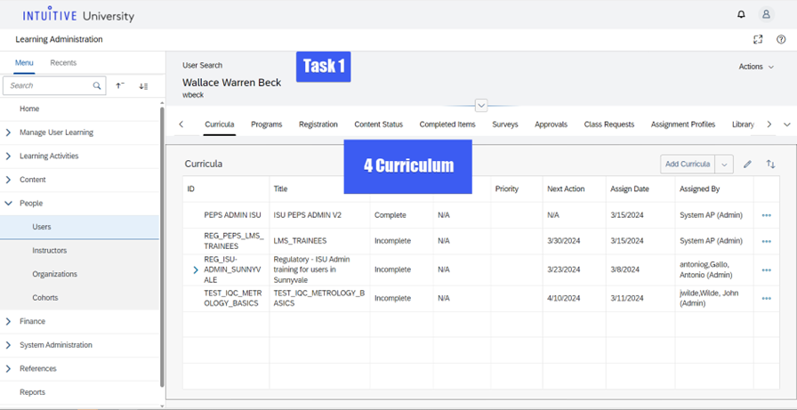
Count the number of curricula assigned.
Notes:
Count the number of curricula assigned.

Slide 2
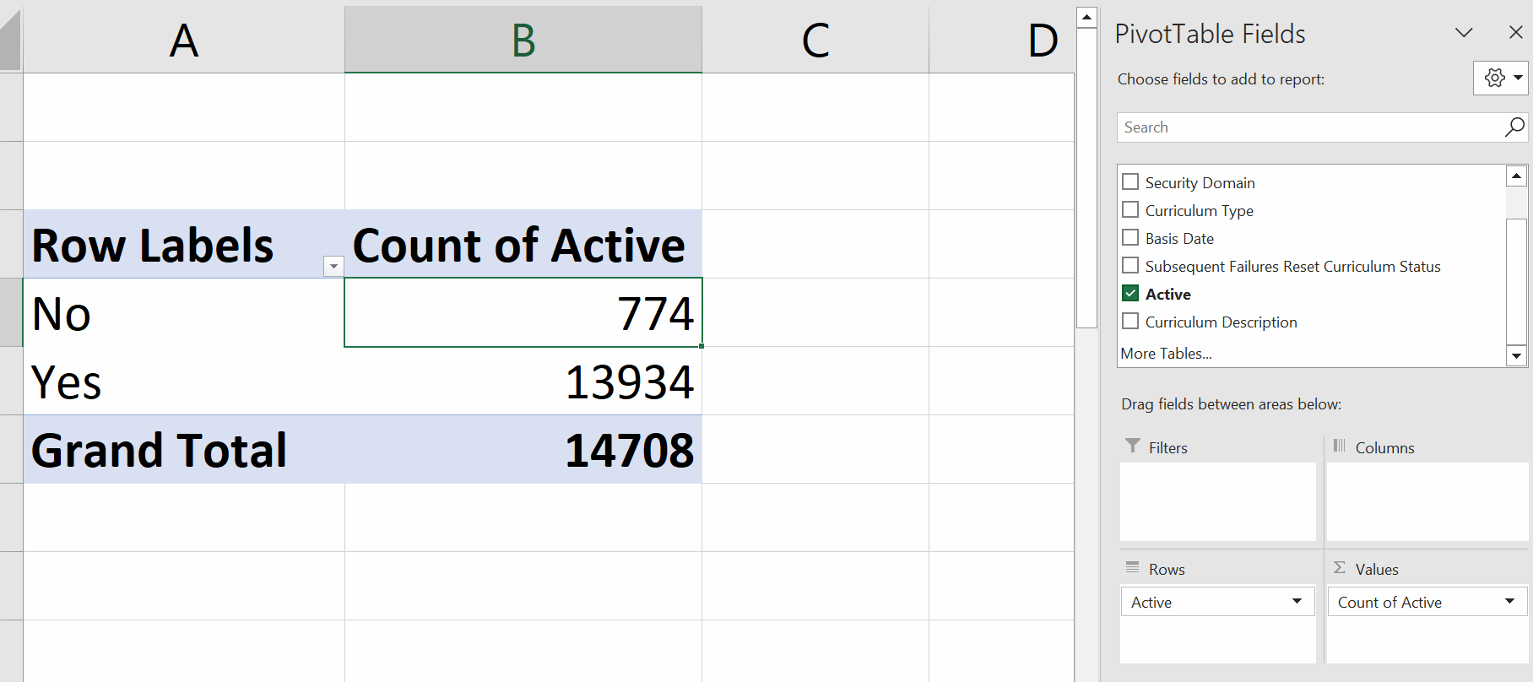
Navigate to the Curricula tab and provide a count of:
Active AGL curricula: 13934
Inactive AGL curricula: 774

Slide 3
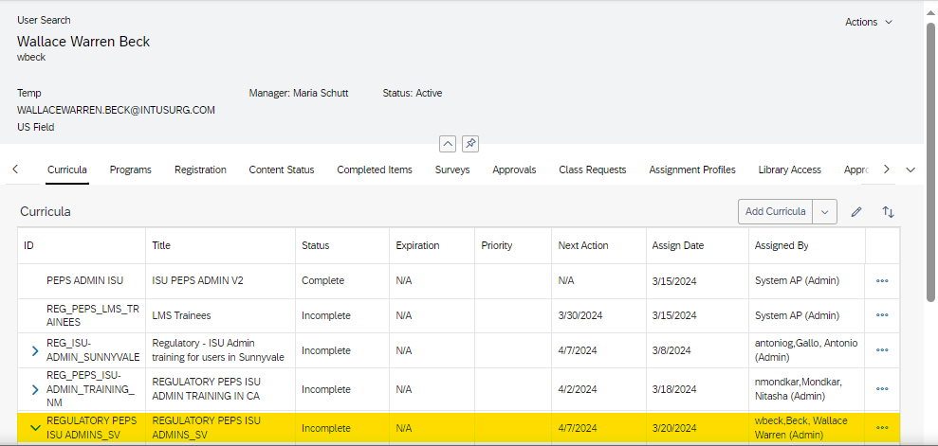
Add a curriculum to multiple users.

Slide 4
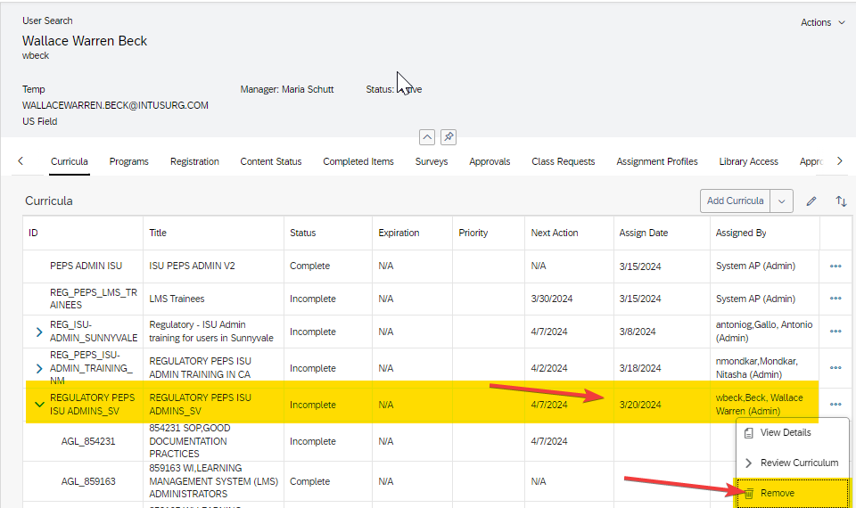
Remove a curriculum from your training requirements
Notes:
Remove a curriculum from your training requirements

Slide 5
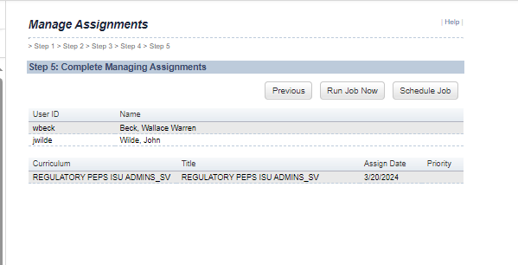
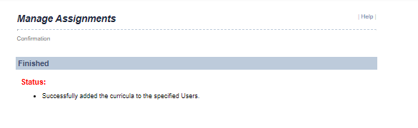
Add a curriculum to multiple users.
Notes:
Add a curriculum to multiple users.

Slide 6
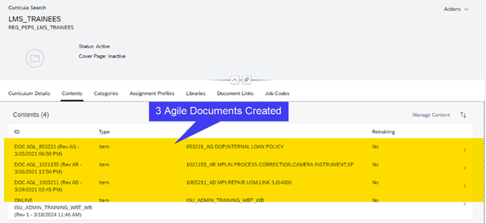
Add a curriculum to multiple users.

Slide 7
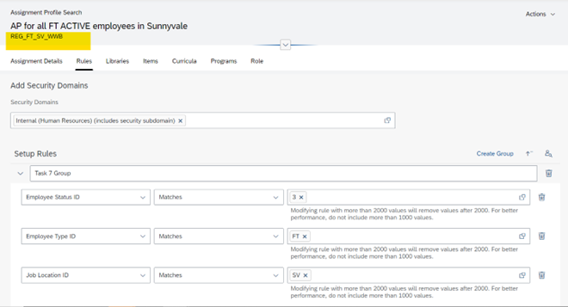
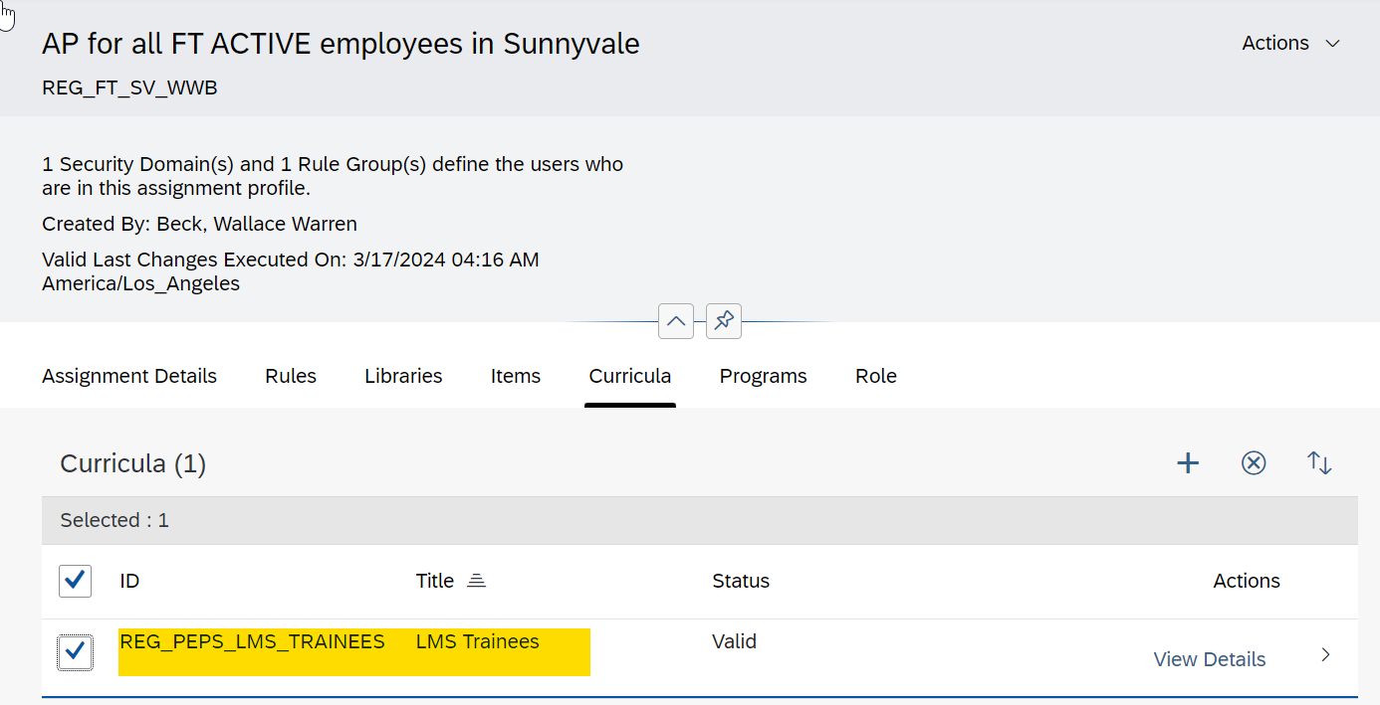
Distribute curriculum through an Assignment Profile to ACTIVE, FULL TIME employees in Sunnyvale.
Notes:
Distribute curriculum through an Assignment Profile to ACTIVE, FULL TIME employees in Sunnyvale.

Slide 8
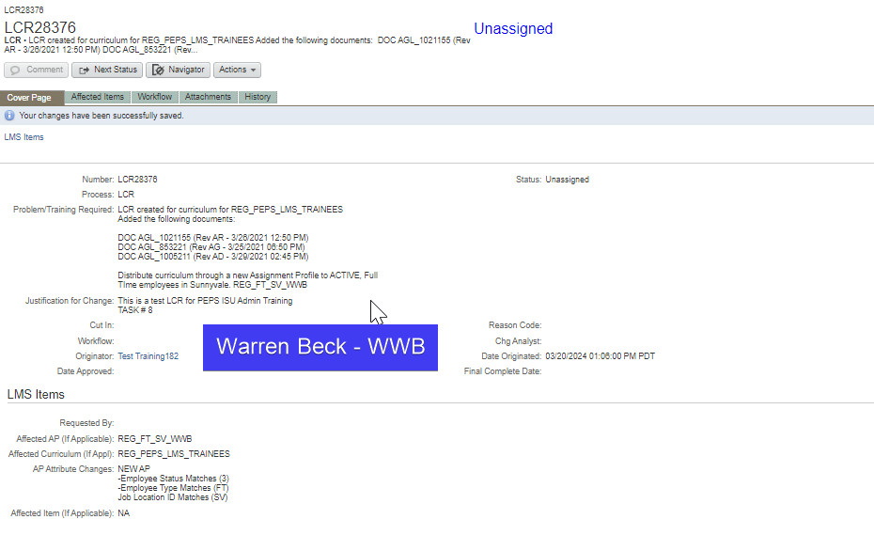
Create an LCR to document the 2 previous changes.
LCR__________

Slide 9
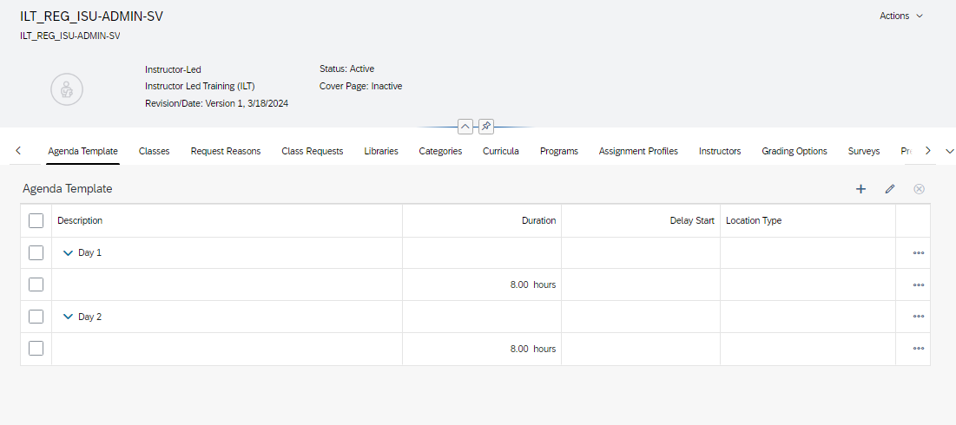

Slide 10
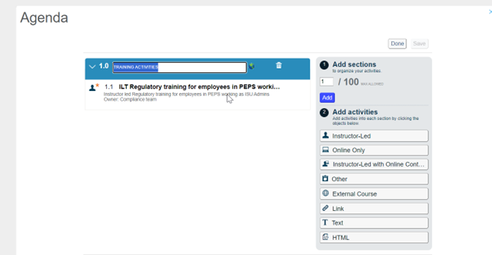
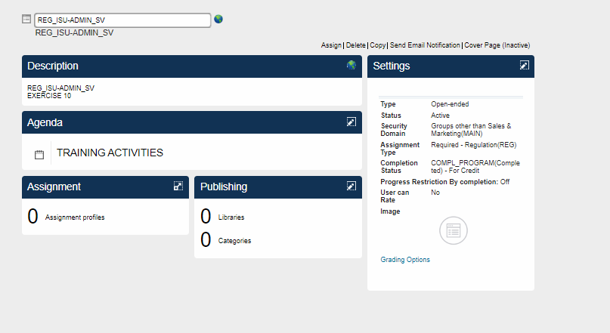
Create a Program and Add the ILT item to Program.

Slide 11
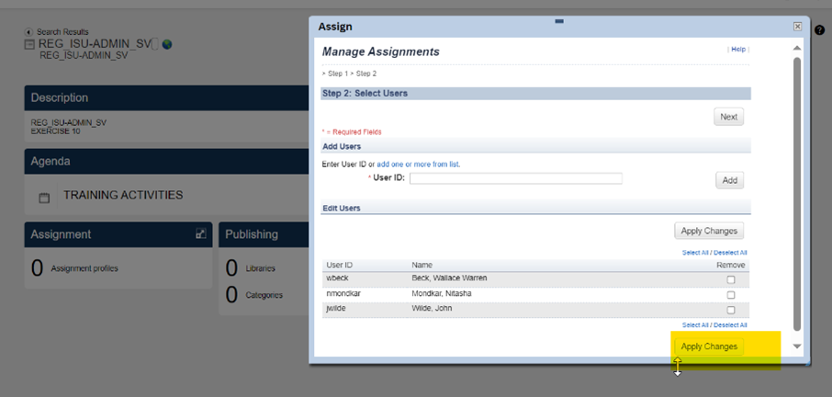
Assign the new Program to a group of users.

Slide 12
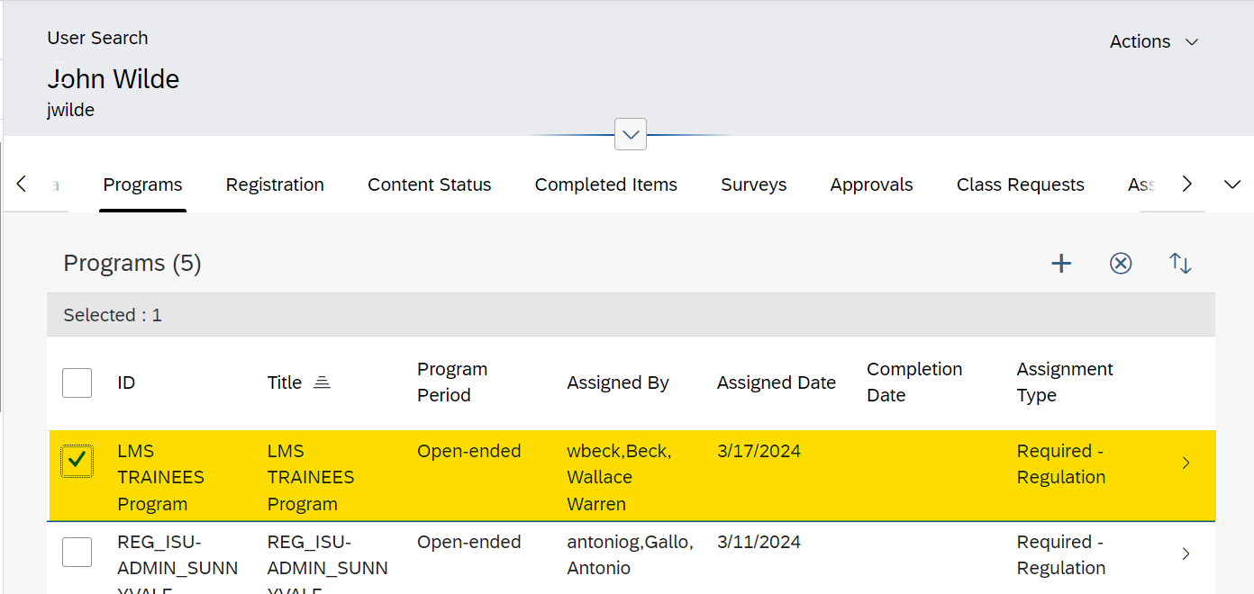
Remove the program from a user

Slide 13
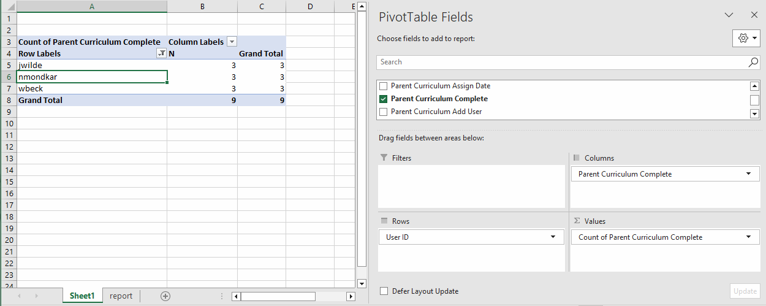
Generate a report with curriculum status for your group and enter the following numbers for Curriculum Complete results:
Yes: 3_____
No: ______

Slide 14
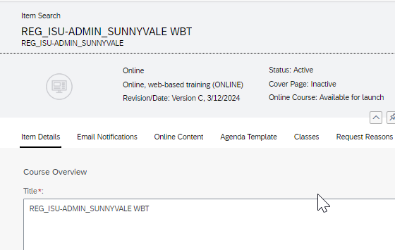
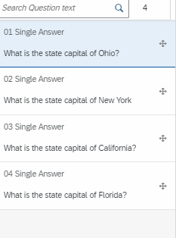
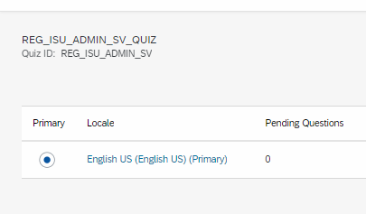
Create an assessment with 4 questions and add to an item.

Slide 15
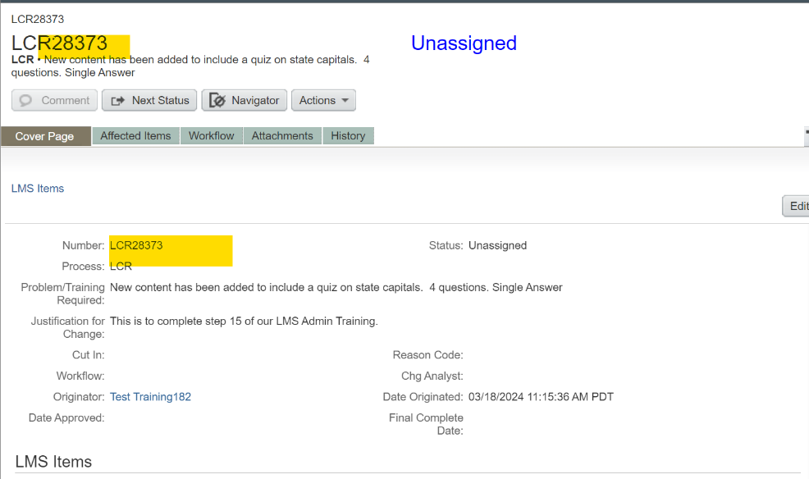
Add item with an assessment to a curriculum and generate an LCR
LCR_______

Slide 16
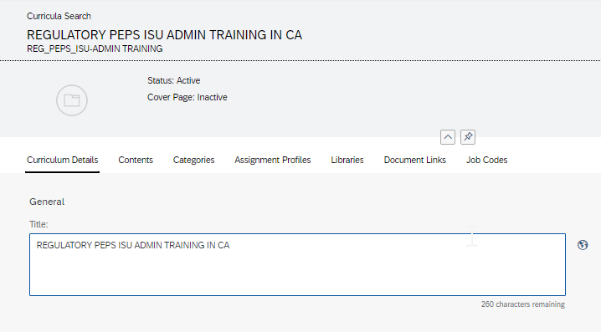
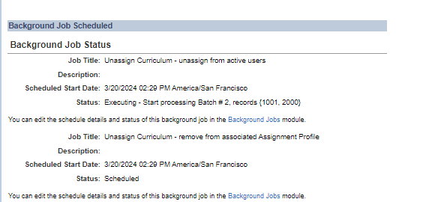
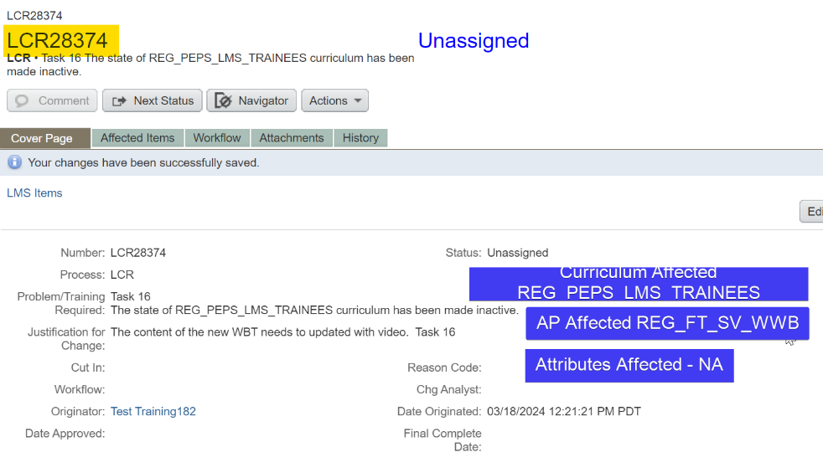
Promote a curriculum to inactive status and generate an LCR
LCR_______
Notes:
Promote a curriculum to inactive status and generate an LCR
LCR_______

Slide 17
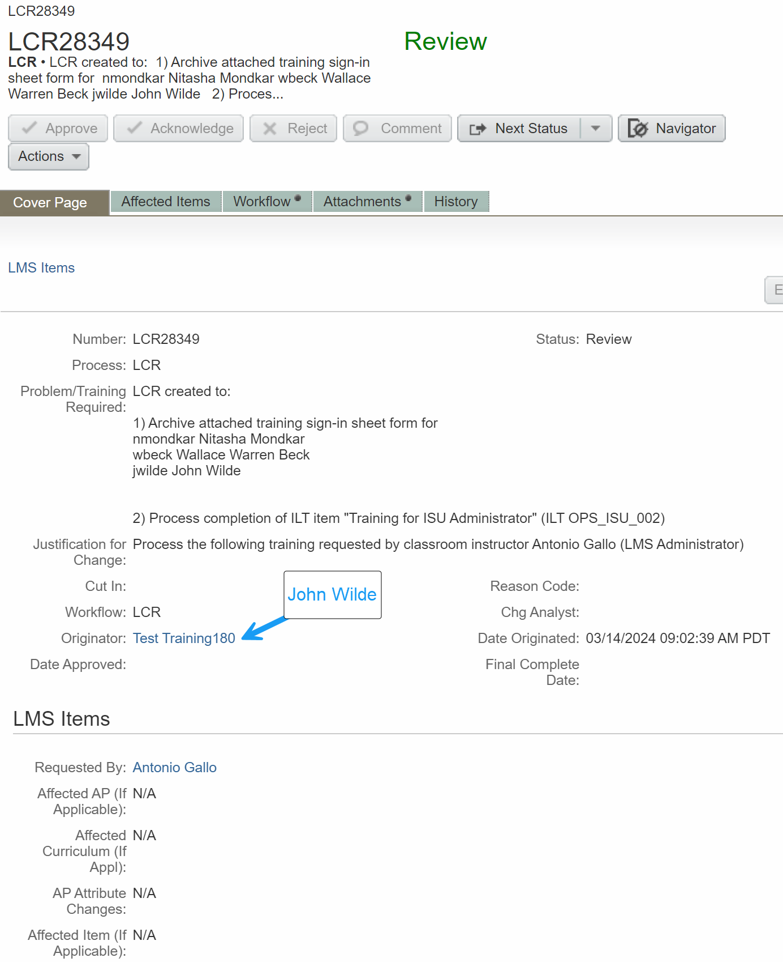
Process a "paper" training record (external training certificate, OJT tracker, classroom training sign-in sheet, proof of item completion, etc.)
WWB
Test Training 182

Slide 18
