Slide 1
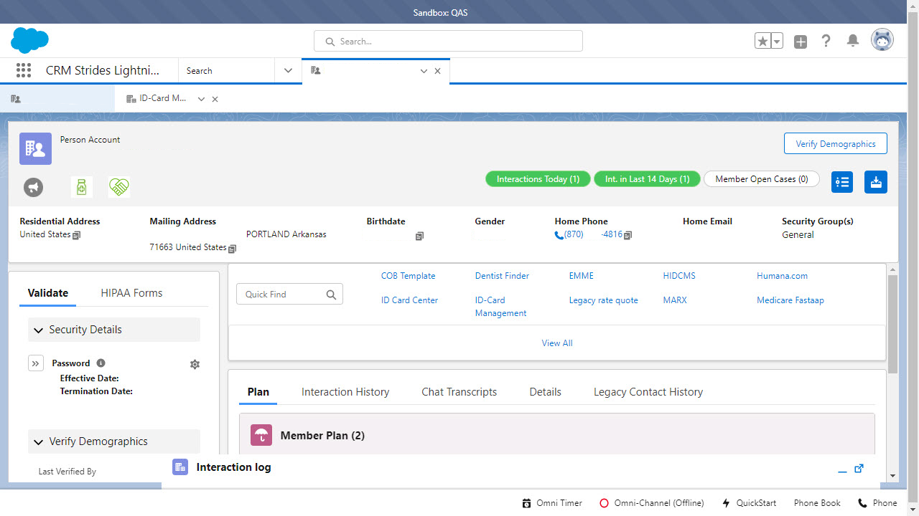
Login Menu

Slide 2
Alerts Tabs

Slide 3
Title Tab

Slide 4
Application Launcher

Slide 5
Verify Tab

Slide 6
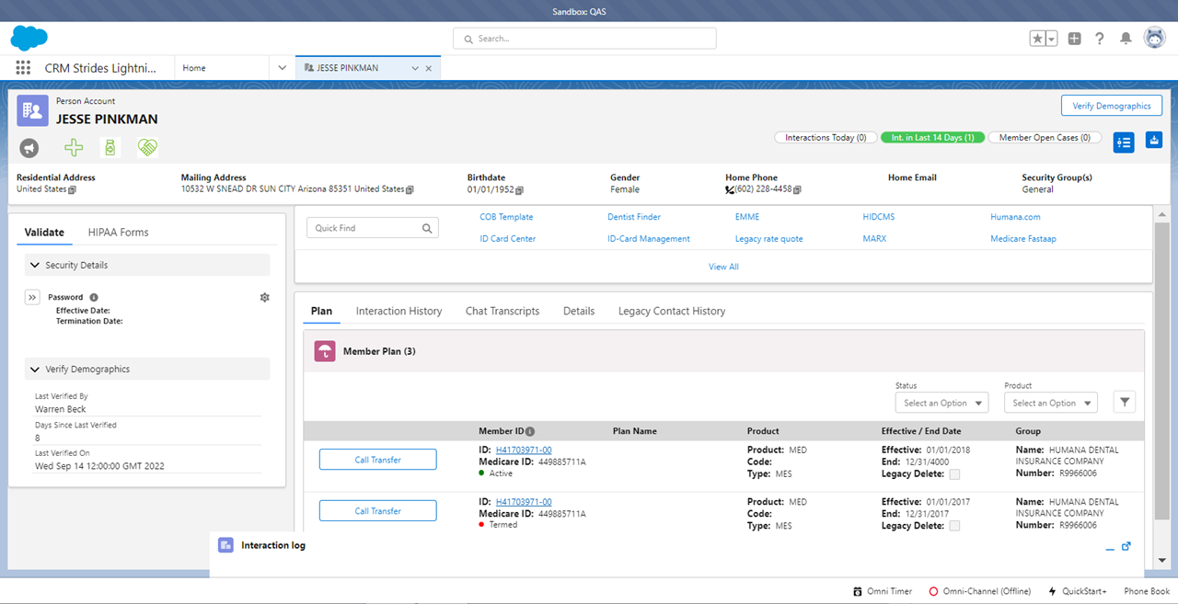
Validation Tab

Slide 7
Horizontal Tab

Slide 8
Quick Find Tab

Slide 9
Plan Tab

Slide 10
Interactions Tab

Slide 12
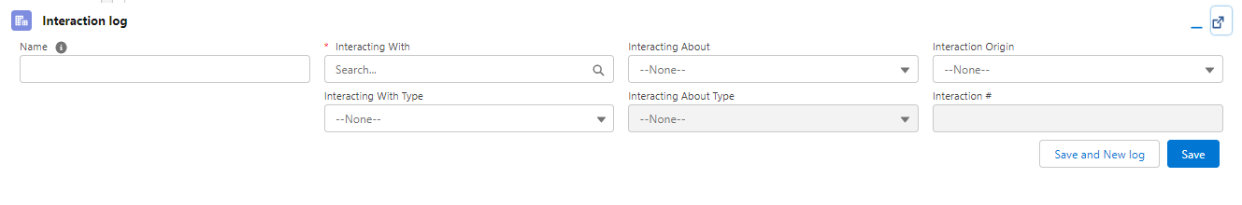
Interaction Log

