Slide 1
CRM
Home
Cases
Dashboards
Accounts
Search

Slide 2
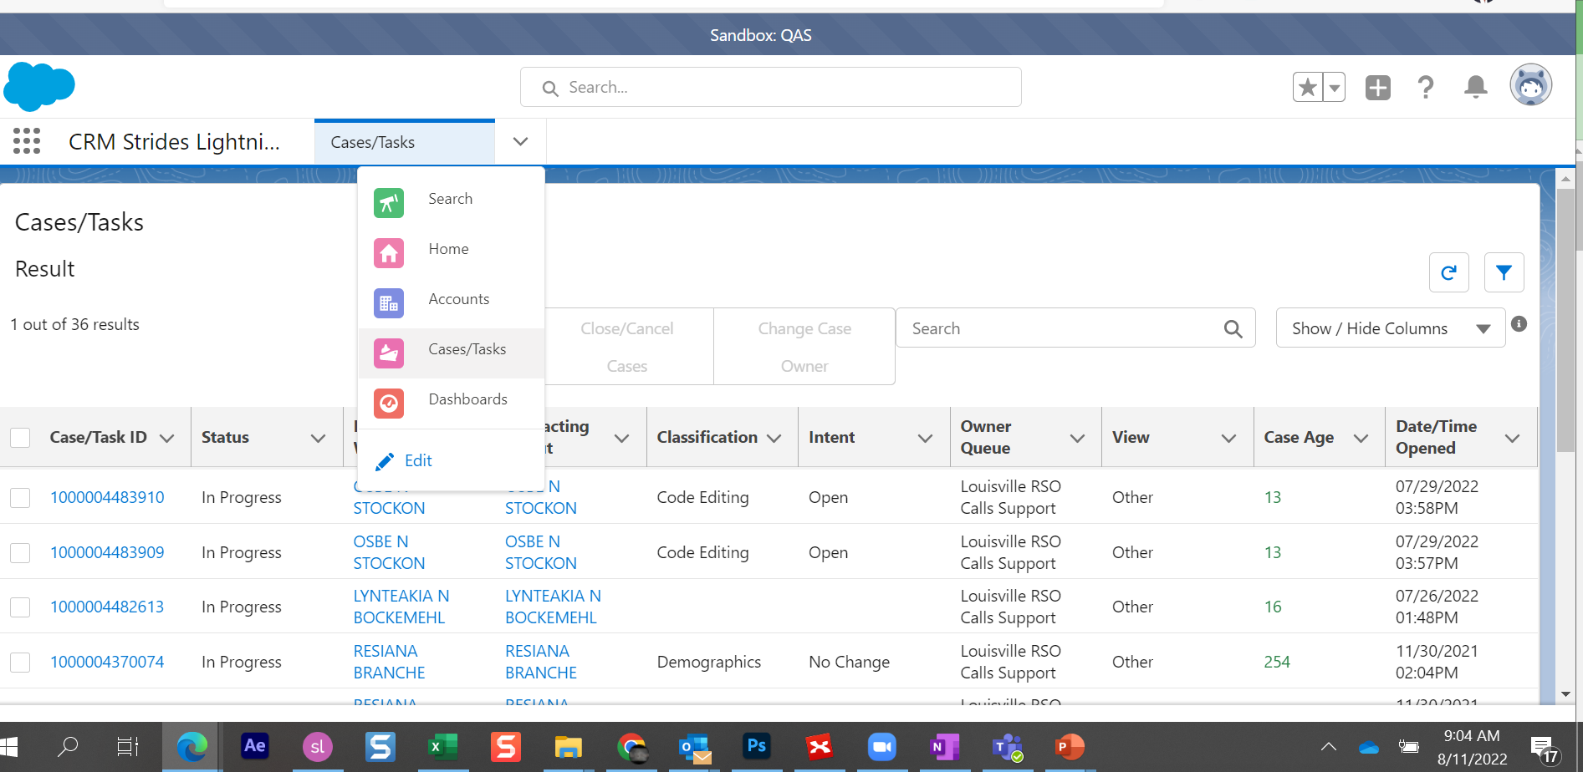
CRM
Home
Cases
Dashboards
Accounts
Search

Slide 3
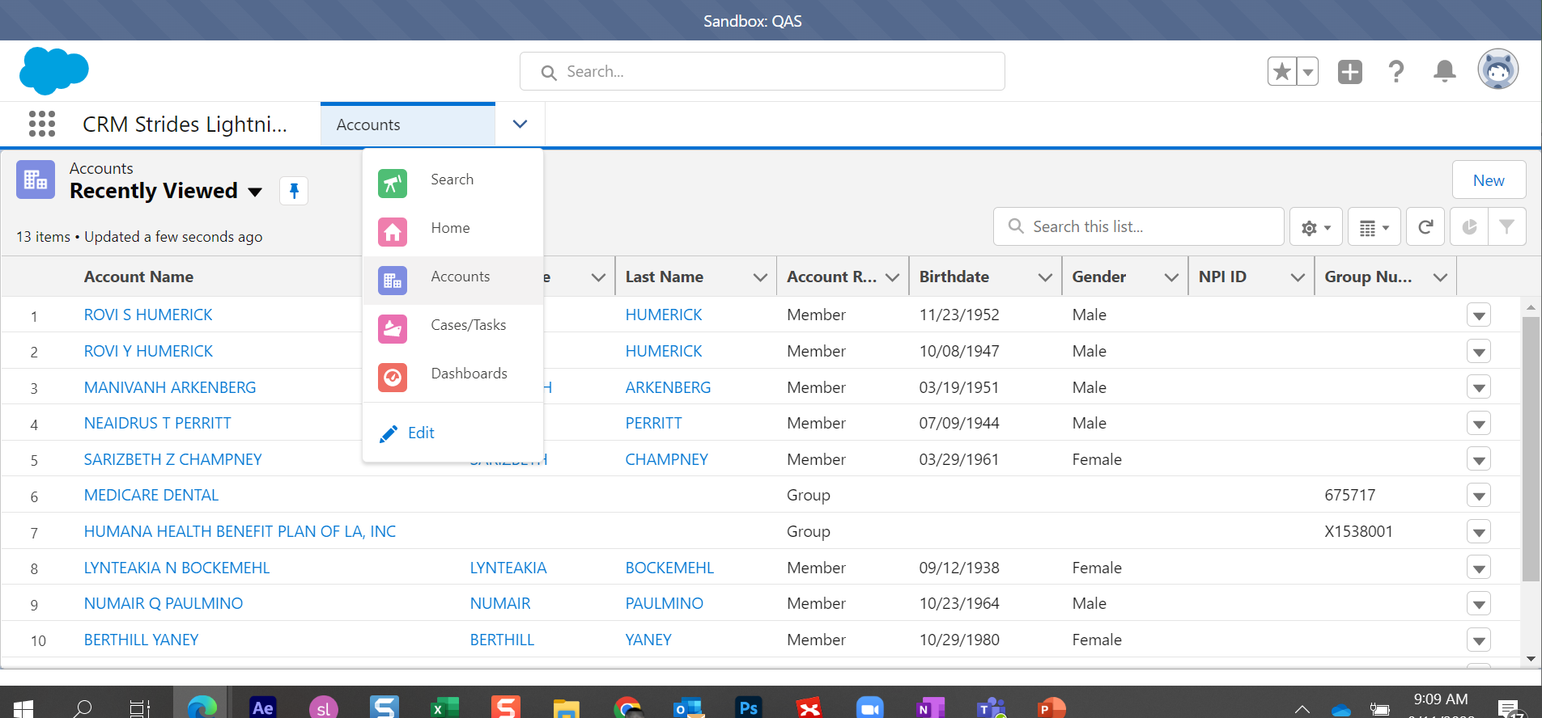
CRM
Home
Cases
Dashboards
Accounts
Search

Slide 4
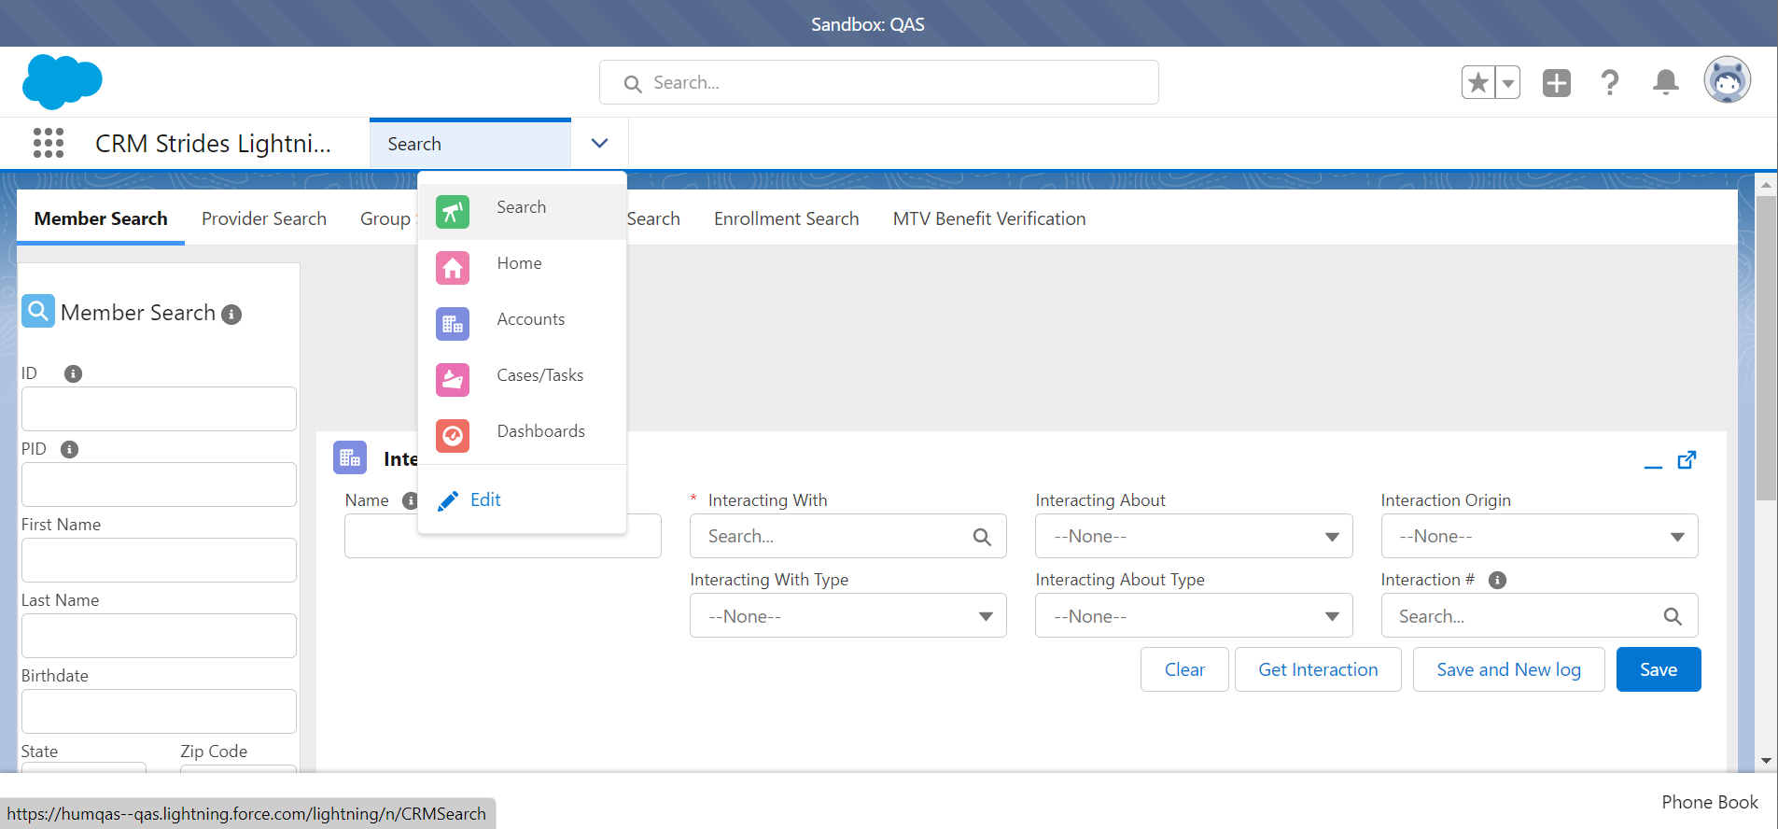
CRM
Home
Cases
Dashboards
Accounts
Search

Slide 5
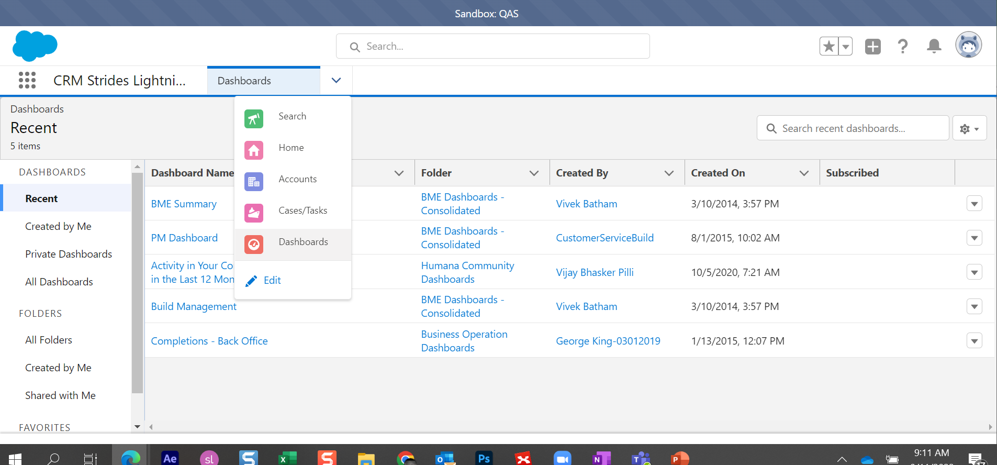
CRM
Home
Cases
Dashboards
Accounts
Search
CRM
Home
Cases
Dashboards
Accounts
Search

Slide 6
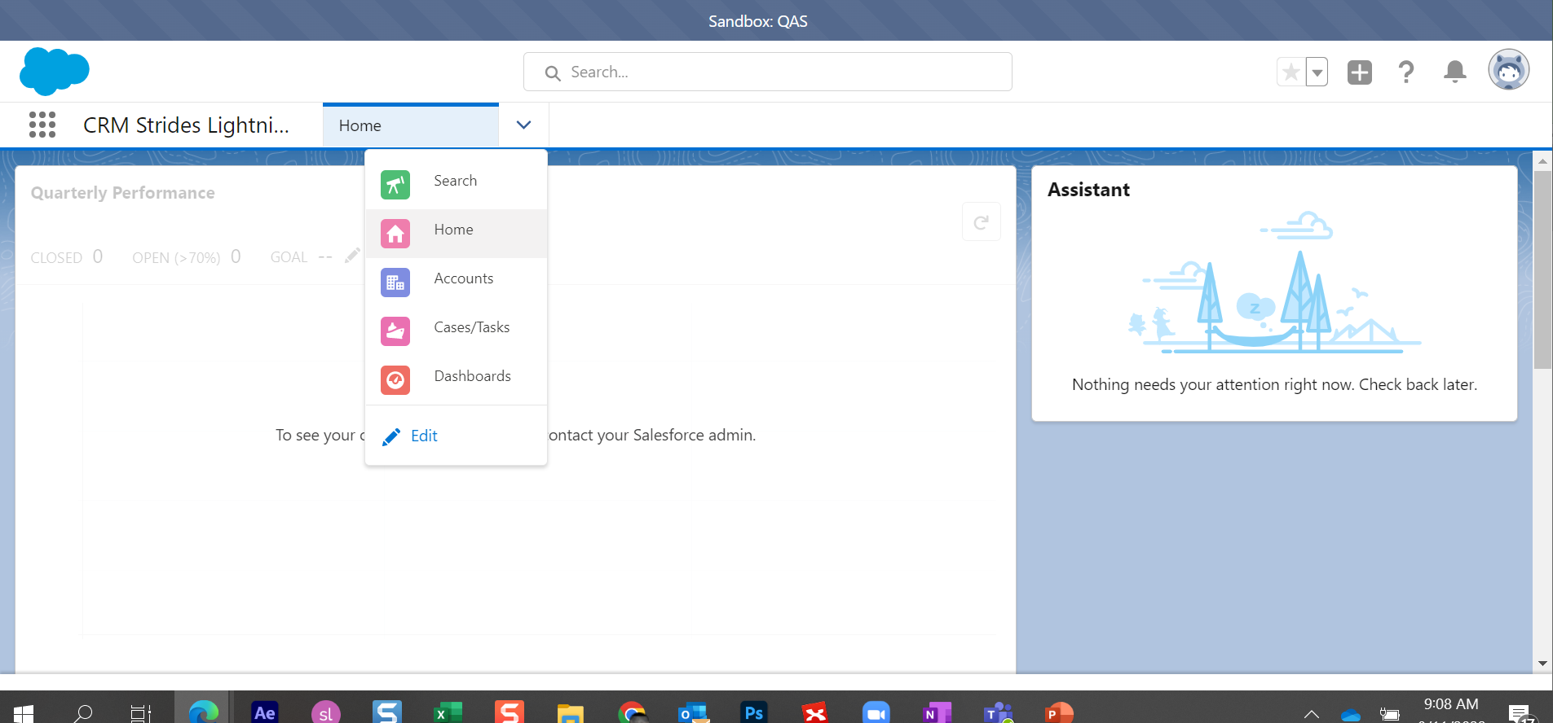
CRM
Home
Cases
Dashboards
Accounts
Search

