Slide 1

SIT Study Abroad Alumni Long-Term Impacts and Outcomes Survey
Academic Director Workshop/ Partnership Council Meeting
August 2014
Notes:
Welcome to SIT Study Abroad 101 information session
Thanks for coming during busy conference
Hope to give you an overview so you have a better understanding of what SIT has to offer

Slide 2
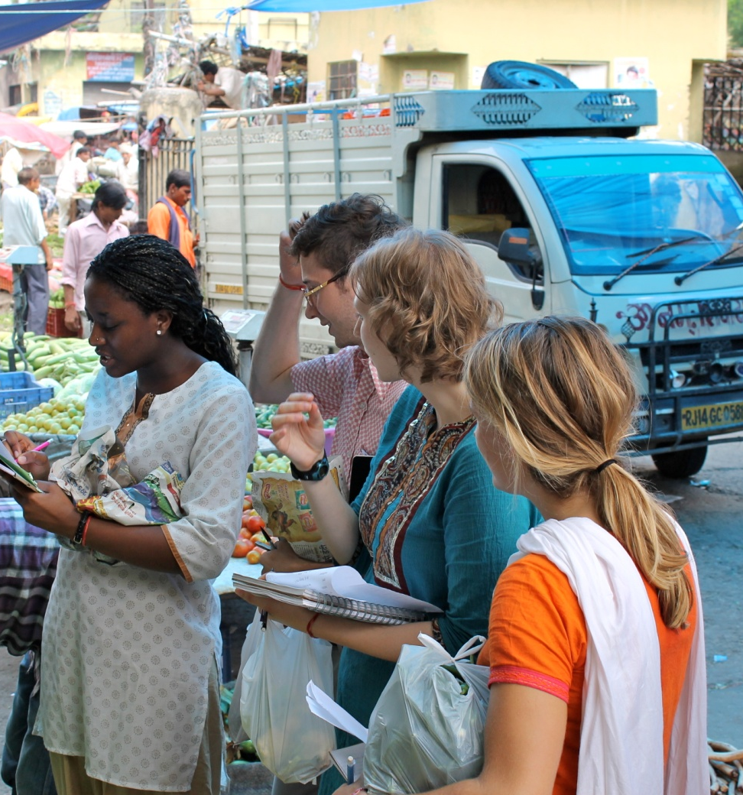
SIT ALUMNI SURVEY
16K alumni from 1982-2011, 2107 responses, 13% response rate
Career Impact
72% experience influenced career
choice to some or large degree
81% experience helped gain a sense of
social responsibility or interest in social
issues that influenced career choice
72% experience helpful in job interview
59% have continued to engage with
issues explored in their ISP
Notes:
Results in programs that are different from typical study abroad programs

Slide 3
SAGE STUDY
2006 University of Minnesota
55.8% overall said occupation/career choice influenced to a large or some degree by study abroad
SIT only rate goes up by 20% to 75%

Slide 4
SIT China alumni quote
“It’s definitely an interesting and attractive line on my resume. Even if it’s not directly related to jobs that I’m applying for, employers have often asked about it and have been interested in hearing about my research projects. I think it helps demonstrate my ability to navigate new situations and be self-directed in completing a major project.”

Slide 5
“The ISP set the trajectory for the work I love and will continue throughout my career.” (SIT Kenya 2007 alumna)

Slide 6
Academic Impact
75% found SIT experience useful in applications or interviews for graduate programs
64% reported SIT experience influenced their decision to pursue an advanced degree
67% have earned or are currently pursuing an advanced degree

Slide 7
Health/Environment
Health program alumni report that study abroad had much higher rate of influence on career choice than average
Career choice dominated by health/medical fields
Earned advanced degrees at higher rate, 99%
12% on health programs, 18% health focus overall for advanced degrees

