Slide 1
RM 03-11

Slide 2
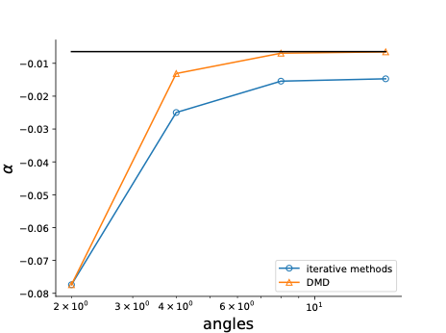
K-alpha
For coarse meshes, DMD converges better than power iteration
Fluke?

