Slide 1

Reptile: Aggregation-level Explanations for Hierarchical Data
汇报人：魏伯繁
2022年12月1日

Slide 2
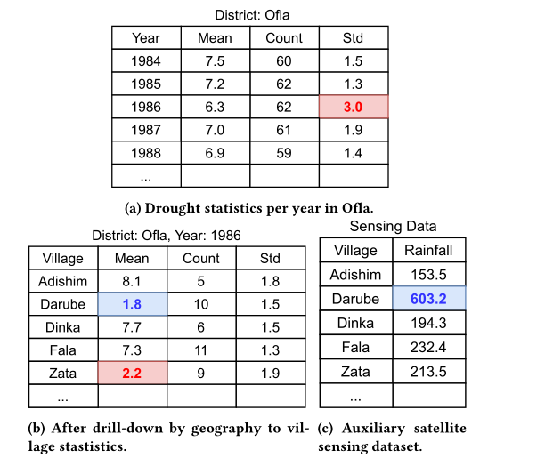
PART 1 PROBLEM
Tables are made by aggregating
Hierarchical struct && Attribute
Htime（YEAR,MONTH）
HGEO（District，village）

Slide 3
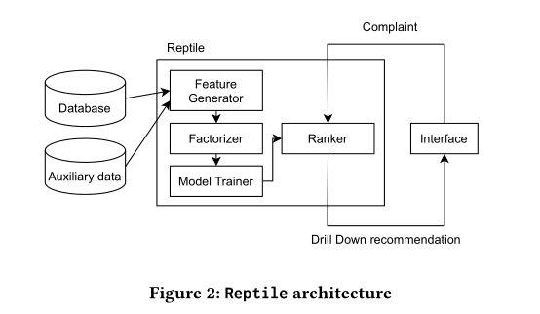
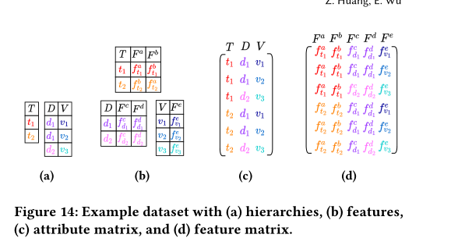


PART 2 OVERVIEW & FEATRUE GENERATOR

Slide 4
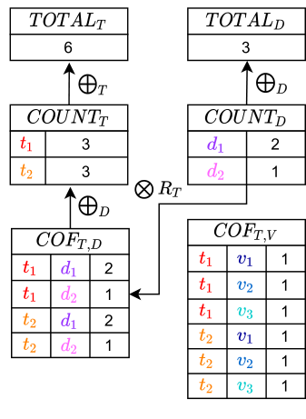
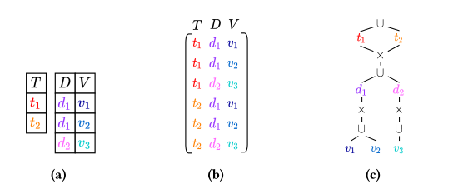
PART 2 FACTORIZER

Slide 5
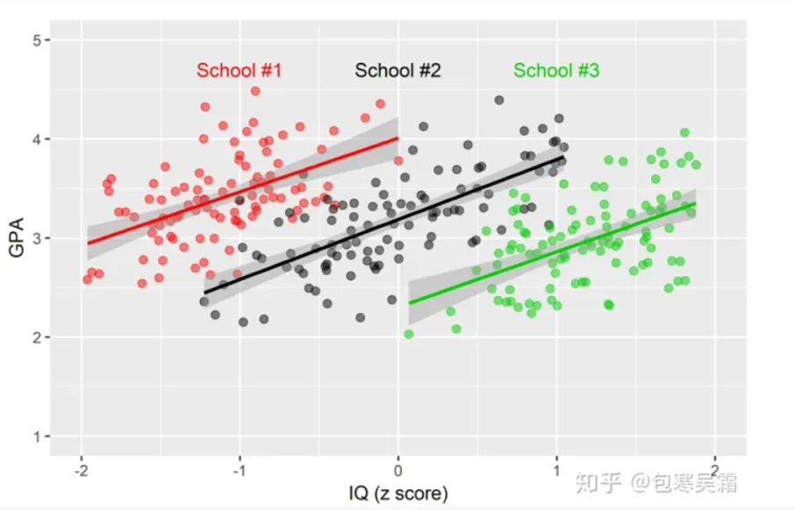


PART 2 REPAIR

Slide 6
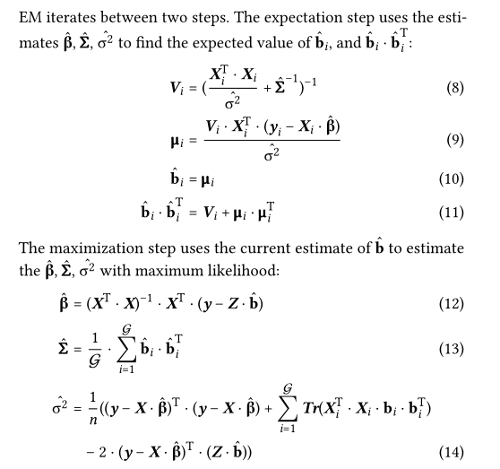


PART 2 REPAIR

Slide 7
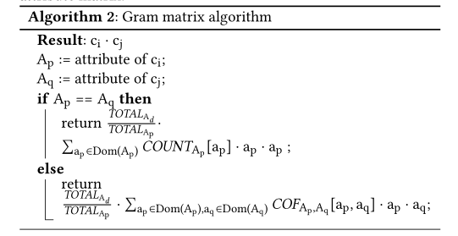
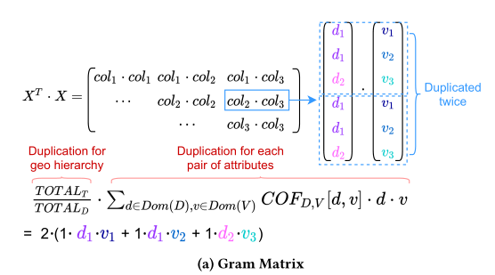
PART 2 ME ALG

Slide 8
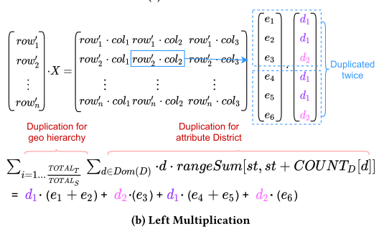
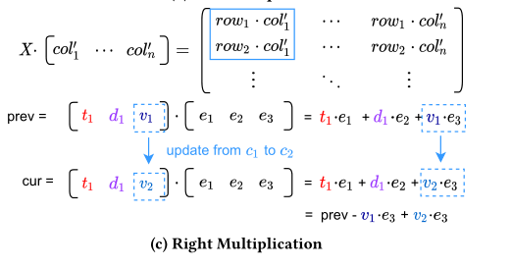
PART 2 ME ALG

Slide 9
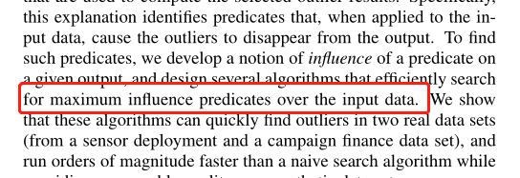


PART 2 EXP
Sensitivity
support
RAW

Slide 10
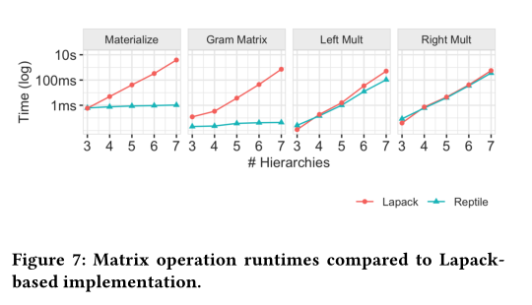
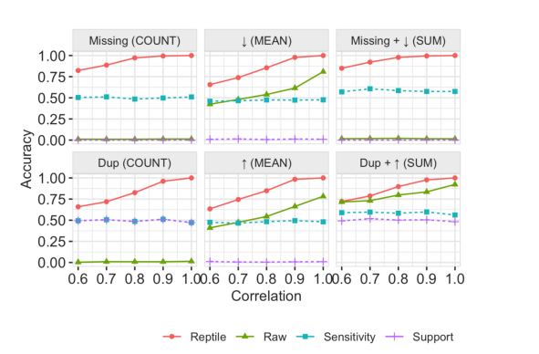

PART 2 EXPERIMENT

Slide 11
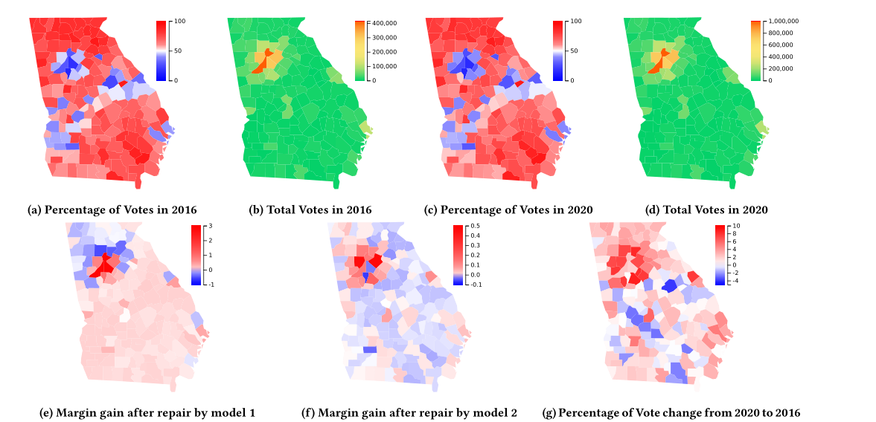
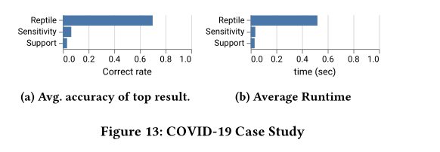
PART 2 EXPERIMENT

