Slide 1
CurrentClean 依据时空关系的陈旧数据清洗
汇报人：魏伯繁
时间：2022年9月15日

Slide 2
Data Currency
Out-of-date or stale data occurs when changes to an entity in the real world are not captured in the database due to missing or incorrect updates.
t1 | 100 | 100
t2 | 200 | 200
t3 | 300 | 200
t4 | 450 | 200

Slide 3

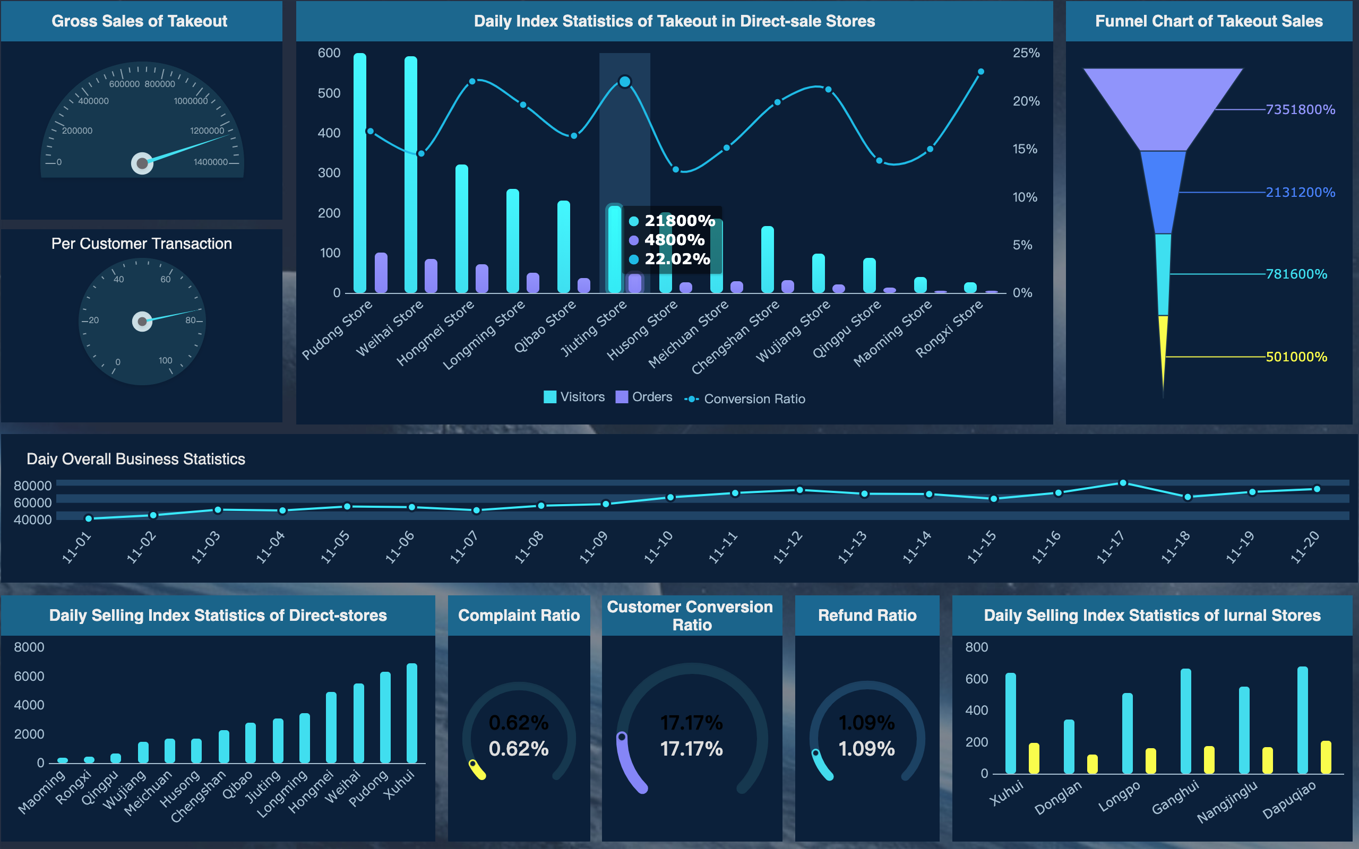
Importance

Slide 4
constraint-based repairs
t1 | 100 | 100
t2 | 200 | 200
t3 | 300 | 200
t4 | 450 | 200

Slide 5
coupling with master data
t1 | 100 | 100
t2 | 200 | 200
t3 | 300 | 200
t4 | 450 | 200
t3 | 300 | ---
t4 | 450 | ---

Slide 6
captrue semantics
t1 | 就业 | 6000
t2 | 下岗 | 2000
t3 | 下岗 | 2000
t4 | 下岗 | 10000

Slide 7
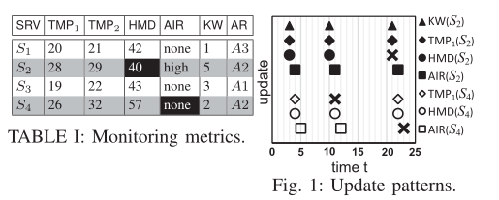
Spatio-Temporal&&correlated updates

Slide 8
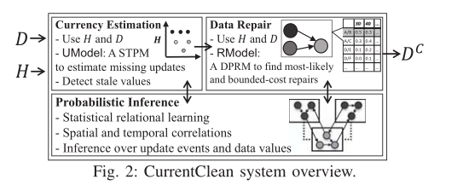
overview

Slide 9
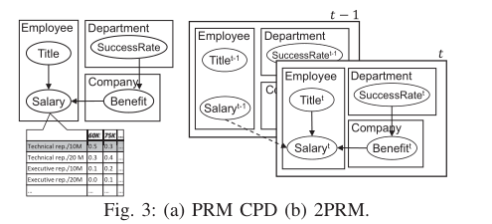
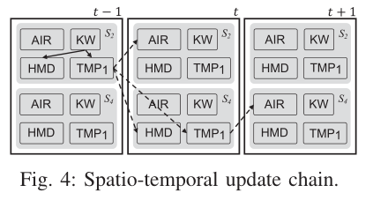
STPM(Umodel)
specifies the joint probability distribution of updates over a database at different times.

Slide 10



RModel
RModel captures the joint probability distribution of
database instances Dt for t ∈ [0, T ].

Slide 11



Detect&&Repair
MLR
We assume a user-given currency threshold β
that is used to select stale cells in E with current(c) < β.
BCR

Slide 12
detect
t1 | 100 | 100
t2 | 200 | 200
t3 | 300 | 200
t4 | 450 | 200
@weight（w6）=1 p(6)=0.7
@weight（w7）=1 p(7)=0.8
@weight（w8）=0.1 p(8)=0.1
threshold=0.01
t3时：0.3*0.2=0.06
t4时：（0.3*0.3）*（0.2*0.2）=0.09*0.04=0.0036

Slide 13
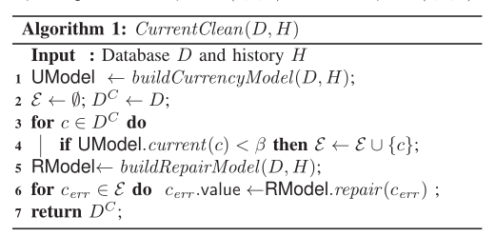
Algorithm overview

Slide 14
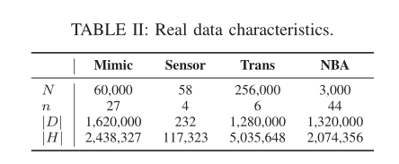
Real data characteristic
Intel Xeon CPUs E5-2687W v4
3.00GHz
32GB of memory.

Slide 15
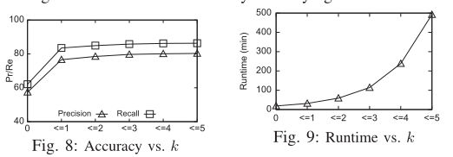
OPT
base0：use rmodel only on ε
base1：limit the link length（Mimic data）

Slide 16
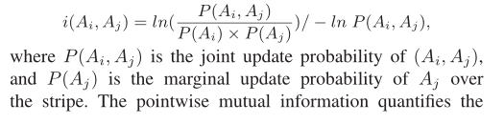
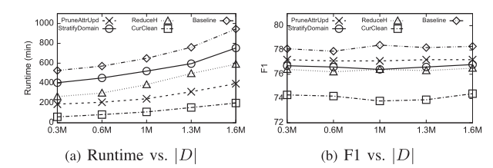
OPT
base2:use 2-variable rules only
opt1：Pruning Weakly-Correlated Attributes
opt2：Partitioning the Attribute Domain
opt3：Reducing the Size of H

Slide 17
prune
t1 | 100 | 100
t2 | 200 | 200
t3 | 300 | 200
t4 | 450 | 200
@weight（w6）=1 p(6)=0.7 f=0.45
@weight（w7）=2 p(7)=0.8 f=0.45
@weight（w8）=0.1 p(8)=0.1 f=0.45
threshold=0.01
0.45*1=0.45
0.45*2=0.9
0.45*0.1=0.045

Slide 18
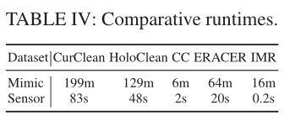
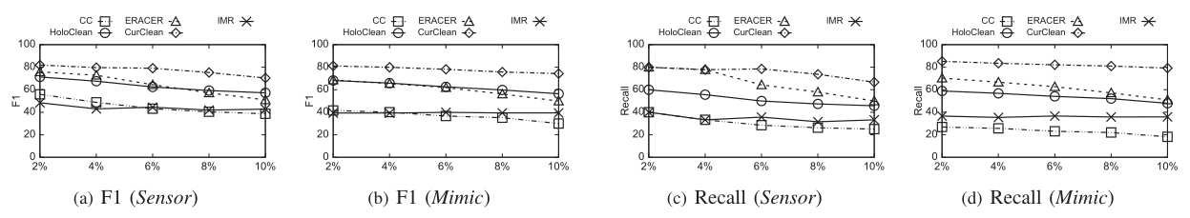
Contrast
Currency Constrains
HoloClean
IMR
ERACE

