Slide 1
Leveraging Currency for Repairing Inconsistent and Incomplete Data
IMP3C
汇报人：魏伯繁

Slide 2
PROBLEMS
CURRENCY(timestamp missing)
CONSISTENCY（violate CFD）
COMPLETENESS（missing value）

Slide 3
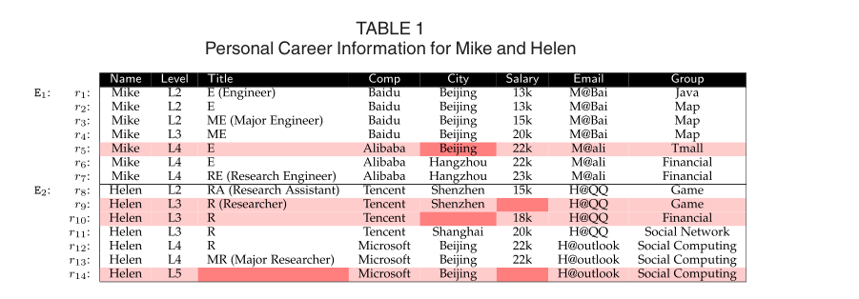
RELATED WORK
With precise timestamps in database, data cleaning tasks such as constraint-based data repairing can be solved by the state-of-art data cleaning methods
shortcomings of existing data repairing methods without leveraging currency issues.

Slide 4
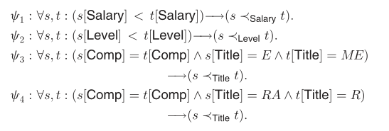
currency constraint
1、constant defined
2、op defined
3、other cc defined

Slide 5
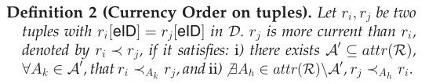
Currency Order on tuples
NO CONFLICT
S
T
S
T

Slide 6
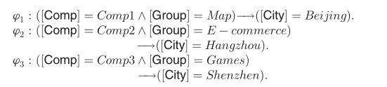
CFD

Slide 7
overview of IMP3C
construct currency order graphs
determine the currency order
do inconsistent repair
repair the incomplete values with Bayesian strategy in the final step

Slide 8
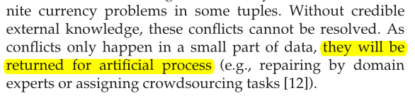
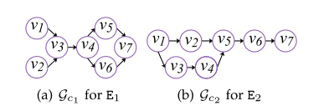
construct currency order graphs

Slide 9
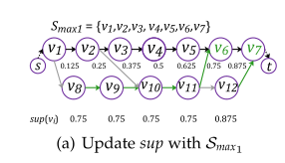
determine the currency order
we need to find out the maximal currency order chain Smax with the longest depth on Gc between two nodes

Slide 10
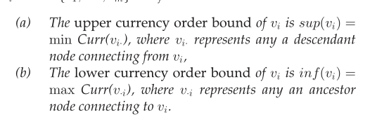
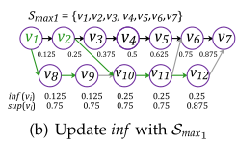
determine the currency order

Slide 11
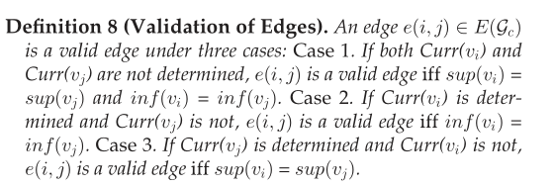
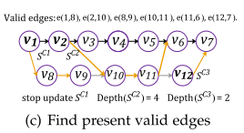
determine the currency order
For the equidistant assignment to be feasible, all nodes in the chain must have inherited the same constraints on the range of possible timestamps from their predecessors and successors.
1、both undifined：same sup & inf
2、i difined：inf(i)=inf(j)
3、j difined:sup(i)=sup(j)

Slide 12
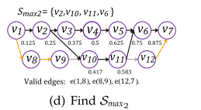
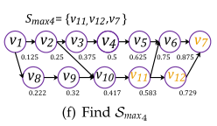
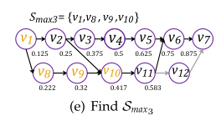
determine the currency order
Discovering the Maximal Chain

Slide 13
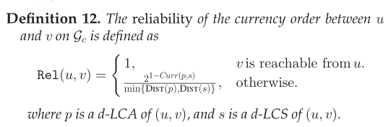

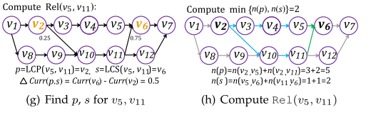
The Reliability of Currency Order Pairs

Slide 14
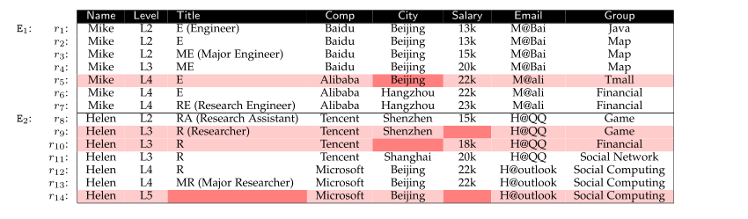



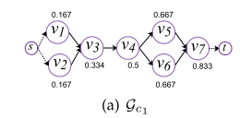


INCONSISTENCY REPAIR
dist=0.2
μ=0.4
$$0.4×\frac{2}{3}+（1−0.4）×\frac{0.167}{2}=0.32$$
$$0.4×\frac{2}{3}+（1−0.4）×\frac{0}{2}=0.27$$

Slide 15


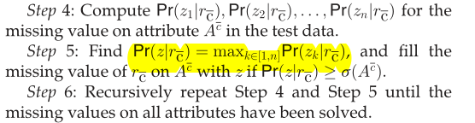

INCOMPLETENESS REPAIR
In the former step, the missing attribute values in tuples detected by Σ are treated as a kind of violation in data consistency.
Construct the training set with the complete tuples
discretize continuous variables in attr(R) and currency values into intervals with
categorical variables

Slide 16
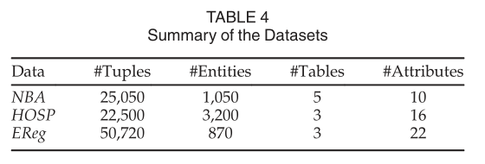
EXPERIMENTAL STUDY
CCs and CFDs according to methods proposed in Certain methods
置信下线：0.9
μ=0.6
dist=0.2

Slide 17
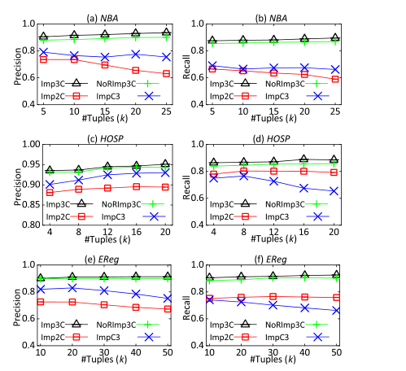
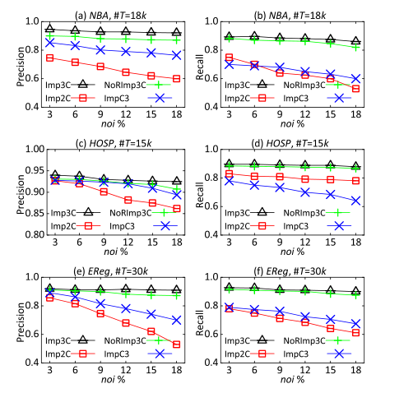
Vertical contrast

Slide 18
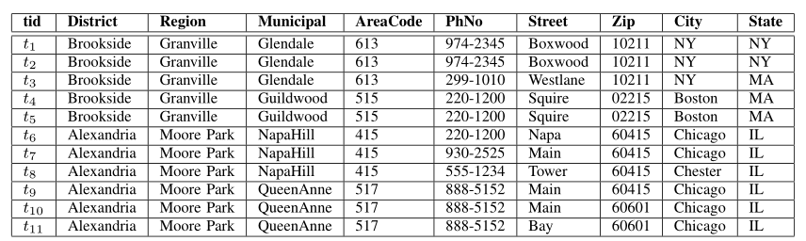
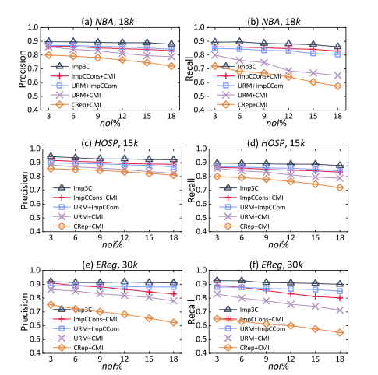
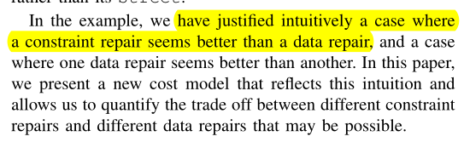
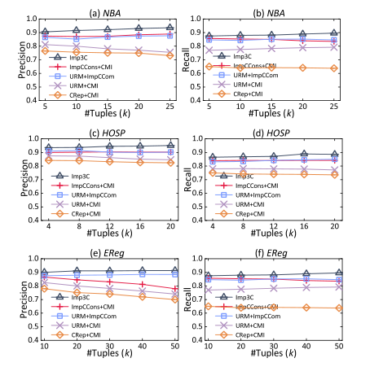
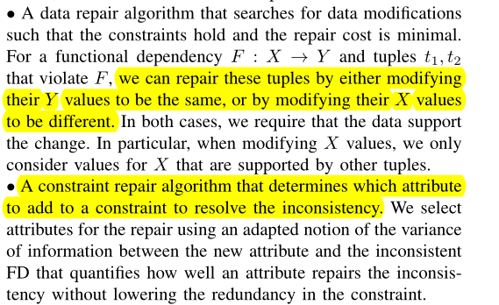

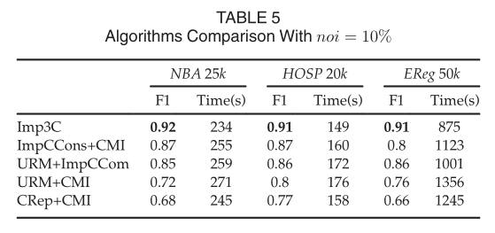
Horizontal contrast
ImpCCons+CMI
URM+ImpCCom
URM+CMI
CRep+CMI
IMP3C

