Slide 1
Project 1: Cancer Deathrate prediction using Linear Regression
By: Barker French

Slide 2
Introduction
1.8 Million Americans will be diagnosed with cancer in 2020
600,000 Americans will die from Cancer in 2020.
Death rates vary dramatically across the country
Pitkin county, Colorado: 60 people in 100,000 will die
Union county, Florida: 360 people in 100,000 will die
Can socio-economic variables predict cancer deathrates?

Slide 3
Data set
Source: https://data.world/nrippner/ols-regression-challenge
31 Numeric predictors: (Disease, Insurance, Education, Population, race, Income, Age)
1 Numeric Response: target_deathrate (County-Level Deathrate per 100,000 people)
Average Annual Deathrate: 178
3047 observations at the county level
Data are Originally sourced from 2013 Census, and 2010-2016 Cancer.gov and clinialtrials.gov

Slide 4
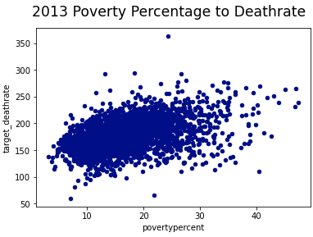
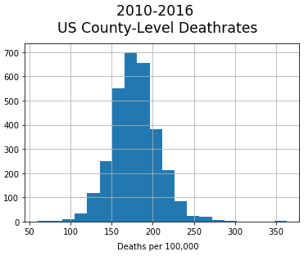
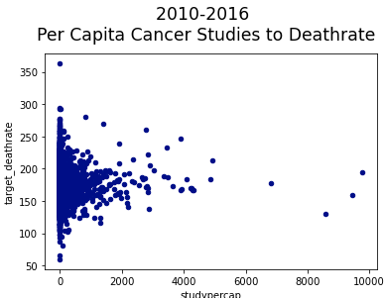
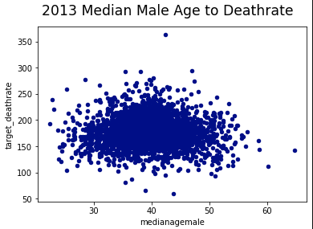
Exploratory data analysis
Response Variable
Normal Distribution
Outliers
Predictor-Response Relationships
Weak Linear :
16 Predictors
Funnel Shape:
9 Predictors
No Observable Relationship:
6 Predictors

Slide 5
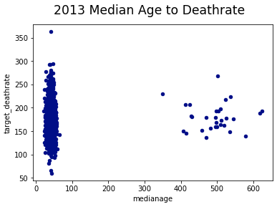
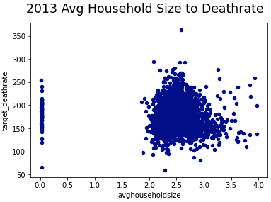
Data Cleaning
Response Variable:
Drop 56 observations 1.5x IQR
Median Age:
Drop 30 observations > 100 years
Average Household Size:
Drop 61 observations < 1

Slide 6
Feature Engineering
Drop Variables with Null Values:
Percentage people with some college between 18 and 24
Percentage of people 16 and older who are employed
Percentage of people with private insurance coverage alone
Drop Non-numeric Variables:
Geography
Binned Income

Slide 7
Modeling methodology
Linear Regression on various predictors sets
Method (Variable Set) | Results
Statsmodels OLS (All Predictors) | R^2 = 0.487
SKLearn Linear Regression (Significant Predictors) | RMSE = 18.3
SKLearn Linear Regression (Predictors w/Weak Linear Relations to Response) | RMSE = 22.5
SKLearn Lasso Regression (All Predictors) | RMSE = 18.9
SKLearn Rigid Regression (All Predictors) | RMSE = 18.5

Slide 8
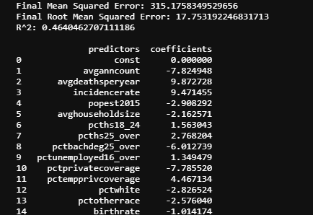
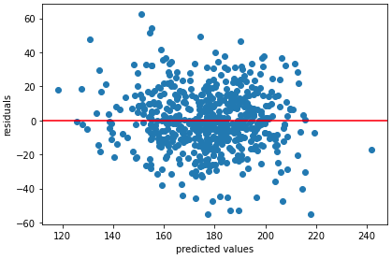
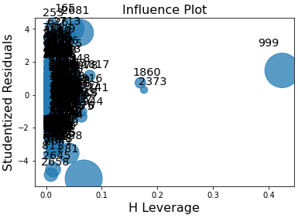
Best Model: SKLearn Linear Regression (Significant Predictors, Test Data)
Results
Residual Plot
Influence Plot

Slide 9
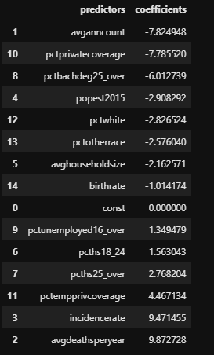
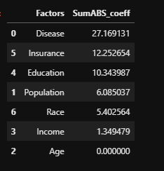
Research Questions:
Can socio-economic variable be used to predict cancer death rates in the United States?
F-statistic = 148 > 1
Which socio-economic variables are positively related to cancer death rates and which socio-economic variables are negatively related to cancer death rates?
Which group of socio-economic variables has the greatest impact?

Slide 10
Conclusions/Takeaways
Coefficients are Significant: F-statistic = 148 > 1
Residuals High Leverage Points/Outliers Exist
Potential to improve model
For more interesting results Exclude Disease Predictors

