Slide 1


SQLTuner: AI Assistant for Automating Database Performance Optimization
Automating Query Generation, Evaluation, and Tuning
Nguyen Le Quoc Huy | ID: 102220191
Class: 22T_DT4 | Faculty of Information Technology
Da Nang University of Science and Technology

Slide 2


Project Overview
This project originated during an internship at
DAC Data Technology Vietnam, a company
specializing in big data solutions.
The focus was on addressing critical challenges in database performance optimization that impact developer productivity and system efficiency.

Slide 3
Core Challenges
Expertise Barrier: Complex SQL tuning requires deep technical knowledge and significant manual effort.
LLM Fragmentations: Current AI assistants generate code but lack awareness of actual performance or schema scale.
Security Risks: Executing AI-generated code on production systems poses risks of data corruption or loss.
Lack of Testing: No standardized frameworks for batch evaluation of AI-generated SQL accuracy.

Slide 4






The SQLTuner Solution
Generation
Optimization
Evaluation
Translates natural language into executable SQL using metadata-aware Local LLMs.
Analyzes Execution Plans (EXPLAIN) to propose indexing and query refactoring.
Automated batch testing against Spider/BIRD benchmarks in a secure sandbox.

Slide 5



System Technologies
Backend
AI Engine
FastAPI & SQLAlchemy for high-performance async processing.
Local LLMs (Qwen, Llama-3) to ensure complete data privacy.
Database
Infrastructure
PostgreSQL integrated with deep Execution Plan analysis tools.
Docker for containerization and Sandbox isolation.

Slide 6


Theoretical Foundation
Prompt Engineering
Performance Metrics
Utilizing Chain-of-Thought and Few-shot prompting to guide LLMs through complex schema linking and logic derivation.
Measuring Execution Accuracy and Exact Match to quantitatively score model quality vs standard datasets.

Slide 7
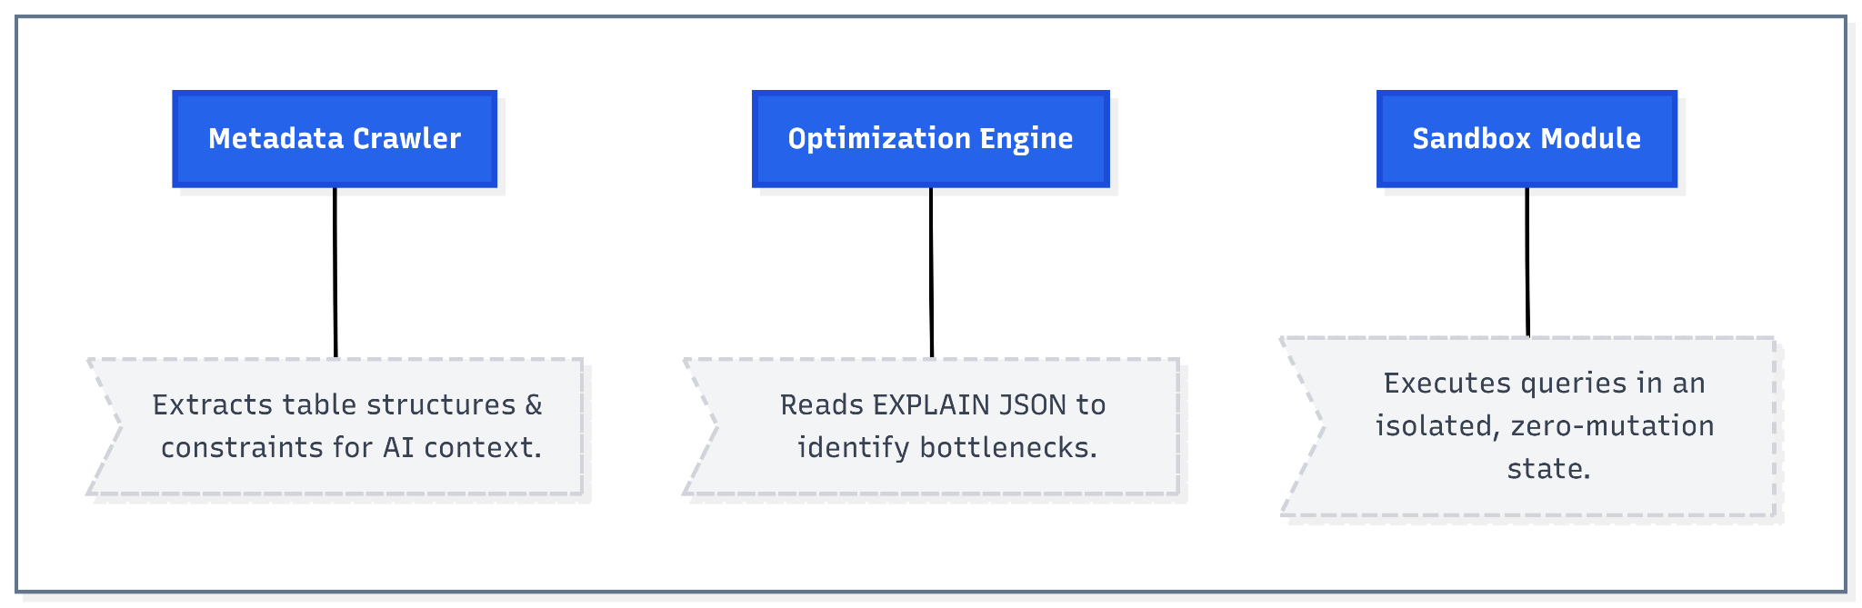
System Architecture
Metadata Crawler: Extracts table structures and constraints for AI context.
Optimization Engine: Reads EXPLAIN JSON to identify bottlenecks.
Sandbox Module: Executes queries in an isolated, zero-mutation state.

Slide 8
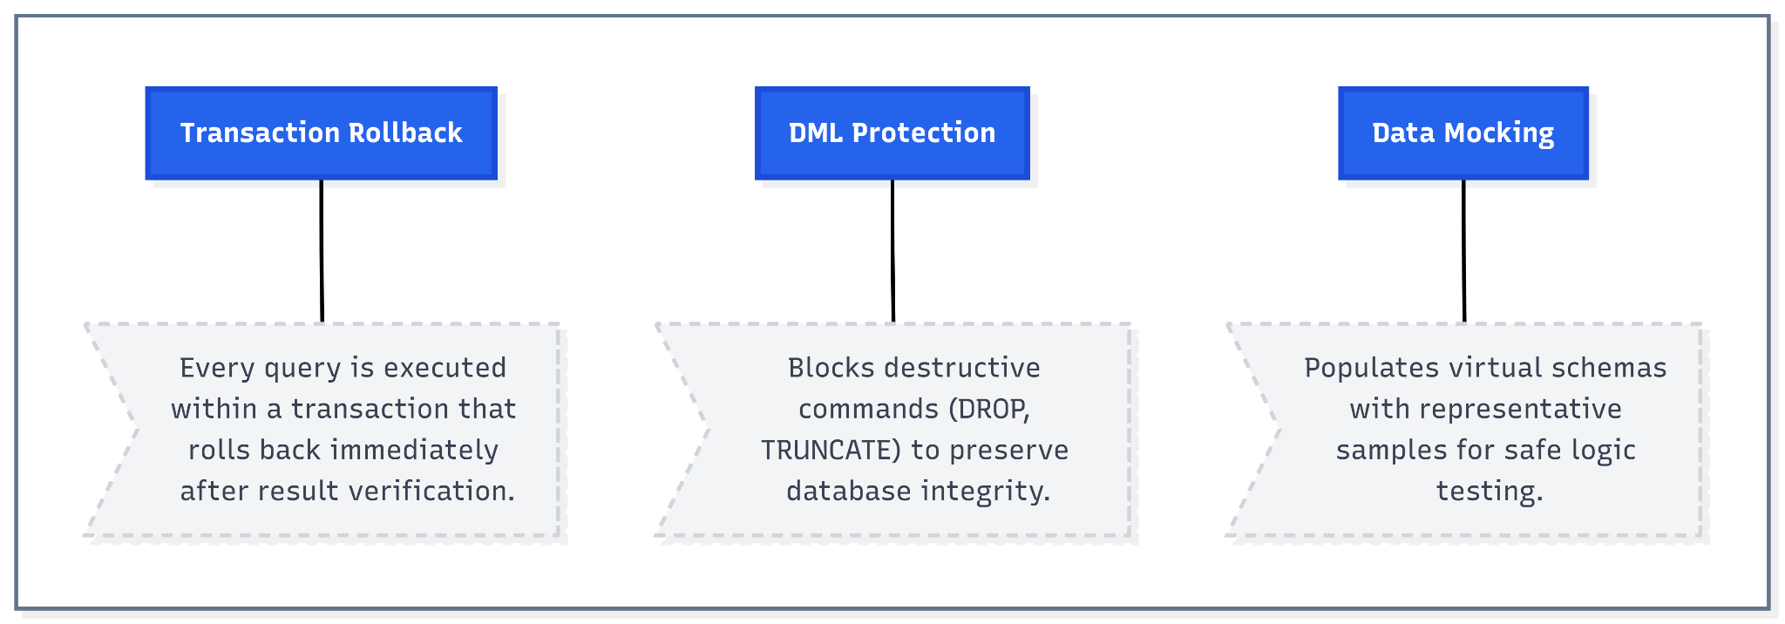
Secure Sandbox Environment
Transaction Rollback: Every query is executed within a transaction that rolls back immediately after result verification.
DML Protection: Blocks destructive commands (DROP, TRUNCATE) to preserve database integrity.
Data Mocking: Populates virtual schemas with representative samples for safe logic testing.

Slide 9
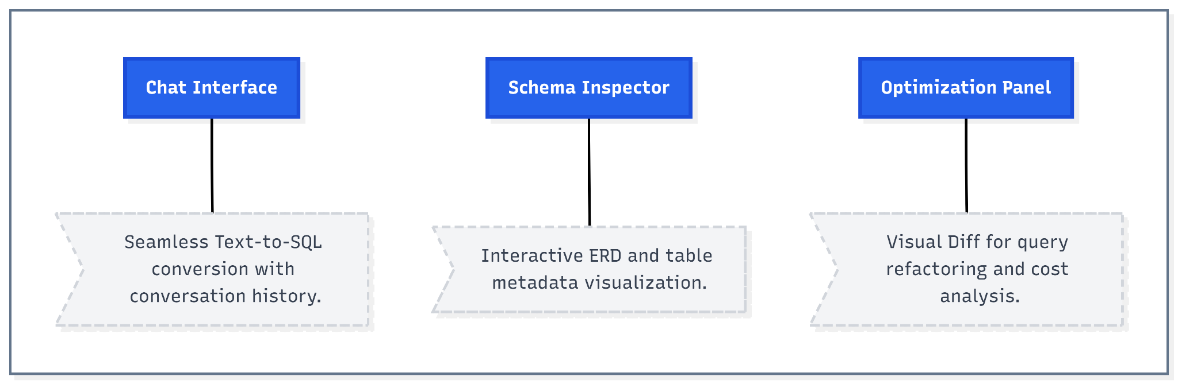
Intelligent Interface
Chat Interface: Seamless Text-to-SQL conversion with conversation history.
Schema Inspector: Interactive ERD and table metadata visualization.
Optimization Panel: Visual "Diff" for query refactoring and cost analysis.

Slide 10
Conclusion & Future Work
Key Results
Future Directions
Integrated platform for query generation and evaluation.
Implementing RAG for better domain knowledge.
Significant DBA workload reduction through AI optimization.
Expanding to cloud data warehouses (BigQuery/Snowflake).
Secure execution via Sandbox technology.
Incorporating RLHF for better user alignment.

Slide 11

Thank you for your attention!
Nguyen Le Quoc Huy
Da Nang University of Science and Technology

Slide 12
Thank you for your attention!
Nguyen Le Quoc Huy
Da Nang University of Science and Technology

Slide 13
Optimization Impact
65%
10x
0
Reduction in Cost
Faster Performance
Manual Risks
"Automatically detecting Sequential Scans and proposing Index fixes reduces resource consumption significantly."

Slide 14
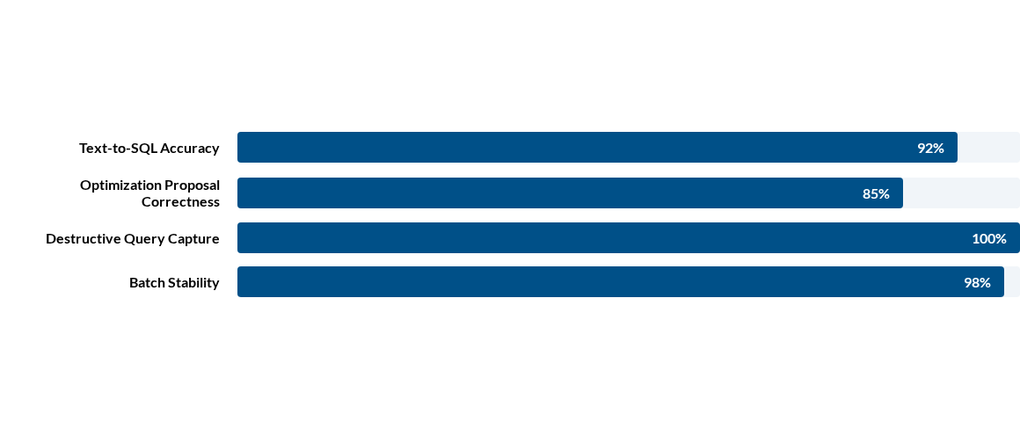
System Performance

Slide 15

Benchmark Results
Metric | Spider Benchmark | BIRD Benchmark | Avg. Latency
Execution Accuracy (EX) | 68.2% | 54.5% | 3.1s
Exact Match (EM) | 13.6% | 8.2% | —
Schema Linkage | 85.3% | 76.1% | —

