Slide 1

朱—刘算法
——python实现

Slide 2
import numpy as np # 定义网络的属性 class Edge(object): def __init__(self, u, v, w): self.u = u self.v = v self.w = w def __str__(self): return str(self.u) + str(self.v) + str(self.w)
u
w
v
'''获取网络各条边的信息''' def get_edges(): n, m, root = list(map(int, input('请输入网络的顶点个数、其边数以及网络的根（以空格分隔,例如：5 6 1）：\n').split())) # 输入各条边的信息 edges = [] for i in range(m): u, v, w = list(map(int, input(f'请输入网络第{i + 1}/{m}条边的信息（以空格分隔，例如：1 2 5）：\n').split())) edges.append(Edge(u - 1, v - 1, w)) # 输入的点是1开始的，-1改为0开始的
‘‘’求指定根的最小树形图''' for edge in edges: if edge.v == root - 1: edge.w = 999 return n, m, root, edges
v₀
6
5
v₁
3
v₂
2

Slide 3
'''
定义朱-刘算法的三个关键图：D图、H图、C(圈) Step 1 ''' def in_edge(edges, n): while True: H_pre = [-1] * n # H_pre用来表示最小入弧集，用列表存储 H_in_weight = [999] * n # H_in_weight表示最小入弧的权重，用列表存储，初始为无穷 '''寻找最小入边''' for edge in edges: if edge.u != edge.v and edge.w < H_in_weight[edge.v]: H_pre[edge.v] = edge.u H_in_weight[edge.v] = edge.w F = np.sum(list(map(lambda x: x > -1, H_pre))) # 计算最小入弧弧集的个数 return H_pre, H_in_weight, F
_{D1}
最小入弧
_{H1}
寻找圈
_{C1}
收缩圈
_{D2}
_{H2}
_{C2}
_{Dk}
₀
₀
6
5
3
₁
₂
3
3
2
₁
₂
₁
₂
2
2
D
H
C

Slide 4

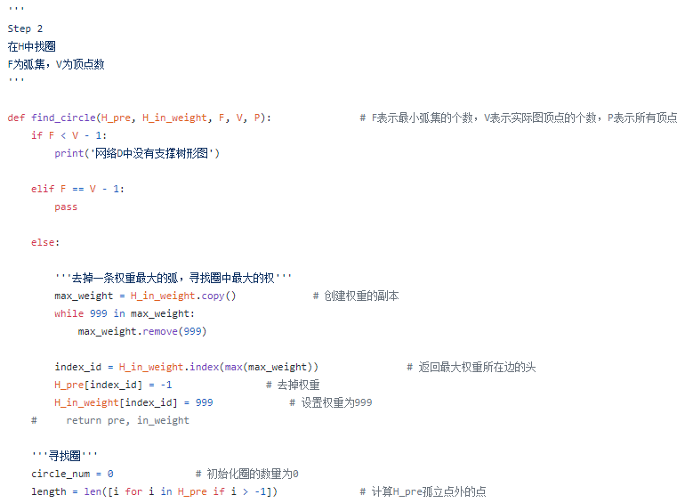
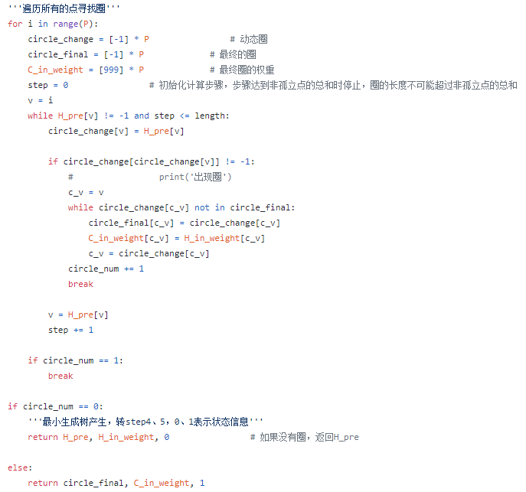

Slide 5
''' Step 2 在H中找圈 F为弧集，V为顶点数 ''' def find_circle(H_pre, H_in_weight, F, V, P): # F表示最小弧集的个数，V表示实际图顶点的个数，P表示所有顶点 if F < V - 1: print('网络D中没有支撑树形图') elif F == V - 1: pass else: '''去掉一条权重最大的弧，寻找圈中最大的权''' max_weight = H_in_weight.copy() # 创建权重的副本 while 999 in max_weight: max_weight.remove(999) index_id = H_in_weight.index(max(max_weight)) # 返回最大权重所在边的头 H_pre[index_id] = -1 # 去掉权重 H_in_weight[index_id] = 999 # 设置权重为999
0
0
1
1
收缩环
5
2
3
2
3
4
4
V = P = 5
V=3（0、5、4）；
P = 6（所有的点）

Slide 6
₃
'''寻找圈''' circle_num = 0 # 初始化圈的数量为0 length = len([i for i in H_pre if i > -1]) # 计算H_pre孤立点外的点
‘’‘遍历所有的点寻找圈’‘’ for i in range(P): circle_change = [-1] * P # 动态圈 circle_final = [-1] * P # 最终的圈 C_in_weight = [999] * P # 最终圈的权重 step = 0 # 初始化计算步骤，步骤达到非孤立点的总和时停止，圈的长度不可能超过非孤立点的总和 v = i while H_pre[v] != -1 and step <= length: circle_change[v] = H_pre[v] if circle_change[circle_change[v]] != -1: # print(‘出现圈’) c_v = v while circle_change[c_v] not in circle_final: circle_final[c_v] = circle_change[c_v] C_in_weight[c_v] = H_in_weight[c_v] c_v = circle_change[c_v] circle_num += 1 break v = H_pre[v] step += 1 if circle_num == 1: break if circle_num == 0: ‘’‘最小生成树产生，转step4、5。0、1表示状态信息''' return H_pre, H_in_weight, 0 # 如果没有圈，返回H_pre else: return circle_final, C_in_weight, 1
₀
₁
₂
H_pre
0 | 1 | 2 | 3
1 | 3 | 1 | 2
₃
₀
₁
₂
circle_change
0 | 1 | 2 | 3
1 | 3 | 1 | 2
₃
₀
₁
₂
circle_final
0 | 1 | 2 | 3
-1 | 3 | 1 | 2

Slide 7
''' Step 3 塌缩环，对图D进行收缩 ''' def systole(D_edges, circle_final, C_in_weight, P): # 寻找圈中最大的权 max_weight = C_in_weight.copy() while 999 in max_weight: max_weight.remove(999) for D_edge in D_edges: if D_edge.v in circle_final: if D_edge.u not in circle_final: for j in circle_final: if D_edge.v == j: # print(D_edges[i].w, C_in_weight[circle_final.index(j)], max(max_weight)) D_edges.append(Edge(D_edge.u, P, (int(D_edge.w) - C_in_weight[j] + max(max_weight)))) D_edge.w = 999 else: D_edge.w = 999 if D_edge.u in circle_final: D_edge.u = P return D_edges
0
0
1
1
P
收缩环
2
3
2
3
4
4
D
D

Slide 8
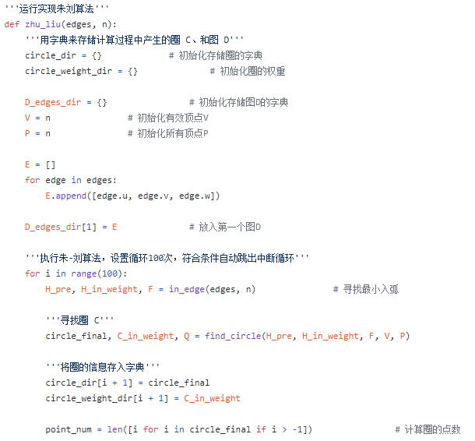
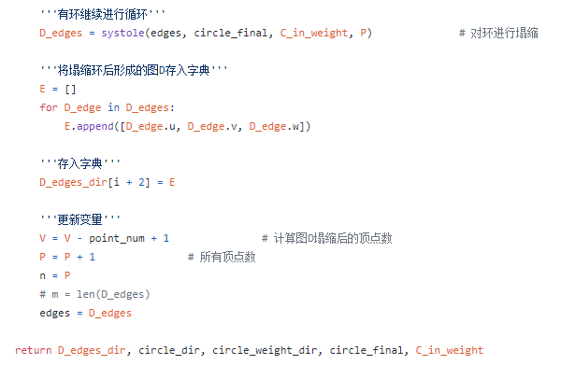

Slide 9
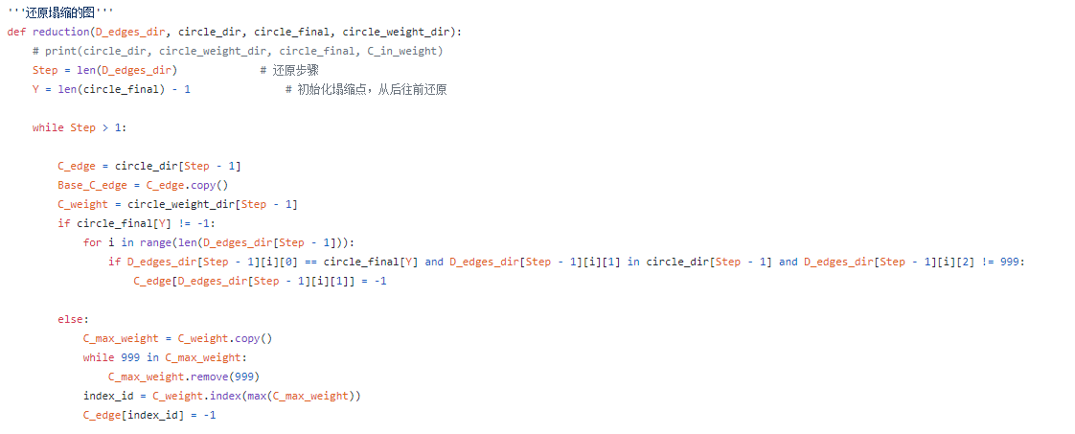
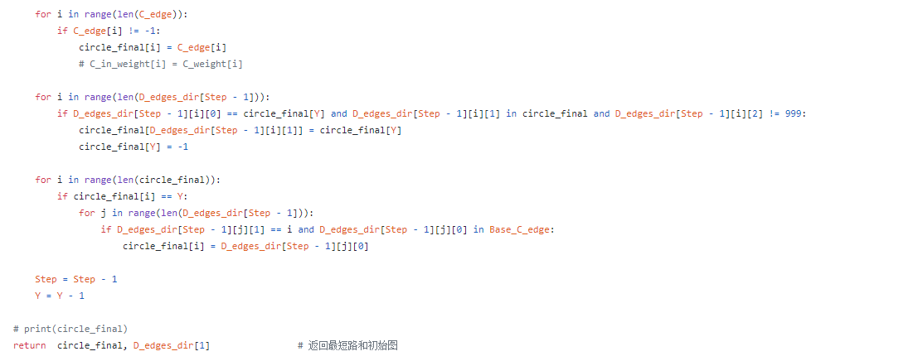

Slide 10
def reduction(D_edges_dir, circle_dir, circle_final, circle_weight_dir):
Step = len(D_edges_dir) # 还原步骤 Y = len(circle_final) - 1 # 初始化塌缩点，从后往前还原 while Step > 1: C_edge = circle_dir[Step - 1] Base_C_edge = C_edge.copy() C_weight = circle_weight_dir[Step - 1]
# 寻找、删除a边 if circle_final[Y] != -1: for i in range(len(D_edges_dir[Step - 1])): if D_edges_dir[Step - 1][i][0] == circle_final[Y] and D_edges_dir[Step - 1][i][1] in circle_dir[Step - 1] and D_edges_dir[Step - 1][i][2] != 999: C_edge[D_edges_dir[Step - 1][i][1]] = -1 else: C_max_weight = C_weight.copy() while 999 in C_max_weight: C_max_weight.remove(999) index_id = C_weight.index(max(C_max_weight)) C_edge[index_id] = -1
此时的circle_final是H
circle_final/H
0 | 1 | 2 | 3 | 4 | Y
-1 | -1 | -1 | -1 | Y | 0
0
0
1
1
1
C
Y
2
3
2
3
2
3
4
4
C-a
H

Slide 11
circle_final/H
# 还原C
for i in range(len(C_edge)): if C_edge[i] != -1: circle_final[i] = C_edge[i]
0 | 1 | 2 | 3 | 4 | Y
-1 | -1 | -1 | -1 | Y | 0
0
0
1
1
1
Y
Y
2
3
2
3
2
3
4
4
C-a
H
H

Slide 12
# 还原以塌缩点Y为头的弧 for i in range(len(D_edges_dir[Step - 1])): if D_edges_dir[Step - 1][i][0] == circle_final[Y] and D_edges_dir[Step - 1][i][1] in circle_final and D_edges_dir[Step - 1][i][2] != 999: circle_final[D_edges_dir[Step - 1][i][1]] = circle_final[Y] circle_final[Y] = -1
circle_final/H
0 | 1 | 2 | 3 | 4 | Y
-1 | -1 | 1 | 2 | Y | 0
0
0
0
1
1
1
Y
Y
2
3
2
3
2
3
4
4
4
D
H
H

Slide 13
circle_final/H
# 还原以塌缩点Y为尾的弧
for i in range(len(circle_final)): if circle_final[i] == Y: for j in range(len(D_edges_dir[Step - 1])): if D_edges_dir[Step - 1][j][1] == i and D_edges_dir[Step - 1][j][0] in Base_C_edge: circle_final[i] = D_edges_dir[Step - 1][j][0] Step = Step - 1 Y = Y - 1
0 | 1 | 2 | 3 | 4 | Y
-1 | 0 | 1 | 2 | Y | -1
0
0
0
1
1
1
Y
Y
2
3
2
3
2
3
4
4
4
D
H
H

Slide 14
if __name__ == "__main__": n, m, root, edges = get_edges() D_edges_dir, circle_dir, circle_weight_dir, circle_final, C_in_weight = zhu_liu(edges, n) min_tree, begin_graph = reduction(D_edges_dir, circle_dir, circle_final, circle_weight_dir) # print(min_tree) print('朱—刘算法求得的最小树形图为：') for i in range(len(min_tree)): if min_tree[i] != -1: for j in range(len(begin_graph)): if begin_graph[j][0] == min_tree[i] and begin_graph[j][1] == i: print(f'v_{int(min_tree[i])+1}—>v_{i+1}，权重为：{begin_graph[j][2]}') else: continue

Slide 15
谢谢大家！

