Slide 1
Lesson 3: Improving Reliability with MyPy and Type Hinting
Based on Raymond Hettinger’s course “Modern Python LiveLessons: Big Ideas and Little Code in Python”

Slide 2
Review Code
1_kmeans_code_lessons.py

Slide 3
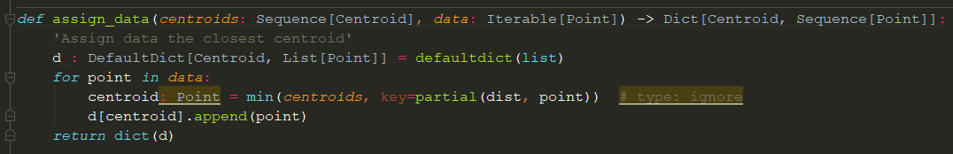
Type Hinting

Slide 4
Standardized Documentation that is Useful
Helps your IDE/tools help you - Makes programming easier!
Better autocompletion
More helpful tooltips
Helps users of your function – Make your API more user friendly!
Most popular python 3 packages already have type hints, so you are already benefiting!
Helps programmers think at the interface level when creating functions

Slide 5
Catch Bugs Automatically
Static Type Checking - A very inexpensive way to catch ~15% of bugs
There’s a reason most large projects use statically-typed languages!
The 15% comes from a study where they quickly added types to javascript repos, catching ~15% of reported bugs.
The systematic use of types would likely catch more bugs - before you try to debug them, and before they get into production code!
Adding types would be more or less helpful in other contexts.
All Bugs
Unit Testing
Other Levels of Testing
Static Type Checking/Linting

Slide 6
Access elegant Python 3.5+ features
Some elegant Python 3.5+ features only work with type hinting

Slide 7
Static Type-Checking with MyPy
mypy path/to/file.py
Let’s try it!

Slide 8
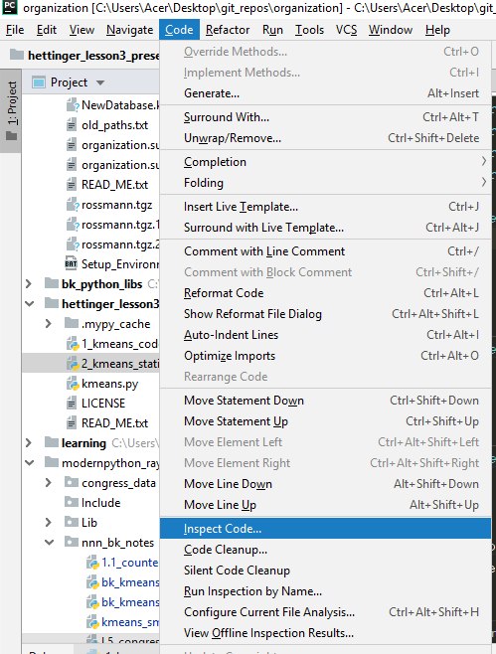
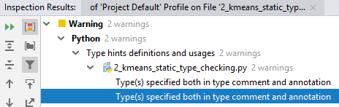
Static Type-Checking with PyCharm
Inspect your code
Let’s try it!
In this case, PyCharm catches a non-error, and misses the real error (unlike mypy)

Slide 9
What to type?
Function/method arguments and return types
Only if the default values do not make the type clear!
OK
Better
Occasionally in other places if:
It helps you, the programmer
MyPy requests you add a type because it can’t infer the type
MyPy infers the incorrect type and is giving you an error

Slide 10
When to Add Type Hints?
When it helps you the programmer
When you want MyPy’s help finding a bug
AND OTHERWISE
Before each pull-request!

Slide 11
What to do with hard-to-type variables?
Type ignore
Use Any
Don’t try to type everything perfectly!
You lose some of the 4X benefit of dynamic languages, duck-typing, etc!
But 90% of the time you aren’t using Python’s dynamic capabilities, so adding type hints shouldn’t be a problem.

Slide 12
Python Features that Require Type Hints

Slide 13
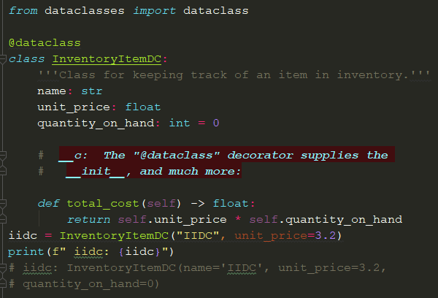
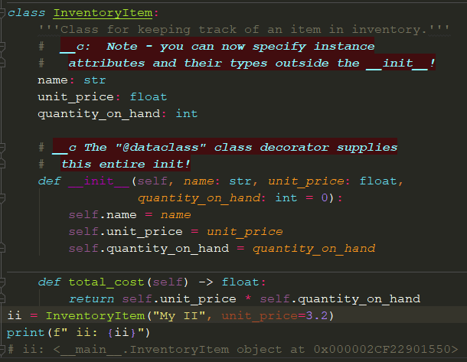
Dataclasses

Slide 14
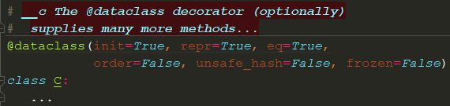
Dataclasses optionally supply many methods

Slide 15
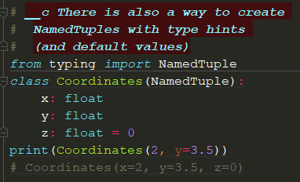
Named Tuples with Type Hints

Slide 16
Linting
Automated checking for common errors

Slide 17
Why Lint?
It’s fairly easy
It catches some errors that your tests won’t
Some of these common errors can be a pain to debug otherwise!
All Bugs
Unit Testing
Other Levels of Testing
Linting
Static Type Checking/Linting

Slide 18
Let’s lint!
pyflakes – a fast linter
pyflakes file/path.py
pylint – a slow but thorough linter. Requires customization
pylint --disable=file/path.py
pycharm – a fast, customizable linter
“Code” Menu => “Inspect Code”

Slide 19
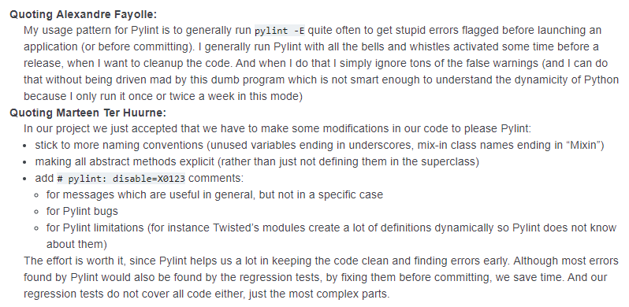
How to use Pylint
Adapt to it or
Customize it to your needs

Slide 20

Integrating into you editor/IDE
Varying degrees of integration into your editor/IDE are possible
Linting in the background, with red squiglies to indicate errors
Running inside your editor’s terminal, on the currently active file, with links back to the source code

Slide 21
Wrapping Up
How was the presentation?
What are you taking away?
What do you want to use in your workflow?
Is this worth presenting in a lunch and learn?
What other tools should be an important part of most python developers toolchain? Has anyone tried the online automatic code review tools?
Other questions/comments?

