Slide 1
Lesson 3: Improving Reliability with MyPy and Type Hinting
Based on Raymond Hettinger’s course “Modern Python LiveLessons: Big Ideas and Little Code in Python”

Slide 2
Review Code
1_kmeans_code_lessons.py

Slide 3
Type Hinting

Slide 4
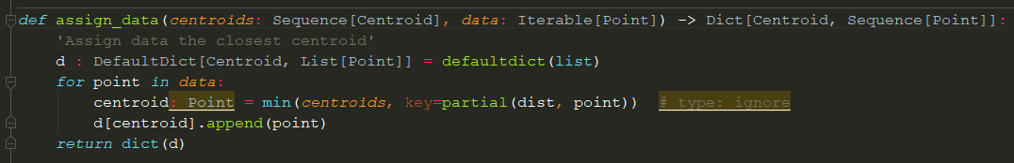
Why use type-hinting?
For documentation – what is this function intended to do?
Helps think when creating functions
Helps users of your function

Slide 5
Why use type-hinting?
Static Type Checking
A very inexpensive way to catch ~15% of bugs
There’s a reason most large projects use dynamically-typed languages!
The 15% comes from a study where they quickly added types to javascript repos, catching ~15% of reported bugs.
All Bugs
Unit Testing
Other Levels of Testing
Static Type Checking/Linting

Slide 6
Static Type-Checking with MyPy
mypy path/to/file.py
Let’s try it!

Slide 7
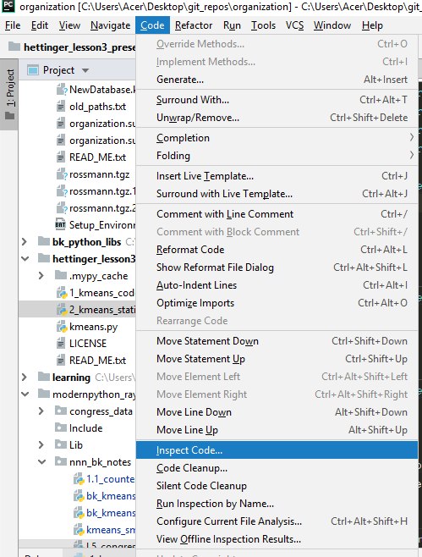
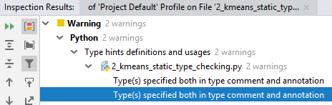
Static Type-Checking with PyCharm
Inspect your code
Let’s try it!
In this case, PyCharm catches a non-error, and misses the real error (unlike mypy)

Slide 8
What to type?
Function/method arguments and return types
Only if the default values do not make the type clear!
OK
Better
Occasionally in other places if:
It helps you, the programmer
MyPy requests you add a type because it can’t infer the type
MyPy infers the incorrect type and is giving you an error

Slide 9
When to Add Type Hints?
When it helps you the programmer
When you want MyPy’s help finding a bug
AND OTHERWISE
Before each pull-request!

Slide 10
What to do with hard-to-type variables?
Type ignore
Use Any
Don’t try to type everything perfectly!
You lose some of the 4X benefit of dynamic languages, duck-typing, etc!
But 90% of the time you aren’t using Python’s dynamic capabilities, so adding type hints shouldn’t be a problem.

Slide 11
Linting
Automated checking for common errors

Slide 12
Why Lint?
It’s fairly easy
It catches some errors that your tests won’t
Some of these common errors can be a pain to debug otherwise!
All Bugs
Unit Testing
Other Levels of Testing
Linting
Static Type Checking/Linting

Slide 13
Let’s lint!
pyflakes – a fast linter
pyflakes file/path.py
pylint – a slow but thorough linter. Requires customization
pylint --disable=file/path.py
pycharm – a fast, customizable linter
“Code” Menu => “Inspect Code”

Slide 14
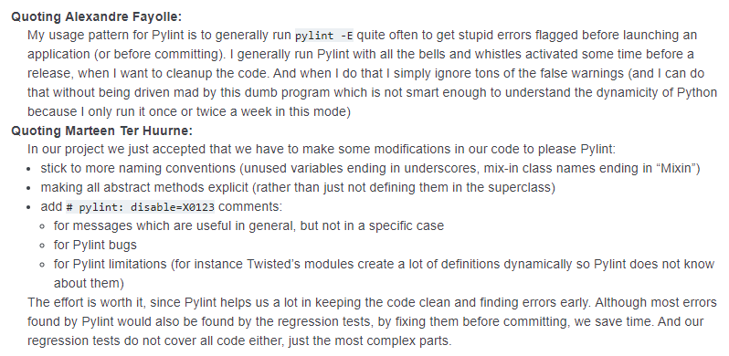
How to use Pylint
Adapt to it or
Customize it to your needs

Slide 15

Integrating into you editor/IDE
Varying degrees of integration into your editor/IDE are possible
Linting in the background, with red squiglies to indicate errors
Running inside your editor’s terminal, on the currently active file, with links back to the source code

