Slide 1
Pytest Magic
What pytest offers
Where to learn more.

Slide 2
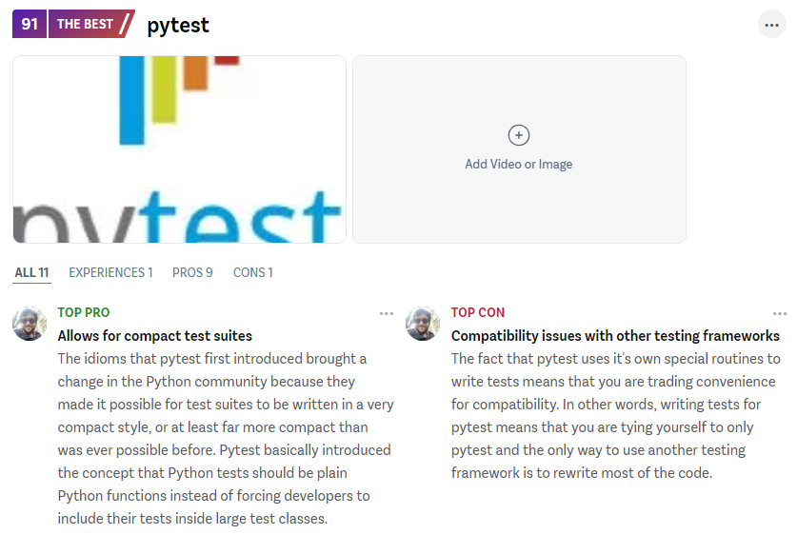
What is Pytest?
A python testing framework
Compared to Unittest, it:
  Reduces boilerplate
  Nicer syntax
  Provides additional features
Can run Unittest tests
  And Tensorflow tests (b/c subclasses Unittest)
Is the best python testing framework
  according to slant

Slide 3

Why is this Important?
Makes testing easier
  Less time learning how to write tests
  Streamlines test-writing and reduces boilerplate
  Easier to interpret test results? And maintain tests? And target selected tests to run them more often?
=> Better quality test and production code, with fewer bugs

Slide 4
Pytest Basics

Slide 5
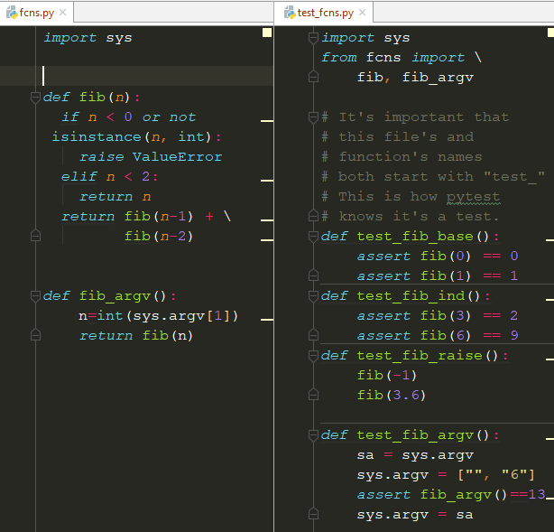
Pytest Basics

Slide 6
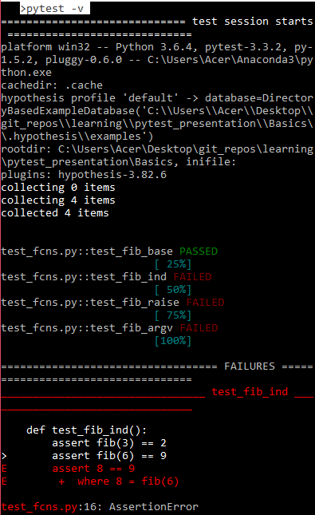
Pytest Basics - note the assert introspection!

Slide 7
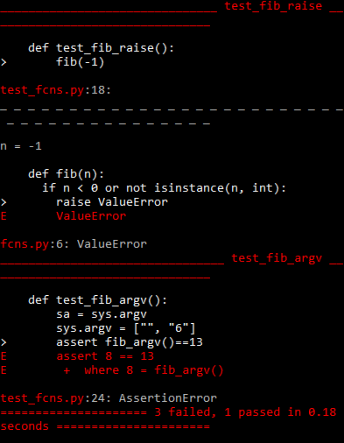
Pytest Basics - note the assert introspection!

Slide 8
Marks, Fixtures

Slide 9
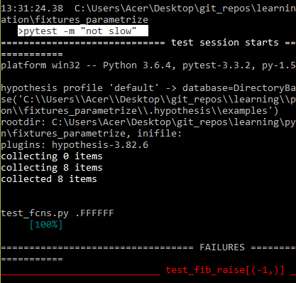
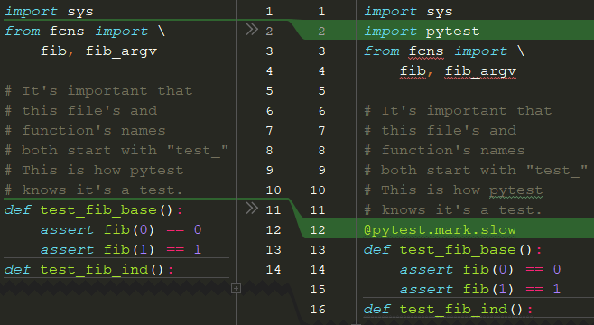

Skipping tests marked “slow”
Before
After

Slide 10
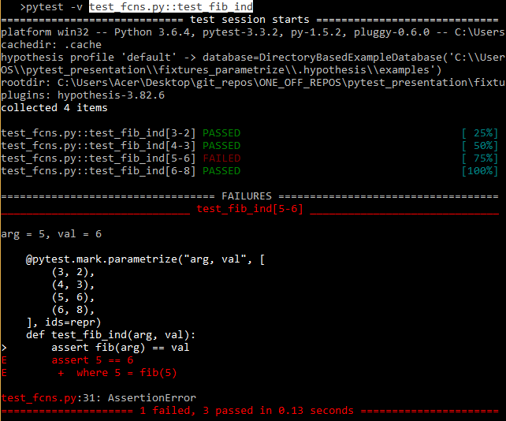

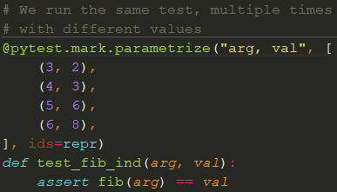
Running parametrized tests
Before (2 asserts in 1 test)
After (4 tests from parametrizing a single method)

Slide 11
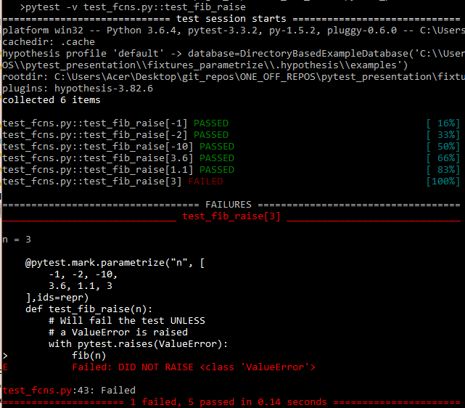
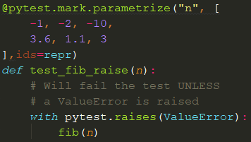
Testing that errors are raised

Slide 12
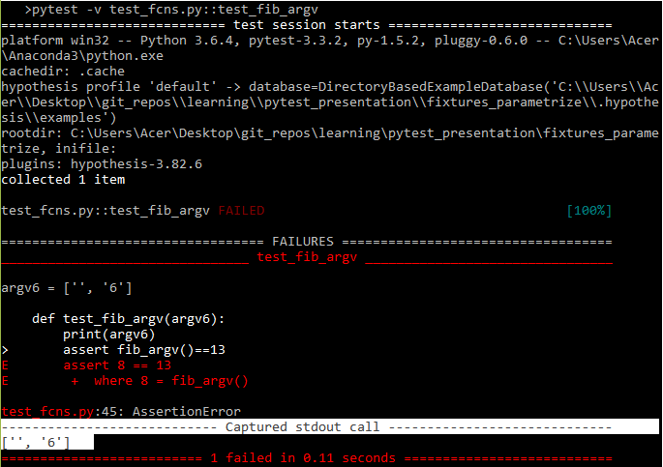
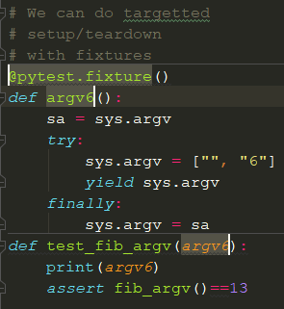
Fixtures (Setup and Teardown)

Slide 13
Built-in Fixtures

Slide 14
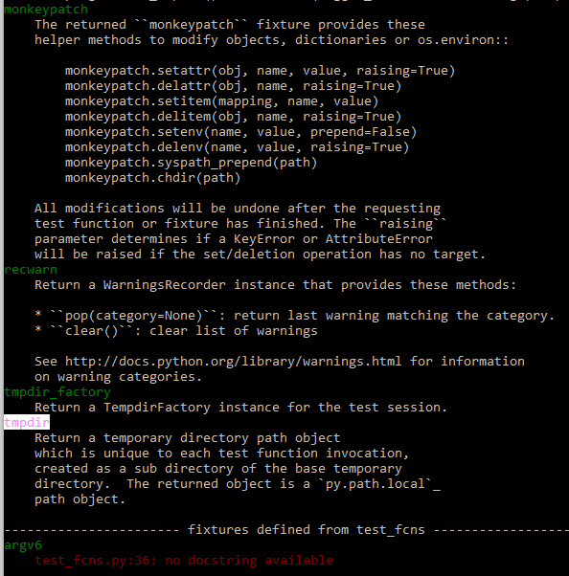
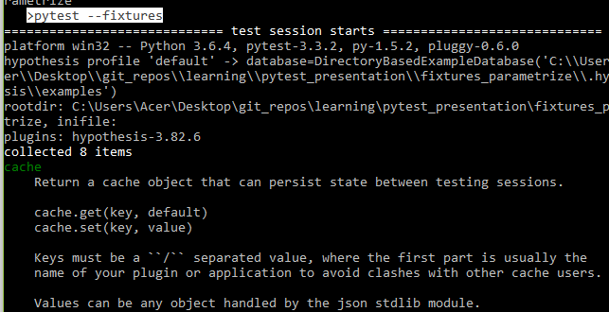
Built-in Fixtures

Slide 15
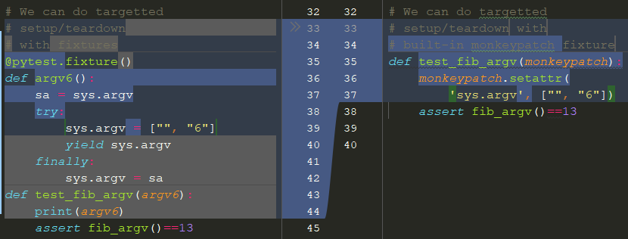
The Built-in monkeypatch Fixture
This saves a lot of boilerplate!
Before
After

Slide 16
PyCharm and Pytest
The Pytest testing framework is popular
Tools are being programmed to understand its magic.
I use PyCharm

Slide 17
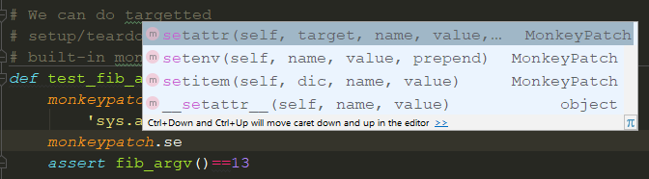
The Built-in monkeypatch Fixture
PyCharm understands pytest (and maybe other editors do too?)

Slide 18
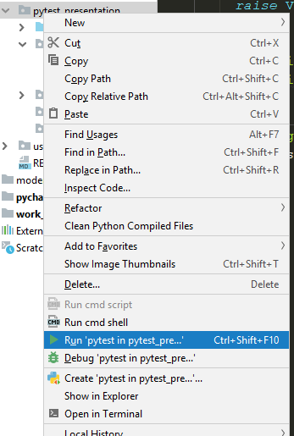
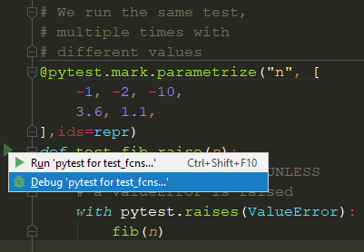
Easily run/debug tests
Run/debug all tests in a file/directory
Run/debug individual test

Slide 19
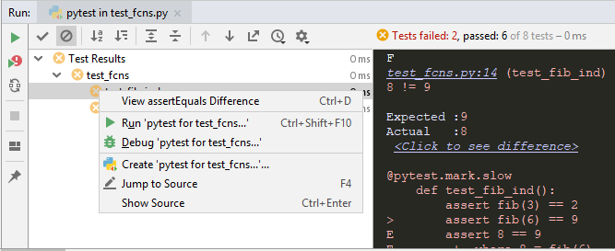
Easily re-run/debug failed tests

Slide 20
Github Repo of Code for this presentation
https://github.com/wbkdef/pytest_magic_presentation

Slide 21
Resources I used for Learning PyTest
I found learning just from pytest.org difficult. I used this material from Brian Okken
BOOK: Python Testing with Pytest: Simple, Rapid, Effective, and Scalable
  by Brian Okken, Oct 2017
  https://www.oreilly.com/library/view/python-testing-with/9781680502848/ , 4.23 on Goodreads
VID: Visual Testing with PyCharm and pytest => https://www.youtube.com/watch?v=FjojZxDZscQ
VID: Productive pytest with PyCharm => https://www.youtube.com/watch?v=ixqeebhUa-w
VID: How Testing Strategy can Increase Developer Efficiency and Effectiveness https://www.youtube.com/watch?v=o9D2ZxMO3Nw
Google

