Slide 1
Algorithm Implementation
CPML
2008.01.24 작성됨.

Slide 2
CPML
NIM에 대한 내용은 담겨 있지 않다.(NIM에 대한 cpml은 따로 다시 만들어야 한다. 왜냐하면 다음의 내용은 Chb가 상수일 경우만 고려되기 때문이다. Chb가 array일 경우는 다시 만들어져야 한다. 또한 NIM이 PML안으로 들어갈 경우 매우 불안정하므로 새로운 알고리즘을 적용해야 한다.)

Slide 3
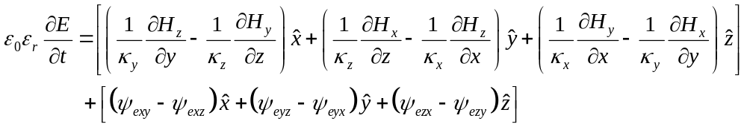
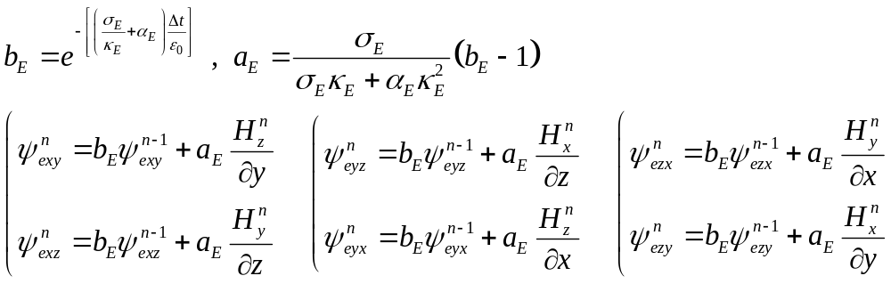
CPML (Convolution Perfect Matched Layer) (1)
Ampere’s law formula with CPML terms

Slide 4
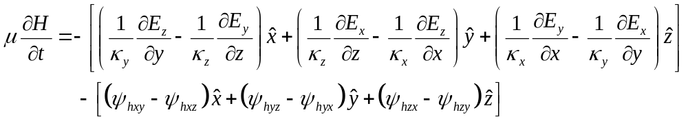
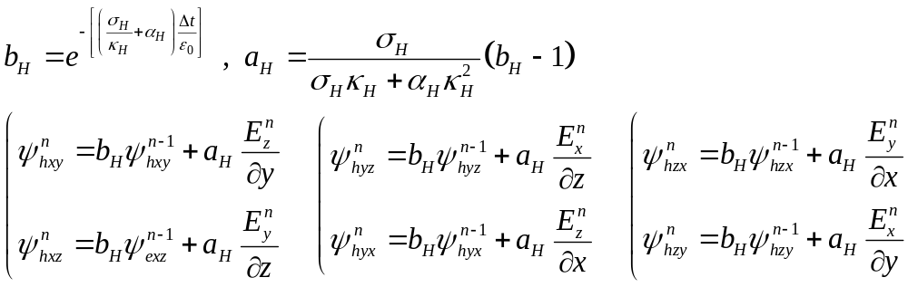
CPML (2)
Faraday’s law formula with CPML terms

Slide 5
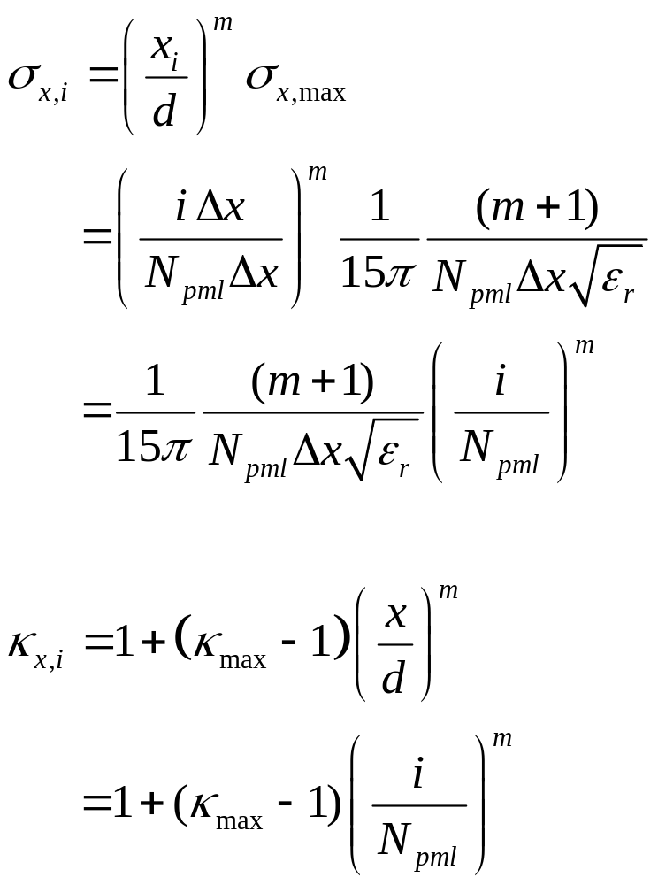
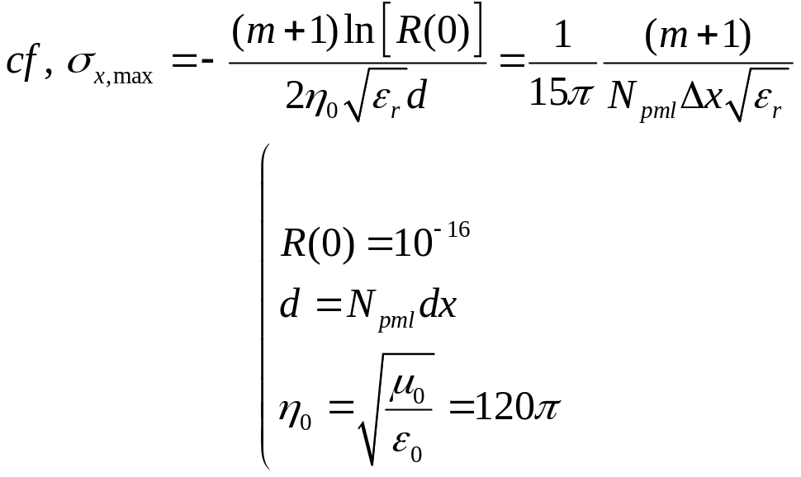
CPML (3)
CPML variables

Slide 6
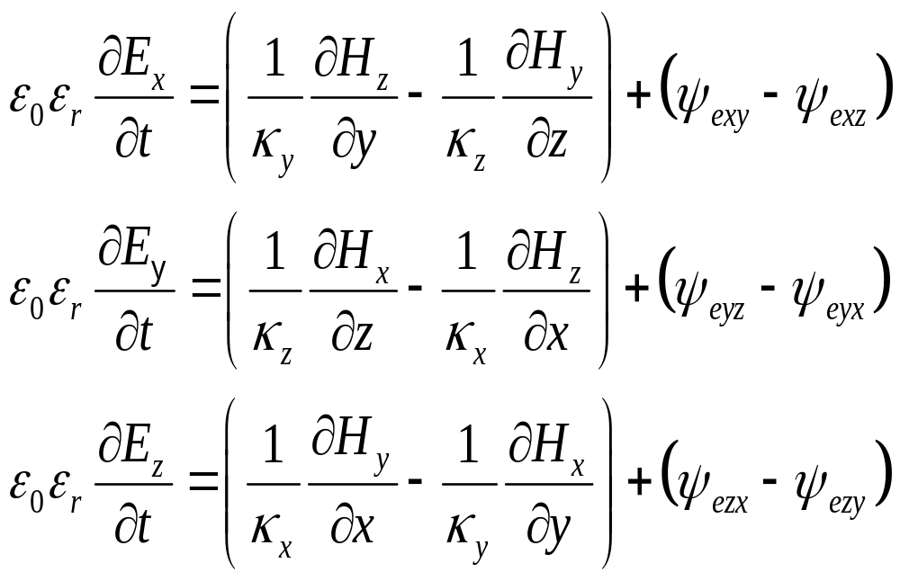
CPML (4)
Select the valid terms along each directions
Because are only depend on a normal direction,
x direction
y direction
z direction

Slide 7
H faced

Slide 8
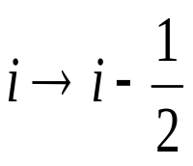
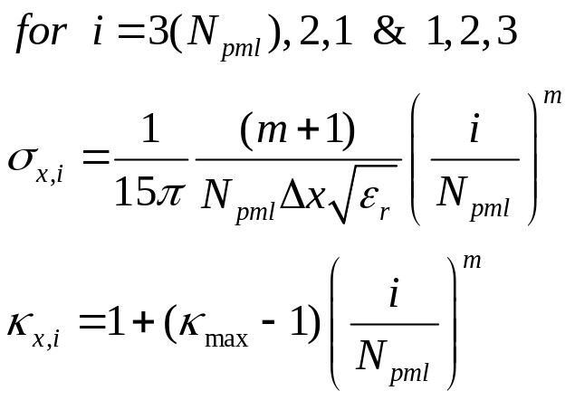
CPML (H5)
CPML variables index
Hy 0,3
Hy 1,3
Hy 2,3
Hy 3,3
Hy 5,3
Hy 6,3
Hy 7,3
Hy 8,3
Ez 0,2
Ez 1,2
Ez 2,2
Ez 5,2
Ez 6,2
Ez 7,2
Hz 0,2
Ey 0,1
Hz 1,2
Ey 1,1
Hz 2,2
Ey 2,1
Hz 3,2
Hz 5,2
Ey 5,1
Hz 6,2
Ey 6,1
Hz 7,2
Ey 7,1
Hz 8,2
Hy 0,2
Hy 1,2
Hy 2,2
Hy 3,2
Hy 5,2
Hy 6,2
Hy 7,2
Hy 8,2
Ez 0,1
Ez 1,1
Ez 2,1
Ez 5,1
Ez 6,1
Ez 7,1
x
Full depth
Half depth

Slide 9
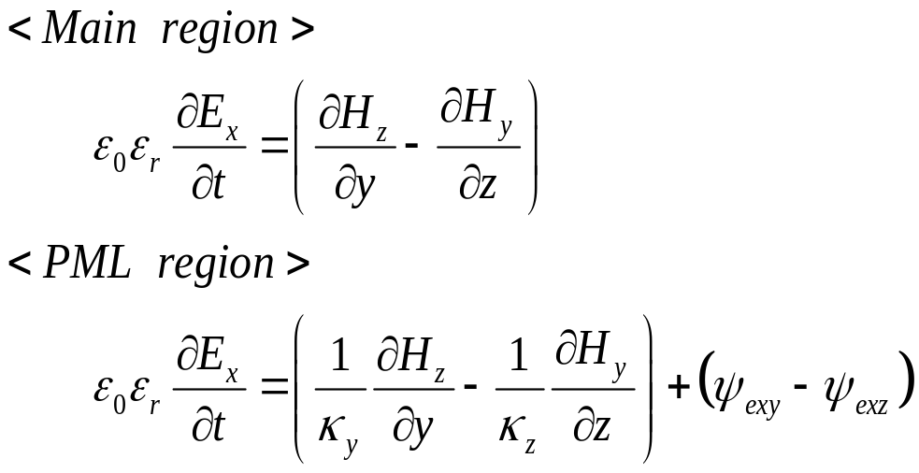
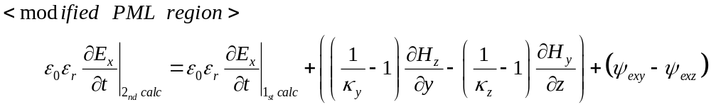
CPML (H6)
Easy apply CPML to code
Because similarity between eqs,
First, calculate the whole region by above eq.
Second, calculate the PML region with below eq.

Slide 10
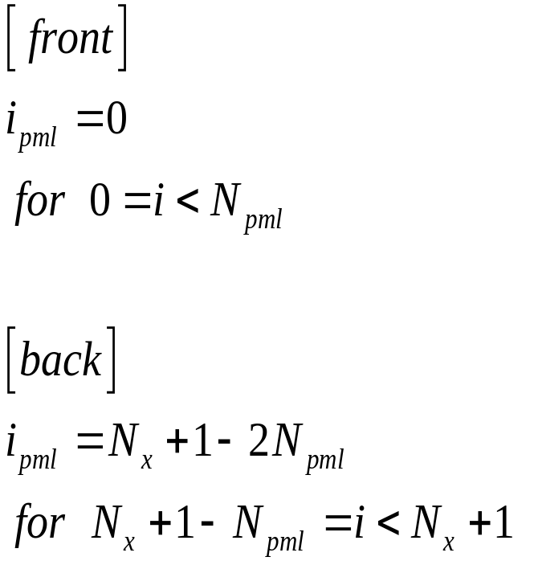
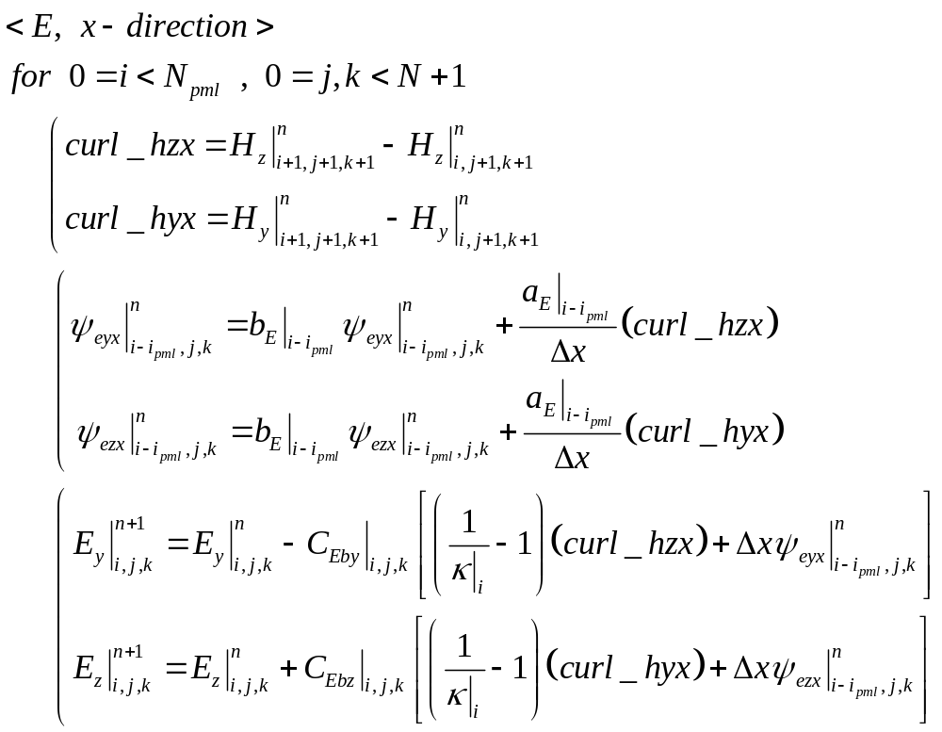
CPML (H7)
Full code index for E field (1)

Slide 11

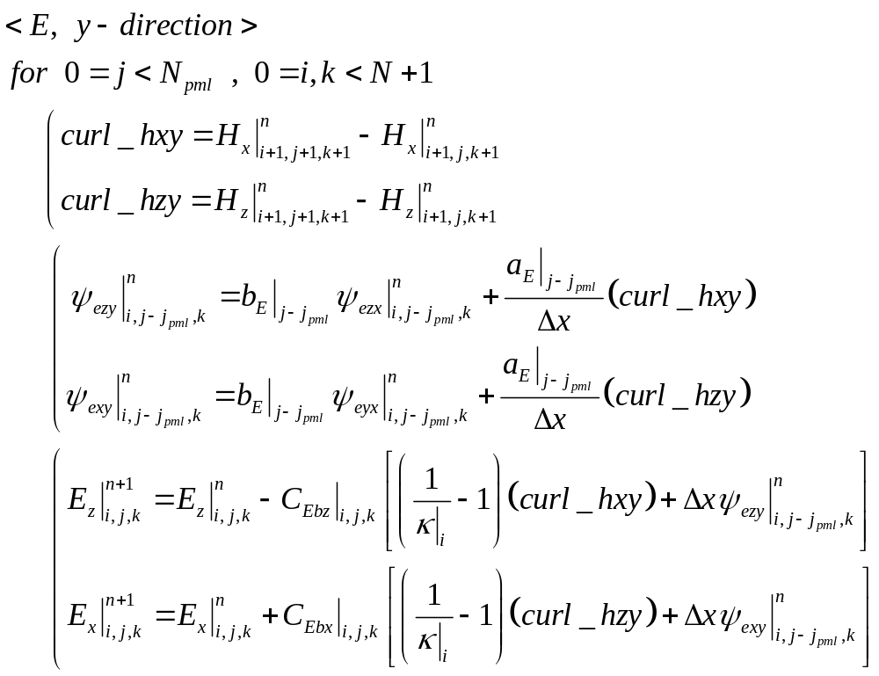
CPML (H8)
Full code index for E field (2)

Slide 12
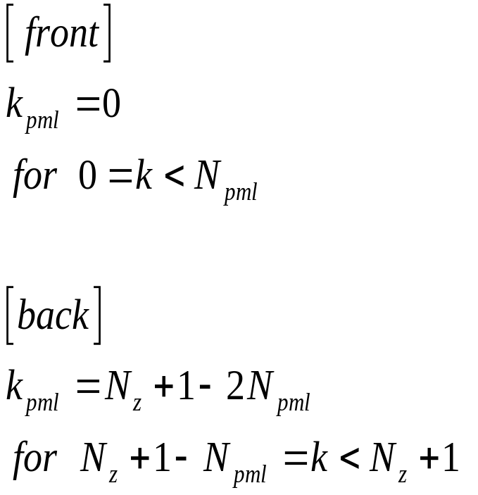
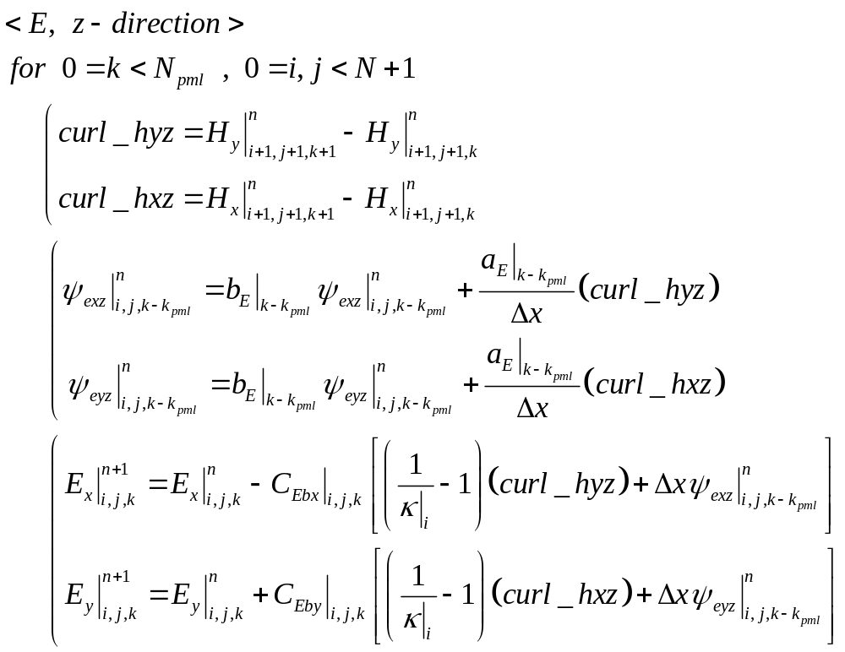
CPML (H9)
Full code index for E field (3)

Slide 13
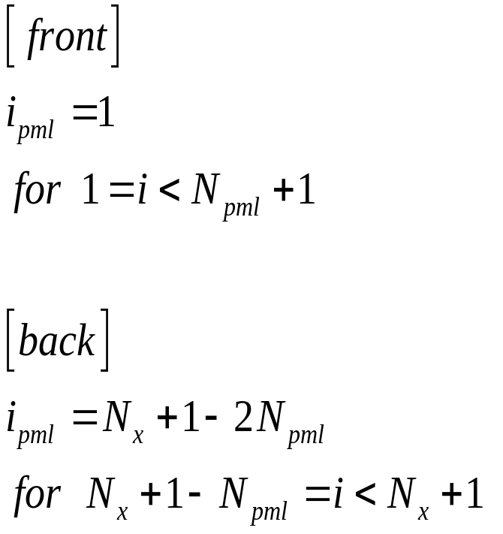
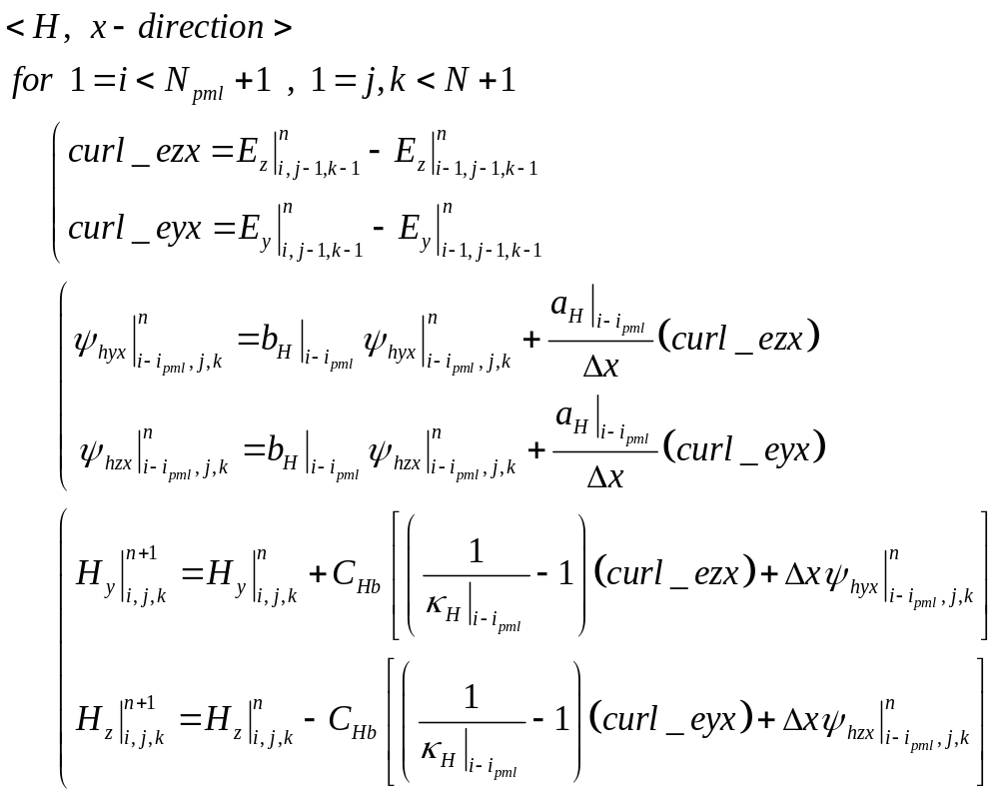
CPML (H10-1)
Full code index for H field (1)

Slide 14
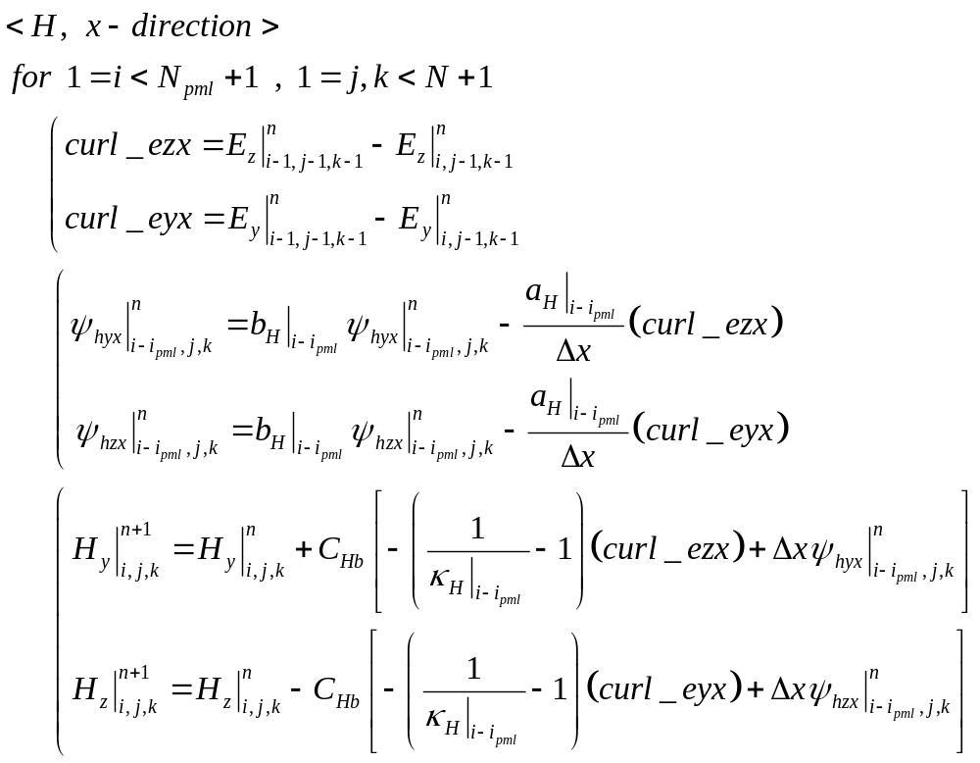
CPML (H10-2)
Full code index for H field (1)

Slide 15
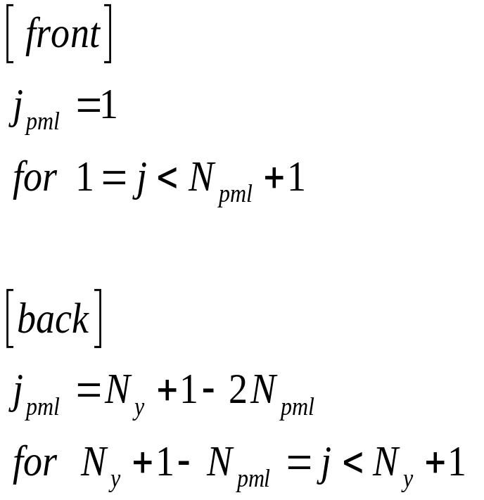
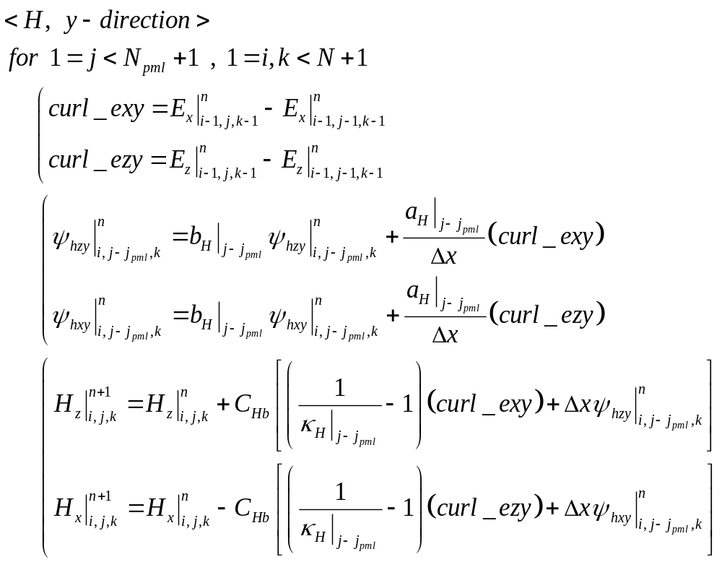
CPML (H11-1)
Full code index for H field (2)

Slide 16
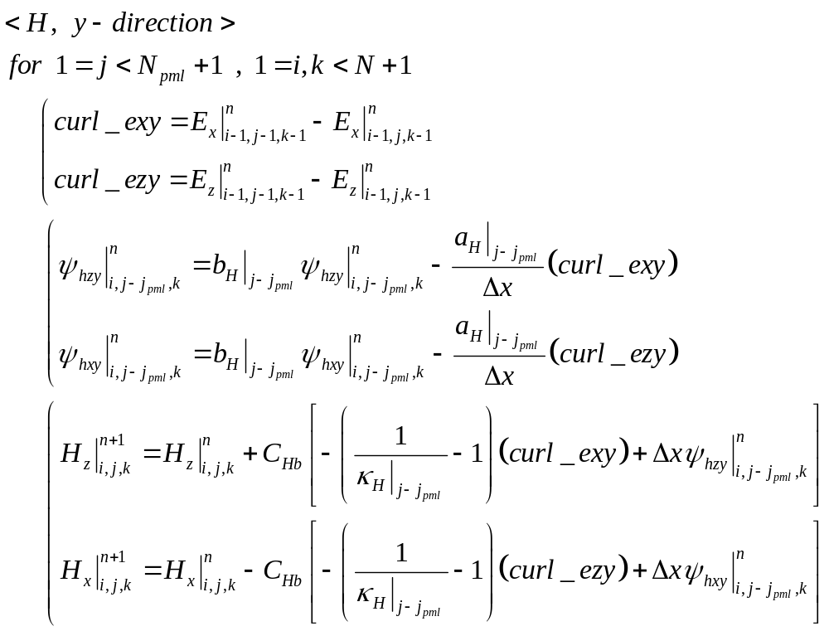
CPML (H11-2)
Full code index for H field (2)

Slide 17

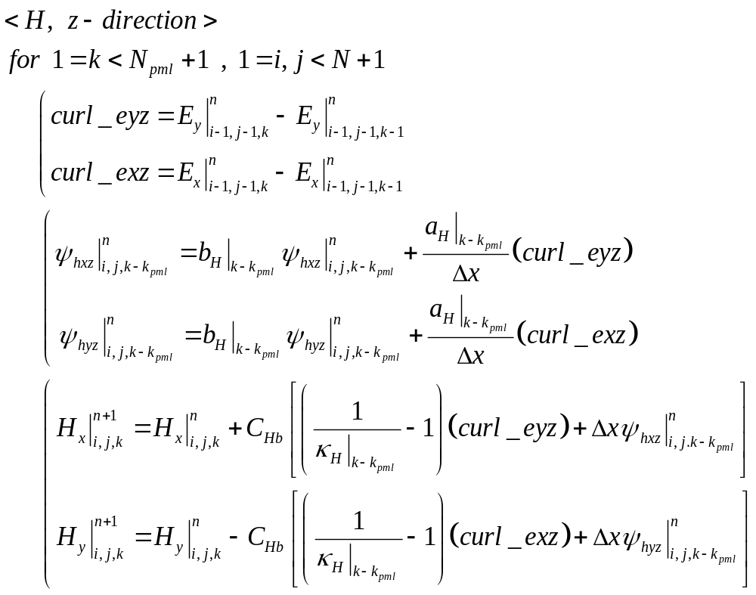
CPML (H12-1)
Full code index for H field (3)

Slide 18
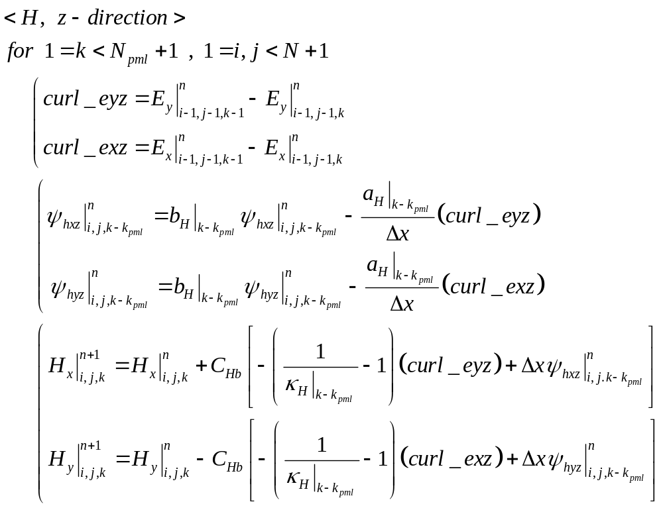
CPML (H12-2)
Full code index for H field (3)

Slide 19
E faced

Slide 20
CPML (E5)
CPML variables index
Ey 0,3
Ey 1,3
Ey 2,3
Ey 3,3
Ey 5,3
Ey 6,3
Ey 7,3
Ey 8,3
Hz 0,2
Hz 1,2
Hz 2,2
Hz 5,2
Hz 6,2
Hz 7,2
Ez 0,2
Hy 0,1
Ez 1,2
Hy 1,1
Ez 2,2
Hy 2,1
Ez 3,2
Ez 5,2
Hy 5,1
Ez 6,2
Hy 6,1
Ez 7,2
Hy 7,1
Ez 8,2
Ey 0,2
Ey 1,2
Ey 2,2
Ey 3,2
Ey 5,2
Ey 6,2
Ey 7,2
Ey 8,2
Hz 0,1
Hz 1,1
Hz 2,1
Hz 5,1
Hz 6,1
Hz 7,1
x
Full depth
Half depth

Slide 21
CPML (E6)
Easy apply CPML to code
Because similarity between eqs,
First, calculate the whole region by above eq.
Second, calculate the PML region with below eq.

Slide 22
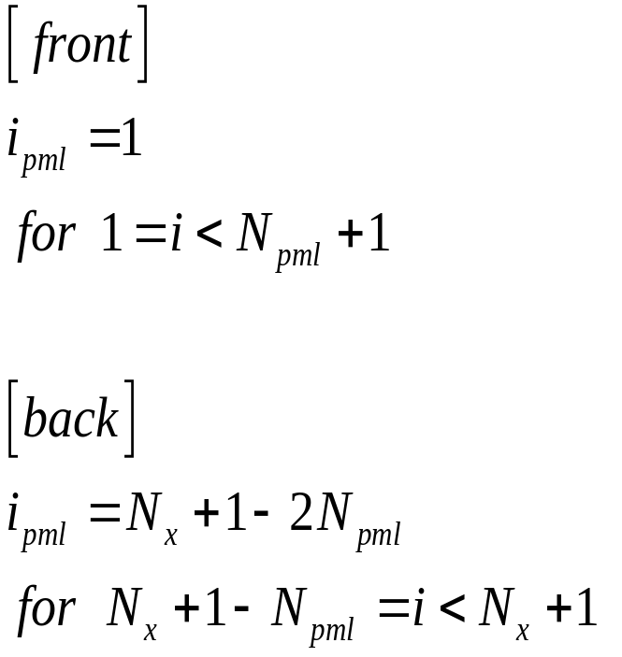
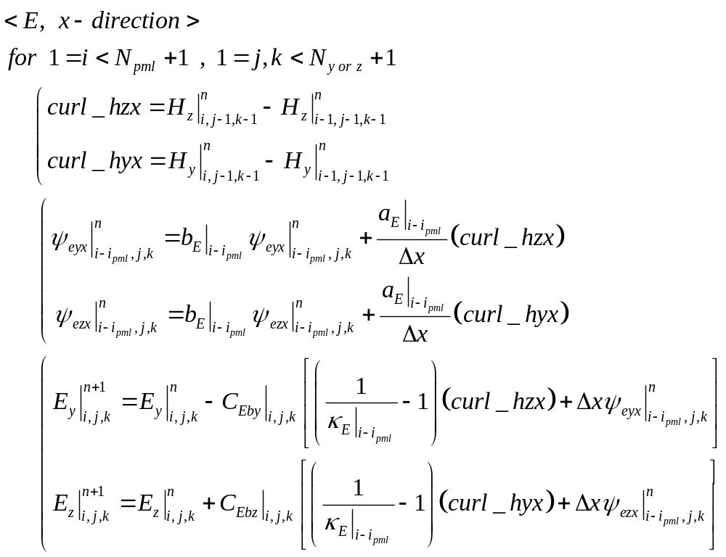
CPML (E7-1)
Full code index for E field (1)

Slide 23
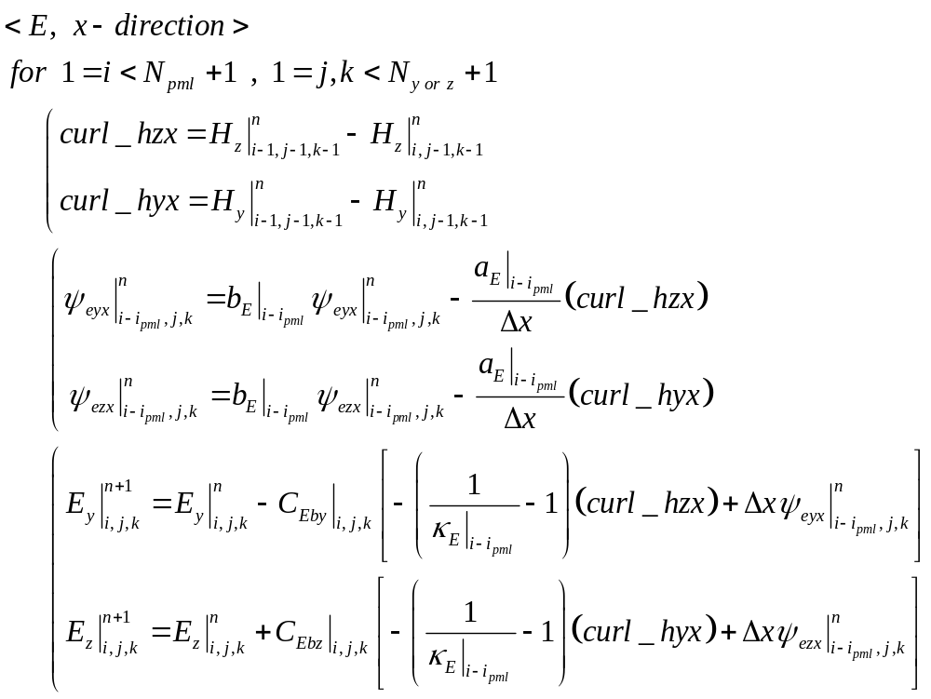
CPML (E7-2)
Full code index for E field (1)

Slide 24

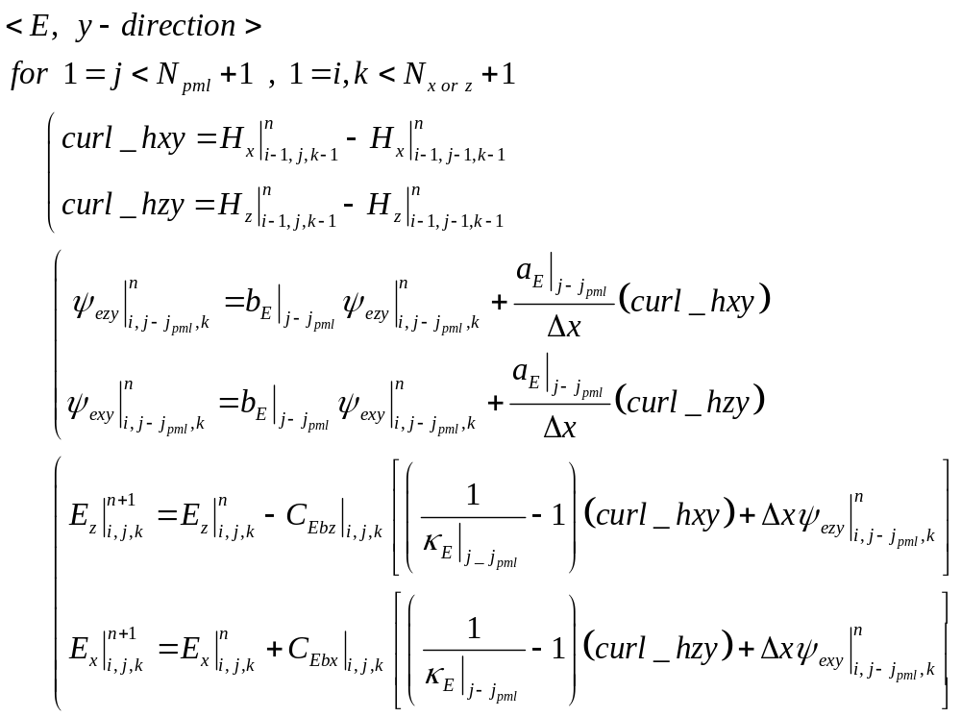
CPML (E8-1)
Full code index for E field (2)

Slide 25
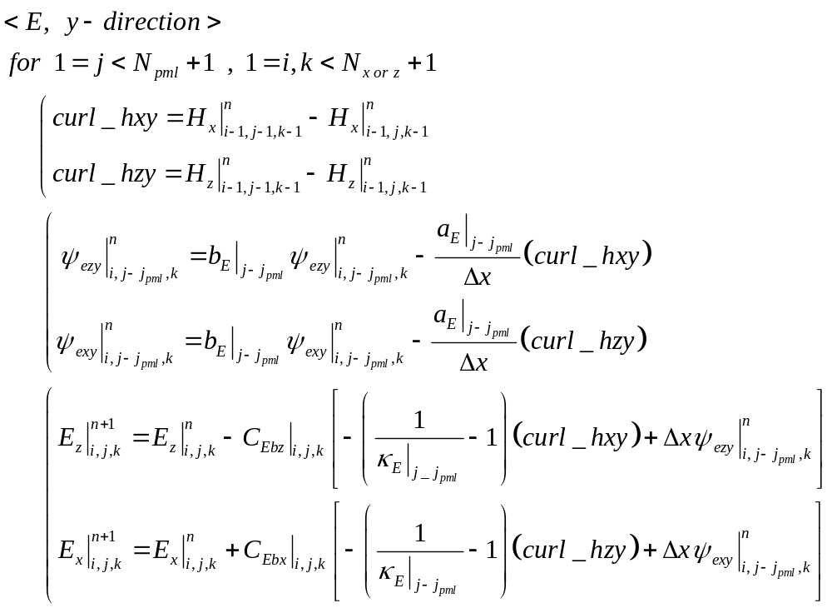
CPML (E8-2)
Full code index for E field (2)

Slide 26

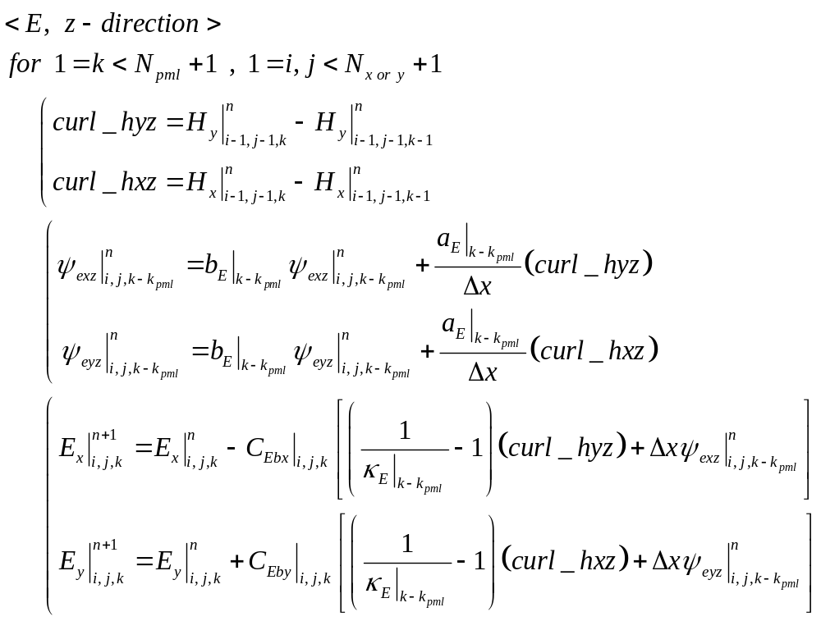
CPML (E9-1)
Full code index for E field (3)

Slide 27
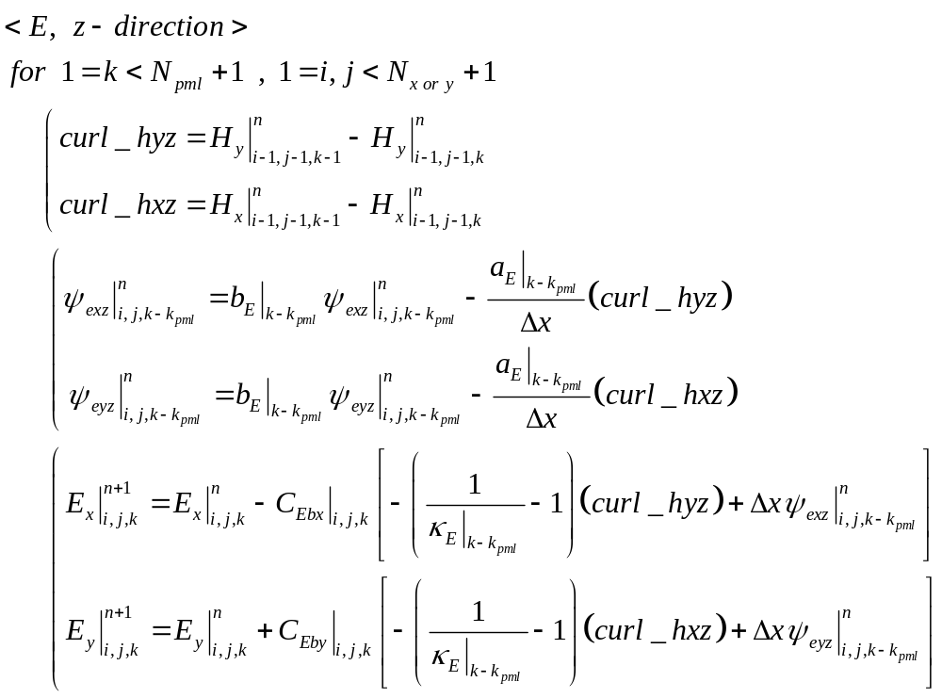
CPML (E9-2)
Full code index for E field (3)

Slide 28


CPML (E10)
Full code index for H field (1)

Slide 29

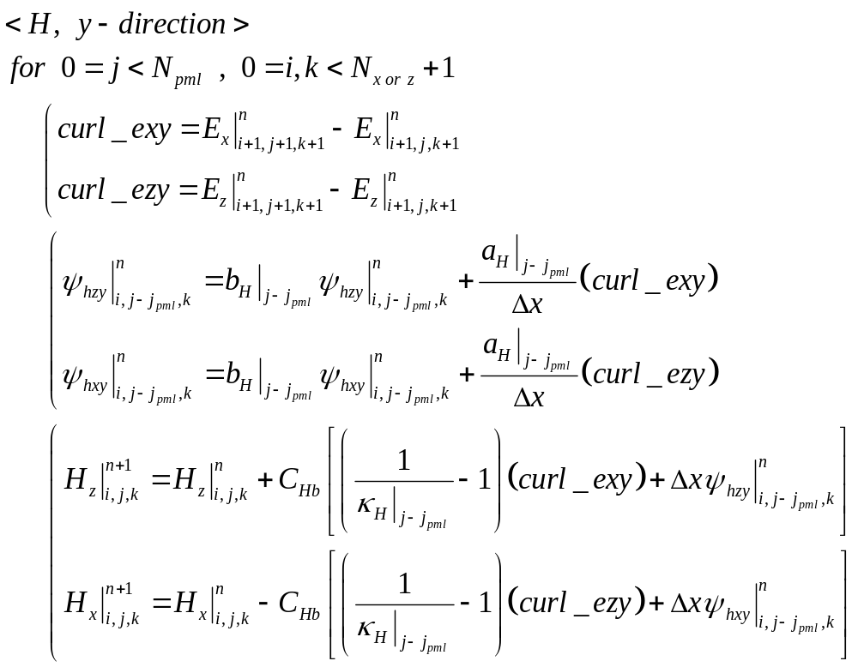
CPML (E11)
Full code index for H field (2)

Slide 30

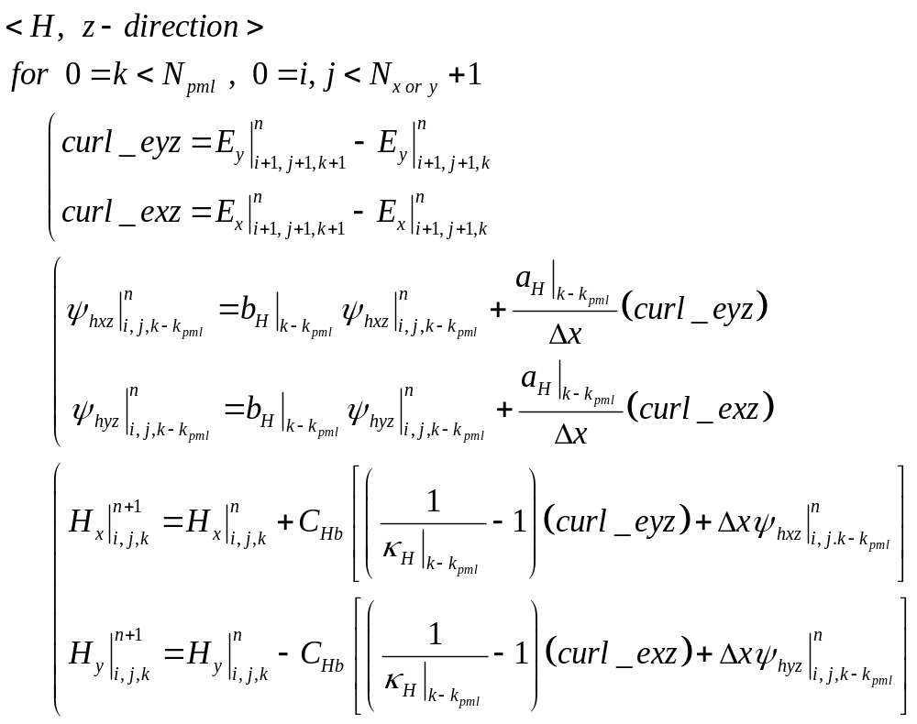
CPML (E12)
Full code index for H field (3)

Slide 31
E faced and H faced Comapre and Rearrange
Basic Fromular

Slide 32
x direction

Slide 33
CPML (Hfaced- E(in) update – x direction)
Full code index for E field (1)

Slide 34
CPML (Efaced- E(out) update – x direction))
Full code index for E field (1)

Slide 35
CPML (Hfaced- H(out) update – x direction)
Full code index for H field (1)

Slide 36
CPML (Efaced- H(in) update – x direction)
Full code index for H field (1)

Slide 37
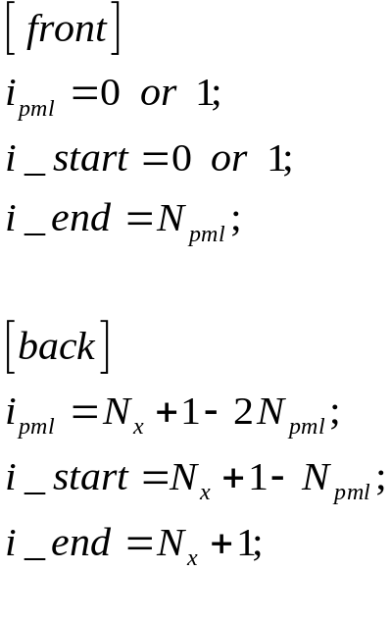
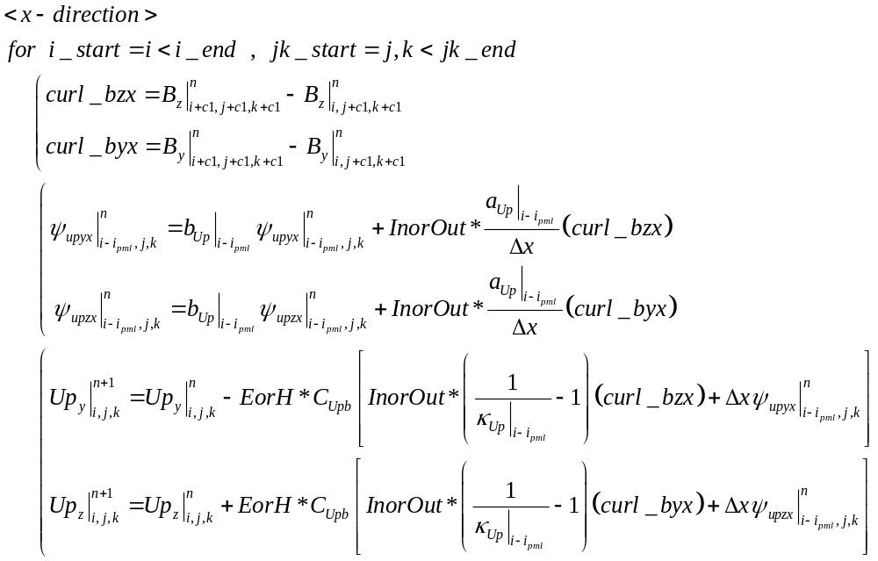
CPML (Combine – x direction)
Full code index

Slide 38
CPML (Combine – x direction)
Up = Update field
B = Base field
In field update
  InorOut= +1
  c1=+1;
  i_start, i_end, ipml
    (front) i_start=0; i_end=Npml; ipml=0;
    (back) i_start=Nx+1-Npml; i_end=Nx+1; ipml=Nx+1-2*Npml;
  j_start=0; j_end=Ny+1; k_start=0; k_end=Nz+1;
Out field update
  InorOut= -1
  c1=-1;
  i_start, i_end, ipml
    (front) i_start=1; i_end=Npml+1; ipml=1;
    (back) i_start=Nx+1-Npml; i_end=Nx+1; ipml=Nx+1-2*Npml;
  j_start=1; j_end=Ny+1; k_start=1; k_end=Nz+1;
EorH
  if E field 업데이트 : EorH = +1
  if H field 업데이트 : EorH = -1

Slide 39
y direction

Slide 40
CPML (Hfaced- E(in) update – y direction)
Full code index for E field (2)

Slide 41
CPML (Efaced- E(out) update – y direction)
Full code index for E field (2)

Slide 42
CPML (Hfaced- H(out) update – y direction)
Full code index for H field (2)

Slide 43
CPML (Efaced- H(in) update – y direction)
Full code index for H field (2)

Slide 44
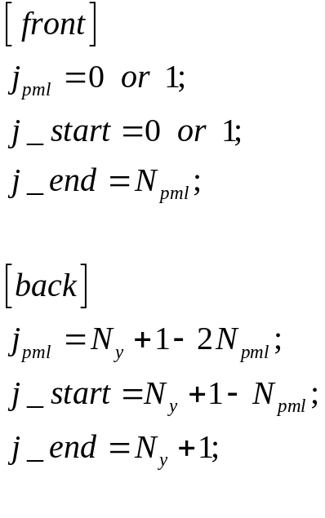
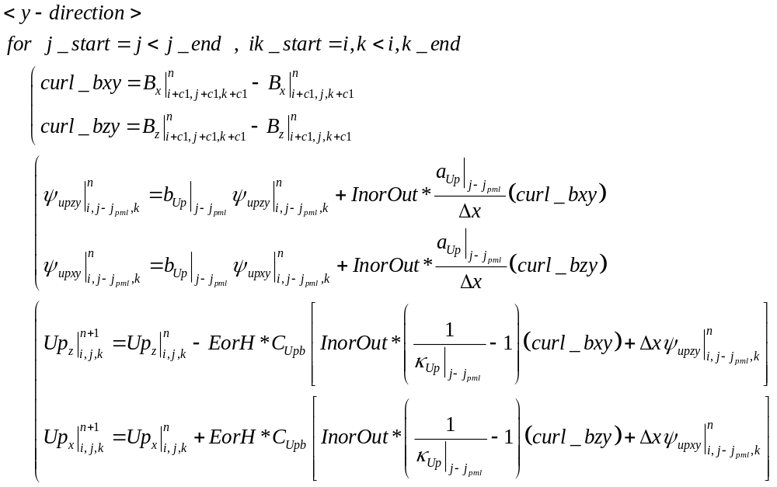
CPML (Combine – y direction)
Full code index

Slide 45
CPML (Combine – y direction)
Up = Update field
B = Base field
In field update
  InorOut= +1
  c1=+1;
  j_start, j_end, jpml
    (front) j_start=0; j_end=Npml; jpml=0;
    (back) j_start=Ny+1-Npml; j_end=Ny+1; jpml=Ny+1-2*Npml;
  i_start=0; i_end=Nx+1; k_start=0; k_end=Nz+1;
Out field update
  InorOut= -1
  c1=-1;
  j_start, j_end, jpml
    (front) j_start=1; j_end=Npml+1; jpml=1;
    (back) j_start=Ny+1-Npml; j_end=Ny+1; jpml=Ny+1-2*Npml;
  i_start=1; i_end=Nx+1; k_start=1; k_end=Nz+1;
EorH
  if E field 업데이트 : EorH = +1
  if H field 업데이트 : EorH = -1

Slide 46
z direction

Slide 47
CPML (Hfaced- E(in) update – z direction)
Full code index for E field (3)

Slide 48
CPML (Efaced- E(out) update – z direction)
Full code index for E field (3)

Slide 49
CPML (Hfaced- H(out) update – z direction)
Full code index for H field (3)

Slide 50
CPML (Efaced- H(in) update – z direction)
Full code index for H field (3)

Slide 51
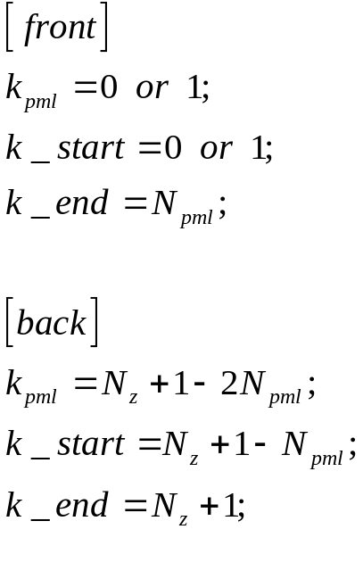
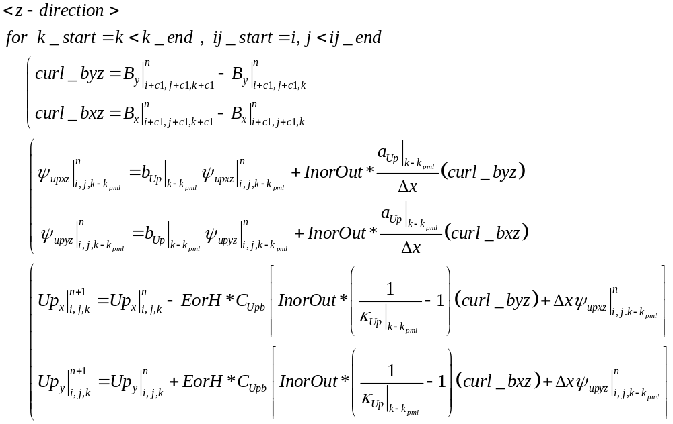
CPML (Combine –z direction)
Full code index

Slide 52
CPML (Combine –z direction)
Up = Update field
B = Base field
In field update
  InorOut= +1
  c1=+1;
  k_start, k_end, kpml
    (front) k_start=0; k_end=Npml; jpml=0;
    (back) k_start=Nz+1-Npml; k_end=Nz+1; kpml=Nz+1-2*Npml;
  i_start=0; i_end=Nx+1; j_start=0; j_end=Ny+1;
Out field update
  InorOut= -1
  c1=-1;
  k_start, k_end, kpml
    (front) k_start=1; k_end=Npml+1; kpml=1;
    (back) k_start=Nz+1-Npml; k_end=Nz+1; kpml=Nz+1-2*Npml;
  i_start=1; i_end=Nx+1; j_start=1; j_end=Ny+1;
EorH
  if E field 업데이트 : EorH = +1
  if H field 업데이트 : EorH = -1

Slide 53
CPML 방향까지 통합하는 과정

Slide 54
CPML (Combine – x direction)
Full code index – x direction

Slide 55
CPML (Combine – y direction)
Full code index – y direction

Slide 56
CPML (Combine –z direction)
Full code index – z direction

Slide 57
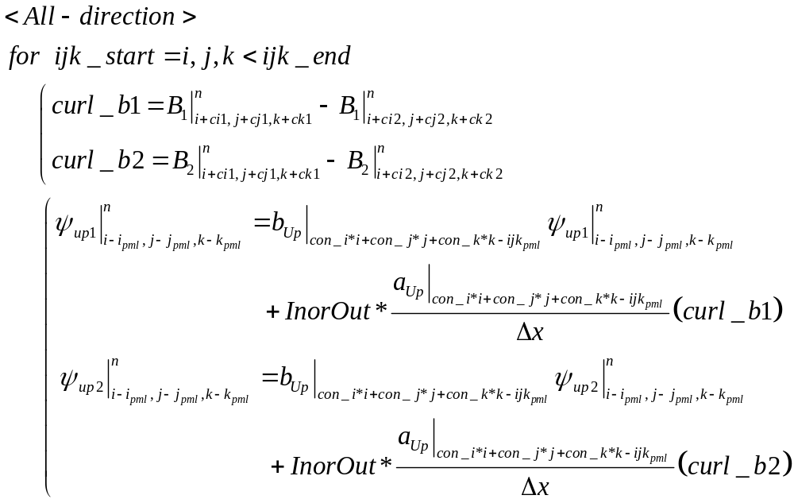
CPML (Combine – All direction)
Full code index – All direction

Slide 58
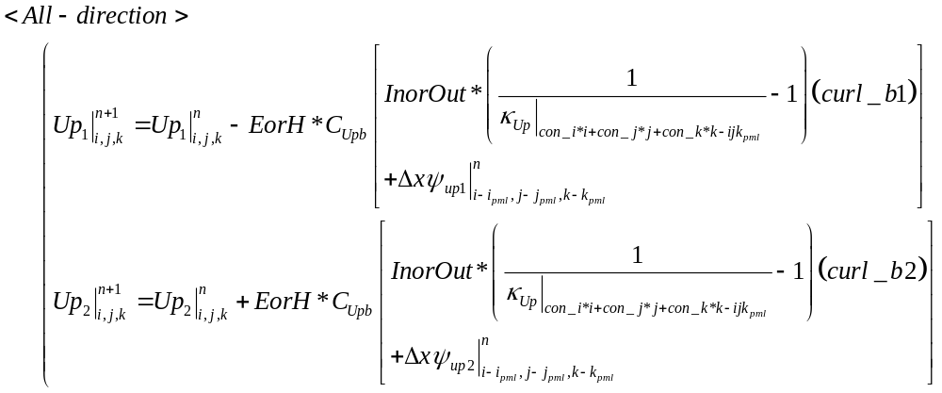
CPML (Combine – All direction)
Full code index – All direction (계속)

Slide 59
x direction parameters
x direction
  Inner field update
    front
      i_start =0; i_end=Npml; j_start=0; j_end=Ny+1; k_start=0; k_end=Nz+1;
      ipml=0; jpml=0; kpml=0; ijkpml=0;
    back
      i_start =Nx+1-Npml; i_end=Nx+1; j_start=0; j_end=Ny+1; k_start=0; k_end=Nz+1;
      ipml=Nx+1-2*Npml; jpml=0; kpml=0; ijkpml=Nx+1-2*Npml;
    B1=Bz; B2=By; Up1=Upy; Up2=Upz; psi_up1=psi_upyx; psi_up2=psi_upzx;
    ci1=+1; cj1=+1; ck1=+1; ci2=0; cj2=+1; ck2=+1;
    con_i=1; con_j=0; con_k=0;
    InorOut=+1; if E-update : EorH=+1; if H-update : EorH=-1;
  Outer field update
    front
      i_start =1; i_end=Npml+1; j_start=1; j_end=Ny+1; k_start=1; k_end=Nz+1;
      ipml=1; jpml=0; kpml=0; ijkpml=1;
    back
      i_start =Nx+1-Npml; i_end=Nx+1; j_start=1; j_end=Ny+1; k_start=1; k_end=Nz+1;
      ipml=Nx+1-2*Npml; jpml=0; kpml=0; ijkpml=Nx+1-2*Npml;
    B1=Bz; B2=By; Up1=Upy; Up2=Upz; psi_up1=psi_upyx; psi_up2=psi_upzx;
    ci1=-1; cj1=-1; ck1=-1; ci2=0; cj2=-1; ck2=-1;
    con_i=1; con_j=0; con_k=0;
    InorOut=-1; if E-update : EorH=+1; if H-update : EorH=-1;

Slide 60
y direction parameters
y direction
  Inner field update
    front
      i_start =0; i_end=Nx+1; j_start=0; j_end=Npml; k_start=0; k_end=Nz+1;
      ipml=0; jpml=0; kpml=0; ijkpml=0;
    back
      i_start =0; i_end=Nx+1; j_start=Ny+1-Npml; j_end=Ny+1; k_start=0; k_end=Nz+1;
      ipml=0; jpml=Ny+1-2*Npml; kpml=0; ijkpml=Ny+1-2*Npml;
    B1=Bx; B2=Bz; Up1=Upz; Up2=Upx; psi_up1=psi_upzy; psi_up2=psi_upxy;
    ci1=+1; cj1=+1; ck1=+1; ci2=+1; cj2=0; ck2=+1;
    con_i=0; con_j=1; con_k=0;
    InorOut=+1; if E-update : EorH=+1; if H-update : EorH=-1;
  Outer field update
    front
      i_start =1; i_end=Nx+1; j_start=1; j_end=Npml+1; k_start=1; k_end=Nz+1;
      ipml=0; jpml=1; kpml=0; ijkpml=1;
    back
      i_start =1; i_end=Nx+1; j_start=Ny+1-Npml; j_end=Ny+1; k_start=1; k_end=Nz+1;
      ipml=0; jpml=Ny+1-2*Npml; kpml=0; ijkpml=Ny+1-2*Npml;
    B1=Bx; B2=Bz; Up1=Upz; Up2=Upx; psi_up1=psi_upzy; psi_up2=psi_upxy;
    ci1=-1; cj1=-1; ck1=-1; ci2=-1; cj2=0; ck2=-1;
    con_i=0; con_j=1; con_k=0;
    InorOut=-1; if E-update : EorH=+1; if H-update : EorH=-1;

Slide 61
z direction parameters
z direction
  Inner field update
    front
      i_start =0; i_end=Nx+1; j_start=0; j_end=Ny+1; k_start=0; k_end=Npml;
      ipml=0; jpml=0; kpml=0; ijkpml=0;
    back
      i_start =0; i_end=Nx+1; j_start=0; j_end=Ny+1; k_start=0; k_end=Nz+1-Npml;
      ipml=0; jpml=0; kpml=Nz+1-2*Npml; ijkpml=Nz+1-2*Npml;
    B1=By; B2=Bx; Up1=Upx; Up2=Upy; psi_up1=psi_upxz; psi_up2=psi_upyz;
    ci1=+1; cj1=+1; ck1=+1; ci2=+1; cj2=+1; ck2=0;
    con_i=0; con_j=0; con_k=1;
    InorOut=+1; if E-update : EorH=+1; if H-update : EorH=-1;
  Outer field update
    front
      i_start =1; i_end=Nx+1; j_start=1; j_end=Ny+1; k_start=1; k_end=Npml+1;
      ipml=0; jpml=0; kpml=1; ijkpml=1;
    back
      i_start =1; i_end=Nx+1; j_start=1; j_end=Ny+1; k_start=1; k_end=Nz+1-Npml;
      ipml=0; jpml=0; kpml=Nz+1-2*Npml; ijkpml=Nz+1-2*Npml;
    B1=By; B2=Bx; Up1=Upx; Up2=Upy; psi_up1=psi_upxz; psi_up2=psi_upyz;
    ci1=-1; cj1=-1; ck1=-1; ci2=-1; cj2=-1; ck2=0;
    con_i=0; con_j=0; con_k=1;
    InorOut=-1; if E-update : EorH=+1; if H-update : EorH=-1;

Slide 62
총정리

Slide 63
총정리(1) – cpml( ) 함수
입력변수(Python)
  String pml_position
    ‘front’ or ‘back’. 다른 값들은 에러를 일으킨다.
    problem 공간에서 pml이 적용되는 위치를 결정한다.
  String in_out
    ‘in_field’ or ‘out_field’. 다른 값들은 에러를 일으킨다.
    업데이트 되는 field가 inner field인지 혹은 outer field 인지 결정한다.
    이로 인해서 c1의 값이 +1이냐 혹은 -1이냐가 결정된다.
  Integer info_direction
    x direction = 0 , y direction = 1, z direction = 2 의 값을 가진다. 다른 값들은 에러를 일으킨다.
    pml이 적용되는 방향을 가리킨다.
  Integer npml
    pml이 적용되는 cell의 개수를 의미한다. (전체 pml depth)
  Float ds
    단위 cell 길이
  List number_cells
    [Nx, Ny, Nz]
    field array의 cell 공통적으로 적용되는 cell 개수를 의미한다. 즉 [Nx, Ny, Nz]이다. inner field의 경우 cell 개수는 (Nx+1, Ny+1, Nz+1)이고 outer field의 경우 (Nx+2, Ny+2, Nz+2)이다.

Slide 64
총정리 (2)– cpml( ) 함수
입력변수(Python-계속)
  List update_field
    update_field = [Ex, Ey, Ez] or [Hx, Hy, Hz]
    E field array or H field array
    이 함수 안에서 업데이트 되는 필드를 의미한다.
  List base_field
    base_field = [Ex, Ey, Ez] or [Hx, Hy, Hz]
    E field array or H field array
    이 함수 안에서 업데이트 될 때 필요한 counter field를 의미한다.
  List psi
    psi_e or psi_h
    psi_e = [psi_eyx, psi_ezx, psi_ezy, psi_exy, psi_exz, psi_eyz]
    psi_h = [psi_hyx, psi_hzx, psi_hzy, psi_hxy, psi_hxz, psi_hyz]
  List pml_parameter
    pml_parameter = [kapa_E, rcm_bE, mrcm_aE] or [kapa_H, rcm_bH, mrcm_aH]
  List cb
    Chb 혹은 Ceb 이다.
출력 값(Python)
  출력 값은 None으로 array 위에서 특정한 연산만을 수행하도록 하는 함수이다.

Slide 65
총정리(3) – cpml( ) 함수
C 함수 안에서의 지역변수
  char *in_out -> from String in_out
  char *pml_position -> from String pml_position
  int N[3] = {Nx, Ny, Nz} -> from List number_cells
  int info_direction -> from Integer info_direction
  int npml -> from Integer npml
  float ds -> from Float ds
  PyArrayObject *up1, *up2 -> from List update_field
  PyArrayObject *base1, *base2 -> from List base_field
  PyArrayObject *psi_up1, *psi_up2 -> from List psi
  PyArrayObject *kapa, *rcm_b, *mrcm_a -> from List pml_parameter
  PyArrayObject *cb1, *cb2 -> from List cb

Slide 66
총정리(4) – cpml( ) 함수
C 함수 안에서의 지역변수 (계속)
  int permutation1, permutation2
info_direction (pml 방향) | up1 | up2 | base1 | base2 | psi_up1 | psi_up2
x(0) | y(1) | z(2) | z(2) | y(1) | y(1) | z(2)
y(1) | z(2) | x(0) | x(0) | z(2) | z(2) | x(0)
z(2) | x(0) | y(1) | y(1) | x(0) | x(0) | y(1)
 | permutation1 | permutation2 | permutation2 | permutation1 | permutation1 | permutation2
 | permutation1 | (info_directoin+1) % 3
 | permutation2 | (info_directoin+2) % 3

Slide 67
총정리(5) – cpml( ) 함수
C 함수 안에서의 지역변수 (계속)
  int con[3] = {con_i, con_j, con_k}
  int INorOUT
  int c1[3] = {ci1, cj1, ck1}
  int c2[3] = {ci2, cj2, ck2}
  int start[3] = {i_start, j_start, k_start}
  int end[3] = {i_end, j_end, k_end}
  int pml[3] = {ipml, jpml, kpml}
  int ijkpml
  위의 값들은 아래 4개의 표와 같은 구성을 갖는다.

Slide 68
총정리(6) – cpml( ) 함수 – C 지역변수 (계속)
In or Out | Front or Back | 변수 | 초기치 |  | x 방향 | y 방향 | z 방향
In | Front | int INorOUT | 1 |  | 1 | 1 | 1
 |  | int c1[3] | {1, 1, 1} | c1[x] | 1 | 1 | 1
 |  |  |  | c1[y] | 1 | 1 | 1
 |  |  |  | c1[z] | 1 | 1 | 1
 |  | int c2[3] | {1, 1, 1} | c2[x] | 0 | 1 | 1
 |  |  |  | c2[y] | 1 | 0 | 1
 |  |  |  | c2[z] | 1 | 1 | 0
 |  | int start[3] | {0, 0, 0} | start[x] | 0 | 0 | 0
 |  |  |  | start[y] | 0 | 0 | 0
 |  |  |  | start[z] | 0 | 0 | 0
 |  | int end[3] | {Nx+1, Ny+1, Nz+1} | end[x] | npml | Nx+1 | Nx+1
 |  |  |  | end[y] | Ny+1 | npml | Ny+1
 |  |  |  | end[z] | Nz+1 | Nz+1 | npml
 |  | int pml[3] | {0, 0, 0} | pml[x] | 0 | 0 | 0
 |  |  |  | pml[y] | 0 | 0 | 0
 |  |  |  | pml[z] | 0 | 0 | 0
 |  | int ijkpml | 0 |  | 0 | 0 | 0
 |  | int con[3] | {0, 0, 0} | con[x] | 1 | 0 | 0
 |  |  |  | con[y] | 0 | 1 | 0
 |  |  |  | con[z] | 0 | 0 | 1

Slide 69
총정리(7) – cpml( ) 함수 – C 지역변수 (계속)
In or Out | Front or Back | 변수 | 초기치 |  | x 방향 | y 방향 | z 방향
In | Back | int INorOUT | 1 |  | 1 | 1 | 1
 |  | int c1[3] | {1, 1, 1} | c1[x] | 1 | 1 | 1
 |  |  |  | c1[y] | 1 | 1 | 1
 |  |  |  | c1[z] | 1 | 1 | 1
 |  | int c2[3] | {1, 1, 1} | c2[x] | 0 | 1 | 1
 |  |  |  | c2[y] | 1 | 0 | 1
 |  |  |  | c2[z] | 1 | 1 | 0
 |  | int start[3] | {0, 0, 0} | start[x] | Nx+1-npml | 0 | 0
 |  |  |  | start[y] | 0 | Ny+1-npml | 0
 |  |  |  | start[z] | 0 | 0 | Nz+1-npml
 |  | int end[3] | {Nx+1, Ny+1, Nz+1} | end[x] | Nx+1 | Nx+1 | Nx+1
 |  |  |  | end[y] | Ny+1 | Ny+1 | Ny+1
 |  |  |  | end[z] | Nz+1 | Nz+1 | Nz+1
 |  | int pml[3] | {0, 0, 0} | pml[x] | Nx+1-2*npml | 0 | 0
 |  |  |  | pml[y] | 0 | Nx+1-2*npml | 0
 |  |  |  | pml[z] | 0 | 0 | Nx+1-2*npml
 |  | int ijkpml | 0 |  | Nx+1-2*npml | Nx+1-2*npml | Nx+1-2*npml
 |  | int con[3] | {0, 0, 0} | con[x] | 1 | 0 | 0
 |  |  |  | con[y] | 0 | 1 | 0
 |  |  |  | con[z] | 0 | 0 | 1

Slide 70
총정리(8) – cpml( ) 함수 – C 지역변수 (계속)
In or Out | Front or Back | 변수 | 초기치 |  | x 방향 | y 방향 | z 방향
Out | Front | int INorOUT | -1 |  | -1 | -1 | -1
 |  | int c1[3] | {-1, -1, -1} | c1[x] | -1 | -1 | -1
 |  |  |  | c1[y] | -1 | -1 | -1
 |  |  |  | c1[z] | -1 | -1 | -1
 |  | int c2[3] | {-1, -1, -1} | c2[x] | 0 | -1 | -1
 |  |  |  | c2[y] | -1 | 0 | -1
 |  |  |  | c2[z] | -1 | -1 | 0
 |  | int start[3] | {1, 1, 1} | start[x] | 1 | 1 | 1
 |  |  |  | start[y] | 1 | 1 | 1
 |  |  |  | start[z] | 1 | 1 | 1
 |  | int end[3] | {Nx+1, Ny+1, Nz+1} | end[x] | npml+1 | Nx+1 | Nx+1
 |  |  |  | end[y] | Ny+1 | npml+1 | Ny+1
 |  |  |  | end[z] | Nz+1 | Nz+1 | npml+1
 |  | int pml[3] | {0, 0, 0} | pml[x] | 1 | 0 | 0
 |  |  |  | pml[y] | 0 | 1 | 0
 |  |  |  | pml[z] | 0 | 0 | 1
 |  | int ijkpml | 1 |  | 1 | 1 | 1
 |  | int con[3] | {0, 0, 0} | con[x] | 1 | 0 | 0
 |  |  |  | con[y] | 0 | 1 | 0
 |  |  |  | con[z] | 0 | 0 | 1

Slide 71
총정리(9) – cpml( ) 함수 – C 지역변수 (계속)
In or Out | Front or Back | 변수 | 초기치 |  | x 방향 | y 방향 | z 방향
Out | Back | int INorOUT | -1 |  | -1 | -1 | -1
 |  | int c1[3] | {-1, -1, -1} | c1[x] | -1 | -1 | -1
 |  |  |  | c1[y] | -1 | -1 | -1
 |  |  |  | c1[z] | -1 | -1 | -1
 |  | int c2[3] | {-1, -1, -1} | c2[x] | 0 | -1 | -1
 |  |  |  | c2[y] | -1 | 0 | -1
 |  |  |  | c2[z] | -1 | -1 | 0
 |  | int start[3] | {1, 1, 1} | start[x] | Nx+1-npml | 1 | 1
 |  |  |  | start[y] | 1 | Ny+1-npml | 1
 |  |  |  | start[z] | 1 | 1 | Nz+1-npml
 |  | int end[3] | {Nx+1, Ny+1, Nz+1} | end[x] | Nx+1 | Nx+1 | Nx+1
 |  |  |  | end[y] | Ny+1 | Ny+1 | Ny+1
 |  |  |  | end[z] | Nz+1 | Nz+1 | Nz+1
 |  | int pml[3] | {0, 0, 0} | pml[x] | Nx+1-2*npml | 0 | 0
 |  |  |  | pml[y] | 0 | Nx+1-2*npml | 0
 |  |  |  | pml[z] | 0 | 0 | Nx+1-2*npml
 |  | int ijkpml | 1 |  | Nx+1-2*npml | Nx+1-2*npml | Nx+1-2*npml
 |  | int con[3] | {0, 0, 0} | con[x] | 1 | 0 | 0
 |  |  |  | con[y] | 0 | 1 | 0
 |  |  |  | con[z] | 0 | 0 | 1

Slide 72
총정리(10) – cpml( ) 함수
C 함수 안에서의 지역변수 (계속)
  int cb_EorH
    cb가 ceb인지 chb인지 결정하는 parameter.
    cb가 ceb이면 E field update이며, chb이면 H field update이다.
  int c_EH
    E field update : c_EH = 1; H field update : c_EH = 0;
  int EorH
    E field update : EorH = 1; H field update : EorH = -1;
 |  | cb_EorH(x 방향) | cb_EorH(y 방향) | cb_EorH(z 방향) | c_EH | EorH
Efaced | E field update (ceb) | (Ny+Nz)+4 | (Nz+Nx)+4 | (Nx+Ny)+4 | 1 | 1
 | H field update (chb) | 6 | 6 | 6 | 0 | -1
Hfaced | E field update (ceb) | (Ny+Nz)+2 | (Nz+Nx)+2 | (Nx+Ny)+2 | 1 | 1
 | H field update (chb) | 6 | 6 | 6 | 0 | -1

Slide 73
총정리(11) – cpml( ) 함수
C 함수 안에서의 지역변수 (계속)
  float curl_b1, curl_b2
    curl of base1 and curl of base2
  int i_ci1, i_ci2, i_ipml
    i_ci1 = i + ci1; i_ci2 = i + ci2; i_ipml = i – jpml
  int j_cj1, j_cj2, j_jpml
    j_cj1 = j + cj1; j_cj2 = j + cj2; j_jpml = j – jpml
  int k_ck1, k_ck2, k_kpml
    k_ck1 = k + ck1; k_ck2 = k + ck2; k_kpml = k – kpml
  int con_ijkpml
    con_ijkpml = con_i * I + con_j * j + con_k * k -ijkpml
  int c_EH_i, c_EH_j, c_EH_k`
    c_EH_i = c_EH * i; c_EH_j = c_EH * j; c_EH_k = c_EH * k;

Slide 74
총정리(12) – cpml_direction(x,y,z)( ) 함수
마지막으로 update field가 outer field이면 대칭적인 계산을 위해서 추가로 계산해 줘야 하는 부분이 있다. 이 부분에 대해서는 updated field가 outer field일 경우만 계산을 하도록 한다.
  x direction (X_AXIS)
    (1) y index 끝에서 한 줄 더 계산해 준다.
      j = j_end; j_jpml = 0; -> psi_up1 의 안 쓰는 한 면을 활용하는 것임.
    (2) z index 끝에서 한 줄 더 계산해 준다.
      k = k_end; k_kpml = 0; -> psi_up2 의 안 쓰는 한 면을 활용하는 것임.
  y direction (Y_AXIS)
    (1) z index 끝에서 한 줄 더 계산해 준다.
      k = k_end; k_kpml = 0; -> psi_up1 의 안 쓰는 한 면을 활용하는 것임.
    (2) x index 끝에서 한 줄 더 계산해 준다.
      i = i_end; i_ipml = 0; -> psi_up2 의 안 쓰는 한 면을 활용하는 것임.
  z direction (Z_AXIS)
    (1) x index 끝에서 한 줄 더 계산해 준다.
      i = i_end; i_ipml = 0; -> psi_up1 의 안 쓰는 한 면을 활용하는 것임.
    (2) y index 끝에서 한 줄 더 계산해 준다.
      j = j_end; j_jpml = 0; -> psi_up2 의 안 쓰는 한 면을 활용하는 것임.

