Slide 1
Mental and Physical Health Among US Veterans: Behavioral Risk Factor Surveillance System 2020
Will Bliss
Term Project 2021
CHS 766

Slide 2
Research Question
Does veteran status have a significant impact on an individual’s mental and physical health?

Slide 3
Background
Department of Veterans Affairs (VA) spends the fifth most of all federal agencies, accounting for 5% of federal spending
The VA spends money on veterans through two programs, the Disability Compensation program and the Veterans Health Administration (VHA)
The Disability Compensation program provides monthly benefits to veterans with service-related disabilities
The VHA oversees all medical care for the VA. It is the largest integrated health care system in the US
US recently pulled all troops out of Afghanistan to end America’s longest war

Slide 4
Research Method
This study will be done using the 2020 Behavioral Risk Factor Surveillance System, a state based national telephone survey

Slide 5
Dependent Variable
POORHLTH: During the past 30 days, for about how many days did poor physical or mental health keep you from doing your usual activities, such as self-care, work, or recreation?

Slide 6
Exposure Variables
VETERAN3: Have you ever served on active duty in the United States Armed Forces, either in the regular military or in a National Guard or military reserve unit?
_SEX: What was your sex at birth? (calculated variable from multiple questions asking about sex)
_IMPRACE: Imputed race/ethnicity value

Slide 7
Exposure Variables
_AGE_G: Six-level imputed age category
EMPLOY1: Employment status
_TOTINDA: Adults who reported doing physical activity or exercise during the past 30 days other than their regular job

Slide 8
Table 1: Descriptive Characteristics of Behavioral Risk Factor Surveillance Survey Participants in the US, 2020
Characteristics |  | n = 401,958
 |  | n | %
Poor Health | No | 111,321 | 56.70
 | Yes | 85,027 | 43.30
Veteran | No | 351,210 | 87.93
 | Yes | 48,211 | 12.07
Sex | Female | 218,027 | 54.24
 | Male | 183,931 | 45.76
Race | White | 303,886 | 75.60
 | American Indian / Alaskan Native | 6,954 | 1.73
 | Asian | 10,243 | 2.55
 | Black | 30,390 | 7.56
 | Hispanic | 36,408 | 9.06
 | Other | 14,077 | 3.50
Age | 18 – 34 | 70,034 | 17.42
 | 35 – 64 | 192,093 | 47.79
 | 65+ | 139,831 | 34.79
Employed | No | 166,279 | 42.11
 | Yes | 228,603 | 57.89
Physically Active | No | 95,393 | 23.77
 | Yes | 305,883 | 76.23
205,610 respondents did not respond to the poor health question

Slide 9
Table 2: Factors Associated with Reporting Poor Health in the Last 40 Days, Among Adults in the US, 2020
Characteristics |  | Reported Poor Health
 |  | n = 401,958
 |  | Yes (%) | No (%) | p Value
Veteran | No | 75,675 (44.7%) | 99,513 (55.3%) | 0.3193
 | Yes | 8,930 (43.8%) | 11,236 (56.2%)
Sex | Female | 51,738 (46.3%) | 65,708 (53.7%) | <0.0001
 | Male | 33,289 (42.3%) | 45,613 (57.6%)
Race | White | 63,249 (43.2%) | 86,152 (56.8%) | <0.0001
 | American Indian / Alaskan Native | 1,958 (52.8%) | 1,743 (47.2%)
 | Asian | 1,692 (44.3%) | 2,217 (55.7%)
 | Black | 6,826 (46.1%) | 8,306 (53.9%)
 | Hispanic | 7,622 (47.6%) | 8,961 (52.4%)
 | Other | 3,680 (49.9%) | 3,942 (50.1%)
Age | 18 – 34 | 19,065 (46.9%) | 22,207 (53.1%) | <0.0001
 | 35 – 64 | 42,507 (44.5%) | 53,077 (55.5%)
 | 65+ | 23,455 (40.6%) | 36,037 (59.4%)
Employed | No | 41,570 (52.6%) | 41,581 (47.4%) | <0.0001
 | Yes | 42,218 (40.3%) | 67,766 (59.7%)
Physically Active | No | 27,775 (53.2%) | 25,071 (46.8%) | <0.0001
 | Yes | 57,091 (41.6%) | 86,075 (58.4%)

Slide 10
Inferences from Table 2
A larger portion of non-veterans reported poor health compared to veterans
P-Value above 0.05 for the veteran variable’s distribution
Higher percentages of poor health for
American Indian/Alaskan Native respondents
Unemployed respondents
Physically inactive respondents

Slide 11
Table 3: Factors Independently Associated with Poor Health Among Adults in the US, 2020
Characteristics |  | aOR | Lower CL | Upper CL | p Value
Veteran | No | Reference
 | Yes | 1.0720 | 0.9924 | 1.1580 | 0.0773
Sex | Female | Reference
 | Male | 0.8365 | 0.7992 | 0.8756 | <0.0001
Race | White | Reference
 | American Indian / Alaskan Native | 1.3965 | 1.1904 | 1.6382 | <0.0001
 | Asian | 1.0423 | 0.8983 | 1.2094 | 0.5849
 | Black | 0.9902 | 0.9240 | 1.0612 | 0.7812
 | Hispanic | 1.1025 | 1.0172 | 1.1950 | 0.0176
 | Other | 1.2381 | 1.1124 | 1.3781 | <0.0001
Age | 18 – 34 | Reference
 | 35 – 64 | 0.7600 | 0.7215 | 0.8004 | <0.0001
 | 65+ | 0.4175 | 0.3878 | 0.4494 | <0.0001
Employed | No | Reference
 | Yes | 0.4750 | 0.4497 | 0.5018 | <0.0001
Physically Active | No | Reference
 | Yes | 0.6499 | 0.6178 | 0.6837 | <0.0001

Slide 12
Inferences from Table 3
Veterans status produces an odds ratio of 1.0720, implying that it is more likely for a veteran to report poor health vs non-veterans, contradictory to Table 2
P-Value above 0.05 for this adjusted odds ratio
American Indian/Alaskan Native race is much more likely to report poor health than white respondents, and this is independent of veteran status
Might explain why “American Indian/Alaska Native veterans reported more physically unhealthy days” (Luncheon)
Older age groups are less likely to report poor health, as compared to the 18 – 34 age group

Slide 13
Table 4: Analysis of Maximum Likelihood Estimates Using Logistic Regression
Parameter |  | Estimate | Standard Error | p value
Intercept |  | 0.00768 | 0.0283 | 0.7859
Veteran | Yes | Reference
 | No | -0.0348 | 0.0197 | 0.0773
Sex | Male | Reference
 | Female | 0.0892 | 0.0116 | <.0001
Race | White | Reference
 | American Indian / Alaskan Native | 0.2211 | 0.0695 | 0.0015
 | Asian | -0.0714 | 0.0651 | 0.2732
 | Black | -0.1226 | 0.0352 | 0.0005
 | Hispanic | -0.0152 | 0.039 | 0.6964
 | Other | 0.1008 | 0.0489 | 0.0393
Age | 65+ | Reference
 | 18 - 34 | 0.3827 | 0.0189 | <.0001
 | 35 - 64 | 0.1082 | 0.015 | <.0001
Employed | Yes | Reference
 | No | 0.3722 | 0.014 | <.0001
Physically Active | Yes | Reference
 | No | 0.2155 | 0.0129 | <.0001

Slide 14
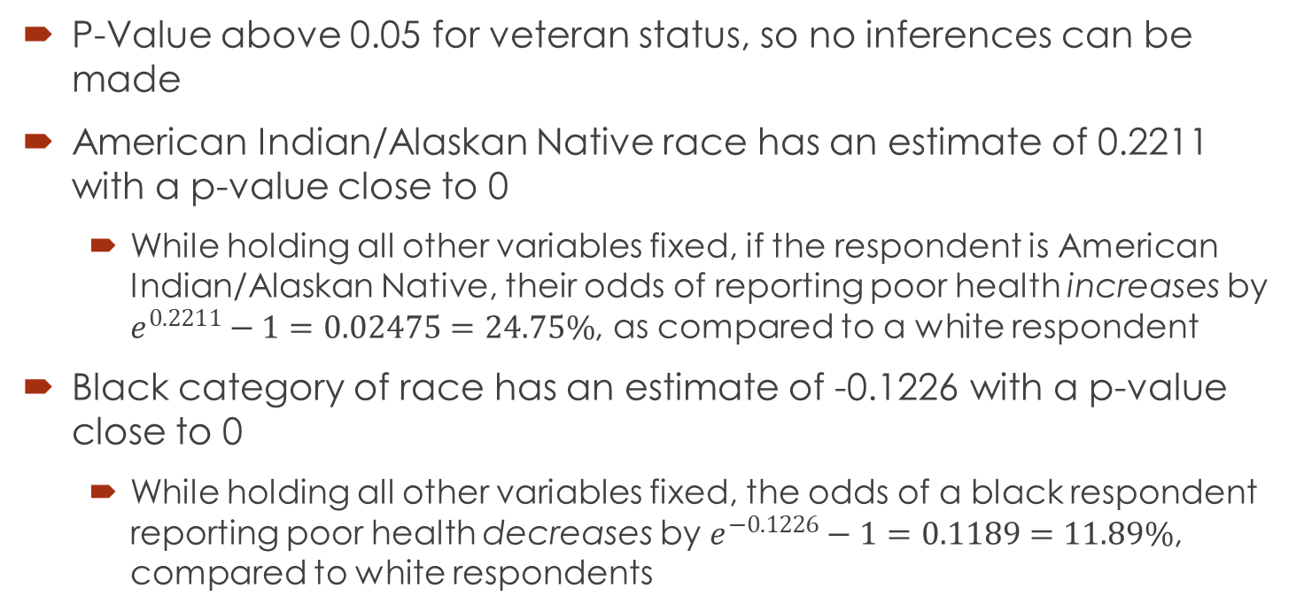
Inferences from Table 4
P-Value above 0.05 for veteran status, so no inferences can be made
American Indian/Alaskan Native race has an estimate of 0.2211 with a p-value close to 0
While holding all other variables fixed, if the respondent is American Indian/Alaskan Native, their odds of reporting poor health increases by $e^{0.2211}−1=0.02475=24.75\%$, as compared to a white respondent
Black category of race has an estimate of -0.1226 with a p-value close to 0
While holding all other variables fixed, the odds of a black respondent reporting poor health decreases by $e^{−0.1226}−1=0.1189=11.89\%$, compared to white respondents

Slide 15
Conclusions
Unemployed veterans reporting a higher frequency of poor health in Table 2 seems natural, but it is helpful to see it represented with data, rather than just assuming that this is the case.
Unfortunately, there is not enough data to confirm that there is anything extraordinary happening after also checking Table 3 and Table 4
There is no obvious increase in the reporting of poor health from non-veterans to veterans

Slide 16
Questions?

Slide 17
Should the VA Increase Funding for the Promotion of Physical and Mental Health?

Slide 18
References
Asdigian, N. L., Bear, U. R., Beals, J., Manson, S. M., & Kaufman, C. E. (2018). Mental health burden in a national sample of American Indian and Alaska Native adults: differences between multiple-race and single-race subgroups. Social psychiatry and psychiatric epidemiology, 53(5), 521–530. https://doi.org/10.1007/s00127-018-1494-1
Faestel, P. M., Littell, C. T., Vitiello, M. V., Forsberg, C. W., & Littman, A. J. (2013). Perceived insufficient rest or sleep among veterans: Behavioral Risk Factor Surveillance System 2009. Journal of clinical sleep medicine : JCSM : official publication of the American Academy of Sleep Medicine, 9(6), 577–584. https://doi.org/10.5664/jcsm.2754
Hein, T. C., Muz, B., Ahmadi-Montecalvo, H., & Smith, T. (2020). Associations among ACEs, Health Behavior, and Veteran Health by Service Era. American journal of health behavior, 44(6), 876–892. https://doi.org/10.5993/AJHB.44.6.11
Hoerster, K. D., Lehavot, K., Simpson, T., McFall, M., Reiber, G., & Nelson, K. M. (2012). Health and health behavior differences: U.S. Military, veteran, and civilian men. American journal of preventive medicine, 43(5), 483–489. https://doi.org/10.1016/j.amepre.2012.07.029
Kaufman, C. E., Asdigian, N. L., Running Bear, U., Beals, J., Manson, S. M., Dailey, N., Bair, B., & Shore, J. H. (2020). Rural and Urban American Indian and Alaska Native Veteran Health Disparities: a Population-Based Study. Journal of racial and ethnic health disparities, 7(6), 1071–1078. https://doi.org/10.1007/s40615-020-00730-w
Lehavot, K., Hoerster, K. D., Nelson, K. M., Jakupcak, M., & Simpson, T. L. (2012). Health indicators for military, veteran, and civilian women. American journal of preventive medicine, 42(5), 473–480. https://doi.org/10.1016/j.amepre.2012.01.006
Li, C., Balluz, L. S., Okoro, C. A., Strine, T. W., Lin, J. M., Town, M., Garvin, W., Murphy, W., Bartoli, W., Valluru, B., & Centers for Disease Control and Prevention (CDC) (2011). Surveillance of certain health behaviors and conditions among states and selected local areas --- Behavioral Risk Factor Surveillance System, United States, 2009. Morbidity and mortality weekly report. Surveillance summaries (Washington, D.C. : 2002), 60(9), 1–250.
Luncheon, C., & Zack, M. (2012). Health-related quality of life among US veterans and civilians by race and ethnicity. Preventing chronic disease, 9, E108. https://doi.org/10.5888/pcd9.110138
Mark W. Hoglund, EdD, Rebecca M. Schwartz, PhD, Mental Health in Deployed and Nondeployed Veteran Men and Women in Comparison With Their Civilian Counterparts, Military Medicine, Volume 179, Issue 1, January 2014, Pages 19–25, https://doi.org/10.7205/MILMED-D-13-00235
Smith D. L. (2014). The relationship between employment and veteran status, disability and gender from 2004-2011 Behavioral Risk Factor Surveillance System (BRFSS). Work (Reading, Mass.), 49(2), 325–334. https://doi.org/10.3233/WOR-131648
USAFacts. (2021, May 4). How much money does the US spend on veterans? USAFacts. Retrieved October 6, 2021, from https://usafacts.org/articles/how-much-money-veterans-spending-us/.
Villagran, M., Ledford, C. J., & Canzona, M. R. (2015). Women's Health Identities in the Transition From Military Member to Service Veteran. Journal of health communication, 20(10), 1125–1132. https://doi.org/10.1080/10810730.2015.1018619
York, J. A., Lamis, D. A., Pope, C. A., & Egede, L. E. (2013). Veteran-specific suicide prevention. The Psychiatric quarterly, 84(2), 219–238. https://doi.org/10.1007/s11126-012-9241-3
Zahran, H. S., Kobau, R., Moriarty, D. G., Zack, M. M., Holt, J., Donehoo, R., & Centers for Disease Control and Prevention (CDC) (2005). Health-related quality of life surveillance--United States, 1993-2002. Morbidity and mortality weekly report. Surveillance summaries (Washington, D.C. : 2002), 54(4), 1–35.
Zucchino, D. (2021, April 22). The U.S. War in Afghanistan: How it started, and how it ended. The New York Times. Retrieved October 6, 2021, from https://www.nytimes.com/article/afghanistan-war-us.html.

