Slide 1
Annual report
BLUE CURRENT
2026
A year of care for our ocean

Slide 2
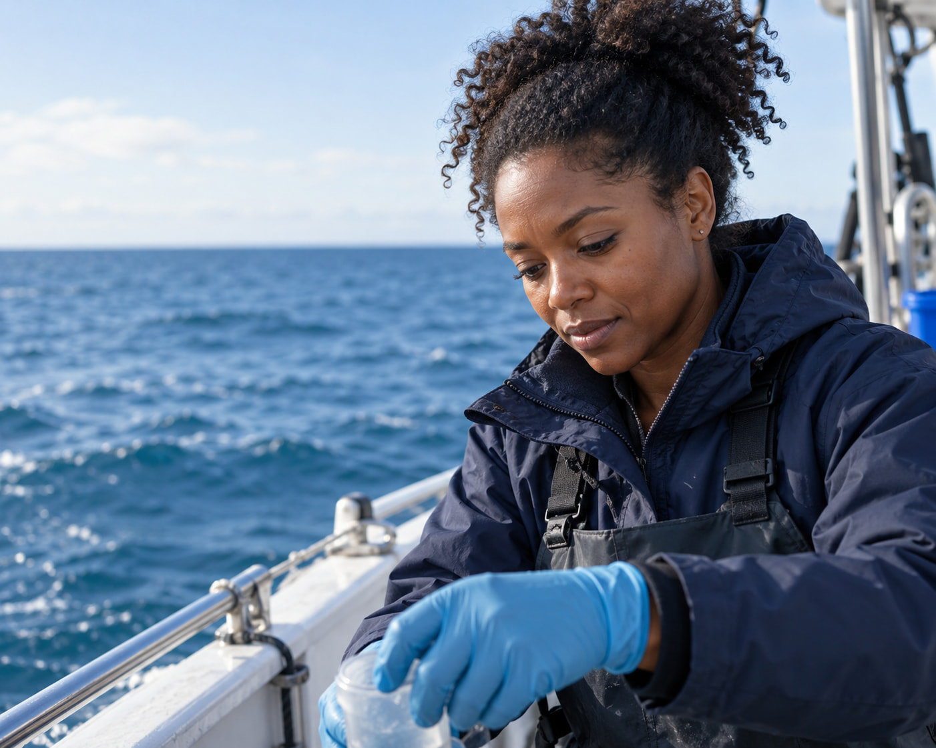
A healthier ocean,
shaped by local care
Blue Current supports communities
working to restore coastal habitats
and reduce marine pollution.
We combine local knowledge with
field research, and share what we
learn along the way.
Healthy habitats
Cleaner waterways
Stronger coastal communities
BLUE CURRENT

Slide 3
Our year
in numbers
Coastal
communities
Healthy
habitats
Local projects connect healthier
habitats with stronger communities.
Ocean
health
Annual impact
Community projects | 18
Volunteer participants | 640
Marine debris collected | 12 t
Habitat under restoration | 42 ha
Care that continues
Long-term partnerships help local teams
monitor change and sustain restoration.
BLUE CURRENT
Illustrative data

Slide 4




More people,
more coastal care
Volunteer participants
Participation grows through local partnerships.
We help volunteers build the skills and
confidence to care for their coast.
640 volunteers
participating in 2026
42 hectares
under restoration
12 tonnes of debris
collected from the coast
18 community projects
supporting local action
Illustrative data for 2022–2026
BLUE CURRENT

Slide 5
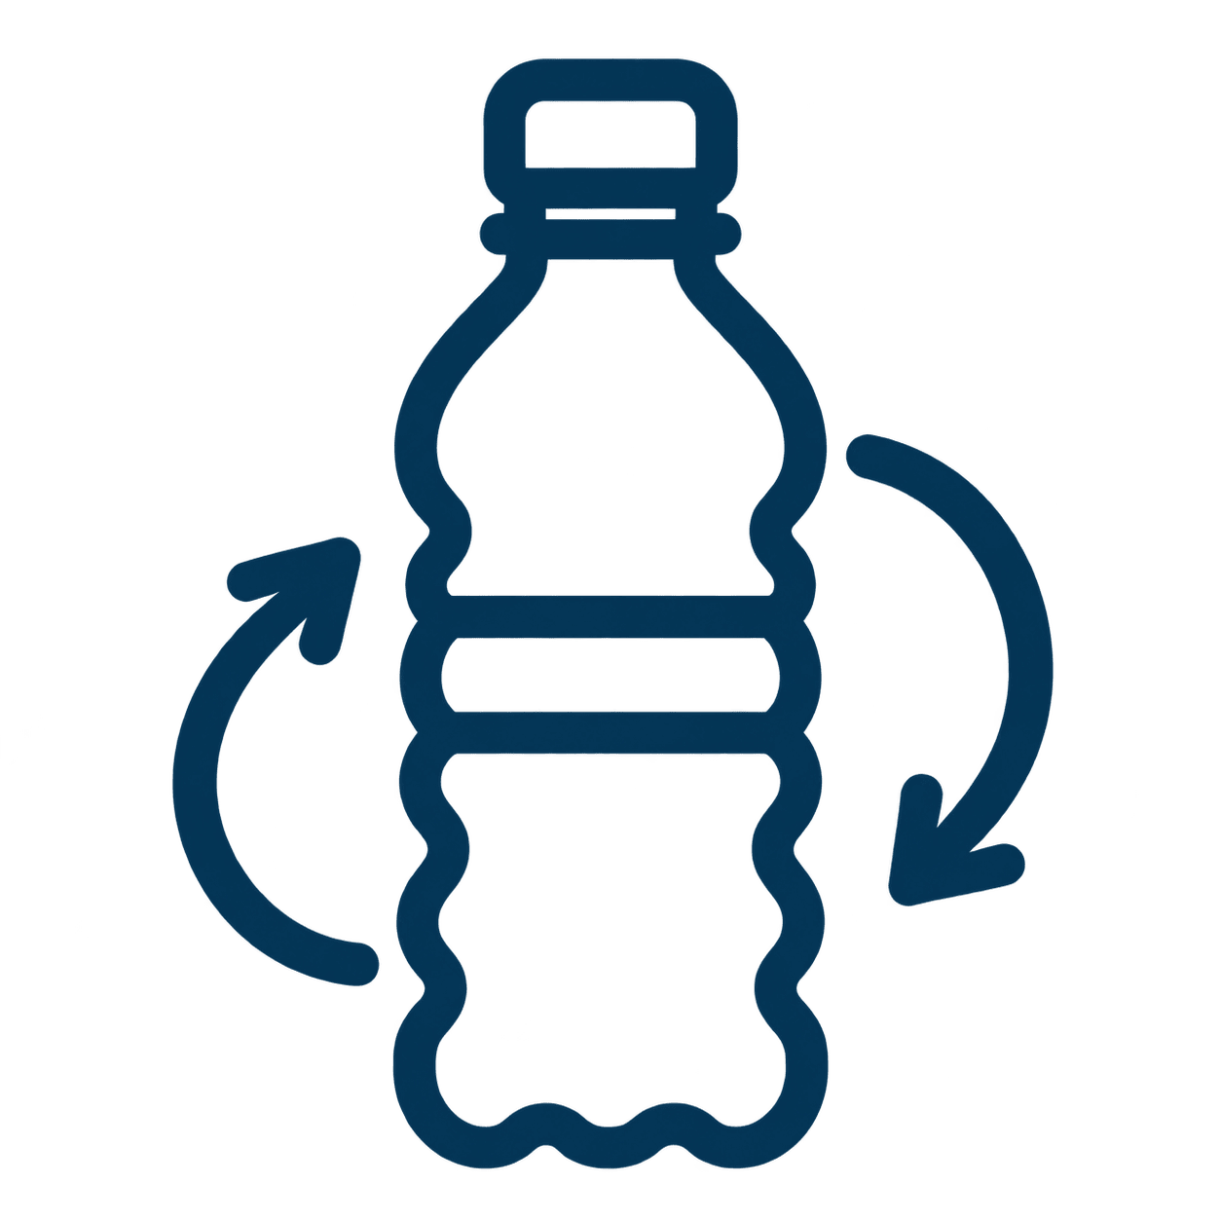

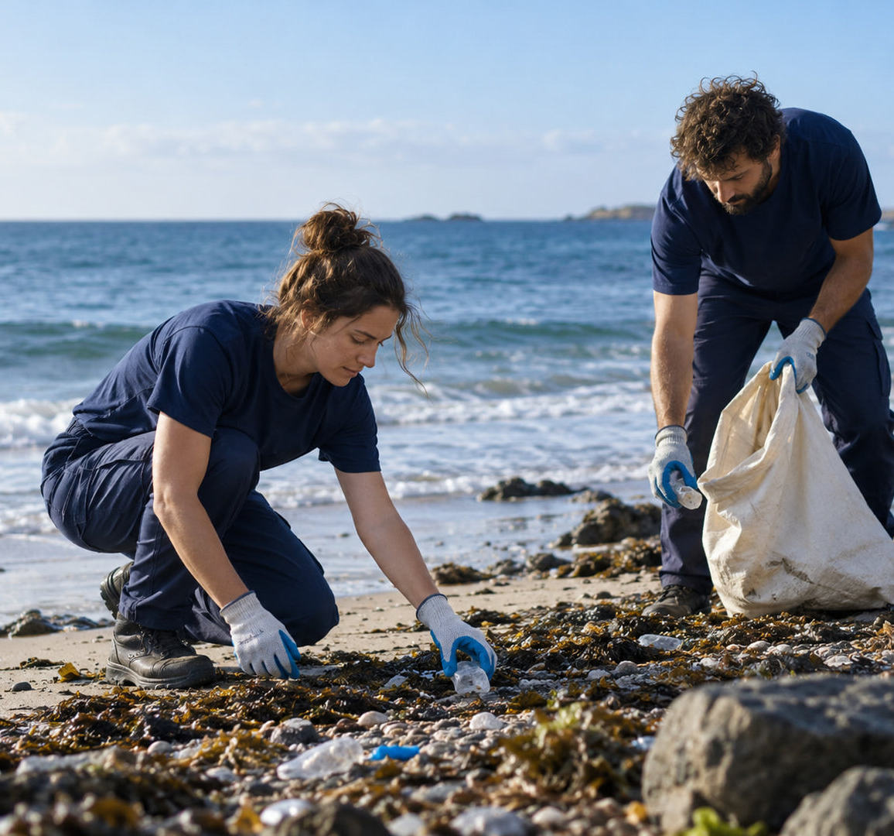

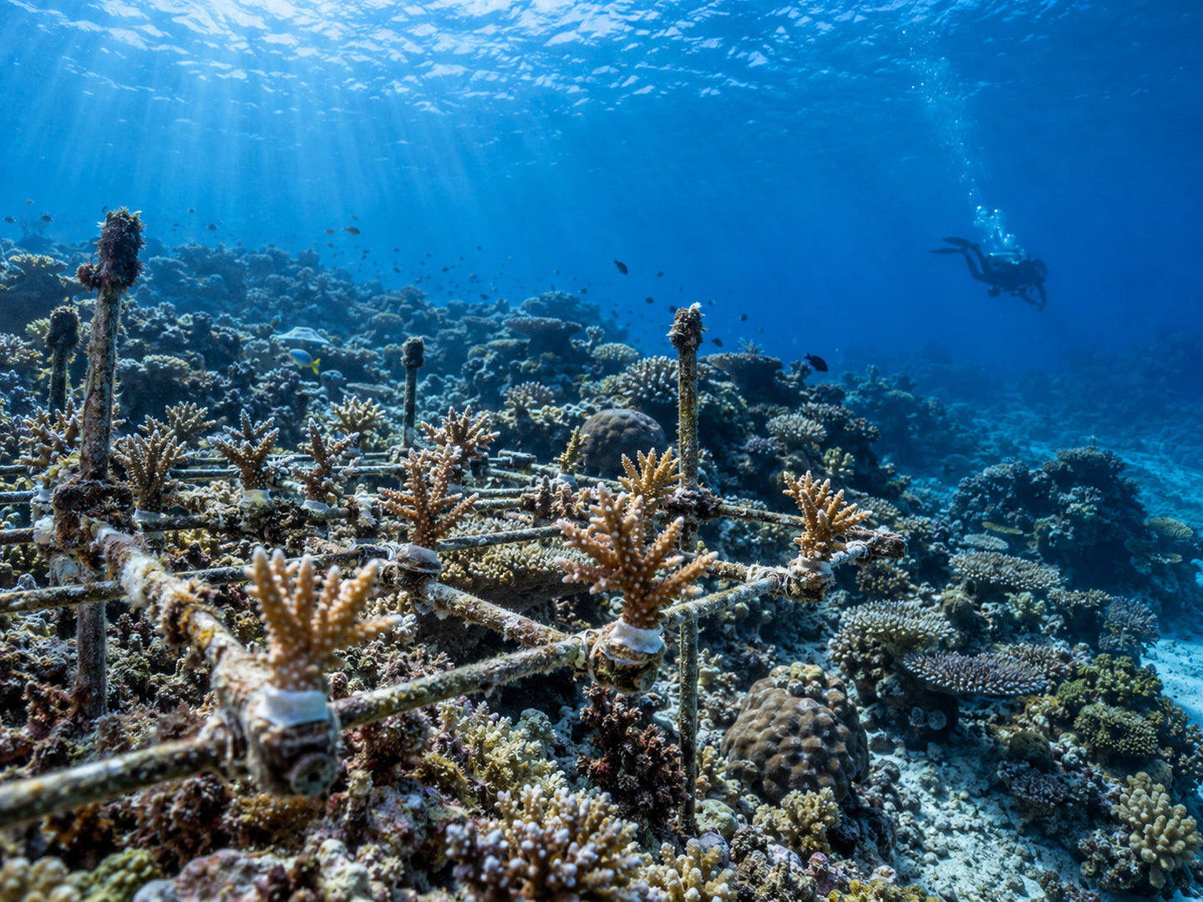
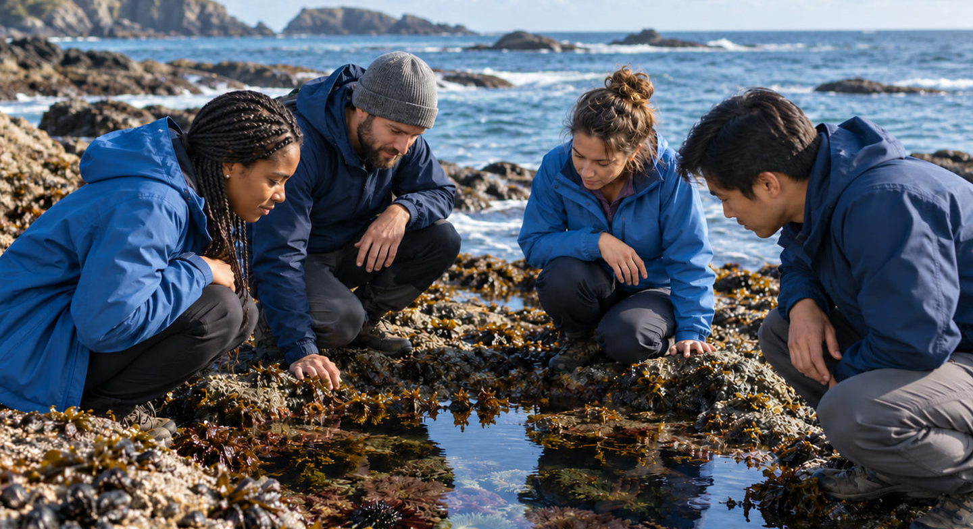
Three ways we care
for our ocean
Local partners shape each program
around the needs of their coast.
Cleaner waterways
Reduce waste at its source.
Coastal restoration
Restore habitats and monitor recovery.
Ocean learning
Build knowledge through local action.
BLUE CURRENT

Slide 6
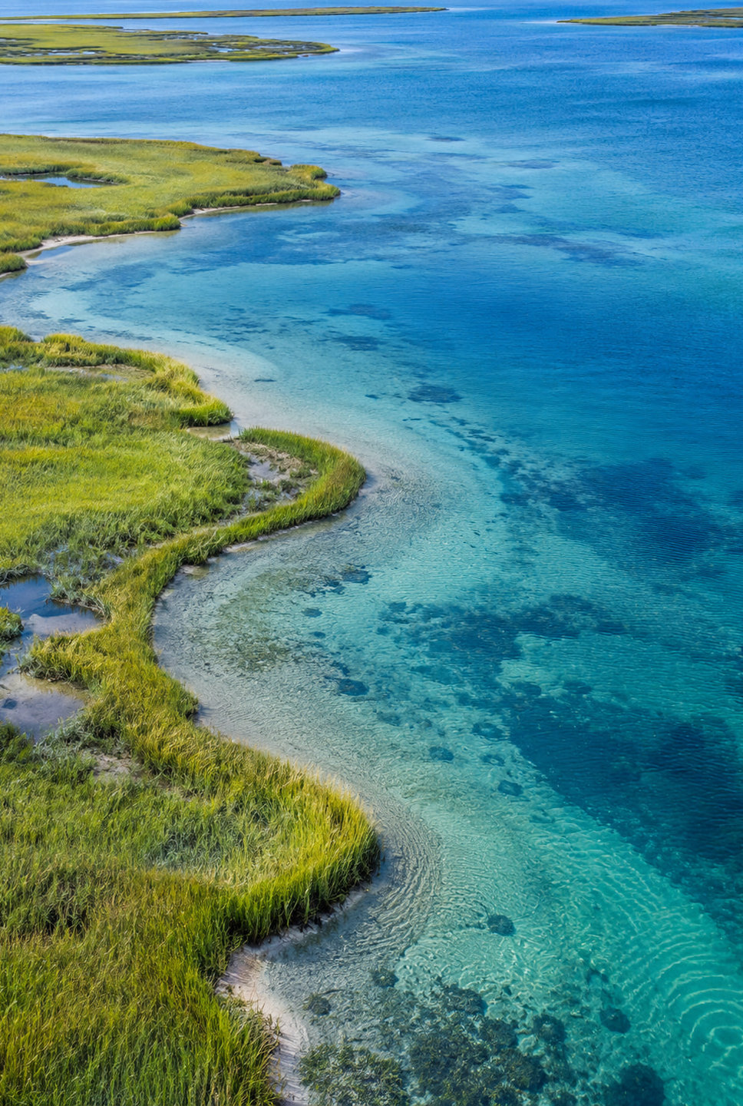
Project spotlight:
a living shoreline
A community-led approach to restoring
habitat along a vulnerable coastal edge.
PROJECT SUMMARY
Focus | Habitat | Community | Evidence
Activity | Native planting | Local training | Seasonal surveys
Outcome | Root cover | Shared skills | Site condition
BLUE CURRENT
Example project

Slide 7
Resources for a
healthier ocean
2026 initiatives
In this example, $2.4M in annual spending
supports coastal care and ocean learning.
Community-led
habitat restoration
Seasonal field surveys
and open findings
Local teams guide the work, with research
and training to support lasting progress.
Local volunteer
training programs
Ocean learning
for coastal communities
Programs | 72%
Operations | 16%
Fundraising | 12%
Illustrative financial data

Slide 8
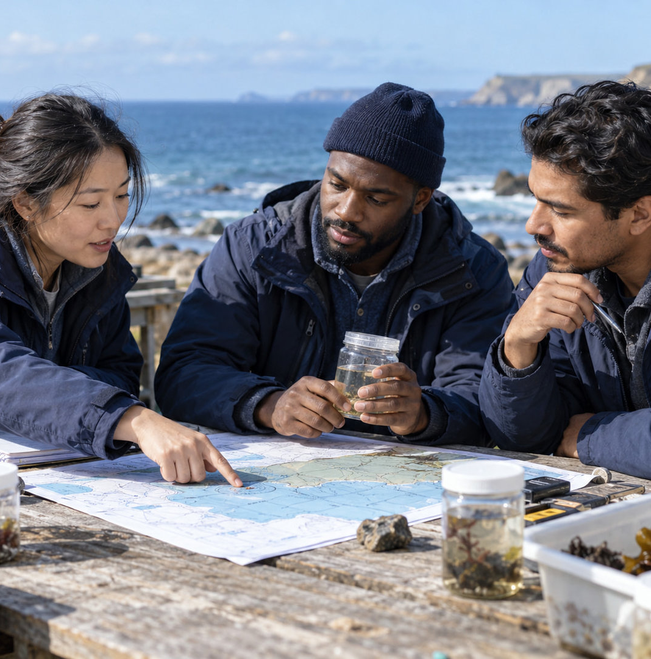
A community
for our coast
People make lasting care possible.
Local groups
Shape priorities and lead work on the ground.
Research partners
Help teams understand and monitor change.
Supporters
Fund the continuity that restoration needs.
BLUE CURRENT

Slide 9
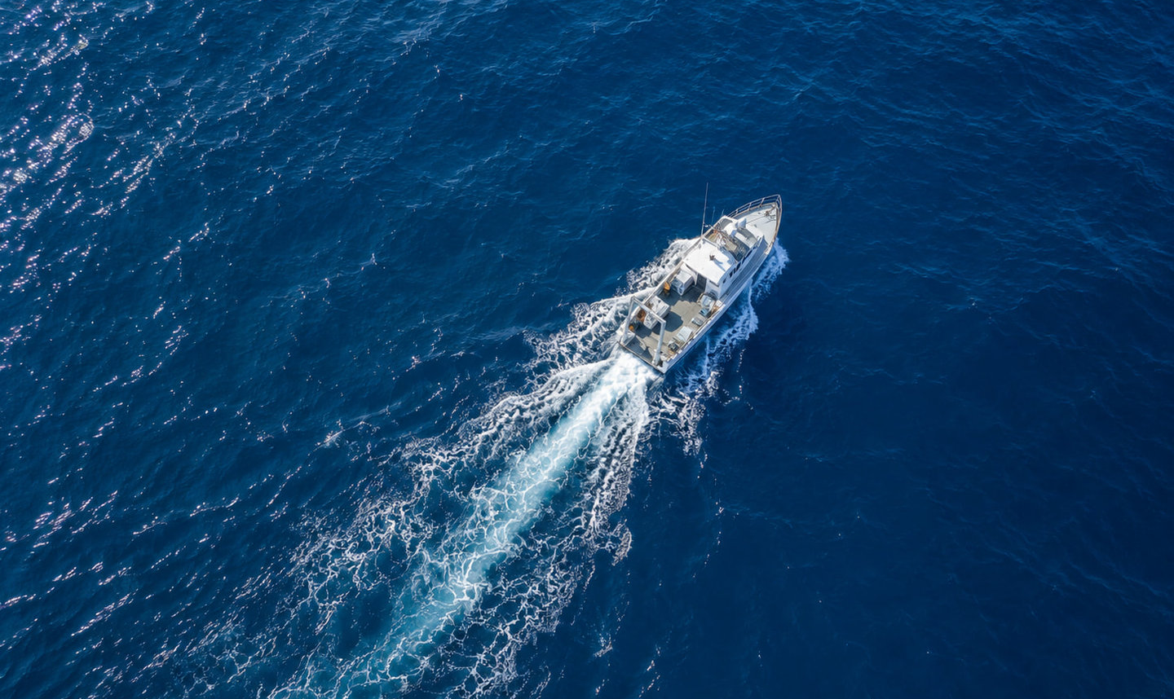
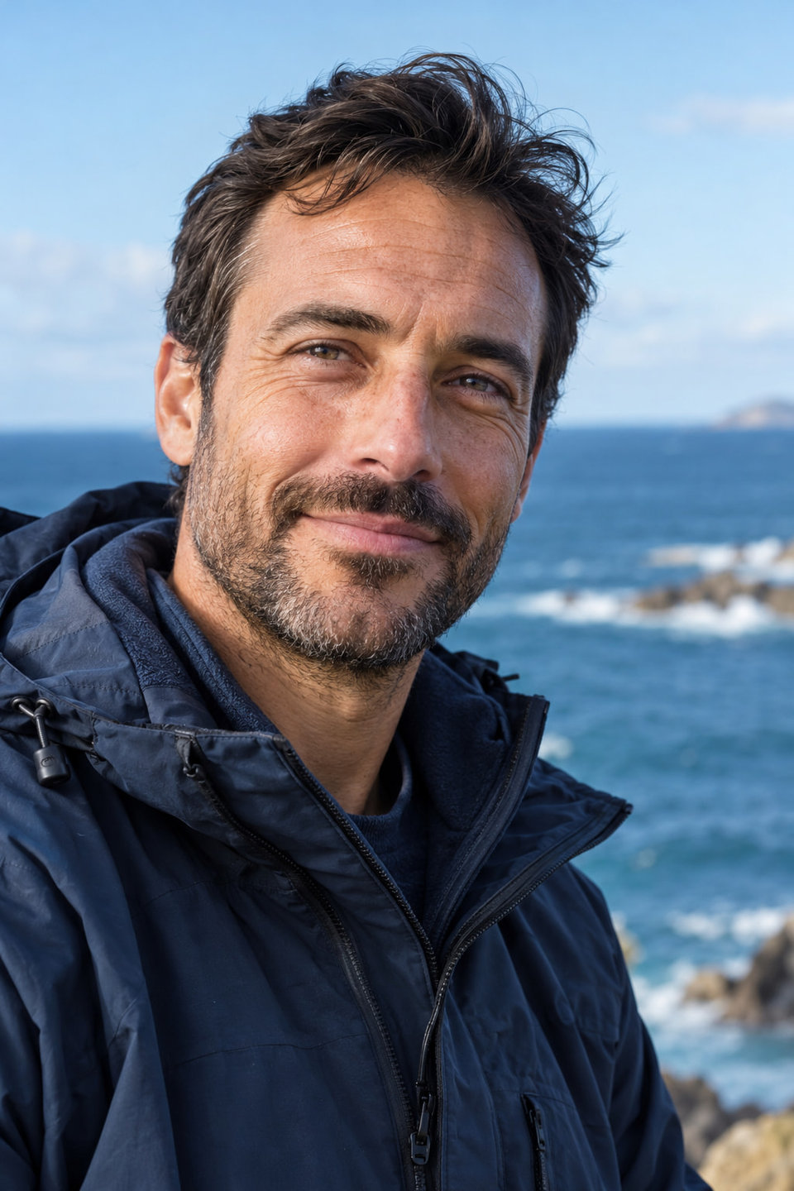
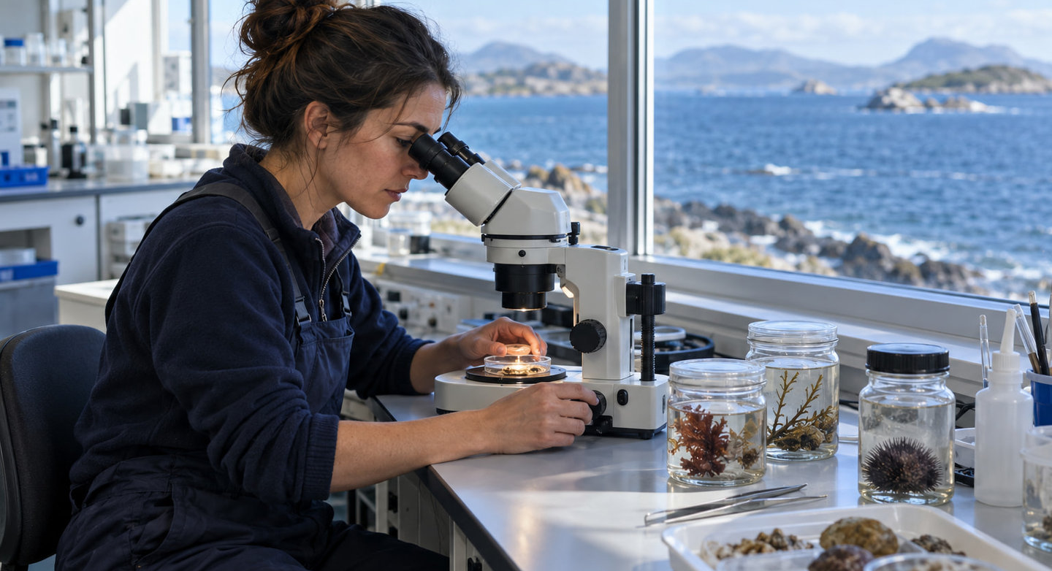
Restoring coastlines
Supporting communities
Q1 2027 Listen and plan
Confirm priorities with coastal partners
Establish project baselines
Plan volunteer training
Q2 2027 Put plans into practice
Begin habitat restoration at priority sites
Launch local learning programs
Support community project leaders
Q3 2027 Measure and adapt
Review seasonal field observations
Share findings with research partners
Refine restoration methods
Q4 2027 Share and sustain
Publish the annual impact report
Plan continued support for local teams
Set priorities for the next year
BLUE CURRENT

Slide 10
For a healthier ocean
BLUE CURRENT
Give. Volunteer. Partner.
[Website]
[Contact email]
Thank you for being part of the work.

