Slide 1
Brand
Guidelines
Studio
Client
Version
Date
Luma
Telescope
2.3
January 2027

Slide 2
Color palette
#F35529
#FFFFFF
#000000
We use color intentionally to create a cohesive visual language, establish recognizable patterns, and make our brand feel familiar and consistent.

Slide 3

Logo
The telescope symbolizes curiosity, discovery, and exploration, reflecting our desire to look beyond the familiar, and seek new perspectives.

Slide 4
Helvetica
Typography
Typography is central to our visual identity, helping us communicate with clarity, character, and consistency across everything we create.

Slide 5




Iconography
Our iconography uses simple, recognizable forms to communicate ideas with clarity and precision, creating a cohesive visual language.

Slide 6
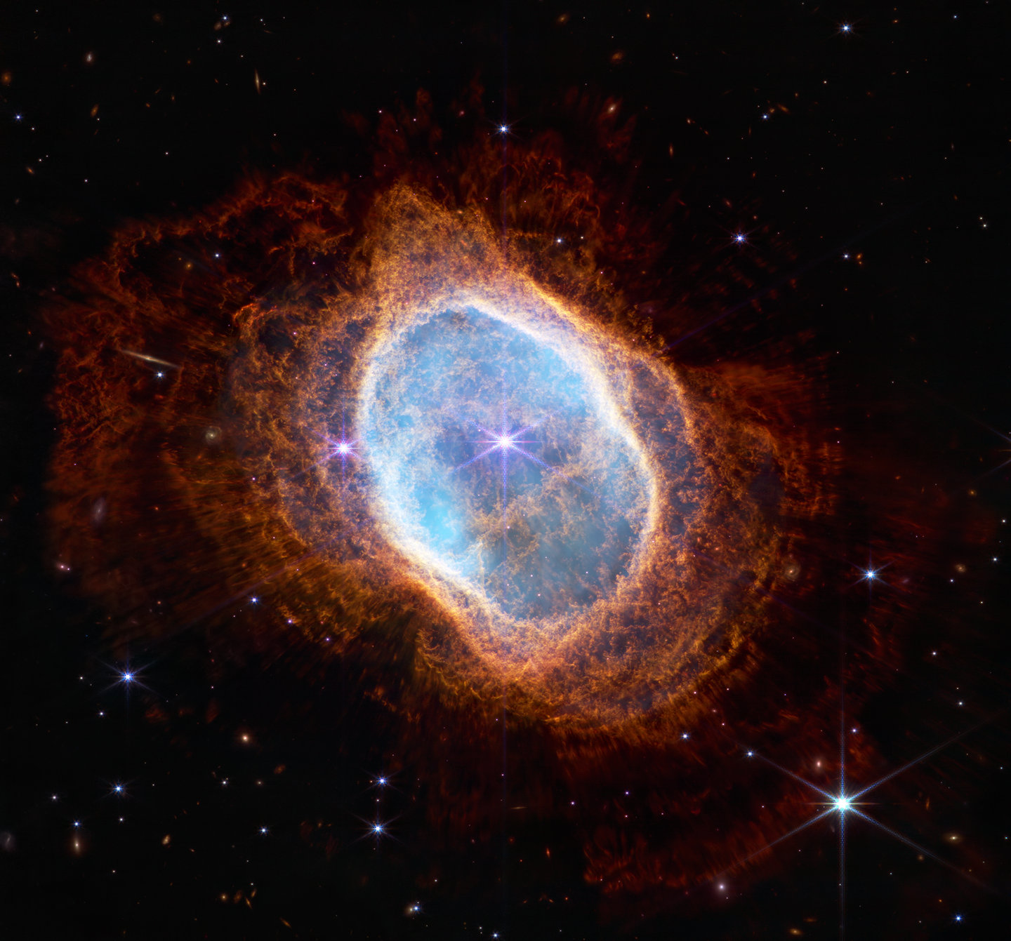
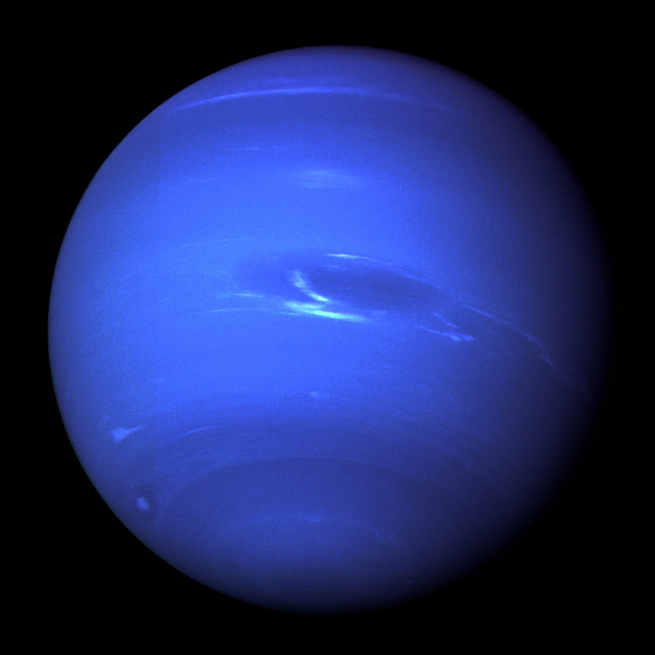
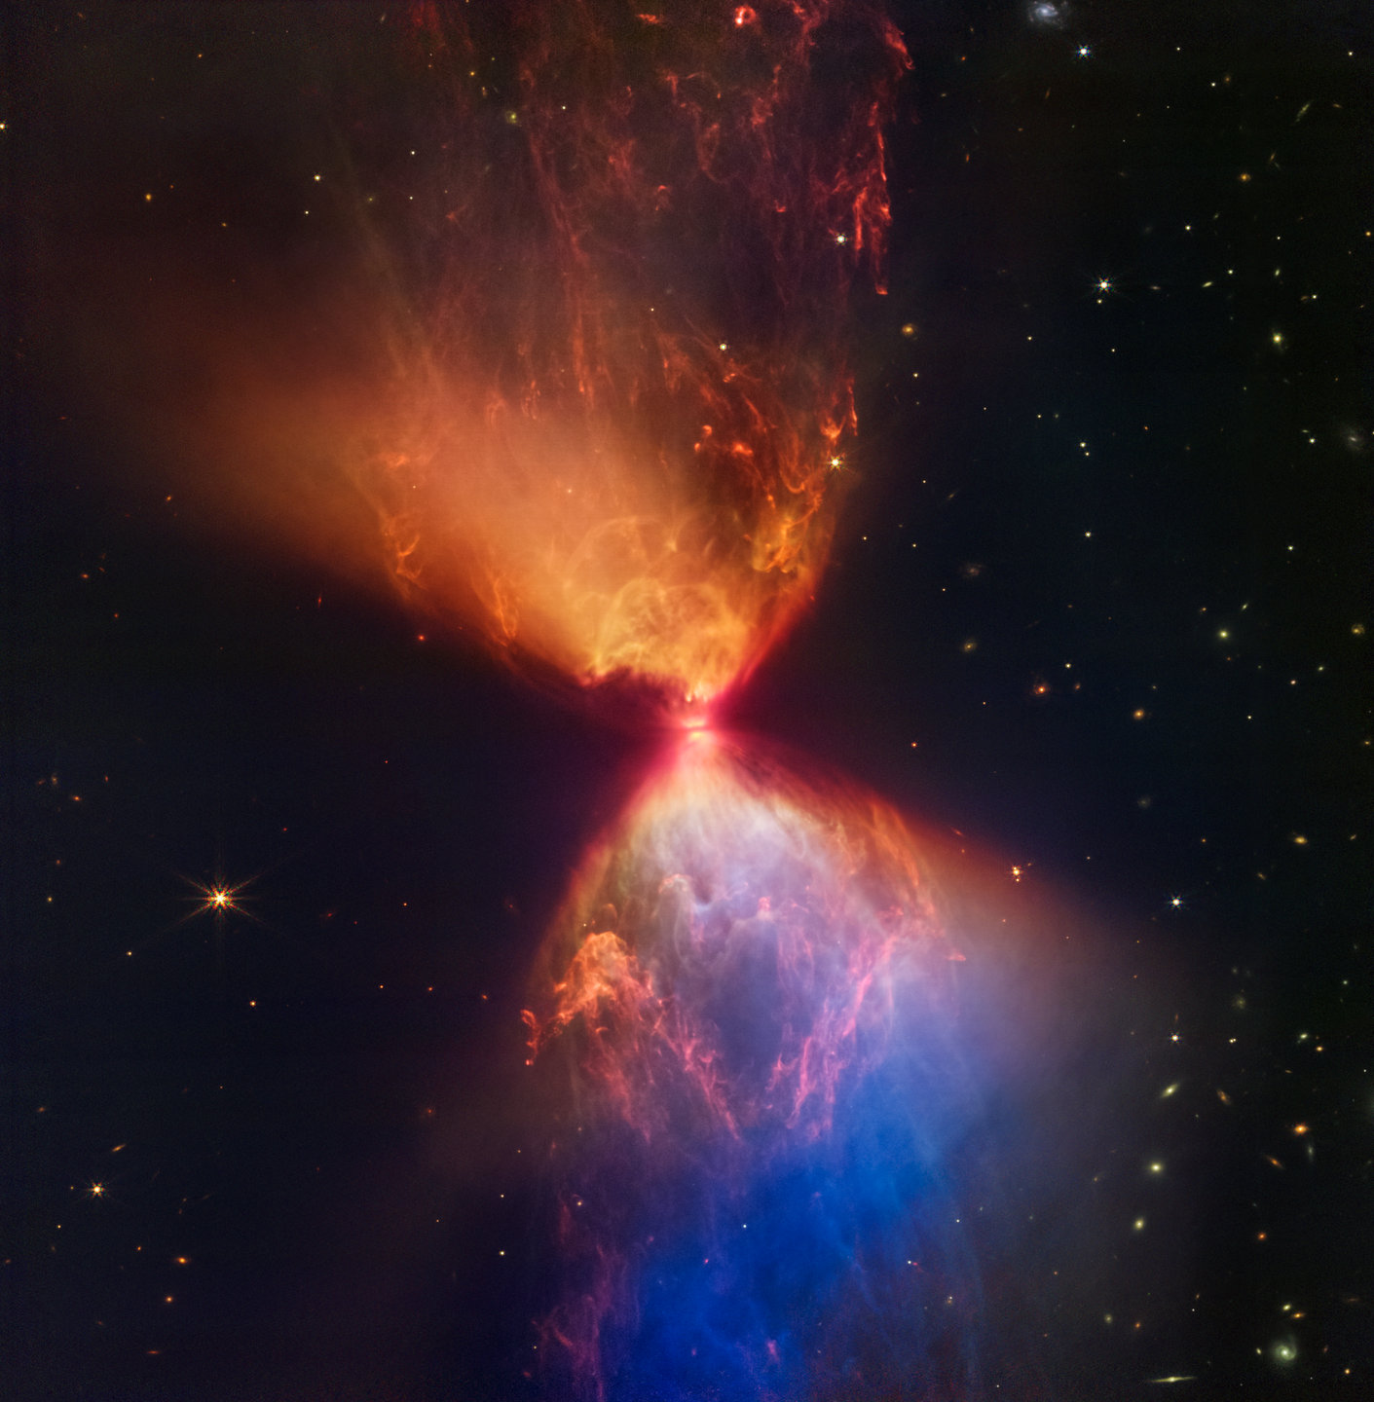
Photography
Our photography captures the wonder of the universe, revealing the beauty of distant worlds and inspiring curiosity about what lies beyond.

