Slide 1
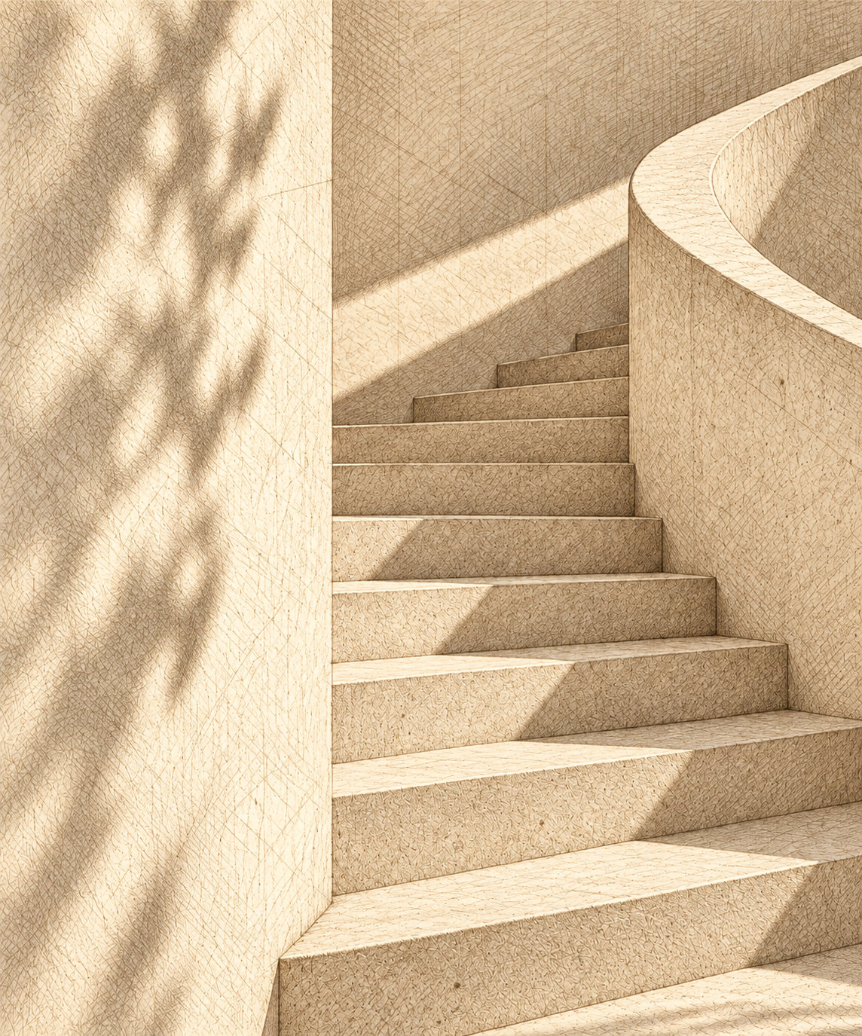
Calder
Estates
1. Project Overview
2. Our Philosophy
3. History of Calder House
4. Construction Details
5. Expected Outcome
Calder House, est. 1947

Slide 2
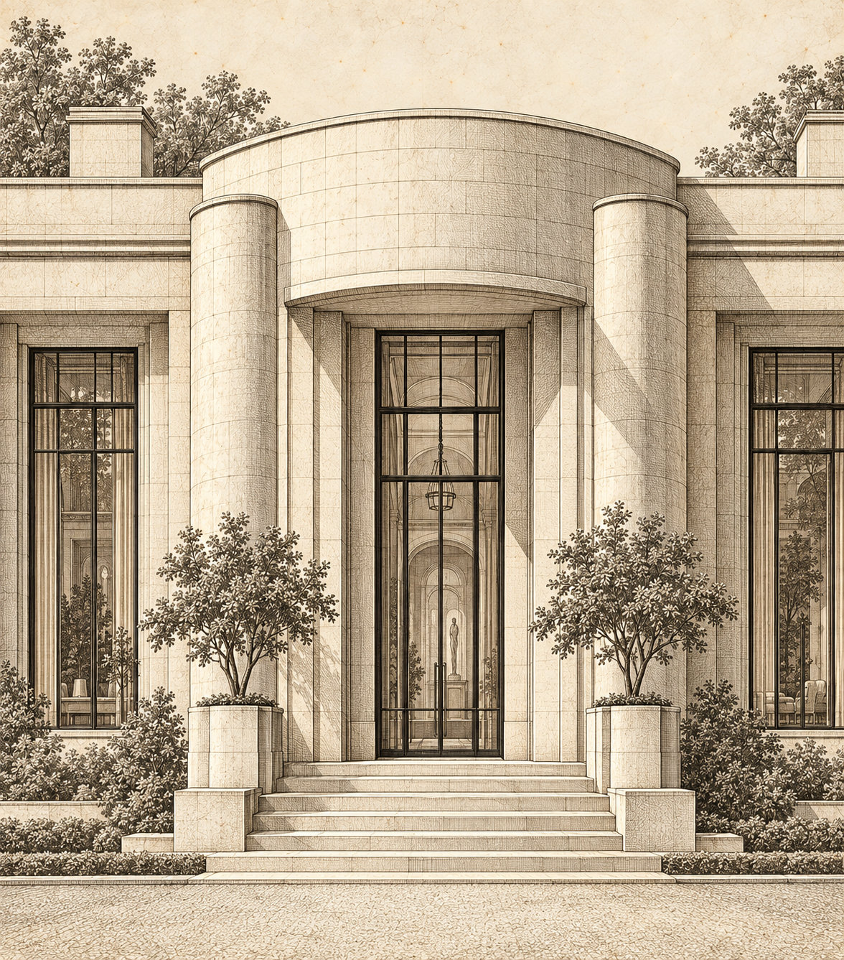
Project overview
Calder House, established in 1947, is a landmark residence reimagined for a new generation.
Our project brings together heritage and contemporary living, crafting a limited collection of residences defined by thoughtful design.
Proposed restoration, 2027

Slide 3
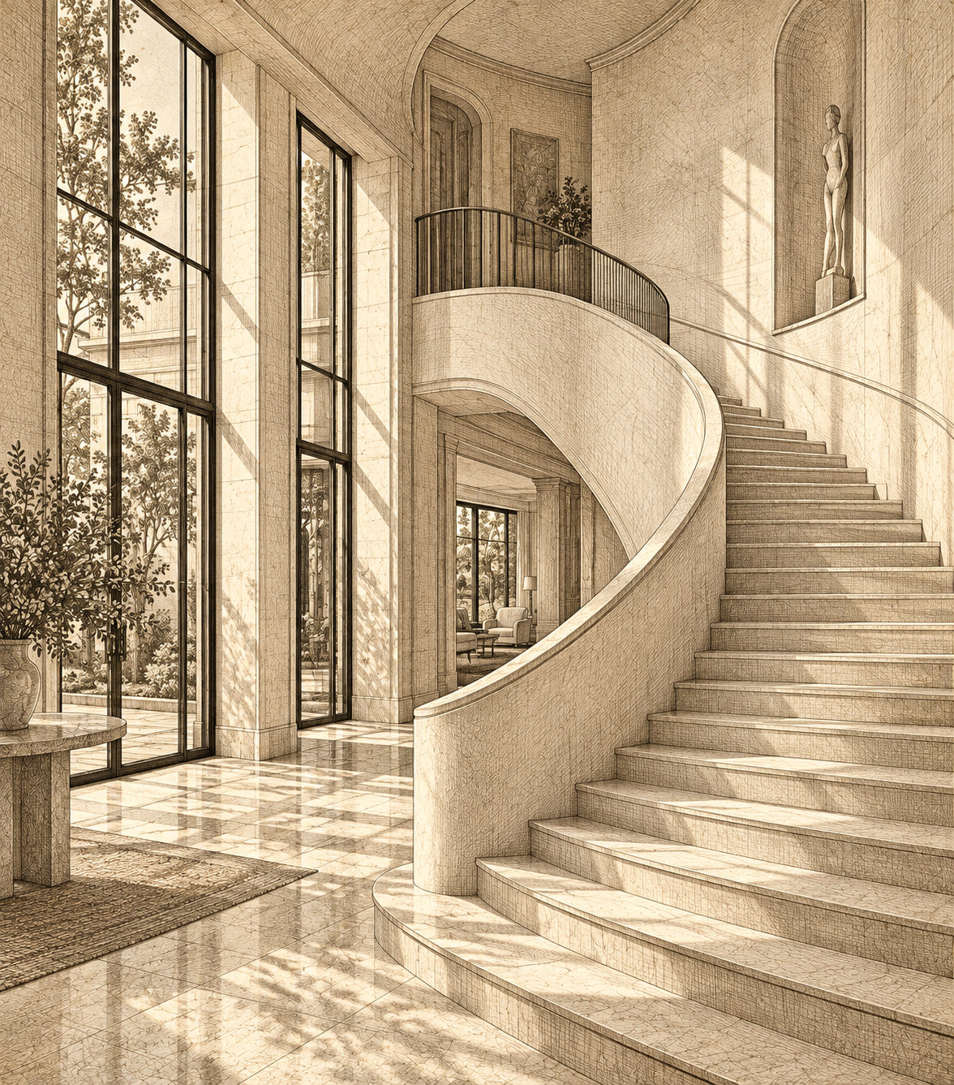
Our Philosophy
At Calder Estates, we believe great architecture should feel both timeless and deeply connected to its surroundings.
The result is a collection of homes designed to age gracefully, inspire everyday rituals, and endure for generations.
Proposed restoration, 2027

Slide 4
History of Calder House
1947 · Original residence established
Calder House was built in 1947 as a private residence, celebrated for its refined proportions, natural materials, and connection to the surrounding landscape.
1978 · A period of transformation
A thoughtful renovation introduced new living spaces and modern comforts while preserving the home's original architectural character.
2004 · A lasting legacy
Calder House was recognized as a local architectural landmark, celebrated for its timeless design and enduring connection to the surrounding landscape.

Slide 5
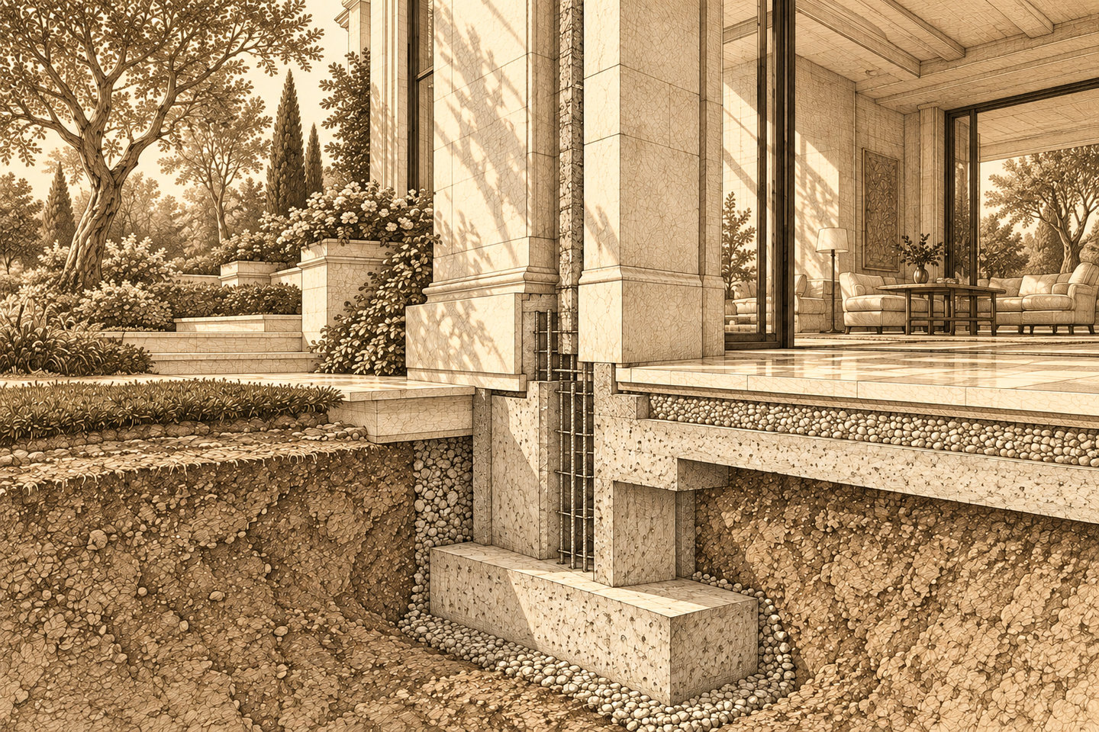
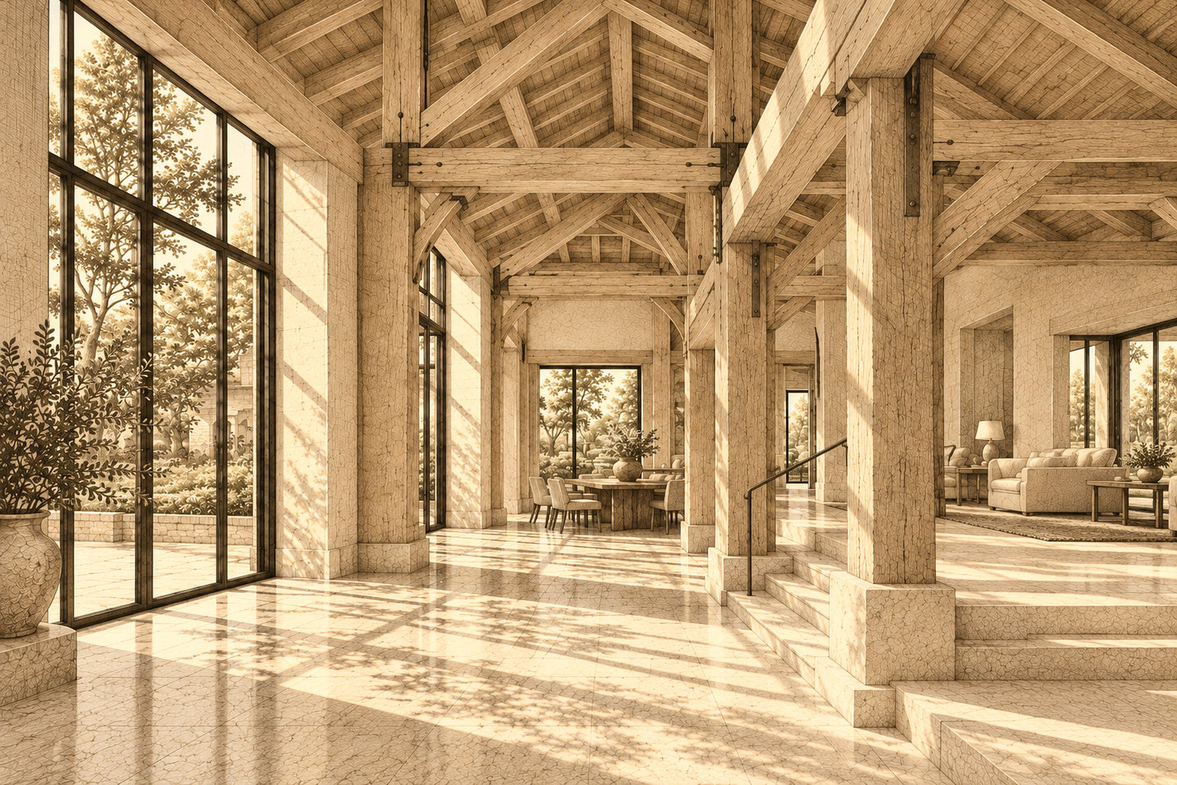
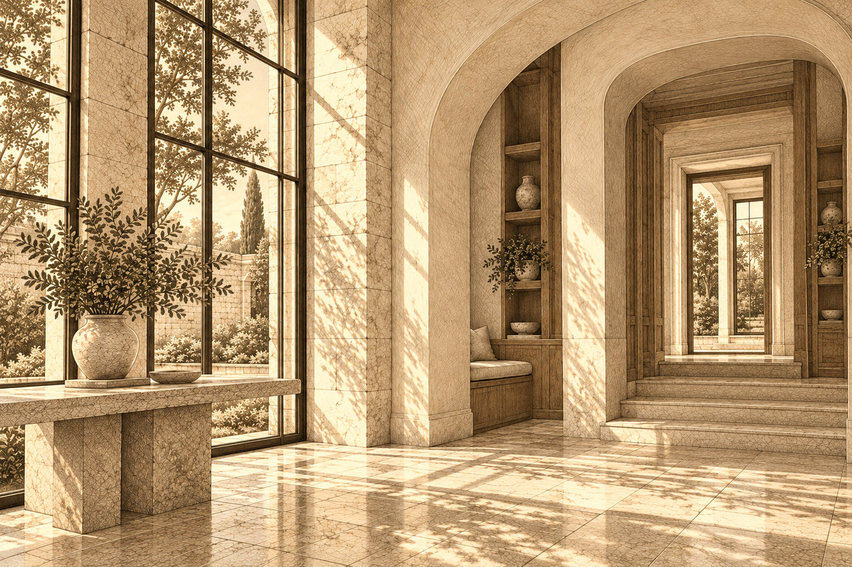
Construction Details
Foundation · Reinforced concrete
The original 1947 foundation has been reinforced to ensure structural stability while preserving the estate's historic footprint.
Structure · Timber framing
Original timber framing has been restored and strengthened to accommodate contemporary living spaces.
Materials · Stone and natural wood
Locally sourced stone, natural timber, and plaster finishes create a material palette that honors the estate's architectural heritage.

Slide 6
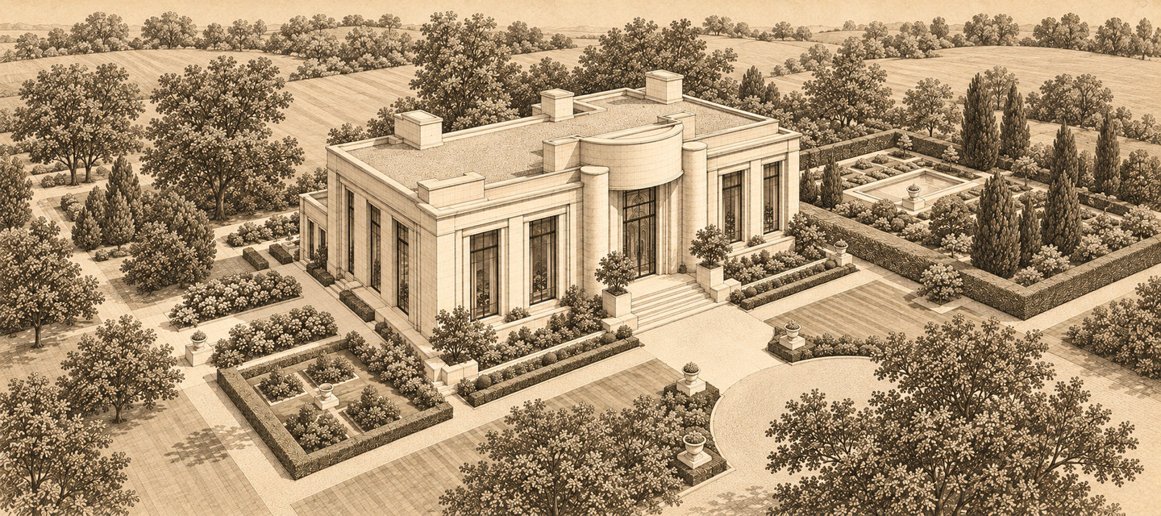
Expected Outcome

