Slide 1
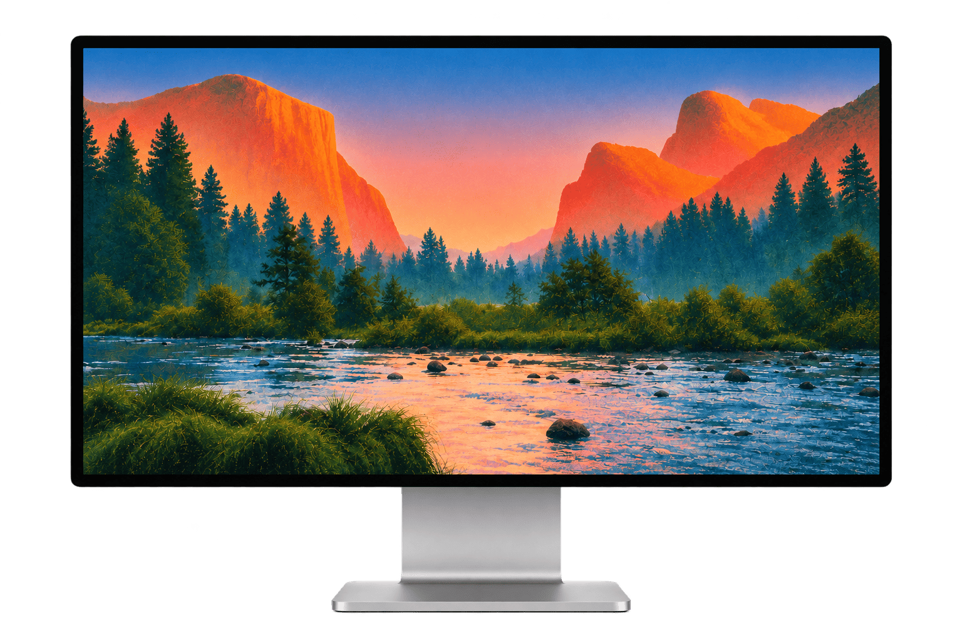
Introducing our next generation OS
More intuitive. More powerful. More you.

Slide 2
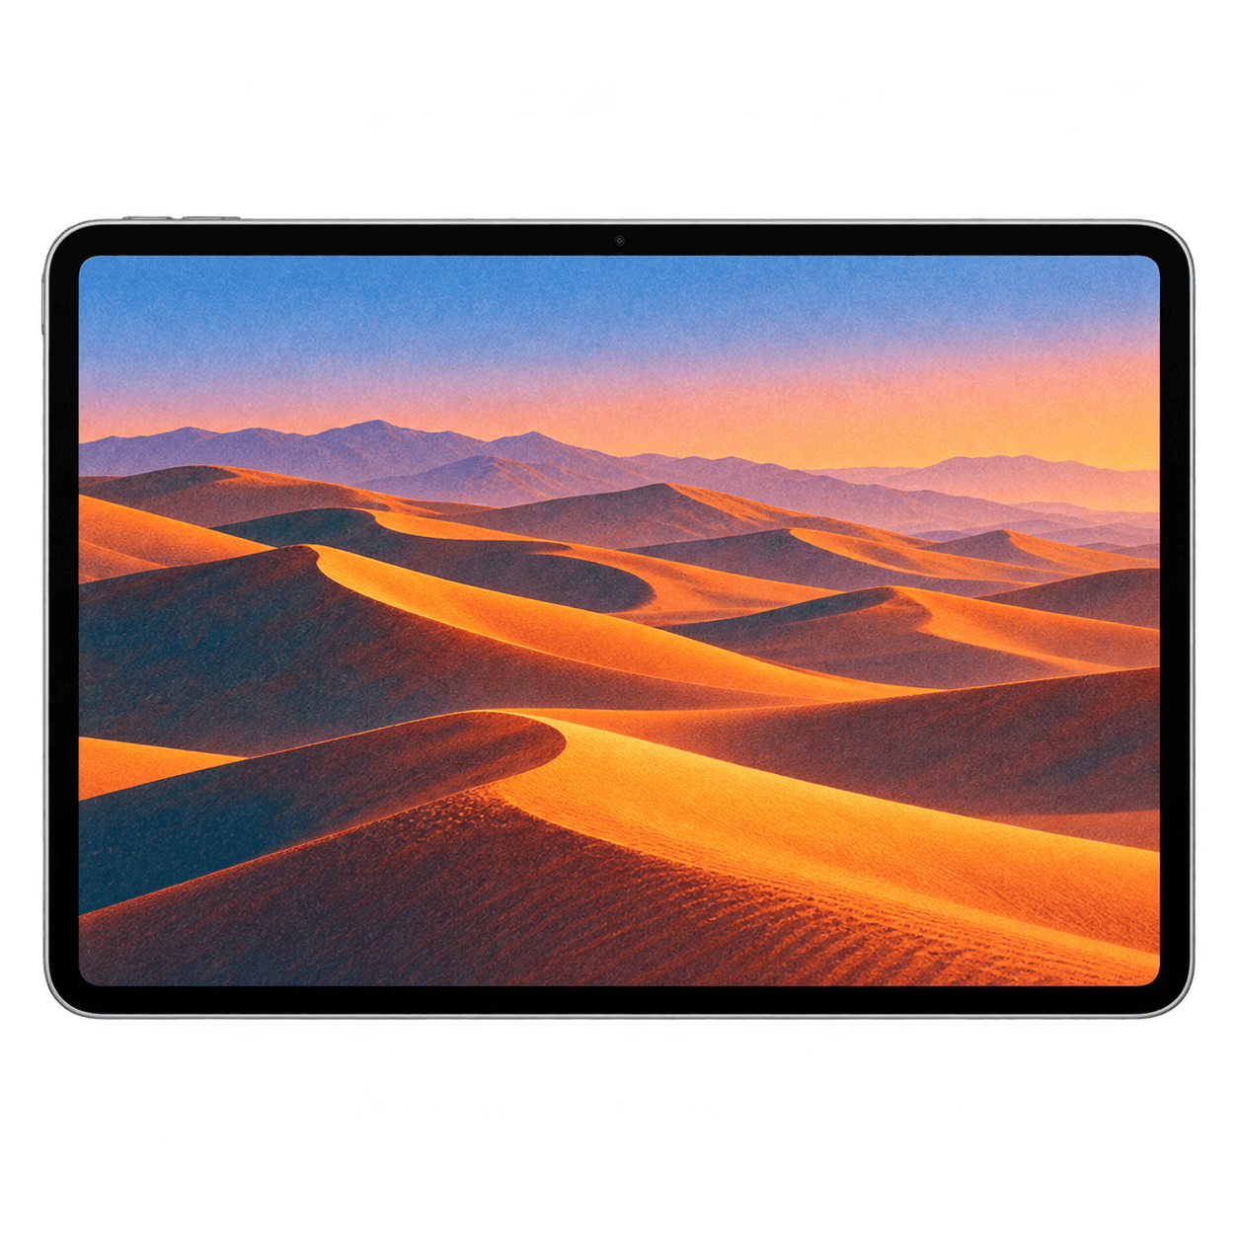
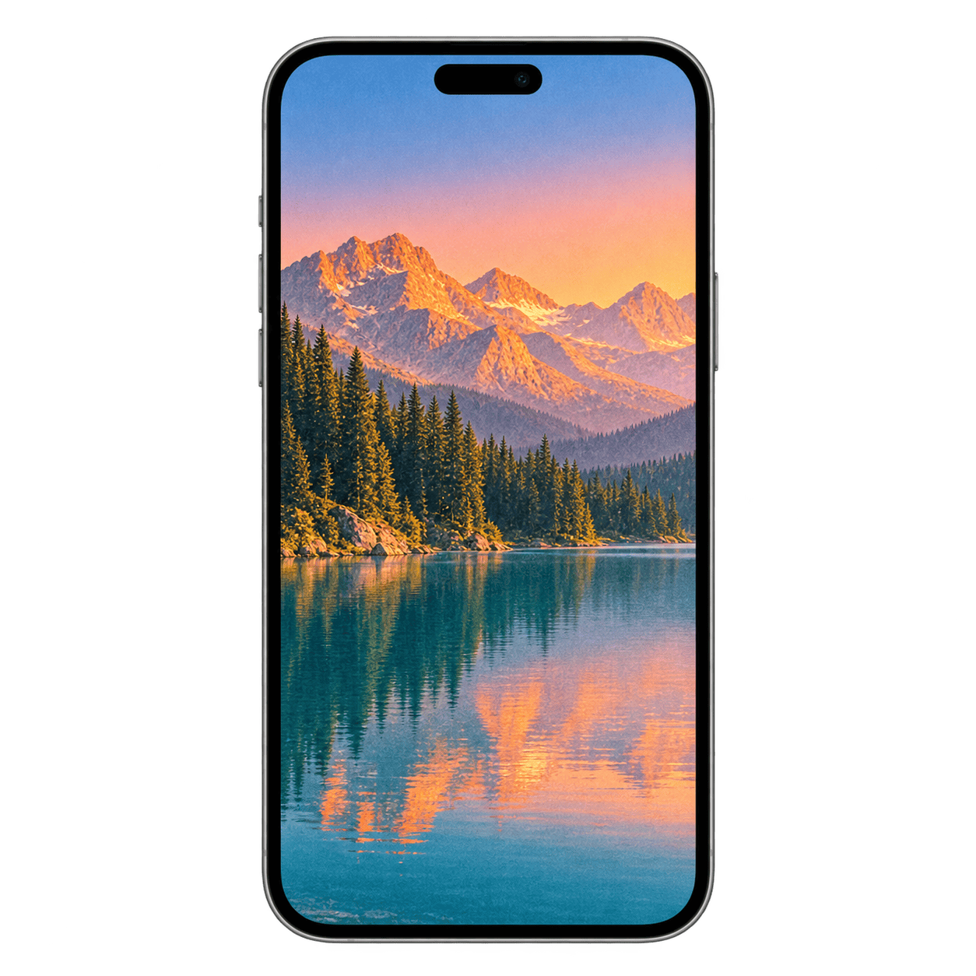
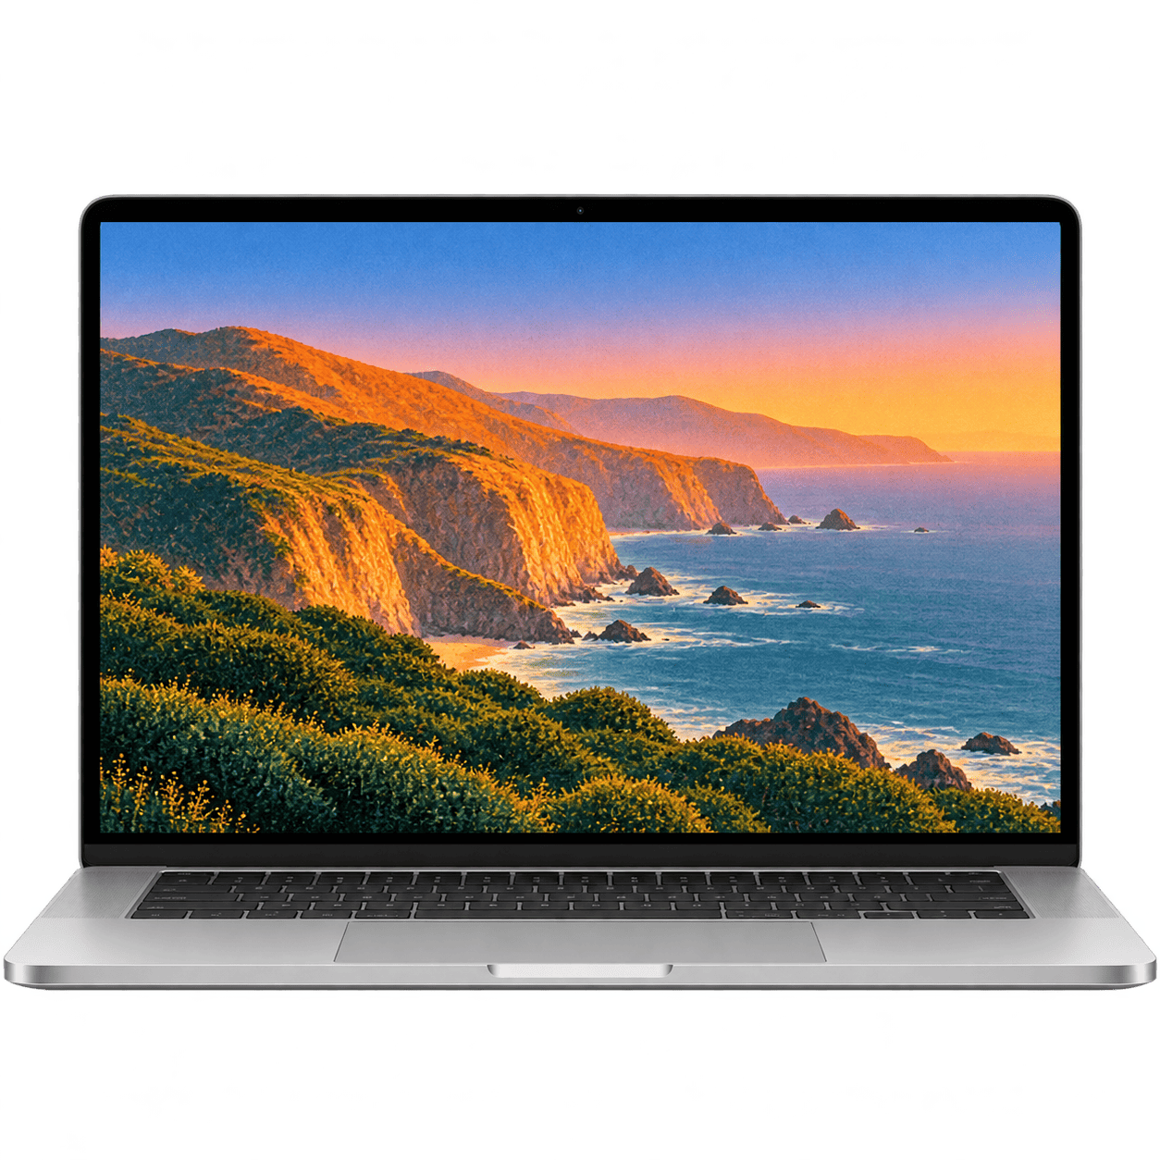
Intelligence for every screen
A new era of personal computing, designed around you.
Your most powerful workspace
Intelligence in your pocket
A canvas without limits
An intelligent desktop experience that helps you create, focus, and get more done.
A more personal mobile experience that anticipates your needs and moves with you.
An intuitive tablet experience that transforms inspiration into possibility, wherever you are.

Slide 3
02. Universal Memory
01. Adaptive Workspace
Your workspace intelligently reorganizes around your tasks, priorities, and daily routines.
Instantly recall conversations, files, and ideas across every app and device.
03. Predictive Actions
Your OS anticipates your next move, preparing tools and completing tasks before you ask.

Slide 4
04. Autonomous Tasks
Delegate complex, multi-step tasks to your OS, from organizing projects to coordinating your schedule.
05. Live Translation
Speak, write, and collaborate across languages with instant, context-aware translation.
06. Generative Interface
Watch apps and controls reshape themselves around your intent, preferences, and workflow.

Slide 5

Launching July 2027
Plus, Pro, and Max users only

