Slide 1
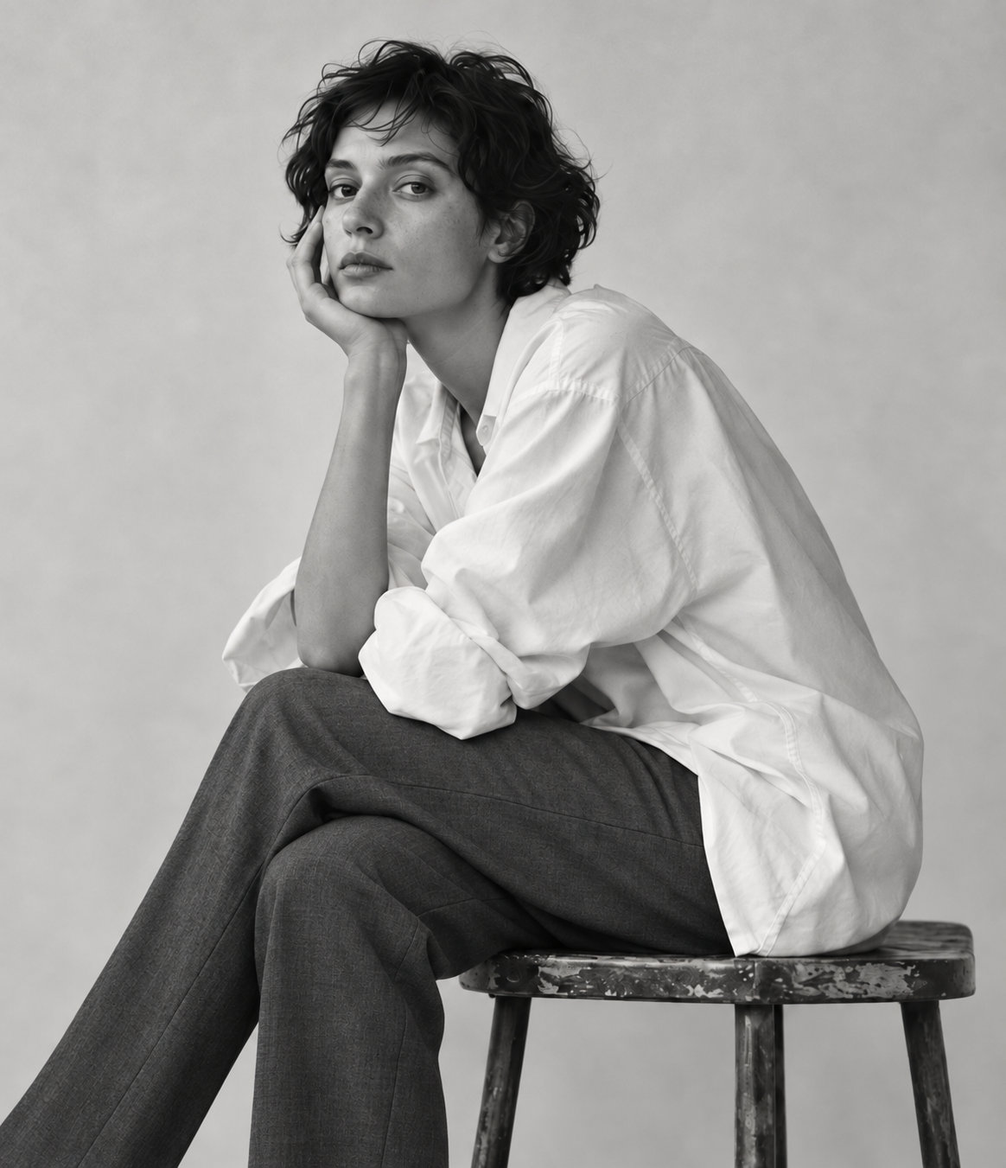
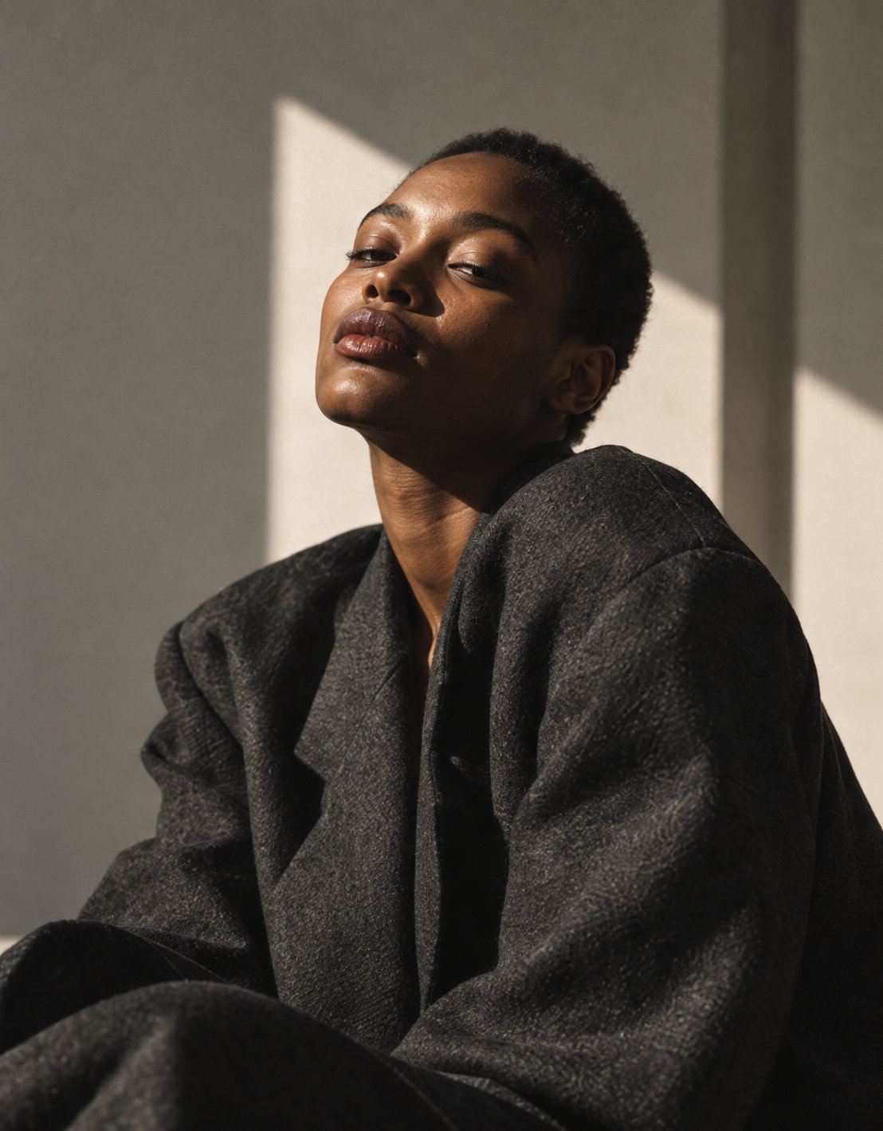
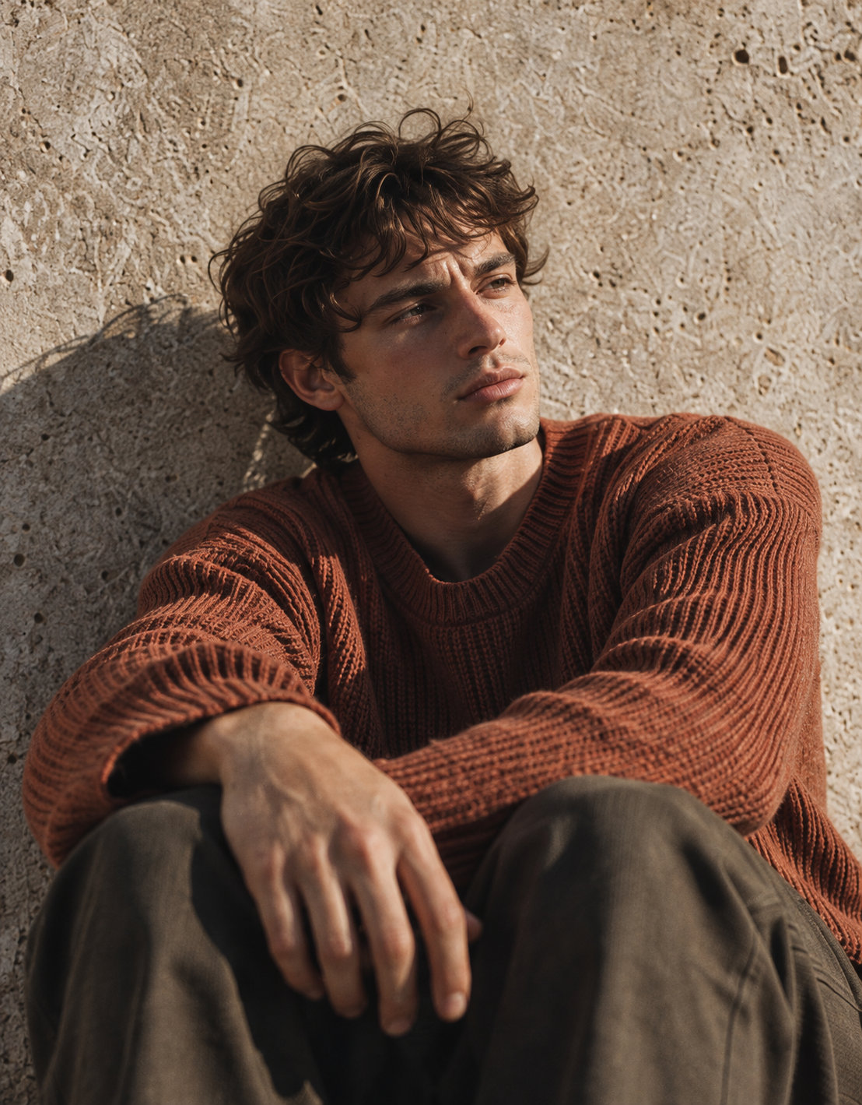
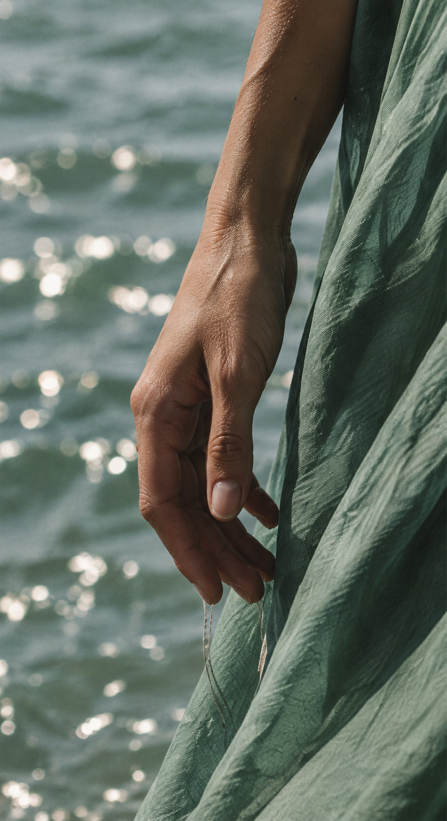
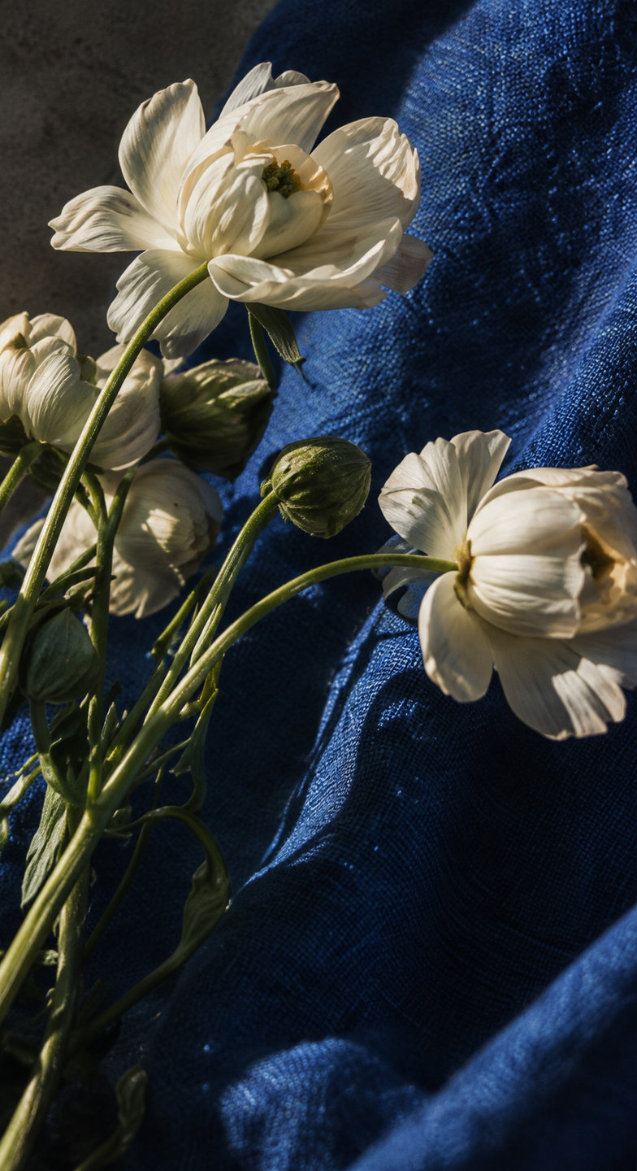
Luma Studio
Selected works
Soft focus / Editorial, 2026

Slide 2
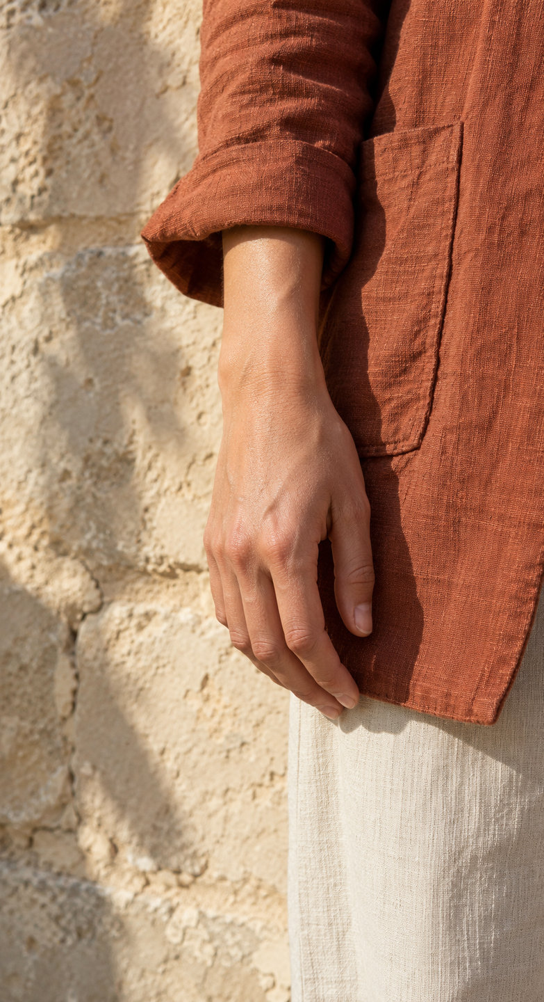
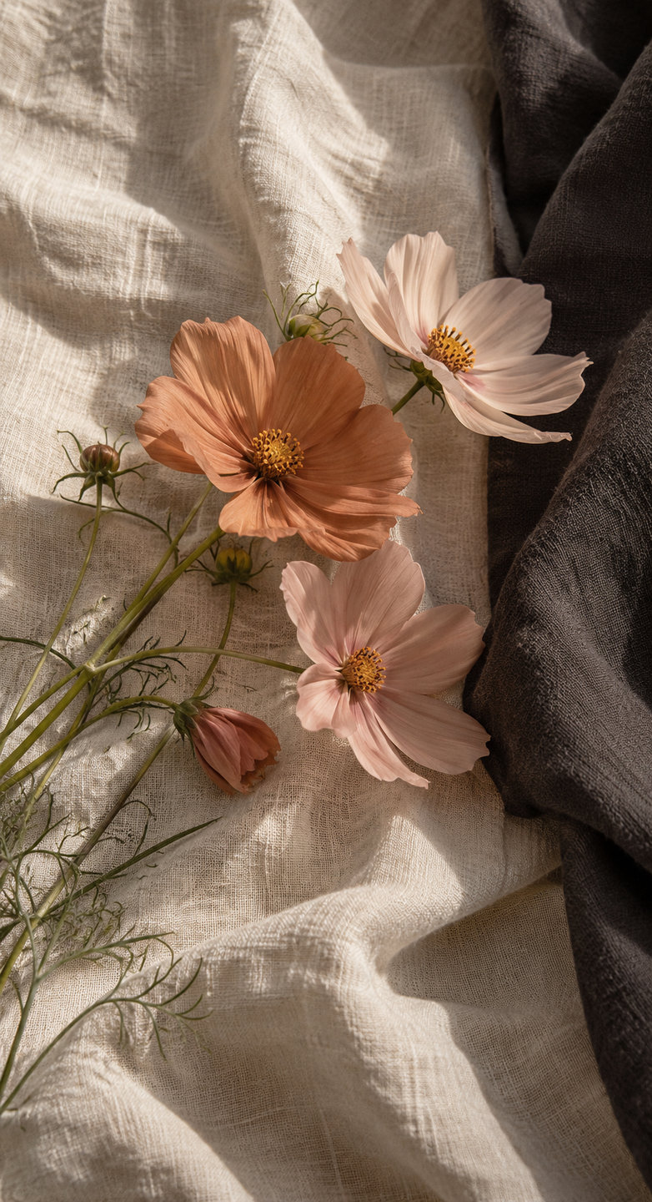
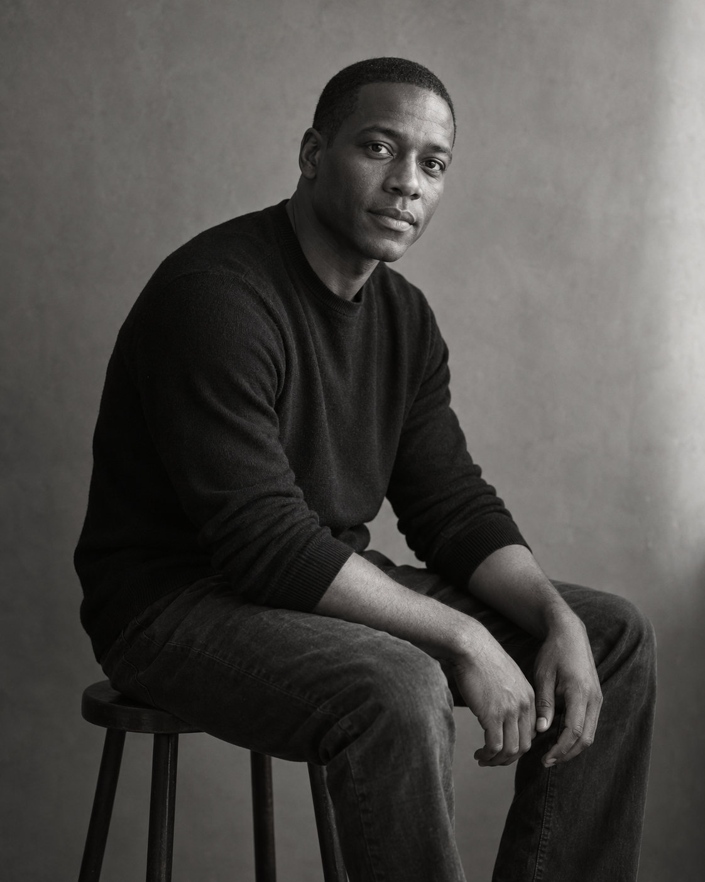
Color portraits
01
02
Detail studies
03
Black and white
04
Photoshoot schedule

Slide 3
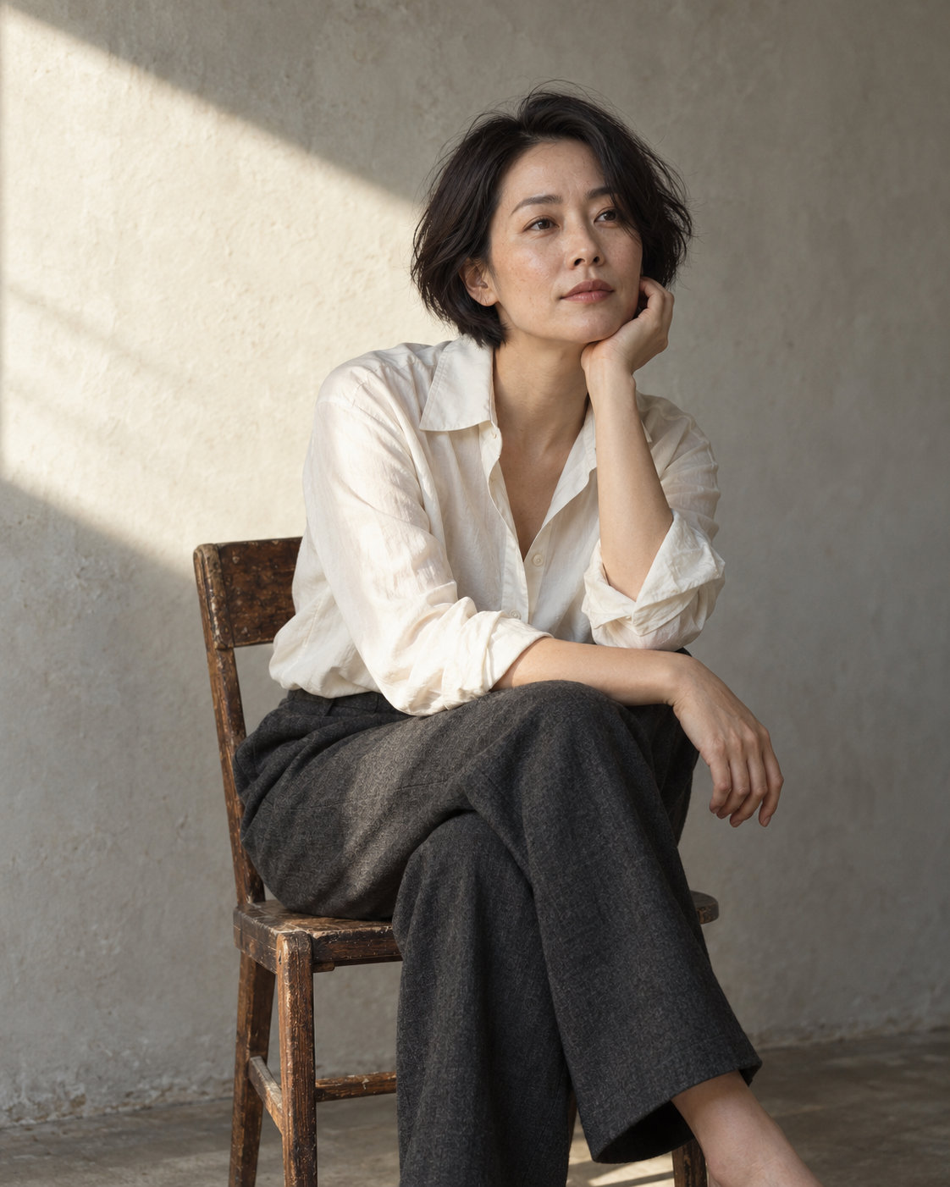
Color portraits
Vibrant expressions of personality, presence, and individuality through thoughtful use of color.
In Golden Light, 2027

Slide 4
Detail studies
An intimate exploration of texture, gesture, and form, revealing beauty in the often overlooked.
Flowers on Linen, 2025

Slide 5
Black and white
Vibrant expressions of personality, presence, and individuality through thoughtful use of color.
The Weight of Stillness, 2024

Slide 6
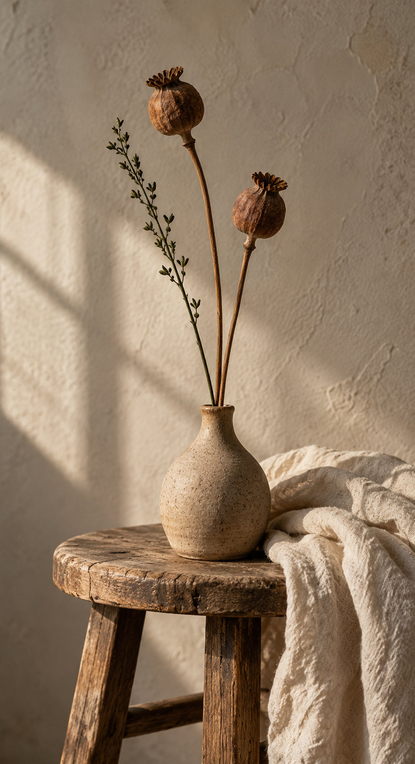
Photoshoot schedule
Time | Focus | About
09:00 | Setup | Light and background checks
09:30 | Portraits | Seated, standing compositions
11:00 | Details | Hands, clothing, and objects
13:00 | Outside | Location scouting

