Slide 1
moss
Your health, in context
Product pitch
2026

Slide 2
Sleep
The problem
A lot of numbers.
Movement
Still no clear picture.
Mood

Slide 3
The opportunity
A clear picture of your health
A calmer way to understand your everyday patterns.
moss

Slide 4
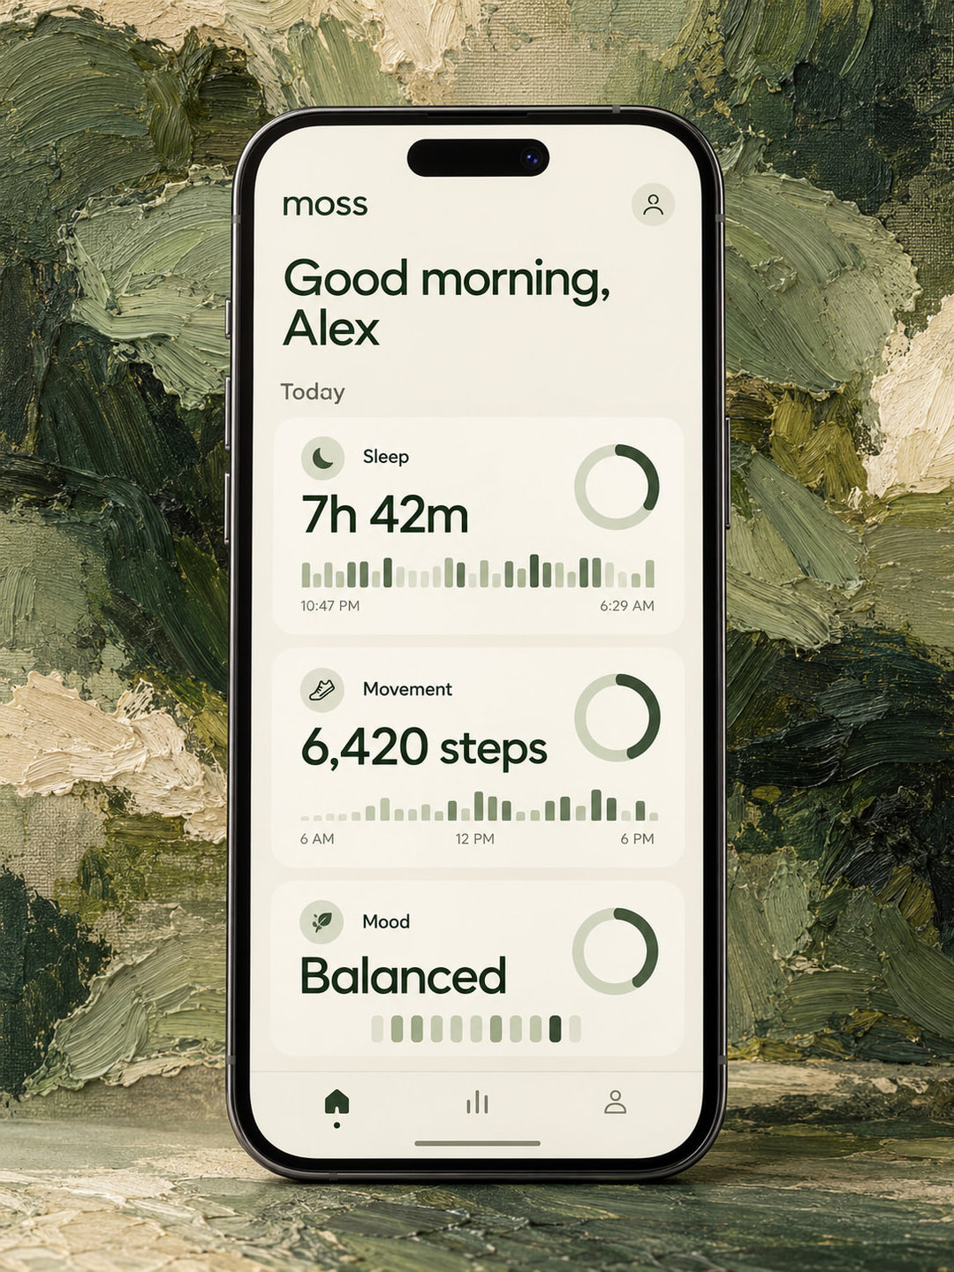
Meet Moss
A health tracking app that brings
sleep, movement and mood
into a single daily view.

Slide 5
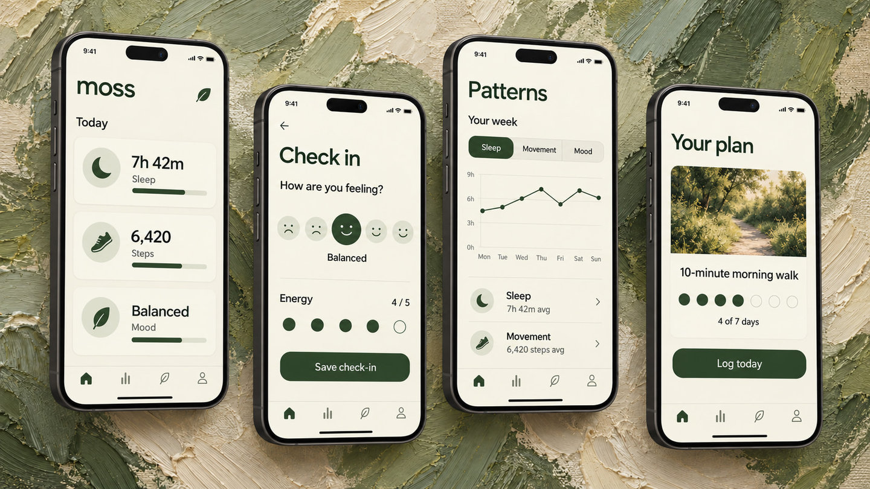

Slide 6
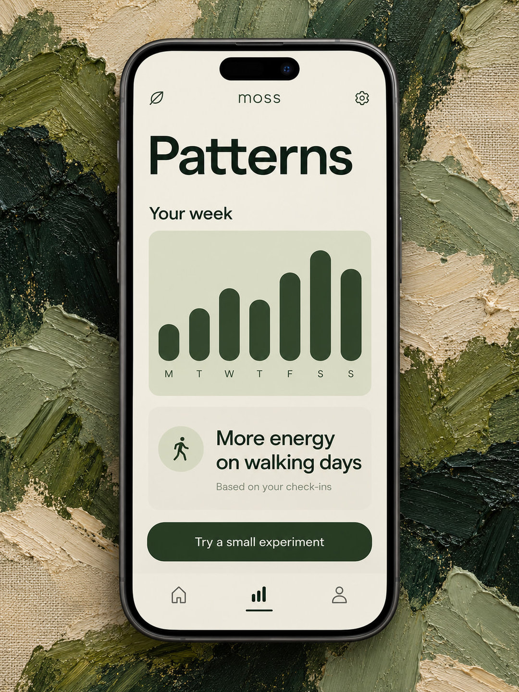
See what trends together
Notice how your sleep, movement
and energy line up across the week.

Slide 7
A little attention.
Every day.
01
02
03
Check in
Look back
Try something
Log your mood and energy.
Add the context only you know.
Explore the patterns
in your recent days.
Choose a small habit.
See how it fits your life.

Slide 8
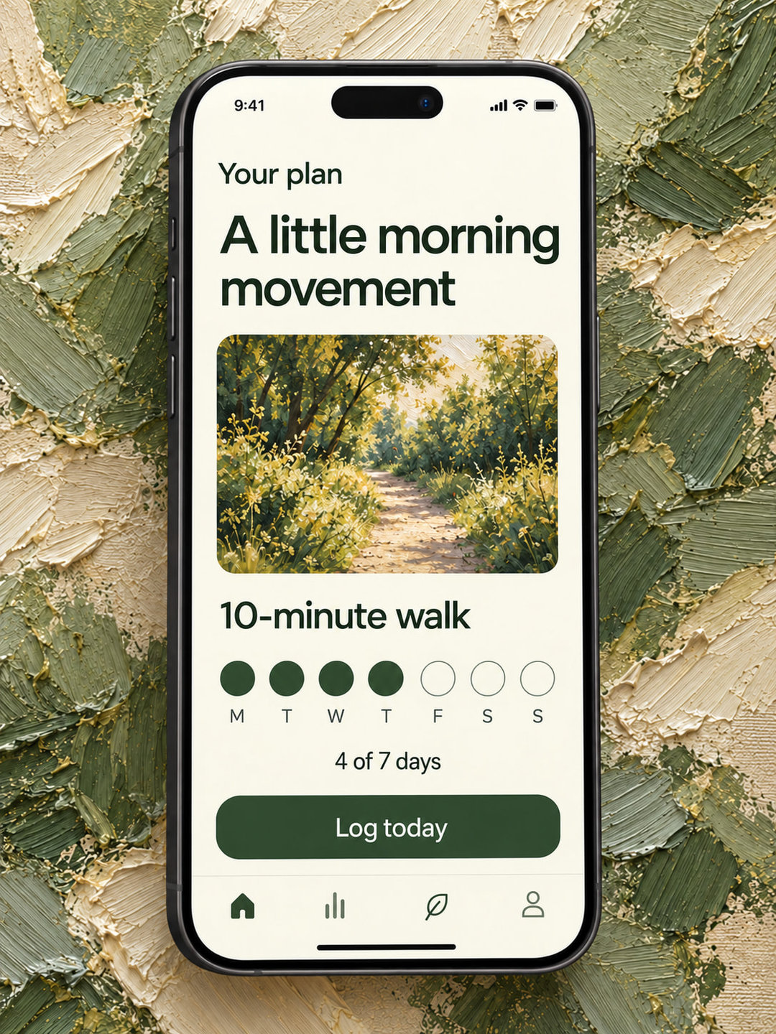
One small thing to try
Choose something manageable.
Try it for a week.
Reflect on how it feels.

Slide 9
Designed for your control
01
Choose what to connect
Your health is personal
Bring in only the signals you want.
02
Decide what to record
Keep check-ins as simple as you like.
03
Keep a way out
Export or delete your information.

Slide 10
Space to start.
Room to go deeper.
Moss
Moss Plus
Free
$8
/ month
Daily tracking and check-ins
A simple weekly view
Longer-term trends
Custom habit experiments
Deeper weekly reflections

Slide 11
A focused path to beta
01
02
03
04
Daily view
Connected data
Personal patterns
Habit experiments
Sleep, movement
and quick check-ins.
Optional device
and app connections.
Weekly views and
thoughtful reflections.
Flexible plans and
progress over time.

Slide 12
moss

