Slide 1
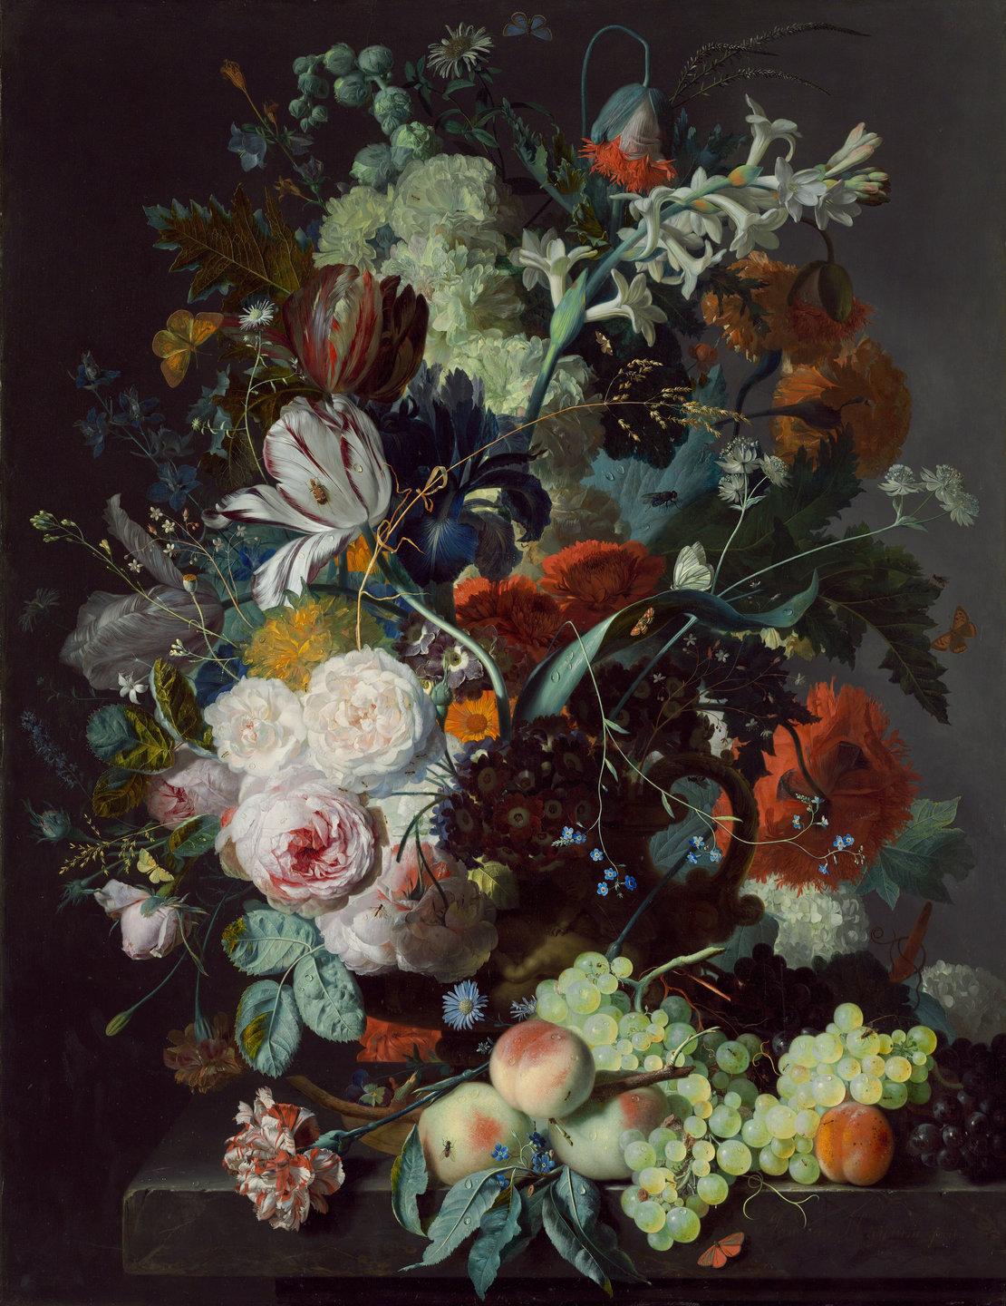
STATE
What role will human creativity play in an AI-generated world?
OF
THE
ART
Exploring the intersection of human imagination and artificial intelligence.

Slide 2
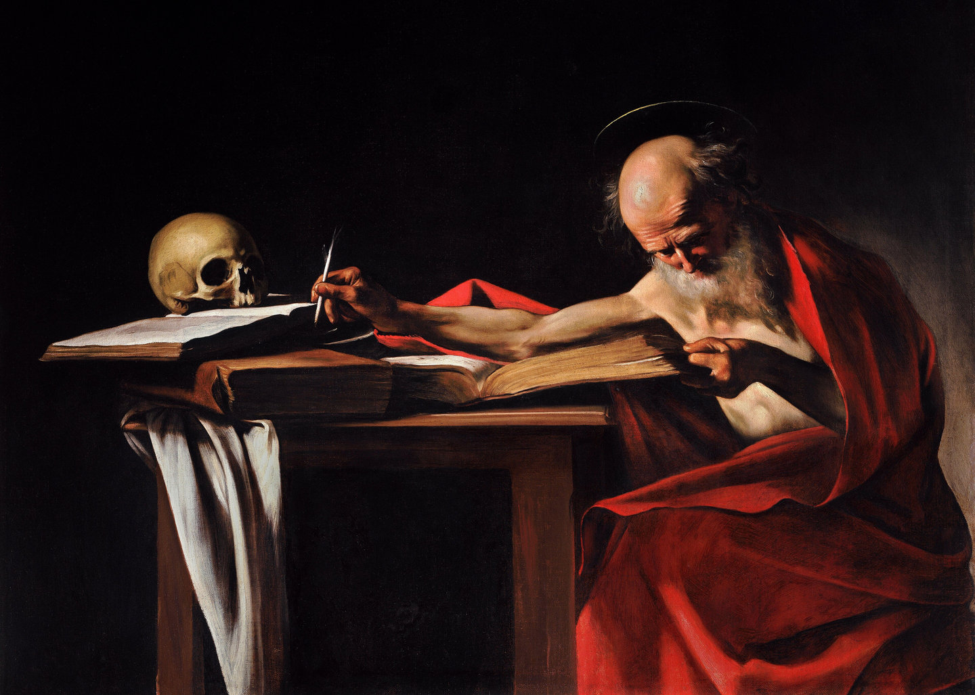
A New Canvas
1
What happens when the tools of creation become creators themselves?

Slide 3
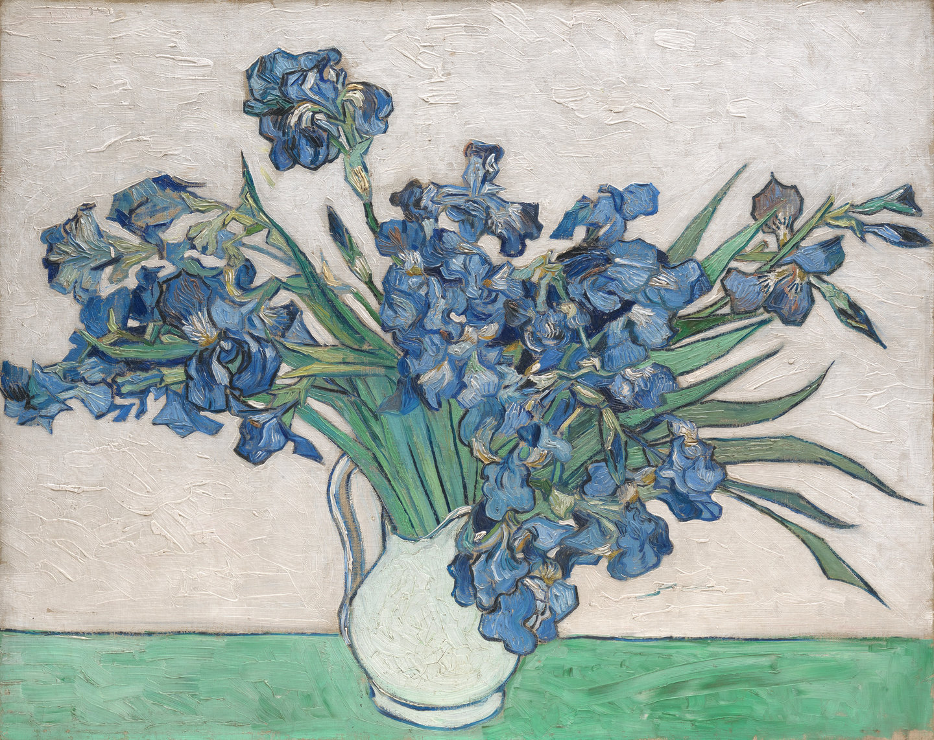
The Creative Machine
2
Can a machine truly create, or does it simply reinterpret?

Slide 4
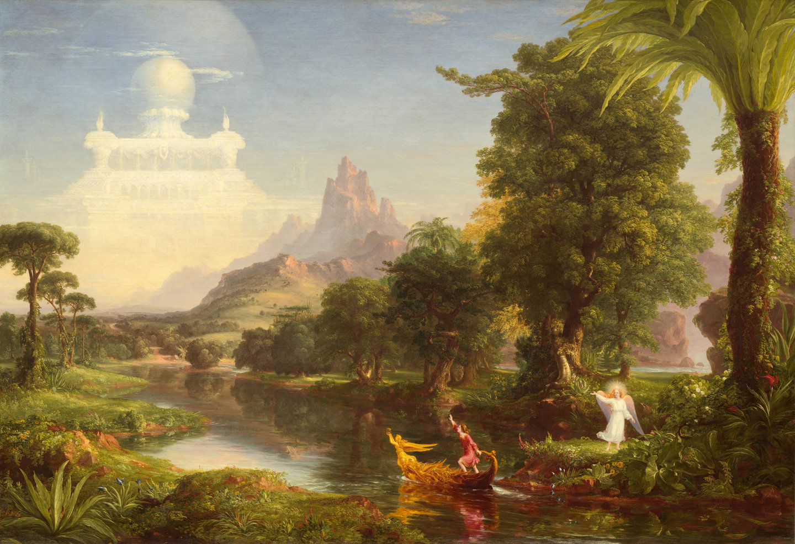
The Human Touch
3
What makes a work of art distinctly human?

Slide 5
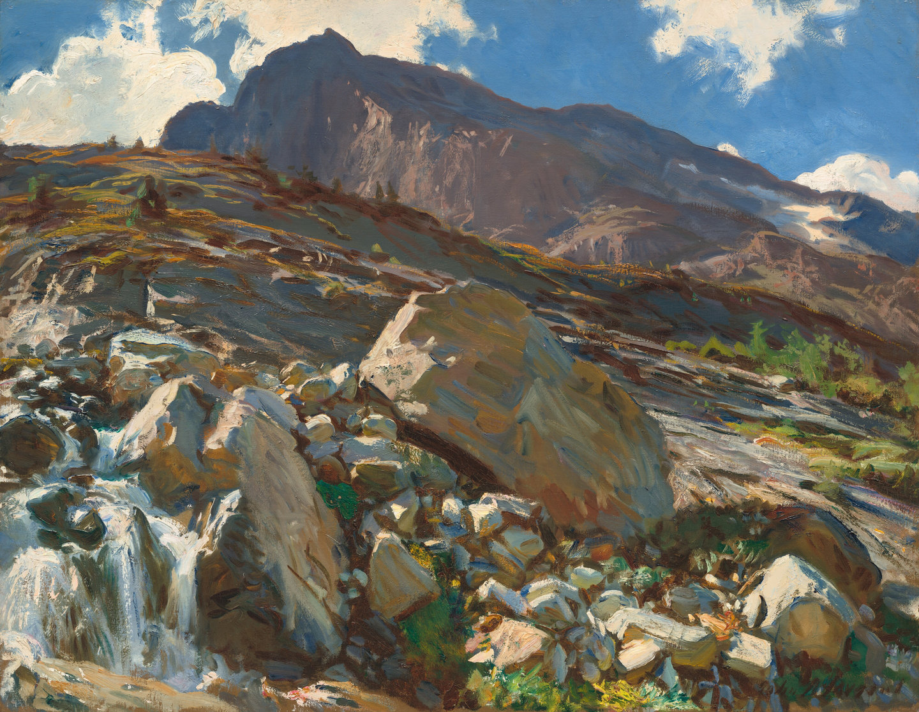
Infinite Possibility
4
What becomes possible when imagination has no technical limits?

Slide 6
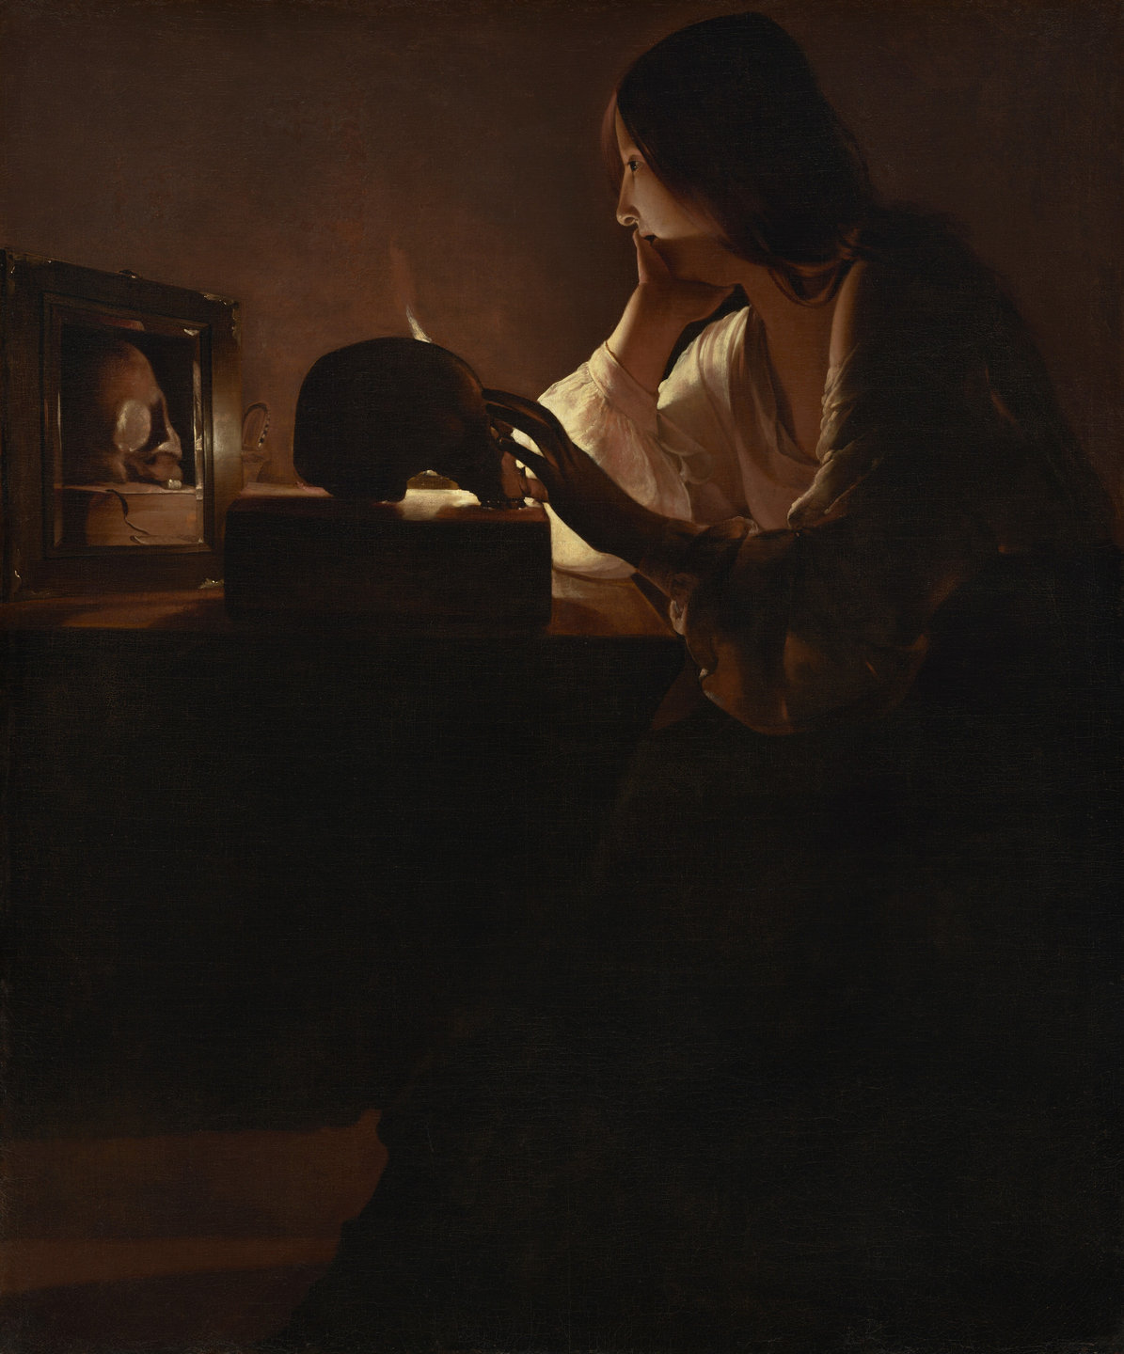
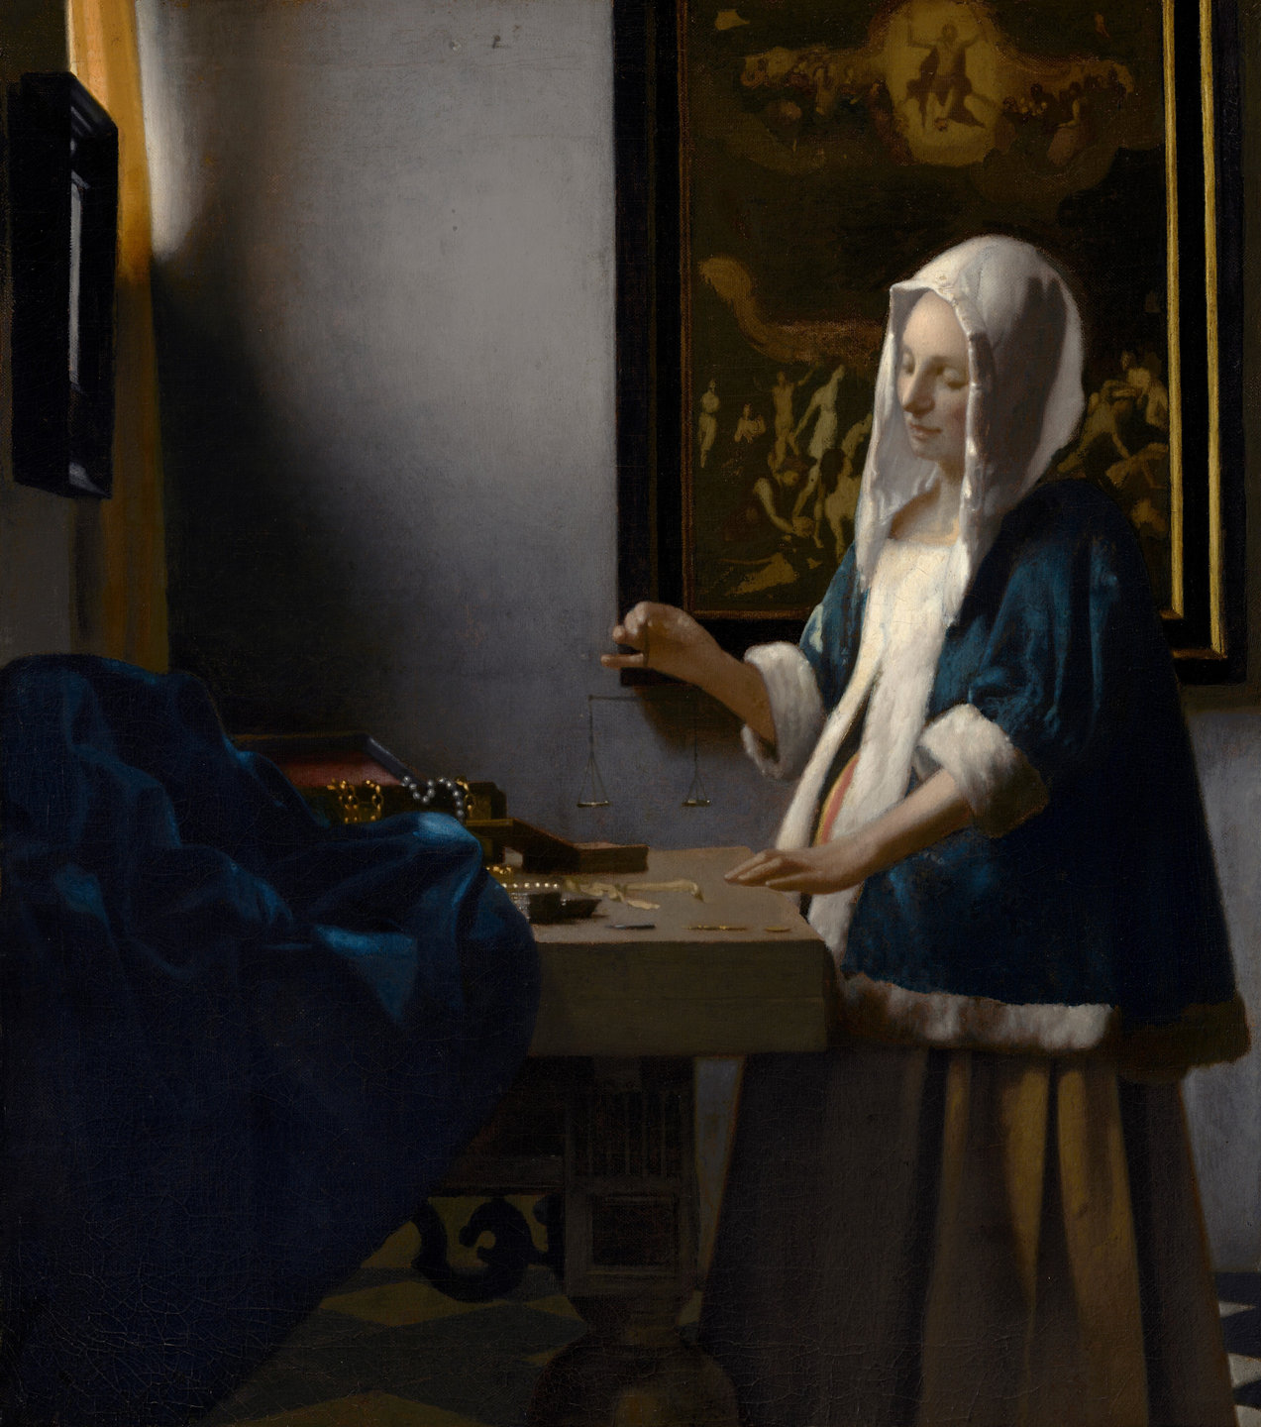
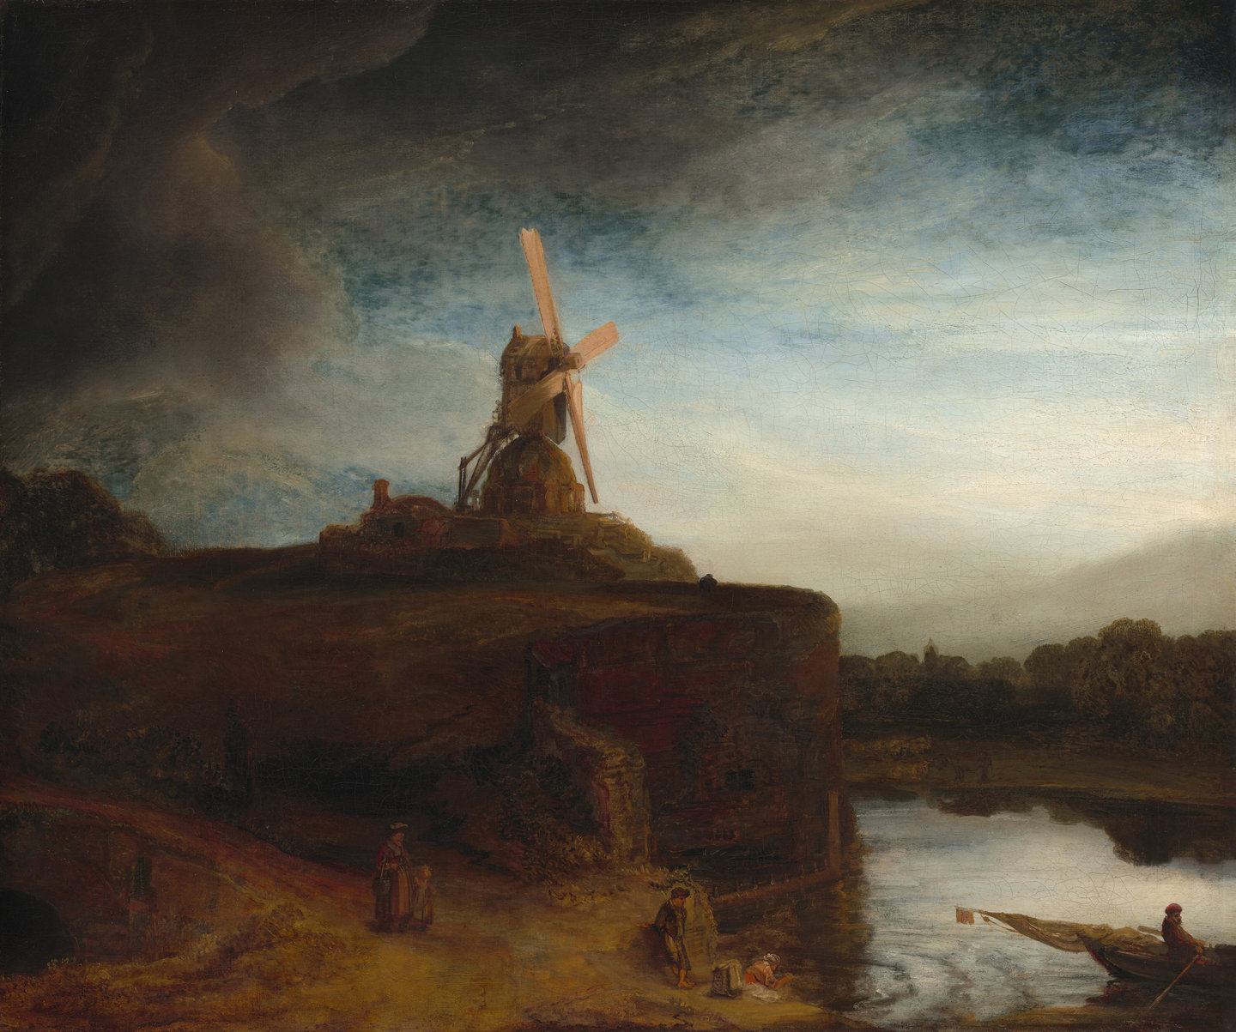
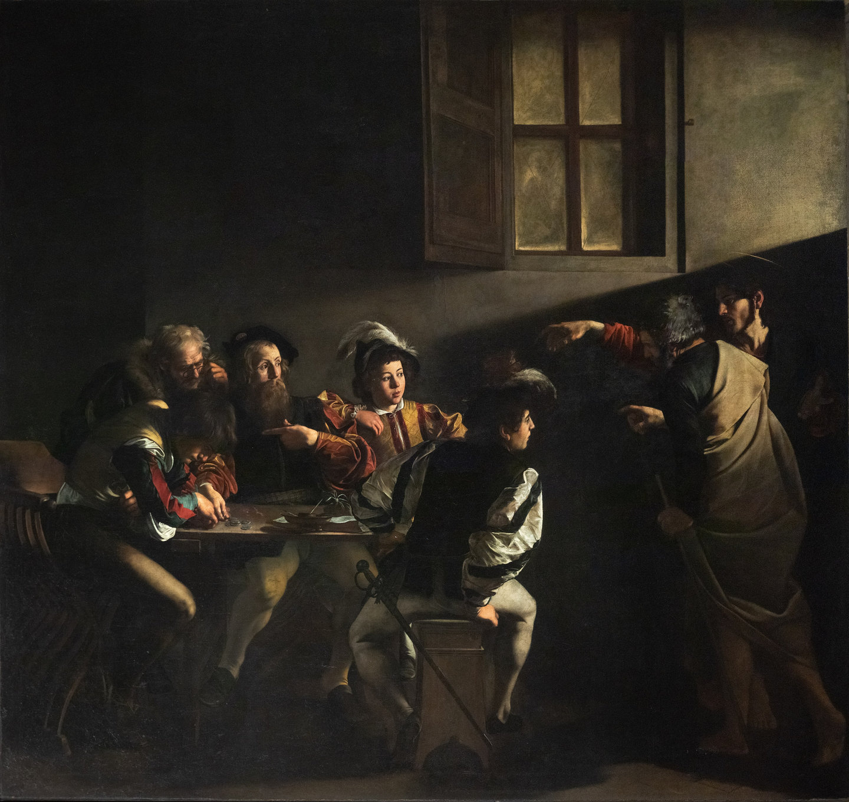
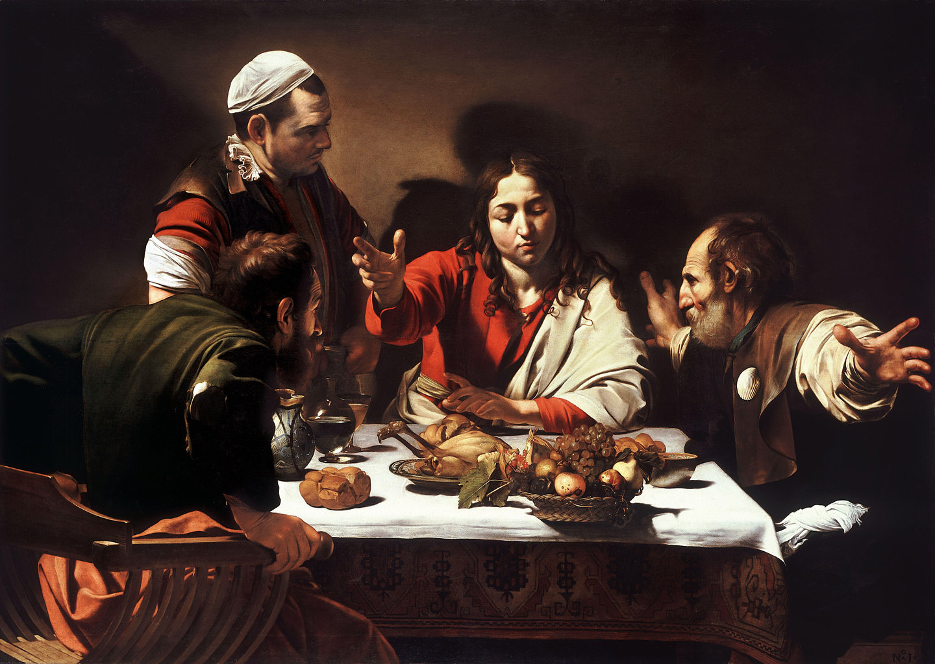
As artificial intelligence reshapes the creative landscape, the value of art lies not simply in what we can produce, but in why we create. Technology expands possibility, but human perspective, intention, and emotion give art its meaning.

