Slide 1
Introduction to Machine Learning
Paulos Charonyktakis
Maria Plakia

Slide 2
Roadmap
Supervised Learning
Algorithms
Artificial Neural Networks
Naïve Bayes Classifier
Decision Trees
Application on VoIP in Wireless Networks

Slide 3
Machine Learning
The study of algorithms and systems that improve their performance with experience (Mitchell book)
Experience?
Experience = data / measurements / observations

Slide 4
Where to Use Machine Learning
You have past data, you want to predict the future
You have data, you want to make sense out of them (find useful patterns)
You have a problem it’s hard to find an algorithm for
Gather some input-output pairs, learn the mapping
Measurements + intelligent behavior usually lead to some form of Machine Learning

Slide 5
Supervised Learning
Learn from examples
Would like to be able to predict an outcome of interest y for an object x
Learn function y = f(x)
For example, x is a VoIP call, y is an indicator of QoE
We are given data with pairs {<x_{i}, y_{i}> : i=1, ..., n},
x_{i} the representation of an object
y_{i} the representation of a known outcome
Learn the function y = f(x) that generalizes from the data the “best” (has minimum average error)

Slide 6
Algorithms:
Artificial Neural Networks

Slide 7
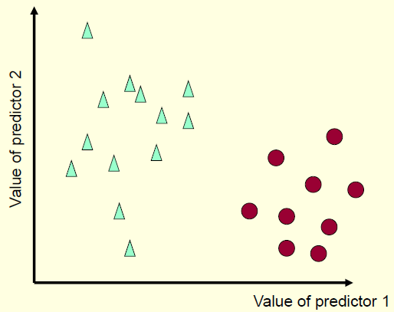
Binary Classification Example

Slide 8
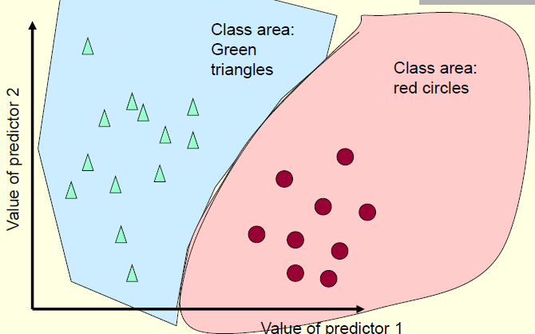
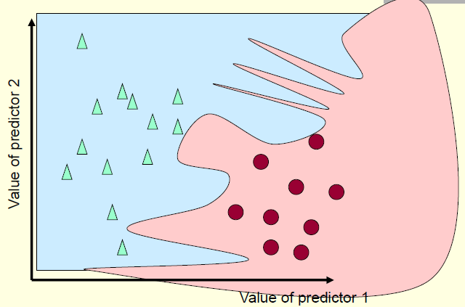
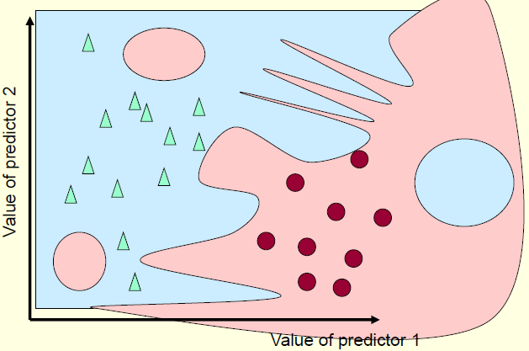
Possible Decision Areas

Slide 9
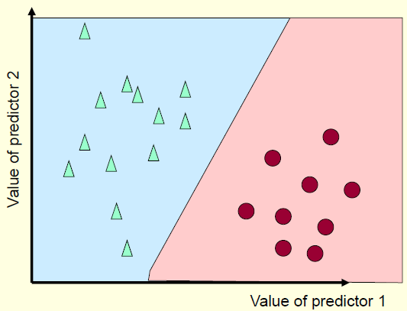
Binary Classification Example
The simplest non-trivial decision function is the straight line (in general a hyperplane)
One decision surface
Decision surface partitions space into two subspaces

Slide 10
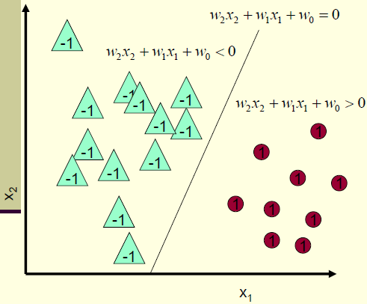

Specifying a Line
Line equation:
Classifier:
If
Output 1
Else
Output -1

Slide 11
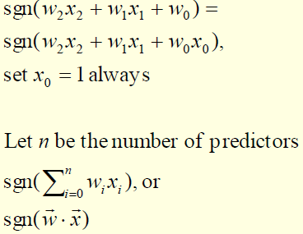
Classifying with Linear Surfaces
Classifier becomes

Slide 12
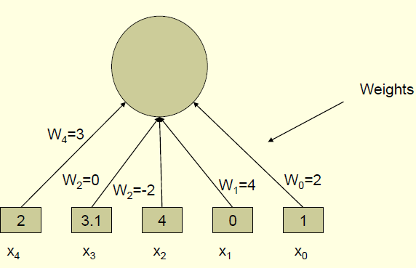
The Perceptron

Slide 13
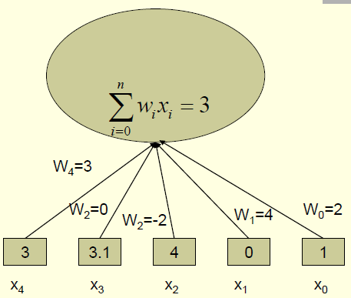
The Perceptron

Slide 14
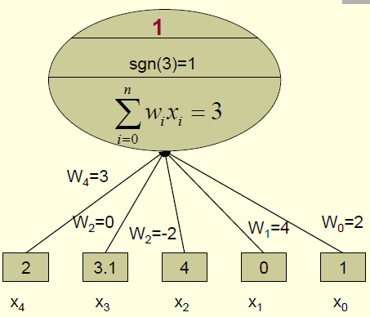
The Perceptron

Slide 15
Training Perceptrons
Start with random weights
Update in an intelligent way to improve them using the data
Intuitively:
Decrease the weights that increase the sum
Increase the weights that decrease the sum
Repeat for all training instances until convergence

Slide 16
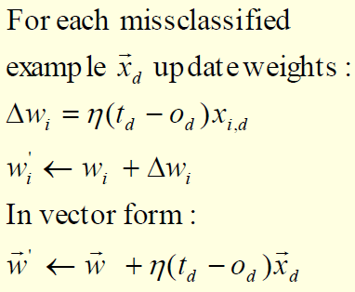
Perceptron Training Rule
η: arbitrary learning rate (e.g. 0.5)
t_{d} : (true) label of the dth example
o_{d}: output of the perceptron on the dth example
x_{i,d}: value of predictor variable i of example d
t_{d} = o_{d} : No change (for correctly classified examples)

Slide 17
Analysis of the Perceptron Training Rule
Algorithm will always converge within finite number of iterations if the data are linearly separable.
Otherwise, it may oscillate (no convergence)

Slide 18
Training by Gradient Descent
Similar but:
Always converges
Generalizes to training networks of perceptrons (neural networks) and training networks for multicategory classification or regression
Idea:
Define an error function
Search for weights that minimize the error, i.e., find weights that zero the error gradient

Slide 19
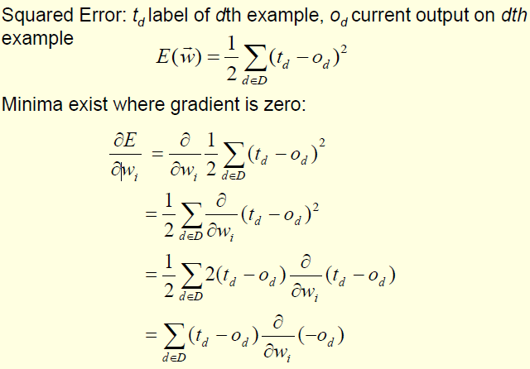
Setting Up the Gradient Descent

Slide 20
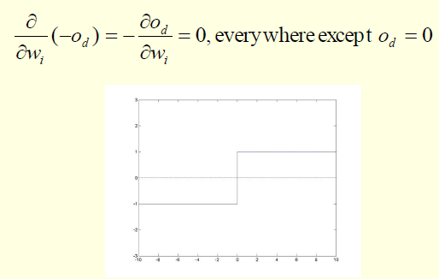
The Sign Function is not Differentiable

Slide 21
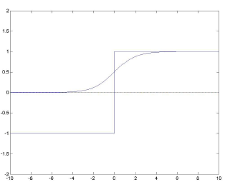
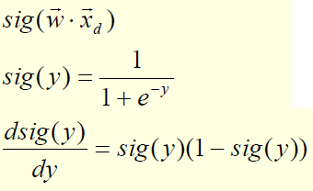
Use Differentiable Transfer Functions
Replace with the sigmoid

Slide 22
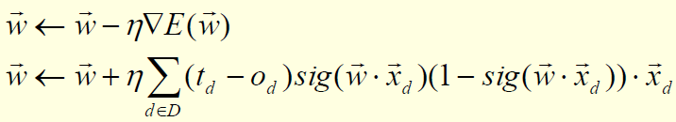
Updating the Weights with Gradient Descent
Each weight update goes through all training instances
Each weight update more expensive but more accurate
Always converges to a local minimum regardless of the data
When using the sigmoid: output is a real number between 0 and 1
Thus, labels (desired outputs) have to be represented with numbers from 0 to 1

Slide 23
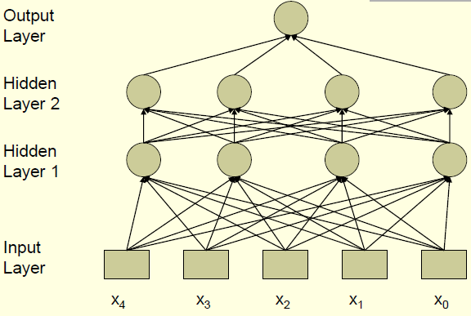
Feed-Forward Neural Networks

Slide 24
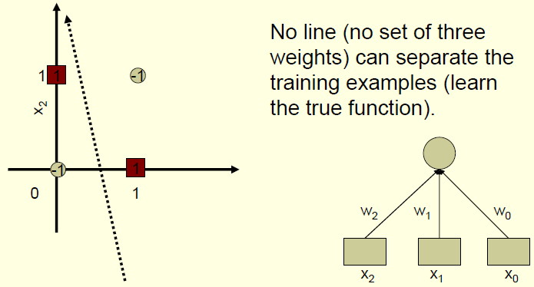
Increased Expressiveness Example: Exclusive OR

Slide 25
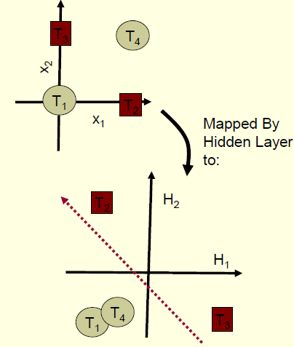
From the Viewpoint of the Output Layer
Each hidden layer maps to a new feature space
•Each hidden node is a new constructed feature
•Original Problem may become separable (or easier)

Slide 26
How to Train Multi-Layered Networks
Select a network structure (number of hidden layers, hidden nodes, and connectivity).
Select transfer functions that are differentiable.
Define a (differentiable) error function.
Search for weights that minimize the error function, using gradient descent or other optimization method.
BACKPROPAGATION

Slide 27
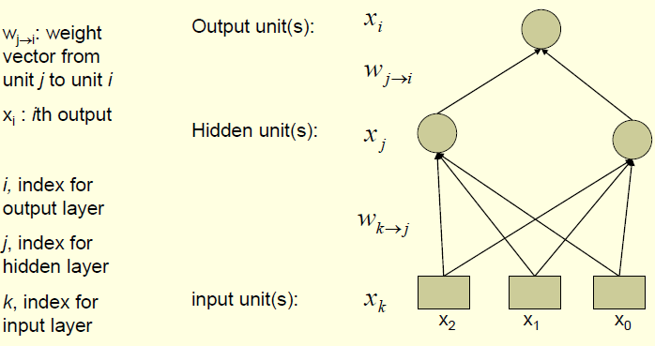
Back-Propagating the Error

Slide 28
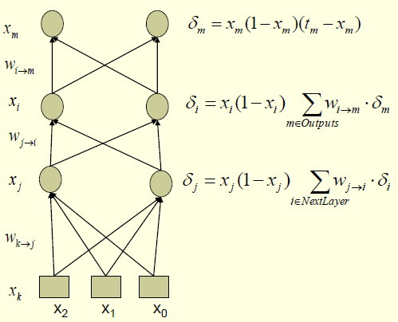
Back-Propagating the Error

Slide 29
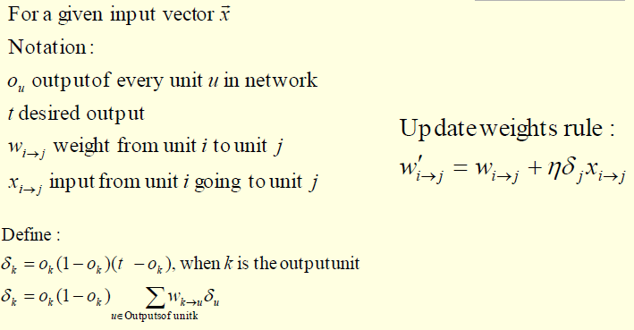
Back-Propagation

Slide 30
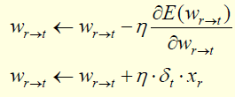
Back-Propagation Algorithm
Propagate the input forward through the network
Calculate the outputs of all nodes (hidden and output)
Propagate the error backward
Update the weights:

Slide 31
Training with Back-Propagation
Going once through all training examples and updating the weights: one epoch
Iterate until a stopping criterion is satisfied
The hidden layers learn new features and map to new spaces
Training reaches a local minimum of the error surface

Slide 32
Overfitting with Neural Networks
If number of hidden units (and weights) is large, it is easy to memorize the training set (or parts of it) and not generalize
Typically, the optimal number of hidden units is much smaller than the input units
Each hidden layer maps to a space of smaller dimension

Slide 33
Representational Power
Perceptron: Can learn only linearly separable functions
Boolean Functions: learnable by a NN with one hidden layer
Continuous Functions: learnable with a NN with one hidden layer and sigmoid units
Arbitrary Functions: learnable with a NN with two hidden layers and sigmoid units
Number of hidden units in all cases unknown

Slide 34
Conclusions
Can deal with both real and discrete domains
Can also perform density or probability estimation
Very fast classification time
Relatively slow training time (does not easily scale to thousands of inputs)
One of the most successful classifiers yet
Successful design choices still a black art
Easy to overfit or underfit if care is not applied

Slide 35
ANN in Matlab
Create an ANN
net =feedforwardnet(hiddenSizes,trainFcn)
[NET,TR] = train(NET,X,T) takes a network NET, input data X and target data T and returns the network after training it, and a training record TR.
sim(NET,X) takes a network NET and inputs X and returns the estimated outputs Y generated by the network.

Slide 36
Algorithms: Naïve Bayes Classifier

Slide 37
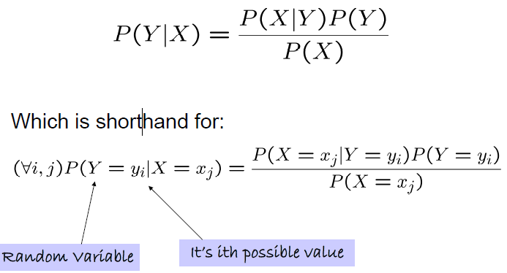
Bayes Rule

Slide 38
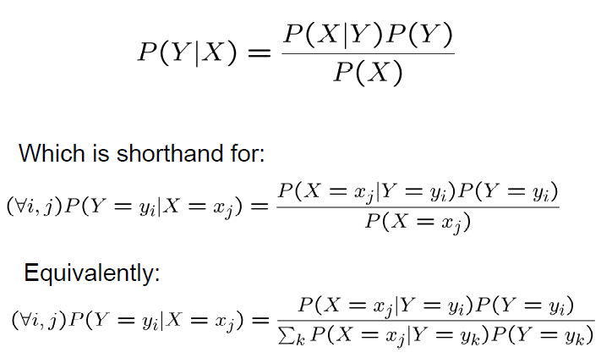
Bayes Rule

Slide 39
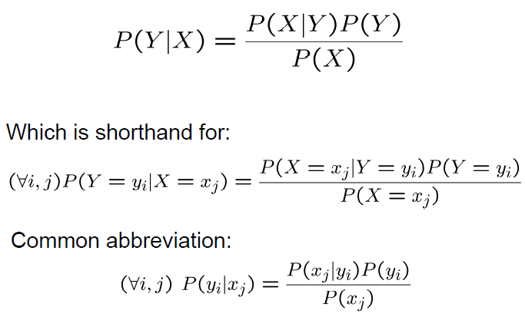
Bayes Rule

Slide 40
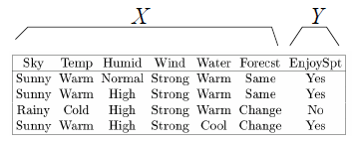
Bayes Classifier
Training data:
Learning = estimating P(X|Y), P(Y)
Classification = using Bayes rule to calculate P(Y | X^{new})

Slide 41

Naïve Bayes
Naïve Bayes assumes
X= <X₁, …, X_{n} >, Y discrete-valued
i.e., that X_{i} and X_{j} are conditionally independent given Y, for all i≠j

Slide 42
Conditional Independence
Definition: X is conditionally independent of Y given Z, if the probability distribution governing X is independent of the value of Y, given the value of Z
P(X| Y, Z) = P(X| Z)

Slide 43
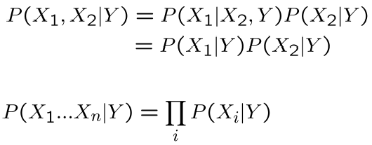
Naïve Bayes
Naïve Bayes uses assumption that the X_{i} are conditionally independent, given Y
then:
How many parameters need to be calculated???

Slide 44



Naïve Bayes classification
Bayes rule:
Assuming conditional independence:
So, classification rule for X^{new} = <X_{i}, …, X_{n} >

Slide 45
Naïve Bayes Algorithm
Train Naïve Bayes (examples)
for each* value y_{k}
Estimate π_{k} = P(Y = y_{k})
for each* value x_{ij} of each attribute X_{i}
Estimate θ_{ijk} = P(X_{i} = x_{ij}| Y = y_{k})
Classify (X^{new})
* parameters must sum to 1

Slide 46
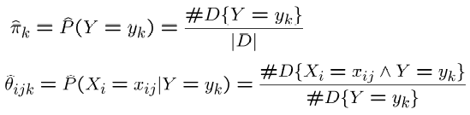
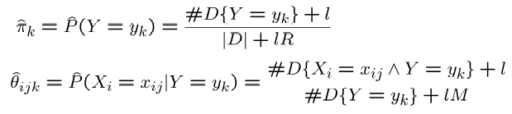
Estimating Parameters: Y, X_{i} discrete-valued
Maximum likelihood estimates:
MAP estimates (uniform Dirichlet priors):

Slide 47
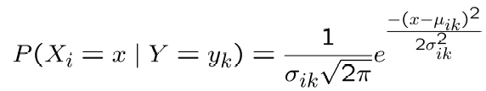
What if we have continuous Xi ?
Gaussian Naïve Bayes (GNB) assume
Sometimes assume variance
is independent of Y (i.e., σi),
or independent of Xi (i.e., σk)
or both (i.e., σ)

Slide 48
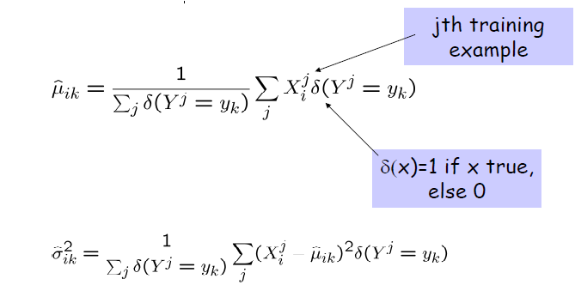
Estimating Parameters: Y discrete, X_{i} continuous
Maximum likelihood estimates:

Slide 49
Naïve Bayes in Matlab
Create a new Naïve object:
NB = NaiveBayes.fit(X, Y), X is a matrix of predictor values, Y is a vector of n response values
post = posterior(nb,test) returns the posterior probability of the observations in test
Predict a value
predictedValue = predict(NB,TEST)

Slide 50
Algorithms: Decision Trees

Slide 51
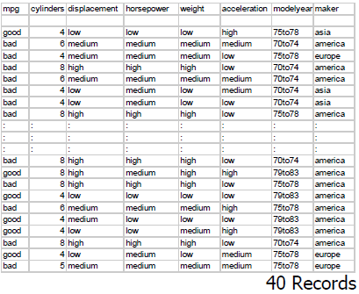
A small dataset: Miles Per Gallon
Suppose we want to predict MPG
From the UCI repository

Slide 52
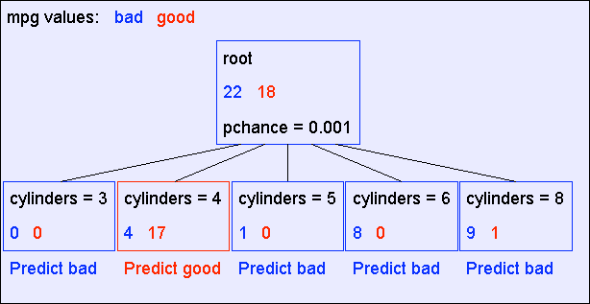
A Decision Stump

Slide 53
Recursion Step
Records
in which
cylinders
= 4
Records
in which
cylinders
= 5
Records
in which
cylinders
= 6
Records
in which
cylinders
= 8
And partition it
according
to the value of
the attribute
we split on
Take the
Original
Dataset..
Build Tree from these Records

Slide 54
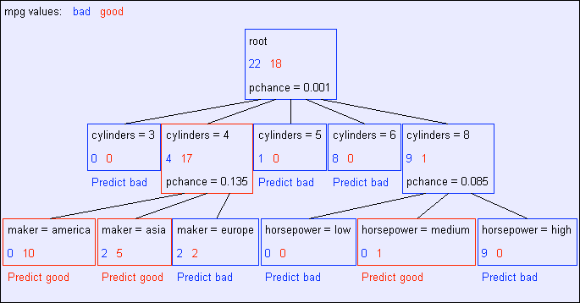
Second level of tree
Recursively build a tree from the seven
records in which there are four cylinders and
the maker was based in Asia
(Similar recursion in the
other cases)

Slide 55
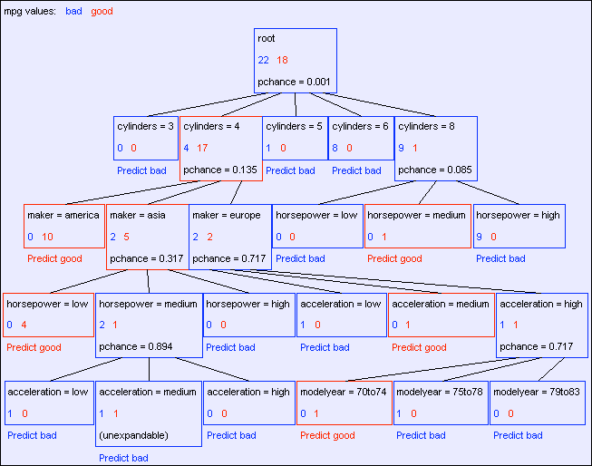
The final tree

Slide 56
Classification of a new example
Classifying a test example
Traverse tree
Report leaf label

Slide 57
Learning decision trees is hard!!!
Learning the simplest (smallest) decision tree is an NP-complete problem [Hyafil & Rivest ’76]
Resort to a greedy heuristic:
Start from empty decision tree
Split on next best attribute (feature)
Recurse

Slide 58
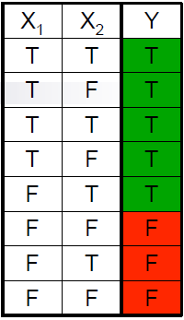
Choosing a good attribute
Good split if we are more certain about classification after split
Deterministic good (all true or all false)
Uniform distribution bad
P(Y=A) = 1/2 | P(Y=B) = 1/4 | P(Y=C) = 1/8 | P(Y=D) = 1/8
P(Y=A) = 1/4 | P(Y=B) = 1/4 | P(Y=C) = 1/4 | P(Y=D) = 1/4

Slide 59
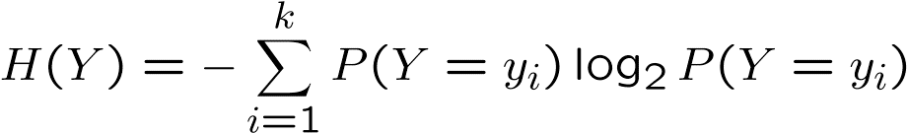
Entropy
Entropy H(X) of a random variable Y
More uncertainty, more entropy!
Information Theory interpretation: H(Y) is the expected number of bits needed
to encode a randomly drawn value of Y (under most efficient code)

Slide 60
Information gain
Advantage of attribute – decrease in uncertainty
Entropy of Y before you split
Entropy after split
Weight by probability of following each branch, i.e., normalized number of records
Information gain is difference

Slide 61
Learning decision trees
Start from empty decision tree
Split on next best attribute (feature)
Use, for example, information gain to select attribute
Split on
Recurse

Slide 62
A Decision Stump

Slide 63
Base Case 1
Don’t split a
node if all
matching
records have
the same
output value

Slide 64
Base Case 2
Don’t split a
node if all
matching
records have
the same
output value

Slide 65
Base Cases
Base Case One: If all records in current data subset have the same output then don’t recurse
Base Case Two: If all records have exactly the same set of input attributes then don’t recurse

Slide 66
Basic Decision Tree Building Summarized
BuildTree(DataSet,Output)
If all output values are the same in DataSet, return a leaf node that says “predict this unique output”
If all input values are the same, return a leaf node that says “predict the majority output”
Else find attribute X with highest Info Gain
Suppose X has n_{X} distinct values (i.e. X has arity n_{X}).
Create and return a non-leaf node with n_{X} children.
The i’th child should be built by calling
BuildTree(DSi,Output)
Where DSi built consists of all those records in DataSet for which X = ith
distinct value of X.

Slide 67
Decision trees will overfit
Standard decision trees are have no learning biased
Training set error is always zero!
(If there is no label noise)
Lots of variance
Will definitely overfit!!!
Must bias towards simpler trees
Many strategies for picking simpler trees:
Fixed depth
Fixed number of leaves
Or something smarter…

Slide 68
Consider this
split

Slide 69
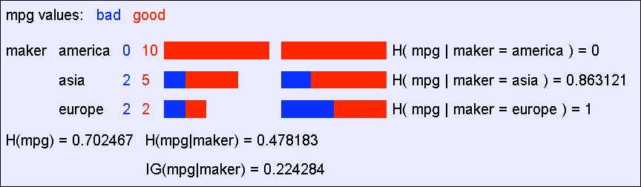
A chi-square test
Suppose that mpg was completely uncorrelated with maker.
What is the chance we’d have seen data of at least this apparent level of association anyway?
By using a particular kind of chi-square test, the answer is 7.2%

Slide 70
Using Chi-squared to avoid overfitting
Build the full decision tree as before
But when you can grow it no more, start to prune:
Beginning at the bottom of the tree, delete splits in which pchance > MaxPchance
Continue working you way up until there are no more prunable nodes

Slide 71
What you need to know about decision trees
Decision trees are one of the most popular data mining tools
Easy to understand
Easy to implement
Easy to use
Computationally cheap (to solve heuristically)
Information gain to select attributes (ID3, C4.5,…)
Presented for classification, can be used for regression and density estimation too
Decision trees will overfit!!!
Zero bias classifier ! Lots of variance
Must use tricks to find “simple trees”, e.g.,
Fixed depth/Early stopping
Pruning
Hypothesis testing

Slide 72
Decision trees in Matlab
Use classregtree class
Create a new tree:
t=classregtree(X,Y), X is a matrix of predictor values, y is a vector of n response values
Prune the tree:
tt = prune(t, alpha, pChance) alpha defines the level of the pruning
Predict a value
y= eval(tt, X)

Slide 73
Application on VoIP in Wireless Networks

Slide 74
Motivation
Wide use of wireless services for communication
Quality of Service (QoS):
Objective network-based metrics (e.g., delay, packet loss)
Quality of Experience (QoE):
Objective and subjective performance metric (e.g., E-model, PESQ)
Objective factors: network, application related
Subjective factors: users expectation (MOS)

Slide 75
Problem Definition
Users are not likely to provide QoE feedback
unless bad QoE is witnessed
Estimation of QoE
difficult because of the many contributing factors using Opinion Models
Use of machine learning algorithms for the estimation of the QoE
based on QoS metrics

Slide 76
Proposed Method
Nested Cross Validation training of
ANN Models
GNB Models
Decision Trees models
Preprocessing of data: normalization

Slide 77
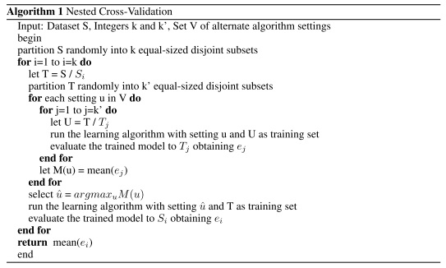
Nested Cross-Validation

Slide 78
Dataset
25 users
18 samples (segments of VoIP calls)
Each user evaluated all the segments with QoE score
10 attributes as predictors

Slide 79
Dataset
Predictors
average delay, packet loss, average jitter, burst ratio, average burst interarrival, average burst size, burst size variance, delay variance, jitter variance, burst interarrival variance
QoE score

Slide 80
Experiments and Results
For ANN we tested different values of nodes at the first and the second hidden layer, with and no normalization of the data
In this table we can see some statistics from the error which appears from the difference between the estimated QoE and the real QoE
 | ANN
Mean error | 0.9018
Median error | 0.6181
Std error | 1.0525

Slide 81
Experiments and Results
In order to train the GNB models we use the data with normalization or not.
Statistics from the error of this model:
 | GNB
Mean error | 0.9018
Median error | 0.6181
Std error | 1.0525

Slide 82
Experiments and Results
For the Decision Trees we used different values of alpha (a) parameter which defines the pruning level of the tree.
Statistics:
 | Decision Trees
Mean error | 0.5475
Median error | 0.3636
Std error | 0.5395

Slide 83
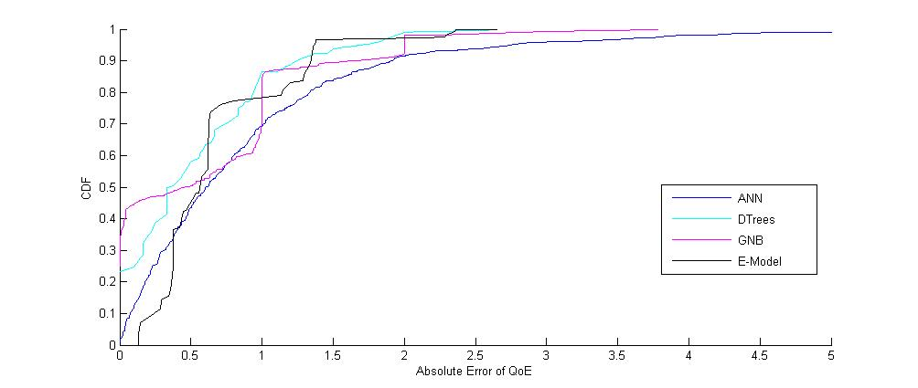

Slide 84
Material
Sources:
Lectures from Machine Learning course CS577

