Slide 1
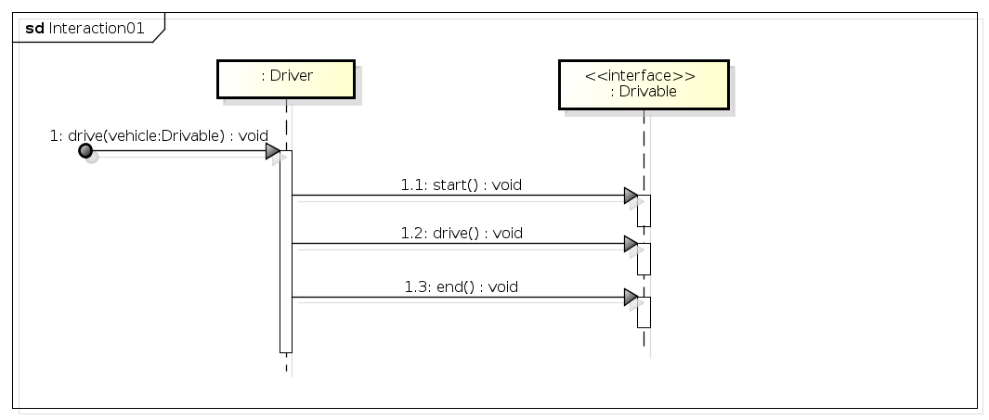
Interaction
Lifeline
MessageOccurence
Specification (sendEvent)
Message (start)
MessageOccurence
Specification (sendEvent)
MessageOccurence
Specification (receiveEvent)
Message
ActionExecution
Specification

