Slide 1
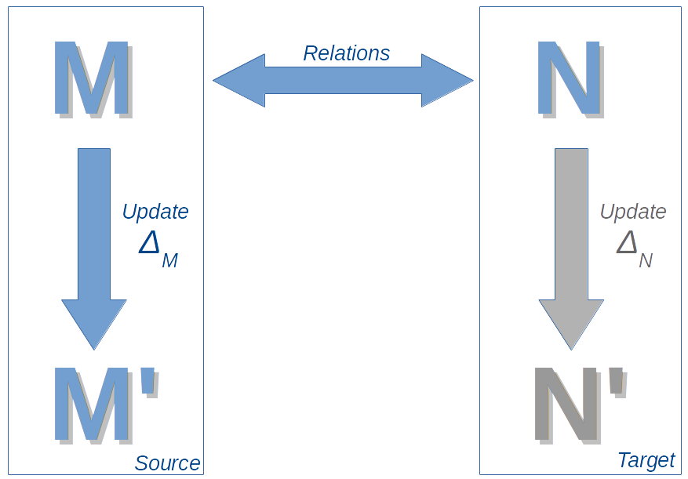
The Metamodels
The Relations
The Synchronization

