Slide 1
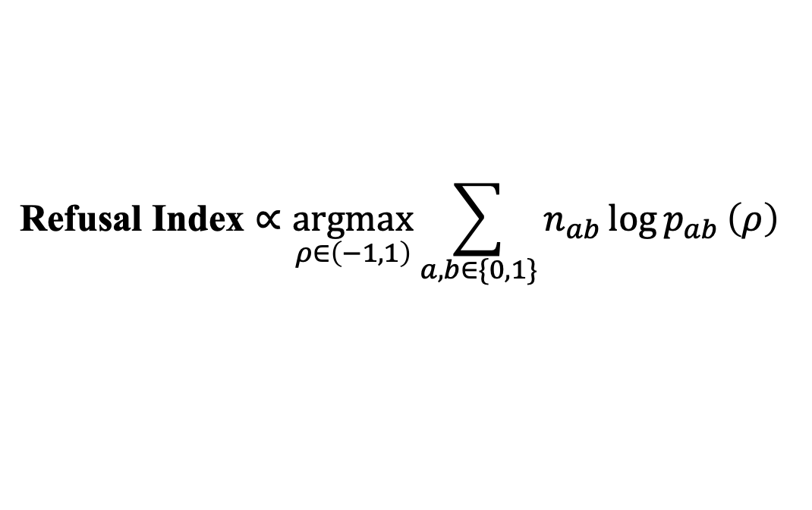
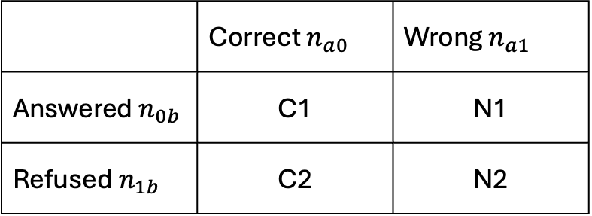
 | Correct $n_{a0}$ | Wrong $n_{a1}$
Answered $n_{0b}$ | C1 | N1
Refused $n_{1b}$ | C2 | N2
$$\text{Refusal} \text{Index}∝\underset{ρ∈\left(−1,1\right)}{argmax}{\sum_{a,b∈\{0,1\}}{n_{ab}}\log{p_{ab}}}\left(ρ\right)$$

