Slide 1
Programming Resources
CS 179
Rishav Mukherji ‘15

Slide 2
What’s been covered so far…
HTML
CSS
Javascript
AJAX
Local Storage
MVC

Slide 3
Agenda
jQuery Mobile
Git
Some other cool tools for prototyping/coding
Team activities

Slide 4
jQuery Mobile
Coding Example

Slide 5
GIT and Version Control
git init – transform the current directory into a git repository
git init <directory> - create new git directory within current folder
git clone <repo> - clones the repository located at <repo> onto the local machine’s current folder
git config --global user.name <name> - configure global user name for git initializations
git config --global user.email <email> - configure global user email for git initializations
git status – lists which files are tracked, untracked, committed, uncommitted etc.
git checkout <branch> or git checkout <commit> or git checkout <commit><file> - checkout some git branch or all files from a certain commit or a certain file from a certain commit
git add <filename> or git add --all - add files to track
git commit -am “<message> - commit all files with some commit message
git push <remote> <branch> - push specified branch to specified remote branch
git log – log of all commits

Slide 6
GIT and Version Control (continued…)
git remote add origin <remote url name> - adds remote url where to push the git repo
git clean –n – performed “dry run” of git clean and shows which files are untracked and will be removed
git clean – remove untracked files from system
git pull <remote> - pull remote branch to merge latest changes (remember to commit previous work before doing this)
git branch <new branch name> - create a new branch for current project (does not checkout the new branch)
git merge <branch> - merge specified branch into current branch
Good Git tutorials and help available here:
https://www.atlassian.com/git/tutorials/setting-up-a-repository
https://try.github.io/levels/1/challenges/1

Slide 7
Free Web Hosting for Final Projects
atspace.cc
http://www.000webhost.com/
Or anything that provides free web-hosting and fulfills your requirements
Contact the staff if there isn’t a free solution you can find
Today’s jQuery demo can be found at the hosting solution I was testing on: http://cs179.site88.net/

Slide 8
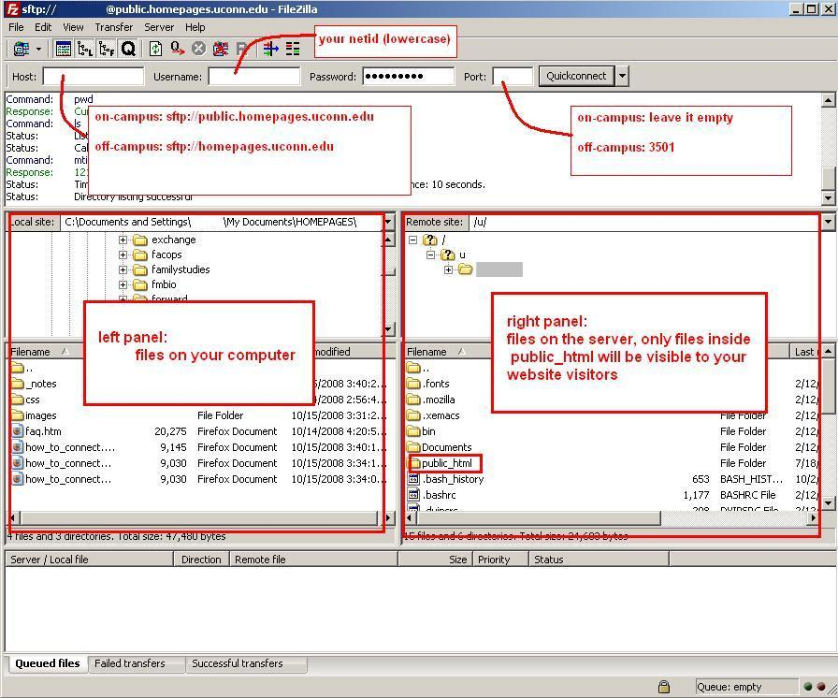
SCP Clients
WinSCP
FileZilla

Slide 9
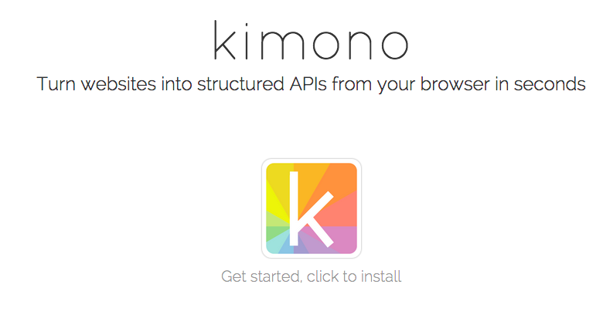
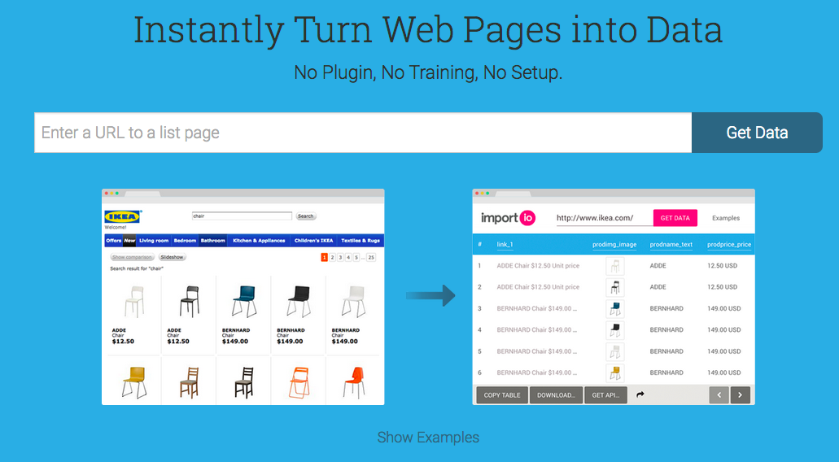
Web Scraping
Kimono
import.io

Slide 10
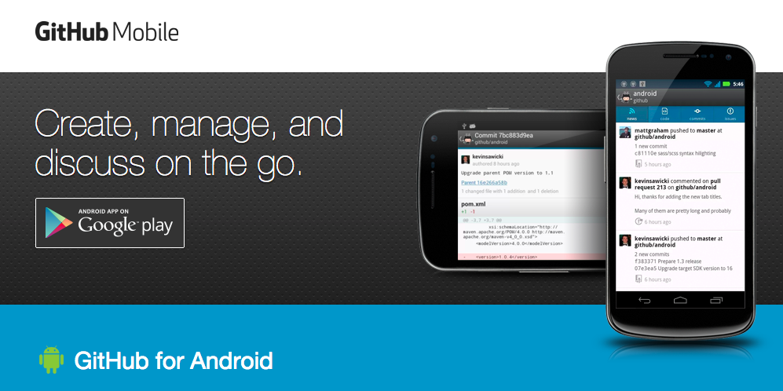
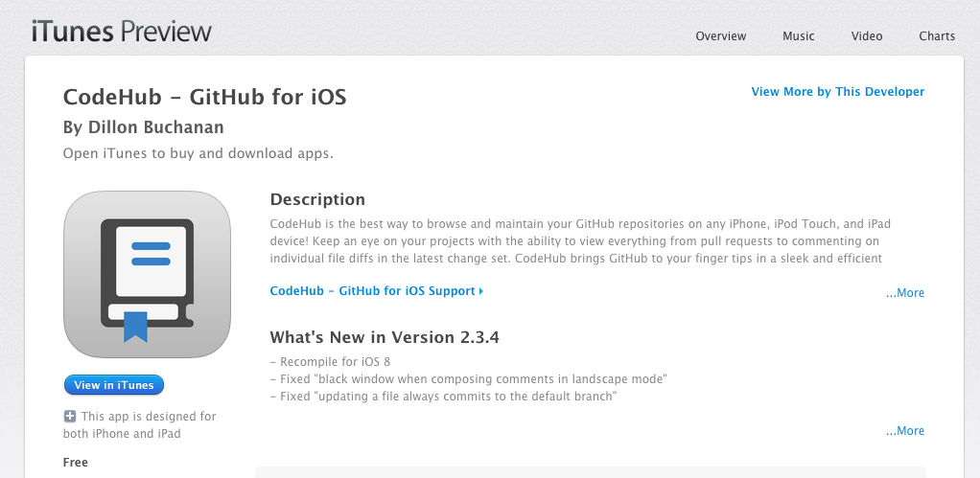
Github for Mobile

Slide 11
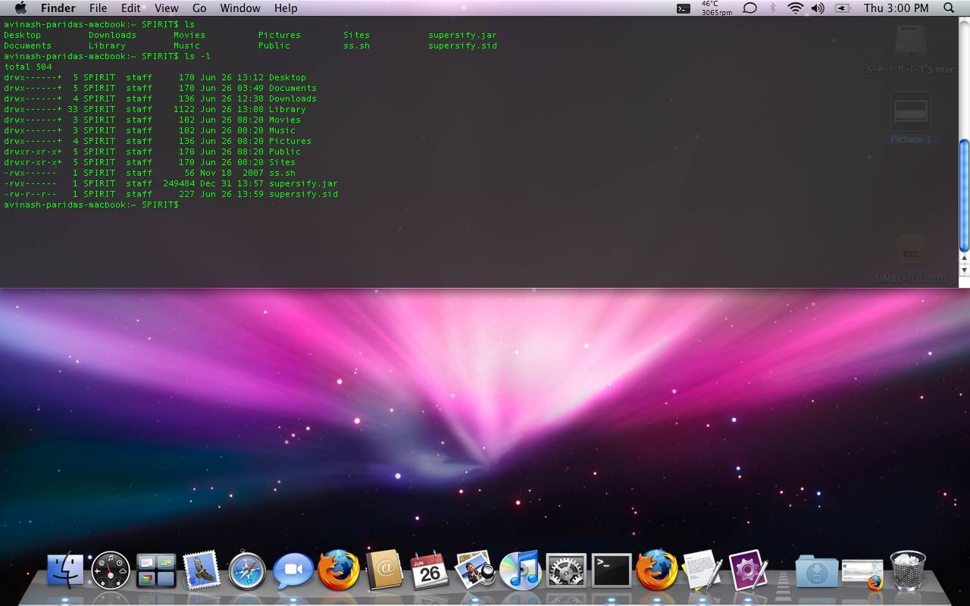
Drop-down Terminals
Guake Terminal for Ubuntu (similar for other Linux distributions)
Total terminal for Mac
Windows Quake Style Console

