Slide 1
Laravel alapok

Slide 2
Az előadás tartalma
Mi is az a Laravel?
Requirements
Installation
Models
Migrations
Routing
Controllers
Views & Layouts
Összefoglalás

Slide 3
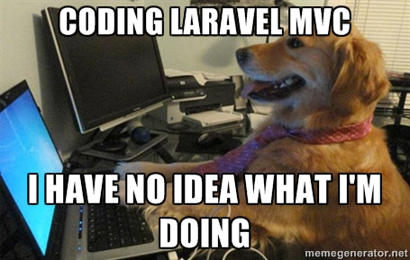
Mi is az a Laravel?

Slide 4
Mi is az a Laravel?
PHP Keretrendszer
Inspiráció: APS.NET MVC
Egyszerűség, olvashatóság:
  PSR-2
  PHP kommentek
  Szimpla metódusok pl.: sync()
ORM, migráció kezelés és séma építő

Slide 5
Requirements
PHP >= 5.5.9
OpenSSL PHP Extension
PDO PHP Extension
Mbstring PHP Extension
Tokenizer PHP Extension

Slide 6
Installation
Laravel installer:
  composer global require "laravel/installer"
  laravel new blog
Composer:
  composer create-project --prefer-dist laravel/laravel blog

Slide 7
Models
Eloquent ORM
Conventions (table names, PK, timestamps)
Query builder
Relationships:
  One To One
  One To Many
  Many To Many
  Has Many Through
  ...

Slide 8
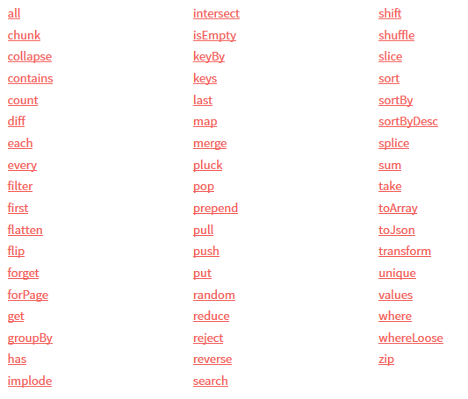
Models - Collections

Slide 9
Migrations
Artisan Console
„Version Control” like
Structure
  up
  down
Migration types:
  Creating Tables, Renaming / Dropping Tables, Creating Columns, Modifying Columns, Dropping Columns, Creating Indexes, Dropping Indexes, Foreign Key Constraints

Slide 10
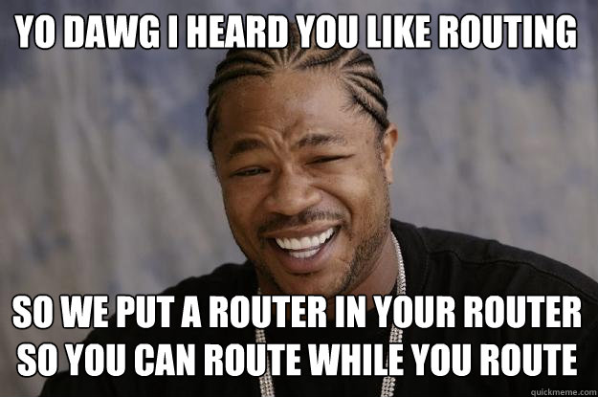
Routing

Slide 11
Routing
Route Parameters
Named Routes
Route Groups
  Namespaces
  Sub-Domain Routing
  Route Prefixes
CSRF Protection
Route Model Binding
Form Method Spoofing

Slide 12
Controllers
RESTful Resource Controllers
  index
  create
  store
  show
  edit
  update
  destroy

Slide 13

Views & Layouts

Slide 14
Views & Layouts
Views
  Passing Data To Views
  Sharing Data With All Views
Blade Templates
  Template Inheritance
  Control Structures

Slide 15
És most...
programozzunk!

Slide 16
Hasznos linkek
https://laracasts.com/
https://laravel.com/docs/master
http://www.sitepoint.com/php/laravel-php/
https://scotch.io/tag/laravel

Slide 17
Laravel alapok
Köszönjük a figyelmet!

