Slide 1
Exam Scores Analysis
William Parker
DATA 824

Slide 2
Data Collection
Source: kaggle.com
Name: Students Performance in Exams
Author/Owner: Aman Chauhan
Background: This dataset is a collection of 1000 students' performances on standardized testing. Also included was the student’s sex, race/ethnicity, parental level of education, lunch status, and whether they took a test preparation course.
Interest: The goal of this application was to analyze this data and see if there were any patterns within the data to determine if there was a common variable that would affect the scores of students.

Slide 3
Data Overview (categorical variables)
sex – factor with 2 levels:
female and male
race_ethnicity – factor with 5 levels:
group A, group B, group C, group D, group E
Groups are anonymous so there is no bias towards one race or ethnicity
parental_education – factor with 6 levels:
some high school, high school, some college, associate’s degree, bachelor’s degree, master’s degree
lunch – factor with 2 levels:
free/reduced, standard
test_prep – factor with 2 levels:
none, completed

Slide 4
Data Overview (quantitative variable)
math_score – math scores from a standardized test
Values range from 13 to 100
Median: 66.5
Mean: 66.4
reading_score – reading scores from a standardized test
Values range from 27 to 100
Median: 70
Mean: 69
writing_score – writing scores from a standardized test
Values range from 23 to 100
Median: 68
Mean: 67.74

Slide 5
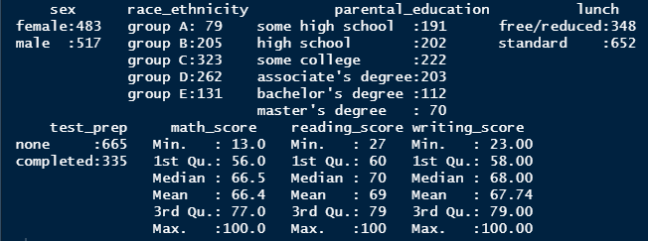
Data Overview (from R)
First step was to look at a summary of the data
This information can be found on the first tab of the shiny app along with the full dataset
This summary includes counts of all the categorical data as well as summary statistics for the quantitative variables
One major thing that stood out was the means and medians were close to each other
Indicates the data might be symmetrical rather than skewed

Slide 6

shiny App Overview
Named Student Exam Scores
It has 4 tabs, each getting deeper into the analysis

Slide 7
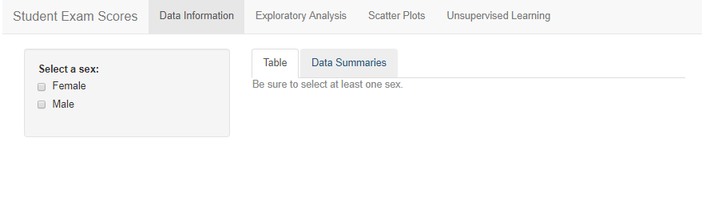
Data Information Tab
Subtabs include Table and Data Summaries
Each can be filtered based on sex
Table can be filtered further as it is interactive
This will give the user an overview of all the data so they can get a feel for distributions and averages

Slide 8
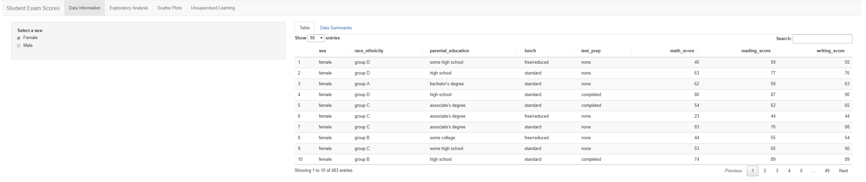
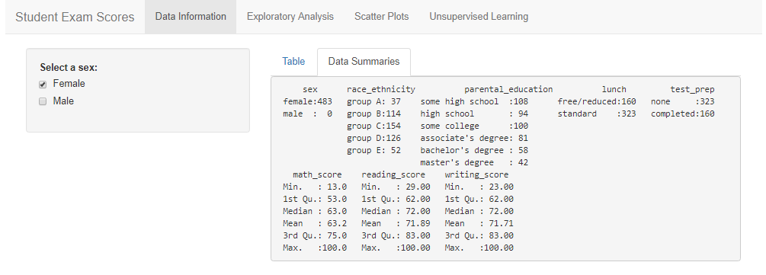
Data Information Tab Example

Slide 9
Exploratory Analysis Tab
Now that the user has an overview of the data, moving over to the Exploratory Analysis tab will give the user the ability to see box plots and density plots of selected variables
The user can select any of the three score variables to analyze
In addition, they can select an attribute variable which will filter the score variable into each factor within that attribute and display a graph for each
Box plots can be used to see the distribution and potential outliers
Density plots can be used to see the distribution curve and any high points (indicating a score that is common)

Slide 10
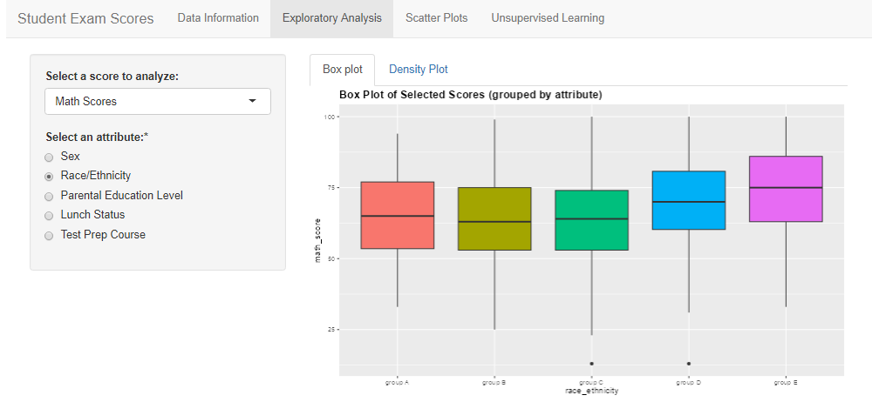
Exploratory Analysis Tab Example
These box plots being all together allow the user to see that group E seems to have higher math scores overall than the rest of the groups

Slide 11
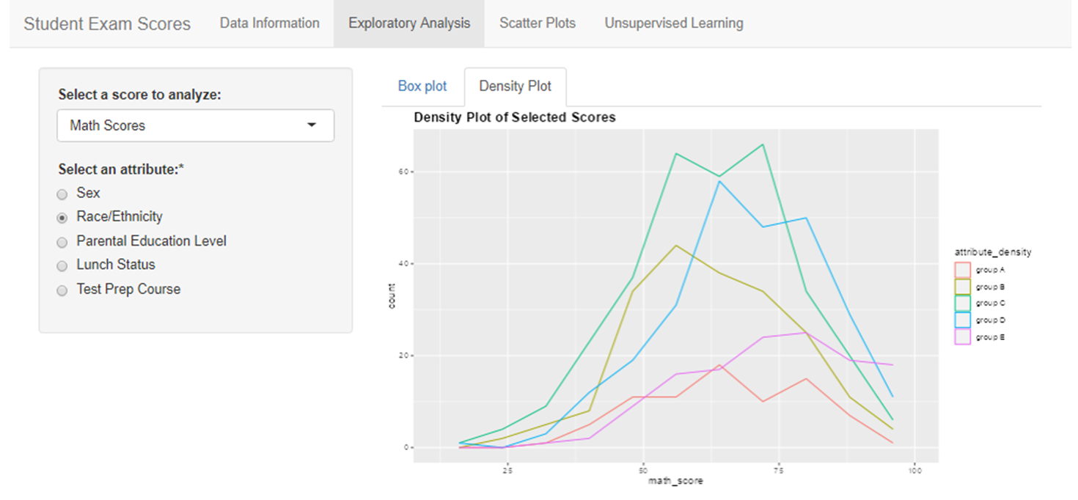
Exploratory Analysis Tab Example cont.

Slide 12
Exploratory Analysis Tab Example cont.
The density plot below allows the user to see the distribution of each group. This also gives us a good indication of the group with the highest frequency (group C). Using both, the user can begin making more informed decisions about the data. For example, while group E had the highest scores, they are also the least represented group. This might lead the user to take a closer look at that group to determine if they are higher or if it was just because the sample was smaller.

Slide 13
Scatter Plots Tab
Now that the user has a good idea of the distributions of the data, it is time to see if there is any correlation between the variables
In addition to correlation, the user will be able to select different attributes and see where the scores fall on the scatter plot
This will allow the user to see if there are patterns in the data
A scatter plot with all factors of the attribute variable will be shown as well as faceted plots with each being an individual factor
The user also has a heatmap tab to see where data points are clustered around.
The app gives the user the ability to select the number of bins to customize their analysis

Slide 14
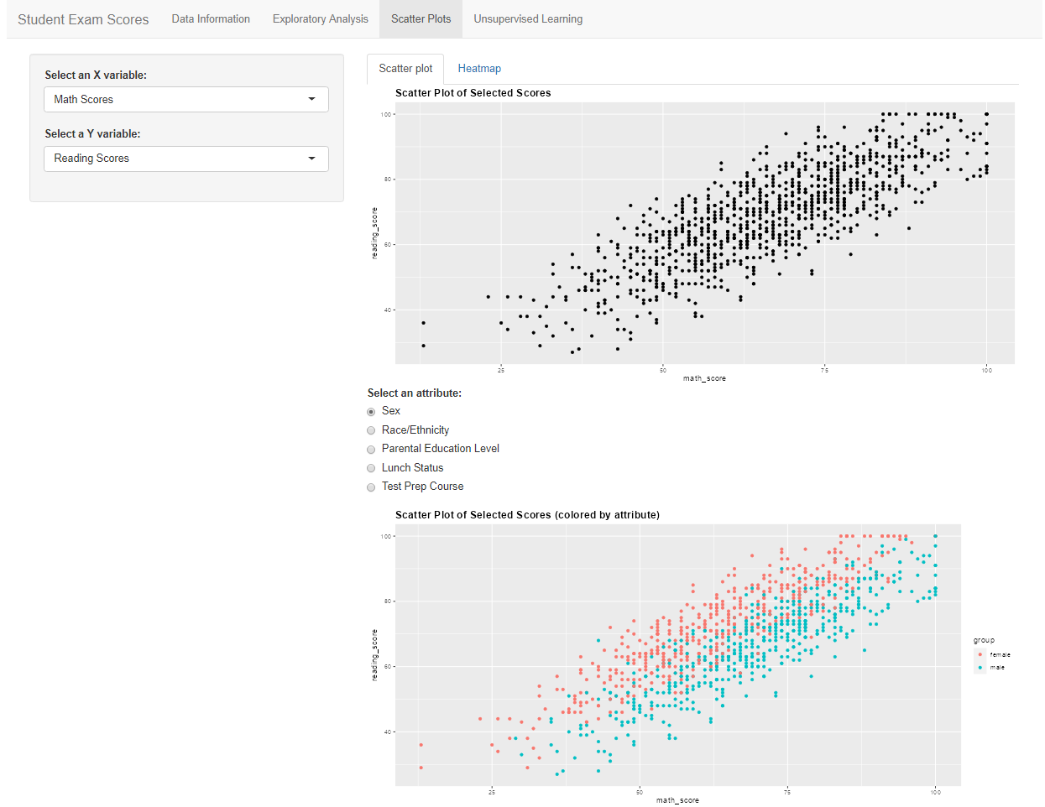
Scatter Plots Tab Example (scatter plot)
Using math scores and reading scores, we can see they appear to be highly correlated
From the second plot, which colorizes the points based on the sex of the student, we can more easily see that the females tend to score higher in reading and the males tend to score higher in math

Slide 15
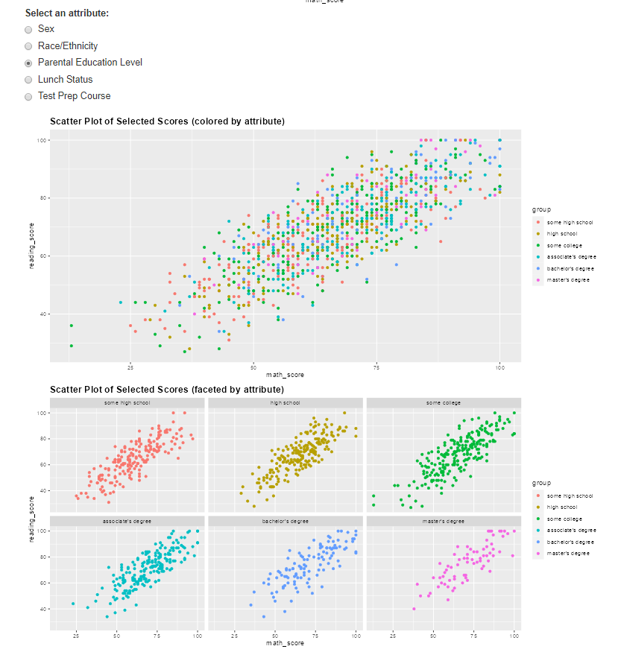
Scatter Plots Tab Example (scatter plot)
With the faceted graphs, the user can individually see what each factor is doing
In this example using the parental education level attribute, it was difficult to see the distribution of scores on the scatter plot when all of the points were together. The faceted graph gives the user the ability to really see what each factor is doing and compare to the grouped graph above.

Slide 16
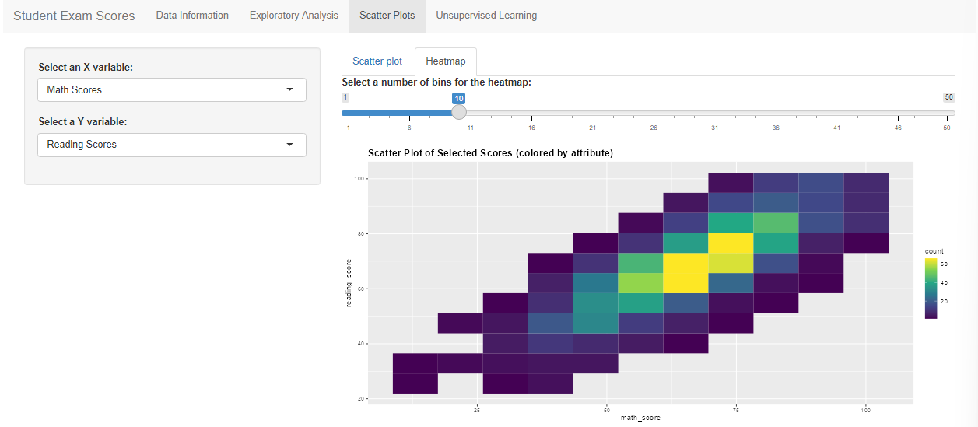
Scatter Plots Tab Example (heatmap)
On the heatmap tab, the user has the ability to choose both the score variables to analyze as well as the number of bins for the heatmap
In this example the bin size of 10 was selected and we can see there was a grouping of data around the math score of 70 and reading score of 75 (shown with the bright yellow portions of the graph)

Slide 17
Unsupervised Learning Tab
Unsupervised learning includes methods such as MCA and clustering to give the user a picture of what groups might be similar to each other
The user will be able to select different attributes (a minimum of 2) and see how that affects the groupings
Under the Clustering tab, the user will be able to control the number of clusters to see different groupings

Slide 18
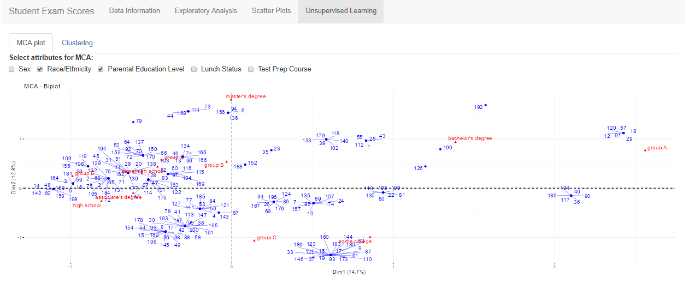
Unsupervised Learning Tab Example (MCA)

Slide 19
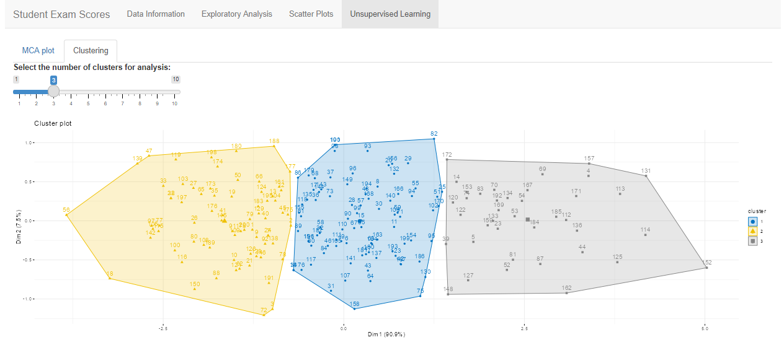
Unsupervised Learning Tab Example (Clustering)

Slide 20
Conclusion
While only one attribute variable can be controlled by the student (whether they take the prep course) we can look at which ones seem to affect the scores the most
It appears that lunch status has the biggest influence in the scores, which is directly related to socioeconomic status of the student. This would be a variable of interest that could included in a further collection of data to determine, in more depth, how this affects the scores
The test prep course seemed to have little overall affect on the scores of the student
A future study could investigate the type of prep course (in person vs online)

Slide 21
Data citation
Chauhan, A. (2022, September). Students Performance in Exams, Retrieved November 21, 2022 from https://www.kaggle.com/datasets/whenamancodes/students-performance-in-exams.

