Slide 1


Tutorial Series on Sequential Decision Analytics
Warren B Powell
Professor Emeritus, Princeton University
Recorded: August 12, 2026
Module: The universal modeling framework (high level) – This module provides a high-level overview of the universal modeling framework.
Predecessor module(s): Introduction to sequential decision problems
Technical level: Minimal mathematics – This module introduces the basic mathematical modeling behind the universal modeling framework.

Slide 2
The universal modeling framework
In most settings, decisions are made over time…
Decisions
Information
Decisions
Information
Decisions
Information
Information that arrives after a decision is made is not known when we made the decision.

Slide 3
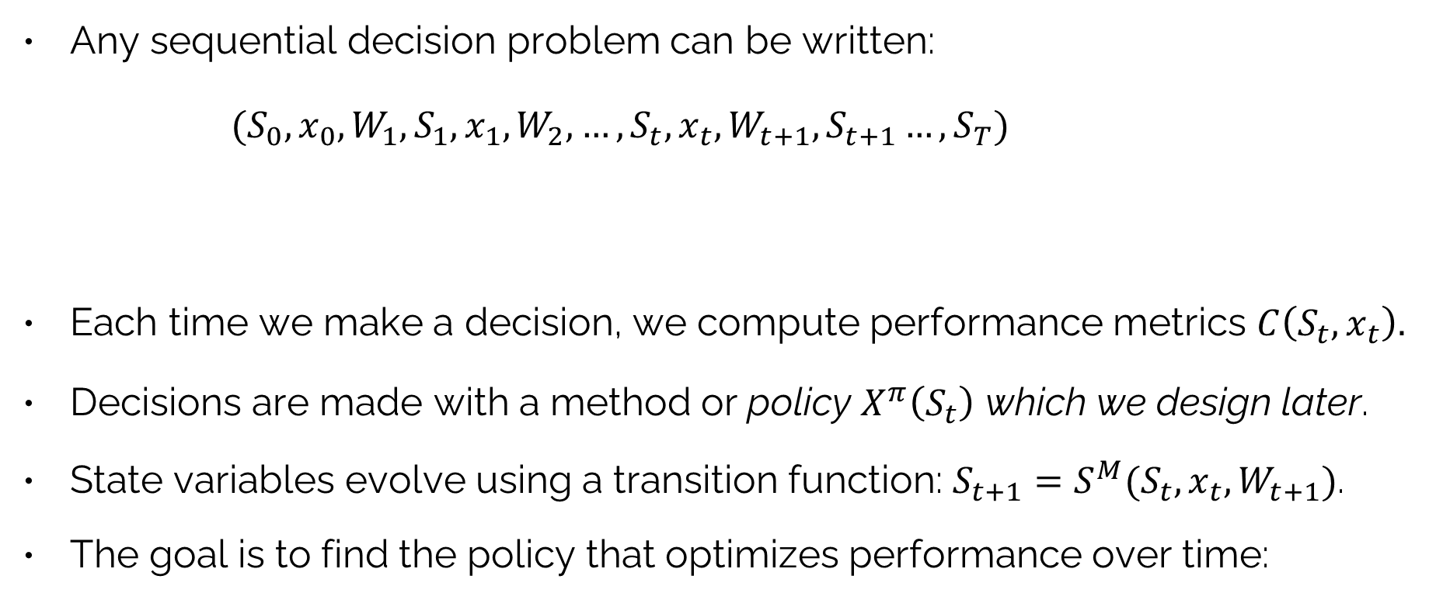
The universal modeling framework
Any sequential decision problem can be written:
$(S_{0},x_{0},W_{1},S_{1},x_{1},W_{2},…, S_{t},x_{t},W_{t+1},S_{t+1}…,S_{T})$
Each time we make a decision, we compute performance metrics $C\left(S_{t},x_{t}\right).$
Decisions are made with a method or policy $X^{π}\left(S_{t}\right)$ which we design later.
State variables evolve using a transition function: $S_{t+1}=S^{M}(S_{t},x_{t},W_{t+1})$.
The goal is to find the policy that optimizes performance over time:
What we know (or believe)
New information
The decisions
$$\max_{π} F^{π}\left(S_{0}\right)=C\left(S_{0},X^{π}\left(S_{0}\right)\right)+C\left(S_{1},X^{π}\left(S_{1}\right)\right)+⋯+C\left(S_{T},X^{π}\left(S_{T}\right)\right){}$$

Slide 4
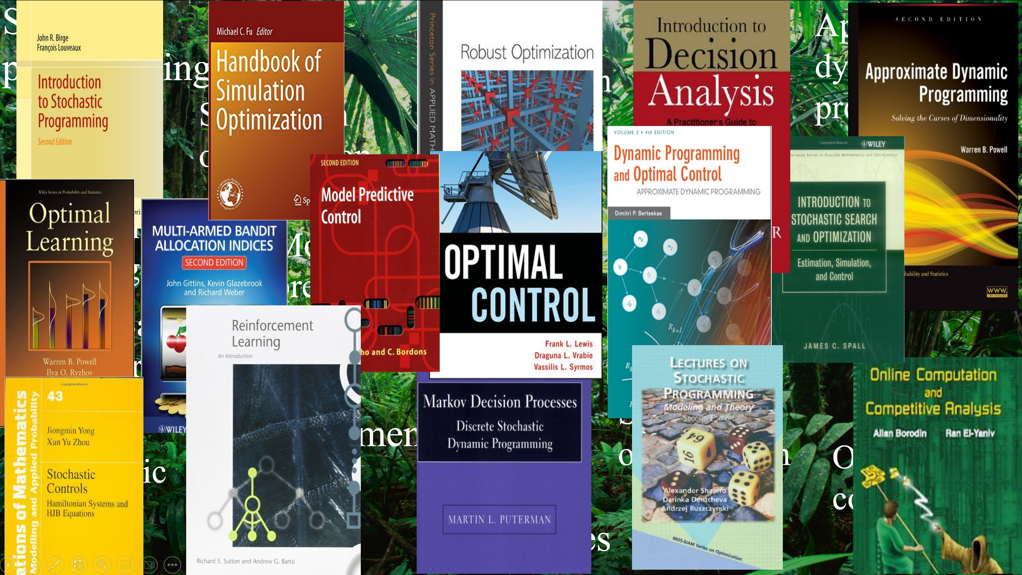


The universal modeling framework
Every sequential decision problem can be modeled using 5 core components
State variables $S_{t}=(R_{t},I_{t},B_{t})$
Physical state $R_{t}$, other information $I_{t}$, beliefs $B_{t}$.
Decision variables $x_{t}$ (or action $a_{t}$, or control $u_{t}$)
Decisions $x_{t}$ are determined by a policy $X^{π}\left(S_{t}|θ\right).$
Exogenous information $W_{t+1}$
This is new information that arrives between $t$ and $t+1$.
Transition function $S_{t+1}=S^{M}(S_{t},x_{t},W_{t+1})$
This is how our state variable evolves given $x_{t}$ and $W_{t+1}$.
Objective function for finding the best policy
$\max_{π}{F^{π}(S_{0}) }=C(S_{0},X^{π}\left(S_{0}\right))+…+C(S_{T},X^{π}\left(S_{T}\right))$

Slide 5
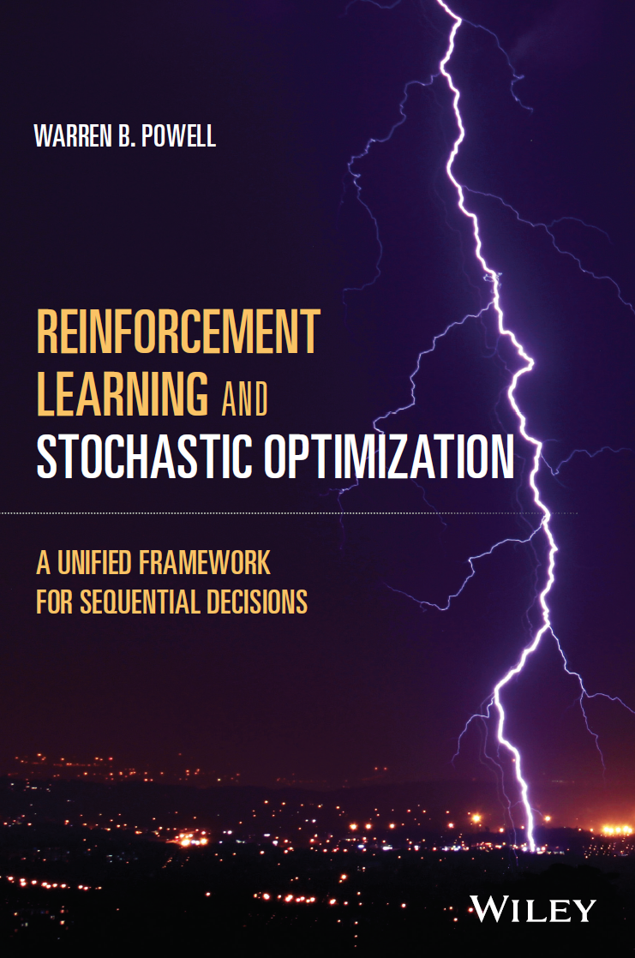
The universal modeling framework
Every sequential decision problem can be modeled using 5 core components
State variables $S_{t}=(R_{t},I_{t},B_{t})$
Physical state $R_{t}$, other information $I_{t}$, beliefs $B_{t}$.
Decision variables $x_{t}$ (or action $a_{t}$, or control $u_{t}$)
Decisions $x_{t}$ are determined by a policy $X^{π}\left(S_{t}|θ\right).$
Exogenous information $W_{t+1}$
This is new information that arrives between $t$ and $t+1$.
Transition function $S_{t+1}=S^{M}(S_{t},x_{t},W_{t+1})$
This is how our state variable evolves given $x_{t}$ and $W_{t+1}$.
Objective function for finding the best policy
$\max_{π}{F^{π}(S_{0}) }=C(S_{0},X^{π}\left(S_{0}\right))+…+C(S_{T},X^{π}\left(S_{T}\right))$
Chapter 9
https://tinyurl.com/RLandSO/

Slide 6
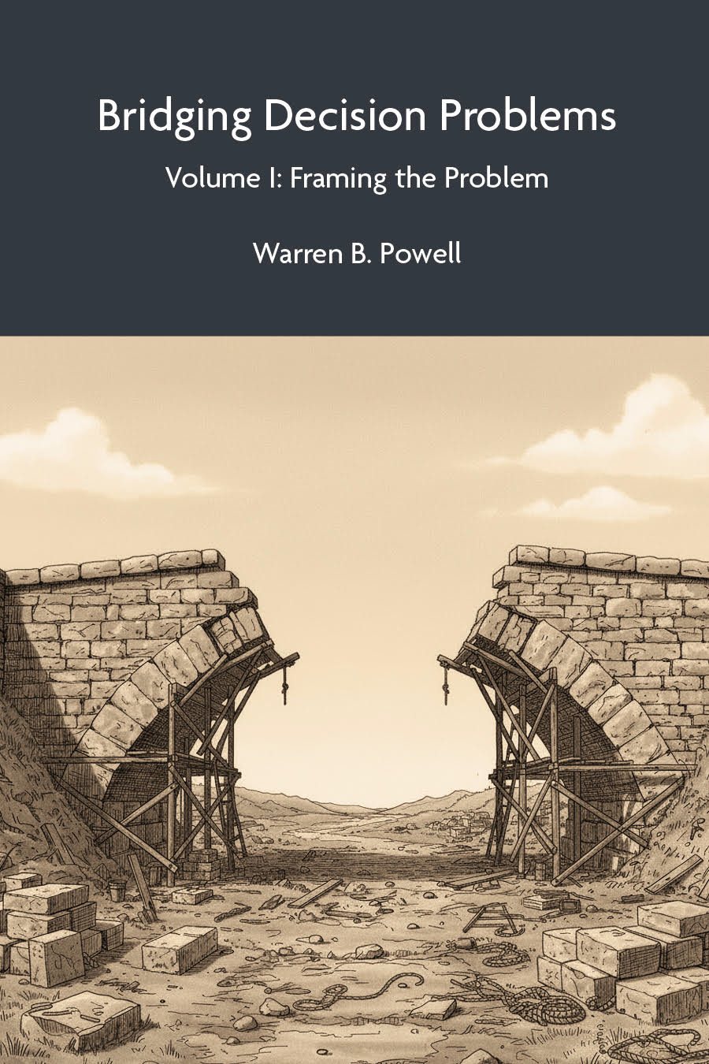
The Universal Modeling Framework
Every sequential decision problem can be modeled using 5 core components
State variables $S_{t}=(R_{t},I_{t},B_{t})$
Physical state $R_{t}$, other information $I_{t}$, beliefs $B_{t}$.
Decision variables $x_{t}$ (or action $a_{t}$, or control $u_{t}$)
Decisions $x_{t}$ are determined by a policy $X^{π}\left(S_{t}|θ\right).$
Exogenous information $W_{t+1}$
This is new information that arrives between $t$ and $t+1$.
Transition function $S_{t+1}=S^{M}(S_{t},x_{t},W_{t+1})$
This is how our state variable evolves given $x_{t}$ and $W_{t+1}$.
Objective function for finding the best policy
$\max_{π}{F^{π}(S_{0}) }=C(S_{0},X^{π}\left(S_{0}\right))+…+C(S_{T},X^{π}\left(S_{T}\right))$
Decisions
Uncertainties
Metrics

Slide 7
Teaching materials
Bridging Decision Problems:
Volume I: Framing the Problem
Chapter 1 – Fundamentals of Framing
Chapter 2 – Applications
Chapter 3 – Metrics
Chapter 4 – Decisions
Chapter 5 – Uncertainties
Chapter 6 – Closing Notes
Now available on Amazon Kindle ($5) or download from:
No math!
https://tinyurl.com/SDAwebsite/

Slide 8
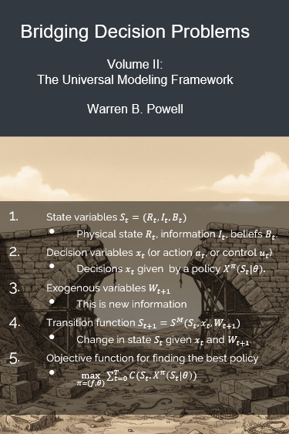
The universal modeling framework
Every sequential decision problem can be modeled using 5 core components
State variables $S_{t}=(R_{t},I_{t},B_{t})$
Physical state $R_{t}$, other information $I_{t}$, beliefs $B_{t}$.
Decision variables $x_{t}$ (or action $a_{t}$, or control $u_{t}$)
Decisions $x_{t}$ are determined by a policy $X^{π}\left(S_{t}|θ\right).$
Exogenous information $W_{t+1}$
This is new information that arrives between $t$ and $t+1$.
Transition function $S_{t+1}=S^{M}(S_{t},x_{t},W_{t+1})$
This is how our state variable evolves given $x_{t}$ and $W_{t+1}$.
Objective function for finding the best policy
$\max_{π}{F^{π}(S_{0}) }=C(S_{0},X^{π}\left(S_{0}\right))+…+C(S_{T},X^{π}\left(S_{T}\right))$
Forthcoming 2026

Slide 9
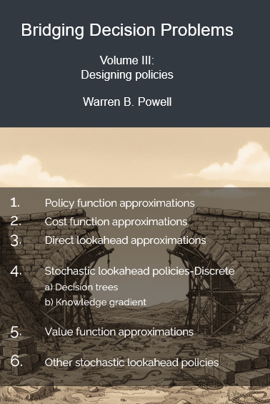
The universal modeling framework
Decisions are made using the four classes of policies:
Policy search methods – These are methods that do not explicitly plan into the future, but are designed to perform well over time:
Policy function approximations (PFAs) – Chapter 1`2
Analytical functions that map state variables to decisions.
Cost function approximations (CFAs) – Chapter 13
Deterministic optimization models that are tuned to work well over time.
Lookahead methods – These are methods that plan into the future to make better decisions now.
3. Value function approximations (VFAs) – Chapters 14-18
These use approximations of the value of landing in a downstream state from a decision made now.
Direct lookahead approximations (DLAs) – Chapter 19
These explicit plan into the future, deterministically or stochastically, to make better decisions now.
Chapter 11
January , 2027?

Slide 10
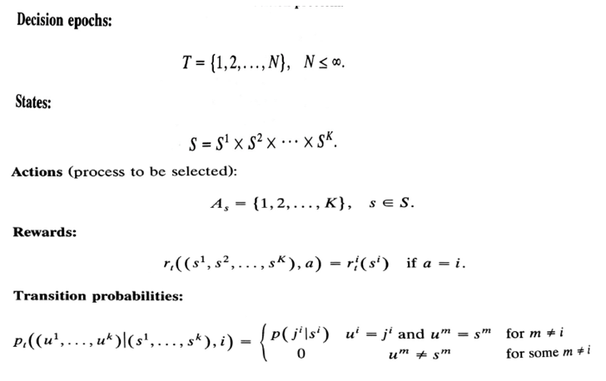
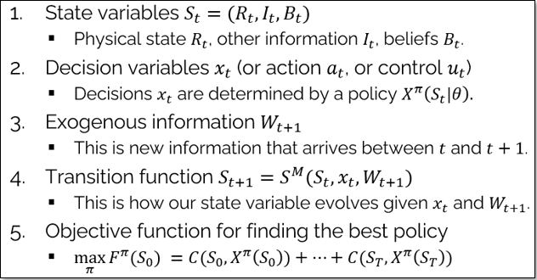


The universal modeling framework
Canonical frameworks
Markov decision process model
(Puterman, 1994)
Universal Modeling Framework
$$r(s,a)$$
$$p(s^{′}|s,a)$$

Slide 11
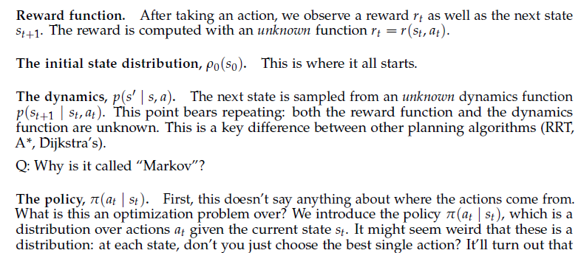
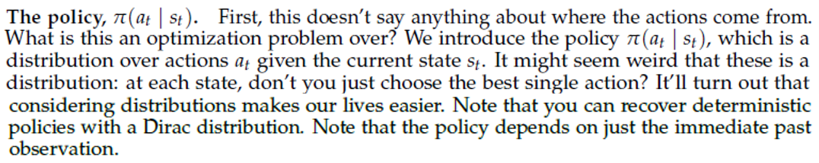
The universal modeling framework
Objective function as stated in Princeton RL course:
Sums over rewards, but does not specify what they are optimizing over (should be policies).
They make the default assumption that policies are stochastic. This is one strategy for exploration, but only useful for special cases.
Should take expectation over the sum, but fail to model the random variables.
Assumes unknown “dynamics function” – while there are problems where it is unknown, there are many problems where it is known.
RL literature never defines state variables (I don’t think they know what it is).
Objective function:

Slide 12


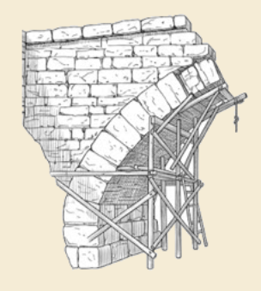
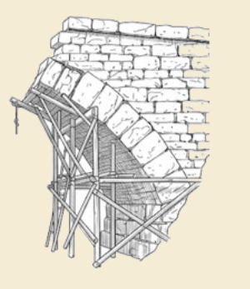
Thank you!
For more information see the Sequential Decision Analytics website at
warrenpowell.org
For more on the universal modeling framework:
warrenpowell.org → Modeling → The Universal Modeling Framework
warrenpowell.org → Teaching materials → Books:
Sequential Decision Analytics and Modeling
Chapter 9 of Reinforcement Learning and Stochastic Optimization

