Slide 1


Tutorial Series on Sequential Decision Analytics
Warren B Powell
Professor Emeritus, Princeton University
Recorded: August 12, 2026
Module: Estimation methods – This module provides a high level overview of some of the most useful machine learning techniques that arise in the context of sequential decision problems.
Predecessor module(s): None
Technical level: Some use of notation. Most (but not all) of the concepts are communicated visually.

Slide 2

OUTLINE
Functions we may need to estimate
Approximation strategies
Exploiting structure
Batch vs. recursive learning

Slide 3
OUTLINE
Functions we may need to estimate
Approximation strategies
Exploiting structure
Batch vs. recursive learning

Slide 4
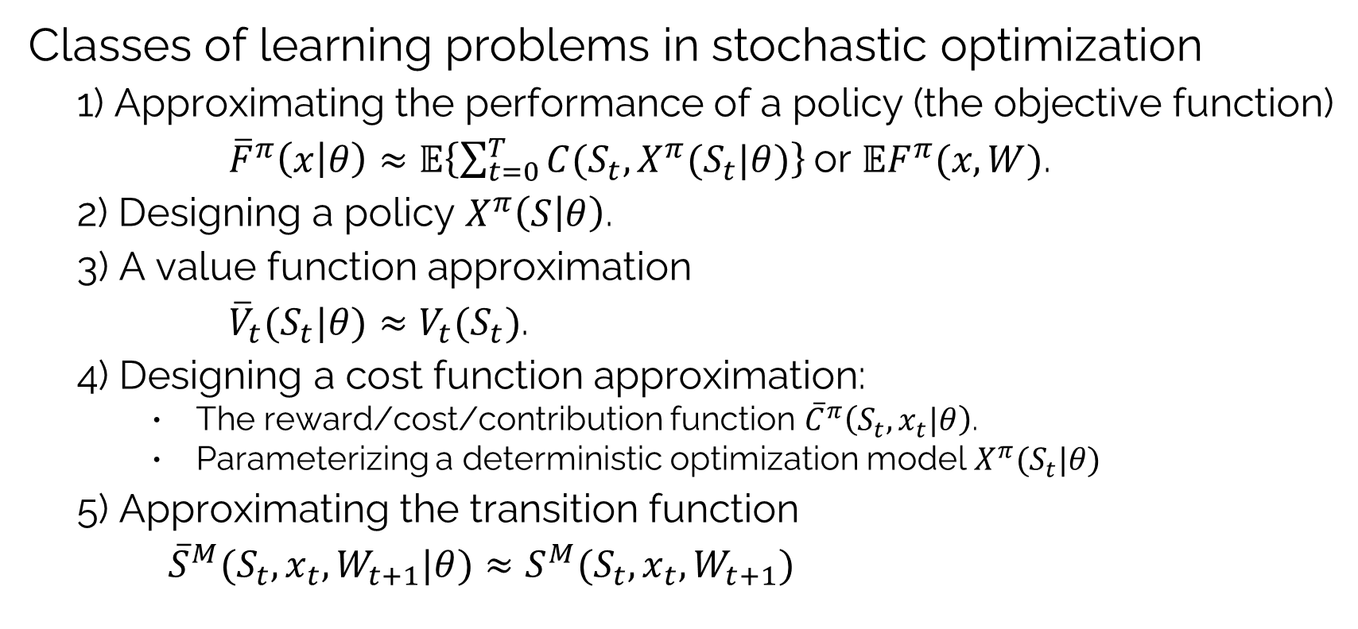
Estimation: Learning problems
Classes of learning problems in stochastic optimization
1) Approximating the performance of a policy (the objective function)
${\overline{F}}^{π}\left(x | θ\right)≈𝔼\left\{\sum_{t=0}^{T}{C(S_{t},X^{π}(S_{t}|θ)}\right\}$or $𝔼F^{π}(x,W)$.
2) Designing a policy $X^{π}\left(S | θ\right)$.
3) A value function approximation
${{\overline{V}}_{t}(S_{t}|θ)≈V}_{t}(S_{t})$.
4) Designing a cost function approximation:
The reward/cost/contribution function ${\overline{C}}^{π}\left(S_{t},x_{t}|θ\right)$.
Parameterizing a deterministic optimization model $X^{π}(S_{t}|θ)$
5) Approximating the transition function
${\overline{S}}^{M}(S_{t},x_{t},W_{t+1}|θ)≈S^{M}(S_{t},x_{t},W_{t+1})$

Slide 5
OUTLINE
Functions we may need to estimate
Approximation strategies
Exploiting structure
Batch vs. recursive learning

Slide 6
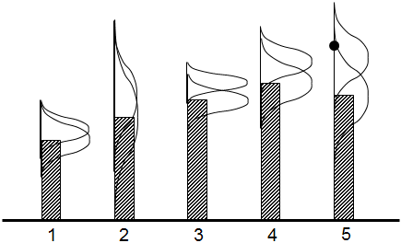
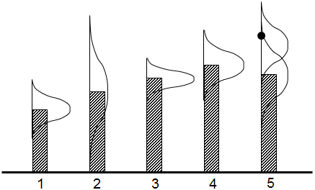
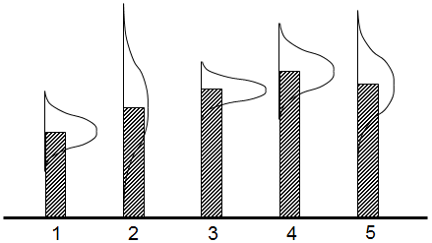
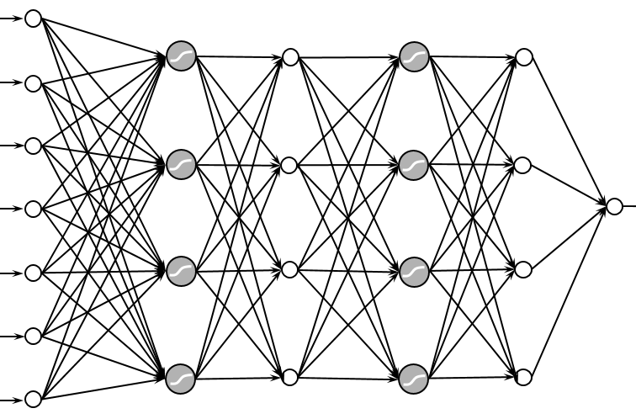
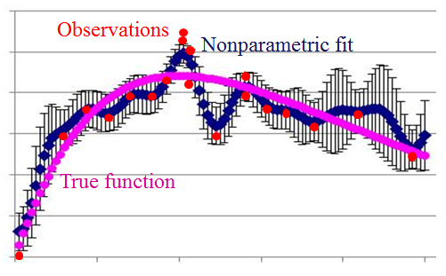
Estimation: Approximation strategies
Approximation strategies
Lookup tables
Independent beliefs
Correlated beliefs
Parametric models
Linear models
Linear models
Sparse-linear
Tree regression
Nonlinear models
Logistic regression
Neural networks
Nonparametric models
Gaussian process regression
Kernel regression
Support vector machines
Deep neural networks

Slide 7
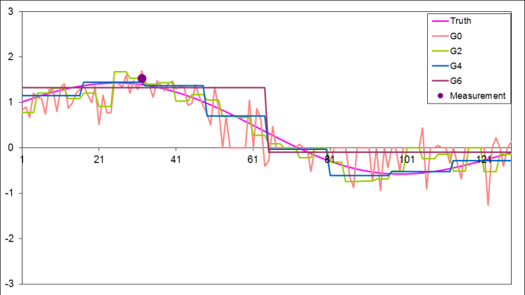
Estimation: Approximation strategies
Lookup tables
Independent beliefs
Correlated beliefs
A few dozen observations can teach us about thousands of points.
Hierarchical models
Create beliefs at different levels of aggregation and then use weighted combinations

Slide 8
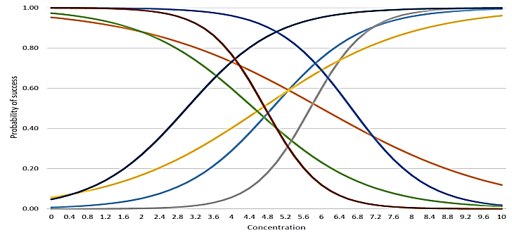
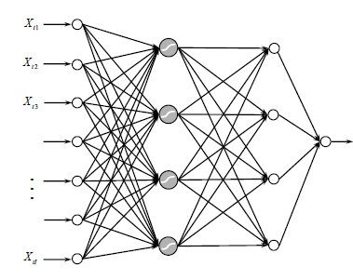
Estimation: Approximation strategies
Parametric models
Linear models
Might include sparse-additive, where many parameters are zero.
Nonlinear models
(Shallow) Neural networks

Slide 9
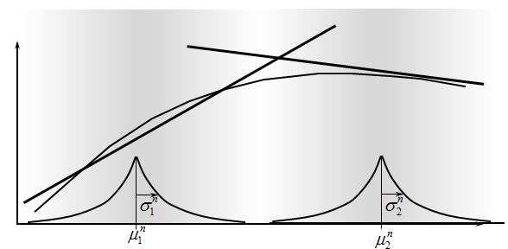
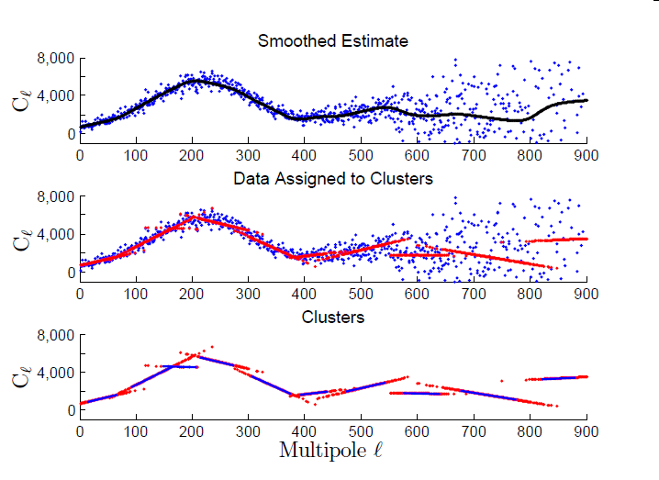
Estimation: Approximation strategies
Nonparametric models
Kernel regression
Weighted average of neighboring points
Limited to low dimensional problems
Locally linear methods
Dirichlet process mixtures
Radial basis functions
Splines
Support vector machines
Deep neural networks

Slide 10
Estimation: Neural networks
Neural networks
There has been a tendency to run to deep neural networks to approximate anything.
The price of flexibility is the need for large/ massive training datasets.
Neural networks struggle with:
Noisy observations
Functions that exhibit structure:
Monotonicity
Convexity
Expensive function valuations

Slide 11
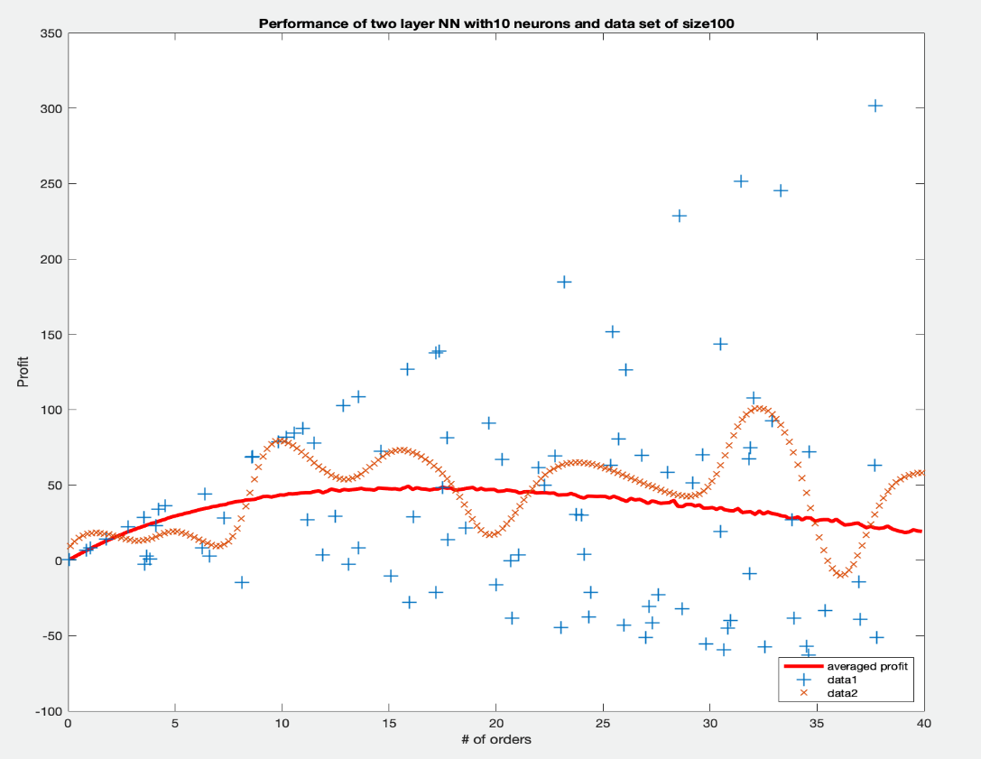

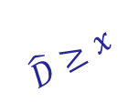

Estimation: Neural networks
Neural networks struggle with:
Noise – Their high flexibility tends to fit the noise.
Structure – It is difficult to communicate structure:
Monotonicity – Higher price means lower demand
Concavity – As with the newsvendor problem to the right.
Newsvendor problem:
$$\hat{D}≥x$$
Profit
Fitted neural
network
Observed profits
True profit
function
Order quantity $x$
Order quantity
$$Profit\left(x\right)= 𝔼_{D}\left(p min\left\{x, \hat{D}\right\}−cx\right)$$

Slide 12
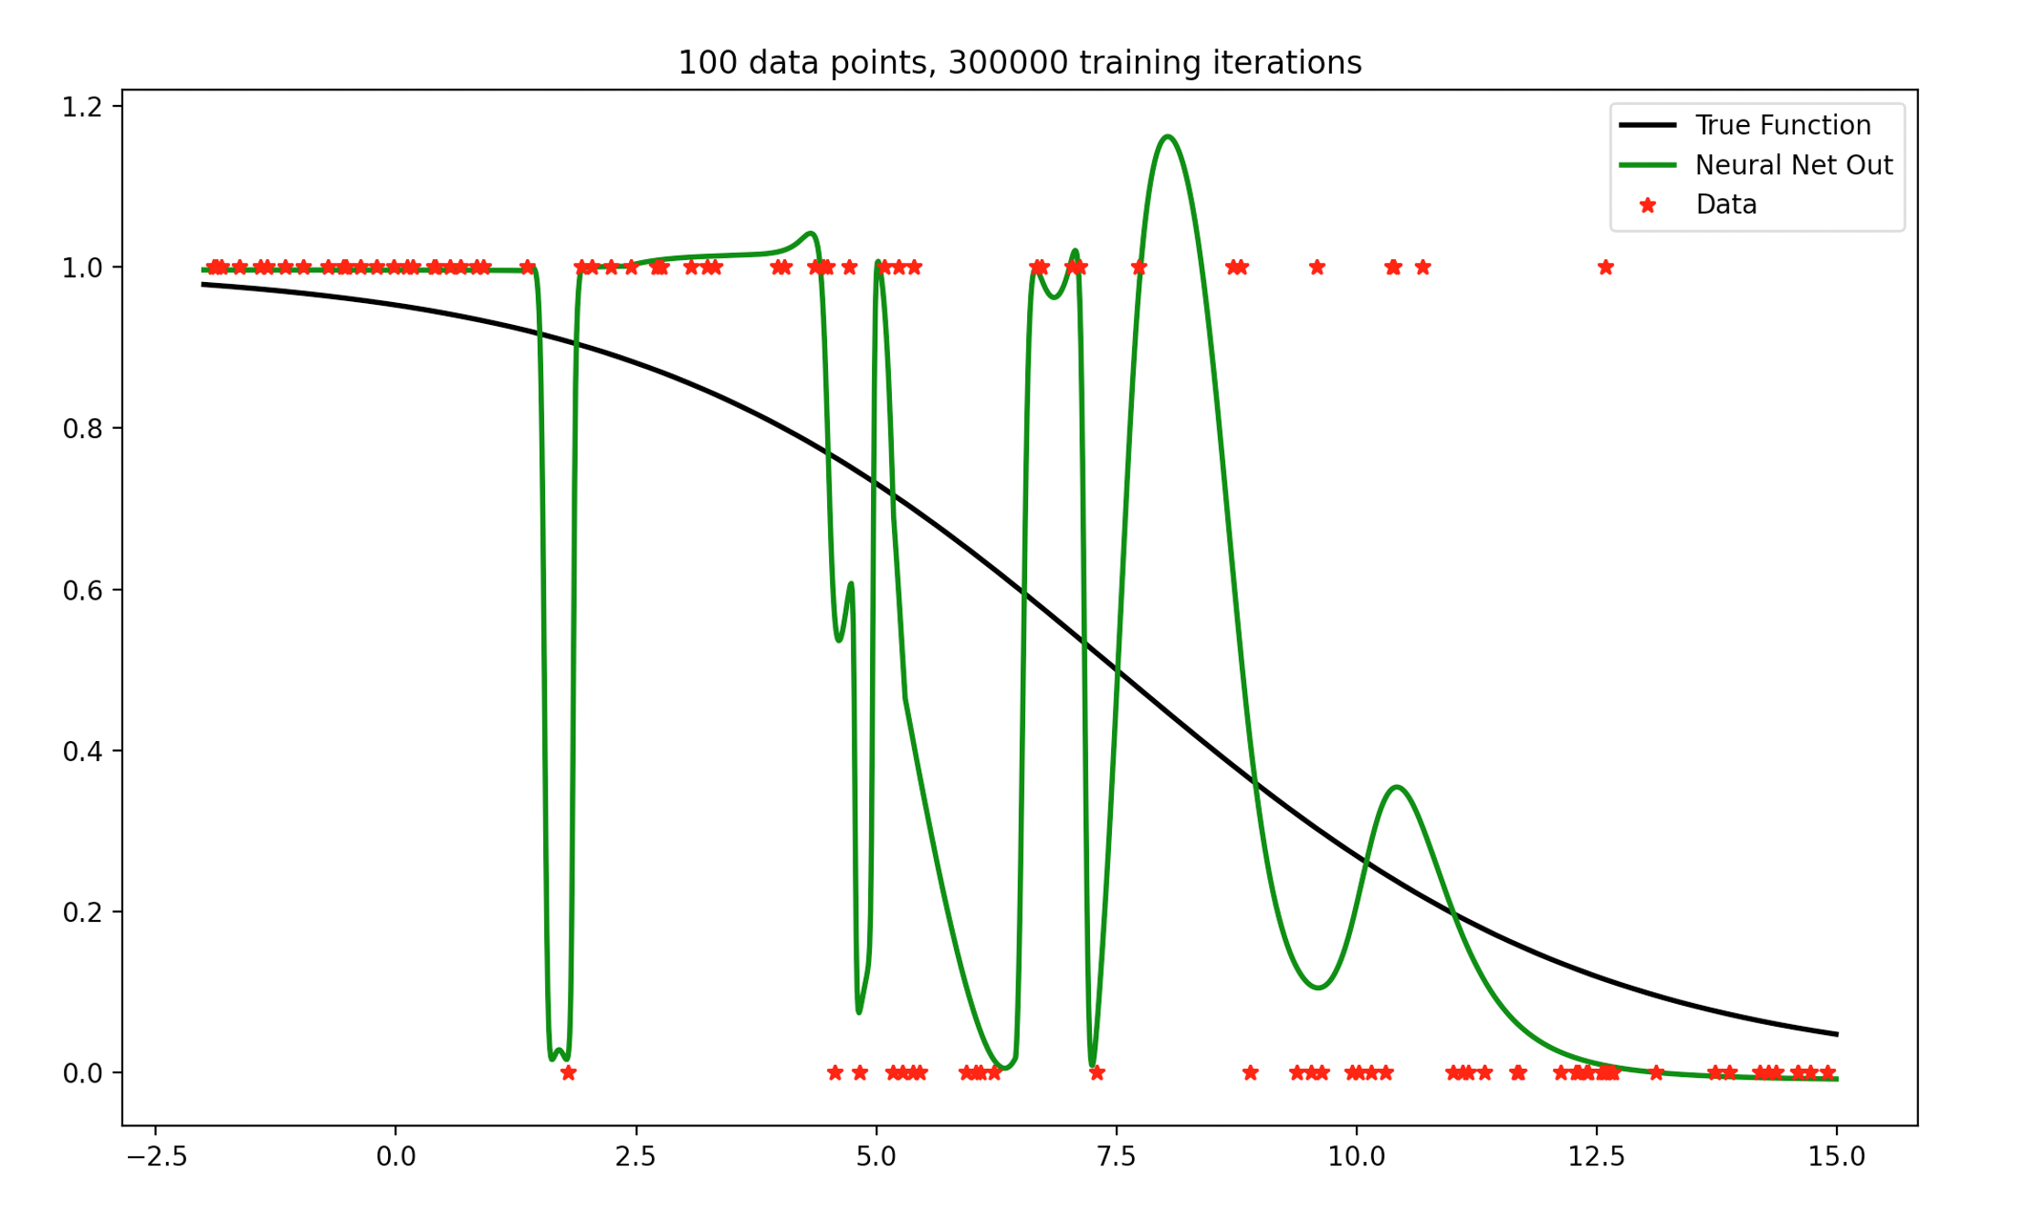
Estimation: Neural networks
Neural network for demand response:
Purchase
Actual purchase decision
Purchase decision
Fitted neural network
Probability of a purchase
Do not
purchase
Price

Slide 13
OUTLINE
Functions we may need to estimate
Approximation strategies
Exploiting structure
Batch vs. recursive learning

Slide 14
Estimation: Exploiting structure
Monotonicity in dynamic programming
There are many problems where the value function increases monotonically with one or more dimensions of a state variable:
Operations research
Equipment repair – Replace when a measure of deterioration exceeds some point
Dispatching customers in a queue – Dispatch when the queue is over some number.
Repair/
dispatch
1
Do nothing
0
Deterioration / Queue length

Slide 15
Estimation: Exploiting structure
Monotonicity in dynamic programming (cont’d)
Energy
Buy when electricity price is below one number, sell when above another number:
Value of energy in storage increases with amount being held (and perhaps price, speed of wind, demand, …)
Sell
1
Do nothing
0
Price
Buy
-1

Slide 16
Estimation: Exploiting structure
Monotonicity in dynamic programming (cont’d)
Health
Dosage of a diabetes drug increases with blood sugar.
Dosage of statins (for reducing cholesterol) increase as the cholesterol level increases (and also increases with age, weight).
Finance
The value of holding cash in a mutual fund increases with the amount of redemptions, stock indices, and interest rates.
The value of holding an option increases with price and volatility.

Slide 17
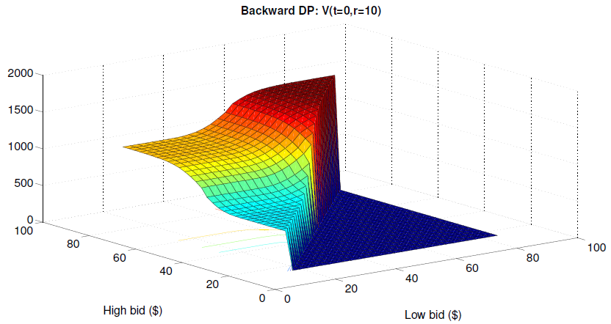
Estimation: Exploiting structure
The exact value function

Slide 18
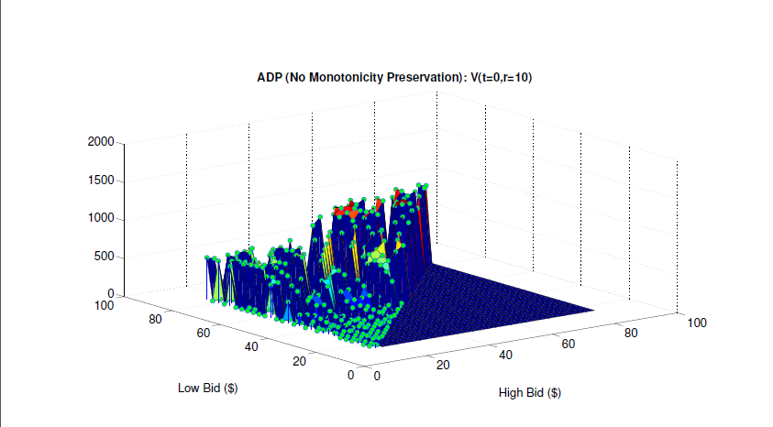
Estimation: Exploiting structure
Approximate value function without monotonicity

Slide 19
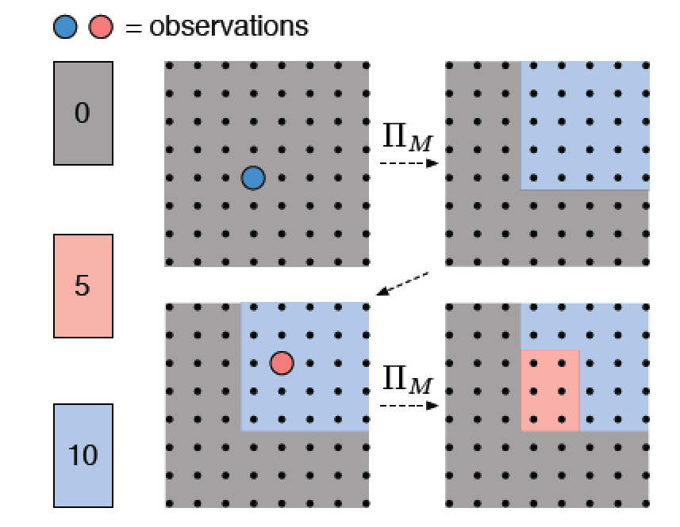
Estimation: Exploiting structure
Maintaining monotonicity

Slide 20
Estimation: Exploiting structure
Maintaining monotonicity

Slide 21
Estimation: Exploiting structure
Maintaining monotonicity

Slide 22
Estimation: Exploiting structure
Maintaining monotonicity

Slide 23
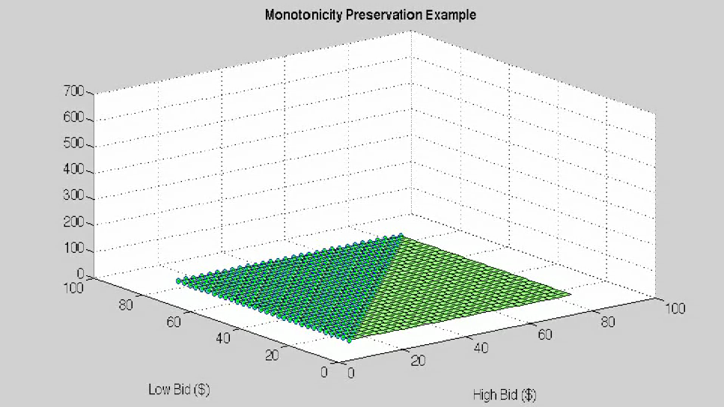
Estimation: Exploiting structure

Slide 24

Estimation: Exploiting structure
Fitting concave functions using piecewise linear approximations:
$${\bar{V}}_{it}^{k}(R_{1t})$$

Slide 25



Estimation: Exploiting structure
Fitting concave functions using piecewise linear approximations:
$${\bar{V}}_{it}^{k}(R_{1t})$$
Left derivative
Right derivative
$${\tilde{v}}_{t}^{+k}$$
$${\tilde{v}}_{t}^{−k}$$

Slide 26


Estimation: Exploiting structure
Fitting concave functions using piecewise linear approximations:
$${\bar{V}}_{it}^{k}(R_{1t})$$
$${\tilde{v}}_{t}^{+(k+1)}$$
$${\tilde{v}}_{t}^{−(k+1)}$$

Slide 27


Estimation: Exploiting structure
Fitting concave functions using piecewise linear approximations:
$${\bar{V}}_{t}(R_{t})$$
$$R_{t}$$

Slide 28
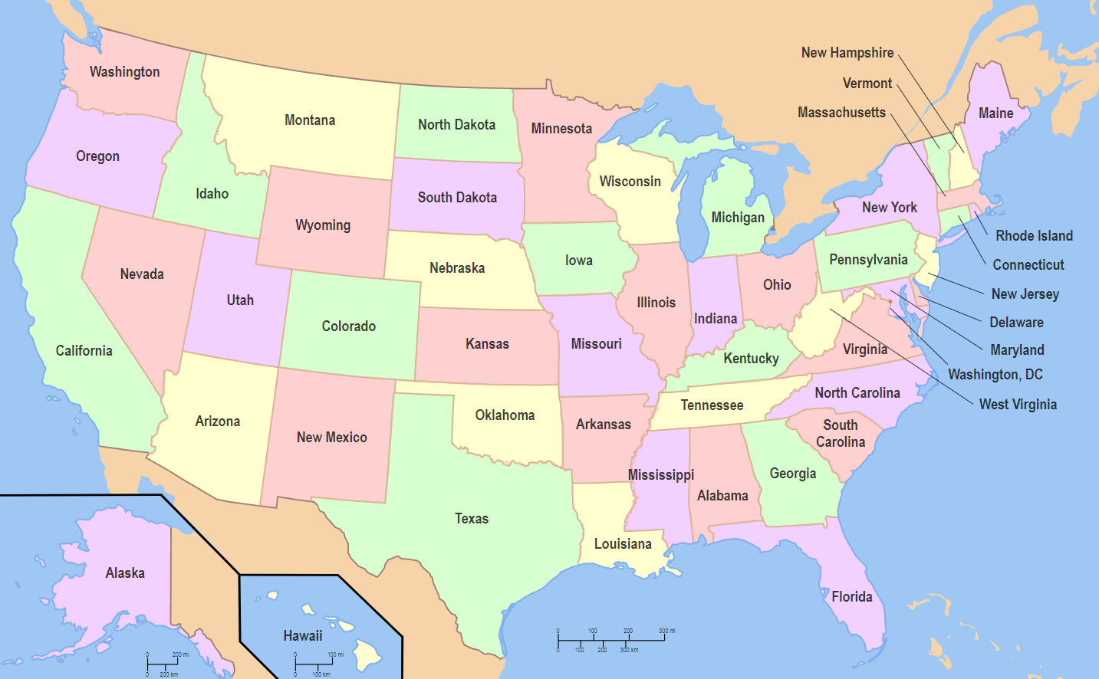
A distribution problem
How much inventory to send to each distribution center?

Slide 29
A distribution problem
We estimate the marginal value of inventory at each distribution center. The more inventory being held, the lower the marginal value.

Slide 30
OUTLINE
Functions we may need to estimate
Approximation strategies
Exploiting structure
Batch vs. recursive learning

Slide 31






Estimation: Batch vs. recursive learning
Frequentist estimation
Lookup tables
Batch estimation
Recursive learning (observe $W^{n}$)
Linear models
Batch (normal equations)
Recursive (observe $y^{n}$)
$${\overline{μ}}^{n}=\frac{1}{n}\sum_{m=1}^{n}{W^{m}}$$
$${\hat{σ}}^{2,n}=\frac{1}{n−1}\sum_{m=1}^{n}{{\left(W^{m}−{\overline{μ}}^{n}\right)}^{2}}$$
$$θ^{n}={\left[{\left(X^{n}\right)}^{T}\left(X^{n}\right)\right]}^{−1}{\left(X^{n}\right)}^{T}Y^{n}$$
$$y=\sum_{f∈ℱ}{θ_{f}φ_{f}(x)}=θ^{T}φ\left(x\right)$$
$$ε^{n}=y^{n}−θ^{n}φ(x^{n})$$
$$θ^{n}=θ^{n−1}−\frac{1}{γ^{n}}M^{n−1}φ^{n}ε^{n}$$
$$M^{n}=M^{n−1}−\frac{1}{γ^{n}}\left(M^{n−1}φ^{n}{\left(φ^{n}\right)}^{T}M^{n−1}\right)$$
$$γ^{n}=1+{\left(φ^{n}\right)}^{T}M^{n−1}φ^{n}$$
${\overline{μ}}^{n}=\left(1−\frac{1}{n}\right){\overline{μ}}^{n−1}+\frac{1}{n}W^{n}$
$${\hat{σ}}^{2,n}=\left\{\begin{matrix}\frac{1}{n}{\left(W^{n}−{\overline{μ}}^{n−1}\right)}^{2} & n=2 \\ \frac{n−2}{n−1}{\hat{σ}}^{2,n−1}+\frac{1}{n}{\left(W^{n}−{\overline{μ}}^{n−1}\right)}^{2} & n>2\end{matrix}\right.$$

Slide 32
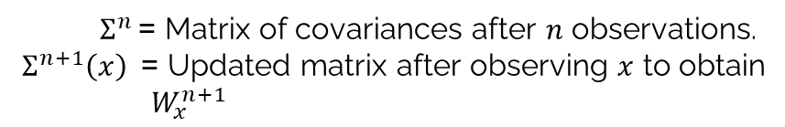

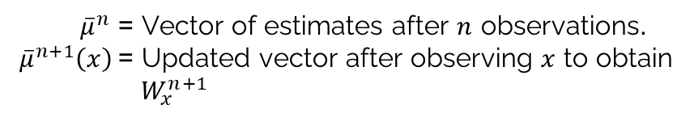
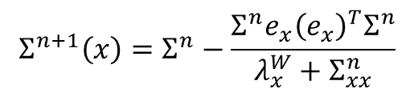
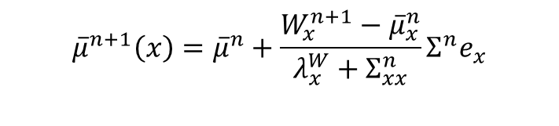
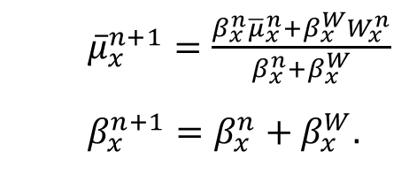
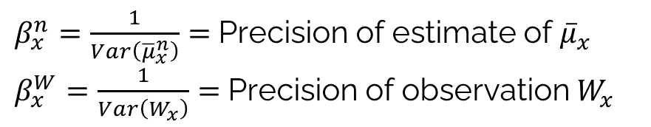
Estimation: Batch vs. recursive learning
Bayesian estimation (recursive updating)
Independent beliefs – updated mean for variable $x$
Correlated beliefs (“Gaussian process regression”)
${\overline{μ}}_{x}^{n+1}=\frac{{β_{x}^{n}{\overline{μ}}_{x}^{n}+β}_{x}^{W}W_{x}^{n}}{{β_{x}^{n}+β}_{x}^{W}}$
$β_{x}^{n+1}=β_{x}^{n}+β_{x}^{W}$.
$β_{x}^{n}=\frac{1}{Var\left({\overline{μ}}_{x}^{n}\right)}=$Precision of estimate of ${\overline{μ}}_{x}$
$β_{x}^{W}=\frac{1}{Var\left(W_{x}\right)}=$Precision of observation $W_{x}$
$${\overline{μ}}^{n+1}\left(x\right)={\overline{μ}}^{n}+\frac{W_{x}^{n+1}−{\overline{μ}}_{x}^{n}}{λ_{x}^{W}+Σ_{xx}^{n}}Σ^{n}e_{x}$$
${\overline{μ}}^{n}$ = Vector of estimates after $n$ observations.
${\overline{μ}}^{n+1}\left(x\right)$= Updated vector after observing $x$ to obtain $W_{x}^{n+1}$
$$Σ^{n+1}\left(x\right)=Σ^{n}−\frac{Σ^{n}e_{x}{\left(e_{x}\right)}^{T}Σ^{n}}{λ_{x}^{W}+Σ_{xx}^{n}}$$
$Σ^{n }$= Matrix of covariances after $n$ observations.
$Σ^{n+1}\left(x\right)$= Updated matrix after observing $x$ to obtain $W_{x}^{n+1}$

Slide 33
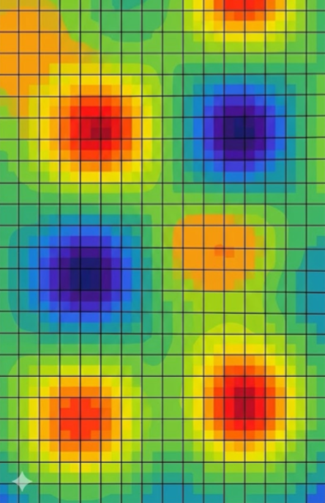


Estimation: Batch vs. recursive learning
Nonlinear models
Nonlinear models need to be fitted using gradient-descent methods.
Compute the temporal difference:
Then perform a gradient update:
This is not the same as re-estimating from scratch.
$$δ_{t}=r\left(S_{t},a_{t}\right)+γV_{t+1}\left(S_{t+1}\right)−V_{t}(S_{t})$$
$$θ←θ+α δ_{t} ∇_{θ}V(S_{t}|θ)$$

Slide 34


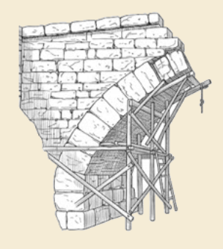
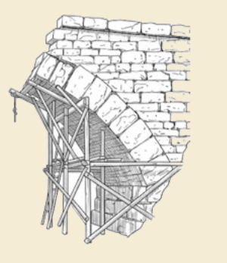
Thank you!
For more information see the Sequential Decision Analytics website at
warrenpowell.org
For more on estimation, see Chapter 3, Reinforcement Learning and Stochastic Optimization, https://warrenpowell.org/rlso/

