Slide 1

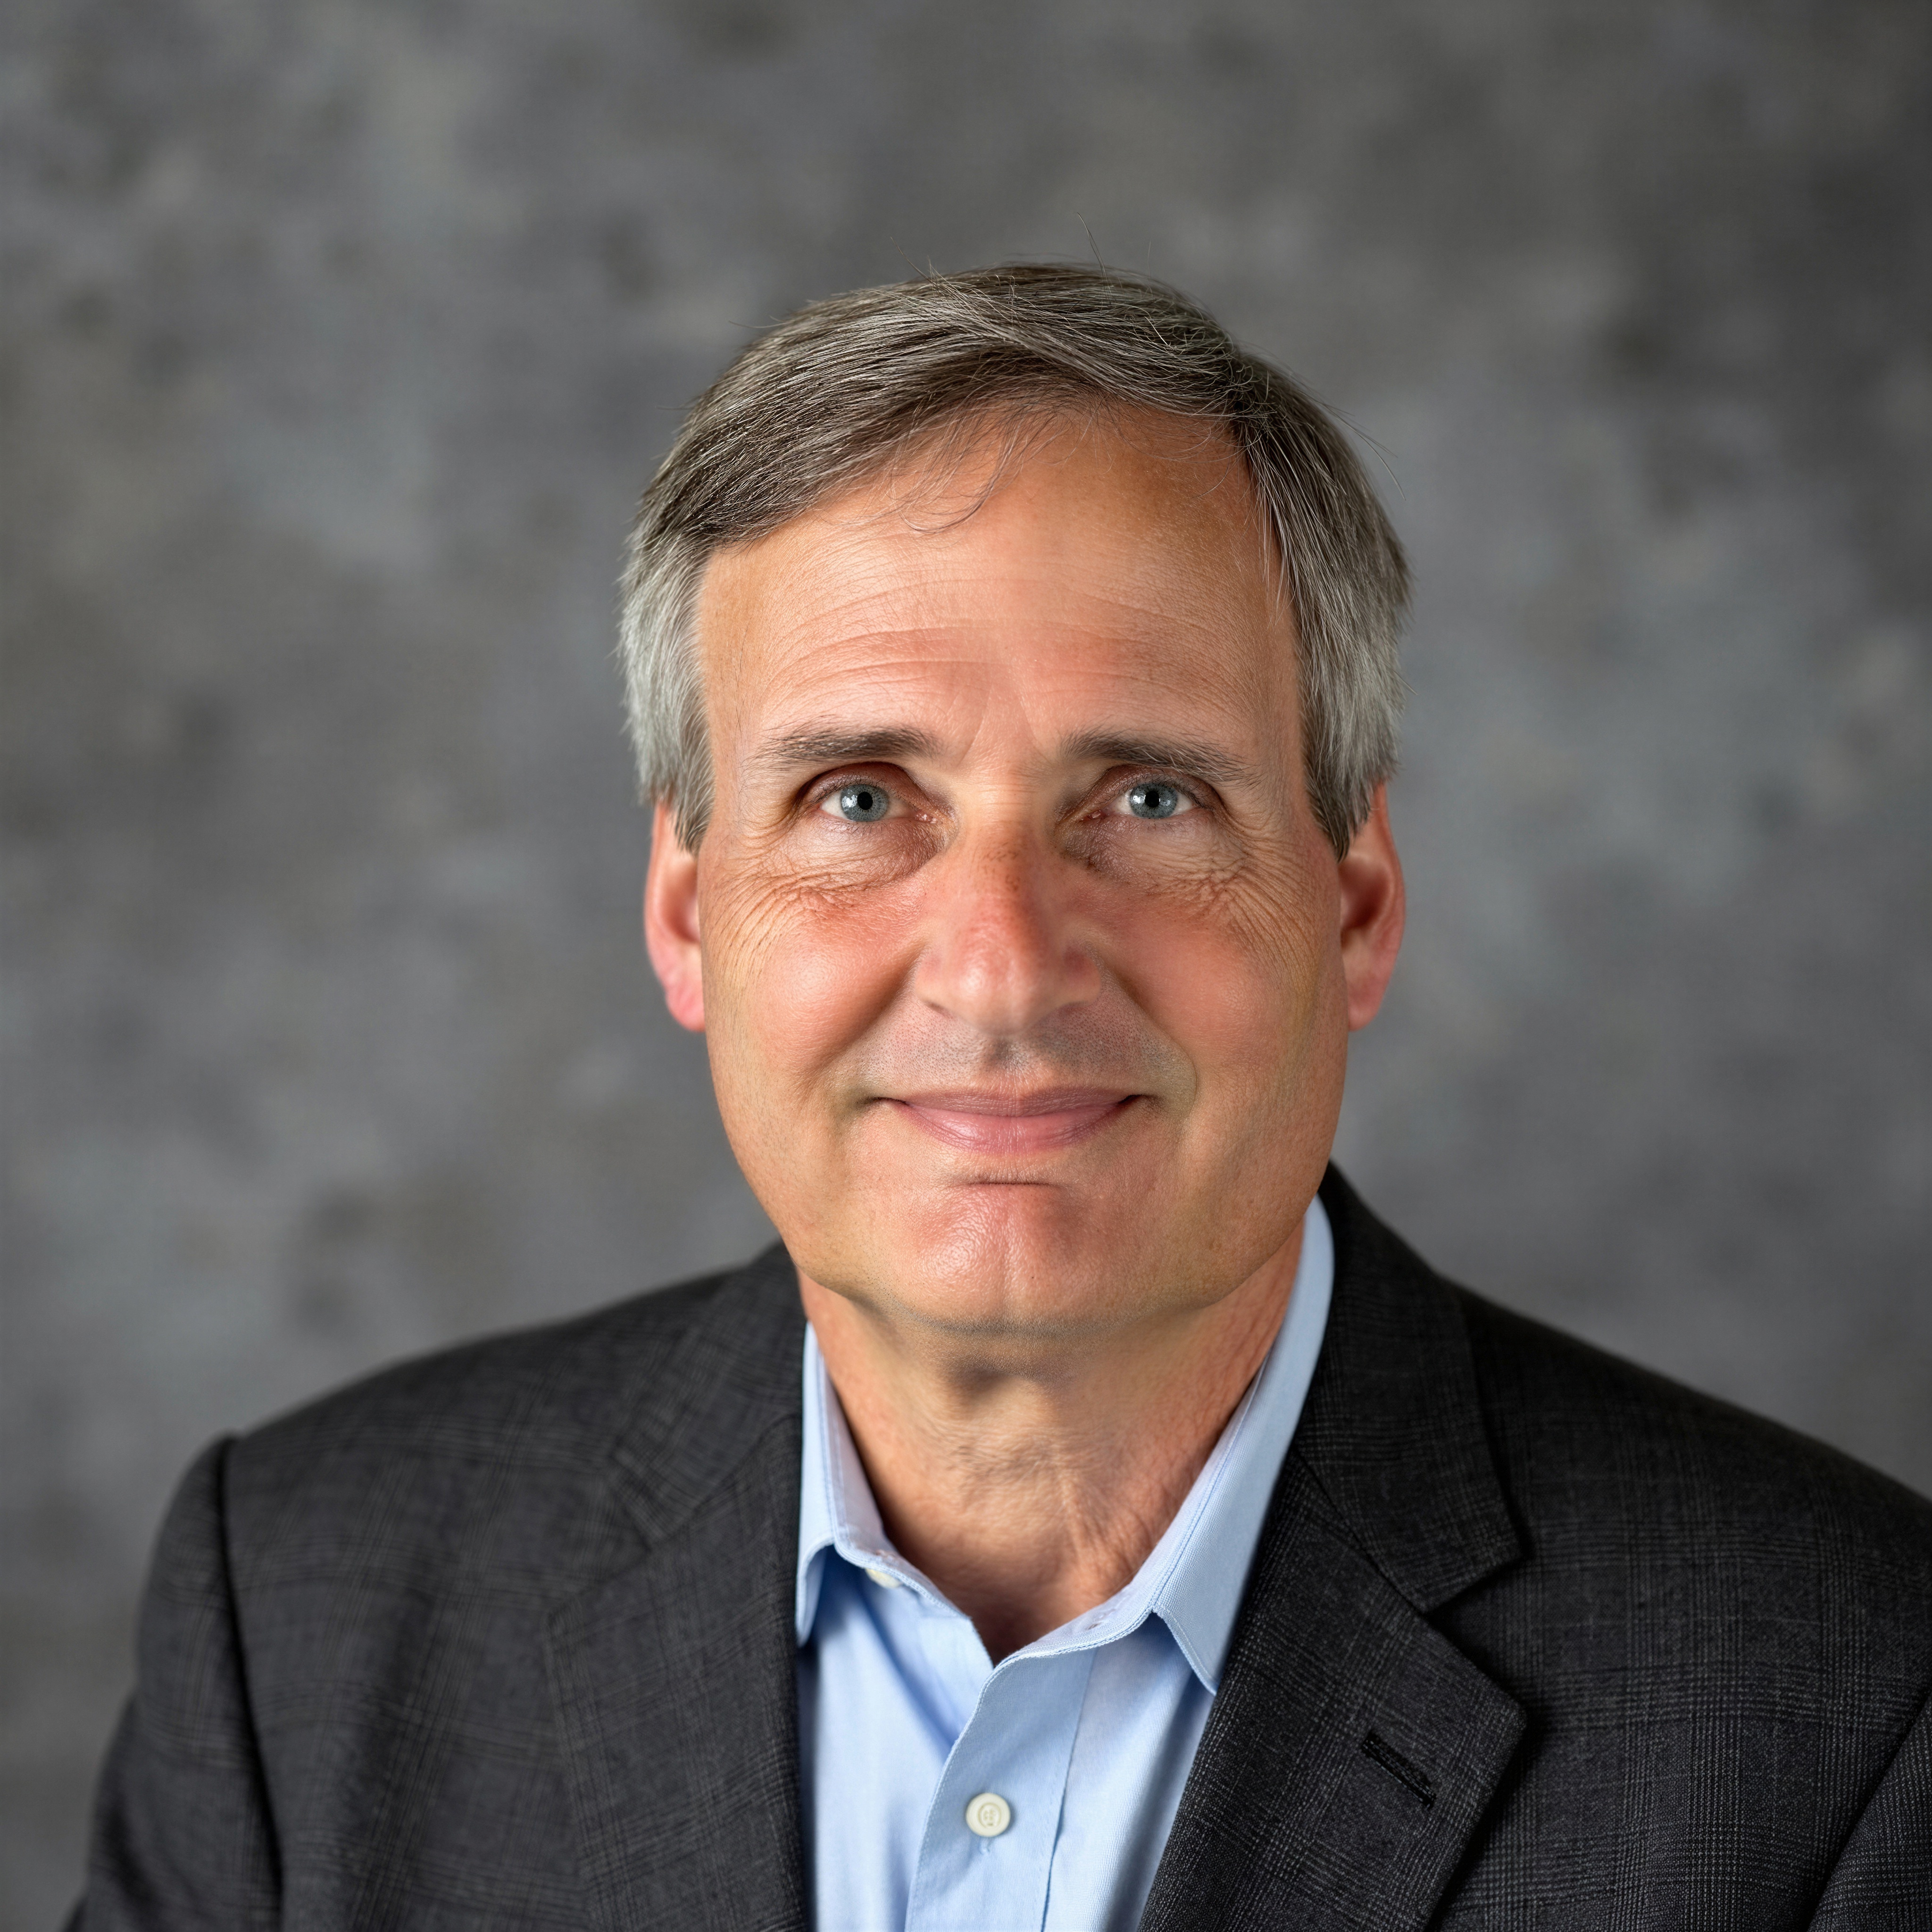
Tutorial Series on Sequential Decision Analytics
Warren B Powell
Professor Emeritus, Princeton University
Recorded: August 12, 2026
Module: The universal modeling framework (detailed) – We are going to present the five elements of the universal modeling framework in much more detail.
Predecessor module(s):
Introduction to sequential decision problems
The universal modeling framework (high level)
There is a brief reference to material in estimation methods.
Technical level: More detailed mathematical modeling

Slide 2

OUTLINE
The universal modeling framework (detailed)
Textbook modeling styles
Modeling time
State variables
Decision variables
Exogenous information
Transition function
Objective function

Slide 3
OUTLINE
The universal modeling framework (detailed)
Textbook modeling styles
Modeling time
State variables
Decision variables
Exogenous information
Transition function
Objective function

Slide 4
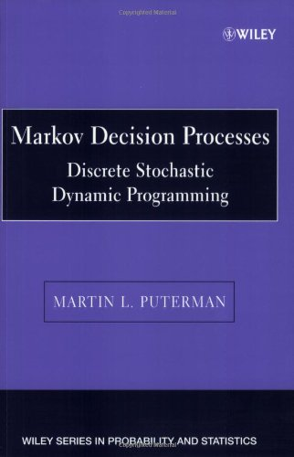
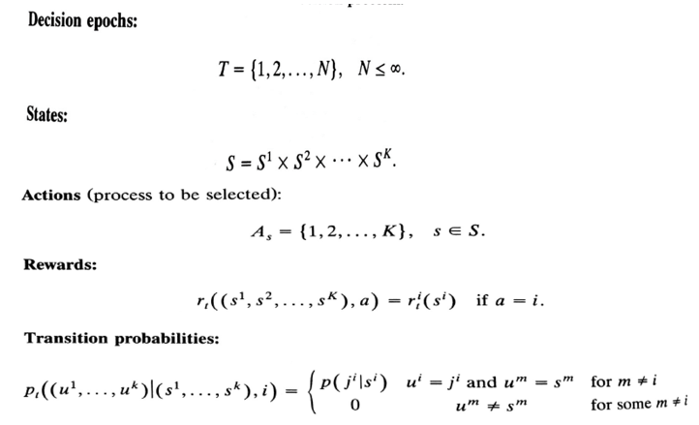


Modeling – Textbook modeling styles
Puterman -Chapter 3 – Examples
Canonical model:
$$r(s,a)$$
$$p(s^{′}|s,a)$$
No objective function!!

Slide 5
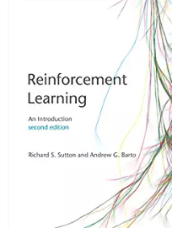
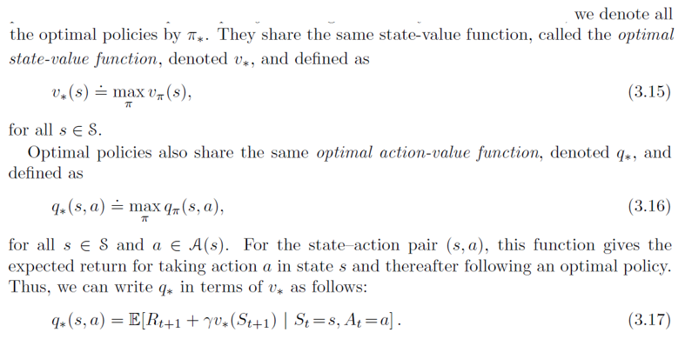
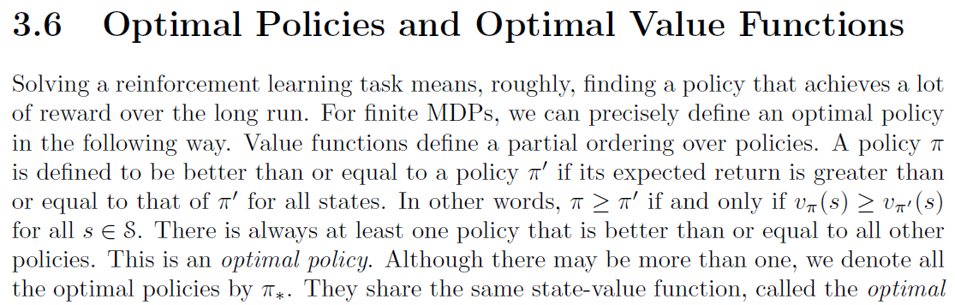
Modeling – Textbook modeling styles
Sutton & Barto - The objective function
Optimizing over policies
Optimizing over policies
Bellman’s equation

Slide 6
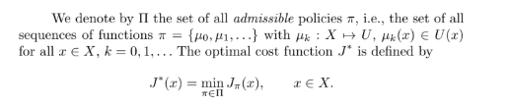
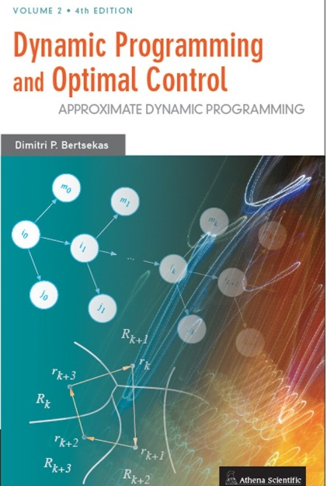
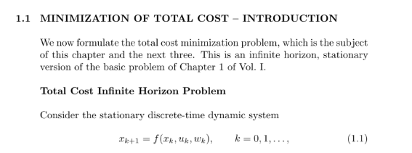
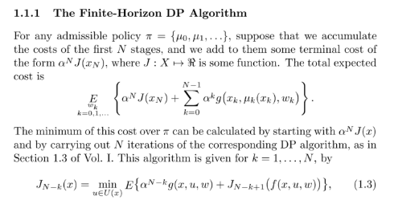
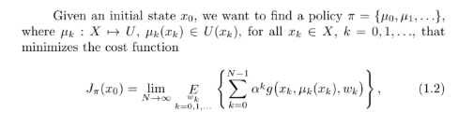
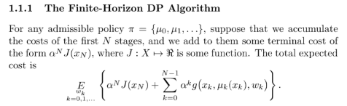
Modeling – Textbook modeling styles
Bertsekas - Chapter 1
Optimizing over policies
Bellman’s equation

Slide 7
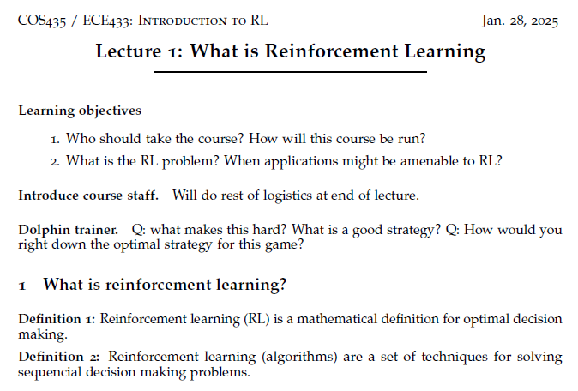
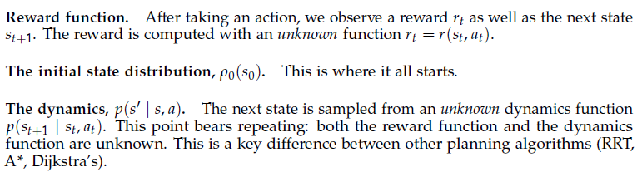
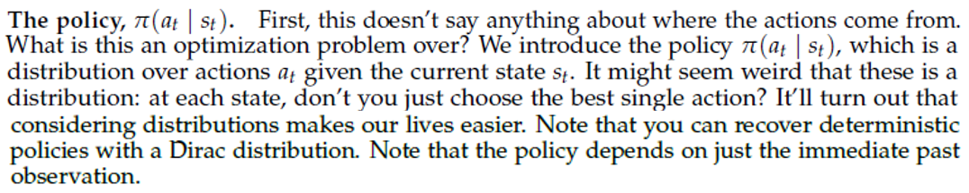

Modeling – Textbook modeling styles
From Princeton’s Reinforcement Learning course:
Objective function:
The description never answers the question of what is being optimized over. Instead, instead the instructor veers off into a discussion on the use of randomized policies.
The answer to the question of what we are optimizing over: We are optimizing over policies.

Slide 8
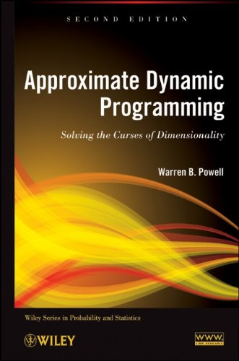

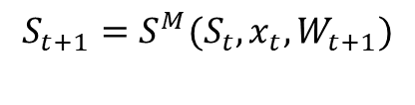
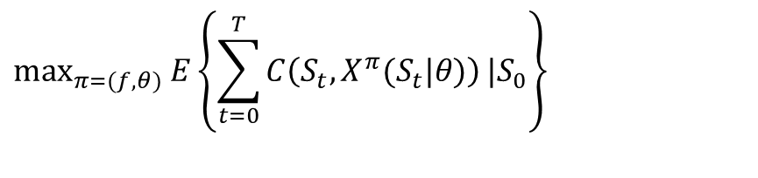
Modeling – Textbook modeling styles
My modeling framework
State $S_{t}$ at time $t.$
Decision $x_{t}$ determined by policy $X^{π}\left(S_{t} | θ\right)$.
Exogenous information process $W_{1},W_{2},…, W_{t}, …,W_{T}$
Transition function:
Objective function
Chapter 5
Remember: $W_{t}=\left(W_{ti}\left(S_{t},x_{t}\right)\right) i∈ℐ^{information}$
$$S_{t+1}=S^{M}(S_{t},x_{t},W_{t+1})$$
Chapter 9
$$\max_{π=(f,θ)}{E}\left\{\sum_{t=0}^{T}{C\left(S_{t},X^{π}(S_{t}|θ)\right)}|S_{0}\right\}$$
Optimizes over policies (hint: all four classes)

Slide 9
OUTLINE
The universal modeling framework (detailed)
Textbook modeling styles
Modeling time
State variables
Decision variables
Exogenous information
Transition function
Objective function

Slide 10
Time scales in energy
Frequency regulation
Power quality management
Battery arbitrage
Energy shifting
Demand peak management
Peak capacity management
Backup power for outages
seconds
minutes
hours
days-weeks
weeks-months
months-years

Slide 11





Modeling: Time
Modeling time
It is important to know the mapping between discrete and continuous time.
It is useful to think of information as arriving continuously over time. Functions (states, decisions) are measured at a point in time.
At time t, any variable indexed by $t^{′}≤t$ is known; if t’ > t it is unknown.
Continuous
time
$$W_{1}$$
$$W_{2}$$
$$W_{3}$$
$$W_{3}$$
Discrete
time

Slide 12
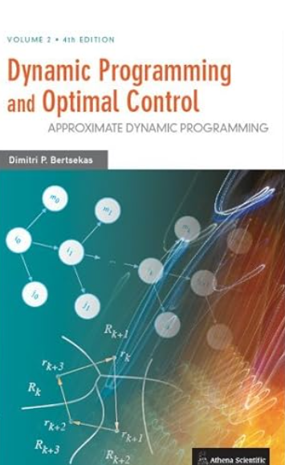
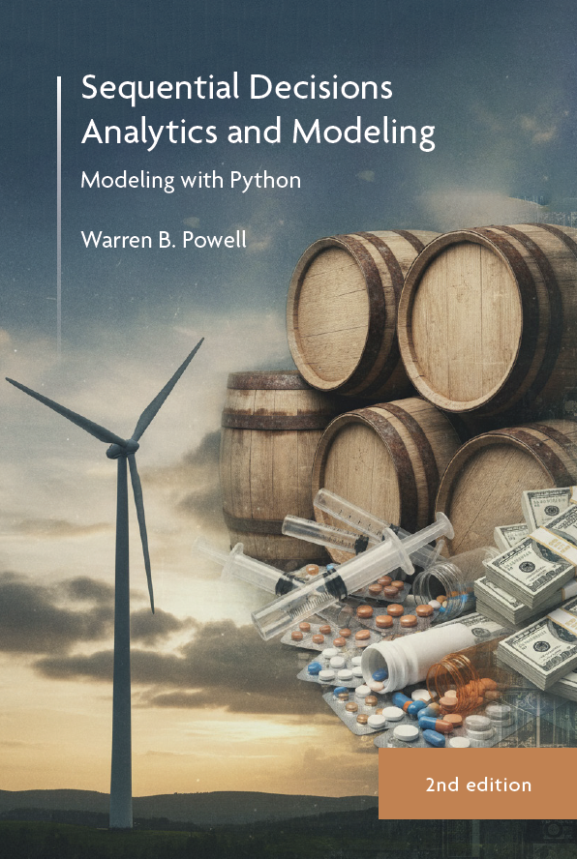
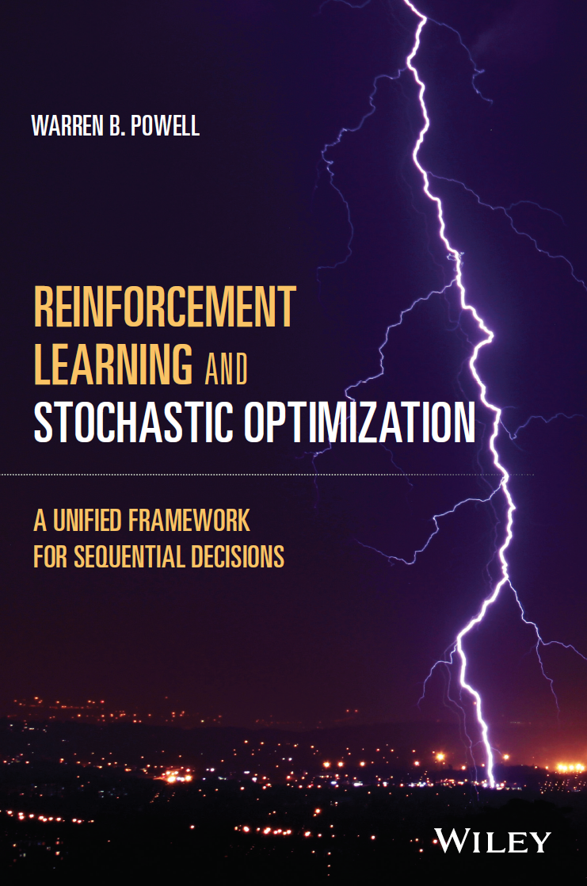



Modeling: Time
Bertsekas – Standard notation used in control theory:
Powell – ADP books, RLSO, etc.
Random at “time” $k$
Random at time $t$

Slide 13
OUTLINE
The universal modeling framework (detailed)
Textbook modeling styles
Modeling time
State variables
Decision variables
Exogenous information
Transition function
Objective function

Slide 14
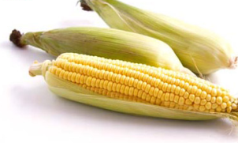
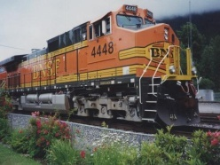
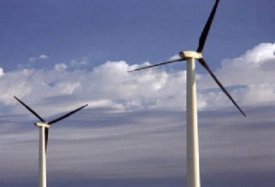
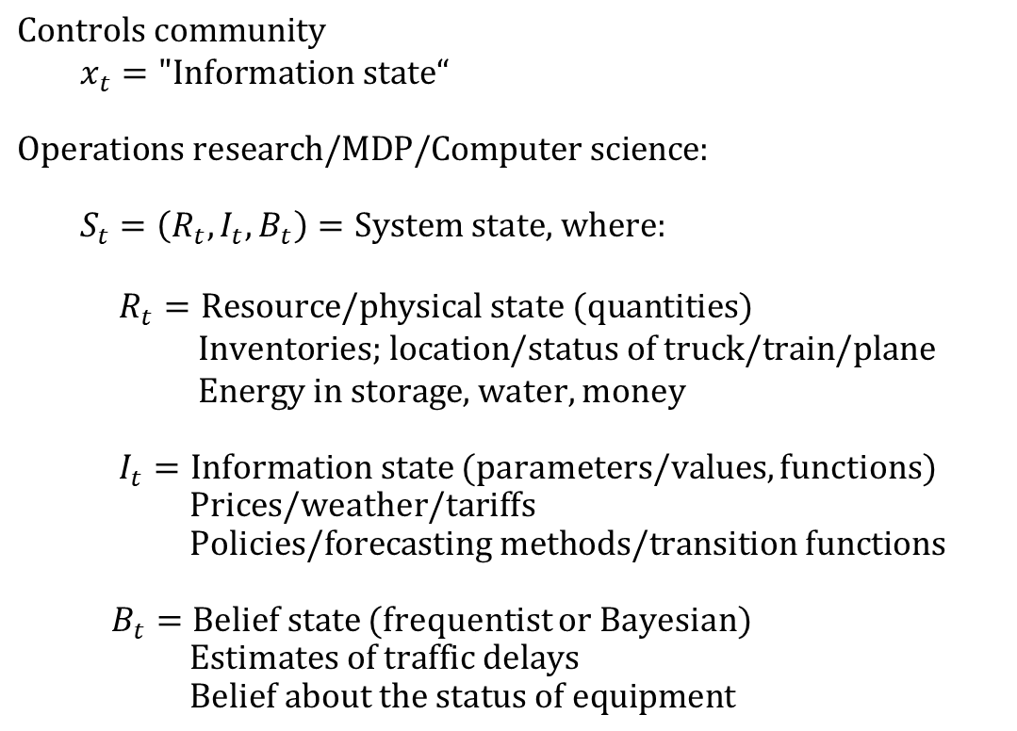
Modeling: State variables
$$\text{Controls community} \\ x_{t}=\text{"Information state}“$$
$\text{Operations research/MDP/Computer science}$:
$$S_{t}=\left(R_{t},I_{t},B_{t}\right)=\text{System state, where:}$$
$$R_{t}=\text{Resource}\text{/physical}\text{ state}\text{ (quantities)} \\ \text{Inventories; location}\text{/status of truck/train/plane}$$ $\text{ Energy in storage}$, water, money
$I_{t}=\text{Information state}$ (parameters/values, functions) $\text{ Prices}$/weather/tariffs $$\text{ Policies/forecasting methods/transition functions}$$
$B_{t}=\text{Belief state}$ (frequentist or Bayesian) $$\text{Estimates of}\text{ traffic delays} \\ \text{ Belief about the status of equipment}$$
The system state:
Notes:
182

Slide 15
Modeling: State variables
State variables are of central importance to any sequential decision problem, and yet are widely misunderstood in the academic literature.
We defer a discussion of state variables to the module “State variables” – please watch this module next.

Slide 16
OUTLINE
The universal modeling framework (detailed)
Textbook modeling styles
Modeling time
State variables
Decision variables
Exogenous information
Transition function
Objective function

Slide 17
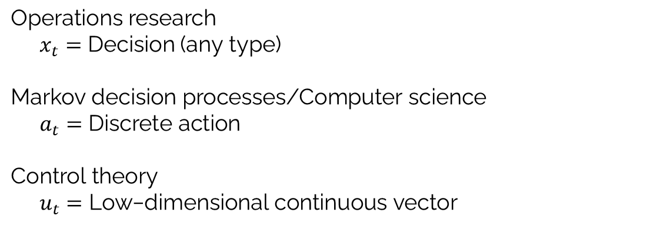
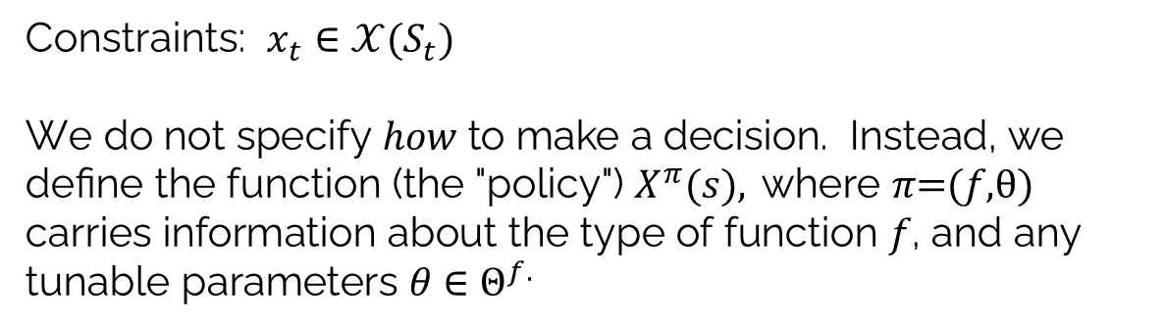
Modeling: Decisions
$$\text{Operations research}$$ $x_{t}=$ Decision (any type)
$$\text{Markov decision processes/Computer science} \\ a_{t}=\text{Discrete action}$$
$$\text{Control theory} \\ u_{t}=\text{Low−dimensional continuous vector}$$
Constraints: $x_{t}∈𝒳(S_{t})$
$$\text{W}\text{e do not specify }how\text{ to make a decision. Instead, we define the} \text{function}\text{ (the "policy") }X^{π}(s), \text{where }π\text{=(}f\text{,}θ)$$
$$\text{carries information} \text{about the type of function }f\text{, and any tunable parameters }θ∈Θ^{f.}$$
Decisions:
Notes:
185

Slide 18
Modeling: Decisions
Types of decisions
Binary
Finite
Continuous scalar
Continuous vector
Discrete vector
Categorical

Slide 19
OUTLINE
The universal modeling framework (detailed)
Textbook modeling styles
Modeling time
State variables
Decision variables
Exogenous information
Transition function
Objective function

Slide 20
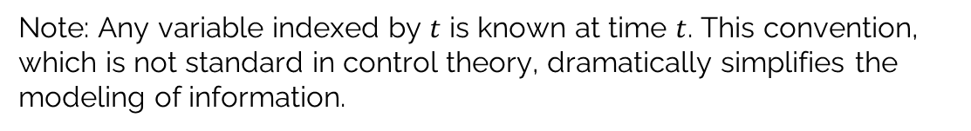
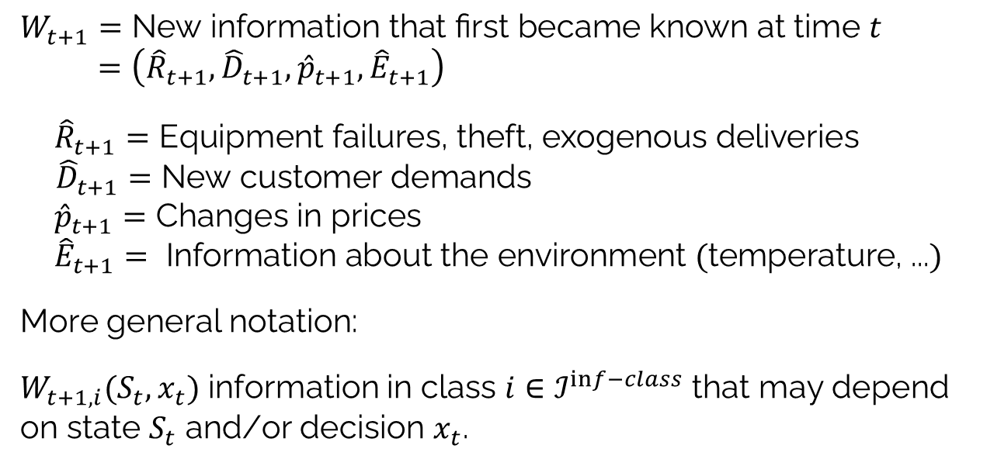
Modeling: Exogenous information
Exogenous information:
$$W_{t+1}=\text{New information that first became known at time }t \\ =\left({\hat{R}}_{t+1},{\hat{D}}_{t+1},{\hat{p}}_{t+1},{\hat{E}}_{t+1}\right)$$
$${\hat{R}}_{t+1}=\text{E}\text{quipment failures}\text{, theft, exogenous deliveries}$$ ${\hat{D}}_{t+1}=\text{New customer demands}$ ${\hat{p}}_{t+1}=\text{Changes in prices}$ $${\hat{E}}_{t+1}=\text{ Information about the environment }(\text{temperature, ...})$$
More general notation:
$W_{t+1,i}(S_{t},x_{t})$ information in class $i∈ℐ^{inf−class}$ that may depend on state $S_{t}$ and/or decision $x_{t}$.
Note: Any variable indexed by $t$ is known at time $t$. This convention, which is not standard in control theory, dramatically simplifies the modeling of information.
Notes:
188

Slide 21
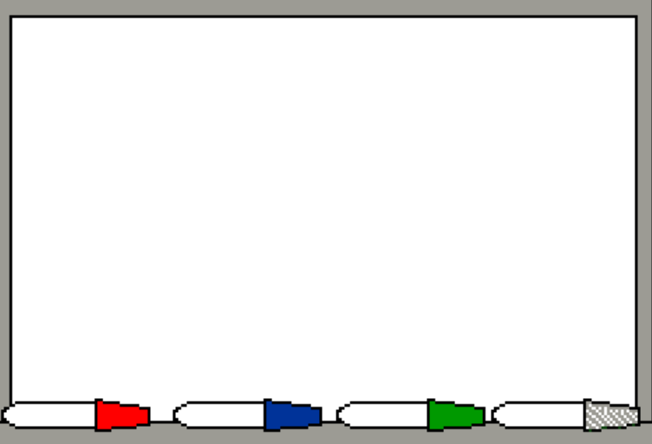
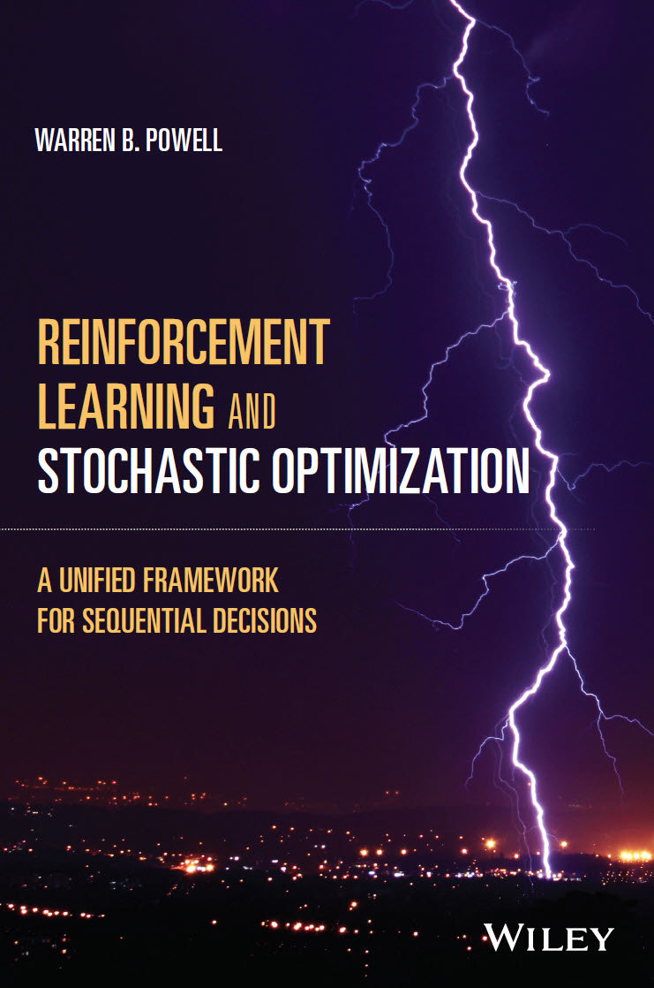
Modeling: Exogenous information
We have to identify the different classes of uncertainty:
Language of models
Language of the problem domain
Suppliers:
Daily production, yield
Future commitments
Delivery times
Costs
Market/customers
Orders, returns
Price paid
Service requirements
Personnel
Availability
Departures, hiring
Performance
Equipment
Up-time, failures
Productivity
Network
Transit times
Weather, earthquakes
12 classes of uncertainty
Observational errors
Exogenous uncertainty
Prognostic uncertainty
Inferential uncertainty
Experimental uncertainty
Model uncertainty
Transitional uncertainty
Implementation uncertainty
Communication errors
Algorithmic uncertainty
Goal uncertainty
Environmental uncertainty
Chapter 10

Slide 22
Modeling: Exogenous information
12 Classes of uncertainty
Observational uncertainty
Exogenous uncertainty
Prognostic uncertainty
Inferential uncertainty
Experimental variability
Model uncertainty
Transitional uncertainty
Implementation uncertainty
Communication errors
Algorithmic instability
Goal uncertainty
Environmental uncertainty
Public health
What are infection rates
Mutations of the virus
Forecasting prevalent flu this fall
Estimating transmission rates
Testing dosages
Modeling spread of disease
Actual disease transitions
Failure to get vaccinated
Lack of clarity in instructions
Variations in algorithmic results
Minimize infections? Costs?
Changing policies on vaccinations

Slide 23
Modeling: Exogenous information
Generating sample observations
From history
Use observations from the past
Assumes that these are not affected by prior decisions
Learning while doing
Optimize in the field as decisions are being made.
https://tinyurl.com/LearningWhileDoing/
Create samples from a mathematical model
Requires creating a mathematical model that captures actual behaviors
Allows us to capture the effect of state/decision on observations

Slide 24
OUTLINE
The universal modeling framework (detailed)
Textbook modeling styles
Modeling time
State variables
Decision variables
Exogenous information
Transition function
Objective function

Slide 25

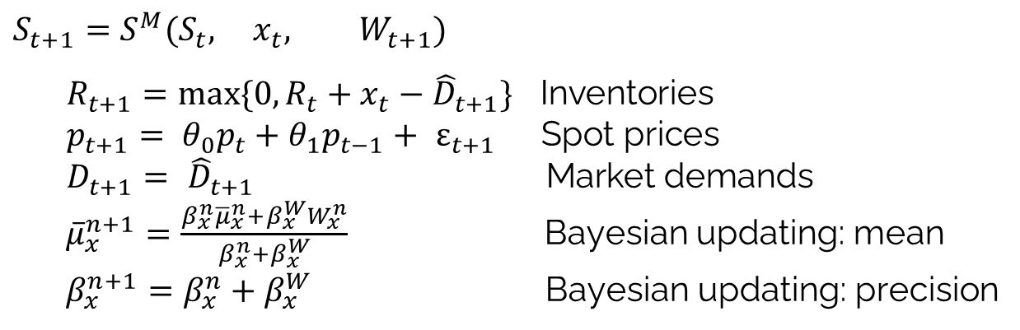


Modeling: Transition function
The transition function (or “state transition model”)
Controls community
$$x_{t+1}=f(x_{t}, u_{t},w_{t})$$
My notation:
$$S_{t+1}=S^{M}(S_{t}, { x}_{t}, W_{t+1})$$
$$R_{t+1}=max⁡\{0,R_{t}+x_{t}−{\hat{D}}_{t+1}\}\text{ Inventories} \\ p_{t+1}= {θ_{0}p}_{t}+θ_{1}p_{t−1}+ ε_{t+1} \text{Spot prices} \\ D_{t+1}= {\hat{D}}_{t+1} \text{Market demands}$$
${\overline{μ}}_{x}^{n+1}=\frac{{β_{x}^{n}{\overline{μ}}_{x}^{n}+β}_{x}^{W}W_{x}^{n}}{{β_{x}^{n}+β}_{x}^{W}}$ Bayesian updating: mean
$β_{x}^{n+1}=β_{x}^{n}+β_{x}^{W}$ Bayesian updating: precision
$$S_{t+1}=$$
Also known as the system model, plant model, plant equation, and transfer function.
Notes:
193

Slide 26

Modeling: Transition function
From transition function to transition matrix:
The transition function:
Easy to compute, scales to ultra large-scale problems.
The transition matrix:
Impossible to compute for anything larger than a toy problem, even if we use Monte Carlo simulation!
$$S_{t+1}=S^{M}(S_{t},x_{t},W_{t+1})$$
$$P\left({S_{t+1}=s}^{′} | S_{t}=s,x_{t}=x\right)=\int_{w_{1}}{{\int_{W_{2}}{⋯\int_{W_{k}}{P^{W}(W_{t+1}=w|S_{t}=s,x_{t}=x)1_{\left\{s^{′}=S^{M}\left(S_{t}=s,x_{t}=x,W_{t+1}=w\right)\right\}}}}}^{}}$$

Slide 27
OUTLINE
The universal modeling framework (detailed)
Textbook modeling styles
Modeling time
State variables
Decision variables
Exogenous information
Transition function
Objective function

Slide 28
Modeling: Objective function
The objective function:
Categories of performance metrics:
Financial metrics
Productivity metrics
Effectiveness metrics
Service performance
External performance ratings
Behavior metrics
Estimation metrics
This is modeling for real-world problems.
Notes:
196

Slide 29
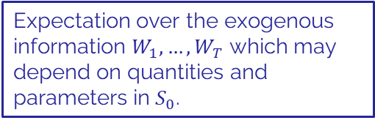
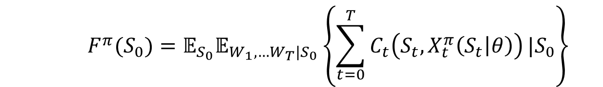
Modeling: Objective function
The base objective function
We approximate the objective function (assuming cumulative reward):
$$F^{π}(S_{0})=𝔼_{S_{0}}𝔼_{{W_{1},…W_{T}|S}_{0}}\left\{\sum_{t=0}^{T}{C_{t}\left(S_{t},X_{t}^{π}\left(S_{t} | θ\right)\right)}|S_{0}\right\}$$
If there are probabilistic beliefs about inputs, we take the expectation over these beliefs.
Expectation over the exogenous information $W_{1},…,W_{T}$ which may depend on quantities and parameters in $S_{0}$.

Slide 30
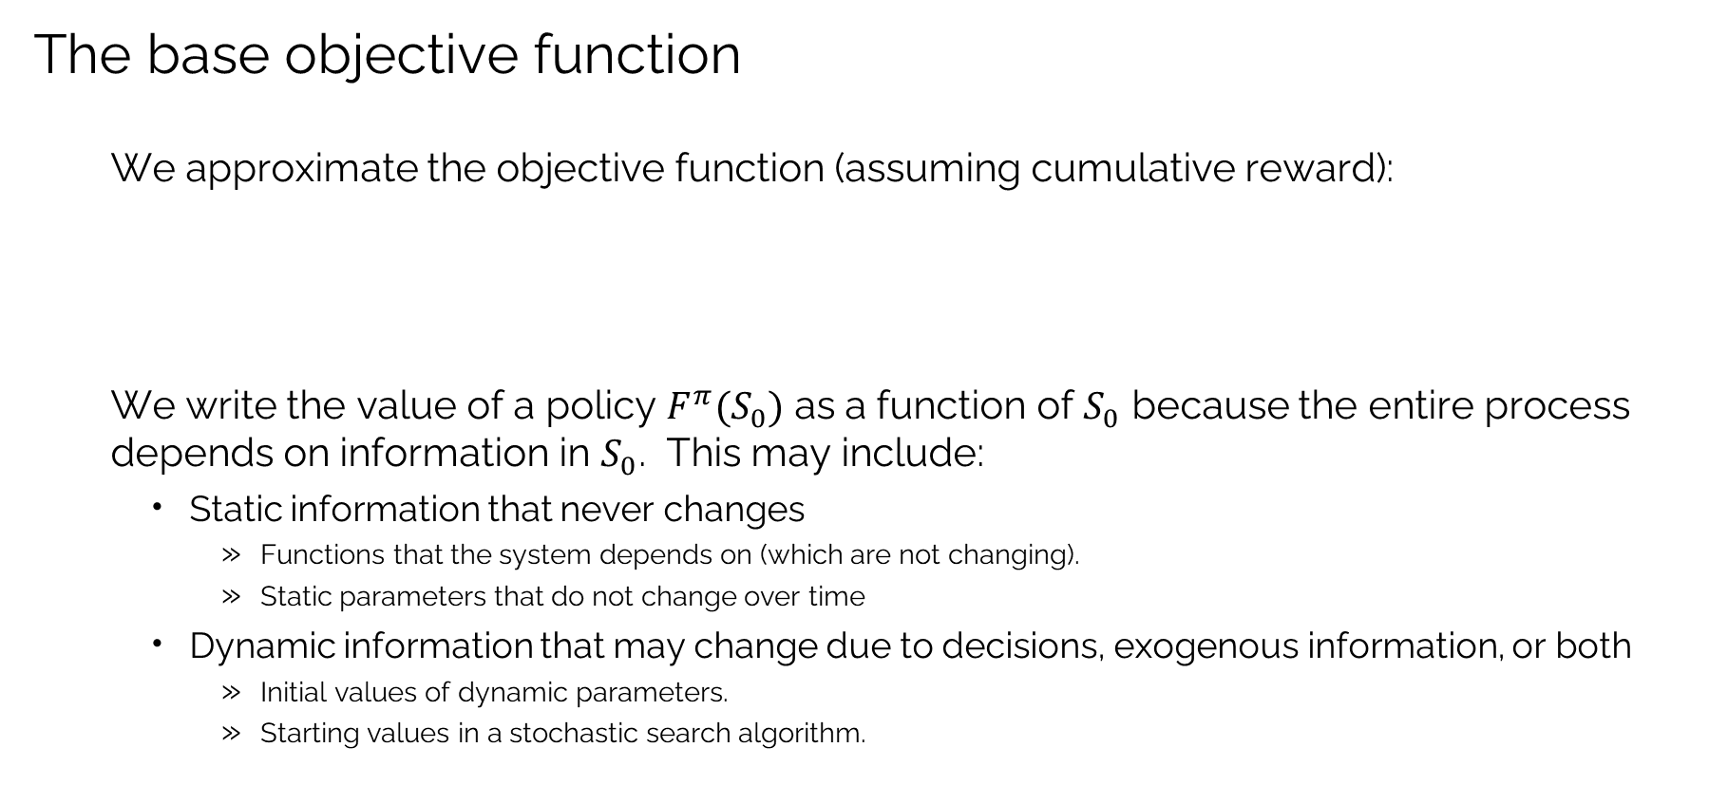
Modeling: Objective function
The base objective function
We approximate the objective function (assuming cumulative reward):
We write the value of a policy $F^{π}(S_{0})$ as a function of $S_{0}$ because the entire process depends on information in $S_{0}$. This may include:
Static information that never changes
Functions that the system depends on (which are not changing).
Static parameters that do not change over time
Dynamic information that may change due to decisions, exogenous information, or both
Initial values of dynamic parameters.
Starting values in a stochastic search algorithm.
$$F^{π}(S_{0})=𝔼_{S_{0}}𝔼_{{W_{1},…W_{T}|S}_{0}}\left\{\sum_{t=0}^{T}{C_{t}\left(S_{t},X_{t}^{π}\left(S_{t} | θ\right)\right)}|S_{0}\right\}$$

Slide 31





Modeling: Objective function
The base objective function
We approximate the objective function:
$$F^{π}(S_{0})=𝔼\left\{\sum_{t=0}^{T}{C_{t}\left(S_{t},X_{t}^{π}\left(S_{t} | θ\right)\right)}|S_{0}\right\}$$
$$R_{0}$$
$$I_{0}$$
$$B_{0}$$
State of the world
Inventories
People
Equipment
Facilities
Cash
Investments
….
Forecasts
Market response
Arrival times
Yield
Competitor behavior
….
Travel times
Prices
Weather
Taxes
Tariffs
….

Slide 32

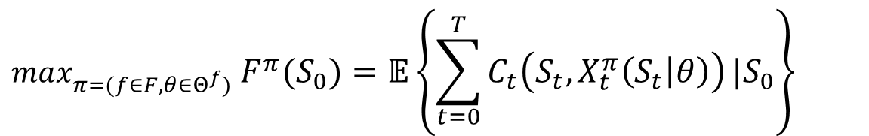

Modeling: Objective function
The base objective function
We now want to find the best policy
Functional forms:
Simple rules
Linear functions (“linear decision rules”)
Neural networks
Linear/nonlinear/integer program
Optimizing over a planning horizon
$$max_{π=(f∈F,θ∈Θ^{f})} F^{π}(S_{0})=𝔼\left\{\sum_{t=0}^{T}{C_{t}\left(S_{t},X_{t}^{π}\left(S_{t} | θ\right)\right)}|S_{0}\right\}$$
Type of policy
(structure of function)
Parameter
tuning
$$θ^{n+1}=θ^{n}+α_{n}∇_{θ}F(θ^{n},W^{n+1})$$

Slide 33


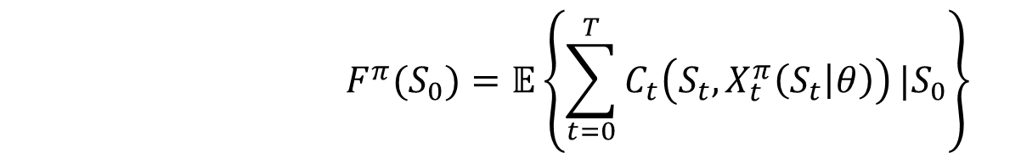
Modeling: Objective function
Evaluating policies
Theoretically
Optimality proofs
Asymptotic optimality
Regret bounds
The base objective function
Evaluating the policy:
Computer simulation
$$F^{π}(S_{0})=𝔼\left\{\sum_{t=0}^{T}{C_{t}\left(S_{t},X_{t}^{π}\left(S_{t} | θ\right)\right)}|S_{0}\right\}$$
Field/online testing

Slide 34
Modeling: Objective function
Evaluating policies
1) Solution quality
On average
Worst case performance
2) Computational
Speed
Reliability
3) Transparency
4) Robustness to data errors
5) Tuning requirements
6) Flexibility/adaptability
7) Methodological complexity
8) Data requirements
The base objective function
Evaluating the policy:
$$F^{π}(S_{0})=𝔼\left\{\sum_{t=0}^{T}{C_{t}\left(S_{t},X_{t}^{π}\left(S_{t} | θ\right)\right)}|S_{0}\right\}$$
Optimal policies are largely a myth… we want to find high quality policies that are robust, flexible and transparent which are easy to develop and implement.

Slide 35
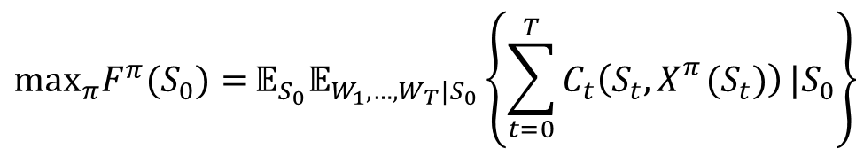

Modeling: Objective function
Cumulative reward
Also known as “online learning”
Examples:
Trying different medications on a patient
Testing stock trading strategies
Pricing a product and observing revenue
A/B testing of webpage designs
How we write it:
.
Final reward
Also known as “offline learning”
Examples:
Testing a new catalyst in a lab
Simulating different plant layouts
Trying different recipes in a test kitchen
Evaluating the performance of different search algorithms
How we write it
$$\max_{π}F^{π}(S_{0})={𝔼_{S_{0}}𝔼_{W_{1},…,W_{T}|S_{0}}\left\{\sum_{t=0}^{T}{C_{t}\left(S_{t},X_{}^{π}(S_{t})\right)}|S_{0}\right\}}$$
$$\max_{π}{F^{π}(S_{0})=𝔼_{S_{0}}𝔼_{W_{1},…,W_{T}|S_{0}}𝔼_{{\hat{W}|S}_{0}}\left\{F\left(x^{π,N},\hat{W}\right)|S_{0}\right\}}$$
See Chapter 7 of RLSO for more information.

Slide 36
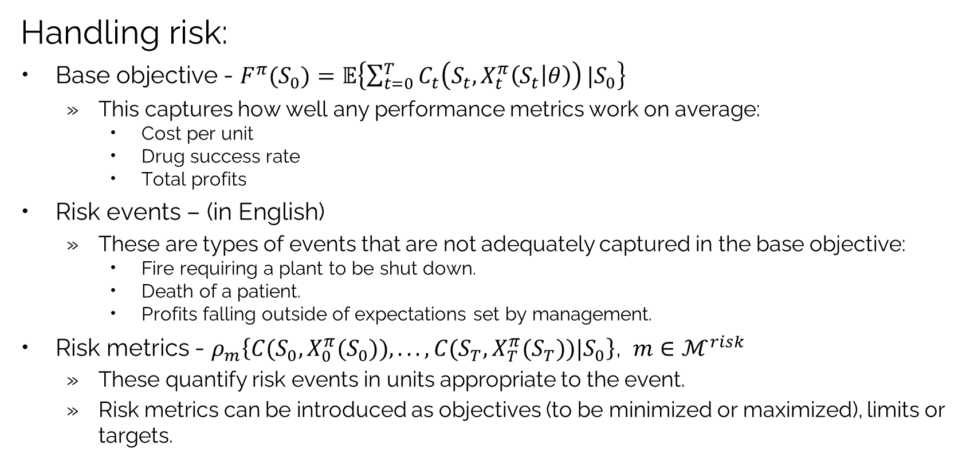
Modeling: Objective function
Handling risk:
Base objective - $F^{π}(S_{0})=𝔼\left\{\sum_{t=0}^{T}{C_{t}\left(S_{t},X_{t}^{π}\left(S_{t} | θ\right)\right)}|S_{0}\right\}$
This captures how well any performance metrics work on average:
Cost per unit
Drug success rate
Total profits
Risk events – (in English)
These are types of events that are not adequately captured in the base objective:
Fire requiring a plant to be shut down.
Death of a patient.
Profits falling outside of expectations set by management.
Risk metrics - $ρ_{m}\left\{C(S_{0},X_{0}^{π}(S_{0})),...,C(S_{T},X_{T}^{π}(S_{T}))|S_{0}\right\}$, $m∈ℳ^{risk}$
These quantify risk events in units appropriate to the event.
Risk metrics can be introduced as objectives (to be minimized or maximized), limits or targets.

Slide 37
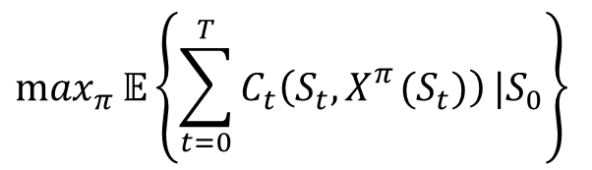
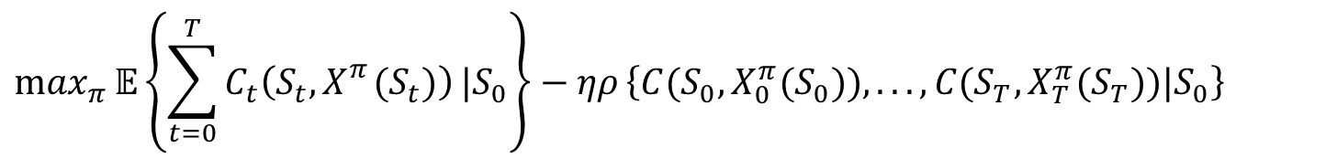


Modeling: Objective function
Handling risk:
In the objective function
As a constraint
subject to
$$\max_{π}{𝔼\left\{\sum_{t=0}^{T}{C_{t}\left(S_{t},X_{}^{π}(S_{t})\right)}|S_{0}\right\}−ηρ}\left\{C(S_{0},X_{0}^{π}(S_{0})),...,C(S_{T},X_{T}^{π}(S_{T}))|S_{0}\right\}$$
Base objective
Risk metric (as objective)
$$\max_{π}{𝔼\left\{\sum_{t=0}^{T}{C_{t}\left(S_{t},X_{}^{π}(S_{t})\right)}|S_{0}\right\}}$$
$$ρ\left\{C(S_{0},X_{0}^{π}(S_{0})),...,C(S_{T},X_{T}^{π}(S_{T}))|S_{0}\right\}≤ρ^{max}$$

Slide 38


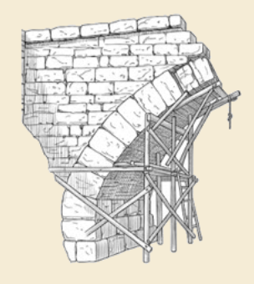
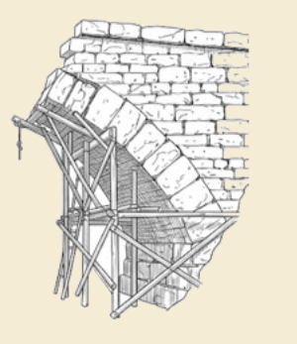
Thank you!
For more information see the Sequential Decision Analytics website at
warrenpowell.org
For more on the universal modeling framework:
warrenpowell.org → Modeling → The Universal Modeling Framework
warrenpowell.org → Teaching materials → Books:
Sequential Decision Analytics and Modeling
Chapter 9 of Reinforcement Learning and Stochastic Optimization

