Slide 1


Tutorial Series on Sequential Decision Analytics
Warren B Powell
Professor Emeritus, Princeton University
Recorded: August 12, 2026
Module: State variables – State variables are of fundamental importance in sequential decision problems, yet there is considerable confusion in how they are presented in the research literature.
Predecessor module(s): The universal modeling framework (detailed) – This module will demonstrate how state variables are used.
Technical level: General modeling notation.

Slide 2

OUTLINE
State variables
State variables defined
A network routing problem
Belief state variables
Pre- and post- decision state variables
A sample of state variables

Slide 3
OUTLINE
State variables
State variables defined
A network routing problem
Belief state variables
Pre- and post- decision state variables
A sample of state variables

Slide 4
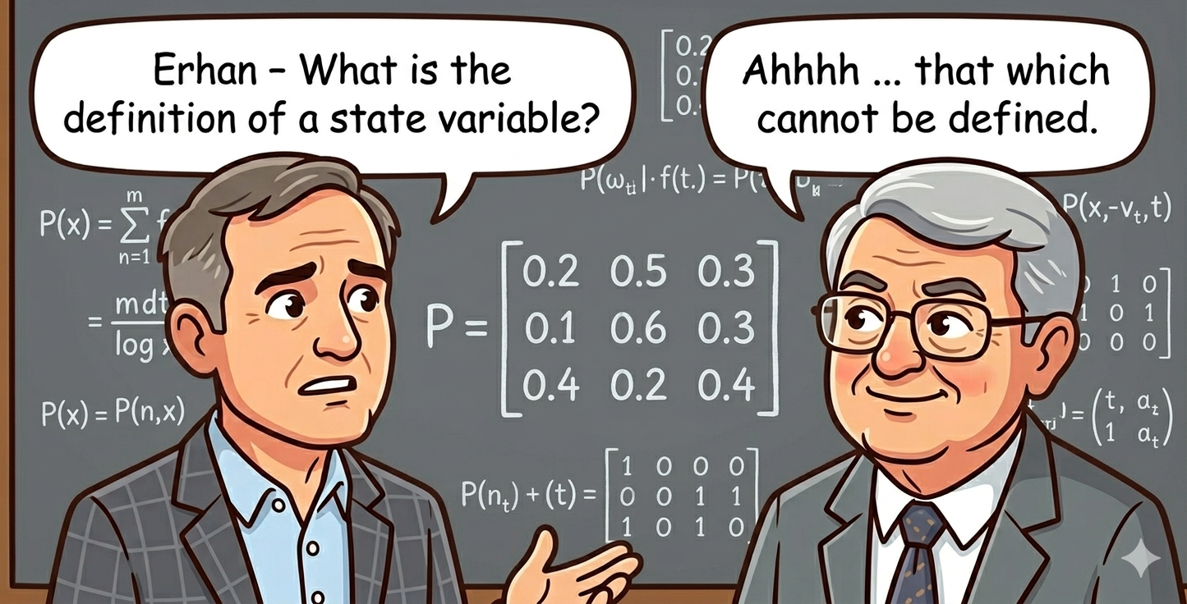
State variables

Slide 5
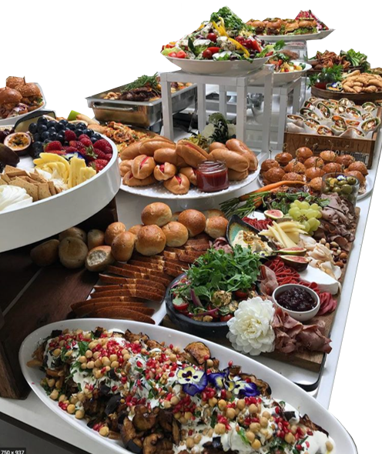
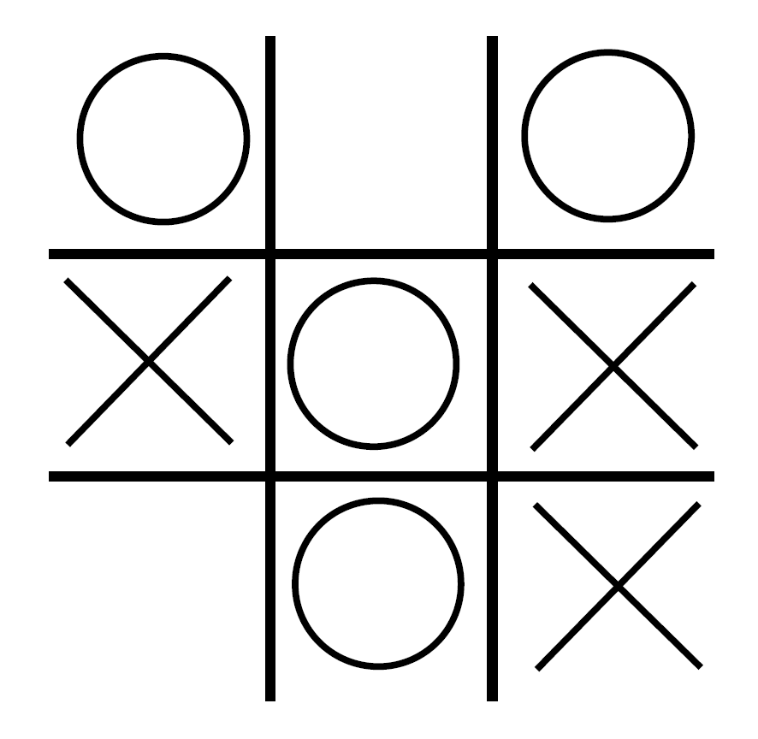
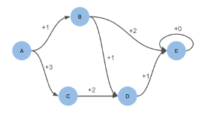
State variables
Textbook
Real world
From Princeton RL course
Real world state variables are quite rich, and subtle. We can use our modeling framework to tell us the information that belongs in the state variable.

Slide 6
State variables: Definition
What is a state variable? – The MDP community
Bellman’s classic text on dynamic programming (1957) describes the state variable with:
“… we have a physical system characterized at any stage by a small set of parameters, the state variables.”
The most popular book on dynamic programming (Puterman, 1994, p.18) “defines” a state variable with the following sentence:
“At each decision epoch, the system occupies a state.”
Wikipedia:
“A state variable is one of the set of variables that are used to describe the mathematical ‘state’ of a dynamical system.”
For a thorough discussion of state variables, go to: https://tinyurl.com/onstatevariables/

Slide 7
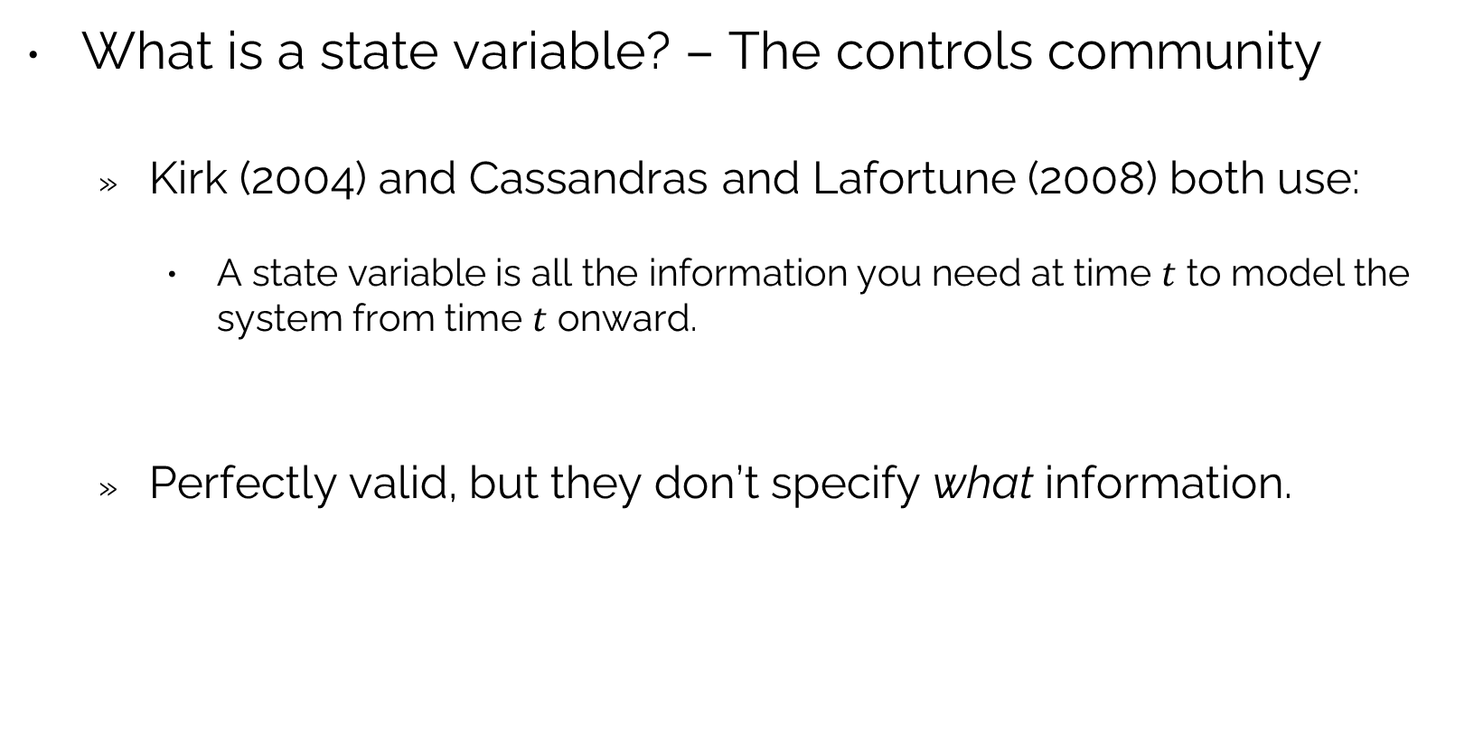
State variables: Definition
What is a state variable? – The controls community
Kirk (2004) and Cassandras and Lafortune (2008) both use:
A state variable is all the information you need at time $t$ to model the system from time $t$ onward.
Perfectly valid, but they don’t specify what information.

Slide 8
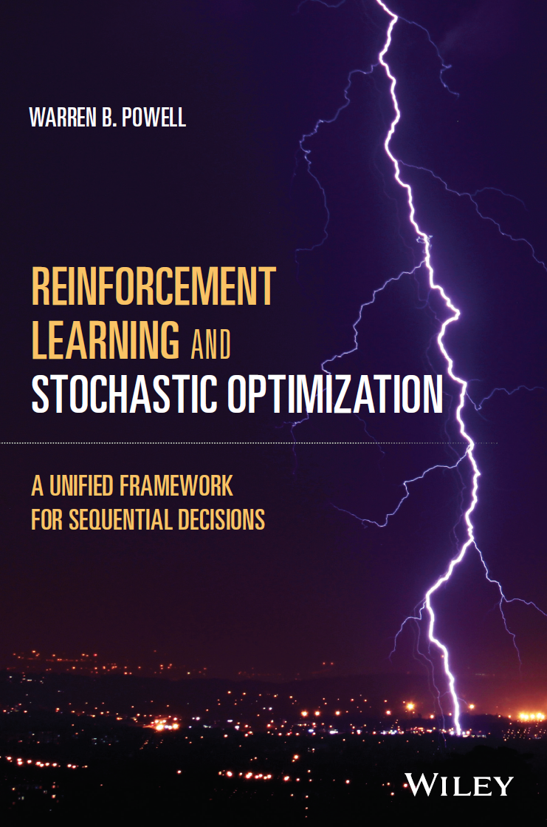
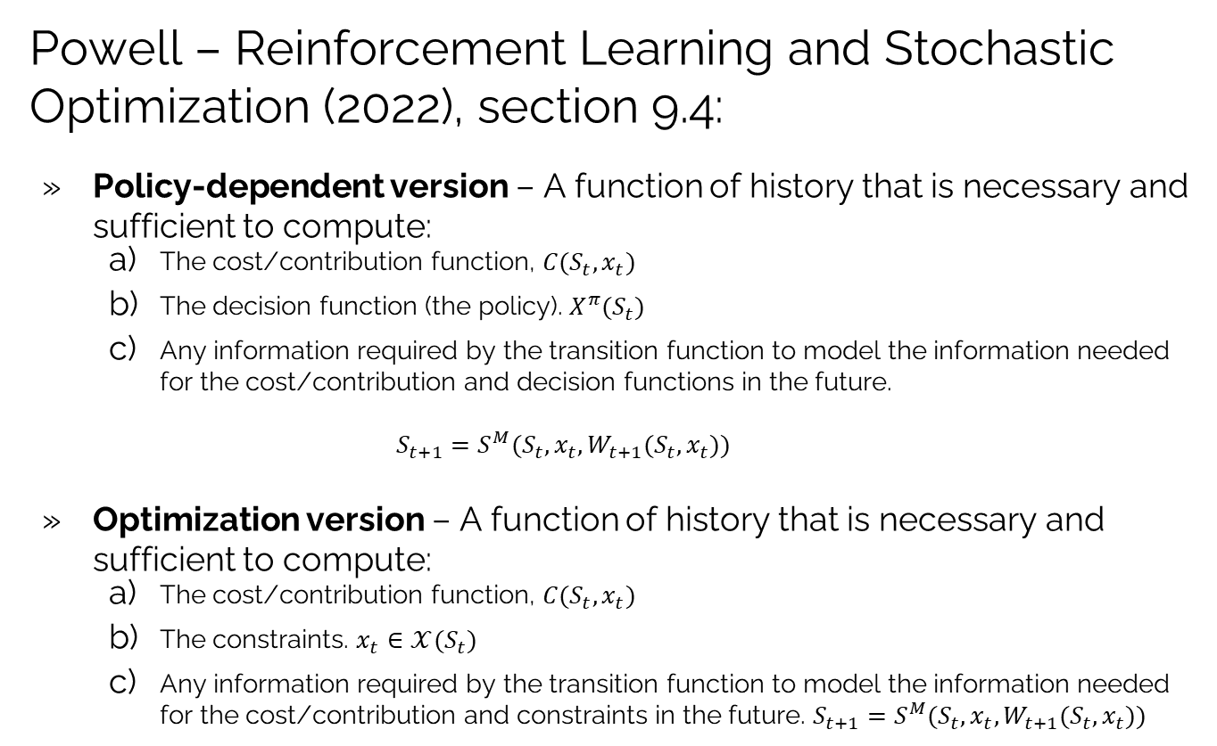
State variables: Definition
Powell – Reinforcement Learning and Stochastic Optimization (2022), section 9.4:
Policy-dependent version – A function of history that is necessary and sufficient to compute:
The cost/contribution function, $C(S_{t},x_{t})$
The decision function (the policy). $X^{π}(S_{t})$
Any information required by the transition function to model the information needed for the cost/contribution and decision functions in the future.
$$S_{t+1}=S^{M}(S_{t},x_{t},W_{t+1}(S_{t},x_{t}))$$
Optimization version – A function of history that is necessary and sufficient to compute:
The cost/contribution function, $C(S_{t},x_{t})$
The constraints. $x_{t}∈𝒳(S_{t})$
Any information required by the transition function to model the information needed for the cost/contribution and constraints in the future. $S_{t+1}=S^{M}(S_{t},x_{t},W_{t+1}(S_{t},x_{t}))$
Chapter 9

Slide 9
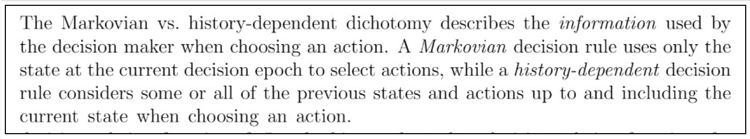
State variables: Definition
From Puterman (2005):
A state variable, by definition, includes whatever information you need from history, so there is no difference between state-dependent and history-dependent.
All properly modeled problems are Markovian, so this adjective is not needed.
(Hidden state variables are modeled using beliefs, which are part of the state variable.)

Slide 10
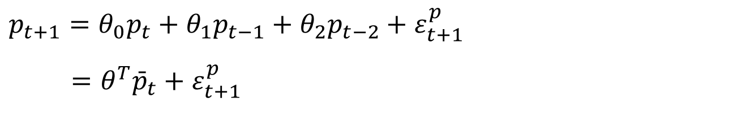
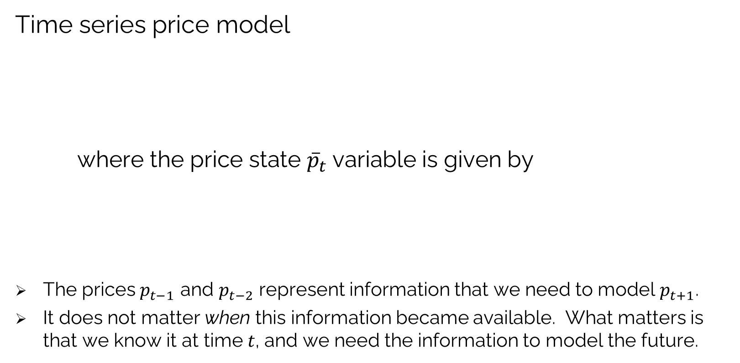
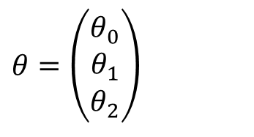
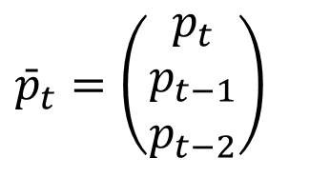
State variables: Definition
Time series price model
where the price state ${\overline{p}}_{t}$variable is given by
The prices $p_{t−1}$ and $p_{t−2}$ represent information that we need to model $p_{t+1}$.
It does not matter when this information became available. What matters is that we know it at time $t$, and we need the information to model the future.
$$p_{t+1}=θ_{0}p_{t}+θ_{1}p_{t−1}+θ_{2}p_{t−2}+ε_{t+1}^{p}$$
$=θ^{T}{\bar{p}}_{t}+ε_{t+1}^{p}$
$$θ=\left(\begin{aligned}θ_{0} \\ θ_{1} \\ θ_{2}\end{aligned}\right)$$
$${\bar{p}}_{t}=\left(\begin{matrix}p_{t} \\ p_{t−1} \\ p_{t−2}\end{matrix}\right)$$

Slide 11
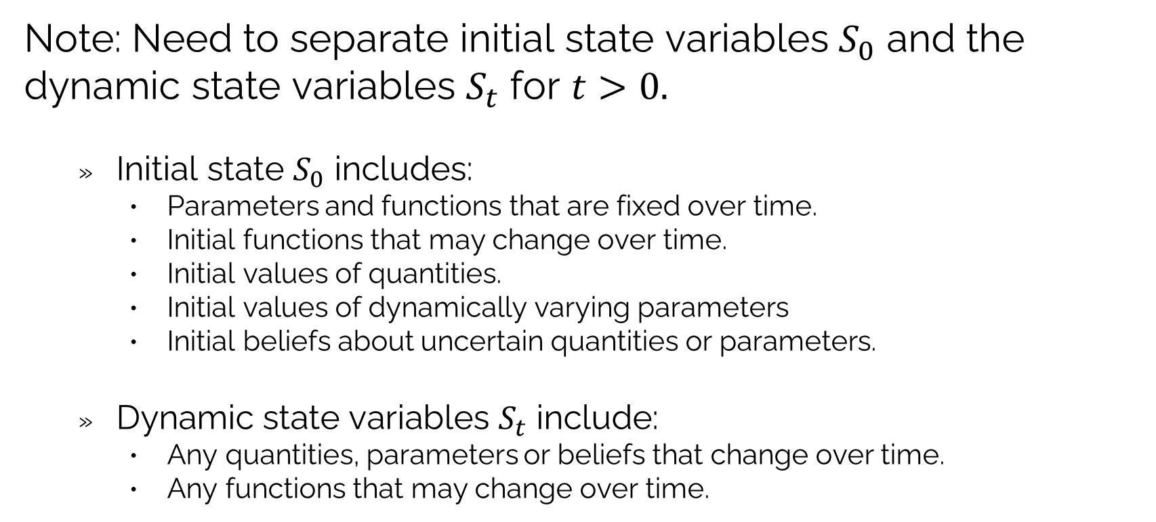
State variables: Definition
Note: Need to separate initial state variables $S_{0}$ and the dynamic state variables $S_{t}$ for $t>0.$
Initial state $S_{0}$ includes:
Parameters and functions that are fixed over time.
Initial functions that may change over time.
Initial values of quantities.
Initial values of dynamically varying parameters
Initial beliefs about uncertain quantities or parameters.
Dynamic state variables $S_{t}$ include:
Any quantities, parameters or beliefs that change over time.
Any functions that may change over time.

Slide 12
OUTLINE
State variables
State variables defined
A network routing problem
Belief state variables
Pre- and post- decision state variables
A sample of state variables

Slide 13
State variables: Network problem
I need four volunteers

Slide 14
State variables: Network problem
Illustrating state variables
A deterministic graph, traveler at node 6.
The set of travel times are fixed, so they are stored in $S_{0}.$

Slide 15


State variables: Network problem
Illustrating state variables
A stochastic graph

Slide 16
State variables: Network problem
Illustrating state variables
A stochastic graph

Slide 17
State variables: Network problem
Illustrating state variables
A stochastic graph with left turn penalties

Slide 18



State variables: Network problem
Variant of problem in Puterman (2005):
Find best path from 1 to 14 that minimizes the second highest arc cost along the path:
If the traveler is at node 9, what is her state?
2
14
5
4
9
8
11
12
8
1
1
8
12
12
10
8
15
7
18
1
3
15
6
9
12
14
8
13
3
11
8
5
5
7
10
8
4
7
10
13
$$S_{t}=?$$
$$S_{t}=(N_{t},\text{(}\text{highest},\text{second highest}\text{)})=(9,(15,12))$$

Slide 19
State variables: Network problem
Illustrating state variables
A stochastic graph with generalized learning

Slide 20


State variables: Network problem
Illustrating state variables
A stochastic graph with generalized learning

Slide 21
OUTLINE
State variables
State variables defined
A network routing problem
Belief state variables
Pre- and post- decision state variables
A sample of state variables

Slide 22
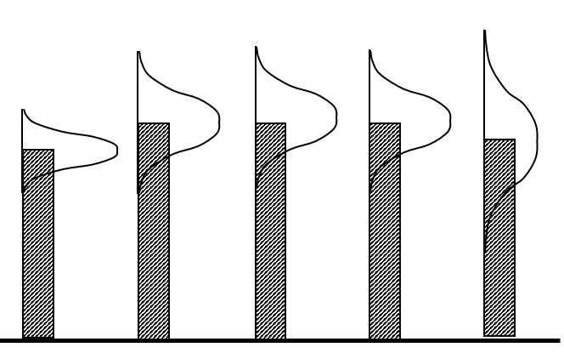
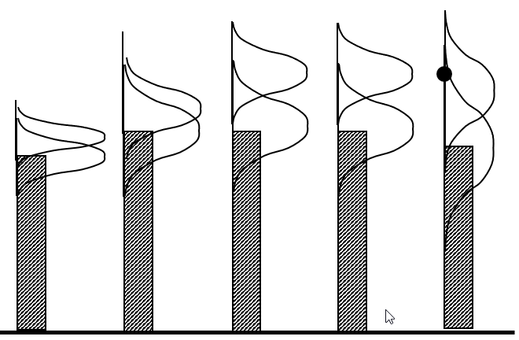
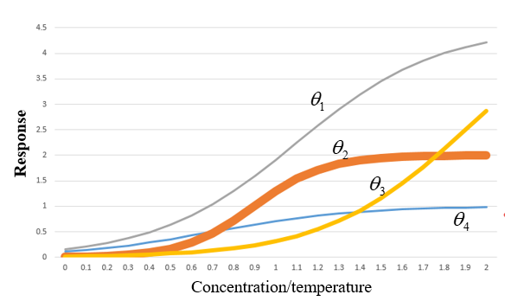
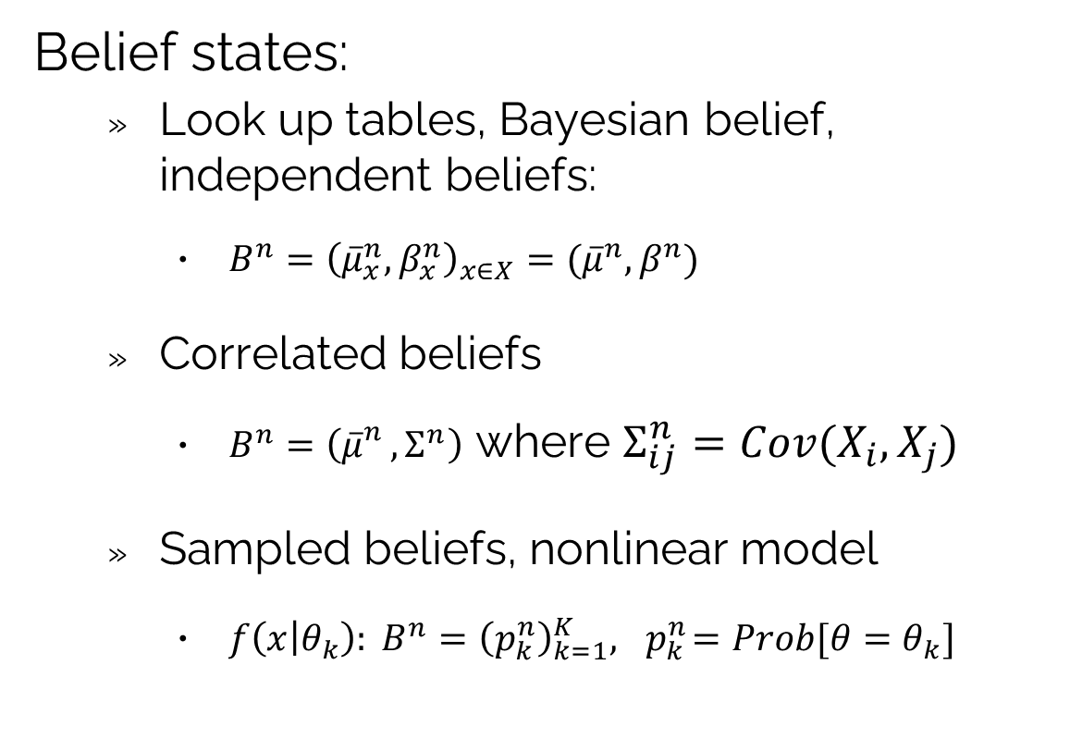
State variables: Belief states
Belief states:
Look up tables, Bayesian belief, independent beliefs:
$B^{n}={\left({\overline{μ}}_{x}^{n},β_{x}^{n}\right)}_{x∈X}=({\overline{μ}}^{n},β^{n})$
Correlated beliefs
$B^{n}=\left({\overline{μ}}_{}^{n}, Σ^{n}\right)$ where $Σ_{ij}^{n}=Cov(X_{i},X_{j})$
Sampled beliefs, nonlinear model
$f\left(x | θ_{k}\right): B^{n}={\left(p_{k}^{n}\right)}_{k=1}^{K}, { p}_{k}^{n}=Prob[θ=θ_{k}]$

Slide 23






State variables: Belief states
Batch vs. recursive learning: frequentist
Lookup tables
Batch estimation
Recursive learning
Linear models
Batch (normal equations)
Recursive
$${\overline{μ}}^{n}=\frac{1}{n}\sum_{m=1}^{n}{W^{m}}$$
$${\hat{σ}}^{2,n}=\frac{1}{n−1}\sum_{m=1}^{n}{{\left(W^{m}−{\overline{μ}}^{n}\right)}^{2}}$$
$$θ^{n}={\left[{\left(X^{n}\right)}^{T}\left(X^{n}\right)\right]}^{−1}{\left(X^{n}\right)}^{T}Y^{n}$$
$$y=\sum_{f∈ℱ}{θ_{f}φ_{f}(x)}=θ^{T}φ\left(x\right)$$
$$ε^{n}=y^{n}−θ^{n}φ(x^{n})$$
$$θ^{n}=θ^{n−1}−\frac{1}{γ^{n}}M^{n−1}φ^{n}ε^{n}$$
$$M^{n}=M^{n−1}−\frac{1}{γ^{n}}\left(M^{n−1}φ^{n}{\left(φ^{n}\right)}^{T}M^{n−1}\right)$$
$$γ^{n}=1+{\left(φ^{n}\right)}^{T}M^{n−1}φ^{n}$$
$$B^{n−1}=(θ^{n−1},M^{n−1})$$
$$B^{n−1}=({\overline{μ}}^{n−1},{\hat{σ}}^{2,n−1})$$
${\overline{μ}}^{n}=\left(1−\frac{1}{n}\right){\overline{μ}}^{n−1}+\frac{1}{n}W^{n}$
$${\hat{σ}}^{2,n}=\left\{\begin{matrix}\frac{1}{n}{\left(W^{n}−{\overline{μ}}^{n−1}\right)}^{2} & n=2 \\ \frac{n−2}{n−1}{\hat{σ}}^{2,n−1}+\frac{1}{n}{\left(W^{n}−{\overline{μ}}^{n−1}\right)}^{2} & n>2\end{matrix}\right.$$

Slide 24
OUTLINE
State variables
State variables defined
A network routing problem
Belief state variables
Pre- and post- decision state variables
A sample of state variables

Slide 25
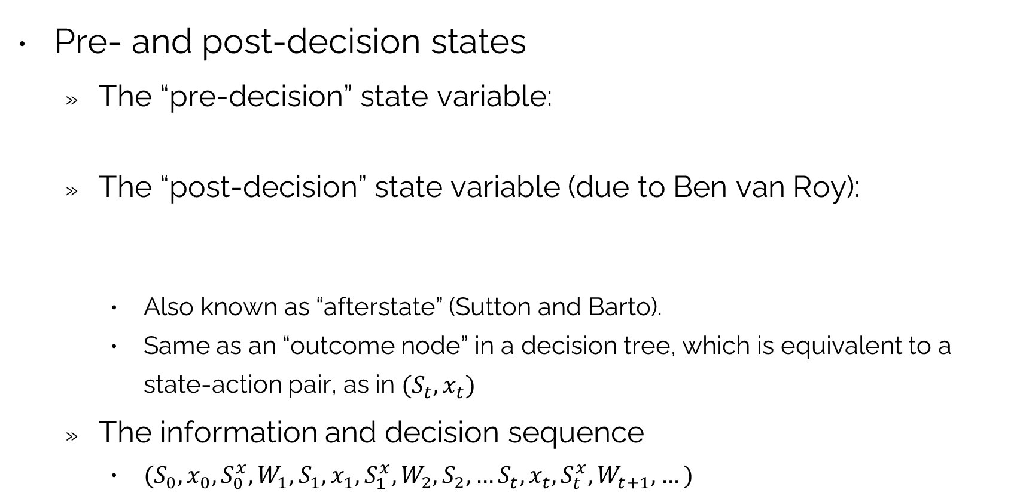
State variables: Pre- and post-decision states
Pre- and post-decision states
The “pre-decision” state variable:
The “post-decision” state variable (due to Ben van Roy):
Also known as “afterstate” (Sutton and Barto).
Same as an “outcome node” in a decision tree, which is equivalent to a state-action pair, as in $(S_{t},x_{t})$
The information and decision sequence
$(S_{0},x_{0},S_{0}^{x},W_{1},S_{1},x_{1},S_{1}^{x},W_{2},S_{2},…S_{t},x_{t},{S_{t}^{x},W}_{t+1},…)$
$$S_{t}=\text{The information required to make a decision }x_{t}$$
$$S_{t}^{x}=\text{The state of what we know immediately after we} \\ \text{ make a decision.}$$

Slide 26

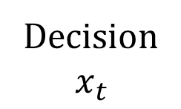
State variables: Pre- and post-decision states
State variables in decision trees
Decision
$$x_{t}$$
Information
$$W_{t+1}$$
Post-decision state are particularly important when using approximate dynamic programming.
Pre-decision
state
Post-decision
state
Pre-decision
state

Slide 27
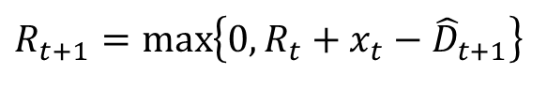
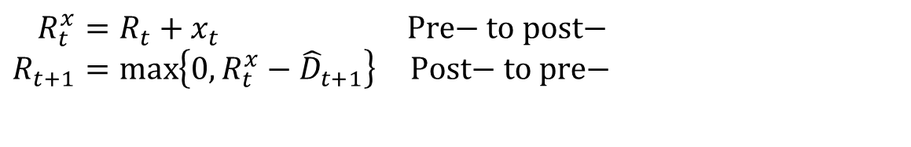
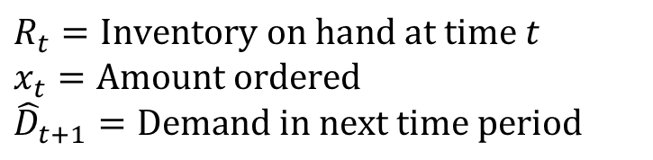
State variables: Pre- and post-decision states
A scalar resource variable:
Our basic inventory equation (water, money, …)
where
Using pre- and post-decision states:
$$R_{t+1}=\max\left\{0,R_{t}+x_{t}−{\hat{D}}_{t+1}\right\}$$
$$R_{t}=\text{Inventory on hand at time }t \\ x_{t}=\text{Amount ordered} \\ {\hat{D}}_{t+1}=\text{Demand in next time period}$$
$$R_{t}^{x}=R_{t}+x_{t} \text{Pre− to post−} \\ R_{t+1}=\max\left\{{0,R}_{t}^{x}−{\hat{D}}_{t+1}\right\}\text{ Post− to pre−}$$

Slide 28
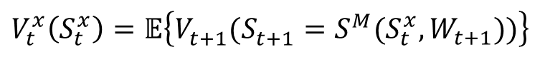
State variables: Pre- and post-decision states
Time-dependent version of Bellman
Pre- to post-decision step
Post- to pre-decision step
$$V_{t}\left(S_{t}\right)=\max_{x_{t}}\left(C\left(S_{t},x_{t}\right)+𝔼\left\{V_{t+1}(S_{t+1})|S_{t},x_{t}\right\}\right)$$
Expectations are a computational nightmare inside an expectation.
$V_{t}\left(S_{t}\right)=\max_{x_{t}}\left(C\left(S_{t},x_{t}\right)+V_{t}^{x}(S_{t}^{x})\right)$ Deterministic optimization problem!
$$V_{t}^{x}\left(S_{t}^{x}\right)=𝔼\left\{V_{t+1}^{}(S_{t+1}^{}=S^{M}(S_{t}^{x},W_{t+1}))\right\}$$
Pure expectation - approximate with Monte-Carlo simulation

Slide 29
OUTLINE
State variables
State variables defined
A network routing problem
Belief state variables
Pre- and post- decision state variables
A sample of state variables

Slide 30
State variables: Examples
Basic inventory, zero lead time (single product)
Inventory with lead times (single product)
Inventory with lead times, dynamic costs and rolling forecasts (single product)
Inventory with lead times, dynamic costs and rolling forecasts (multiple product)
$S_{t}=R_{t}^{inv}=$Inventory on hand at time $t$
$S_{t}=R_{t,t′}^{inv}=$ Inventory that will be available at time $t^{′}=t, t+1, …t+τ$
$S_{t}=\left({(R}_{t,t′}^{inv}),c_{t},(f_{t,t^{′}}^{D})\right)$ for time $t^{′}=t, t+1, …t+τ$
$S_{t}=\left({(R}_{t,t^{′},k}^{inv}),c_{t,k},(f_{t,t^{′},k}^{D})\right)$ for product $k∈𝒦,$ time $t^{′}=t, t+1, …t+τ$

Slide 31
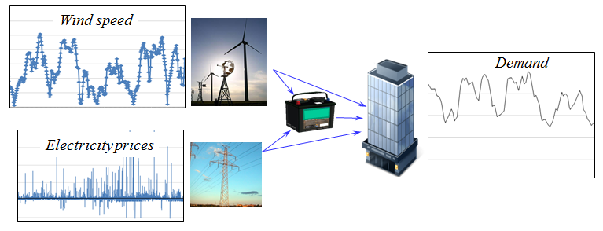
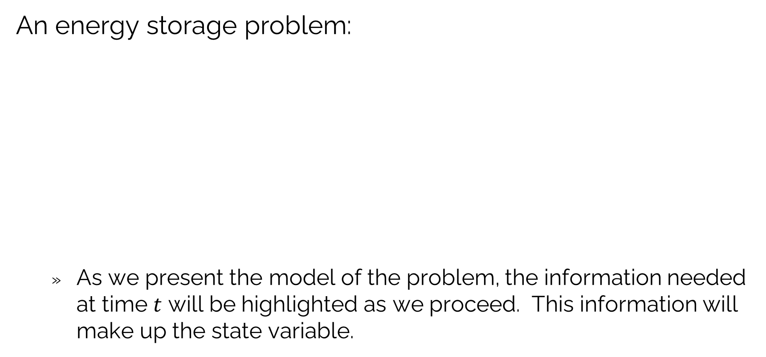
State variables: Examples
An energy storage problem:
As we present the model of the problem, the information needed at time $t$ will be highlighted as we proceed. This information will make up the state variable.
L
E
B
G

Slide 32
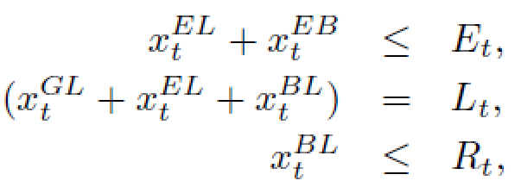
State variables: Examples
Decision variables
Constraints;
L
E
R
G

Slide 33
State variables: Examples
Transition function
L
E
R
G

Slide 34
State variables: Examples
Objective function
L
E
R
G

Slide 35

State variables: Examples
$$S_{t}=(R_{t},E_{t},L_{t},\left(p_{t},p_{t−1},p_{t−2}\right),{\left(f_{tt^{′}}^{L}\right)}_{t^{′}>t})$$
State variables
Cost function
Decision function
Constraints:
Transition function
$$f_{t}^{L}=\text{Needed }\text{in the lookahead}\text{ policy}$$

Slide 36

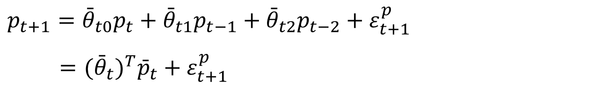

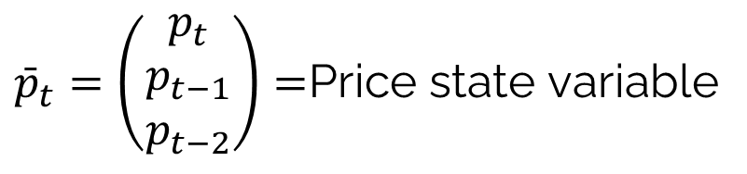
State variables: Examples
Time series modeling
Recursive estimation
System state variable:
$$p_{t+1}={\bar{θ}}_{t0}p_{t}+{\bar{θ}}_{t1}p_{t−1}+{\bar{θ}}_{t2}p_{t−2}+ε_{t+1}^{p}$$
$=({\bar{θ}}_{t})^{T}{\bar{p}}_{t}+ε_{t+1}^{p}$
$$S_{t}=({\bar{p}}_{t},\left({\bar{θ}}_{t},M_{t}\right))$$
Price state variable:
$ε_{t+1}=({\bar{θ}}_{t})^{T}{\bar{p}}_{t}−p_{t+1}$
$${\bar{θ}}_{t+1}={\bar{θ}}_{t}+\frac{1}{γ_{t}}M_{t}{\bar{p}}_{t}ε_{t+1} \\ M_{t+1}=M_{t}−\frac{1}{γ_{t}}M_{t}{\bar{p}}_{t}({\bar{p}}_{t})^{T}M_{t} \\ γ_{t+1}=1−({\bar{p}}_{t})^{T}M_{t}{\bar{p}}_{t}$$
${\bar{p}}_{t}=\left(\begin{matrix}p_{t} \\ p_{t−1} \\ p_{t−2}\end{matrix}\right)=$Price state variable

Slide 37


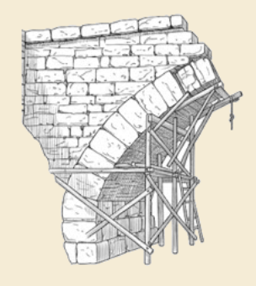
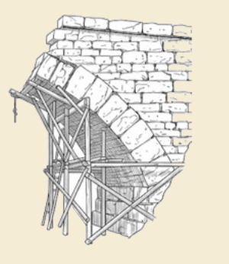
Thank you!
For more information see the Sequential Decision Analytics website at
warrenpowell.org
For more on state variables go to:
warrenpowell.org → Modeling → State variables

