Slide 1

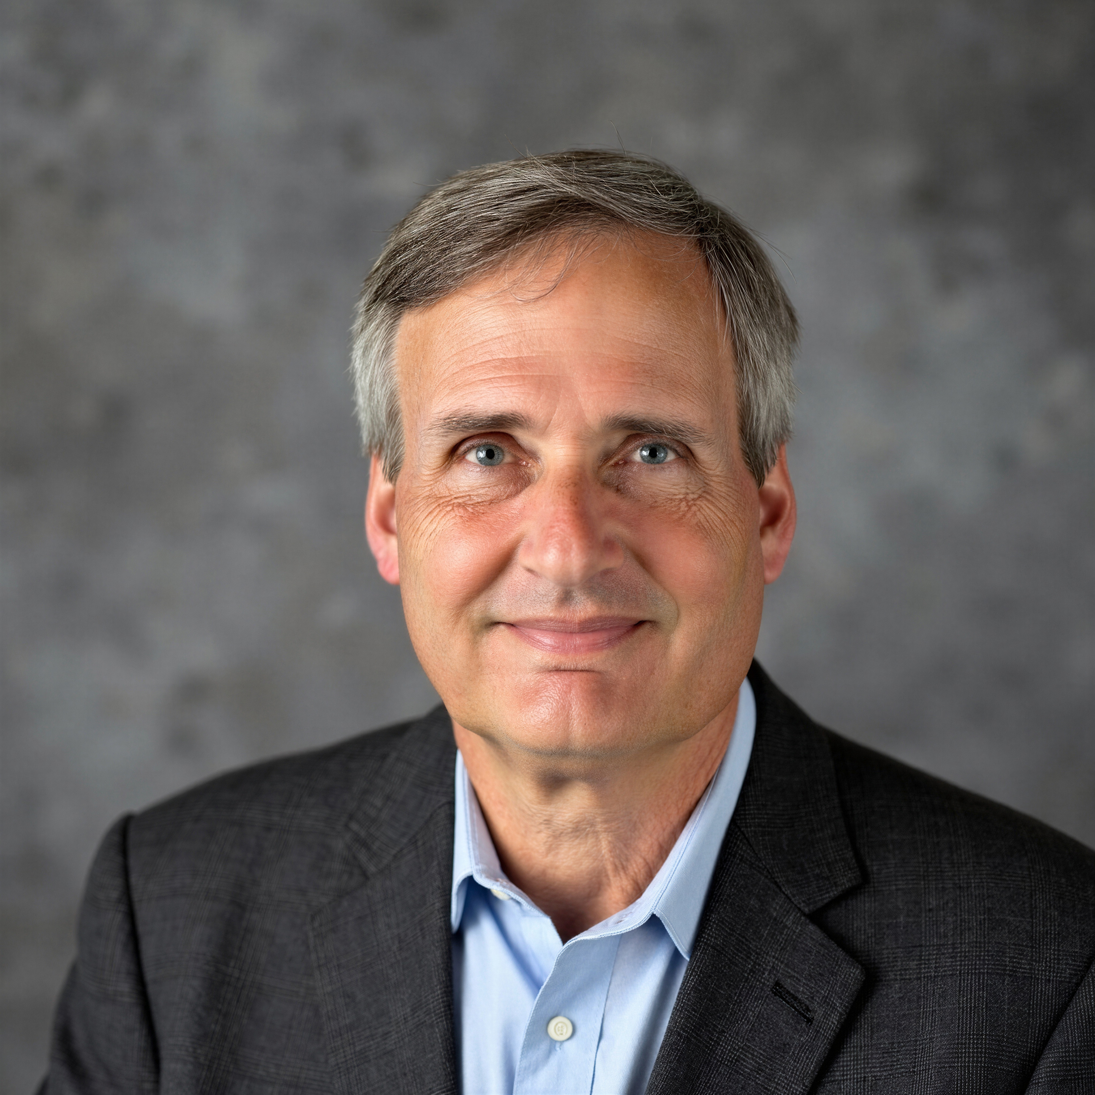
Tutorial Series on Sequential Decision Analytics
Warren B Powell
Professor Emeritus, Princeton University
Recorded: September xx, 2026
Module: Modeling uncertainty – Sequential decision problems have to deal with exogenous information that arrives from outside our “system” (and beyond our control).
Predecessor module(s):
Introduction to sequential decision problems
The universal modeling framework – High level or detailed.
Technical level: Low to moderate

Slide 2

OUTLINE
Modeling uncertainty
Modeling exogenous information
The 12 categories of uncertainty
Different flavors of uncertainty
Generating samples of exogenous information

Slide 3
OUTLINE
Modeling uncertainty
Modeling exogenous information
The 12 categories of uncertainty
Different flavors of uncertainty
Generating samples of exogenous information

Slide 4





Modeling exogenous information
Modeling the flow of information
We start by showing how to model time:
At time t, any variable indexed by $t^{′}≤t$ is known; if t’ > t it is unknown.
Continuous
time
$$W_{1}$$
$$W_{2}$$
$$W_{3}$$
$$W_{3}$$
Discrete
time

Slide 5
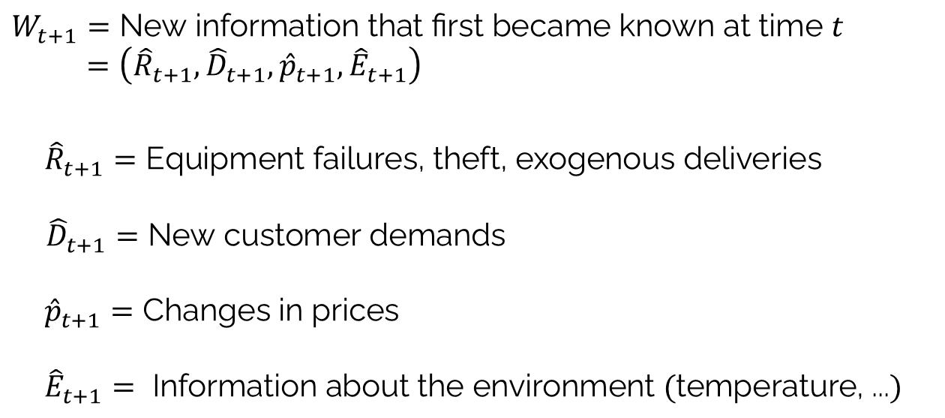
Modeling exogenous information
We write the exogenous information using:
$$W_{t+1}=\text{New information that first became known at time }t \\ =\left({\hat{R}}_{t+1},{\hat{D}}_{t+1},{\hat{p}}_{t+1},{\hat{E}}_{t+1}\right)$$
$${\hat{R}}_{t+1}=\text{E}\text{quipment failures}\text{, theft, exogenous deliveries}$$
${\hat{D}}_{t+1}=\text{New customer demands}$
${\hat{p}}_{t+1}=\text{Changes in prices}$
$${\hat{E}}_{t+1}=\text{ Information about the environment }(\text{temperature, ...})$$
Notes:
248

Slide 6
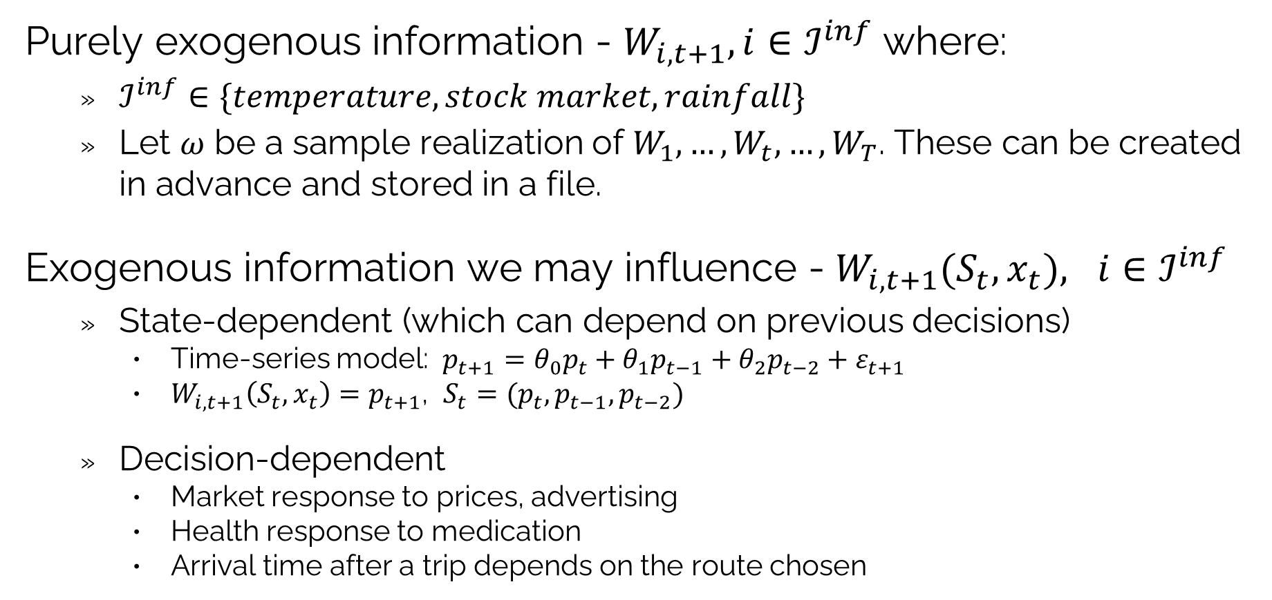
Modeling exogenous information
Purely exogenous information - $W_{i,t+1}, i∈ℐ^{inf}$ where:
$ℐ^{inf}∈\{temperature, stock market, rainfall\}$
Let $ω$ be a sample realization of $W_{1}, …,W_{t},…,W_{T}$. These can be created in advance and stored in a file.
Exogenous information we may influence - $W_{i,t+1}(S_{t},x_{t}), i∈ℐ^{inf}$
State-dependent (which can depend on previous decisions)
Time-series model: $p_{t+1}=θ_{0}p_{t}+θ_{1}p_{t−1}+θ_{2}p_{t−2}+ε_{t+1}$
$W_{i,t+1}\left(S_{t},x_{t}\right)=p_{t+1}$, $S_{t}=(p_{t},p_{t−1},p_{t−2})$
Decision-dependent
Market response to prices, advertising
Health response to medication
Arrival time after a trip depends on the route chosen

Slide 7
Modeling exogenous information
Evolution of knowledge and information
What we know (or believe) at a point in time
The information we control (the decision we make)
Information we do not control (the exogenous information):
Completely beyond human control
Weather, earthquakes, emergence of new diseases
Population behaviors (spread of information, diseases)
Market behavior
Corporate behavior
Decisions made by other people

Slide 8







Modeling exogenous information
Information evolves in three stages:
What we know (or believe) at time $t$.
New information we control, which is the decision we make at time $t$.
New information we do not control, which arrives in the interval $(t,t+1)$.
The only difference between decisions and exogenous information is who controls it.
$S_{t}=$ State of knowledge (what we know or believe)
$x_{t}=$ Decision (using information in $S_{t}$)
$W_{t+1}=$ Exogenous information
$$t$$
$$t+1$$
$$t+2$$

Slide 9



Modeling exogenous information
Information evolves in three stages:
What we know (or believe) at time $t$.
New information we control, which is the decision we make at time $t$.
New information we do not control, which arrives in the interval $(t,t+1)$.
The only difference between decisions and exogenous information is who controls it.
$S_{t+1}=$ State of knowledge (what we know or believe)
$x_{t+1}=$ Decision (using information in $S_{t}$)
$W_{t+2}=$ Exogenous information
$$t$$
$$t+1$$
$$t+2$$

Slide 10
OUTLINE
Modeling uncertainty
Modeling exogenous information
The 12 categories of uncertainty
Different flavors of uncertainty
Generating samples of exogenous information

Slide 11
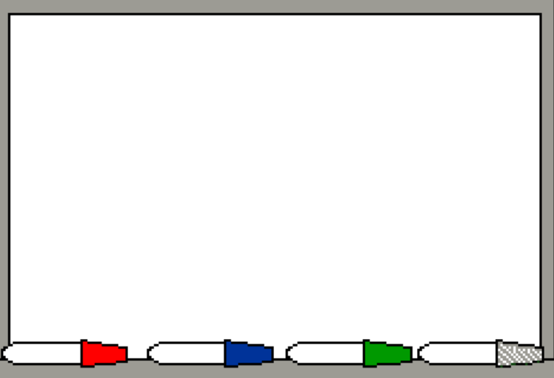
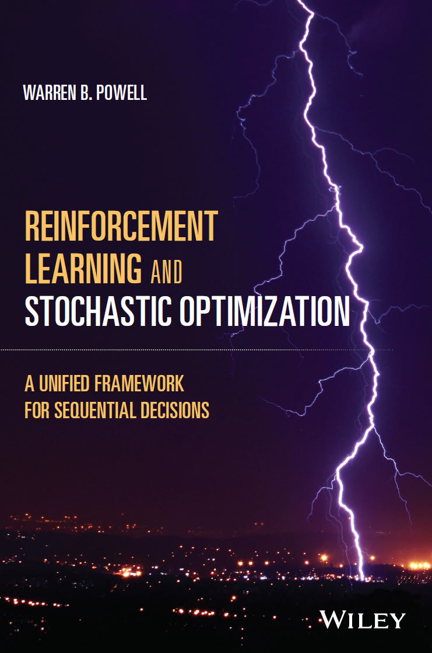
The 12 categories of uncertainty
We have to identify the different classes of uncertainty:
Language of models
Language of the problem domain
Suppliers:
Daily production, yield
Future commitments
Delivery times
Costs
Market/customers
Orders, returns
Price paid
Service requirements
Personnel
Availability
Departures, hiring
Performance
Equipment
Up-time, failures
Productivity
Network
Transit times
Weather, earthquakes
12 classes of uncertainty
Observational errors
Exogenous uncertainty
Prognostic uncertainty
Inferential uncertainty
Experimental uncertainty
Model uncertainty
Transitional uncertainty
Implementation uncertainty
Communication errors
Algorithmic uncertainty
Goal uncertainty
Environmental uncertainty
Chapter 10

Slide 12
The 12 categories of uncertainty
12 Classes of uncertainty
Observational uncertainty
Exogenous uncertainty
Prognostic uncertainty
Inferential uncertainty
Experimental variability
Model uncertainty
Transitional uncertainty
Implementation uncertainty
Communication errors
Algorithmic instability
Goal uncertainty
Environmental uncertainty
Chess
Opponent behavior

Slide 13
The 12 categories of uncertainty
12 Classes of uncertainty
Observational uncertainty
Exogenous uncertainty
Prognostic uncertainty
Inferential uncertainty
Experimental variability
Model uncertainty
Transitional uncertainty
Implementation uncertainty
Communication errors
Algorithmic instability
Goal uncertainty
Environmental uncertainty
Mutual fund cash management
Deposits, redemptions, markets
Forecasts of deposits, redempt.
Performance of different policies
Updating cash on hand
Max. returns, min. stock sales
Changes in interest rates

Slide 14
The 12 categories of uncertainty
12 Classes of uncertainty
Observational uncertainty
Exogenous uncertainty
Prognostic uncertainty
Inferential uncertainty
Experimental variability
Model uncertainty
Transitional uncertainty
Implementation uncertainty
Communication errors
Algorithmic instability
Goal uncertainty
Environmental uncertainty
Supply chain management
Measuring inventory
Market demand
Forecasting
Market response to price
Test market variations
Modeling spread of information
Updating inventories
Failure to follow instructions
Incorrect instructions
Variations in optimal solution
Differences in service priority
Changes in tariffs

Slide 15
The 12 categories of uncertainty
12 Classes of uncertainty
Observational uncertainty
Exogenous uncertainty
Prognostic uncertainty
Inferential uncertainty
Experimental variability
Model uncertainty
Transitional uncertainty
Implementation uncertainty
Communication errors
Algorithmic instability
Goal uncertainty
Environmental uncertainty
Electric power grid operation
Observing voltages
Wind and cloud cover
Weather forecasting
Generator response to signals
Simulation errors
Model of voltages
Generator outputs
Failure to follow instructions
Incorrect instructions
Variations solving large IP
Minimizing cost vs. buffers
Focus on green energy

Slide 16
The 12 categories of uncertainty
12 Classes of uncertainty
Observational uncertainty
Exogenous uncertainty
Prognostic uncertainty
Inferential uncertainty
Experimental variability
Model uncertainty
Transitional uncertainty
Implementation uncertainty
Communication errors
Algorithmic instability
Goal uncertainty
Environmental uncertainty
Public health
What are infection rates
Mutations of the virus
Forecasting prevalent flu this fall
Estimating transmission rates
Testing dosages
Modeling spread of disease
Actual disease transitions
Failure to get vaccinated
Lack of clarity in instructions
Variations in algorithmic results
Minimize infections? Costs?
Changing policies on vaccinations

Slide 17
OUTLINE
Modeling uncertainty
Modeling exogenous information
The 12 categories of uncertainty
Different flavors of uncertainty
Generating samples of exogenous information

Slide 18
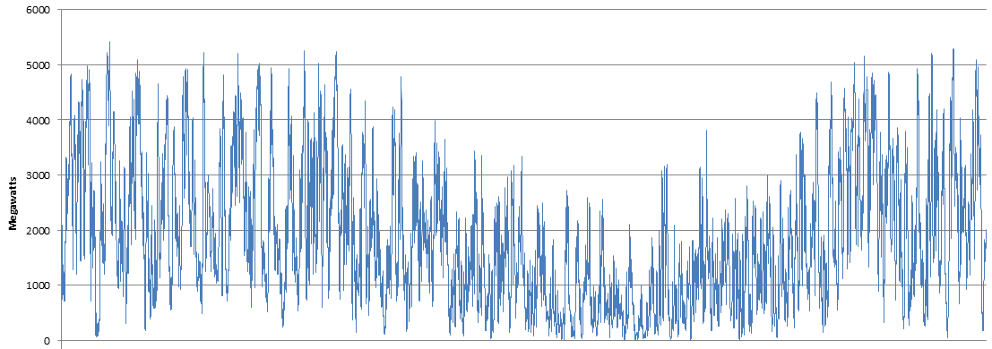
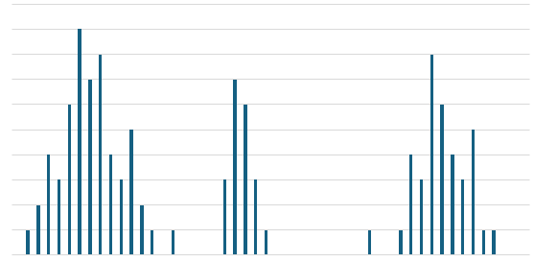
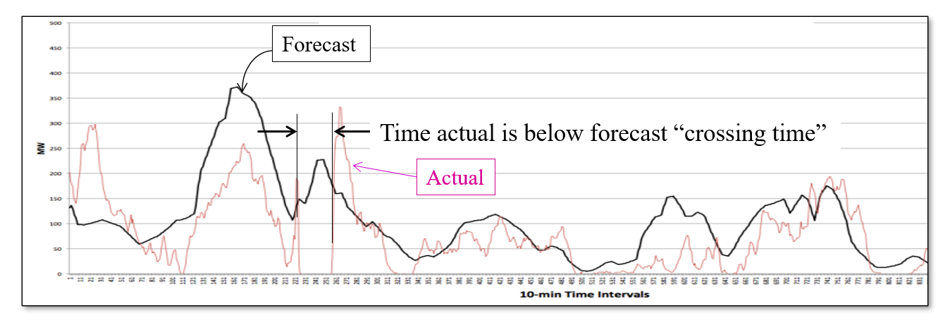
Different flavors of uncertainty
The behaviors of information processes
Hourly-daily variations in demands, prices, …
Bursts, spikes, intermittent demands …
Periodic changes from market shifts, competitive behavior, …
Regional events (political, regulatory, weather, earthquakes, disease)
Systemic events (cyber attacks, public perception, tariffs)
Black swan events
Contingencies of events that might happen, but have not happened in the past.

Slide 19
Different flavors of uncertainty
Correlations over time
Temporal correlations typically reflect depends on unobservable processes.
The graph to the right showing energy from a wind farm reflects unobservable shifts in high- and low-pressure systems.
Since wind energy is not affected by decisions, we can use samples from history to run simulations.
We can also use the idea of “hidden state variables” to model the dynamics of unobservable processes.
Energy from a wind farm

Slide 20
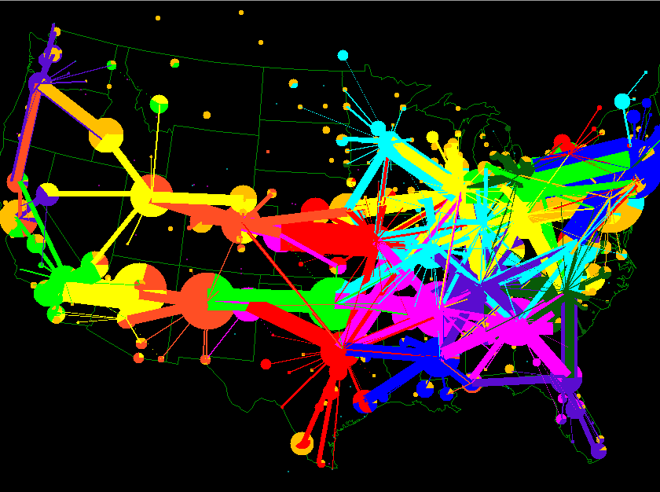
Different flavors of uncertainty
Correlations over space
Spatial flows reflect population densities, manufacturing centers, as well as shipping locations like ports.
Consumption patterns can reflect incomes which tend to fall in geographical clusters.
Activities also reflect weather which depends on latitude, proximity to oceans, and the presence of mountains and rivers.

Slide 21
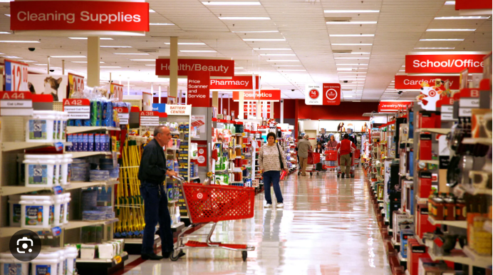
Different flavors of uncertainty
Correlations over attributes
Activities can be described by a vector of attributes, such as purchases of retail goods.
Every item can be organized by high level attributes (clothing, food, household, hardware, sports, toys, …), followed by more specialized attributes.
Seasonal patterns will drive demands for entire product classes creating correlations by attributes.

Slide 22
OUTLINE
Modeling uncertainty
Modeling exogenous information
The 12 categories of uncertainty
Different flavors of uncertainty
Generating samples of exogenous information

Slide 23
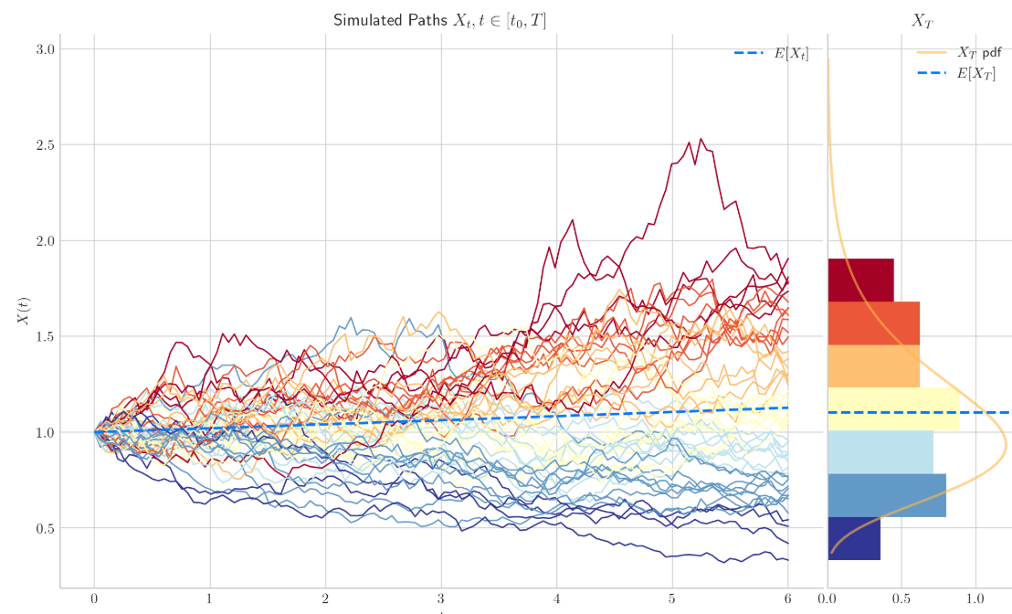
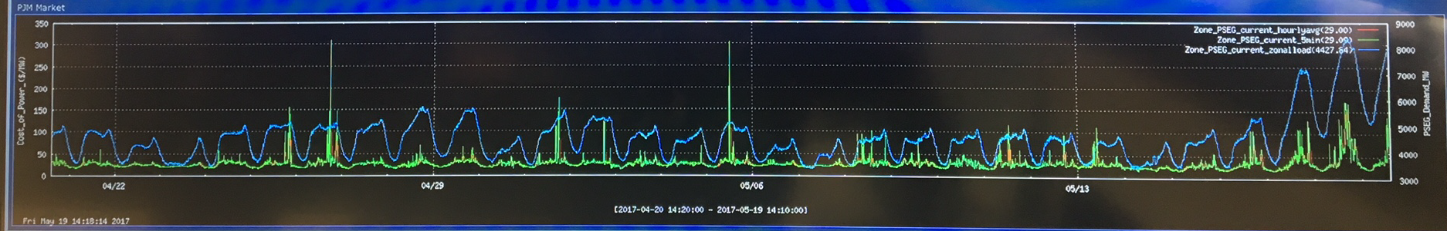
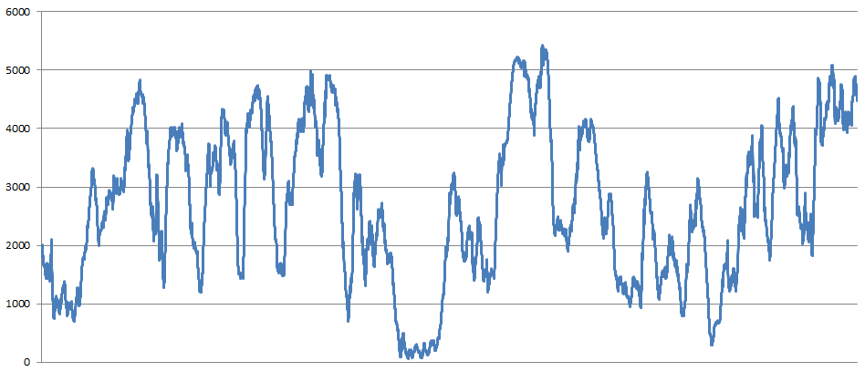
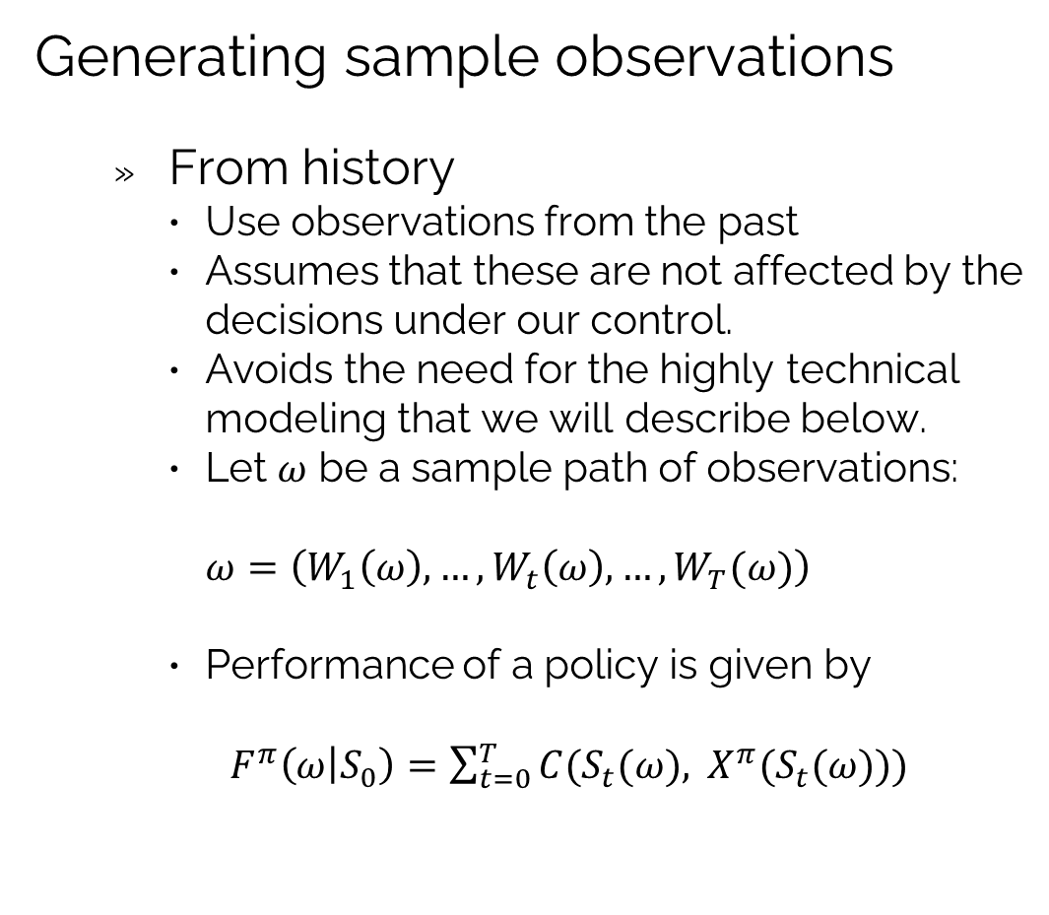
Generating samples of exogenous information
Generating sample observations
From history
Use observations from the past
Assumes that these are not affected by the decisions under our control.
Avoids the need for the highly technical modeling that we will describe below.
Let $ω$ be a sample path of observations:
$$ω=\left(W_{1}\left(ω\right),…,W_{t}\left(ω\right),…,W_{T}(ω)\right)$$
Performance of a policy is given by
$F^{π}\left(ω | S_{0}\right)=\sum_{t=0}^{T}{C(S_{t}(ω), X^{π}(S_{t}(ω))) }$
Stock prices
Electricity prices
Energy from windfarm

Slide 24
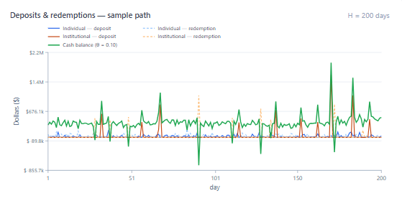
Generating samples of exogenous information
Generating sample observations
Learning while doing
Optimize in the field as decisions are being made, as a mutual fund manager would do to determine how much cash to keep on hand for redemptions (see video):
https://tinyurl.com/LearningWhileDoing/
No modeling of the exogenous information process is required.
Very slow – it takes a day to observe a day
Mistakes are made in the field, so you have to experience poor decisions.
Institutional deposits/redemptions
Cash balance

Slide 25
Generating samples of exogenous information
Generating sample observations
Create samples from a model
Requires creating a mathematical model that captures actual behaviors
Allows us to capture the effect of state/decision on observations
We can also create thousands of samples, making it possible to study the effect of rare or infrequent events.
… but
Information processes can be incredibly subtle.
There are complex behaviors over time…
… and complex correlations over space and parallel information processes (e.g. sales of similar products, performance of related drugs, the yield of competing manufacturing processes).

Slide 26
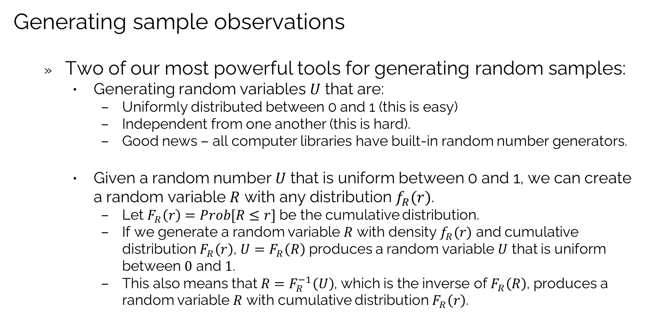
Generating samples of exogenous information
Generating sample observations
Two of our most powerful tools for generating random samples:
Generating random variables $U$ that are:
Uniformly distributed between 0 and 1 (this is easy)
Independent from one another (this is hard).
Good news – all computer libraries have built-in random number generators.
Given a random number $U$ that is uniform between 0 and 1, we can create a random variable $R$ with any distribution $f_{R}(r)$.
Let $F_{R}\left(r\right)=Prob[R≤r]$ be the cumulative distribution.
If we generate a random variable $R$ with density $f_{R}(r)$ and cumulative distribution $F_{R}\left(r\right)$, $U=F_{R}\left(R\right)$ produces a random variable $U$ that is uniform between $0$ and $1$.
This also means that ${R=F}_{R}^{−1}\left(U\right)$, which is the inverse of $F_{R}\left(R\right)$, produces a random variable $R$ with cumulative distribution $F_{R}\left(r\right)$.

Slide 27
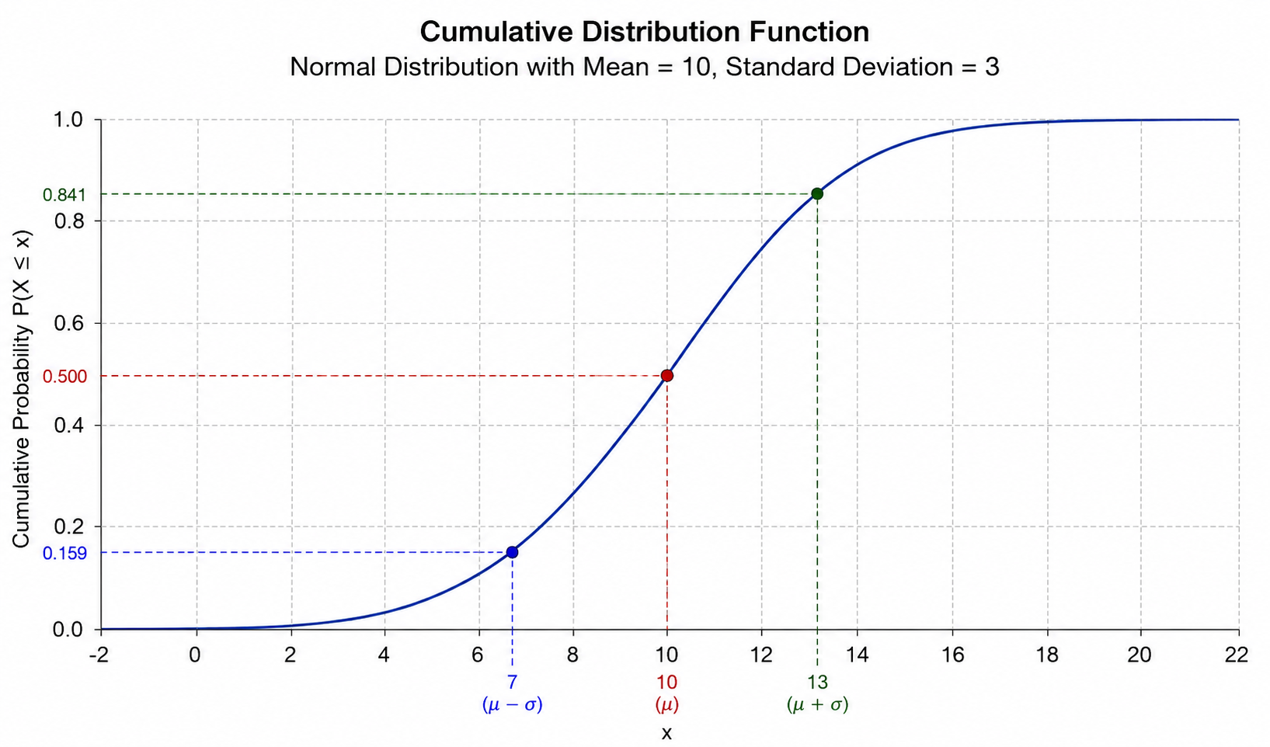
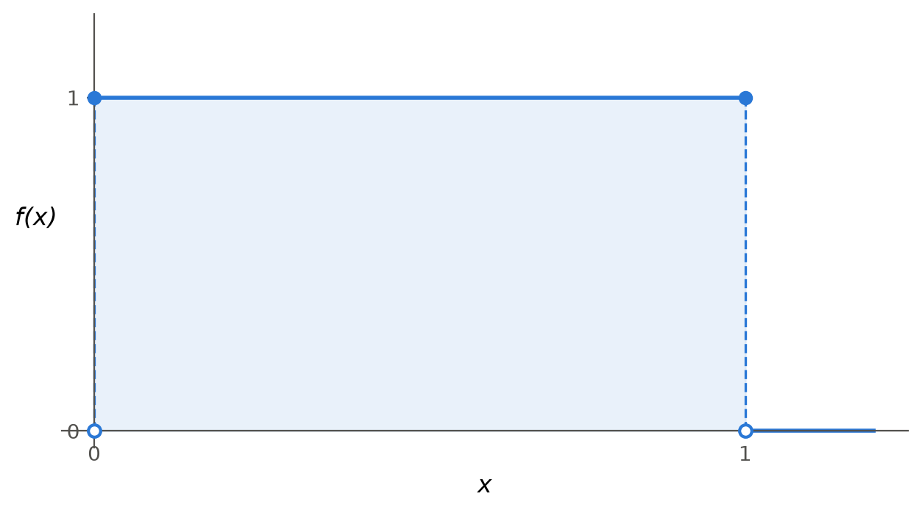
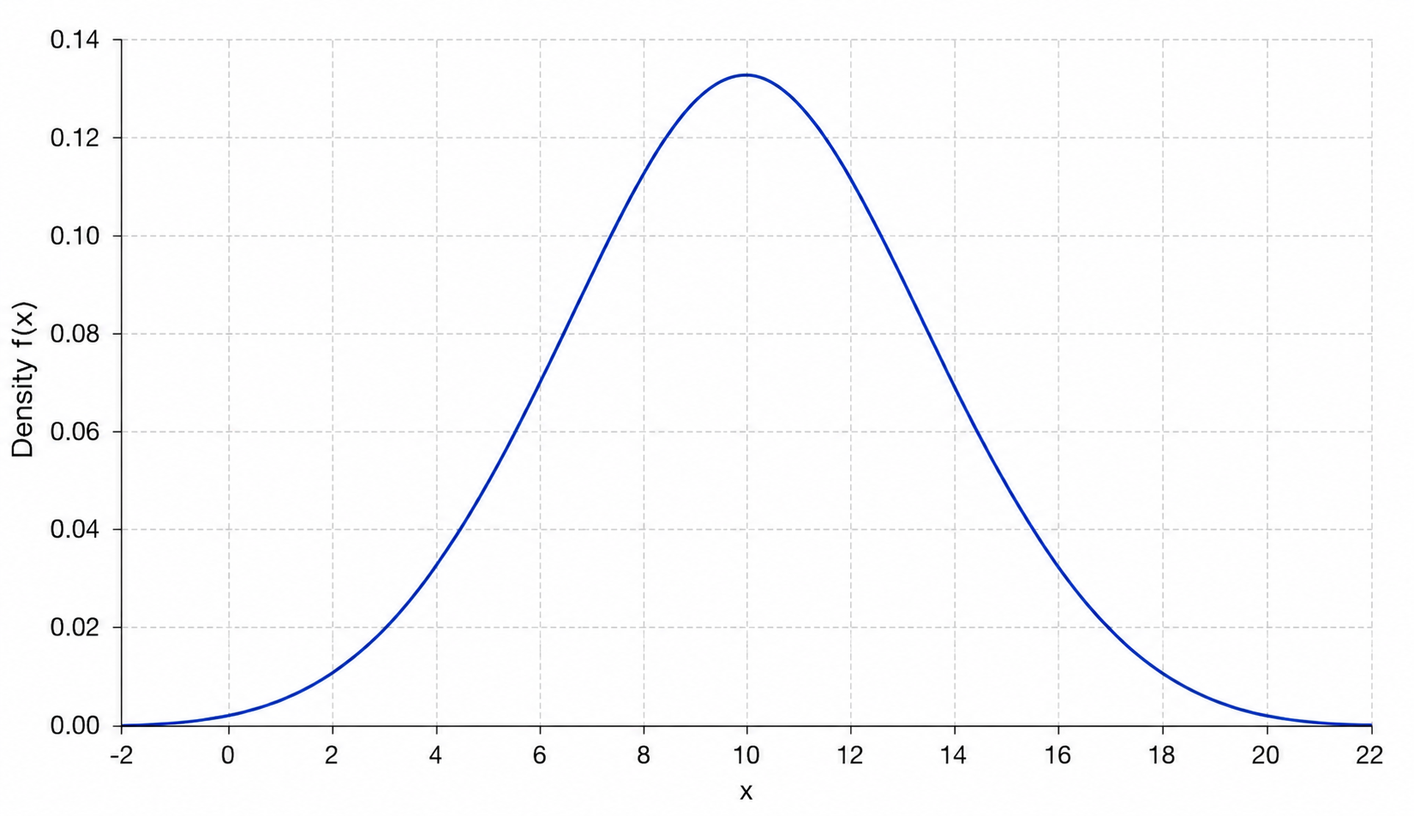
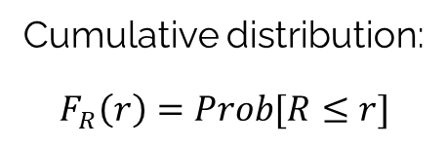
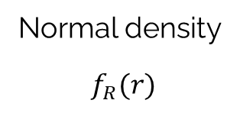
Generating samples of exogenous information
Generating sample observations
Cumulative distribution:
$$F_{R}\left(r\right)=Prob[R≤r]$$
Uniform [0,1] density.
Normal density
$$f_{R}(r)$$

Slide 28
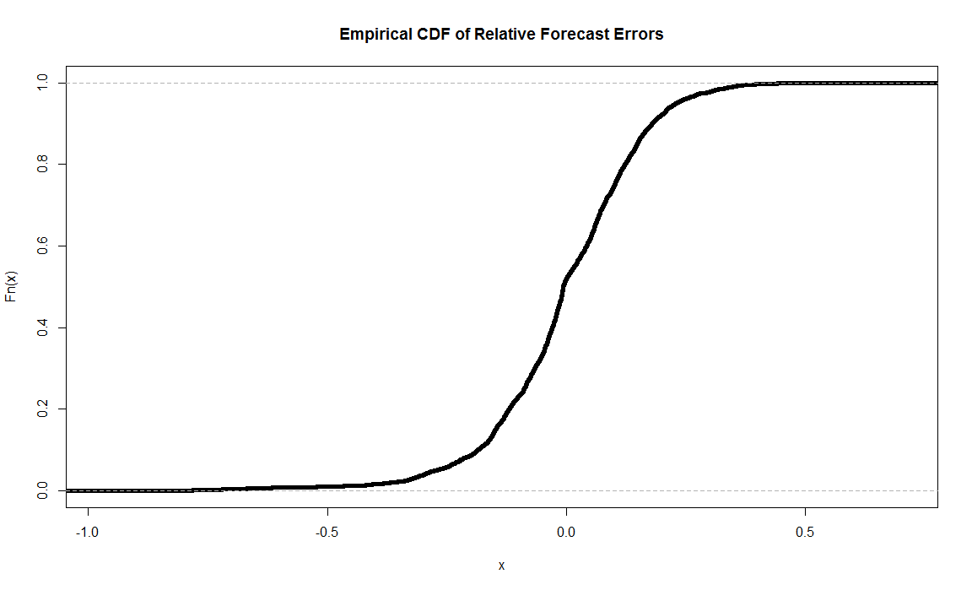
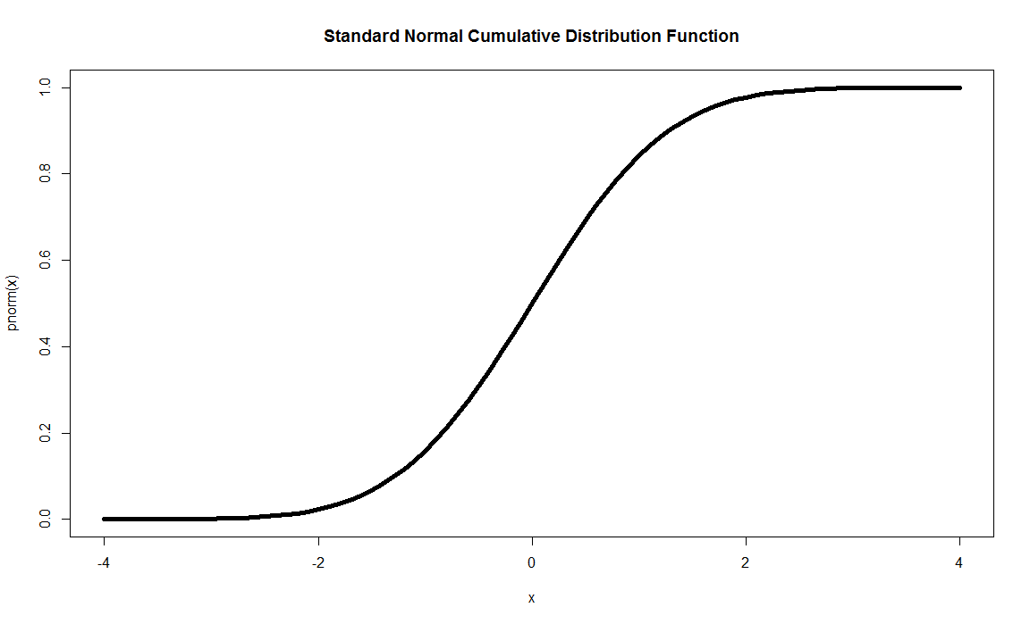
Generating samples of exogenous information
We can use this idea to transform any random variables
We can transform any random variable to a uniform, and then transform the generated uniform random variable to normal… and back again.
Historical cumulative distn
Standard normal distn
1.0
1.0
Uniform distribution.
0.0
0.0
Observed random variable (any distribution)
Standard normal deviate Z

Slide 29
Generating samples of exogenous information
We can use this idea to transform any random variables
We can transform any random variable to a uniform, and then transform the generated uniform random variable to normal… and back again.
Historical cumulative distn
Standard normal distn
1.0
1.0
Uniform distribution.
0.0
0.0
Observed random variable (any distribution)
Standard normal deviate Z

Slide 30
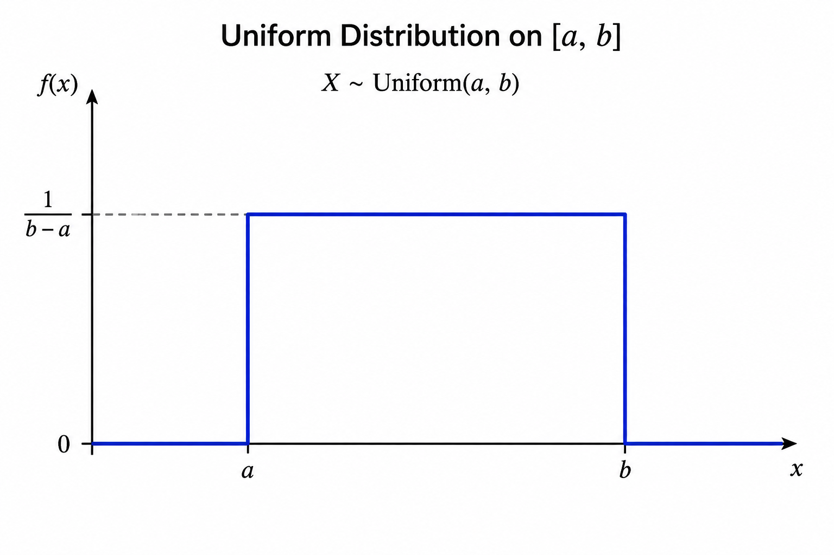
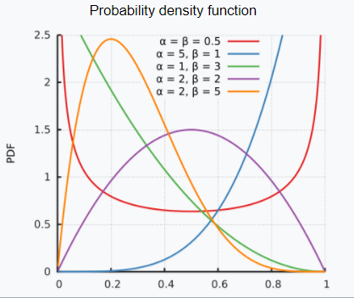

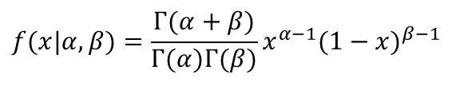



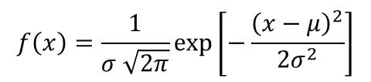
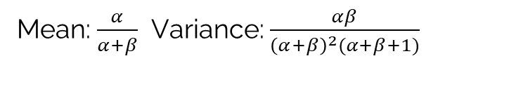

Generating samples of exogenous information
There are two popular ways of creating distributions
Parametric distributions
Normal distribution
Uniform distribution
Beta distribution
$$f\left(x\right)=\frac{1}{σ \sqrt{2π}}exp⁡\left[−\frac{{\left(x−μ\right)}^{2}}{2σ^{2}}\right]$$
Mean: $μ$, Variance: $σ^{2}$
$f\left(x\right)=\frac{1}{b−a}$ $a≤x≤b$
$$a$$
$$b$$
Mean: $\frac{a+b}{2}$, Variance: $\frac{{\left(b−a\right)}^{2}}{12}$
$$f(x|α,β)=\frac{Γ(α+β)}{Γ(α)Γ(β)}x^{α−1}(1−x)^{β−1}$$
Mean: $\frac{α}{α+β}$ Variance: $\frac{αβ}{{\left(α+β\right)}^{2}(α+β+1)}$

Slide 31
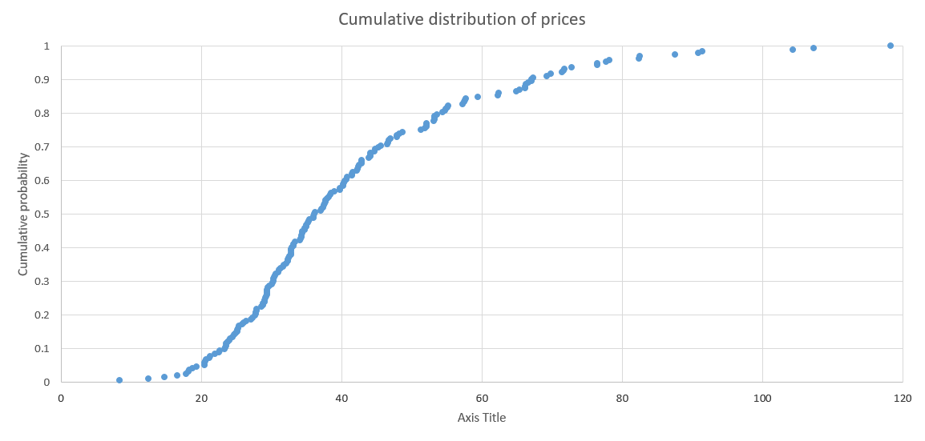


Generating samples of exogenous information
There are two popular ways of creating distributions
Empirical cumulative distributions:
Collect observations in a spreadsheet
Sort the data from smallest to largest
Count the observations in order of their values.
Compute fraction of observations that are equal to or smaller than a chosen observation.
This is known as an empirical cumulative distribution.
$$U=0.7$$
$$R=44$$

Slide 32
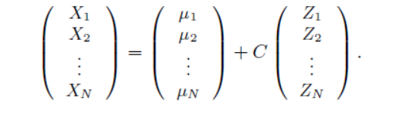
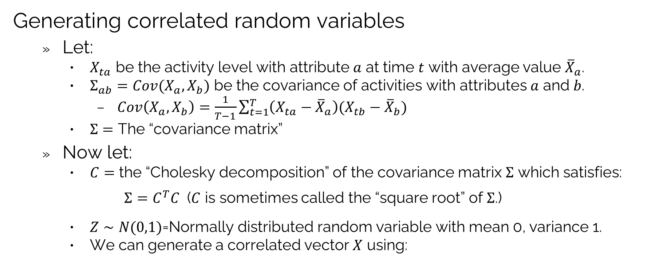
Generating samples of exogenous information
Generating correlated random variables
Let:
$X_{ta}$ be the activity level with attribute $a$ at time $t$ with average value ${\overline{X}}_{a}$.
$Σ_{ab}=Cov(X_{a},X_{b})$ be the covariance of activities with attributes $a$ and $b$.
$Cov\left(X_{a},X_{b}\right)=\frac{1}{T−1}\sum_{t=1}^{T}{\left(X_{ta}−{\overline{X}}_{a}\right)(X_{tb}−{\overline{X}}_{b})}$
$Σ=$ The “covariance matrix”
Now let:
$C=$ the “Cholesky decomposition” of the covariance matrix $Σ$ which satisfies:
$Σ=C^{T}C$ ($C$ is sometimes called the “square root” of $Σ$.)
$Z∼N(0,1)$=Normally distributed random variable with mean 0, variance 1.
We can generate a correlated vector $X$ using:

Slide 33
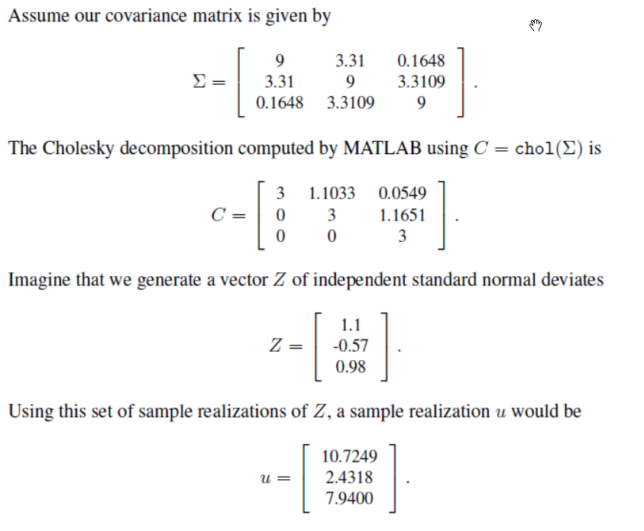

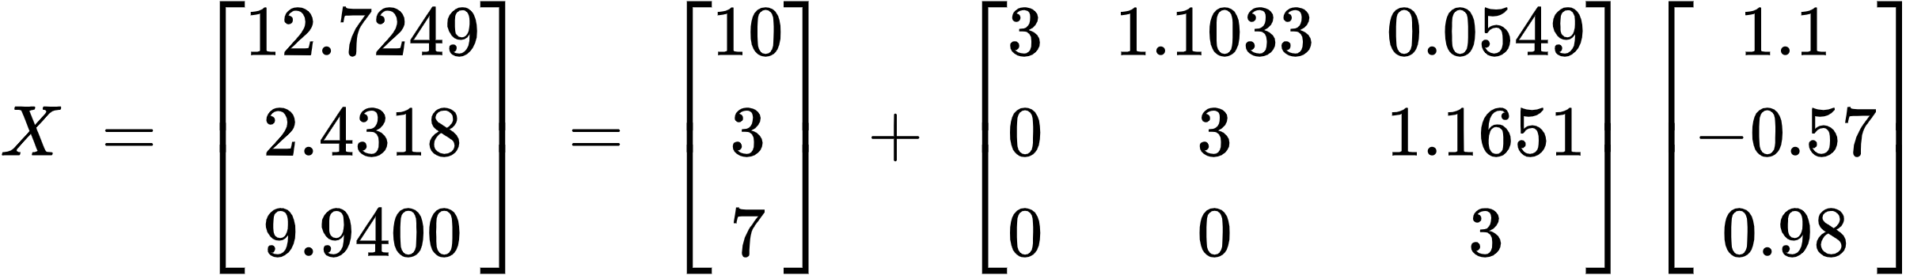
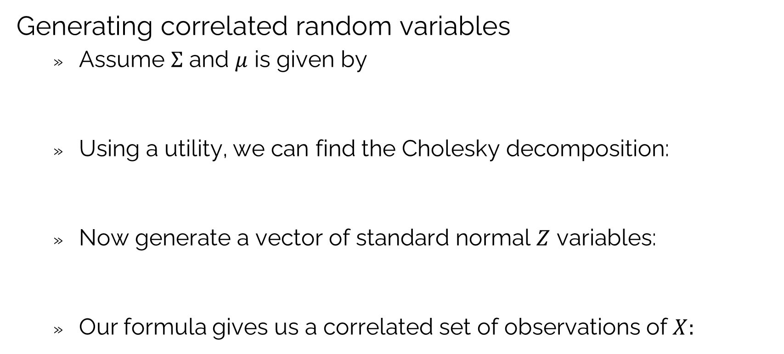
Generating samples of exogenous information
Generating correlated random variables
Assume $Σ$ and $μ$ is given by
Using a utility, we can find the Cholesky decomposition:
Now generate a vector of standard normal $Z$ variables:
Our formula gives us a correlated set of observations of $X:$

Slide 34
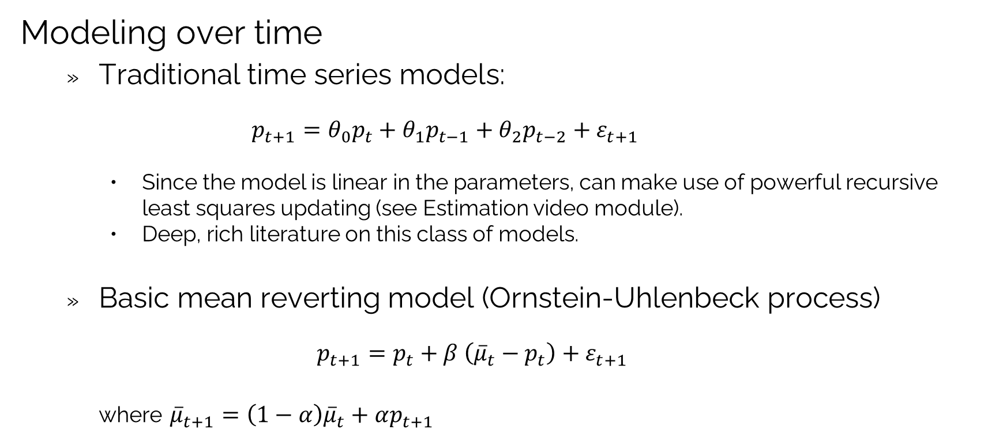
Generating samples of exogenous information
Modeling over time
Traditional time series models:
$$p_{t+1}=θ_{0}p_{t}+θ_{1}p_{t−1}+θ_{2}p_{t−2}+ε_{t+1}$$
Since the model is linear in the parameters, can make use of powerful recursive least squares updating (see Estimation video module).
Deep, rich literature on this class of models.
Basic mean reverting model (Ornstein-Uhlenbeck process)
$$p_{t+1}=p_{t}+β \left({\overline{μ}}_{t}−p_{t}\right)+ε_{t+1}$$
where ${\overline{μ}}_{t+1}=\left(1−α\right){\overline{μ}}_{t}+αp_{t+1}$

Slide 35
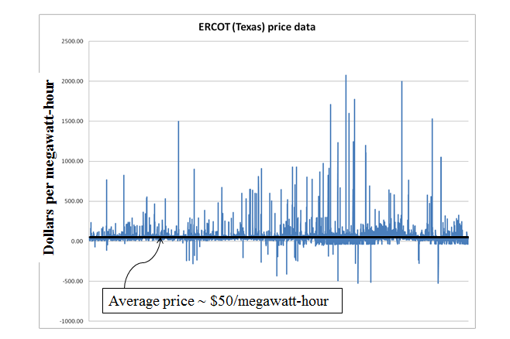
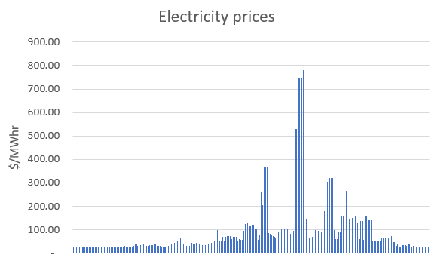
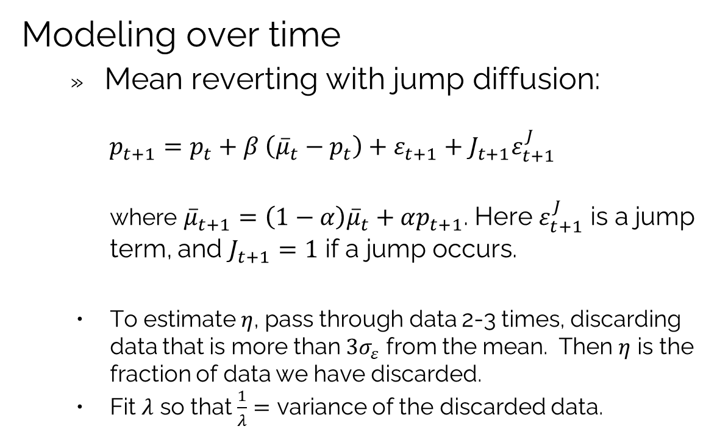
Generating samples of exogenous information
Modeling over time
Mean reverting with jump diffusion:
$$p_{t+1}=p_{t}+β \left({\overline{μ}}_{t}−p_{t}\right)+ε_{t+1}+J_{t+1}ε_{t+1}^{J}$$
where ${\overline{μ}}_{t+1}=\left(1−α\right){\overline{μ}}_{t}+αp_{t+1}$. Here $ε_{t+1}^{J}$ is a jump term, and $J_{t+1}=1$ if a jump occurs.
To estimate $η$, pass through data 2-3 times, discarding data that is more than $3σ_{ε}$ from the mean. Then $η$ is the fraction of data we have discarded.
Fit $λ$ so that $\frac{1}{λ}=$ variance of the discarded data.

Slide 36
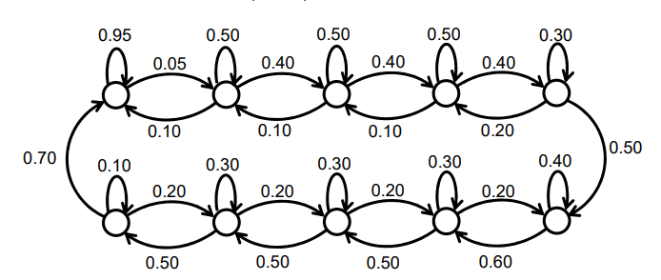
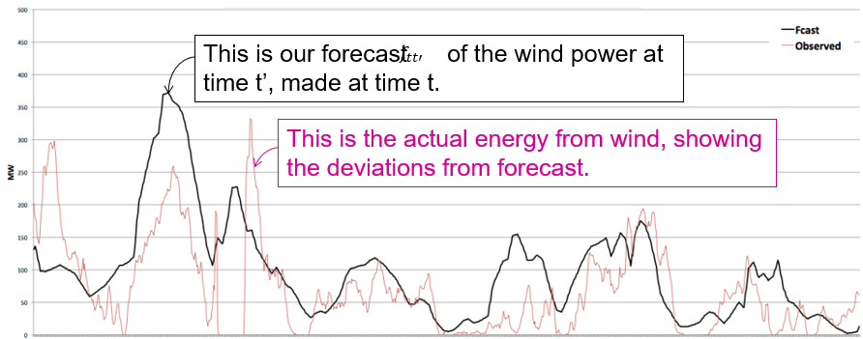
Generating samples of exogenous information
Hidden state variables
Complex behaviors over time typically reflect unobservable processes.
We can handle this by modeling the evolution of a “hidden state” which would change the behavior of a process.
Transitions for hidden state

Slide 37


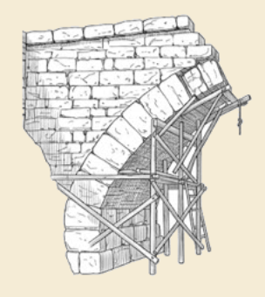
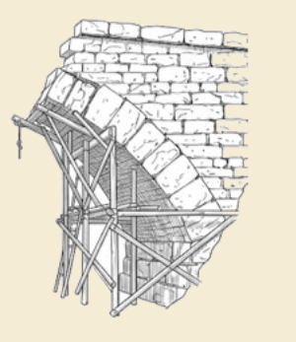
Thank you!
For more information see the Sequential Decision Analytics website at
warrenpowell.org
For more on policies go to:
warrenpowell.org → Modeling → Modeling uncertainty

