Slide 1


Tutorial Series on Sequential Decision Analytics
Warren B Powell
Professor Emeritus, Princeton University
Recorded: August 12, 2026
Module: Designing policies (overview) – This is a high level overview of the four classes of policies.
Predecessor module(s):
Introduction to sequential decision problems
The universal modeling framework – High level or detailed.
There is a brief reference to material in estimation methods.
Technical level:

Slide 2

Designing policies I - Overview
What is a policy?
A policy is a method that makes a decision using the information in the state variable.
… any method.
Notes:
We have to start by describing what we mean by a policy.

Slide 3
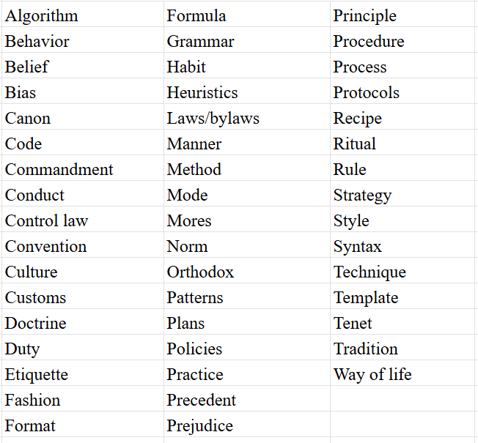
Designing policies I - Overview
Policies and the English language
http://tinyurl.com/policiesanddecisions

Slide 4
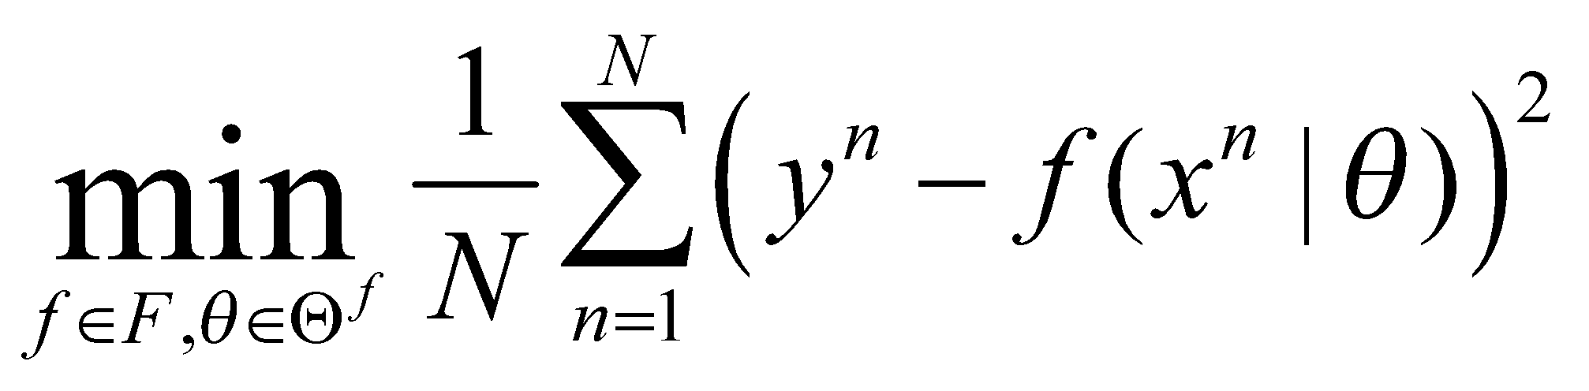
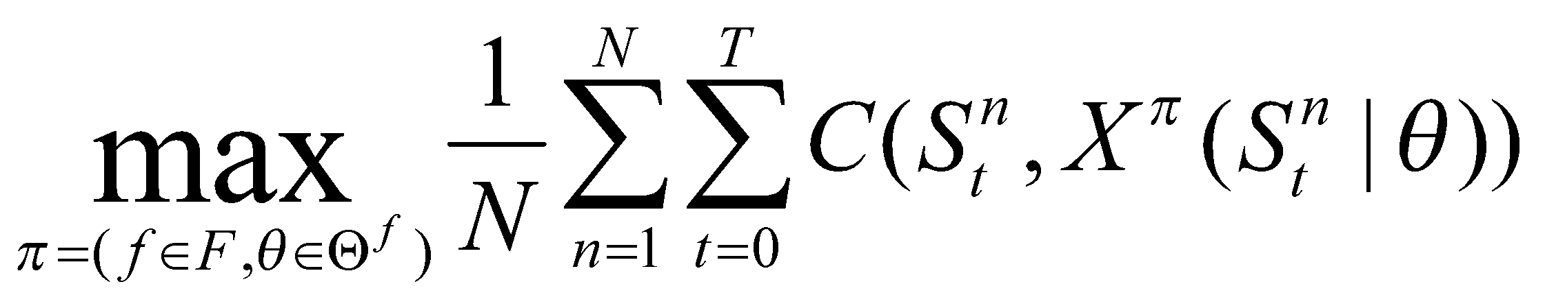
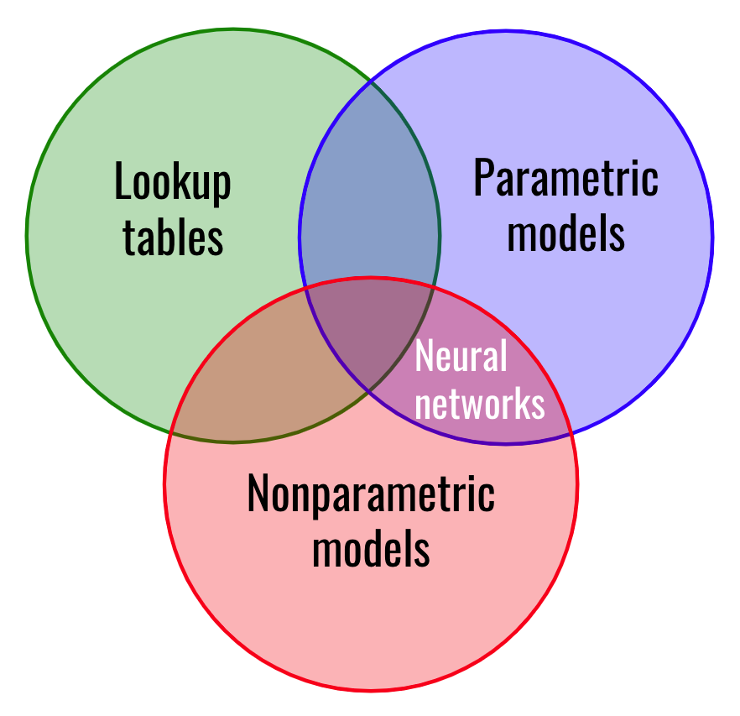

Designing policies I - Overview
Machine learning
Sequential decisions
$$S_{t+1}=S^{M}(S_{t},x_{t},W_{t+1})$$
Searching over functions
“Big dataset”
Searching over policies
System model
How do we search over policies?

Slide 5
Designing policies I - Overview
There are two fundamental strategies for designing policies
Policy search – Search over a class of methods for making decisions to optimize some metric over time.
» Finding the best class of policy.
» Finding the best policy within the class.
Lookahead approximations – Approximate the impact of a decision now on the future.
» The contribution from the first period, plus
» An approximation of the sum of contributions in future time periods resulting from the first decision.

Slide 6
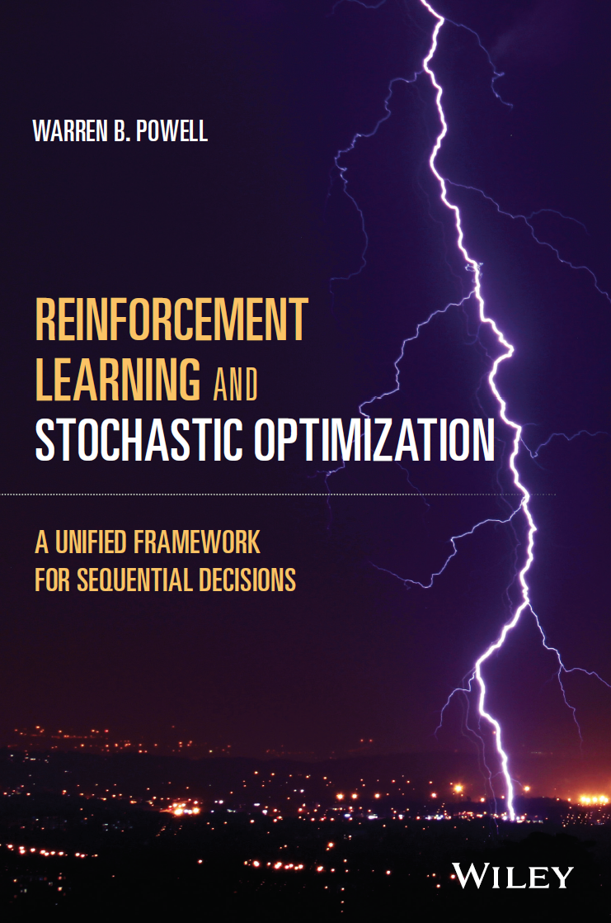
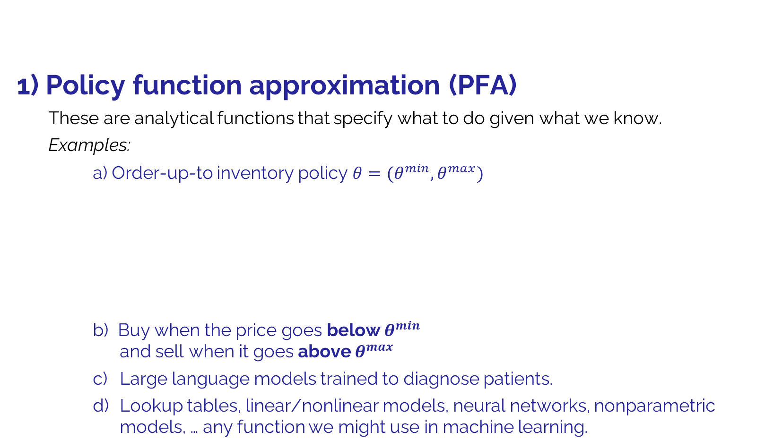

Designing policies I - Overview
1) Policy function approximation (PFA)
These are analytical functions that specify what to do given what we know.
Examples:
a) Order-up-to inventory policy $θ=(θ^{min},θ^{max})$
b) Buy when the price goes below $θ^{min}$ and sell when it goes above $θ^{max}$
c) Large language models trained to diagnose patients.
d) Lookup tables, linear/nonlinear models, neural networks, nonparametric models, … any function we might use in machine learning.
$$θ^{max}$$
$$θ^{min}$$
Chapter 12

Slide 7
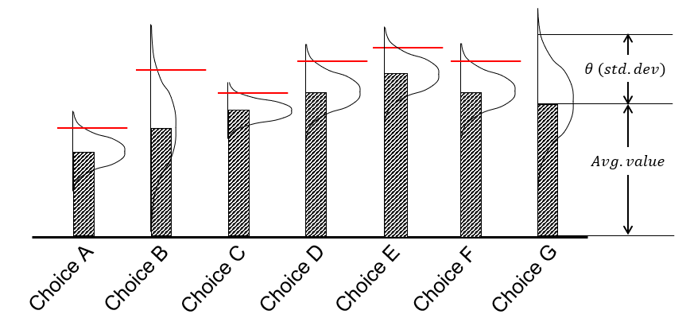
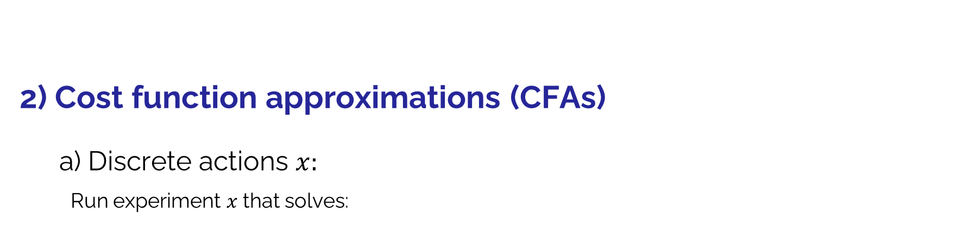
Designing policies I - Overview
2) Cost function approximations (CFAs)
a) Discrete actions $x:$
Run experiment $x$ that solves:
Discrete actions:
Type of drug
Supplier
Trading policy (finance)
Product design
Battery technology
Price (discretized)
Web page design
Product to advertise
Location for a clinic
Diameter of silicon wafer
Financial trading policy
Advertising channel
Choice of manager
“Uncertainty bonus”
$$X^{UCB}\left(S^{n}|θ\right)=\underset{x}{arg max}{(Est. value_{x}^{n}+θ⋅Std dev_{x}^{n})}$$
Optimization problem

Slide 8
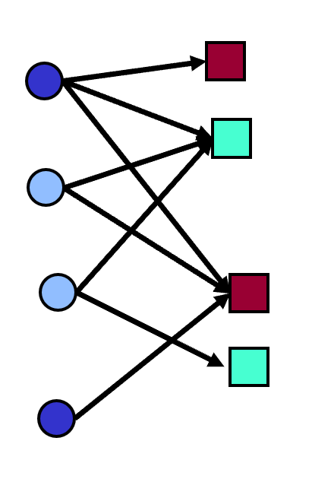



Designing policies I - Overview
2) Cost function approximations (CFAs)
b) Vector decisions $x$ - Our policy is a parameterized LP/MILP/NLP:
$$\underset{}{X^{π}\left(S_{t}\right)=\underset{x}{argmin}}{cx}$$
$$Ax=b$$
$$x≥0$$
$$\underset{}{X^{π}\left(S_{t}|θ\right)=arg\min_{x}}{c(θ)x}$$
$$A(θ)x=b(θ)$$
$$x≥0$$
Chapter 13
Deterministic optimization models can be parameterized to work well over time, under uncertainty.

Slide 9
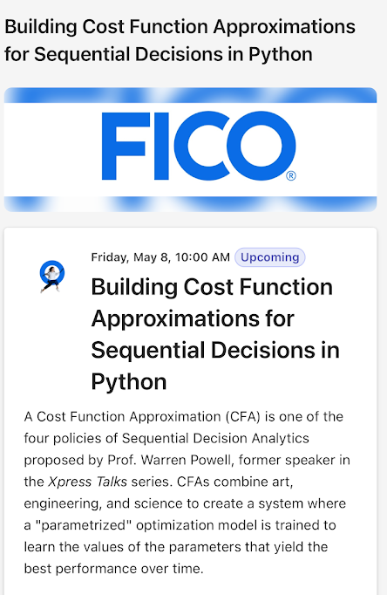
Designing policies I - Overview
2) Cost function approximations (CFAs)
b) CFA policies in industry:
Airlines optimizing schedules with schedule slack to handle weather uncertainty.
Manufacturers using buffer stocks to hedge against production delays and quality problems.
Grid operators scheduling extra generation capacity in case of outages.
These are all parameterized versions of deterministic optimization models introduced earlier.

Slide 10
Designing policies I - Overview
There are two fundamental strategies for designing policies
Policy search – Search over a class of methods for making decisions to optimize some metric over time.
» Finding the best class of policy.
» Finding the best policy within the class.
Lookahead approximations – Approximate the impact of a decision now on the future.
» The contribution from the first period, plus
» An approximation of the sum of contributions in future time periods resulting from the first decision.

Slide 11
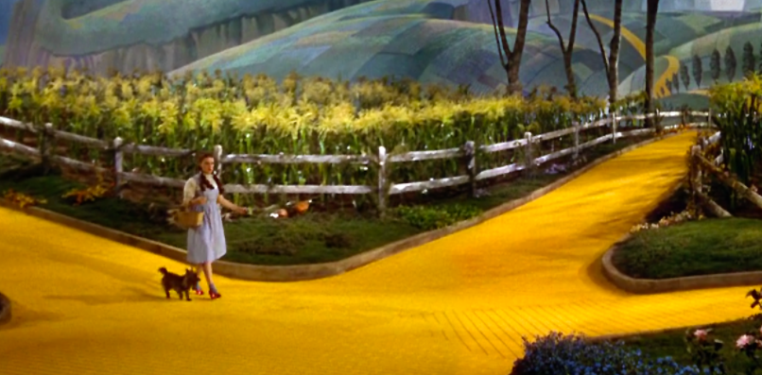
Designing policies I - Overview
Lookahead approximations combine:
The immediate contribution (or cost) of a decision made now…
… and an approximation of future contributions (or costs)

Slide 12
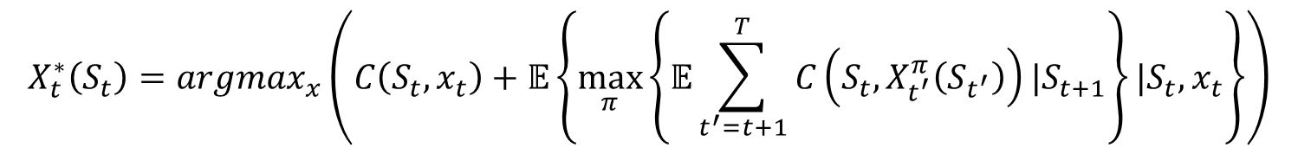
Designing policies I - Overview
A formal statement of a “lookahead policy”
$$X_{t}^{∗}\left(S_{t}\right)=argmax_{x}\left(C\left(S_{t},x_{t}\right)+𝔼\left\{\max_{π}\left\{𝔼\sum_{t^{′}=t+1}^{T}{C\left(S_{t},X_{t^{′}}^{π}\left(S_{t^{′}}\right)\right)|S_{t+1}}\right\}|S_{t},x_{t}\right\}\right)$$
Contribution we receive now
Future contributions
This policy simply states that we want to make the best decision to optimize over the horizon, assuming that we also use optimal policies in the future.
We would be done if we could compute this.

Slide 13
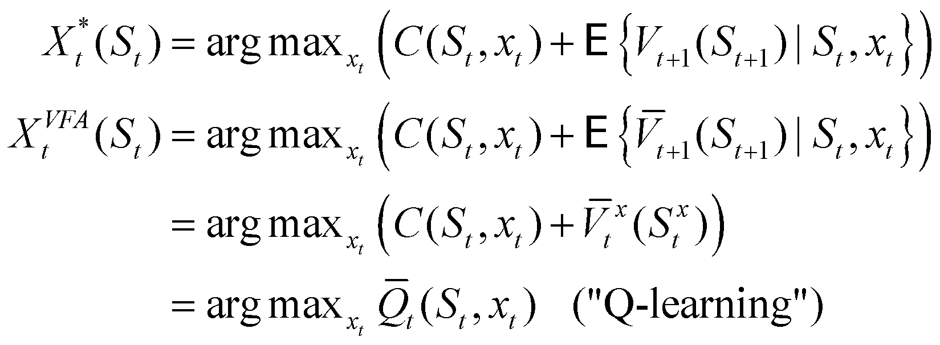
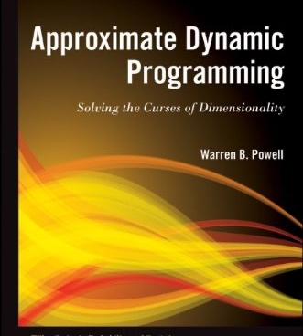
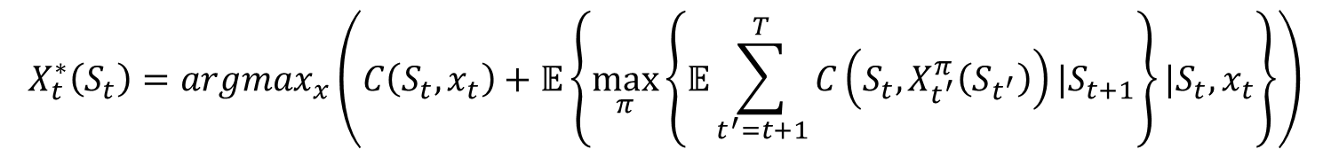
VFA policies
A formal statement of a “lookahead policy”
$$X_{t}^{∗}\left(S_{t}\right)=argmax_{x}\left(C\left(S_{t},x_{t}\right)+𝔼\left\{\max_{π}\left\{𝔼\sum_{t^{′}=t+1}^{T}{C\left(S_{t},X_{t^{′}}^{π}\left(S_{t^{′}}\right)\right)|S_{t+1}}\right\}|S_{t},x_{t}\right\}\right)$$

Slide 14
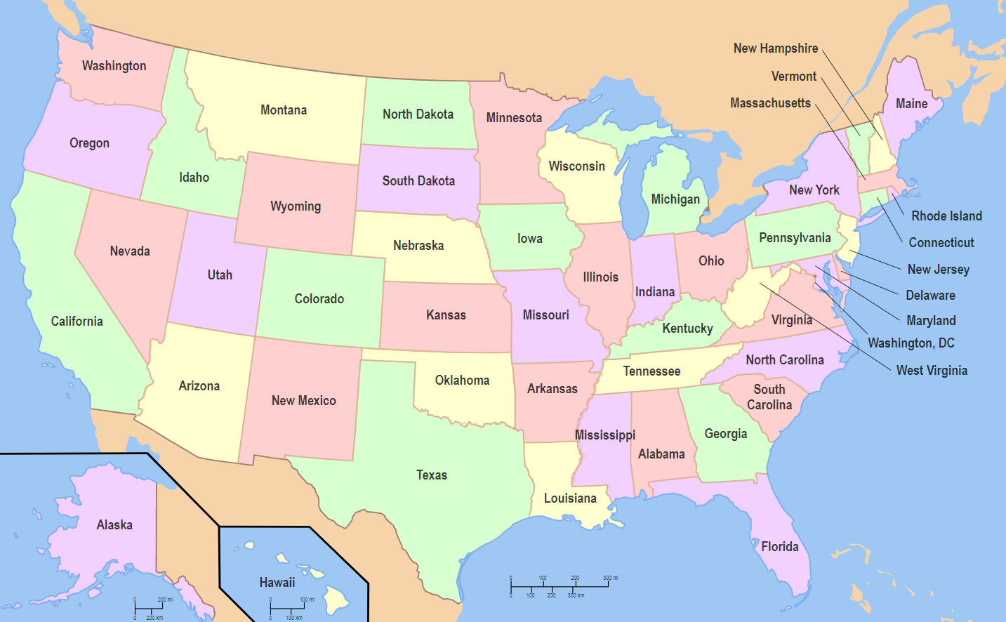
3) Value function approximations (VFAs)
How much inventory to send to each distribution center?

Slide 15
3) Value function approximations (VFAs)
How much inventory to send to each distribution center?
Value function approximations capture the marginal value of inventory.
Chapters 14-18

Slide 16
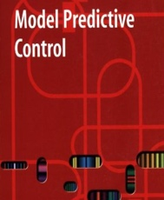
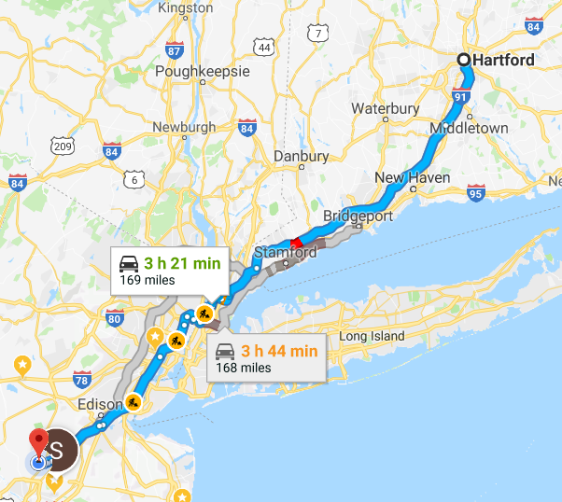
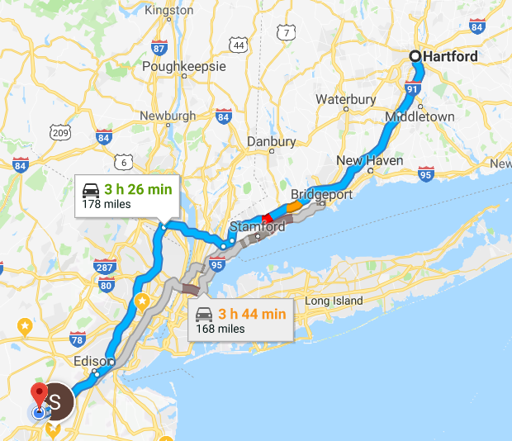
Designing policies I - Overview
4) Direct lookahead policies (DLAs) – We plan into the future to make a decision now:
The deterministic lookahead model
This is what is most widely used in practice.
Standard approach is to use a “best estimate” (which means deterministic) of travel times in the future.
This is often referred to as “model predictive control”
Robust optimization - We could use the 90th percentile of travel times.
Decision trees – Popular with decision analysis community
Approximate dynamic programming applied to approximate lookahead model
Stochastic programming – We represent the future using, say, 20 samples.

Slide 17
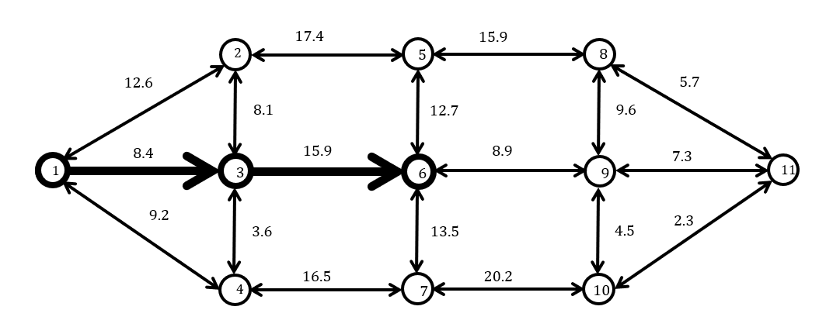








Designing policies I - Overview
Shortest path as a lookahead policy:
$$t′=t+4$$
$$t′=t+3$$
$$t′=t+2$$
The lookahead model
. . . .
$$t′=t+1$$
$$t′=t$$
$$t$$
$$t+1$$
$$t+2$$
$$t+3$$
The base model

Slide 18
Designing policies I - Overview
Shortest path as a lookahead policy:
$$t′=t+4$$
$$t′=t+3$$
$$t′=t+2$$
The lookahead model
. . . .
$$t′=t+1$$
$$t′=t$$
$$t$$
$$t+1$$
$$t+2$$
$$t+3$$
The base model

Slide 19
Designing policies I - Overview
Shortest path as a lookahead policy:
$$t′=t+4$$
$$t′=t+3$$
$$t′=t+2$$
The lookahead model
. . . .
$$t′=t+1$$
$$t′=t$$
$$t$$
$$t+1$$
$$t+2$$
$$t+3$$
The base model

Slide 20
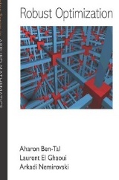
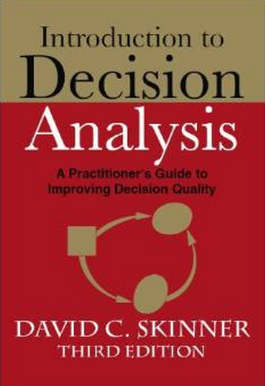
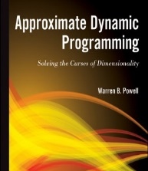
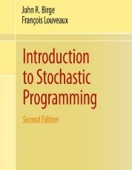
Designing policies I - Overview
4) Direct lookahead policies (DLAs) – We plan into the future to make a decision now:
The deterministic lookahead model
This is what is most widely used in practice.
Standard approach is to use a “best estimate” (which means deterministic) of travel times in the future.
This is often referred to as “model predictive control”
Robust optimization - We could use the 90th percentile of travel times.
Decision trees – Popular with decision analysis community
Approximate dynamic programming applied to approximate lookahead model
Stochastic programming – We represent the future using, say, 20 samples.

Slide 21
Designing policies I - Overview
Policy search policies
Lookahead policies
Policy function approximations (PFAs)
Simple rules, functions
Examples:
Order up to inventory policies
Buy low, sell high
Linear/nonlinear decision rules
Value function approximations (VFAs)
Making a decision now using the value of being in a future state
Examples:
The value of a truck driver
The value of holding an asset
Cost function approximations (CFAs)
Parameterized optimization models
Examples
Schedule slack for scheduling models
Buffer stocks in supply chain models
Power reserves for energy planning
Direct lookaheads (DLAs)
Models that optimize over a planning horizon (deterministically/stochastically)
Examples:
Deterministic lookahead: Google maps
Stochastic lookahead: Decision trees
These four classes cover any method for making decisions that has been studied in the research literature or used in practice. The framework is universal.

Slide 22
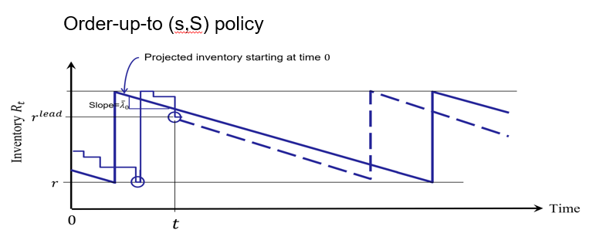
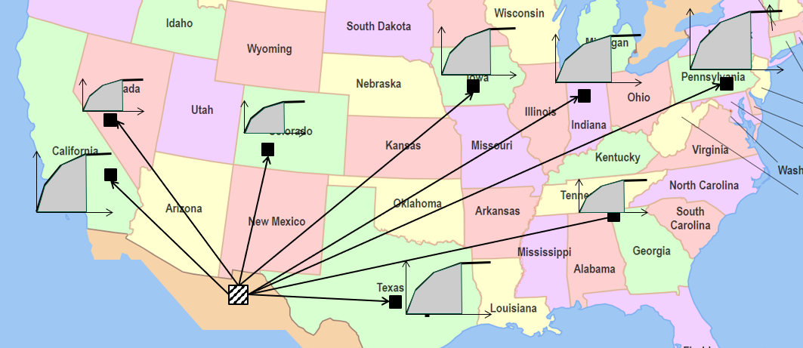
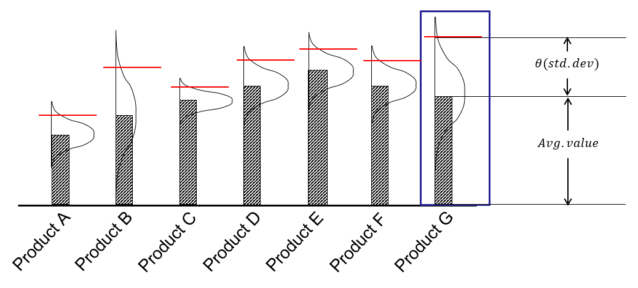
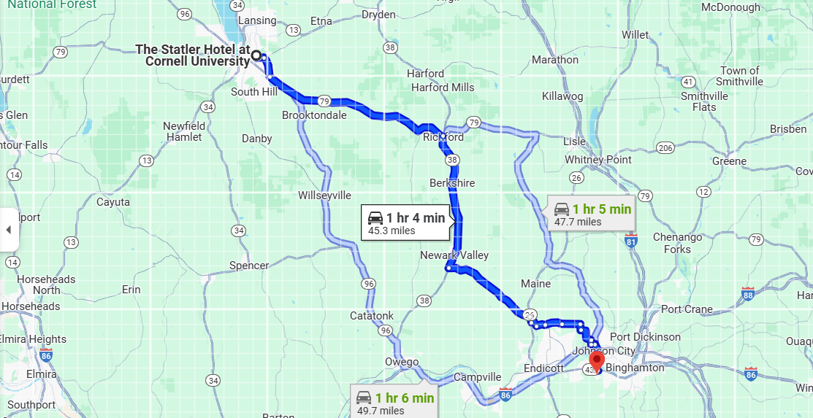
Designing policies I - Overview
Policy search policies
Lookahead policies
Policy function approximations (PFAs)
Simple rules, functions
Examples:
Order up to inventory policies
Buy low, sell high
Linear/nonlinear decision rules
Value function approximations (VFAs)
Making a decision now using the value of being in a future state
Examples:
The value of a truck driver
The value of holding an asset
Cost function approximations (CFAs)
Parameterized optimization models
Examples
Schedule slack for scheduling models
Buffer stocks in supply chain models
Power reserves for energy planning
Direct lookaheads (DLAs)
Models that optimize over a planning horizon (deterministically/stochastically)
Examples:
Deterministic lookahead: Google maps
Stochastic lookahead: Decision trees
These four classes cover any method for making decisions that has been studied in the research literature or used in practice. The framework is universal.

Slide 23
Designing policies I - Overview
Policy search policies
Lookahead policies
Policy function approximations (PFAs)
Simple rules, functions
Examples:
Order up to inventory policies
Buy low, sell high
Linear/nonlinear decision rules
Value function approximations (VFAs)
Making a decision now using the value of being in a future state
Examples:
The value of a truck driver
The value of holding an asset
Cost function approximations (CFAs)
Parameterized optimization models
Examples
Schedule slack for scheduling models
Buffer stocks in supply chain models
Power reserves for energy planning
Direct lookaheads (DLAs)
Models that optimize over a planning horizon (deterministically/stochastically)
Examples:
Deterministic lookahead: Google maps
Stochastic lookahead: Decision trees
These four classes cover any method for making decisions that has been studied in the research literature or used in practice. The framework is universal.

Slide 24
Designing policies I - Overview
Policy search policies
Lookahead policies
Policy function approximations (PFAs)
Simple rules, functions
Examples:
Order up to inventory policies
Buy low, sell high
Linear/nonlinear decision rules
Value function approximations (VFAs)
Making a decision now using the value of being in a future state
Examples:
The value of a truck driver
The value of holding an asset
Cost function approximations (CFAs)
Parameterized optimization models
Examples
Schedule slack for scheduling models
Buffer stocks in supply chain models
Power reserves for energy planning
Direct lookaheads (DLAs)
Models that optimize over a planning horizon (deterministically/stochastically)
Examples:
Deterministic lookahead: Google maps
Stochastic lookahead: Decision trees
These four classes cover any method for making decisions that has been studied in the research literature or used in practice. The framework is universal.
Three of the four classes of policies involve solving optimization problems.

Slide 25
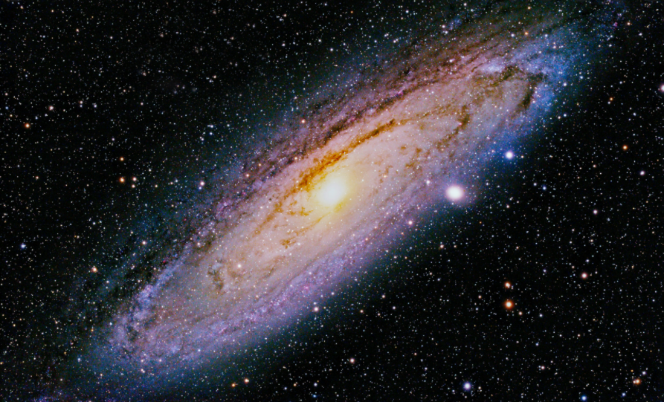
The four classes of policies are universal – they cover every method for making decisions.
It covers every method described in the research literature or used in practice.
This means you are already using one of the four classes of policies (or a hybrid) in your own decisions.

Slide 26
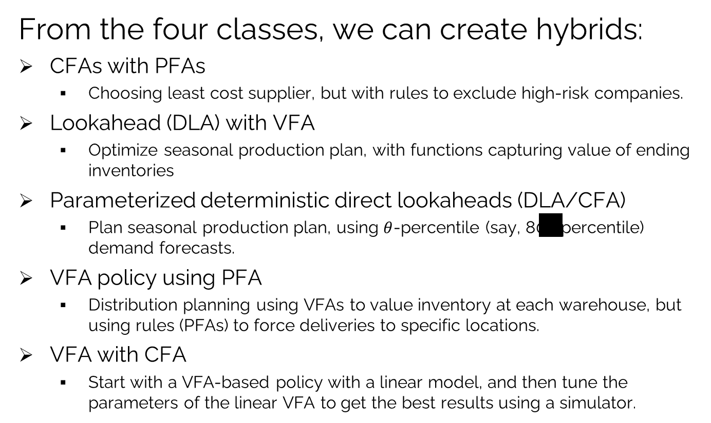
Designing policies I - Overview
From the four classes, we can create hybrids:
CFAs with PFAs
Choosing least cost supplier, but with rules to exclude high-risk companies.
Lookahead (DLA) with VFA
Optimize seasonal production plan, with functions capturing value of ending inventories
Parameterized deterministic direct lookaheads (DLA/CFA)
Plan seasonal production plan, using $θ$-percentile (say, 80th percentile) demand forecasts.
VFA policy using PFA
Distribution planning using VFAs to value inventory at each warehouse, but using rules (PFAs) to force deliveries to specific locations.
VFA with CFA
Start with a VFA-based policy with a linear model, and then tune the parameters of the linear VFA to get the best results using a simulator.
Chapter 11
Section 11.7
The only way to create effective hybrids is to know all four classes of policies.

Slide 27
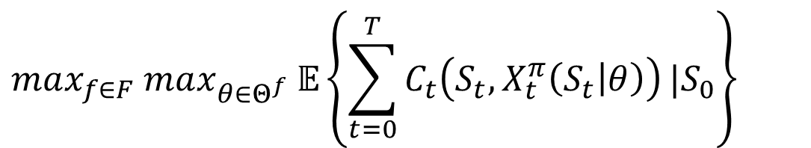
Modeling: Objective function
Searching over policies
$$max_{f∈F} max_{θ∈Θ^{f}} 𝔼\left\{\sum_{t=0}^{T}{C_{t}\left(S_{t},X_{t}^{π}\left(S_{t} | θ\right)\right)}|S_{0}\right\}$$
Hybrids
CFAs with PFAs
DLA with VFA
DLA with CFA
VFA with PFA
VFA with CFA
PFA, CFA, DLA
PFA, DLA, VFA
PFA, CFA, VFA, DLA
The four classes of policies:
Policy function approximations
Cost function approximations
Value function approximations
Direct lookahead approximations

Slide 28

Modeling: Objective function
Searching over policies
$$max_{f∈F} max_{θ∈Θ^{f}} 𝔼\left\{\sum_{t=0}^{T}{C_{t}\left(S_{t},X_{t}^{π}\left(S_{t} | θ\right)\right)}|S_{0}\right\}$$
$$θ^{n+1}=θ^{n}+α_{n}∇_{θ}F(θ^{n},W^{n+1})$$

Slide 29
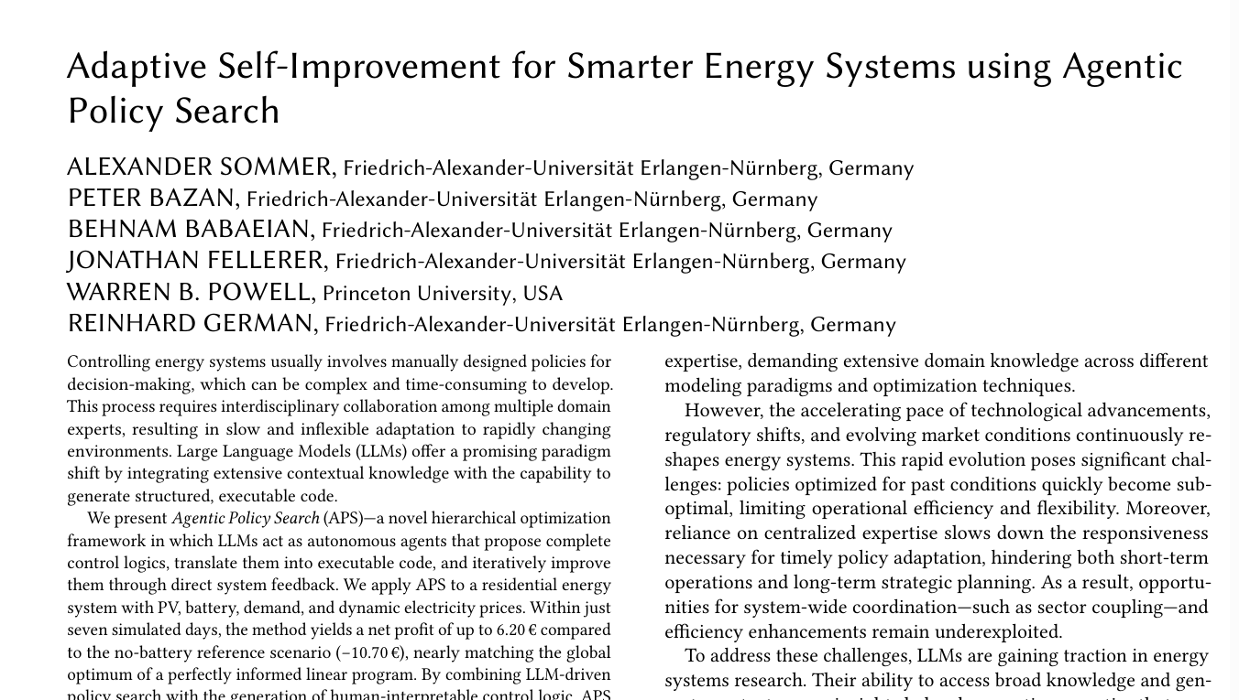
Modeling: Objective function
Policy search using LLM agents.
This structure opens the door to using LLMs to identify promising policies.
These are meta-classes – There is still work to be done choosing functions within each class.
Additional challenge is doing this in an online setting.
Research by Alexander Sommers, on arXiv.

Slide 30
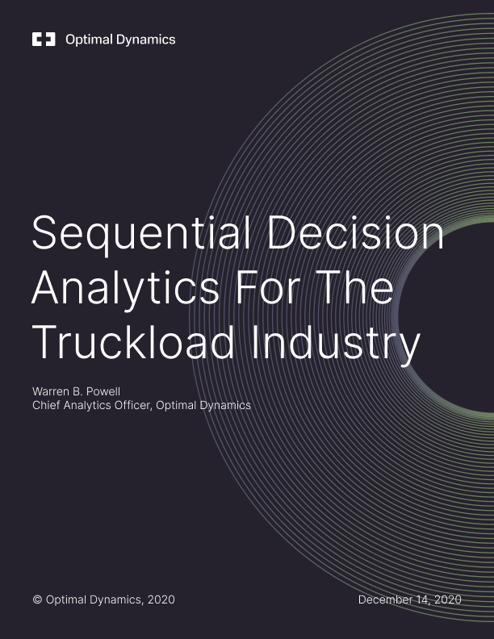
Designing policies I - Overview
Working in the field:
This is the foundation of the decision analytics suite, CORE.ai, at Optimal Dynamics
This white paper outlines, with mathematics, how all four classes of policies are used to perform strategic, tactical and operational planning for truckload operations.
We use all four classes of policies.
http://tinyurl.com/ODwhitepaper
See https://tinyurl.com/ODwhitepaper

Slide 31
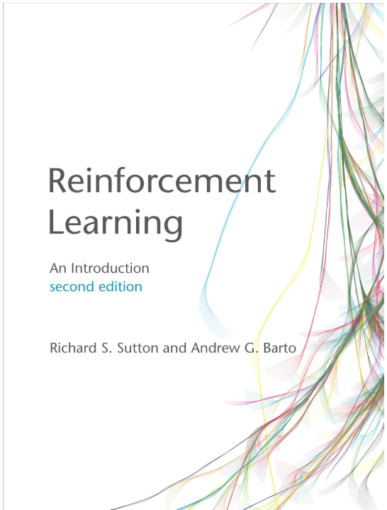
Designing policies I - Overview
Brief tour of policies in Sutton & Barto:
PFAs – “Policy gradient method” Ch. 13
Boltzmann policy
CFAs – UCB policies for bandit problems Ch 2
VFAs – Classical RL based on Bellman’s equation Ch 6, 7, …
TD learning
Q-learning
SARSA
DLAs - Direct lookahead approximations Ch 8
Real-time dynamic programming (RTDP)
Rollout algorithms
Monte Carlo tree search

Slide 32
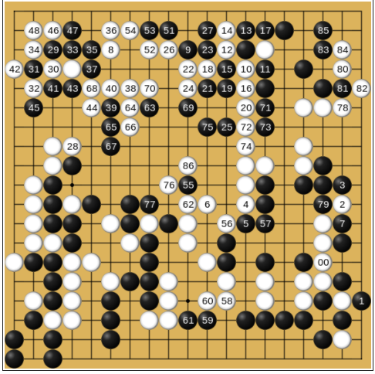
Designing policies I - Overview
AlphaGo/AlphaGo Zero:
Uses hybrid of all four classes of policies:
PFA
CFA
VFA
DLA (Monte Carlo tree search)

Slide 33


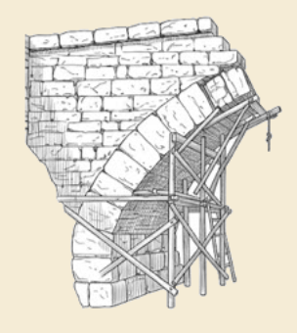
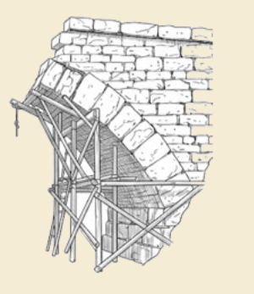
Thank you!
For more information see the Sequential Decision Analytics website at
warrenpowell.org
For more on policies go to:
warrenpowell.org → Policies

